Slide 1
The structure and functions of the musculoskeletal system
1.1.1 Applied anatomy and physiology

Slide 2
Joints
Antagonistic Pairs
Skeletal System
Isotonic Contractions
The structure and functions of the musculoskeletal system
Synergists
Range of movement
Muscular System
Isometric Contractions

Slide 3
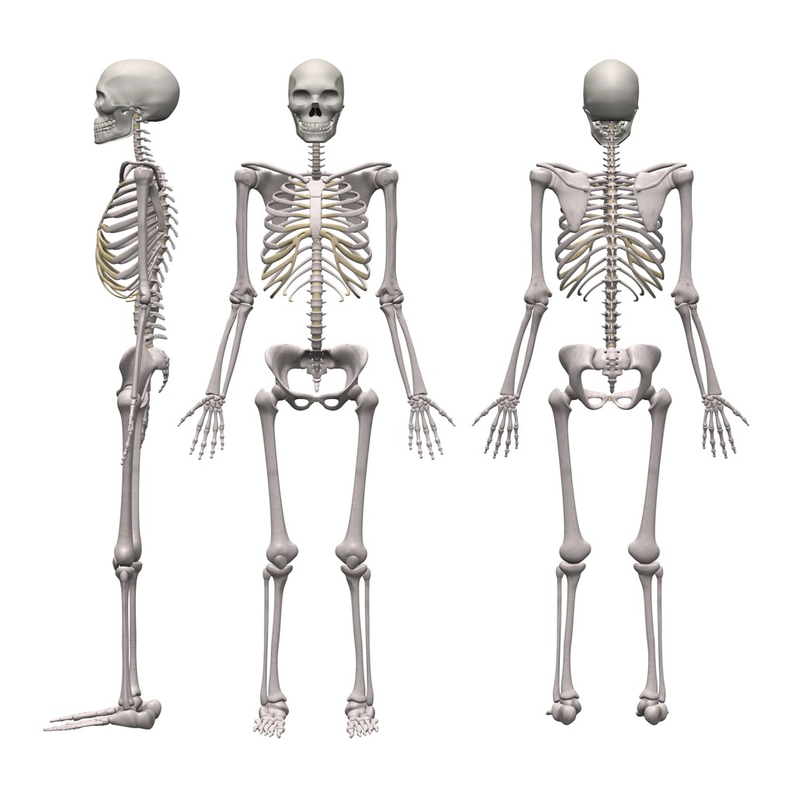
Skeletal System
Scapula
Cranium
Clavicle
Sternum
Humerus
Ribs
Ulna
Vertebrae
Pelvis
Radius
`
Femur
Carpals
Patella
Metacarpals
Tibia
Phalanges
Fibula
Talus
Tarsals
Metatarsals
Phalanges

Slide 4
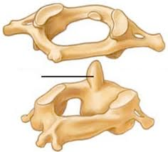
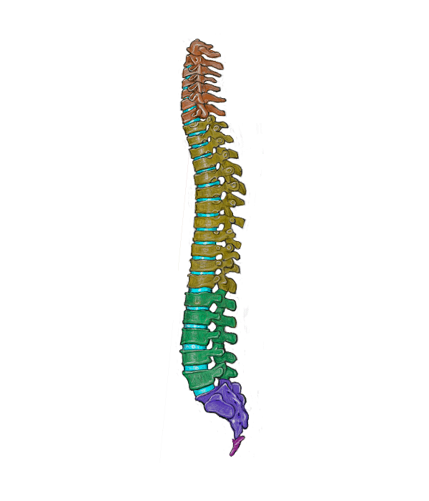
Skeletal System
Atlas
Cervical - 7 bones
Allows movement in the neck
Axis
Thoracic - 12 bones
Allows movement in your torso
Lumbar - 5 bones
This part of the spine bears our weight
Sacrum - 5 bones
These are attached to the pelvis and assist with movement
Coccyx
This is your tail bone

Slide 5
Joints
The human body has joints where bones meet and articulate to create movement.
Shoulder - scapula, clavicle, humerus.
Elbow - humerus, radius, ulna.
Hip - pelvis, femur.
Knee - femur, patella, fibula, talus.
Ankle - tibia, fibula, talus.

Slide 6
Types of bones
Scapula
Cranium
Clavicle
Long Bone
Storage of minerals, blood cell production, levers for movement
Sternum
Humerus
Ribs
Ulna
Vertebrae
Irregular
Bone
Muscle attachment
Radius
Pelvis
`
Femur
Carpals
Patella
Flat Bone
Protection and muscle attachment
Metacarpals
Tibia
Phalanges
Fibula
Short Bone
Strong and supports weight
Tarsals
Metatarsals
Phalanges

Slide 7
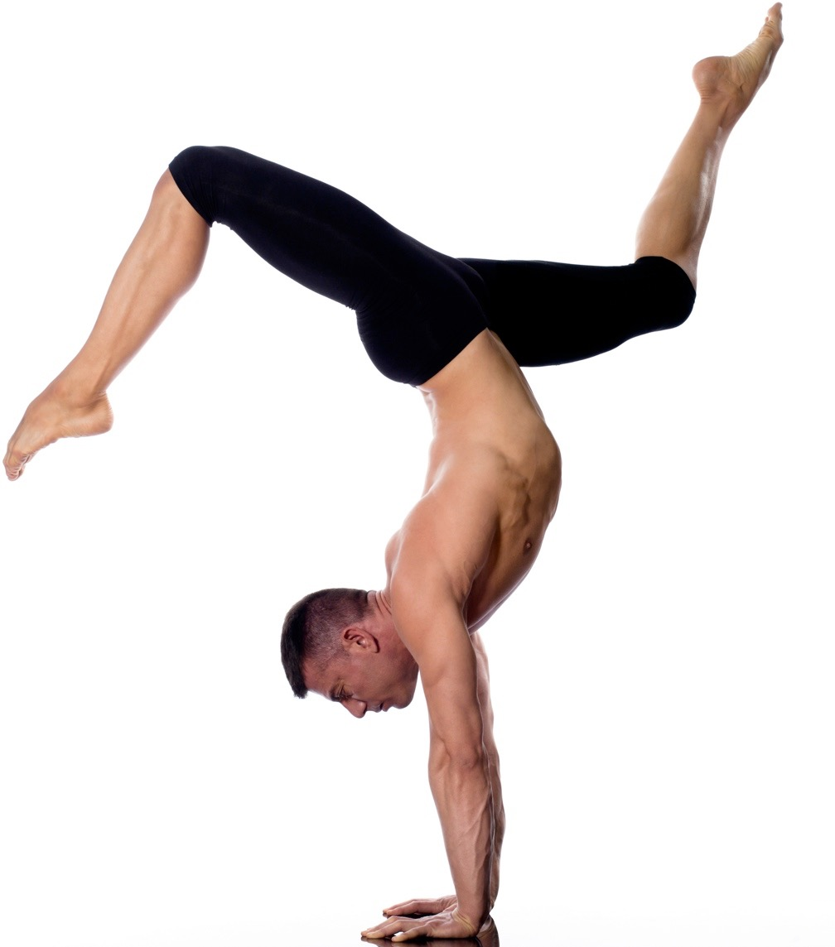
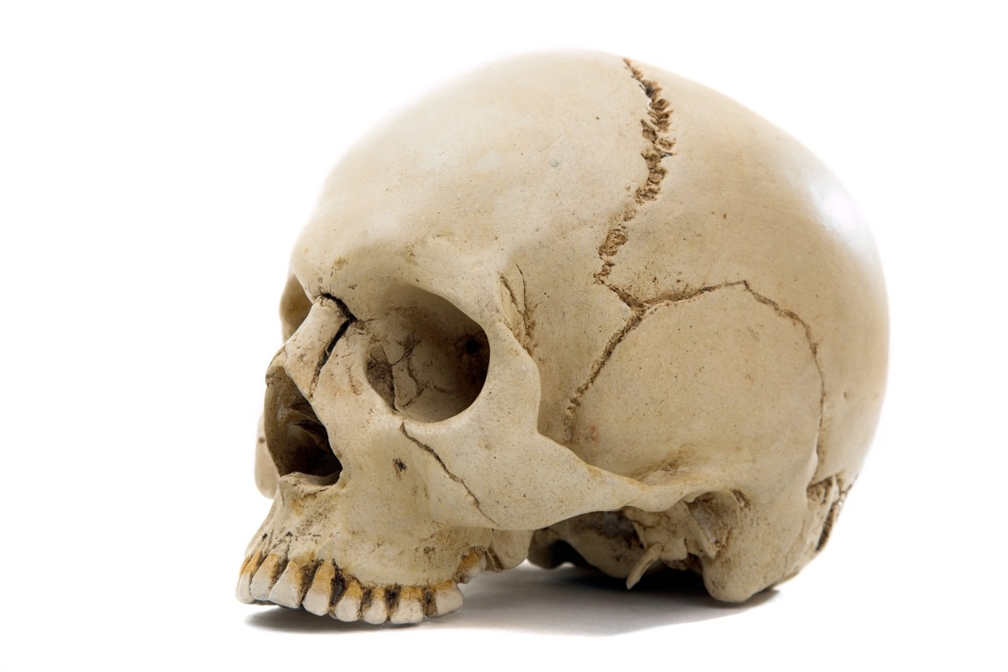
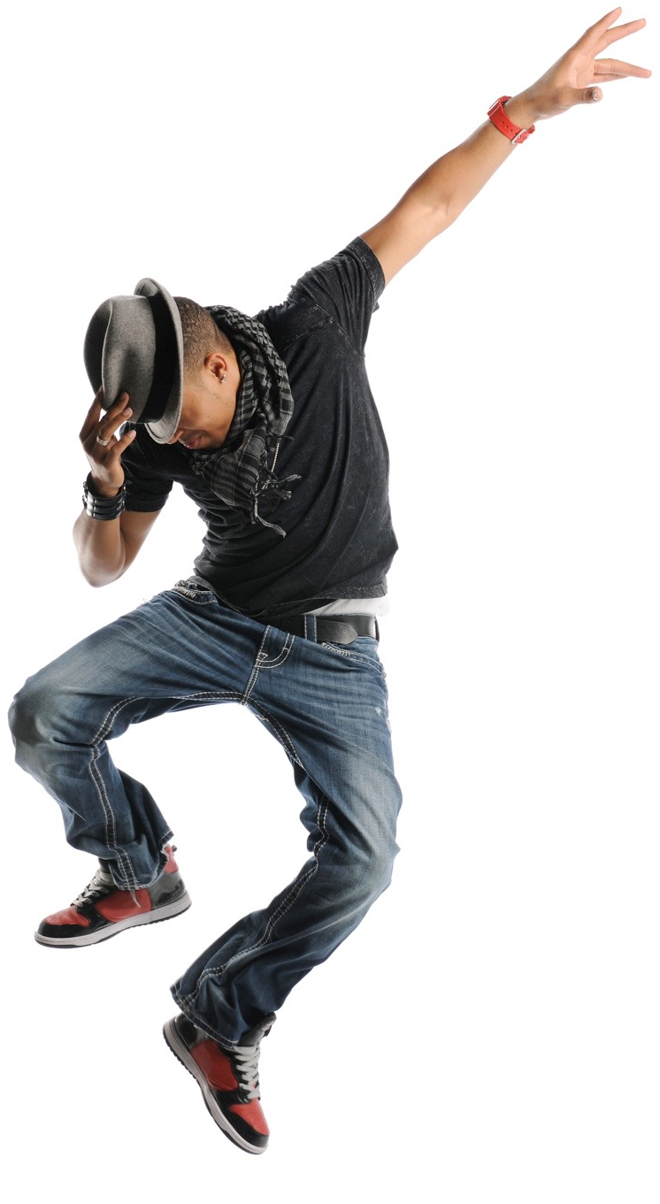
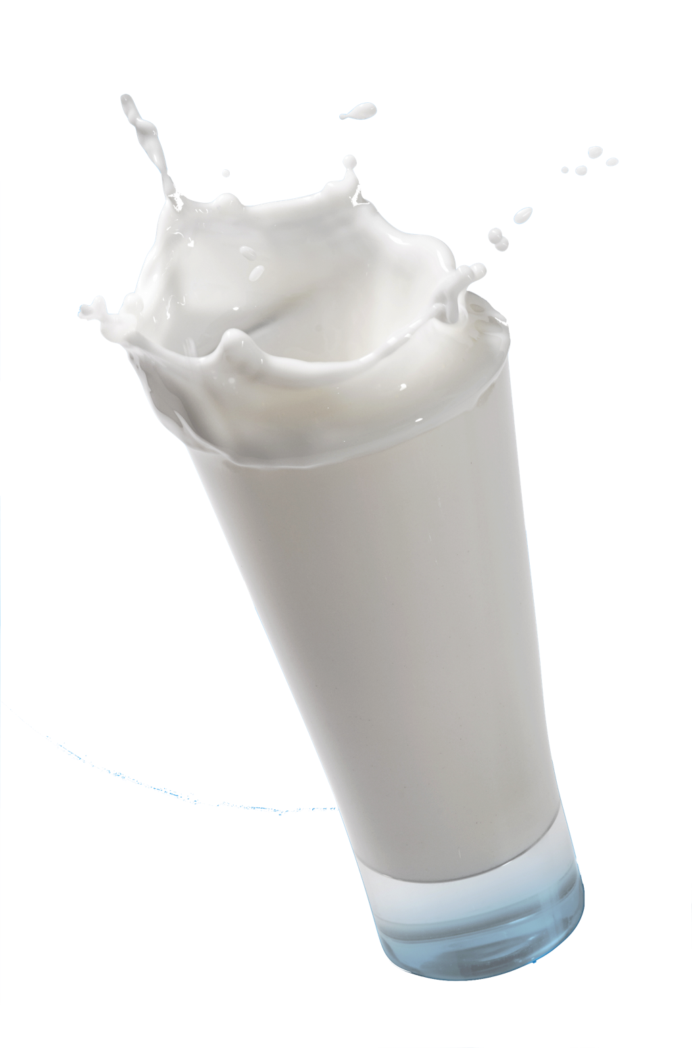
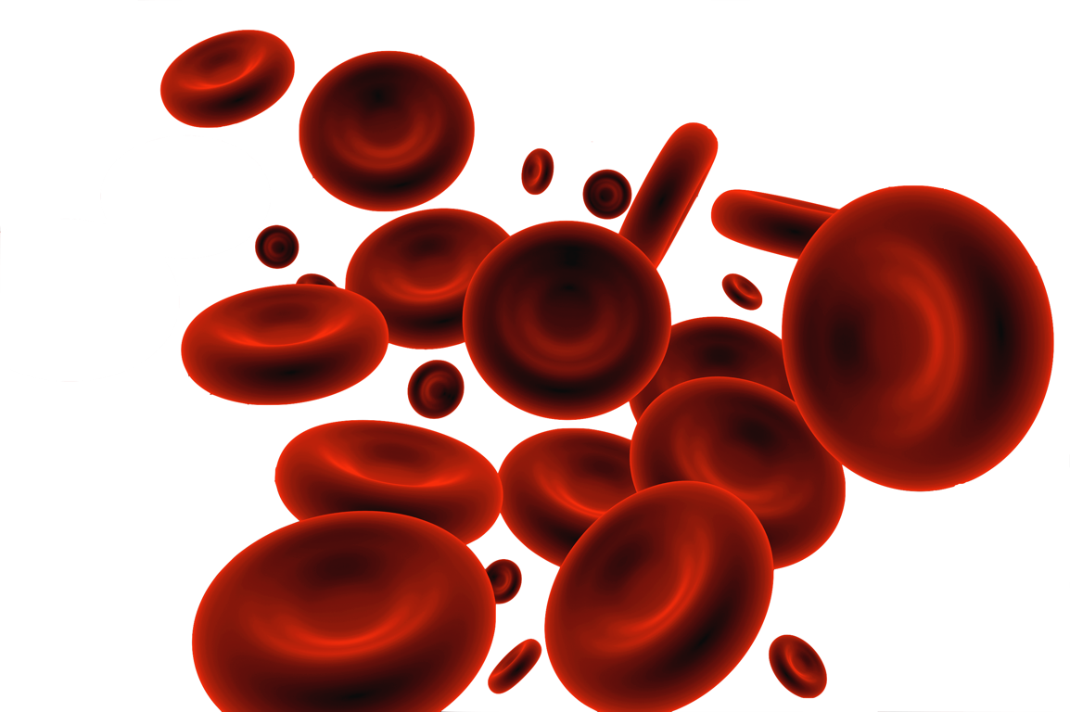
Functions of the skeletal system
  Support - Bones are strong and are able to bear our weight. For example carpals support and weight bear in a handstand.
  Protection - Bones protect our vital organs. For example the flat bones of the cranium protect the brain when heading the ball.
  Structural shape and points for attachment - Muscles attach to bones so when they contract our bones becomes a lever which generates force and allows us to reach. For example when the bicep contracts it moves our radius and ulna when throwing a ball.
  Storage of minerals - Our bones store calcium and phosphorus and release it when needed. This keeps the correct balance of minerals in our body for optimum sports performance.
  Production of blood cells - The marrow in our bones (i.e. femur) produces vital blood cells. Red blood cells for oxygen carriage, white blood cells for fighting disease and platelets for clotting blood when we cut ourselves whilst performing.

Slide 8
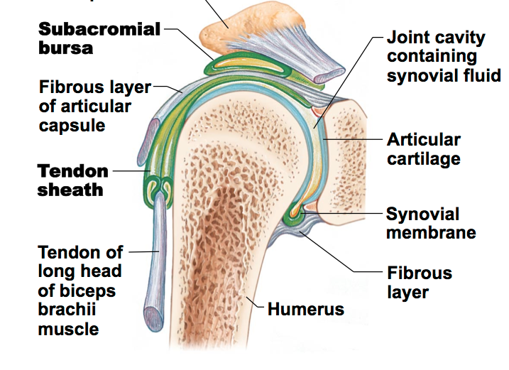
Synovial Joints
These joints move freely.
There are many parts to the synovial joint
that work together to allow smooth movement:
  Joint capsule holds the joint together.
  Joint cavity is the space between the two
  bones.
  Synovial fluid fills the joint cavity and acts as a lubricant preventing friction/pain and wear and tear.
  Hyaline cartilage at the ends of the bones also stops the bones from touching and the smooth material reduces friction preventing wear and tear of the bone. The cartilage also acts as a shock absorber.
  Bursae is a sac of liquid that floats inside the joint to reduce friction between the tendon and bone.
  Ligaments join bone to bone and stabilise the joint.

Slide 9
Types of Joints
Ball and Socket
  Allows the largest amount of movements and are found at the shoulder and the hip.
  Hinge
  Allows two types of movement and are found at the elbow, ankle and the knee.
  Pivot
  Allows only one type of movement and can be found at the neck as well as the radio-ulnar joint.
Range of Movement
Flexion
Extension
Abduction
Adduction
Rotation
Circumduction
Range of Movement
Flexion
Extension
Range of Movement
Rotation

Slide 10
Types of Joints
Saddle
  Also allows a full range of movement and can be found at the thumb.
  Gliding
  Allows a full range of movement and are found between the joints in your hand.
  Condyloid
  Allows a full range of movement and are found in the wrist.
Range of Movement
Flexion
Extension
Abduction
Adduction
Limited Rotation
Range of Movement
Small gliding movements
Range of Movement
Flexion
Extension
Abduction
Adduction
Limited Rotation
Circumduction

Slide 11
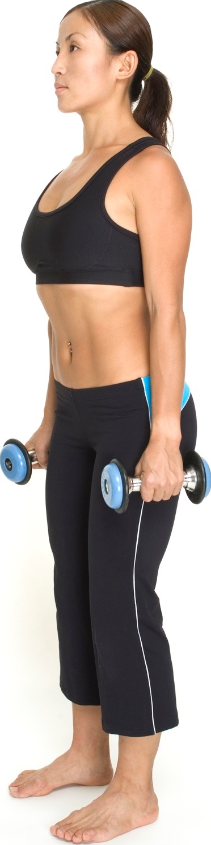
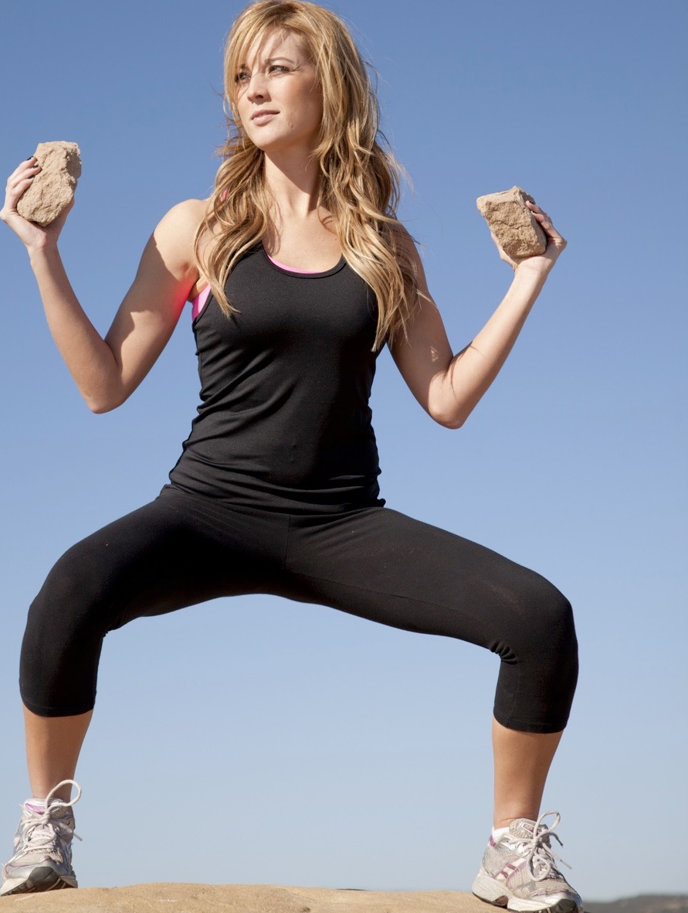
Range of movement
Flexion
Decrease the angle at the joint
Extension
Increase the angle at the joint
Shoulder
and Elbow
Shoulder
and Elbow
Hip
and Knee
Knee
and Hip

Slide 12
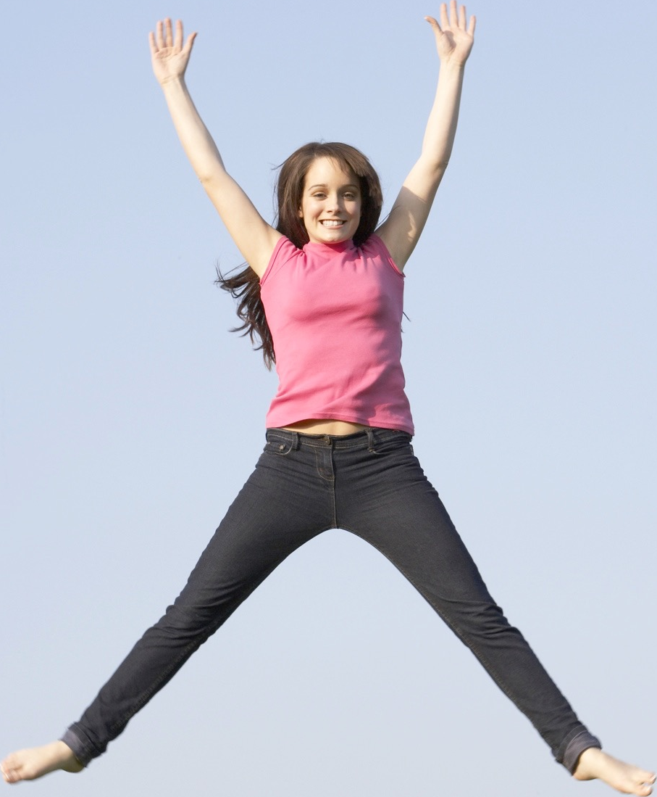
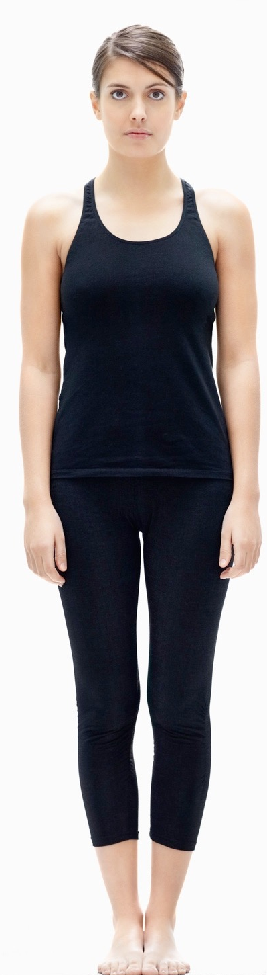
Range of movement
Abduction
Move the limb away
from the central axis
Adduction
Move the limb towards
the central axis
Hip and
Shoulder
Hip and
Shoulder

Slide 13
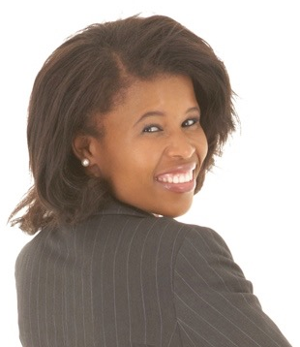
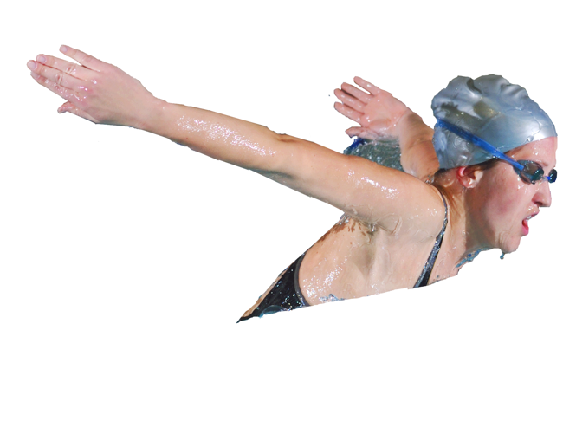
Range of movement
Rotation
Twisting movement around an
axis/rotational movement
Circumduction
A combination of flexion, abduction, adduction and extension.
Neck
Shoulder

Slide 14
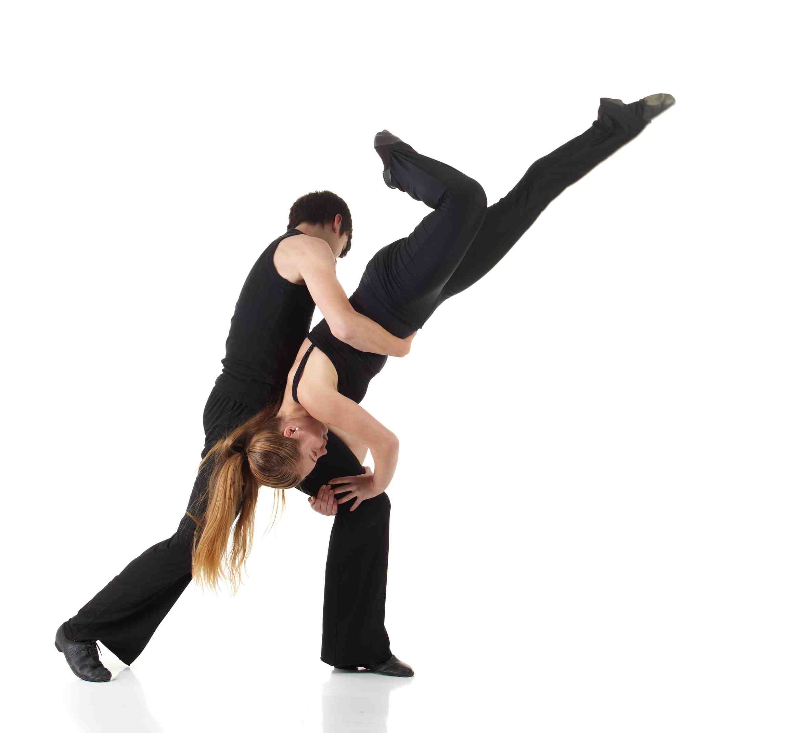
Range of movement
Plantar flexion
Movement at the ankle joint
that points the toes
Dorsiflexion
Movement at the ankle joint
that flexes the foot upwards

Slide 15
Ligaments and tendons
Ligaments
Connect bone to bone.
Slightly elastic and tough.
Restricts movement in the wrong direction preventing dislocation.
Tendons
Connects muscle to bone.
Transmits the mechanical force of the muscle to the bones, creating movement

Slide 16
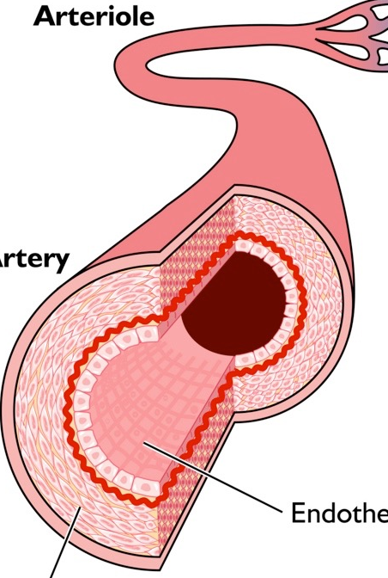
Types of muscle
  Involuntary muscle - Smooth Muscle that works without consciousness.
    Arteries - The walls of the
    arteries contract and push
    the blood along.
    Stomach - When the walls
    contract, food is squeezed
    through the gut.
Lumen
Smooth Muscle

Slide 17
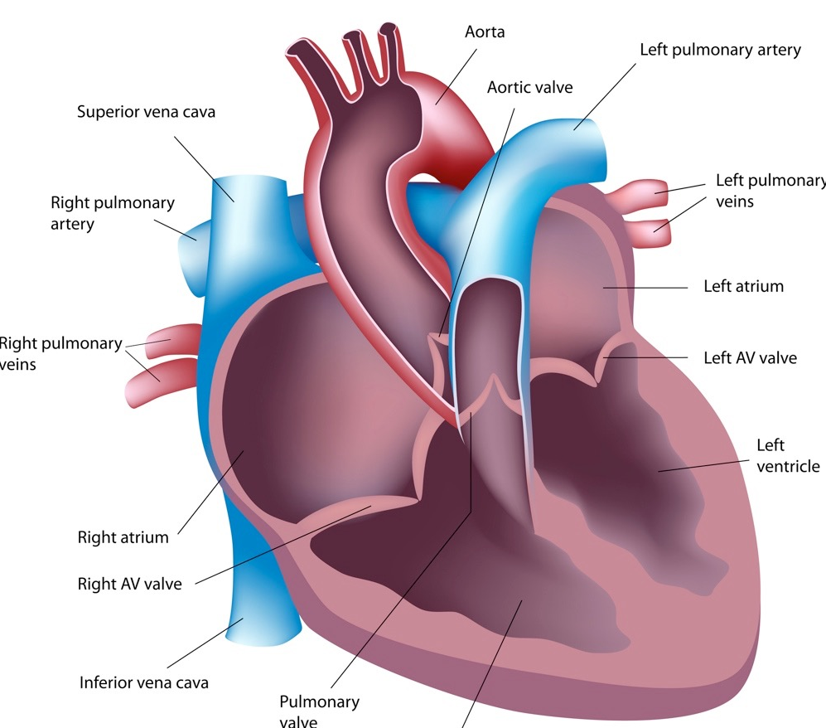
Types of muscle
Cardiac Muscle - Smooth muscle that contracts without consciousness and works non-stop without tiring.
    Found in the walls
    of the heart.
    When it contracts, this is
    your heart beat.
    The walls squeeze
    the blood along the
    circulatory system.

Slide 18
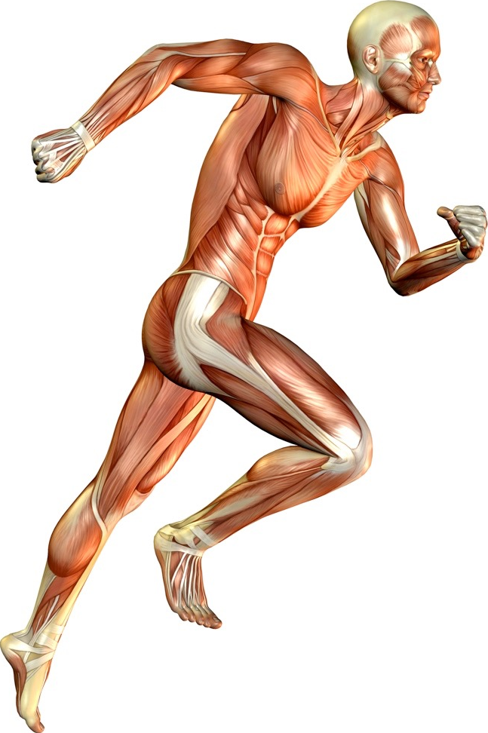
Types of muscle
Voluntary Muscle - Works under
conscious control.
    Skeletal muscle attaches to
    bones by tendons called the
    origin and insertion.
    They create movement but
    they can only pull bones so
    they need to work in pairs.
    Voluntary muscles tire so they can only
    work for a limited amount of time.

Slide 19
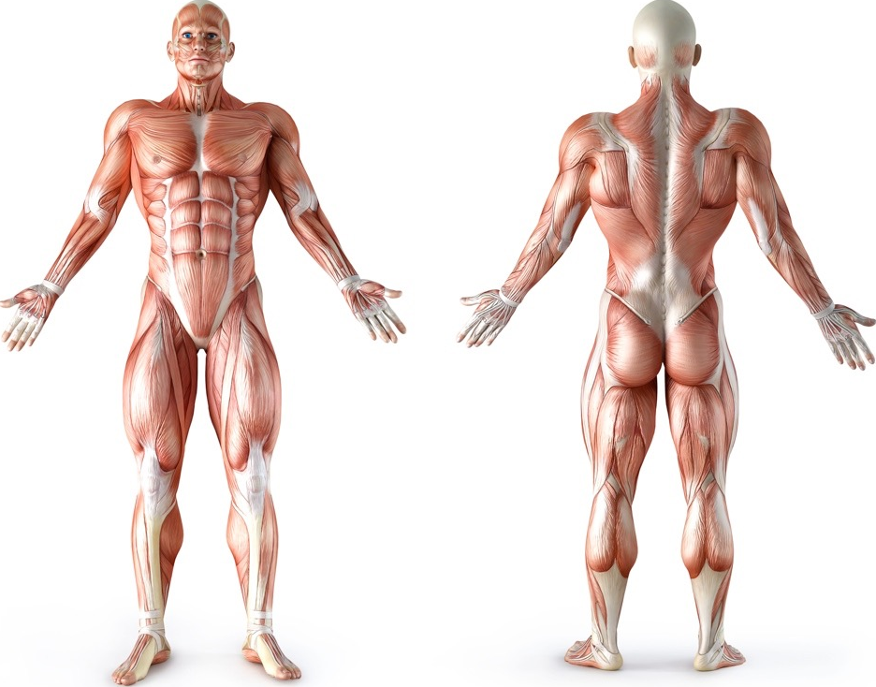
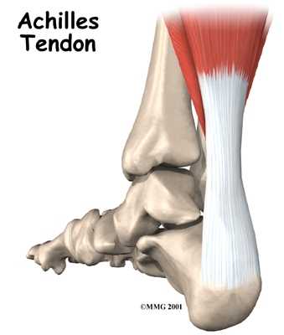
Muscular system
Rotator cuffs
Deltoid
Trapezius
Triceps
Pectorals
Latissimus
Dorsi
Biceps
Abdominals
Gluteals
Hamstrings
Hip flexors
Gastrocnemius
Tibialis anterior
Quadriceps
  Tendons
Attach muscle to bone.
Strong and able to withstand large forces.

Slide 20
Muscle action
Muscle | Main Action
Deltoid | Flexion, extension, adduction and abduction at the shoulder
Trapezius | Rotation at the shoulder
Pectorals | Rotation and adduction at the shoulder
Biceps | Flexion at the elbow
Triceps | Extension at the elbow
Latissimus Dorsi | Adduction, extension and rotation at the shoulder
Abdominals | Flexion at the trunk
Gluteals | Rotation and extension at the hip
Quadriceps | Extension at the knee
Hamstrings | Flexion at the knee
Gastrocnemius | Extension (plantar flexion) at the ankle joint

Slide 21
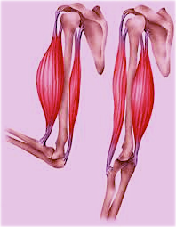
Antagonistic pairs
Two good examples of
antagonistic pairs are:
    Hamstrings and
    Quadriceps
    Biceps and Triceps
Tendon of
Origin
Agonist
Antagonist
Tendon
of Insertion

Slide 22
Antagonistic pairs
Tendon of
Origin
Muscles can only pull so
they have to work in pairs
to create movement.
  When the muscle contracts it pulls on the moveable bone attached by the tendon of insertion.
  It pulls towards the tendon of origin on the fixed bone.
Agonist
Antagonist
Tendon
of Insertion

Slide 23
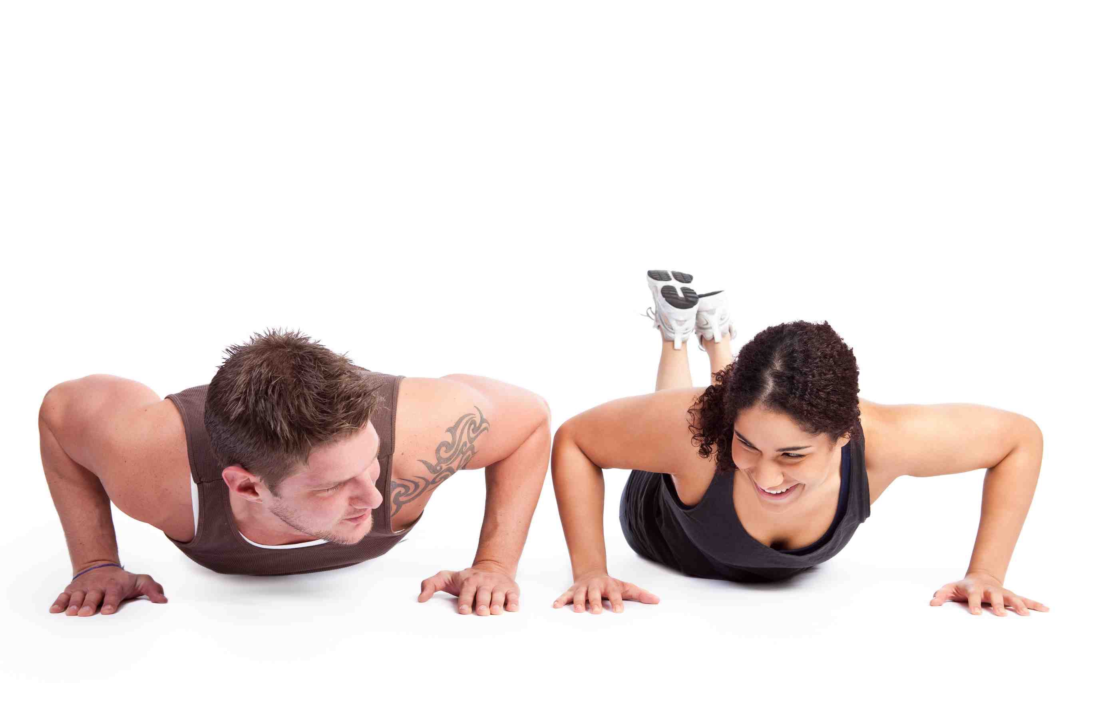
Antagonistic pairs
The contracting muscle is called the prime mover or agonist.
The other muscle in the pair relaxes and this is called the antagonist.
During movement other muscles called synergists contract to support the contraction.

Slide 24
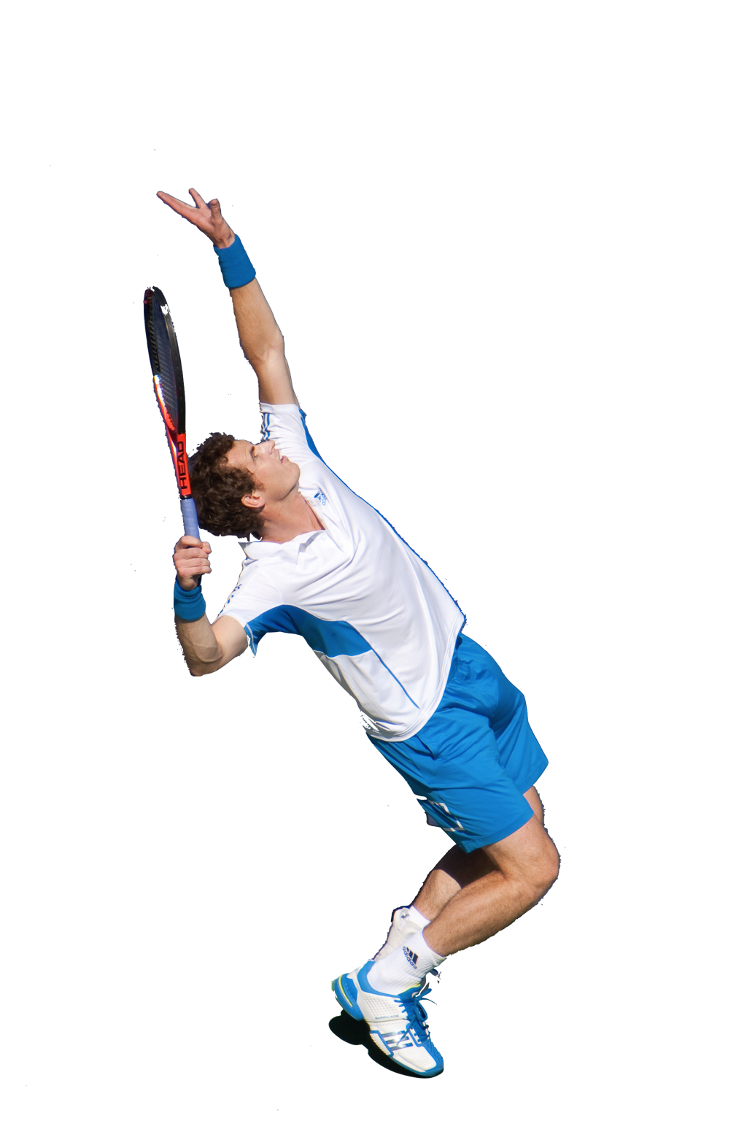
Types of muscular contractions
  Isotonic Contraction - Muscle contraction that results in limb movement.
  This is the most frequent muscle contraction during sports play.
  When the muscle contracts it causes a concentric movement.
  When the muscle relaxes it causes an eccentric movement.
  Training your muscles isotonically improves dynamic (moving) strength, power and endurance.

Slide 25
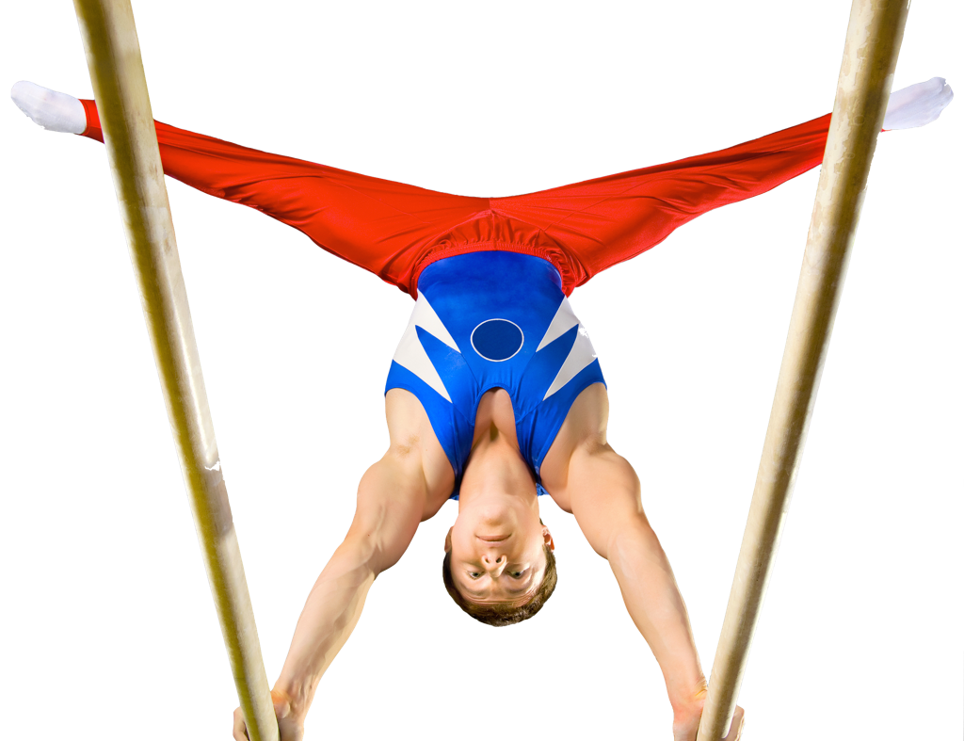
Types of muscular contractions
  Isometric Contraction - Muscle contraction with no limb movement.
    Despite contracting the muscle length stays the same.
    One muscle may contract isometrically to stabilise a movement so others can contract isotonically.
    Less sports require this muscle
    contraction but examples are
    gymnastic handstand or rugby scrum.
    Training isometrically provides little improvements.

Slide 26
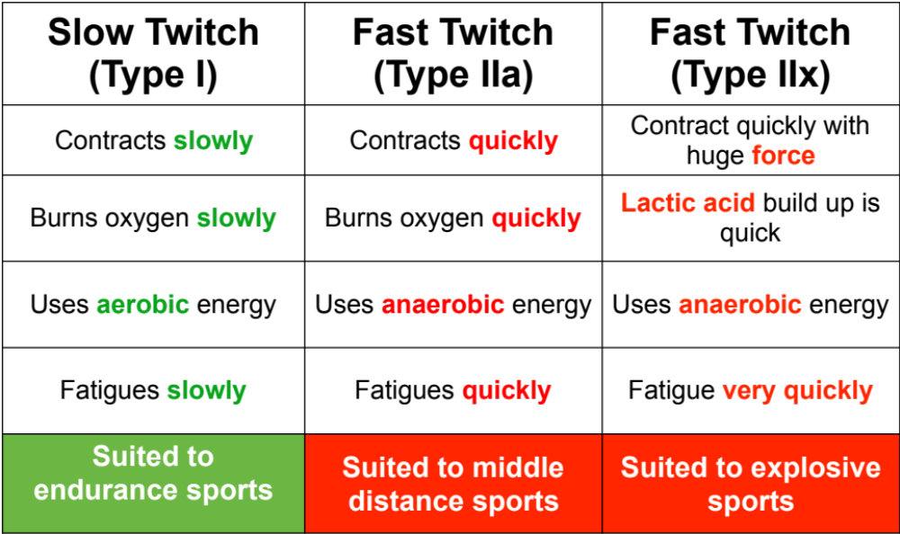
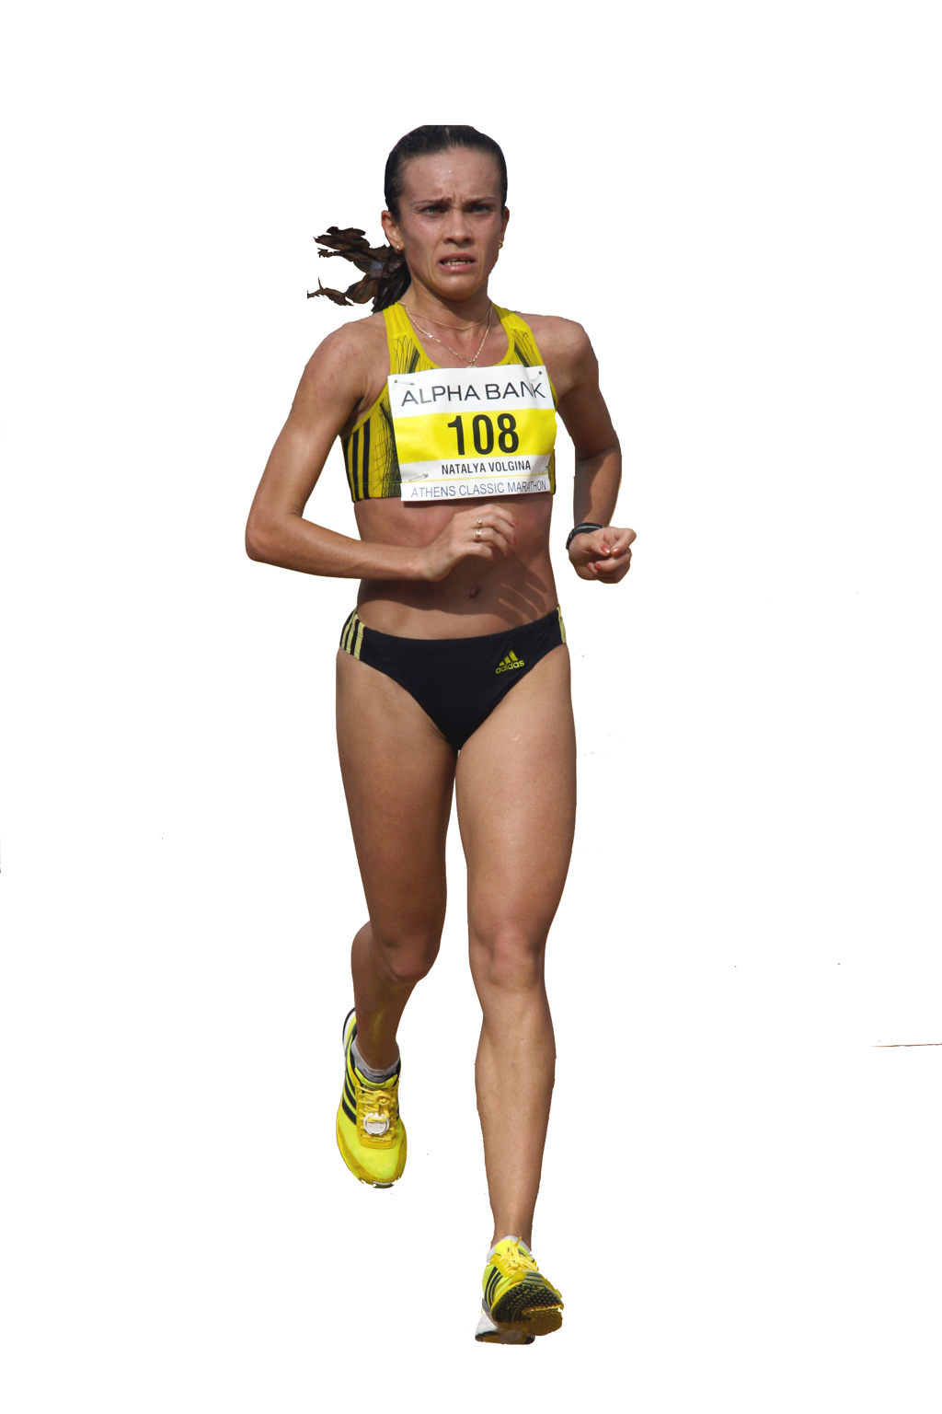
Fast twitch and Sslow twitch
There are three different types of muscle fibre

