Slide 1
How to optimise training and prevent injury
1.3.5 Physical training

Slide 2
PARQ
Injury
Concussion
Drugs
Fracture
Blood Doping
How to optimise training and prevent injury
R.I.C.E.
Over Use
Anabolic Steroids
Soft Tissue
Abrasion

Slide 3

PAR-Q
Physical Activity Readiness Questionnaire
It is important to assess your readiness to perform before becoming active in case you have the following conditions:
    Heart problems.
    Chest pains.
    Dizziness or feeling faint.
    High blood pressure.
    Bone and joint problems.
The questionnaire asks questions to uncover any of these conditions.

Slide 4
Preventing injury
Preventing injury
Warm up and cool down properly.
Use the correct equipment.
Know and follow the rules and regulations.
Wear appropriate protective clothing.
Check equipment for faults.
Check the facilities for any harmful objects and hazards.

Slide 5

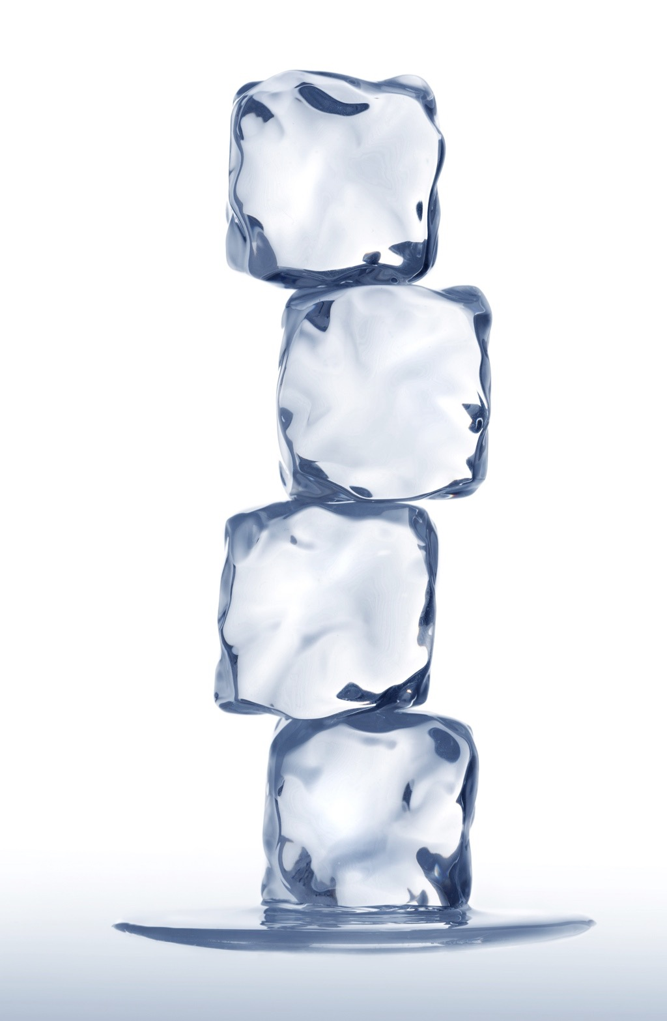
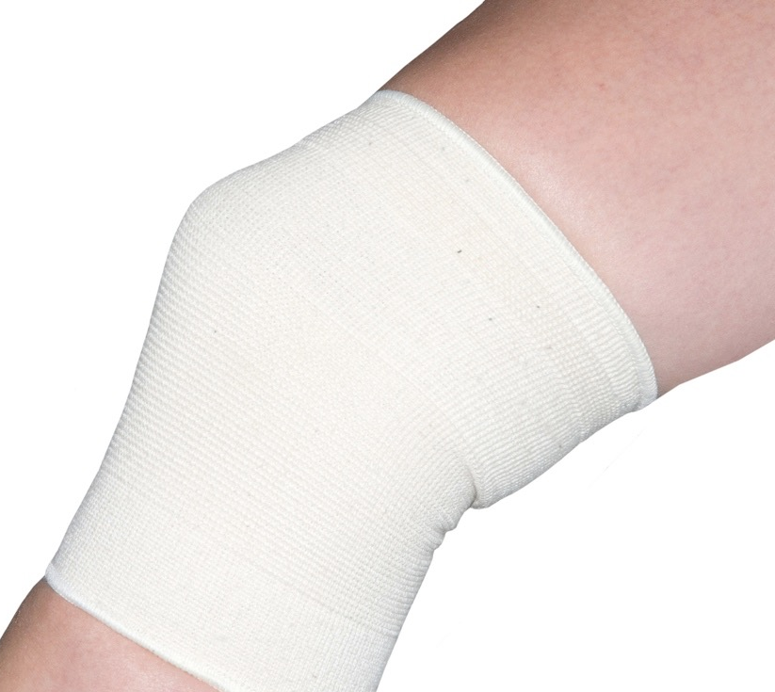
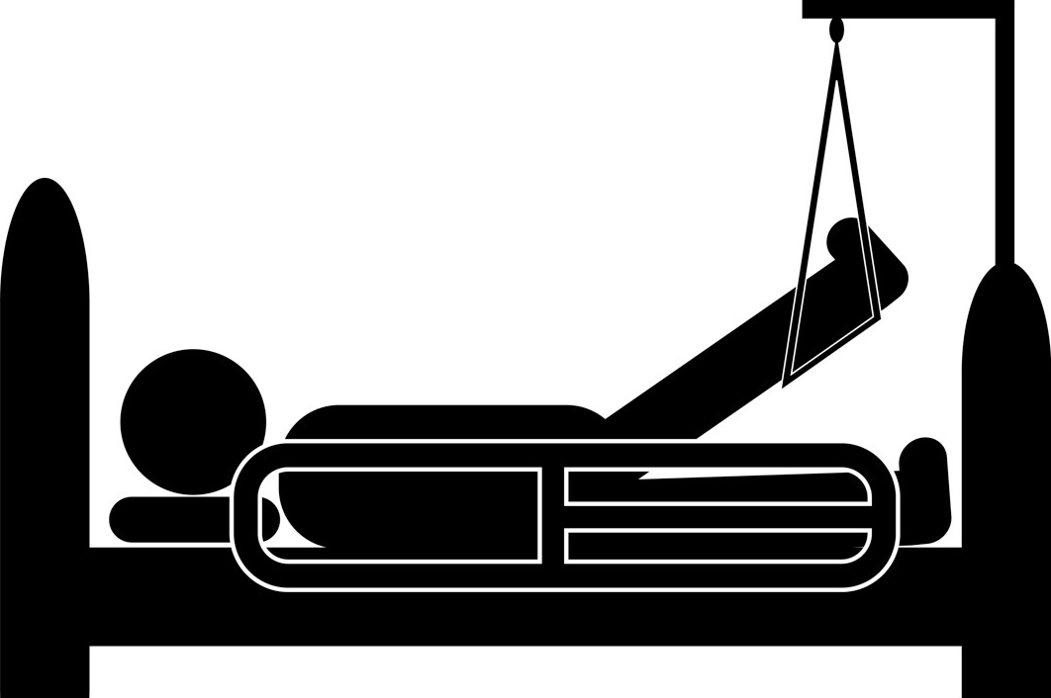
R.I.C.E
There is one form of treatment that is used for a number of minor injuries and you can remember it using the acronym R.I.C.E.
      Rest - sit down or lie down and do not move.
      Ice - cool the injured area by applying ice.
      Compression - use a
      bandage to stop the swelling.
      Elevation - raise the joint higher than the heart to reduce the swelling.

Slide 6
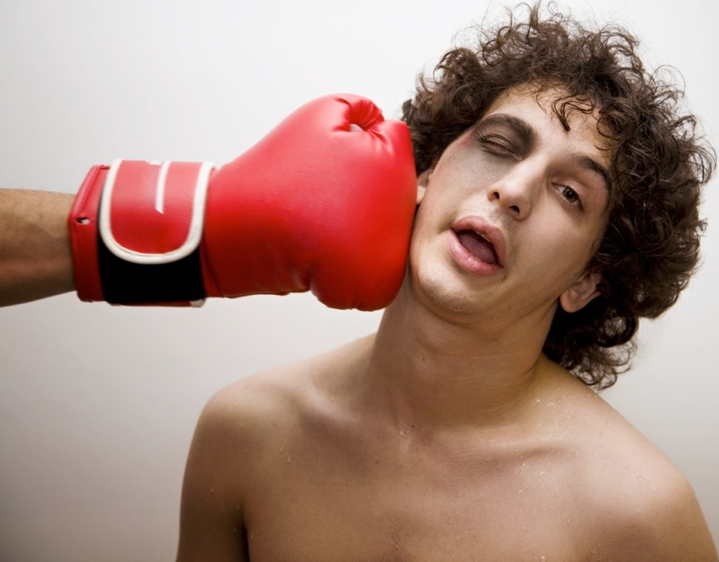
Concussion
Concussion
A person will display a number of symptoms if they are concussed.
Loss of consciousness.
Relaxed limbs.
Weak irregular pulse.
Slow shallow breathing.
Dilated pupils.
Bleeding from the ears.
Treatment
If a performer takes a blow to the head it is important to get help immediately. Then place them in the recovery position making sure their airways are clear.

Slide 7
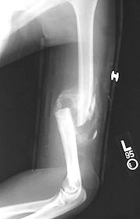
Fractures
Fractures
Compound or open fracture is where the broken bone comes through the skin. There is then a risk of infection entering the damaged skin.
Simple or closed fracture is a break of the bone without
any breaking of the skin.
Greenstick fracture is caused by pressure and impact so
the bone bends but only partially breaks.
Stress fractures are hairline cracks in the bone caused by
constant pressure such as running. When muscles fatigue
they are unable to absorb the shock and the resulting
pressure causes small cracks to appear in the bone.
Treatment
For all types of fractures you should immediately stop and seek medical attention.
Notes:
New Slide
Additional image

Slide 8
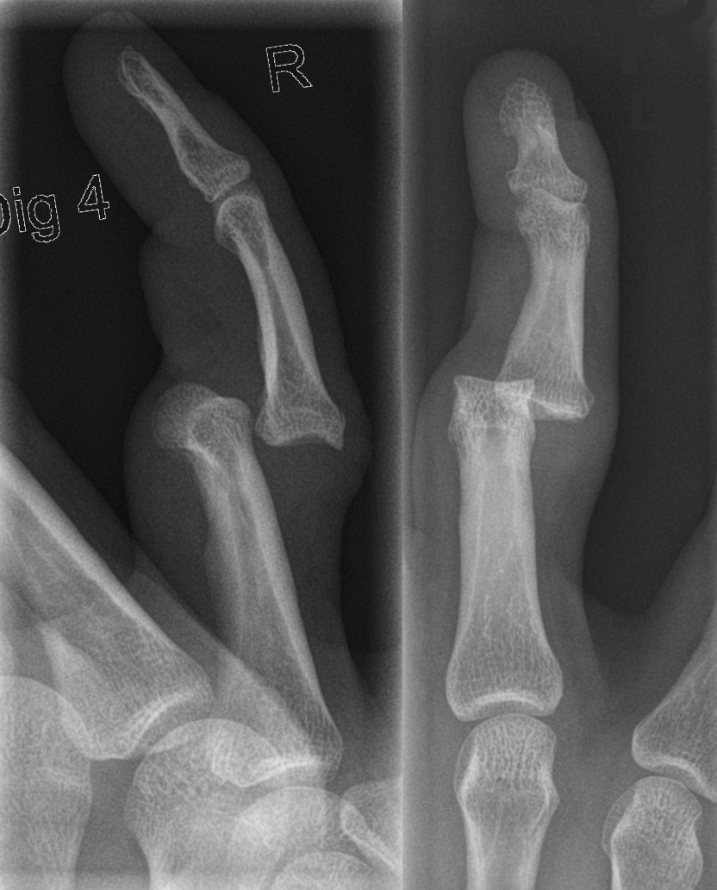
Dislocation
Dislocation
A person will display a number of symptoms if their bones become dislocated at the joint.
The joint looks deformed.
Swelling.
Bruising.
Numbness.
Pain.
Lack of movement.
Treatment
For a dislocation you should immediately stop and seek medical attention.
Notes:
New Slide
Additional image

Slide 9
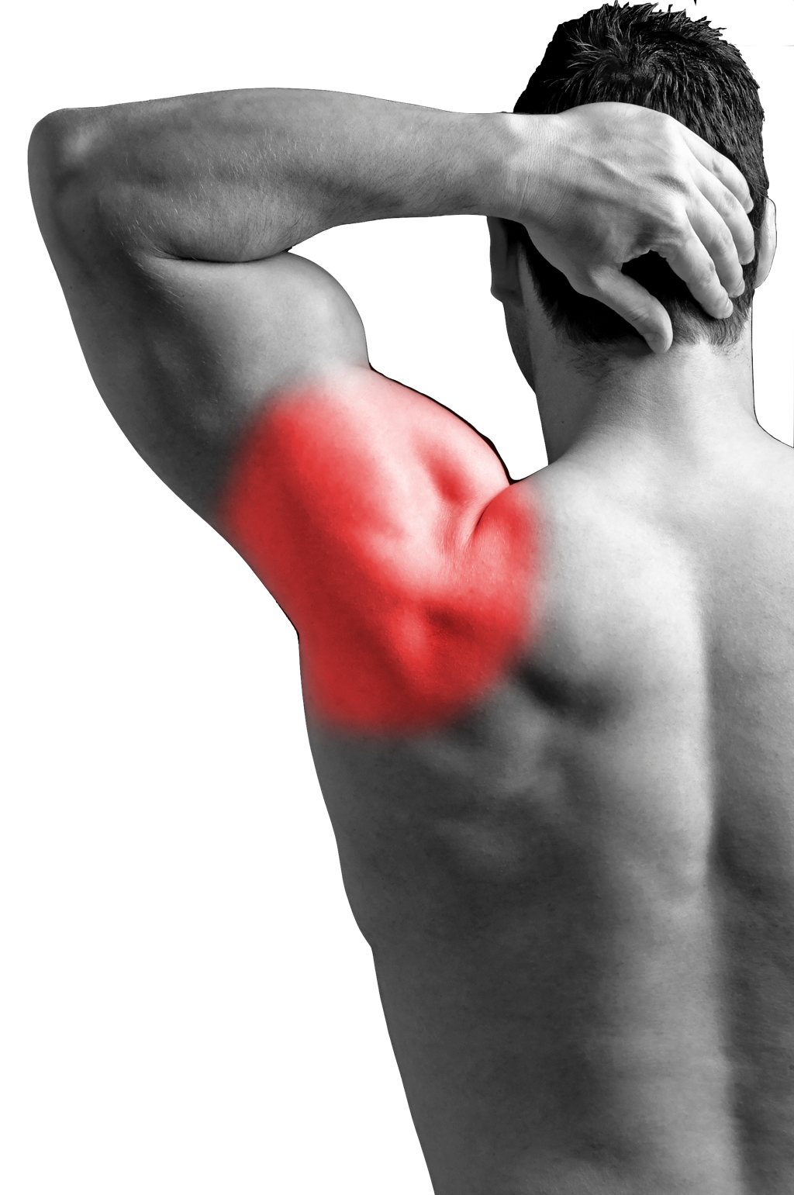
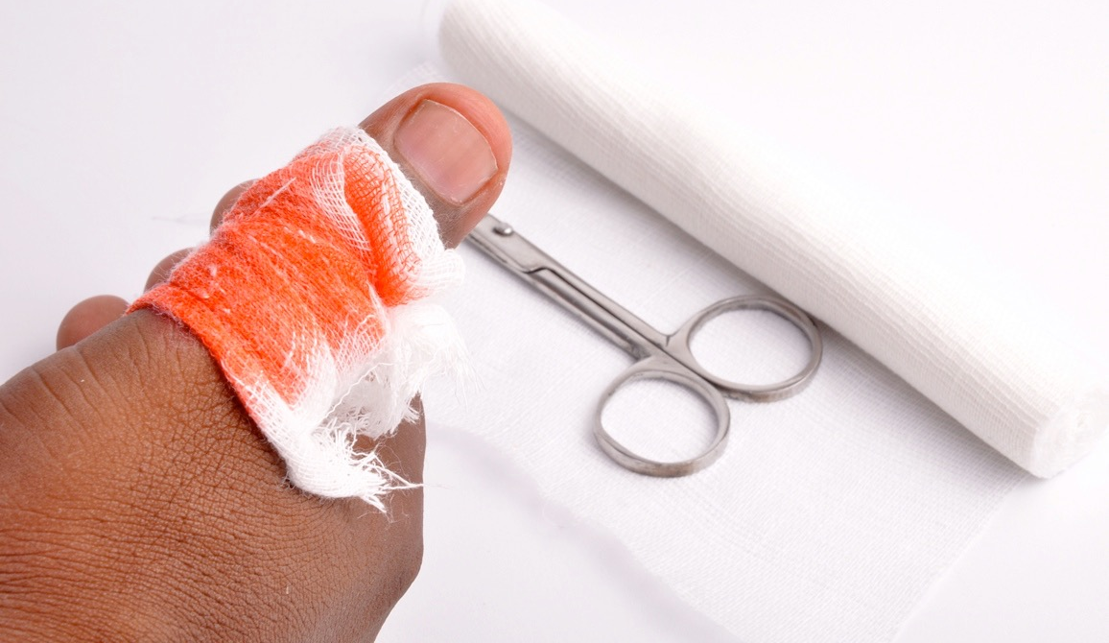
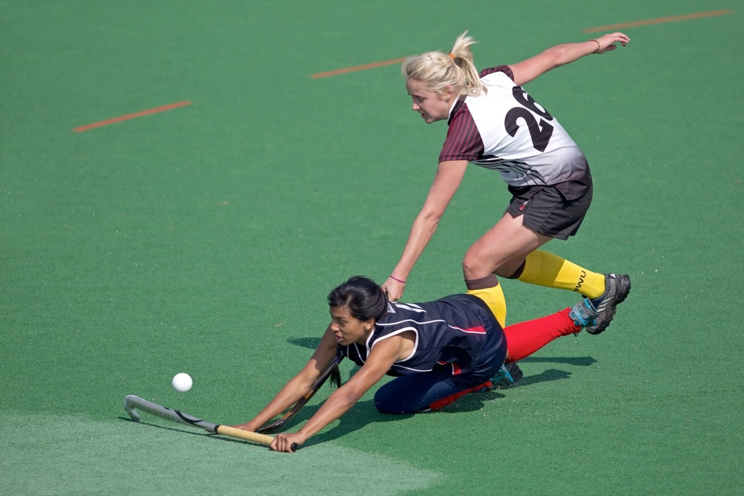
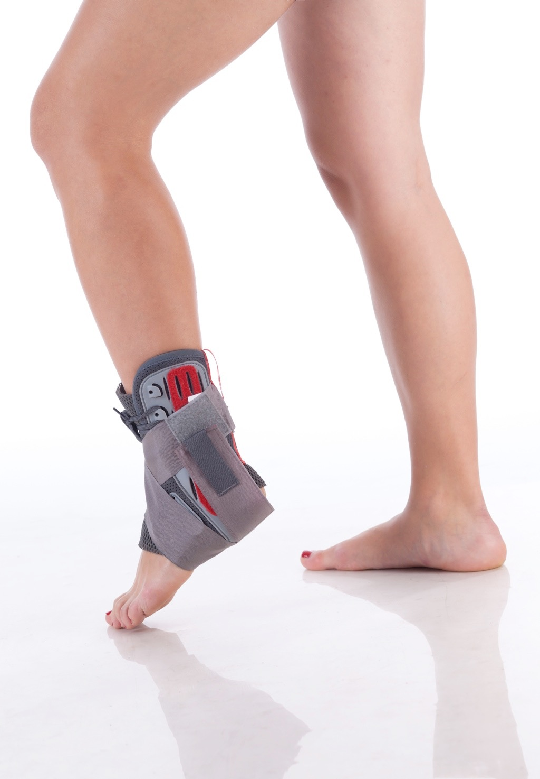
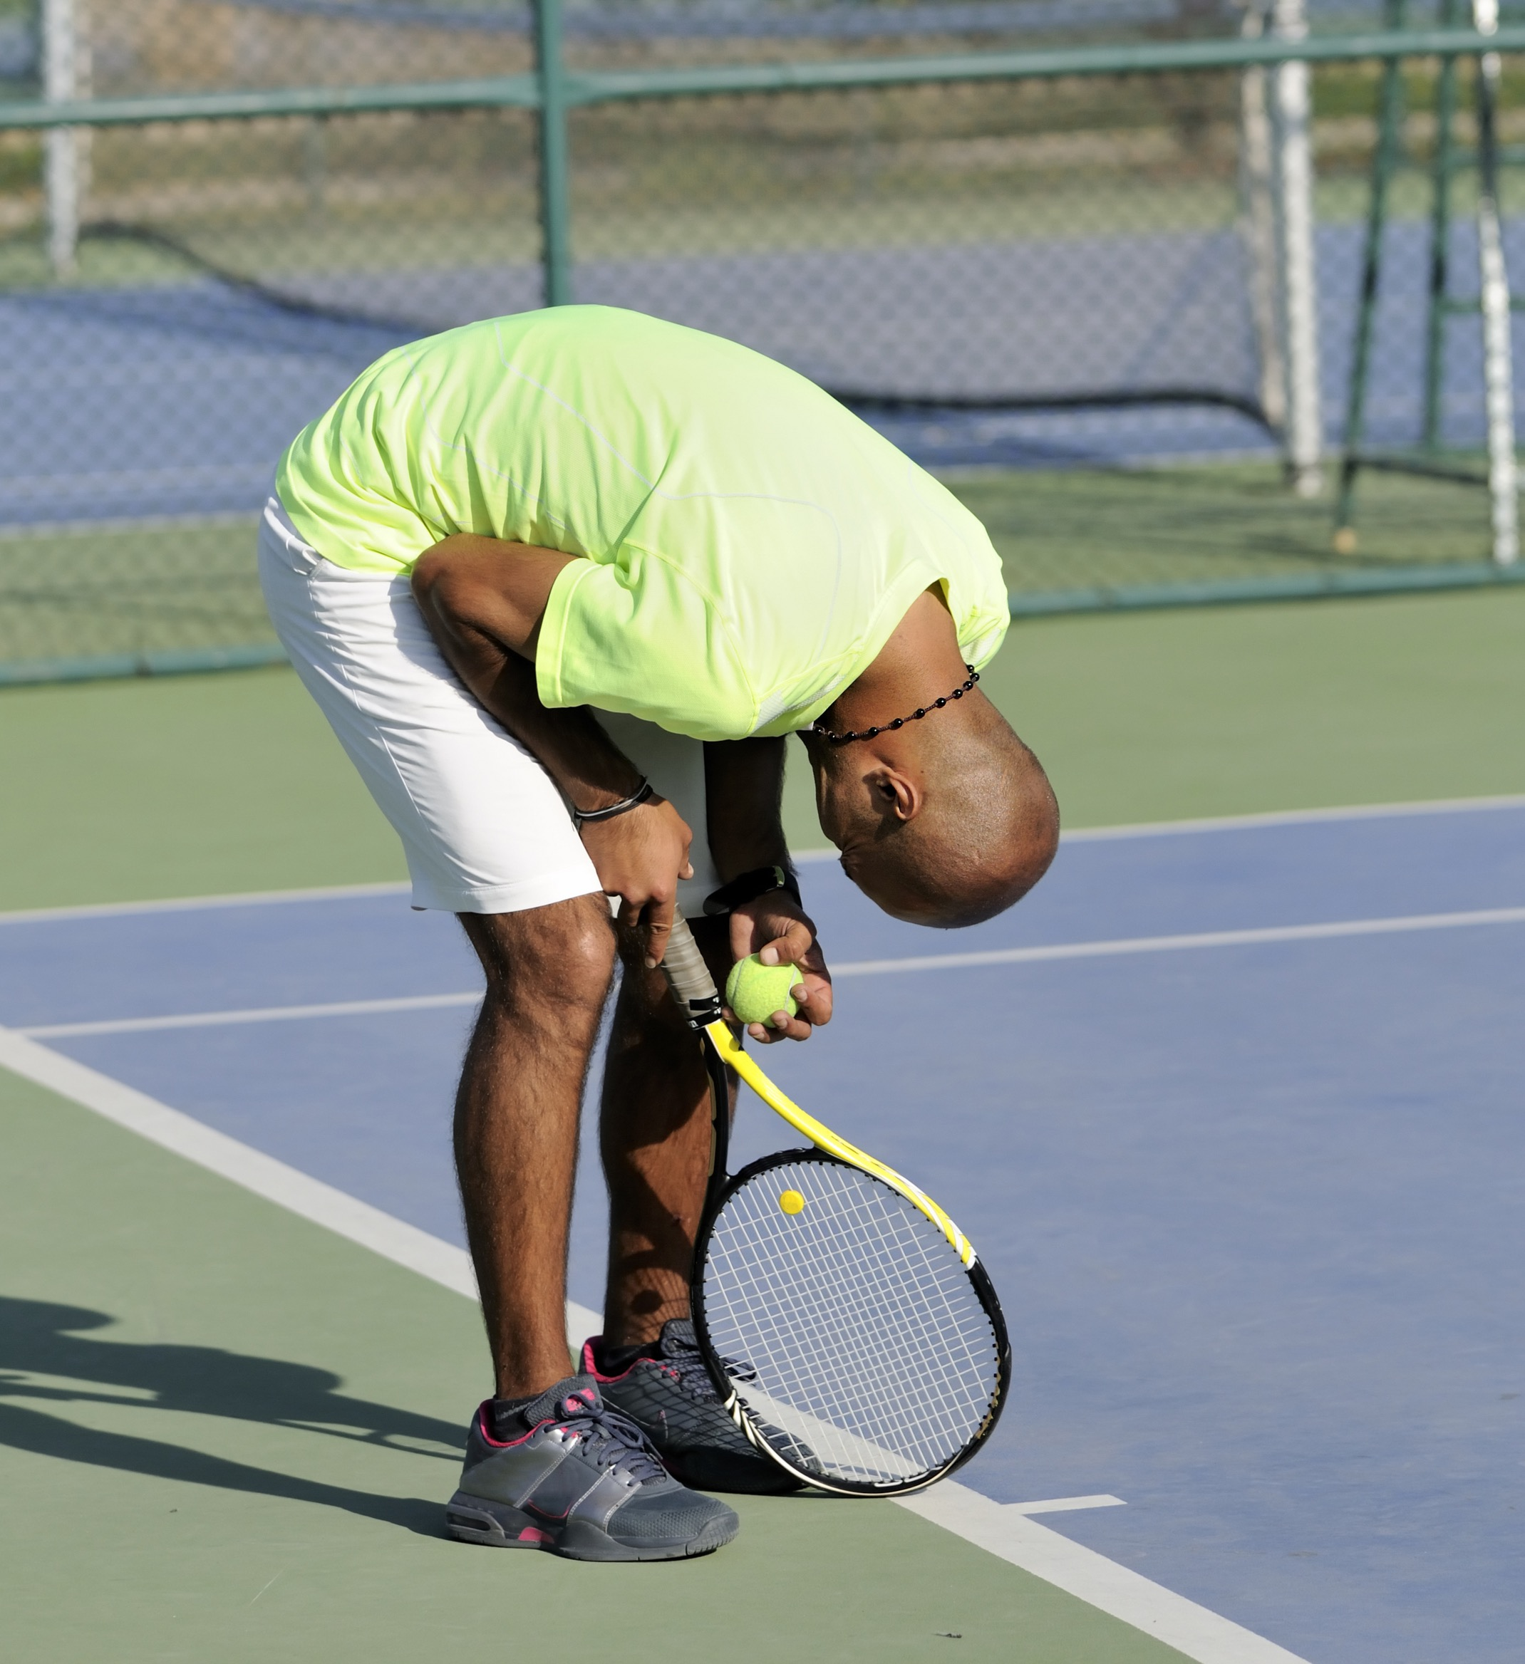
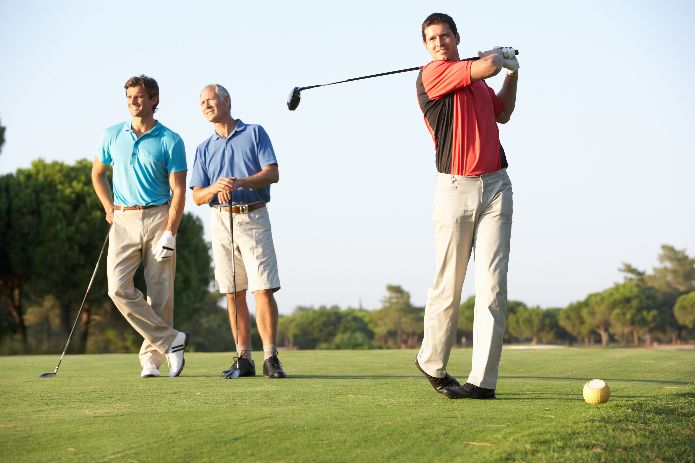
Soft tissue injuries
Soft tissue injuries involve injuries to the muscles, ligaments and tendons.
Strain |  | Cuts
Abrasions |  | Sprain
Tennis Elbow |  | Golfer's Elbow

Slide 10
Strains
Strains - caused by a tear in the
muscle tissue, resulting in pain,
swelling and bruising.
Strains should be treated with R.I.C.E.
    Rest - sit down or lie down and
    do not move.
    Ice - cool the injured area by applying ice.
    Compression - use a bandage to stop the swelling.
    Elevation - raise the joint higher than the heart to reduce the swelling.

Slide 11
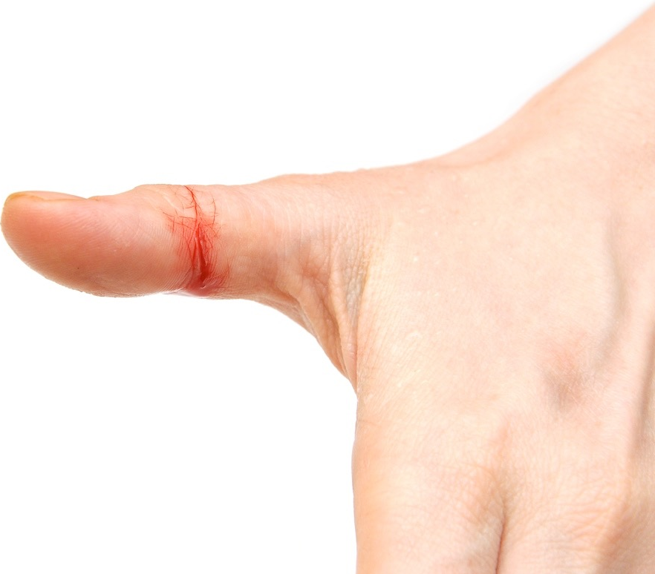
Cuts
Cuts - caused by an impact
breaking the skin.
Requires immediate
attention to reduce
the loss of blood.
They should be cleaned
with an antiseptic first.
Dress them with a plaster or bandage or both so they don’t get infected.

Slide 12
Abrasions
Grazes or abrasions - caused by rubbing against a rough surface
Need to be cleaned
thoroughly as there may
be grit or dirt in the wound.
The graze should then be
covered to prevent
further infection.

Slide 13
Sprain
Sprains - caused by stretched or
torn ligaments from a sudden twisting
movement.
Sprains should be treated with R.I.C.E.
    Rest - sit down or lie down and do
    not move.
    Ice - cool the injured area by applying ice.
    Compression - use a bandage to stop
    the swelling.
    Elevation - raise the joint higher than the heart to reduce the swelling.

Slide 14
Tennis elbow
Tennis elbow - caused by overuse of the tendons and muscles surrounding the elbow.
Tennis elbow should be treated with rest and if symptoms persist speak to a doctor.

Slide 15
Golfer's elbow
Golfer's elbow - caused by overuse of the tendons and muscles surrounding the elbow.
Golfer's elbow should be treated with rest and if symptoms persist speak to a doctor.

Slide 16
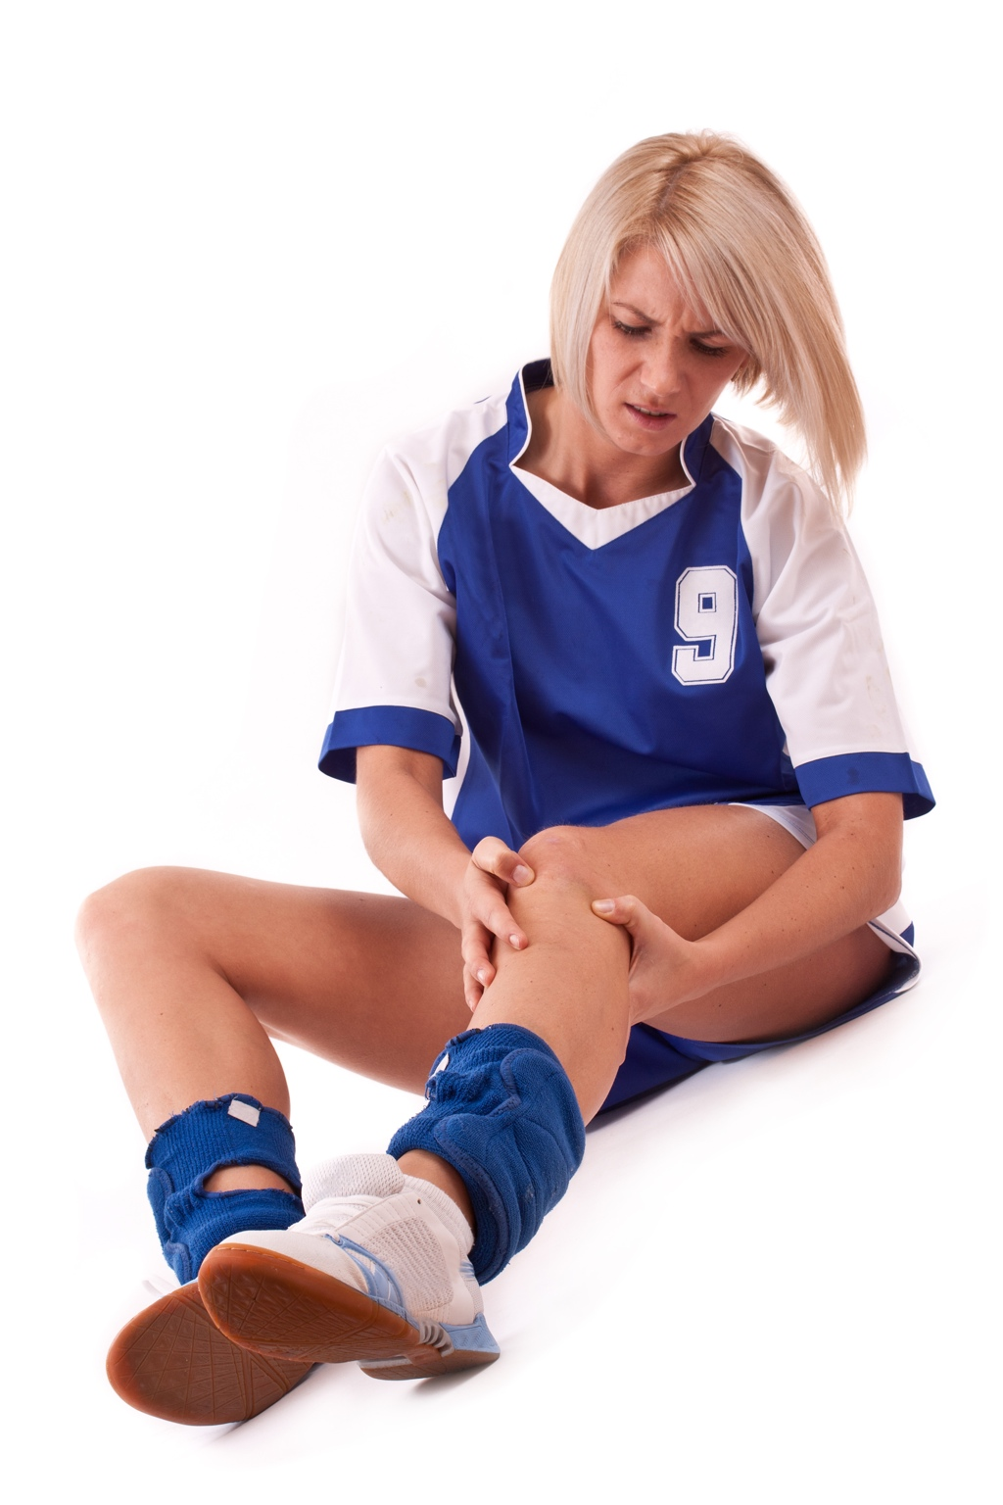
Causes of injury
  Colliding with another person.
  Sudden or twisting movements.
  Hot, cold, wet or windy environments.
  Wearing inappropriate clothing.
  Not following instructions or
  the rules.
  Not warming up and cooling
  down.
  Impacting with the ground or another person.

Slide 17
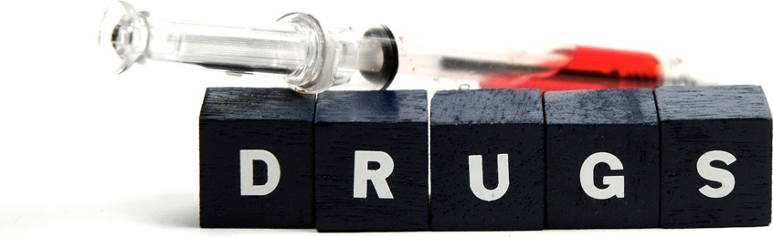
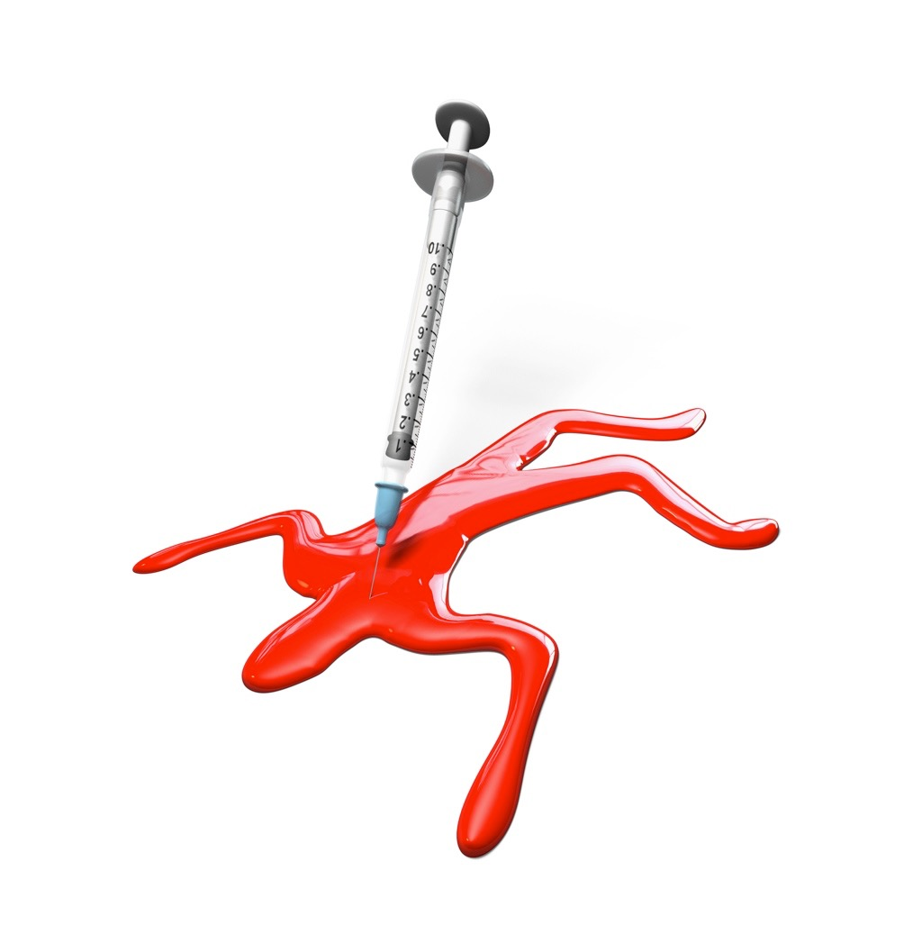
Performance-Enhancing Drugs (PEDs)
Drugs are:
“Any chemical introduced to
the body which affects how
the body works.”
Doping is:
“To improve performance by
taking drugs.”

Slide 18
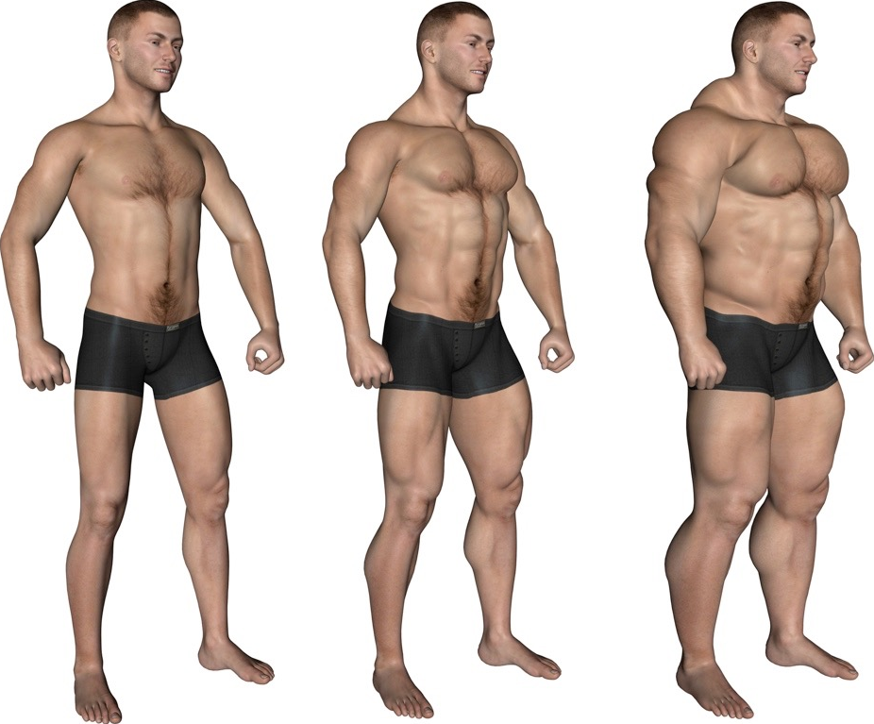
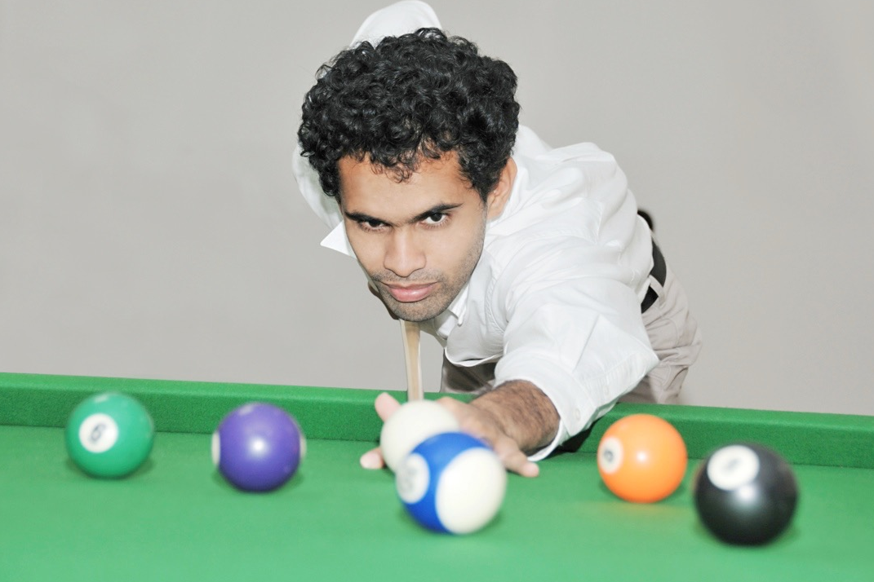
Reasons for taking them
Sports performers may take performance enhancing drugs for a number of reasons. Here are some:
  Steroids help to build muscle quickly.
  Narcotic-analgesics help to kill pain and
  allow the performer to keep going.
  Stimulants make the performer
  more alert.
  Anxiety reducing drugs calm
  performers before an event.

Slide 19
Types of drugs
The following drugs are banned by the International Olympic Committee:
Type of Drug | Effect on Performance | Risks | Sports Used
Stimulants | Reduce tiredness. | Impotence, high blood pressure, heart failure, paranoia and insomnia. | Endurance events such as swimming and cycling.
Narcotic-analgesics | Painkillers mask the pain of injury. | Injuries become more severe, nausea, drowsiness, dry mouth and constipation | Used in all sports where injuries are sustained.
Diuretics | Increase the amount of water excreted. Flush other drugs out of the system. | Muscle weakness, and dehydration. Loss of sodium and potassium salts. | Sports that have weight categories such as boxing and horse racing.

Slide 20
Types of Drugs
The following drugs are banned by the International Olympic Committee:
Type of Drug | Effect on Performance | Risks | Sports Used
Anxiety reducing drugs - Beta Blockers | Slow down and regulate the heart and reduce hand shake. | Diarrhoea, slow heart rate and impotence. | Shooting and archery.
Peptide hormones & analogues (EPO & GH) | They mimic the effect of naturally occurring hormones. Increase muscle strength and growth. | Allergic reactions, high blood pressure, abnormal growth in hands, feet and face. | Weight lifting to increase muscle mass.
Anabolic Steriods | Quick increase in strength. Able to train for longer. | Heart disease, high blood pressure, kidney and liver disease, infertility and aggression. | Strength and power related sports such as weightlifting and sprinting.

Slide 21
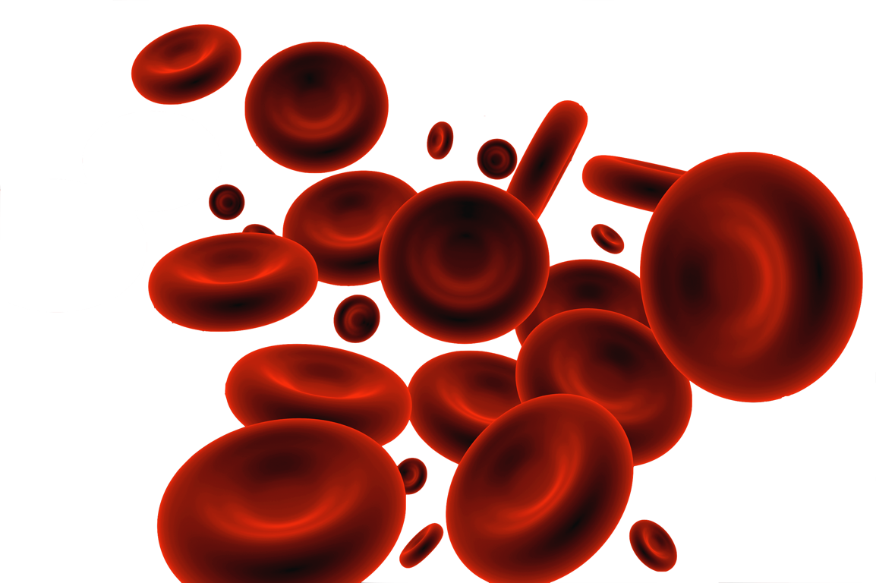
Blood doping
The method:
  Blood is drawn from the athlete a few weeks
  before competition.
  The red blood cells are separated and frozen.
  Just before the event the red blood cells are
  thawed and injected back into the athlete.
  The higher the concentration of red blood cells the more oxygen can be delivered to the working muscles.
  Long distance athletes such as cyclists and marathon runners may use this method.
The dangers:
  Injections could result in infections and blood diseases.
  HIV and AIDS.
  Cheating can result in being banned.

