Slide 1
Effective use of warm up and cool down
1.3.6 Physical training

Slide 2
Warm Up
Compression Garments
Stretching
Eat
Skill
Effective use of warm up and cool down
Mental Rehearsal
Rest
Water
Cool Down
Plunge Pools

Slide 3
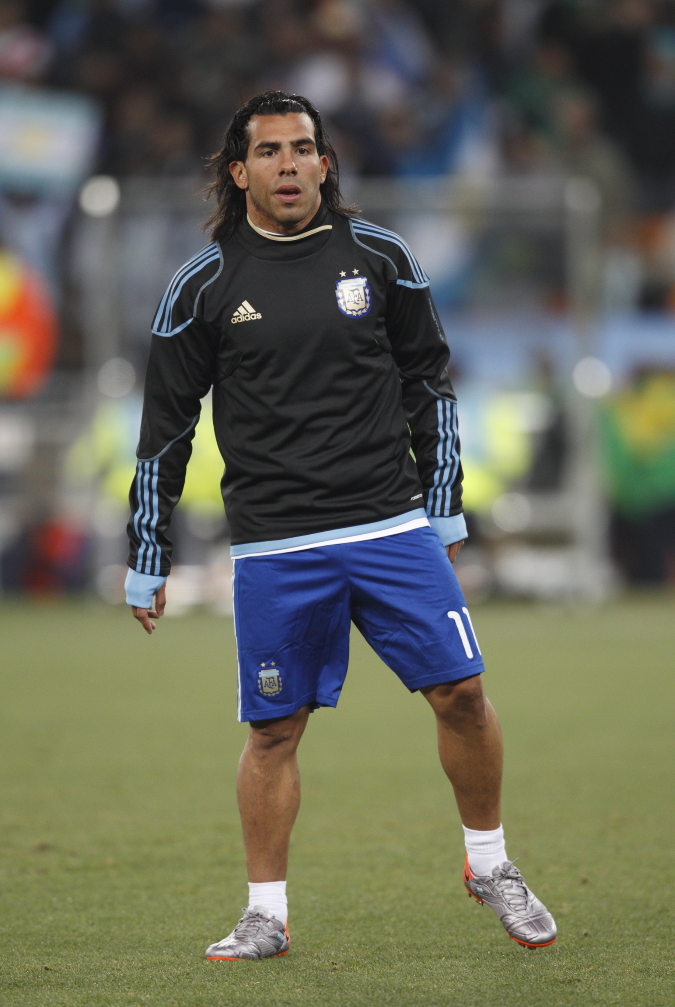
Warm up
Warm Up - There are 4 stages.
    Pulse raising exercise - increase the heart rate and oxygen supply gradually.
    Stretching.
    Skill based. practices/familiarisation - Practise the skills you will use in the activity.
    Mental rehearsal - visualisation of performance and desired outcome.

Slide 4
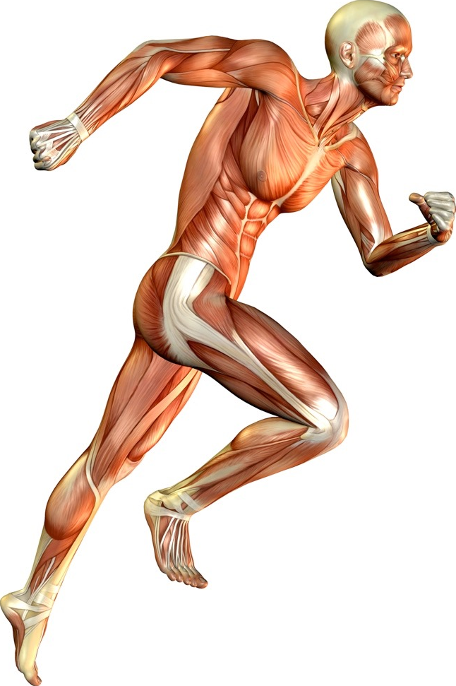
Benefits of warming up
There are a number of benefits to warming up:
  Increases blood and oxygen flow to the muscles.
  Body temperature increased.
  Prevention of injury.
  Psychological preparation
  for activities.
  Increases muscle flexibility
  and warms the muscles.
  Range of movement increases.
  Rehearsal of the skills through a
  full range of movement.
  Helps improve performance.

Slide 5
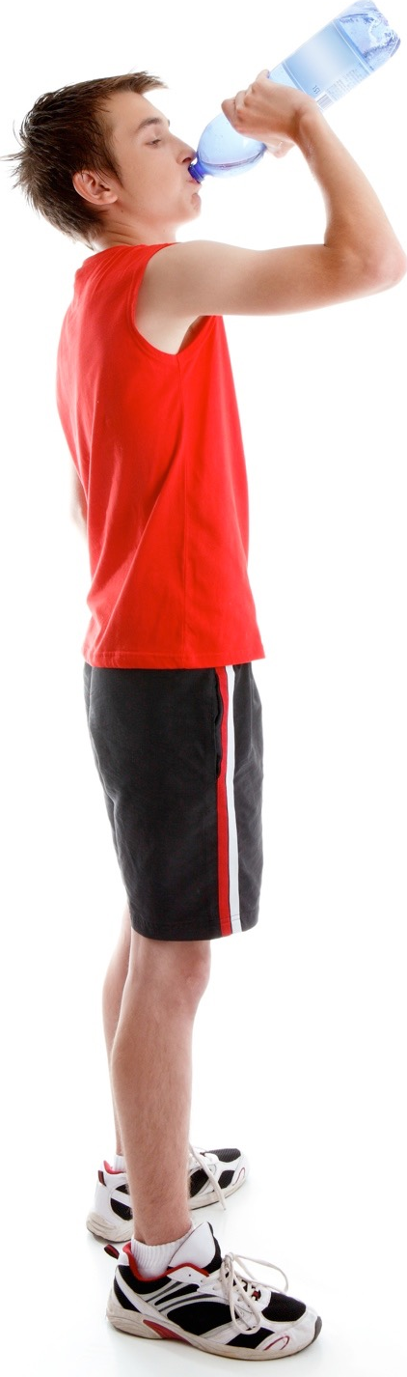
Cool down
Cool Down - Maintain elevated breathing with light exercise and stretch thoroughly to aid recovery by:
  Preventing soreness/delayed onset of muscle fatigue (DOMS).
  Clearing lactic acid and other waste products.
Players can also do a number of other activities to
aid recovery.
  Eat - This replaces energy used in exercise.
  Drink water - Rehydrates the body after losing
  fluids through sweating.
  Rest - Allows the muscles to repair themselves.
  Plunge pools of ice-cold water - Reduce
  muscle swelling and tears.
  Compression garments - Reduce swelling.

