Slide 1
Use of data
1.4.1 Use of data

Slide 2
Qualitative Data
Focus group
Quantitative Data
Questionnaires
Use of Data
Interviews
Surveys
Observations
Measurements

Slide 3
Types of data
Qualitative Data | Quantitative Data
Data can be observed but not measured | Data can be measured
Describes the data | Measures the data
Colours, textures, smells, taste | Height, weight, temperature, age, speed, time
Qualitative - Quality | Quantitative - Quantity

Slide 4
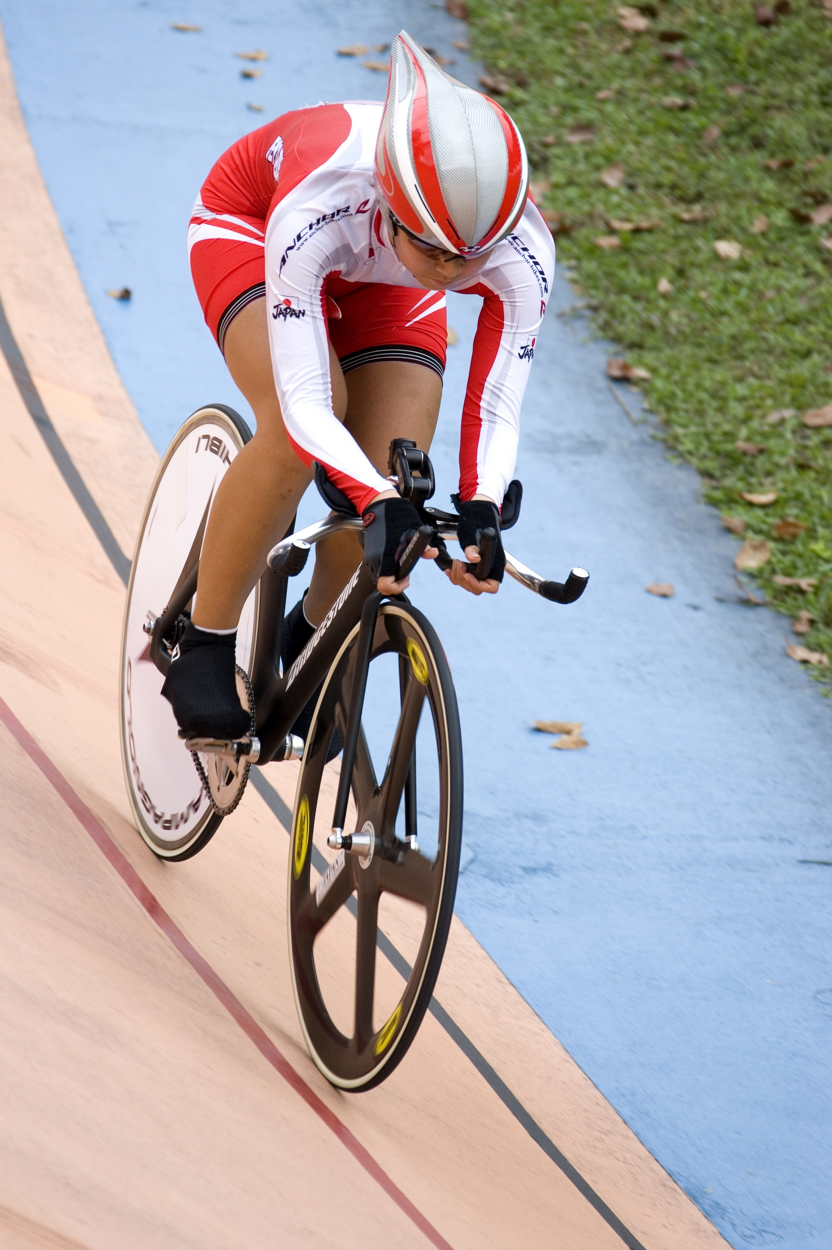
Sporting examples
Qualitative Data | Quantitative Data
Good cycling line, relaxed position, good head position. | Time, speed, cadence.

Slide 5
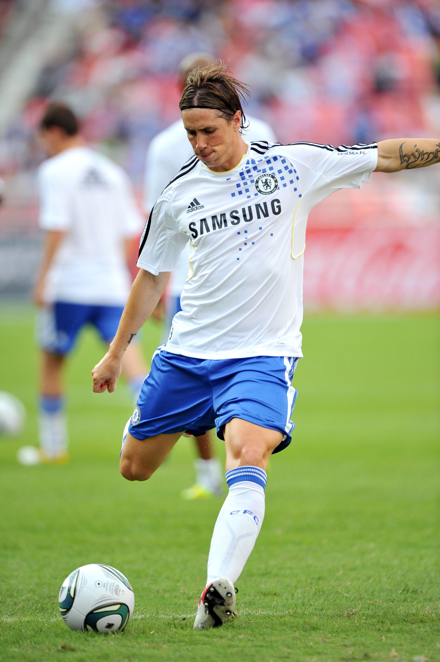
Sporting examples
Qualitative Data | Quantitative Data
Good standing foot position, preparatory swing, good head position. | Speed and direction.

Slide 6


Methods of data collection
Quantitative data
  Questionnaires
  Surveys
  Measurements
Qualitative data
  Interviews
  Observations
  Focus group

Slide 7

Types of presenting data
Three types of data presentation formats
  Tables
  Bar charts
  Line graphs

Slide 8
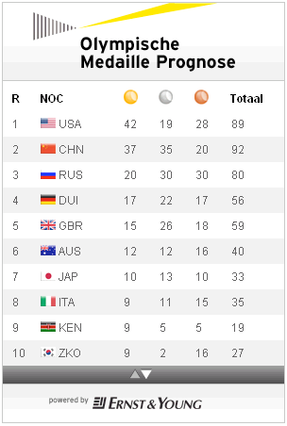
Tables
Tables
Show data.
Give exact comparison between collected data for analysis.
Organised in rows and
columns.
Table title and columns and rows
labelled.

Slide 9
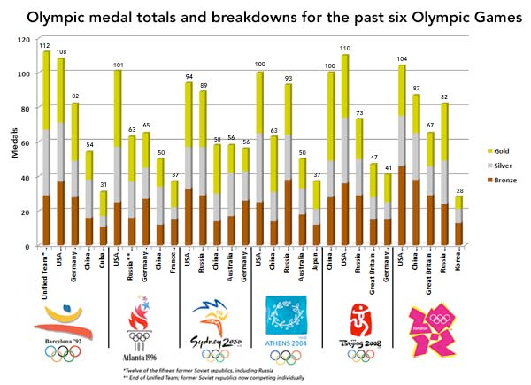
Bar chart
Bar chart
Horizontal and vertical axis.
Rectangular bars showing data comparisons.
Label the axis and
graph.
Legend.
Comparing the
size of each bar
allows direct
comparison and
analysis.

Slide 10
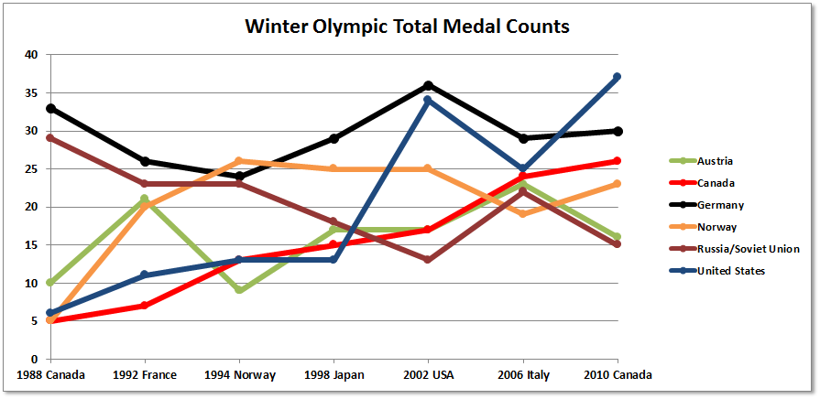
Line graph
Line graph
X and Y axis
Plot points and draw lines between them.
Label the axis and graph.
Legend.
Comparing the
increases and
decreases in each
line allows for
direct comparison
and analysis.

Slide 11
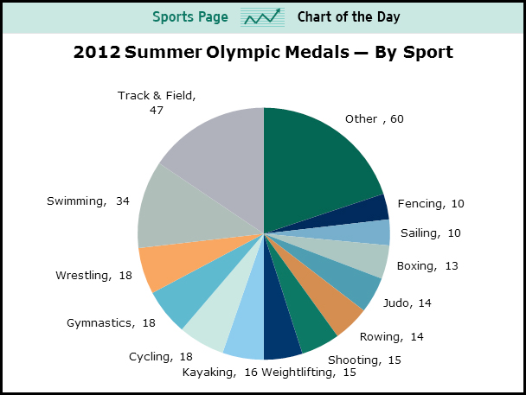
Pie chart
Pie Chart
Divided into sectors and each sector represents a portion of the whole.
Colours and labels for each sector with a legend.
Comparison of the
sector size enables
the analysis of the
data.

