Slide 1
Classification of skills
2.2.1 Sports psychology

Slide 2
Skill
High Organisational
Distributed
Ability
Closed
Open
Classification of skills
Practice
Low Organisational
Fixed
Gross
Massed
Variable

Slide 3
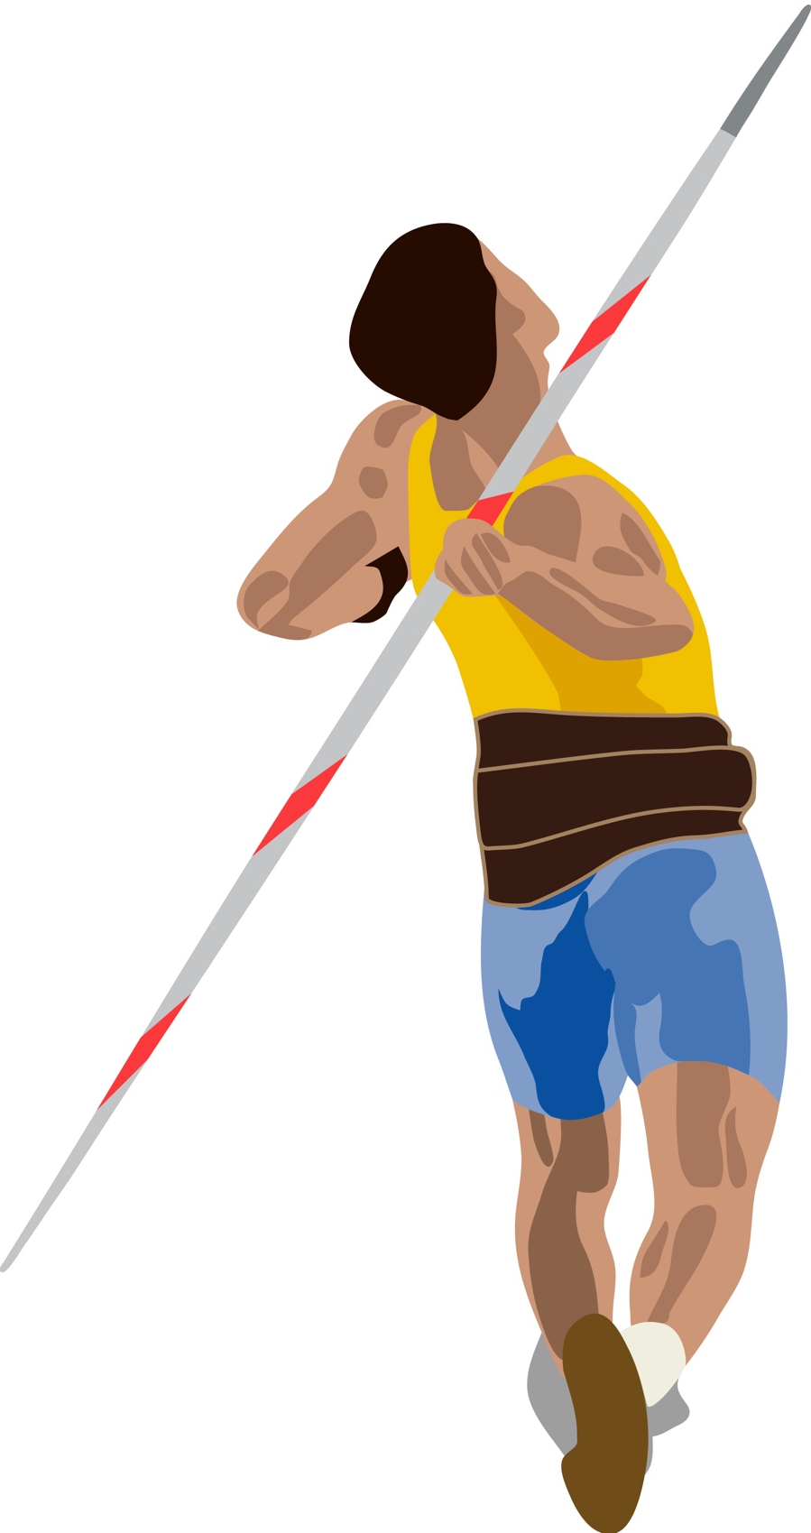
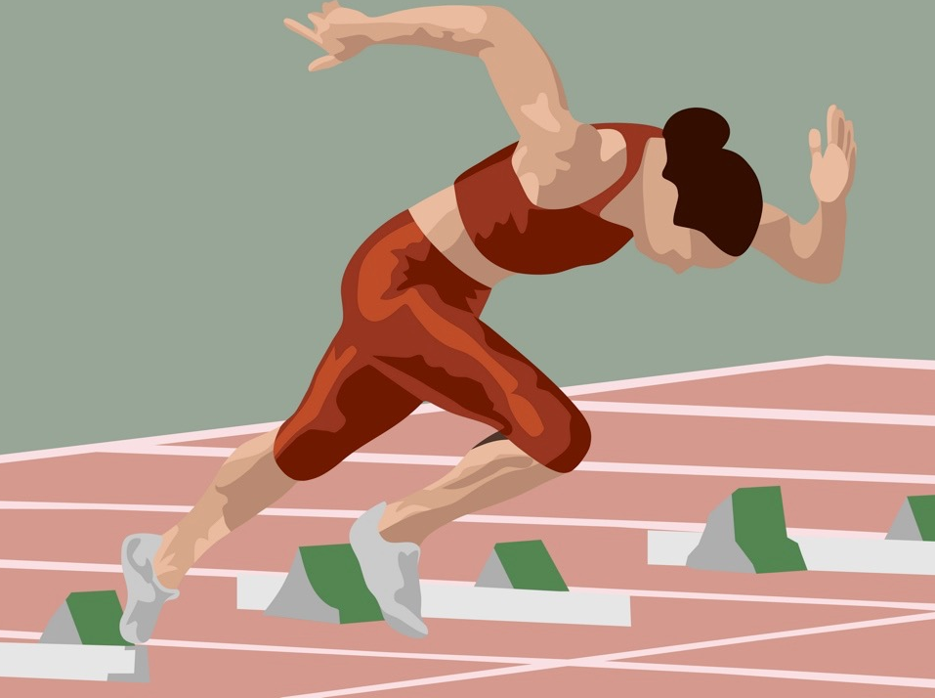
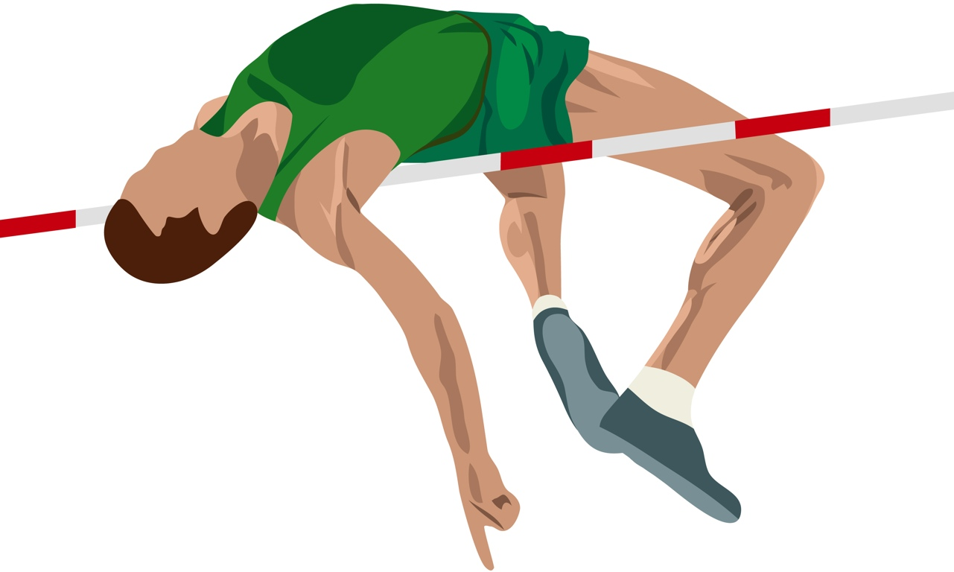
Skill and ability
Skill is defined as:
  “Skill is the learned ability to bring about
  a pre-determined result with maximum certainty and efficiency”
Ability is defined as:
  “Ability is inherited not learnt. It does not change throughout a person's life. Abilities impact a person's potential to learn skills.”

Slide 4
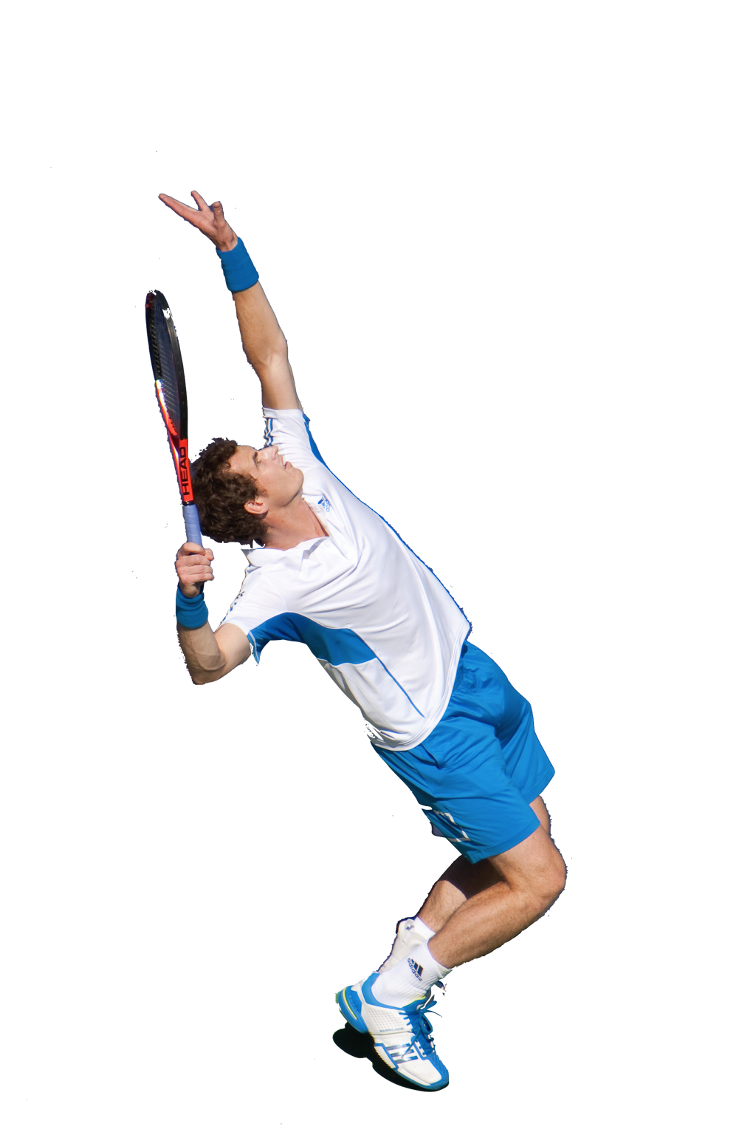
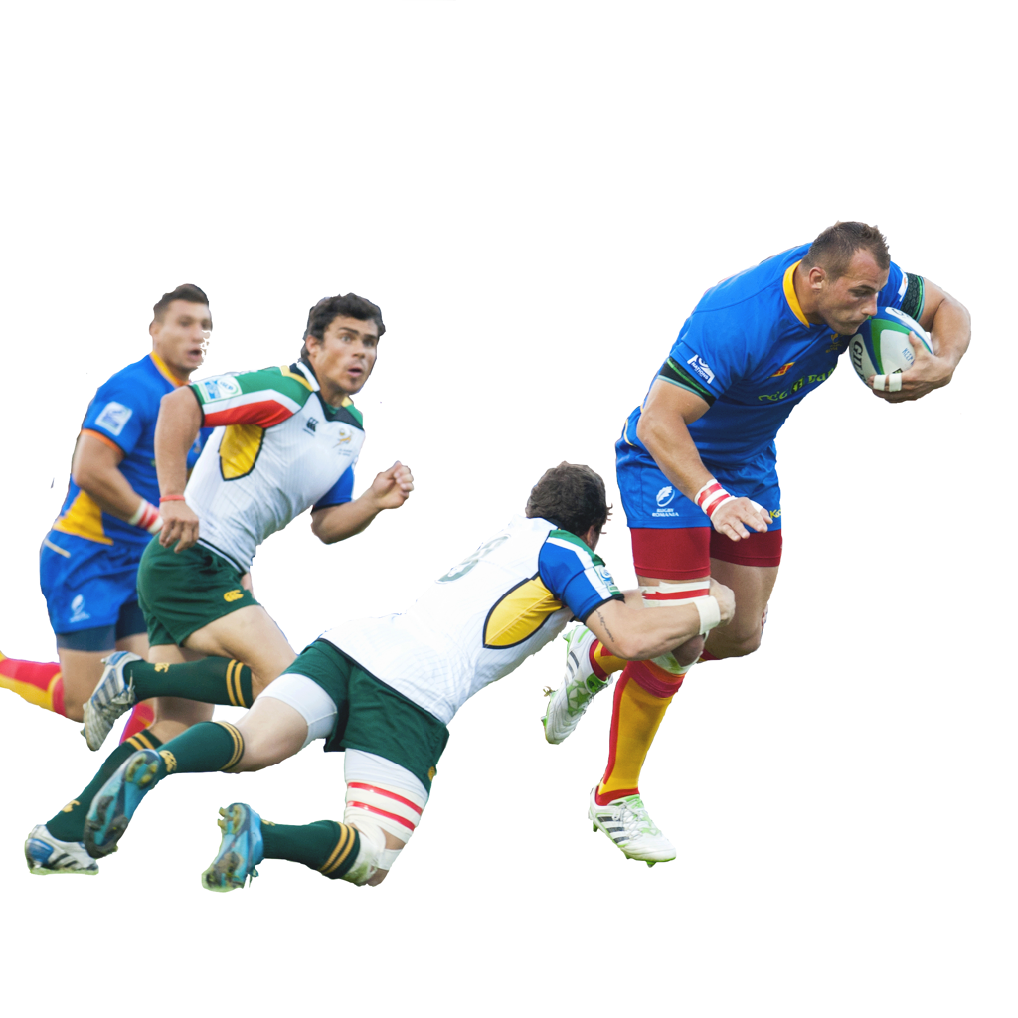


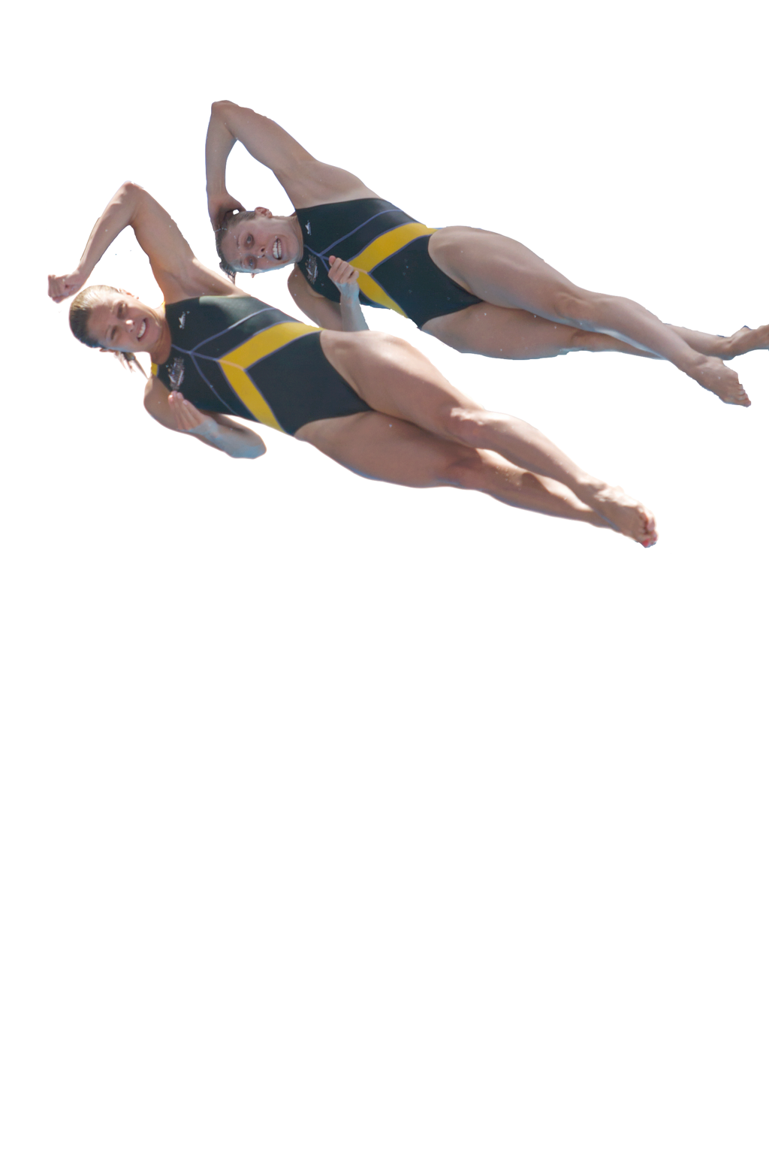
Skill continuums
Skills can be classified on these 3 continuums:
  Open and Closed Skills
  Low Organisational and
  High Organisational
  Basic and Complex Skills
open
closed
Low
High
basic
complex

Slide 5
Open skills
Open Skills
    Some skills need to be
    constantly adapted or
    modified during play.
    The environment is not
    under the performer's control,
    usually because others are involved.
    Some affecting factors may be, opponents, weather and surface.

Slide 6
Closed skills
Closed skills
    These skills are fairly fixed and require
    little adjustment during competition.
    Closed skills are practised repeatedly
    until they become consistent and effective.
    The performer is in control of the environmental factors e.g. in a tennis
    serve the skill is the same every time.
    Some other closed skills do have environmental factors that may require some adaptations for example, the crowd and the goalkeeper when taking a penalty in Football.

Slide 7
Low and high organisational skills
Low organisational Skills
    Can be broken into sub-routines
    i.e. arms, legs, body position, turn,
    start, body position in swimming.
High organisational skills
    Very difficult to separate into
    sub-routines.
    Needs to be practised as a whole
    movement such as a throw.

Slide 8
Basic and complex skills
Basic Skills
    This is a simple movement.
    It requires little concentration and thought.
    Movements can include throwing.
Complex skills
    Use large amounts of concentration.
    The movements are extremely complex and need
    to be practised over and over for
    them to be performed accurately.
    A synchronised dive is a good
    example of a complex skill.

Slide 9
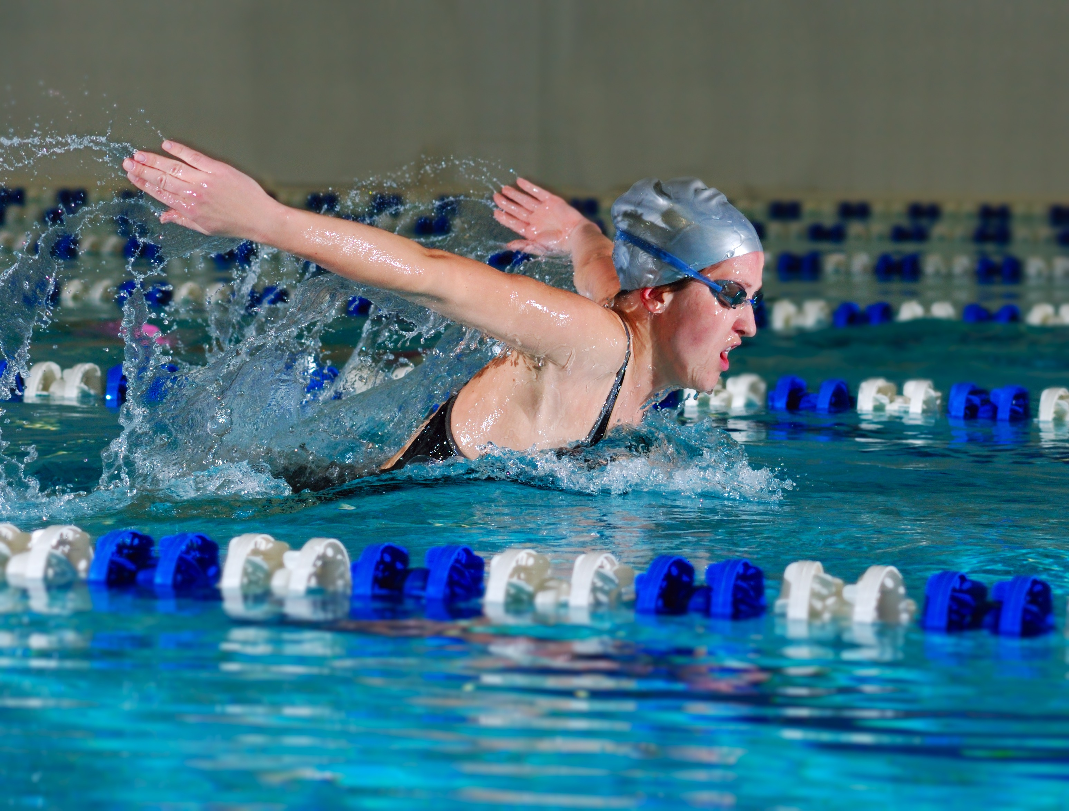
Practice structures
To develop skills we must practise.
To effectively develop skills the practice structure must match the skill classification.
There are four types of practice structures:
  Fixed practice.
  Variable practice.
  Massed practice.
  Distributed practice.

Slide 10
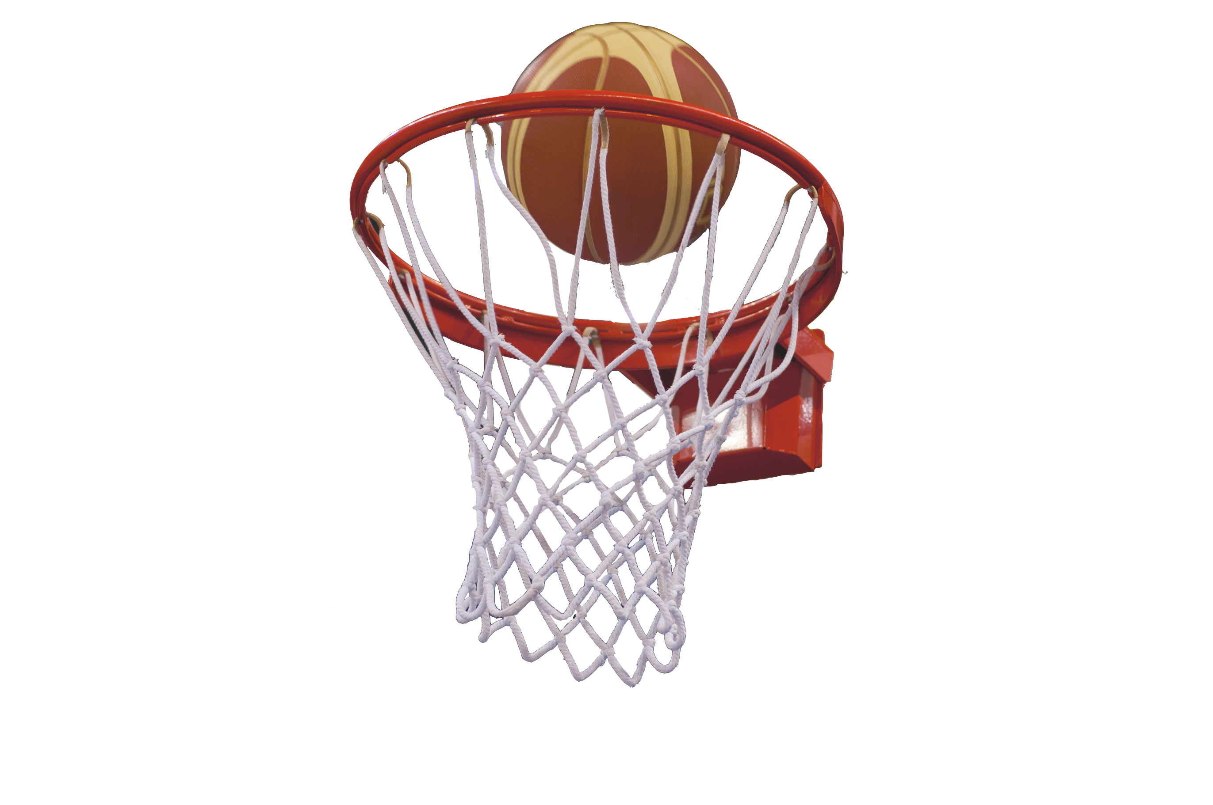
Fixed practice
Fixed practice involves repeating the skill the same way over and over. This is best for closed skills.
The skill can be isolated as the environment has no impact.
Examples of skills that can be developed through fixed practice are:
  Penalty kicks
  Basketball free throws
  Serving in Tennis

Slide 11
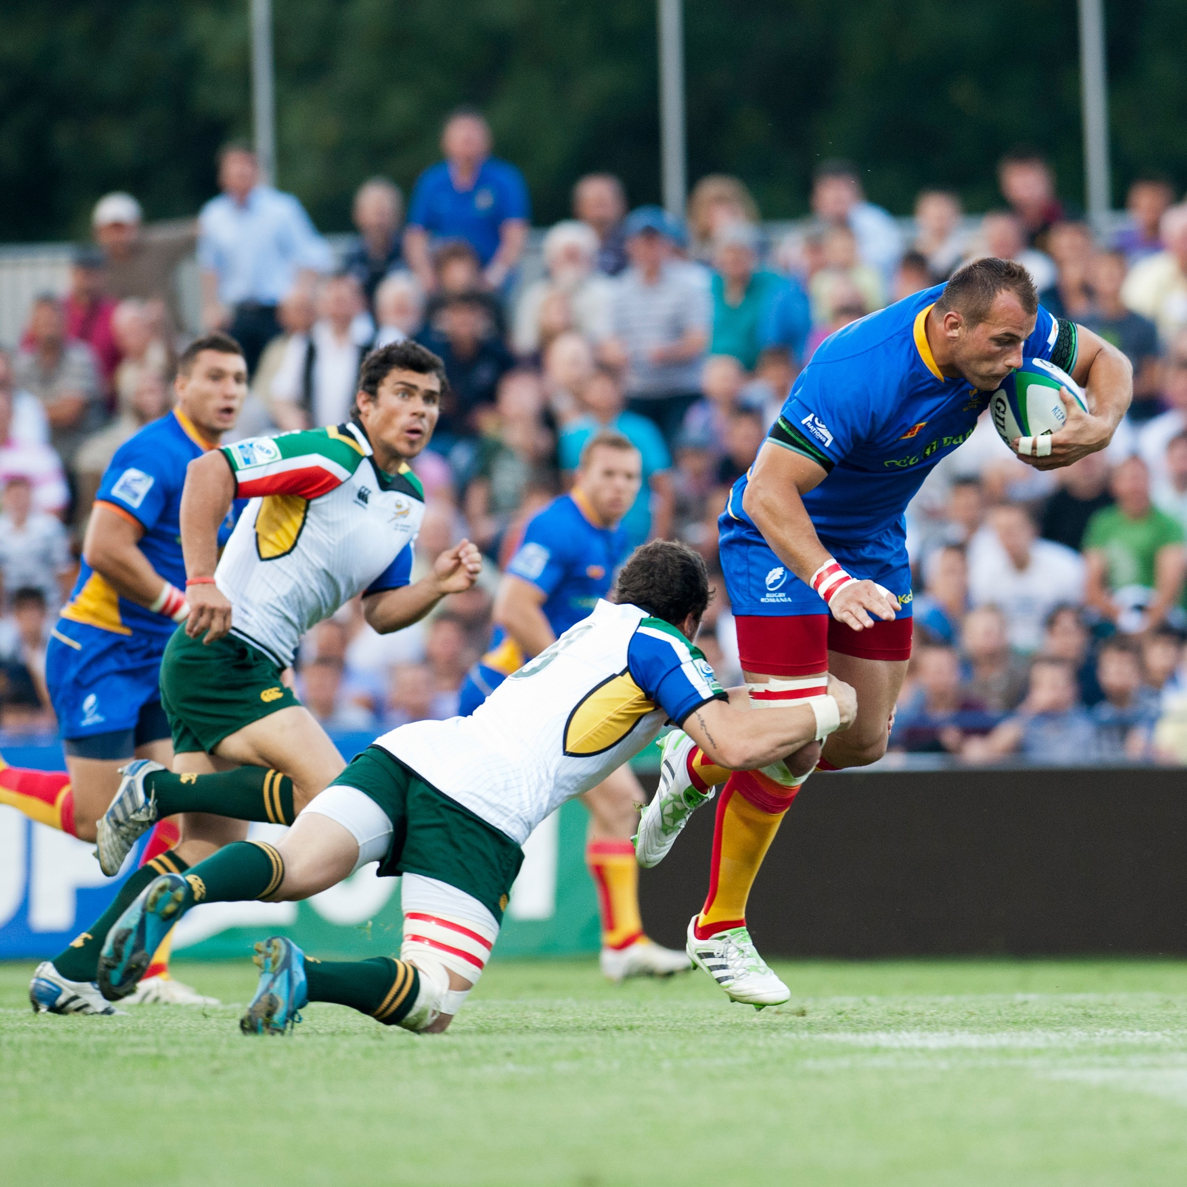
Variable practice
Variable practice involves practising the skill in different settings. This is best for open skills.
The skill is performed in a changing environment so needs to be practised in various situations.
Examples of skills that can be developed through variable practice are:
  passing in games
  running in Rugby
  digging in volleyball

Slide 12
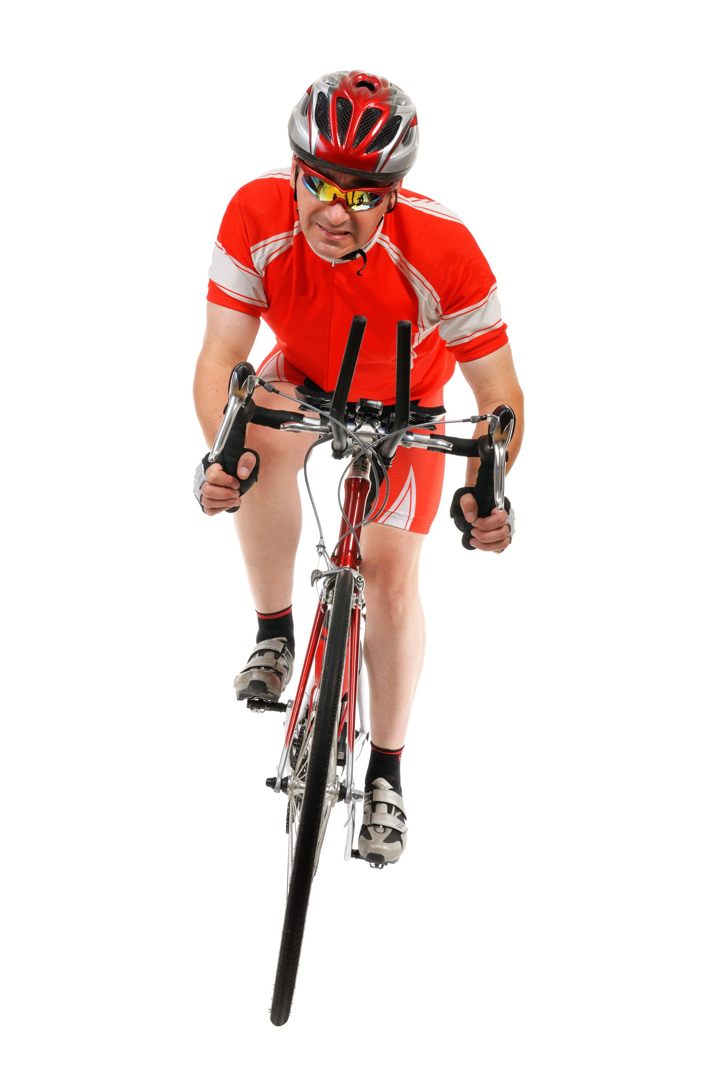
Massed practice
Massed practice involves practising the skill repeatedly for long periods of time.
This skill is best suited to experienced and motivated performers
This improves consistency and
allows the performer to practise
under the stress of fatigue.
This is best suited to low
organised and basic skills.

Slide 13

Distributed practice
Distributed practice involves breaks for rest, feedback and mental rehearsal.
This skill is best suited to beginners and low motivated performers
It allows for feedback which
supports skill development.
This practice is suited to complex skills.

