Slide 1
Guidance and feedback on performance
2.2.3 Sports psychology

Slide 2
Intrinsic Feedback
Concurrent
Extrinsic Feedback
Mechanical
Guidance and feedback on performance
Visual
Verbal
Guidance
Manual
Terminal

Slide 3
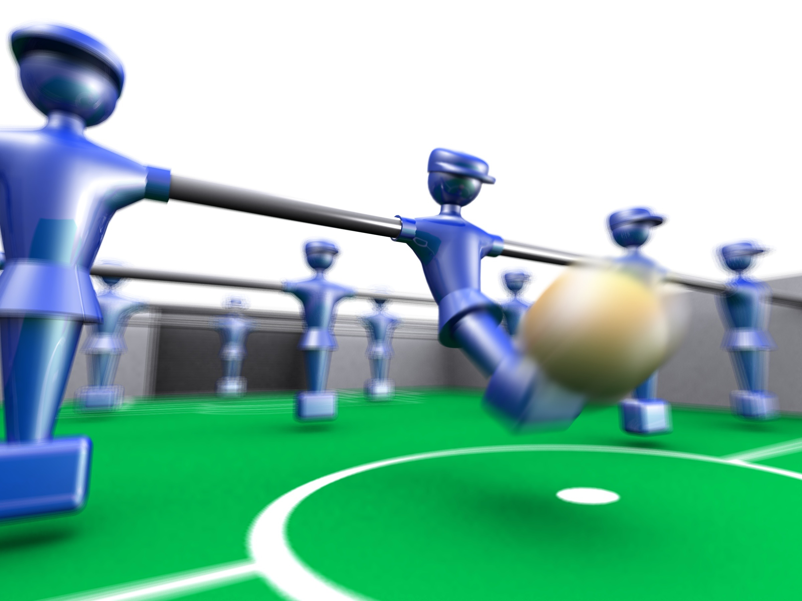
Types of guidance
Guidance is a way of giving information to a performer.
It assists in learning a skill or refining a performance.
There are four different types:
  Visual
  Verbal
  Manual
  Mechanical

Slide 4
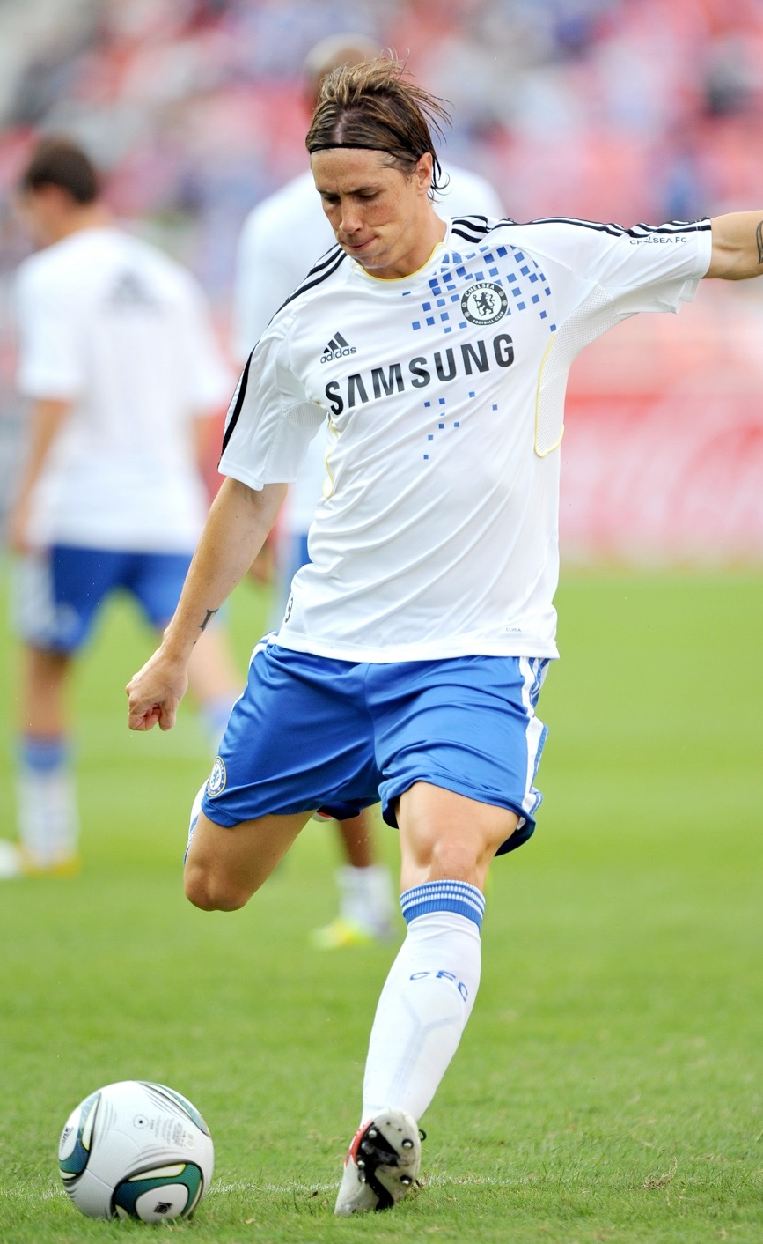
Visual
Visual
Watching someone else perform the skill
can be motivating, inspiring and informative.
Copying someone you admire is stronger
than someone you don’t. Role models
are powerful demonstrators.
It is useful for all levels of performer especially young and inexperienced performers.
When teaching a skill through demonstration it is important that the learner is paying full attention, has the ability to copy the skill and is motivated to repeat it.

Slide 5
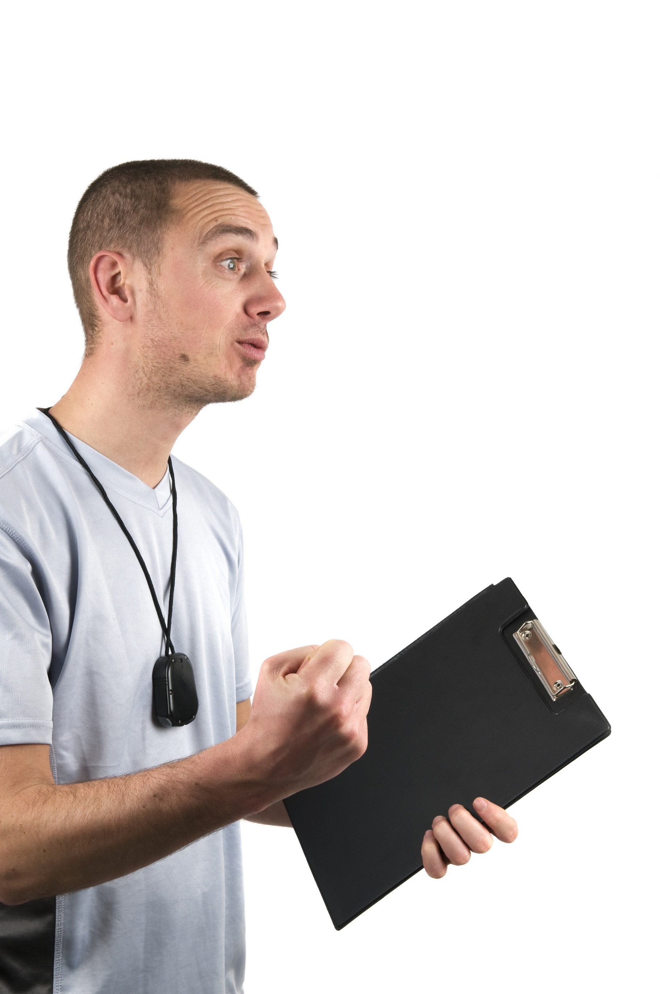
Verbal
Verbal
This is when someone describes the skill.
The performer hears the guidance.
Higher-level performers are able to
respond more readily than inexperienced
performers.
However, this type of guidance can be boring
and often complex tactics or skills are hard to describe.

Slide 6
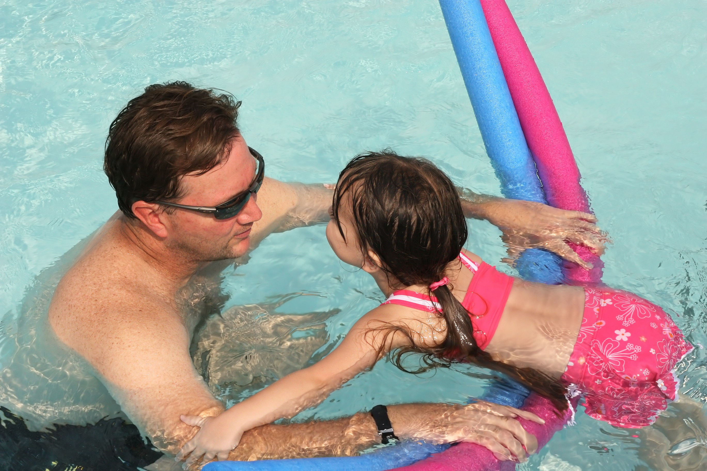
Manual
Manual
This involves a coach physically guiding you through the skill.
They move the body into position and support them in the skill.
This is effective for beginners.
However, it can be
demotivating as the performer
may not feel they are
performing the skill themselves
and it may feel different
without the manual guidance.

Slide 7
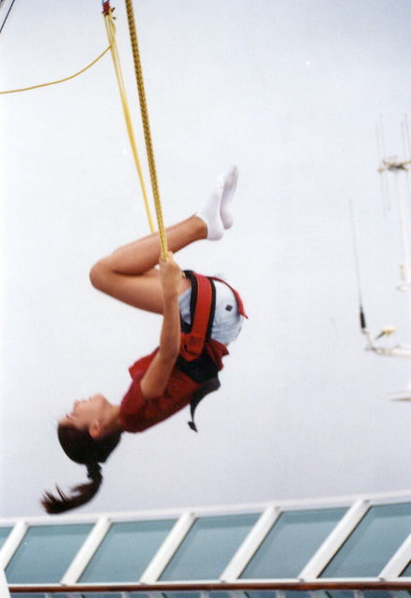
Mechanical
Mechanical
The use of aids or objects to assist in the skill learning process.
These are used in high risk skill
learning found in Gymnastics or
Trampoline.
It allows the performer to learn
without fear.
However, the equipment is often
expensive and the performer may
rely on the aid.

Slide 8
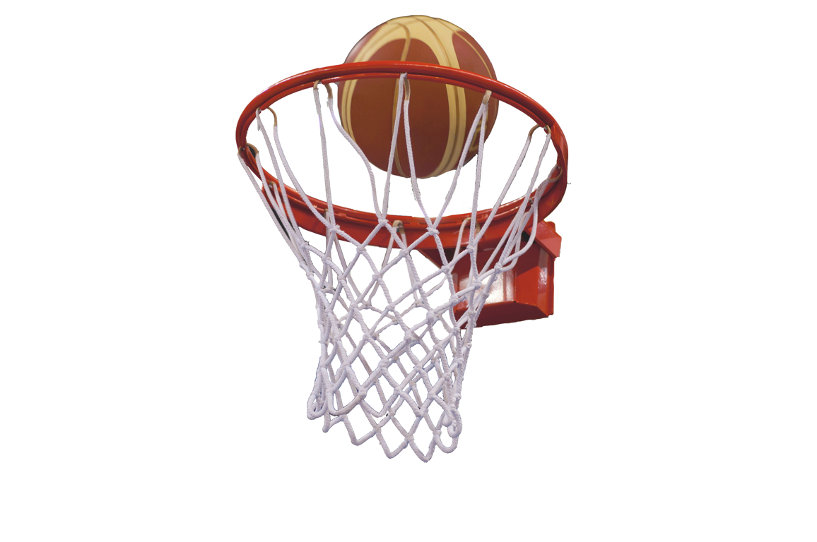
Feedback
The brain is constantly receiving feedback from all the senses this helps to improve and refine the skill learnt. There are different types of feedback:
Intrinsic Feedback – Comes from inside.
This feedback is from the body’s own sensors,
seeing the ball fly when you hit it, hearing the
sound of contact on the ball, feeling the contact
on the ball.
Extrinsic Feedback - Comes from outside.
There are two types of extrinsic feedback;
  Knowledge of Results - Seeing you scored.
  Knowledge of Performance - Your coach tells you that you need to open out of the somersault earlier in diving.

Slide 9
Feedback
Concurrent
Used to motivate the athlete and let them know what they are doing correctly.
However, it may make the athlete feel the performance was more positive than it actually was.
Terminal
Used to inform the athlete about an incorrect movement and what they must do to correct it.
It can be demotivating and overuse can leave athletes not knowing what to focus on.

Slide 10
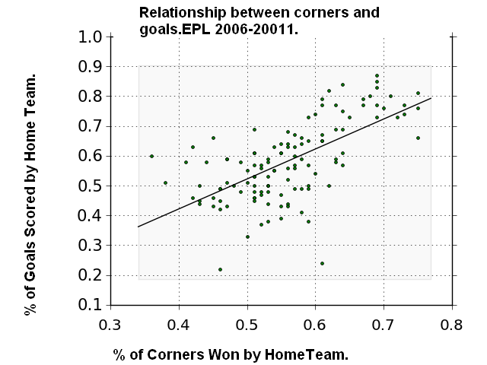
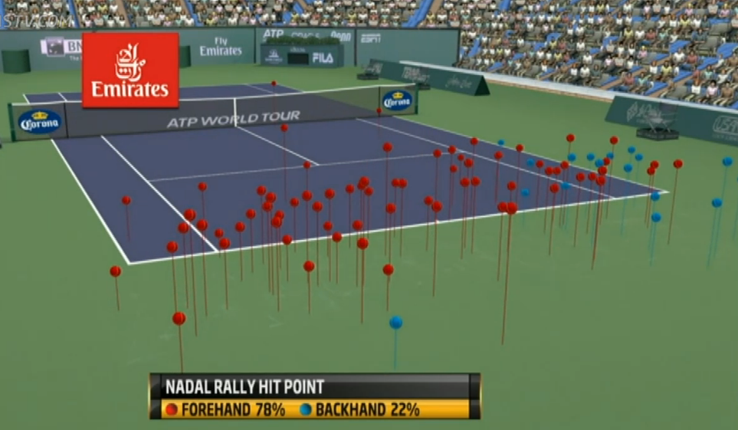
Graphical representation
Sports professionals collect large amounts of data about their individual and team performance.
It can be received at the end of the performance (terminally) or during (concurrent).
This is represented graphically or using images.

