Slide 1
Mental preparation for performance
2.2.4 Sports psychology

Slide 2
Visualisation
Relaxation
Mental Rehearsal
Mental preparation and performance
Motivation
Emotion
Concentration

Slide 3

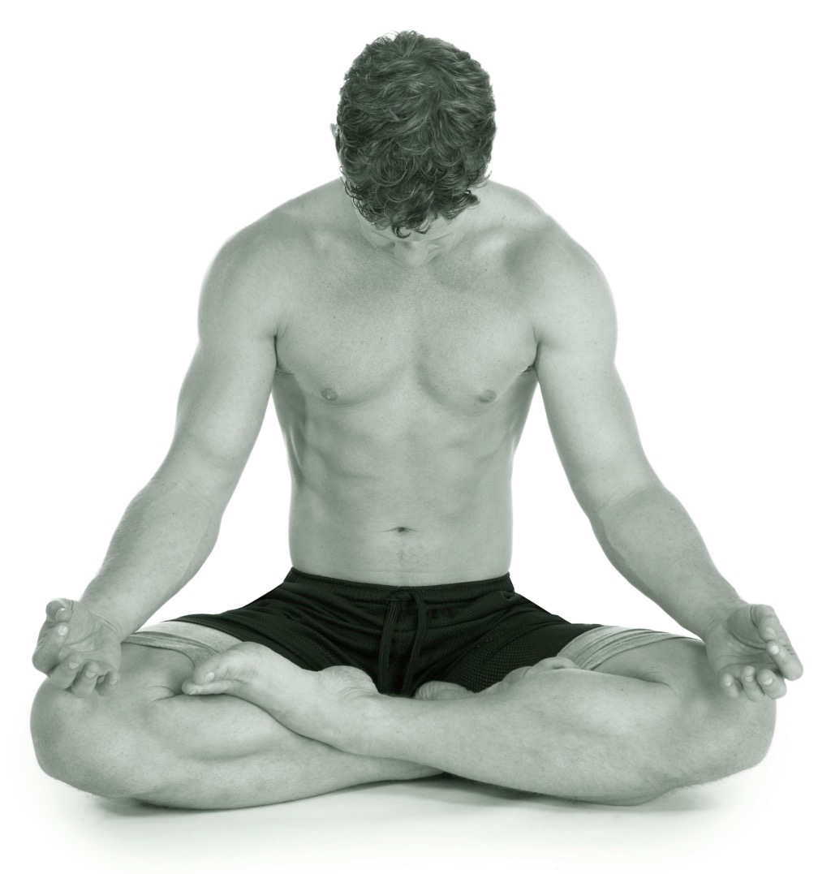
Psychological warm-up
Relaxation
Physical - Involves a number of techniques where the intertwined nature of the body and mind is used to relax the athlete. This might be in the form of progressive muscle relaxation or deep breathing.
Mental - This can be in the form of meditation or positive “self-talk”. The performer should breathe deeply and slowly. The performer can also use distraction techniques like listening to music.

Slide 4
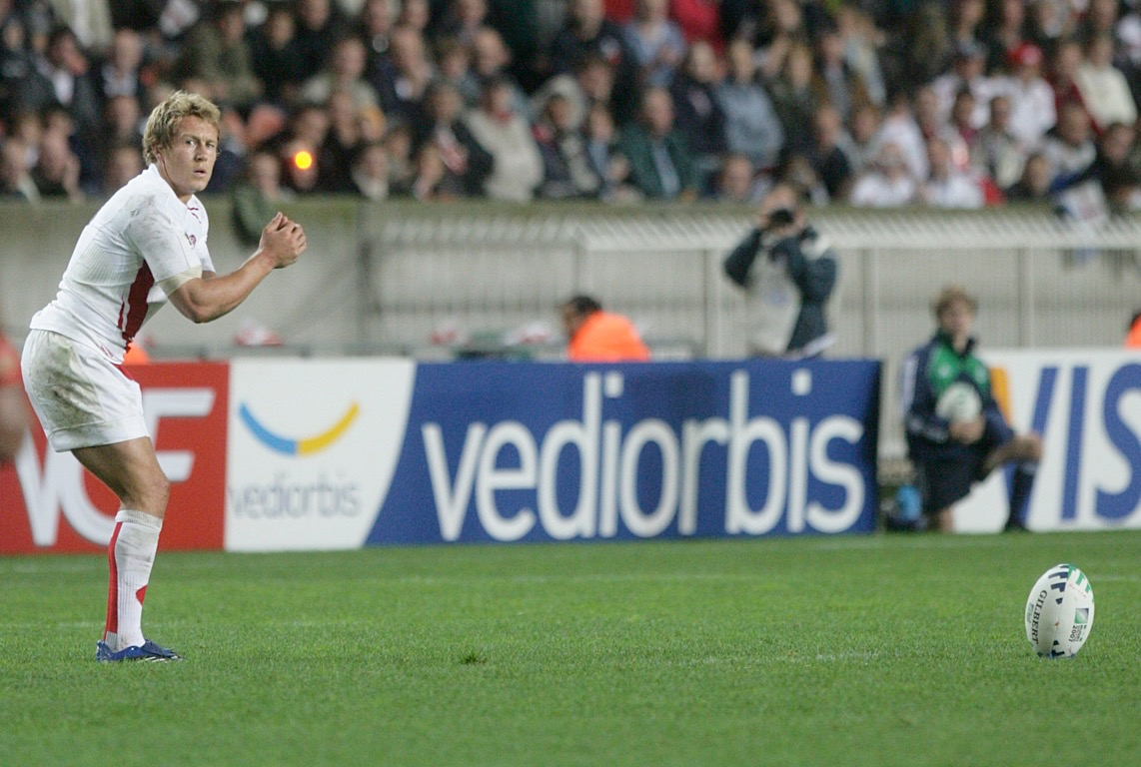
Psychological warm-up
Visualisation and Mental Rehearsal
This is a process of imagining yourself performing the chosen skill in your mind. You imagine yourself performing well and this increases confidence and decreases anxiety.
A tennis player may take a few
seconds to visualise themselves
hitting the perfect serve in the place
where they want.
A quarterback can go through a play in his mind just before performing the play.

Slide 5

Benefits of mental preparation
Using these mental preparation techniques can improve performance.
Controls emotions and less likely to get angry.
Able to make calmer logical decisions.
Can cope better with stress and anxiety.
Improves concentration and focus.
Able to react quicker.
Raises confidence and positive
thinking.
Raises motivation.
“Psychs” you up and gets you
ready for action.

