Slide 1
Engagement patterns of different social groups
2.3.1 Socio-cultural influences

Slide 2
Engagement
Age
Disability
Socio-economic
Engagement patterns of different social groups
Participation
Ethnicity
Gender
Barriers

Slide 3

Engagements patterns
Engagement varies between different social groups.
Engagement patterns are monitored to ensure that specific social groups are not
under-represented.
Specific barriers are identified for each group and provisions are put in place to
increase opportunities and
access for these groups.

Slide 4
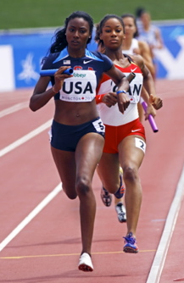
Gender
Boys and men are more likely to engage in
sport and physical activity than girls and women.
Traditionally women are seen as the weaker sex and were not allowed to compete in a number of sports or events.
Female sports played at elite level are less likely to receive media coverage than male sports.
There is less funding in the form of prize money, sponsorship and salaries for women.
Women also have gender roles at home which results in less time to participate in sport.
There are fewer female role models due to these barriers.

Slide 5

Ethnicity
Many individuals from minority ethnic groups
enjoy participation in physical activity. However,
they can face a number of unique barriers.
Some areas that are highly populated by ethnic minorities don’t have a large amount of sports facilities.
A large number of individuals from ethnic minorities face socio-economic barriers.
Sporting prejudices such as African-Caribbeans being poor swimmers, may discourage individuals from certain sports.
Religious traditions such as fasting and dress codes may result in decreased participation.

Slide 6
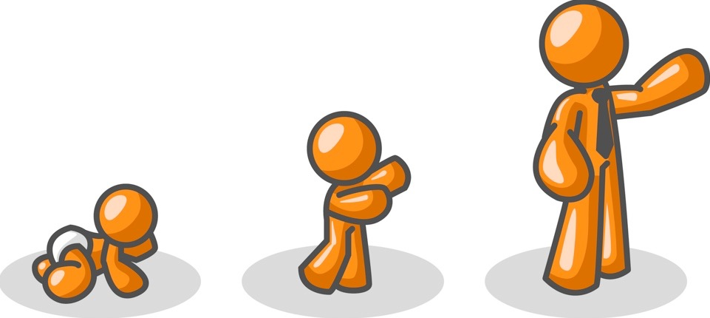
Age
Ageing can affect participation.
Participation peaks
between 16 to 25 years old.
Flexibility, strength, cardiovascular endurance and speed all decrease with age.
Older people are more likely to suffer from injuries and ill health.
As people age they change the types of physical activity they participate in.
School sport is organised in age divisions to ensure people who are more mature don’t compete against those who are less developed.

Slide 7
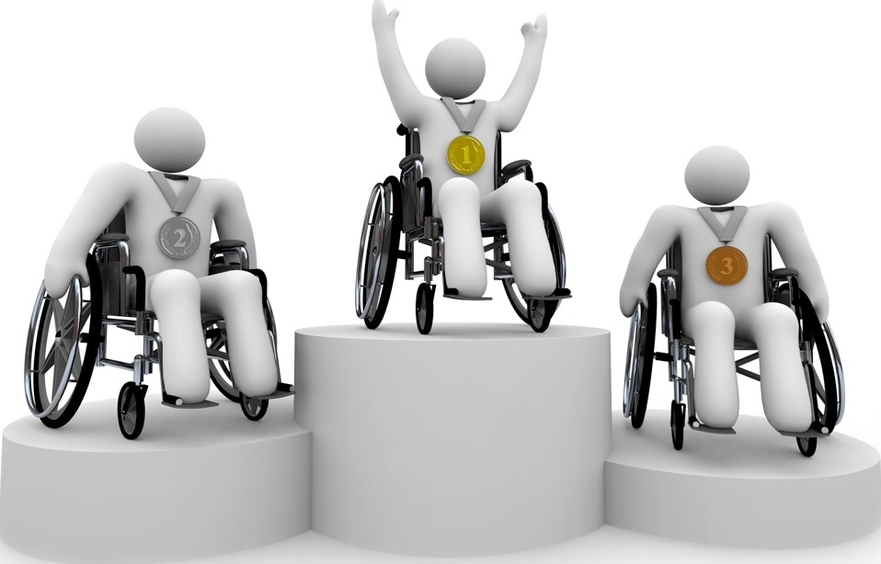
Disability
A disability is defined as a physical and
mental impairment that impacts a person’s ability to carry out normal daily activities.
National Governing Bodies make efforts to assist people with disabilities to access sport.
Despite these efforts barriers still remain:
  Limited coaches and teachers.
  Limited facilities with disability access.
  Travelling can be problematic for people with disabilities.
The Paralympics have increased media coverage and this has inspired people with disabilities to become involved in sport.

Slide 8

Socio-economic
Playing sport involves investment in the form of equipment, facilities, transport or coaching.
Those with a higher disposable income have higher access to sports participation.
Richer countries and areas have more sports facilities.
A person's socio-economic class may dictate the type of sport they access.

Slide 9
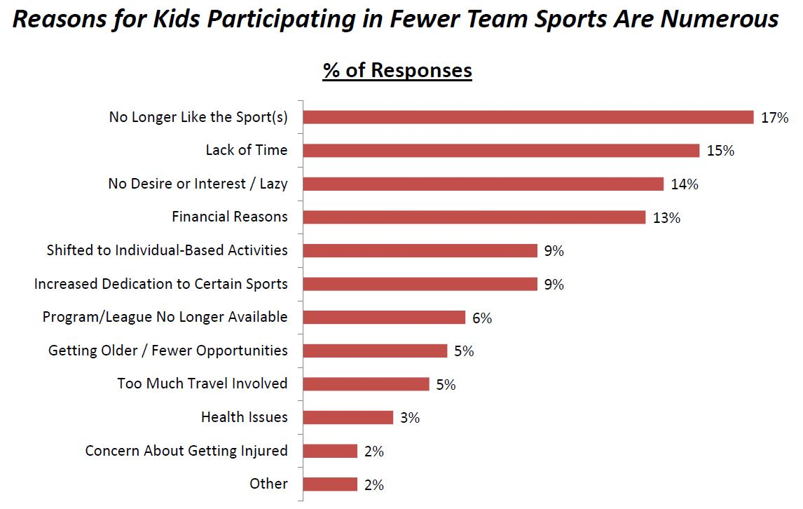
Graphical representation
sportsmarketinglab.com
What does this graph tell us about team sports?

Slide 10
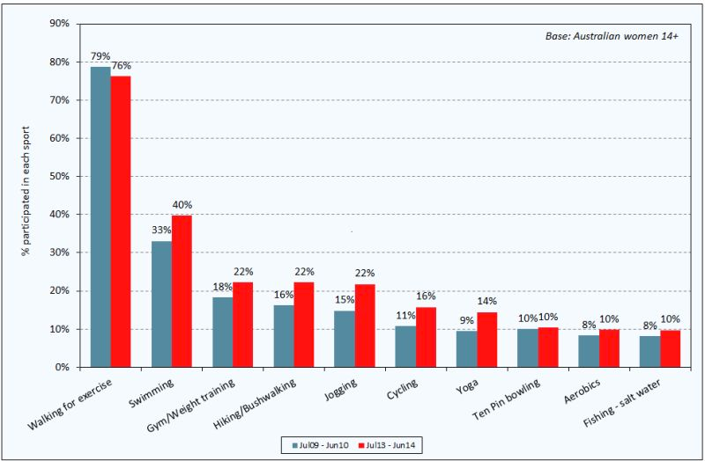
Graphical representation
roymorgan.com
Can you give reasons for the change in sports
participation in a selected sport?

Slide 11
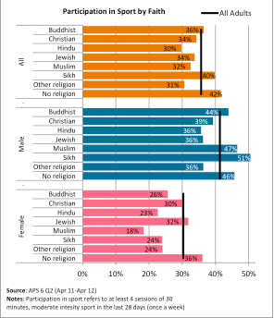
Graphical representation
What does this bar chart tell us about the impact of faith and religion on sports participation?
Sport England

