Slide 1
The structure and functions of the cardio-respiratory system
1.1.2 Applied anatomy and physiology

Slide 2
Respiratory System
Gaseous Exchange
Heart
Oxyhemoglobin
Inspiration
The structure and functions of the cardio-vascular system
Expiration
Spirometer
Stroke Volume
Blood Vessels
Cardiac Output

Slide 3
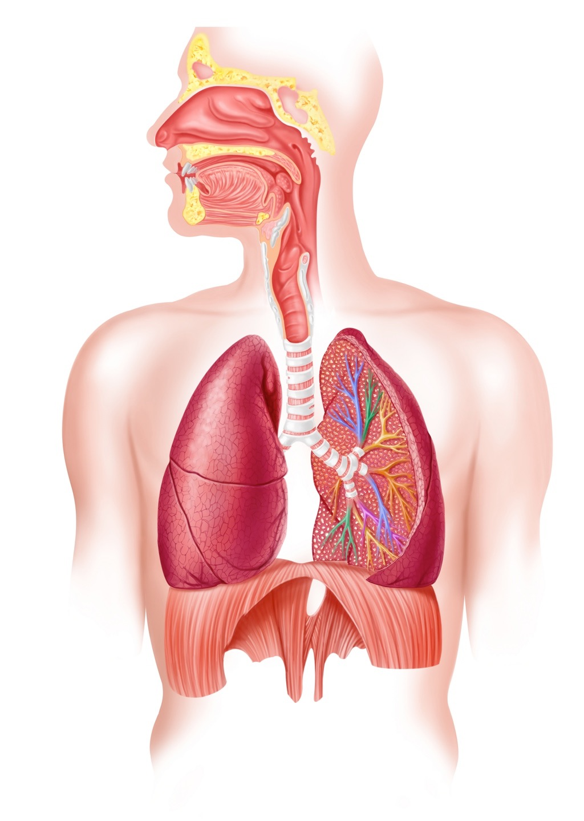
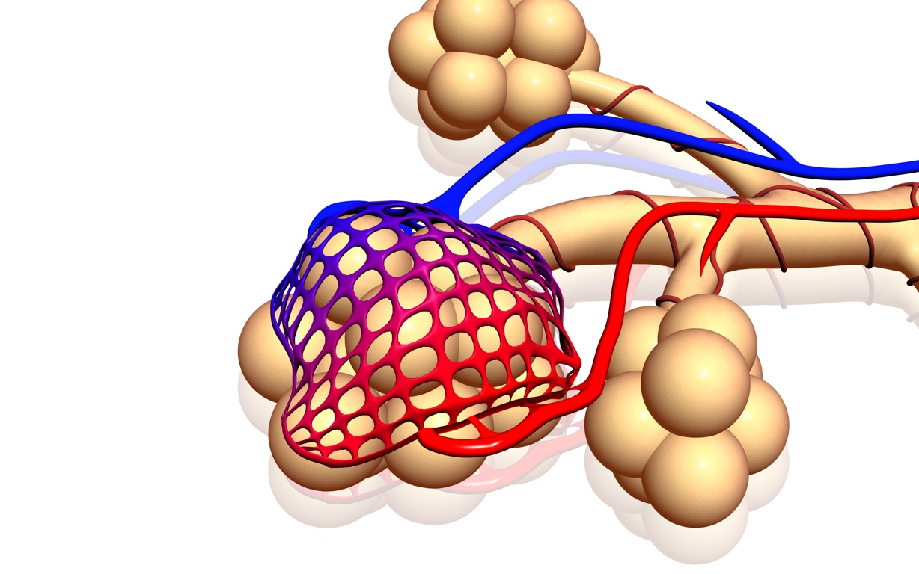
Respiratory system
Nose - has three functions.
Warms the air to internal temperatures.
Cilia hairs filter the air and remove small particles.
Moistens the air so it can be absorbed more easily.
Alveoli
Gaseous exchange happens between the capillaries that surround them.
Trachea
Cartilage rings keep the windpipe open.
Bronchi
Two tubes branch from the trachea into the left and right lung.
Diaphragm
Flattens to move air into the lungs.
Relaxes into a dome shape to expire air.
Bronchioles
Sub-divisions of the bronchi.

Slide 4
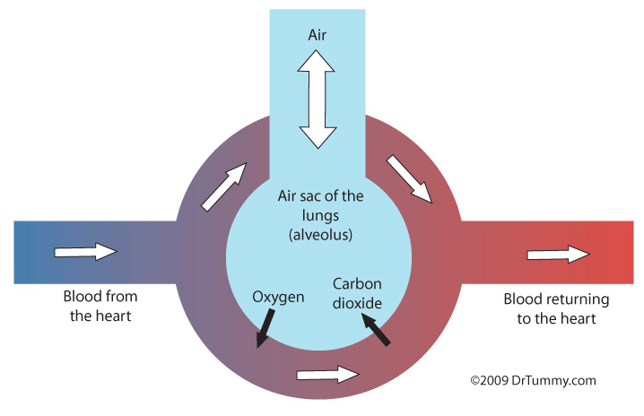
Gaseous exchange
Oxygen breathed in travels to the alveoli which are surrounded by capillaries.
Oxygen diffuses into the blood and combines with haemoglobin to form oxyhaemoglobin and is carried around the body.
At the same time carbon dioxide is released by haemoglobin and diffuses into the alveoli to be breathed out.

Slide 5
Gaseous exchange
Gaseous exchange (diffusion) occurs efficiently for the following reasons:
Large surface area of alveoli and lots of capillaries allows for large amounts of oxygen and carbon dioxide to diffuse between the lungs and the blood vessels.
The alveoli have thin walls that are one cell thick. This reduces the distance of diffusion.
The alveoli provide moisture as gases must first dissolve in liquid before they can diffuse.
The circulatory system provides a large blood supply. This maintains a concentration gradient as gases need to move from a high concentration to a low concentration.

Slide 6
Inhaled and exhaled air
When we inhale air our lungs diffuse oxygen into our blood system.
At the same time carbon dioxide diffuses from the blood system into the exhaled air.
 | Inhaled | Exhaled
Nitrogen | 78% | 78%
Oxygen | 21% | 16%
CO2 | 0.03% | 4%
Other | 0.97% | 2%

Slide 7
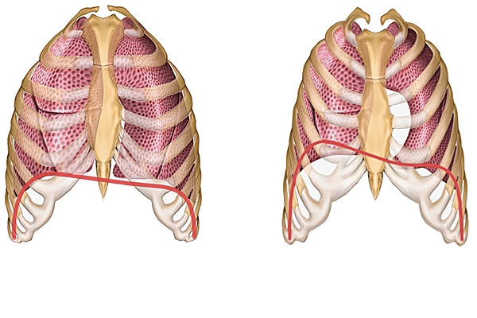
Inspiration and expiration
Inspiration
  The diaphragm contracts and flattens.
  The intercostal muscles contract.
  The ribs move upwards and outwards.
  Air pressure inside the lung
  cavity decreases.
  Air from the atmosphere moves
  into the lungs.

Slide 8
Inspiration and expiration
Expiration
  The diaphragm relaxes into a dome
  shape.
  The intercostal muscles relax.
  The ribs move downwards and
  inwards.
  Air pressure inside the lung cavity increases.
  Air moves from inside the lungs to the atmosphere.

Slide 9
Respiratory changes
  Breathing rate increases.
  Depth of breathing increases due to the use of pectorals and sternocleidomastoid.
  When expiring the abdominals are used to force the air out more quickly.
  Increased gaseous exchange of oxygen and carbon dioxide at the lungs.

Slide 10
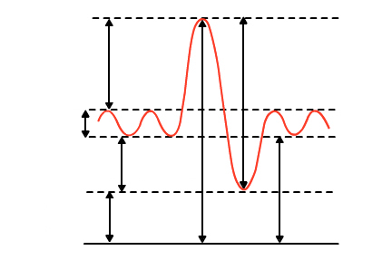
Spirometer
A spirometer measures air capacity of the lungs
Inspiratory reserve volume
The additional air that can be forcibly inspired beyond tidal volume
Vital capacity
The amount of air that can be forcibly expired after the deepest possible inspiration
Tidal volume
Normal amount of air inhaled and exhaled in one breath
Expiratory reserve volume
The amount of air that can be forced out beyond the tidal volume
Residual volume
The amount of air that remains in the lungs
Total lung capacity
Vital capacity plus residual volume

Slide 11
Changes during exercise
Tidal volume increase with exercise.
Expiratory reserve volume decreases during exercise.
Inspiratory reserve volume decreases during exercise.
Residual volume does not change during exercise.
Vital capacity does not change during exercise.
Total lung volume does not change during exercise.

Slide 12
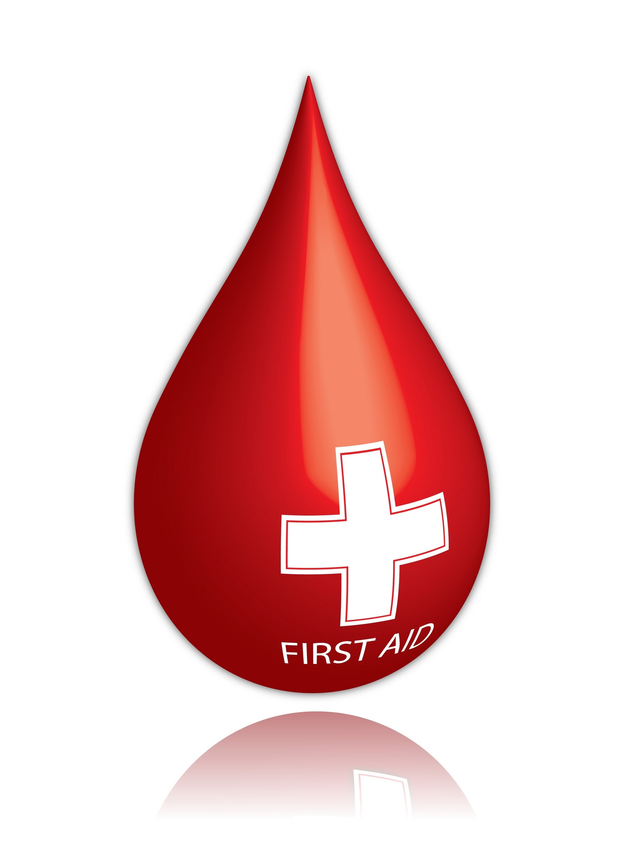
Functions of the cardiovascular system
1. Transportation
  Blood delivers vital components such as oxygen, hormones, and glucose.
  It removes waste products produced by energy production such as carbon dioxide and lactic acid.
2. Clotting
  Platelets in the blood seal open wounds.
3. Temperature regulation
  When the core body temperature increases the walls of the blood vessels vasodilate to allow more blood to the skin where heat can be released.

Slide 13
Spirometer
Tidal volume increase with exercise.
Expiratory reserve volume decreases during exercise.
Inspiratory reserve volume decreases during exercise.
Residual volume does not change during exercise.
Vital capacity does not change during exercise.
Total lung volume does not change during exercise.

Slide 14
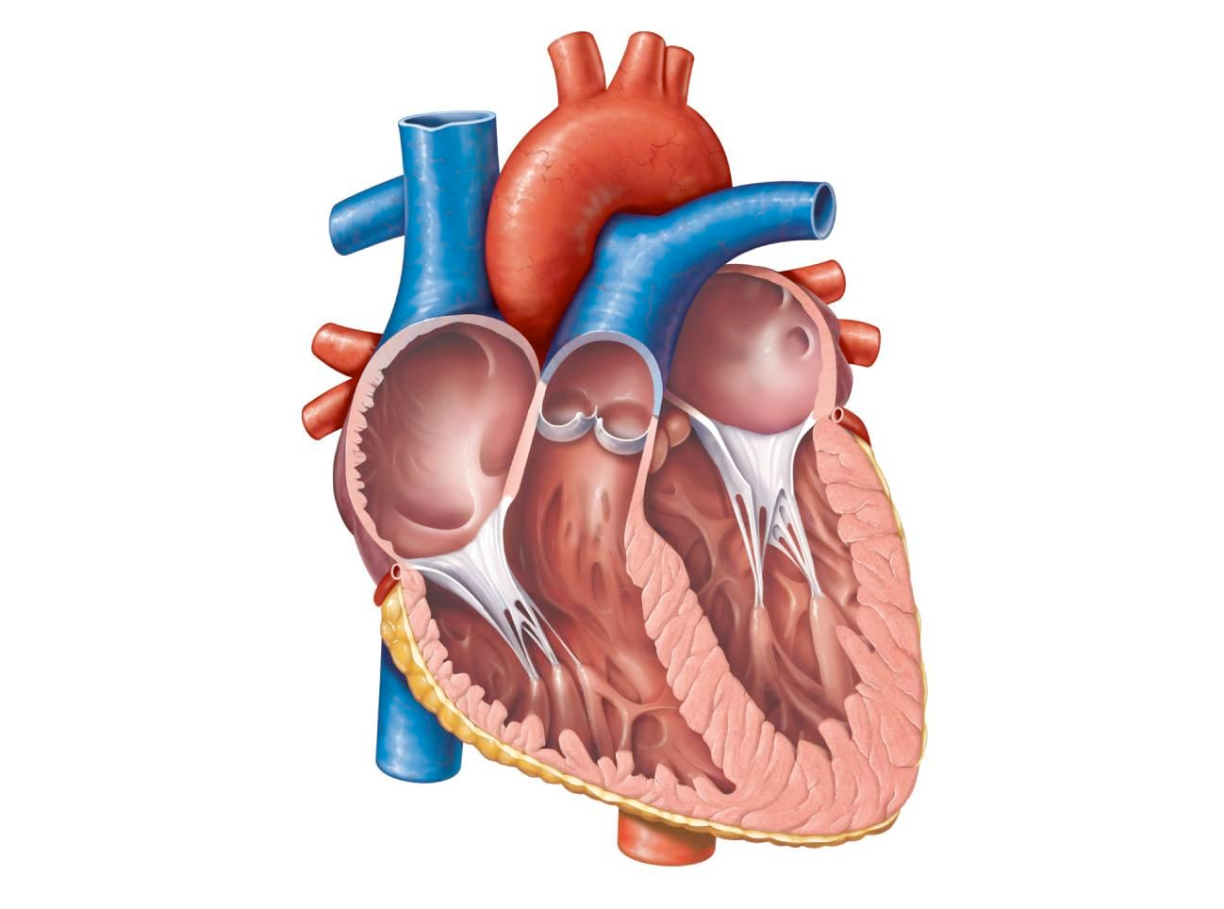
The heart
Aorta
Left Pulmonary Artery
Superior Vena Cava
Right Pulmonary Artery
Left Pulmonary Veins
Right Pulmonary Veins
Right Atrium
Left Atrium
Bicuspid Valve
Tricuspid Valve
Left Ventricle
Inferior Vena Cava
Pulmonary Valve
Semi-Lunar Valve
Right Ventricle

Slide 15
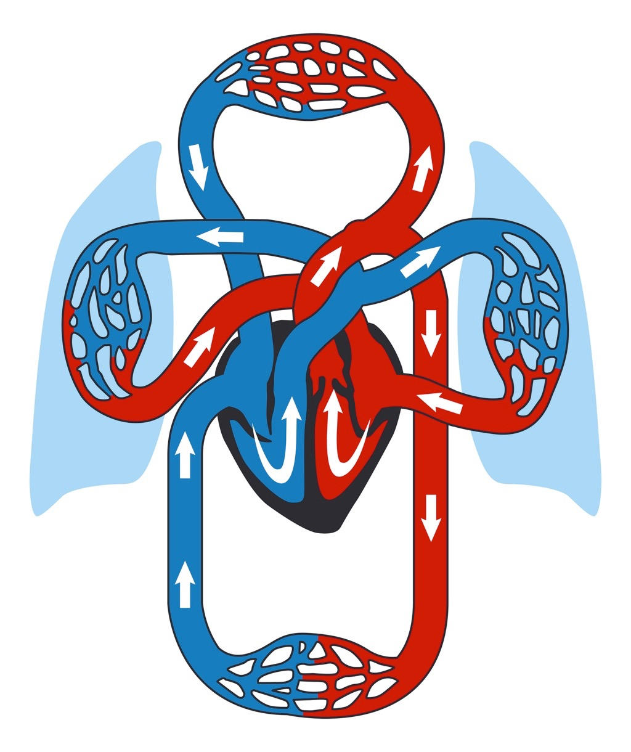
Blood Transportation
4. Left and right lungs
Gaseous exchange occurs at the left and right lungs.
3. Left and right pulmonary artery
These arteries transport deoxygenated blood to the lungs via the semi-lunar valves.
5. Pulmonary vein
Transports oxygenated
blood to the left atrium.
2. Right ventricle
Blood is pumped into the right ventricle through the tricuspid valve.
Right ventricle contracts and pumps the blood to the lungs.
6. Left atrium
Receives oxygenated blood and pumps it into the left ventricle through the bicuspid valve.
1. Right atrium
Deoxygenated blood flows into the RA through the superior and inferior vena cava.
7. Left ventricle
The heart contracts and the left ventricle pumps oxygenated blood to the body’s organs and tissues via the aorta.
8. Organs and tissues
Gaseous exchange occurs at the organs and tissues.

Slide 16
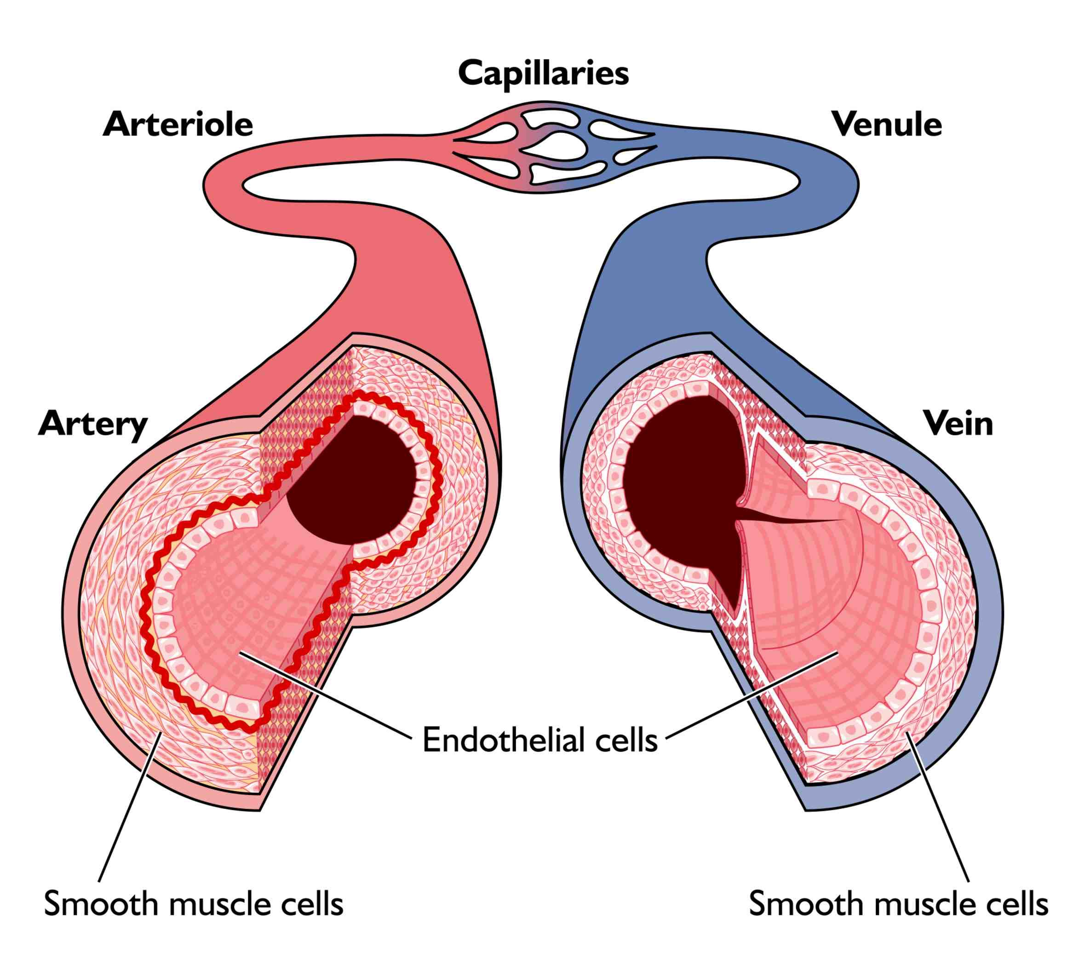
Blood Vessels
Arteries
  Carry oxygenated blood away from the heart.
  Thick muscular walls withstand high blood pressure.
Capillaries
  These are the smallest blood vessels
  with walls that are only one cell thick.
  They are very efficient at gaseous
  exchange at the lungs and muscles.
  Veins
  Carry deoxygenated blood to the heart.
  They have a larger diameter.
  They work under low pressure so have valves to prevent the back flow of blood.

Slide 17
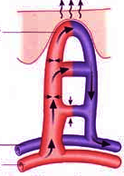
Vasodilation
When we are too hot or we need more oxygen at our working muscles.
    The arteries and capillaries to
    the skin and working muscles
    vasodilate to increase the
    blood flow.
    Heat is lost
    due to radiation and
    sweating at the skin and the
    working muscles receive more
    oxygen.
Vasodilation
Venules
Arterioles

Slide 18
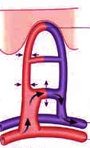
Vasoconstriction
Vasoconstriction is the opposite to vasodilation.
    During exercise blood flow is restricted to non working muscles and
    organs.
    The arteries and capillaries
    vasoconstrict to redirect
    blood flow to the working
    muscles and skin.
Vasoconstriction
Venules
Arterioles

Slide 19
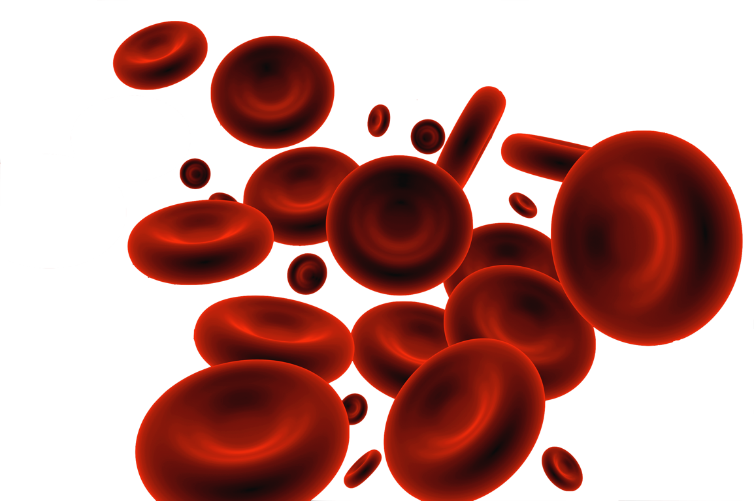
Components of blood
1. Red Blood Cells (RBC)
    RBC’s main function is to carry
    oxygen to the working muscles.
    Haemoglobin, found in RBCs,
    is the oxygen carrying protein.
    Altitude training can increase
    the number of RBCs.
    The more RBCs the more oxygen can be delivered to the working muscles.
    The more RBCs the longer the performer can participate.

Slide 20
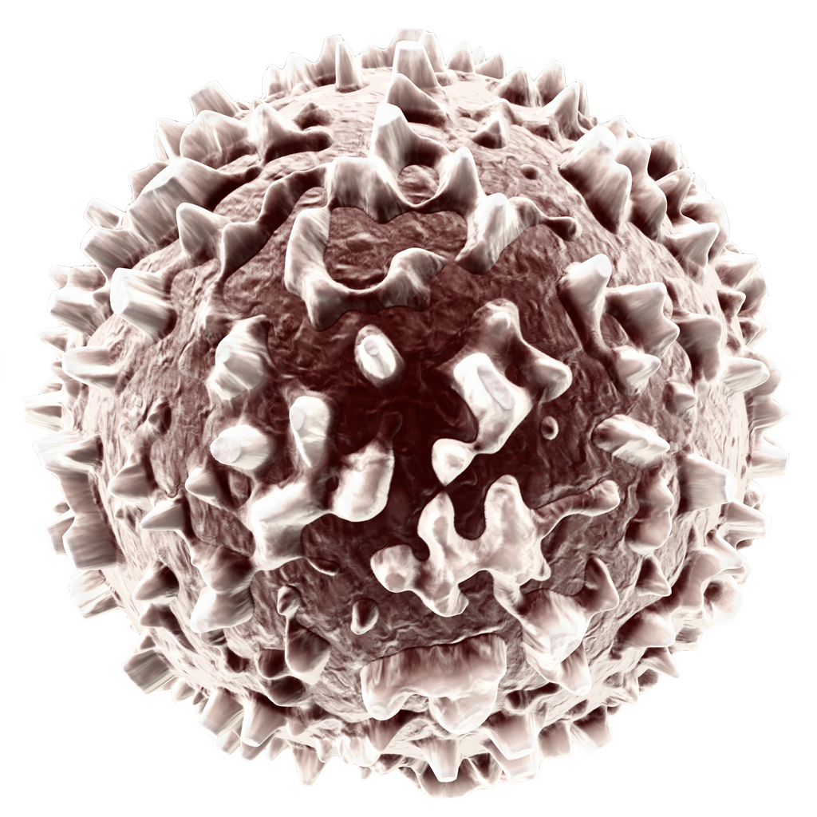
Components of blood
2. White Blood Cells (WBC)
    WBCs are our defence against infection and disease.
    They fight infections and reduce illness.
    This aids recovery and
    allows the participant to
    continue training and
    performing.

Slide 21
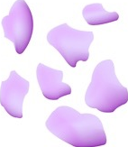
Components of blood
3. Platelets
    The role of platelets is to clot our blood when it comes into contact with air.
    If we sustain a cut, platelets will
    clot the blood to form a scab.
    Cuts and grazes can happen
    frequently in contact sport so
    platelets prevent heavy blood
    loss and aid recovery.

Slide 22
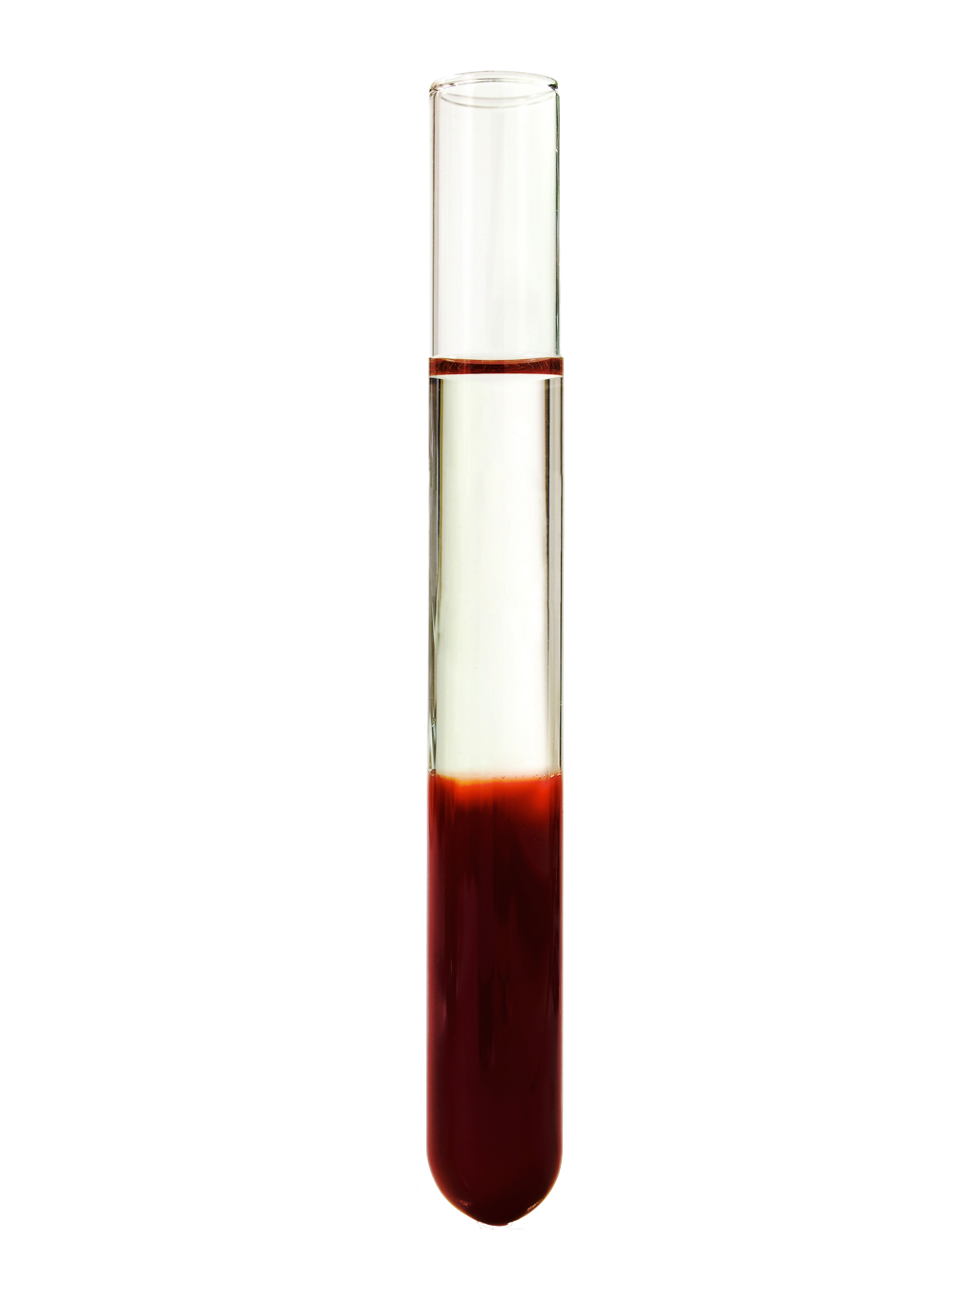
Components of blood
4. Plasma
    Plasma is the blood transport system.
    It carries vital nutrients (glucose,
    vitamins, minerals, etc.) and hormones
    such as adrenalin, which is important in readying a performer to participate.
    It removes waste products such as
    carbon dioxide and lactic acid.
    Plasma regulates the body’s
    temperature by balancing our water content.
    It also maintains the correct chemical balance.

Slide 23
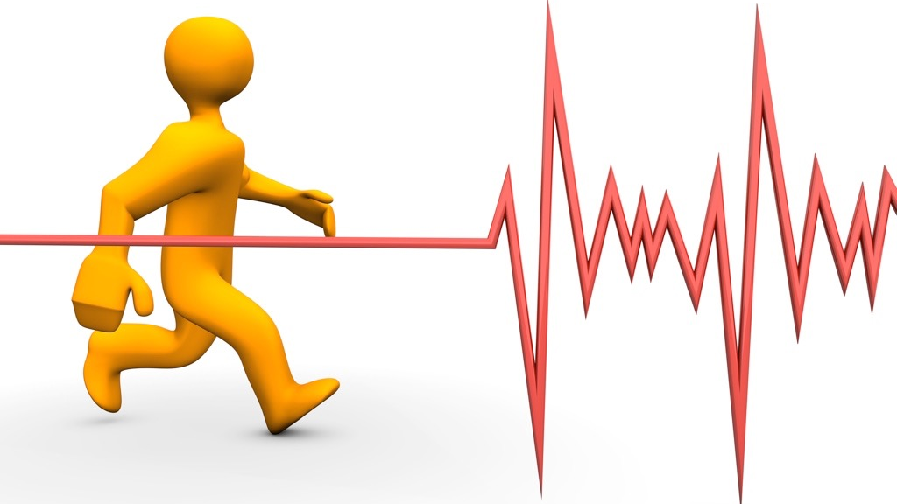
Cardio-vascular measurements
Heart Rate
  This is the amount of times your heart
  beats per minute.
  A low resting heart rate indicates an efficient heart and circulatory system, delivering more oxygen per minute.

Slide 24
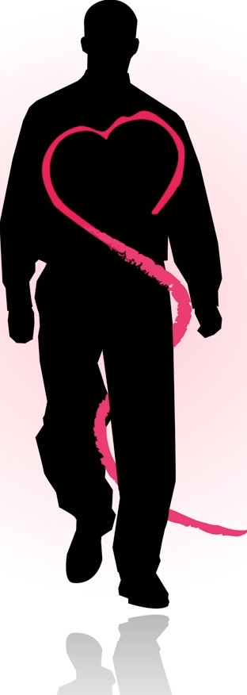
Cardio-vascular measurements
Stroke Volume
  This is the volume of blood the left ventricle of your heart pumps in one beat.
  An improved stroke volume increases gaseous exchange, delivering more oxygen and removing more waste products.

Slide 25


Cardio-vascular measurements
Heart Rate x Stroke Volume = Cardiac Output
Cardiac Output (Q)
This is the volume of blood pumped from the left ventricle in 1 minute.

Slide 26
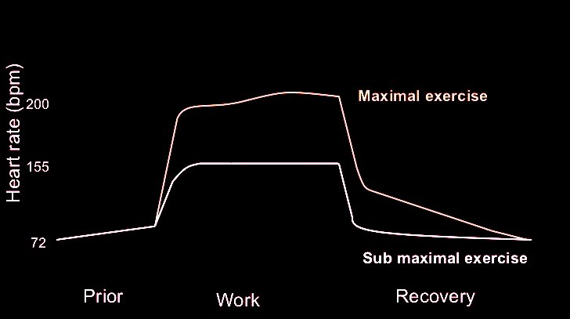
Heart rate graph
Plateau
Maximum heart rate is achieved (220-age) or the oxygen supply meets demand
Recovery
Heart rate remains elevated until oxygen debt is paid.
Heart rate eventually returns to resting
Anticipatory rise
Heart rate raises slightly prior to exercise
Increase in heart rate
As the intensity increases so does the heart rate

Slide 27
How the CV and RS work together
Air is inhaled at the lungs and gaseous
exchange of carbon dioxide and
oxygen occurs at the alveoli and
capillaries.
Oxygenated blood passes
through the heart and is pumped
to the rest of the body.
The tissues of the body use the oxygen
and create carbon dioxide when creating
energy from glucose.
Deoxygenated blood is pumped back to the
lungs through the heart.
Approximately 5 litres of blood is oxygenated and pumped around the body per minute.

