Slide 1
Commercialisation of physical activity and sport
2.3.2 Socio-cultural influences

Slide 2
Money
Player
Role Models
Spectator
Commercialisation of physical activity and sport
Performer
Sponsorship
Media
Commercialisation

Slide 3
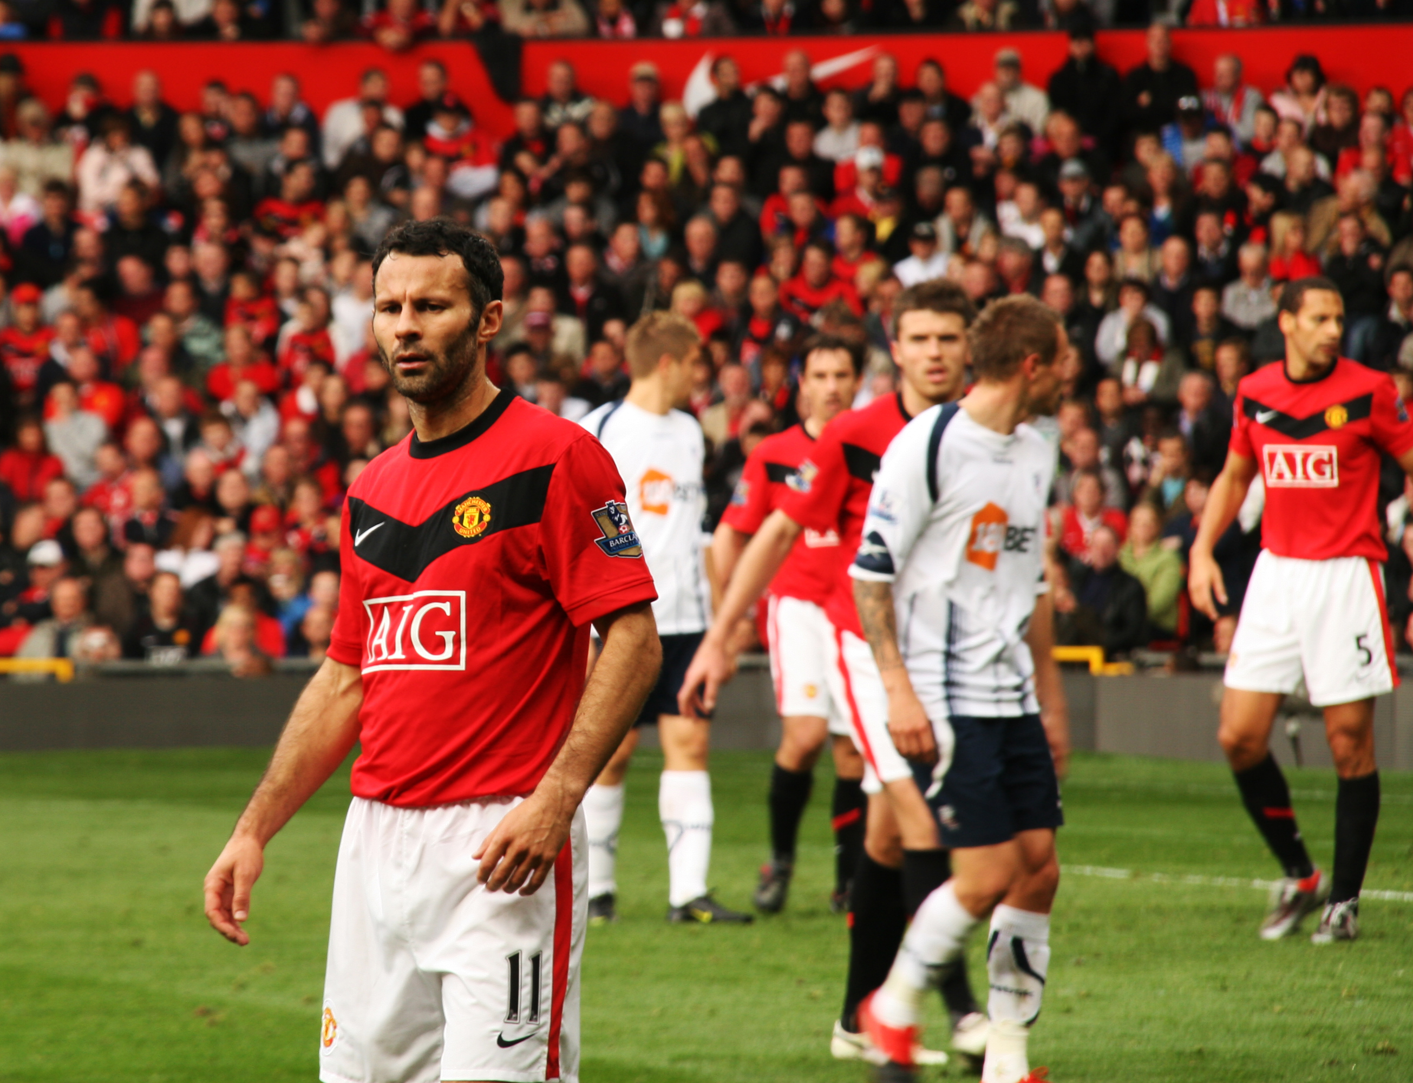
Commercialisation
Commercialisation involves making a profit through the management or exploitation of a person or organisation.

Slide 4






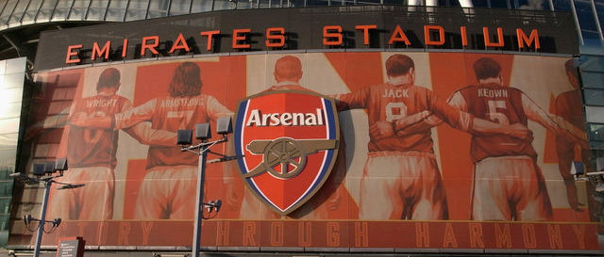
Media
Media Coverage
The media has played a central role in
the commercialisation of sport.
There are many different types:
    Television
    Internet
    Radio
    Magazines
    Newspapers
    Billboards

Slide 5

Business
Sponsorship is where businesses and corporations provide financial backing to clubs, events and individuals.
In return, businesses get exposure
and are able to advertise their
brand to the wider audience
involved in that event or sport.
Sometimes sponsors are
affected when a performer
behaves poorly.

Slide 6

Benefits to performers
Advantages
  Increased funds to pay higher wages to the performer.
  More money for grassroots participants.
  Increased exposure can result in performers being seen as heroes or role models.
  More money for technology and equipment.
  More money for coaching and training.
Disadvantages
  Media presence can increase the pressure
  on the performer .
  Sponsors can make demands on athletes.
  Intense media scrutiny of athletes' private lives.
  Increased number of competitions can lead to injury.
  Women are paid less.
  More competitions can lead to overtraining and injury.

Slide 7

Benefits to sport
Advantages
  Increased funds to support grass-roots development.
  More money for technology and equipment.
  More money for coaching and training.
  Larger prize funds for the competition.
  More role models for the sport.
  Media attention increases interest in the sport.
Disadvantages
  Rules of the sport may be changed to suit media and sponsors.
  Minority sports and female sports get less coverage.
  The media sensationalises controversies.
  Sports may become dependant on the money.
  Sponsors may sell products that contradict the healthy lifestyle sport promotes.

Slide 8

Benefits to spectators
Advantages
  Events and games are scheduled so more people can spectate.
  Commentary educates the viewer and provides information.
  Instant replays, slow motion and close ups available due to funded technology.
  Spectators can feel a part of their role models' lives.
  Top level facilities for spectating.
Disadvantages
  Timings of events mean some athletes have to perform late in the evening so more can watch.
  More people watch sport than play sport.
  Some sports are expensive to watch due to viewing rights.
  Tickets and
  merchandise
  are expensive.
  Less popular
  sports are shown less.

Slide 9

Benefits to sponsor
Advantages
  Sponsors use the clean and healthy image of sport to promote their brand.
  They use the success of athletes and teams to make their brand appear successful.
  Profits are increased.
Disadvantages
  Brand or company may be embarrassed or damaged by poor or reprehensible behaviour of an athlete or team.
  Sponsoring a brand or an athlete can be expensive.

