Slide 1
Ethical and socio-cultural issues
2.2.3 Socio-cultural influences

Slide 2
Performance Enhancing Drugs
Deviant Behaviour
Consequences
Ethical and socio-cultural issues
Gamesmanship
Sportsmanship
Cheating

Slide 3
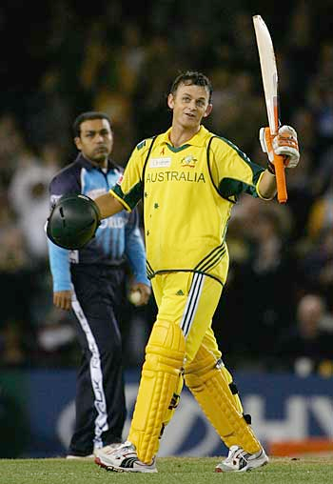
Sportsmanship
Sportsmanship is demonstrated by competing in the spirit of the game.
A good sports person will play within the rules of the sport and demonstrate etiquette.
A performer who demonstrates good sportsmanship is a good role model for others to follow.
Examples of this are:
  Not receiving a red or yellow card.
  Walking if you know you are out in
  Cricket.

Slide 4
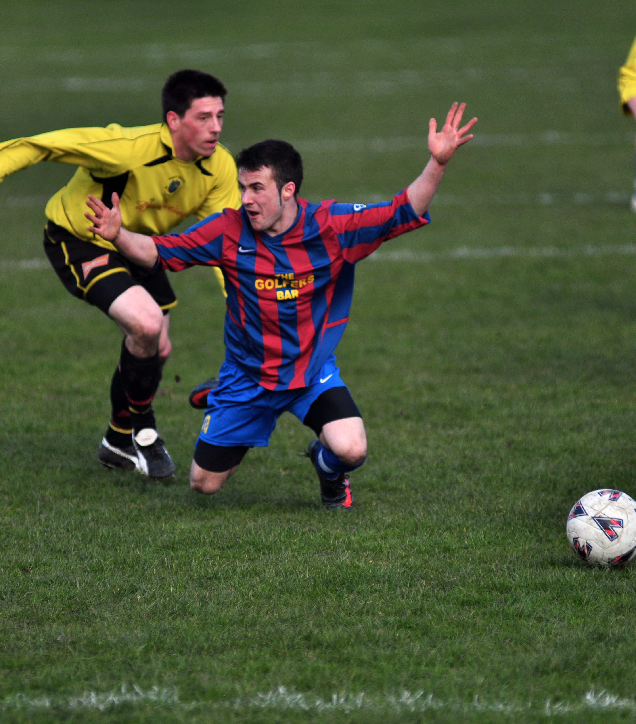
Gamesmanship
Gamesmanship is the opposite of sportsmanship.
Athletes that demonstrate gamesmanship bend the rules and guidelines to gain an advantage so they can win.
Examples of this are:
  Faking an injury to waste time or to cause your opponent to lose momentum.
  Diving in Football to get a penalty.
  Barracking an opponent so they
  lose focus.

Slide 5

Deviant behaviour
Deviant behaviour goes against the moral values of the sport.
Examples include:
  Using performance enhancing drugs.
  Illegal betting on the outcome.
  Player violence.
  Fielding ineligible players.
  Bribery.
  Fan violence or hooliganism.

Slide 6
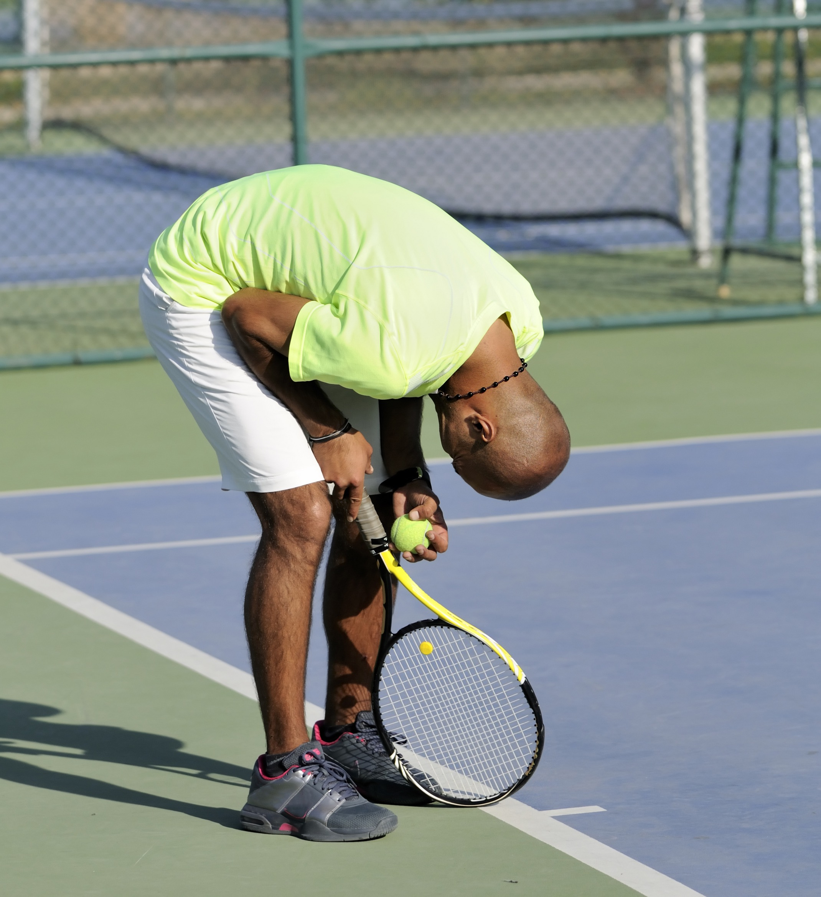
Consequences of deviant behaviour
On field consequences such as a red card or warning.
Off field consequences such as a suspension, monetary fine or points deducted.
Losing your contract with the club.
Causing or receiving a serious injury.
Damaging your professional reputation
or the club you represent.

Slide 7

Reasons for deviant behaviour
Pressure to win by players, coaches, media or family members.
Loss of temper in the moment.
Desire for fame and fortune.
Feeling like others are also cheating so they must do the same.
Feeling like certain decisions are
unfair.

