Slide 1
Physical, emotional & social health and fitness & well-being
2.1.1 Health, fitness and well-being

Slide 2
Social
Physical
Mental
Well-being
Physical, emotional and social health, fitness and well-being
Health
Lifestyle
Emotional
Fitness

Slide 3
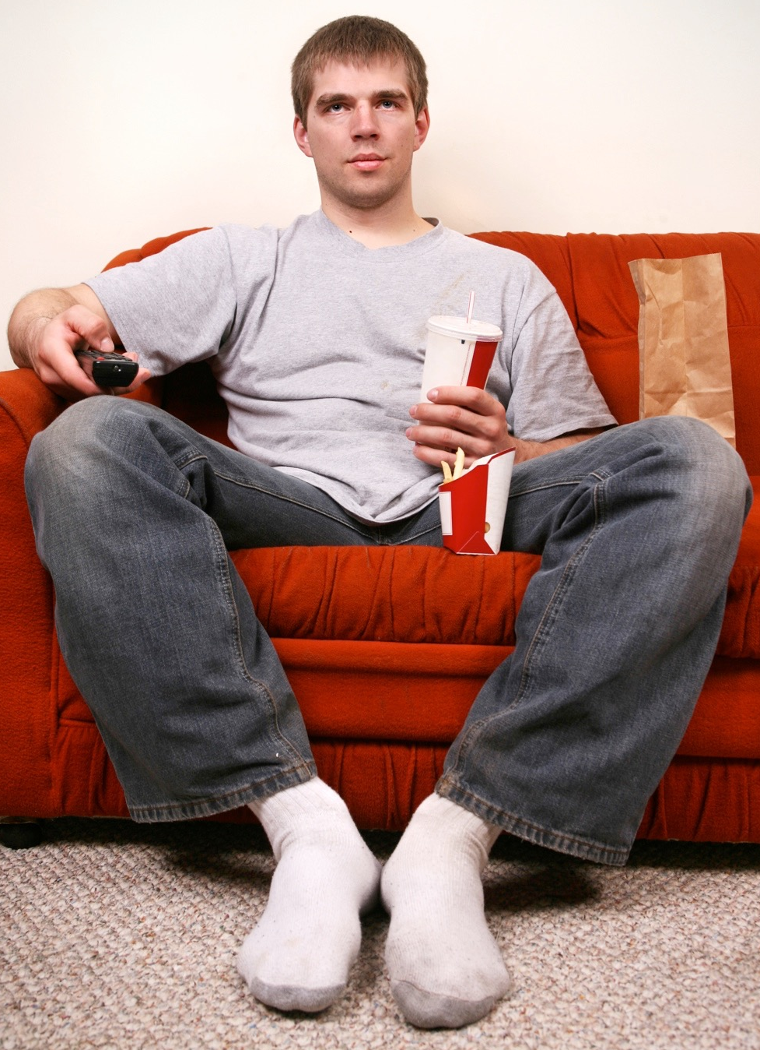
Healths
“Health is a state of complete physical, mental and social well-being”
—World Health Organisation (WHO)
To understand this definition we
need to consider the following:
  Physical health.
  Emotional health.
  Social health.

Slide 4
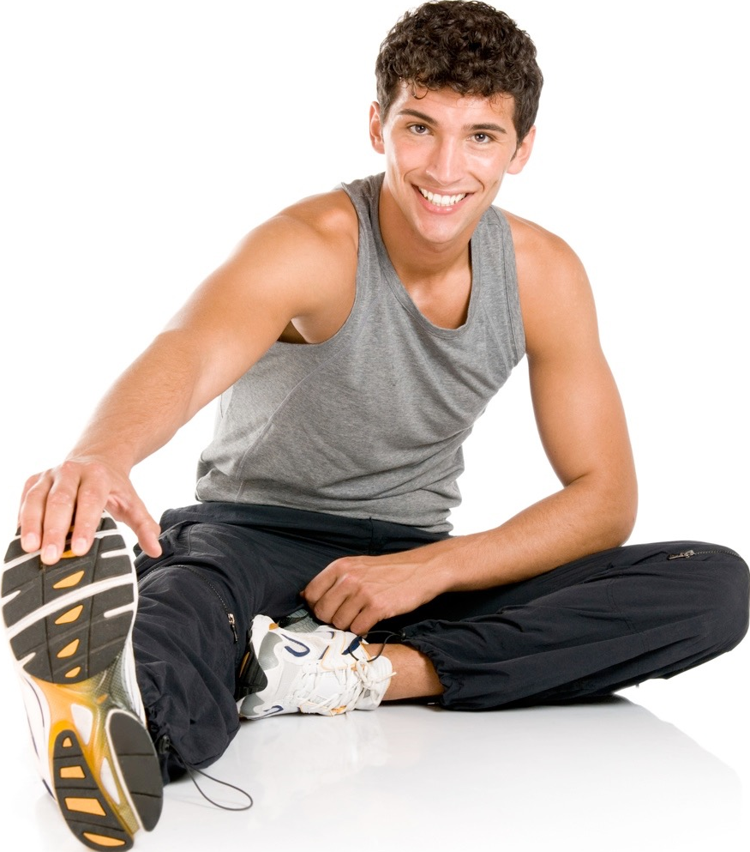
Physical health
Physical activity has physical health and well-being effects:
All body systems work well.
Improved heart function.
Reduced risk of injuries and
illnesses.
Able to carry out
everyday physical tasks.
Avoid obesity.

Slide 5
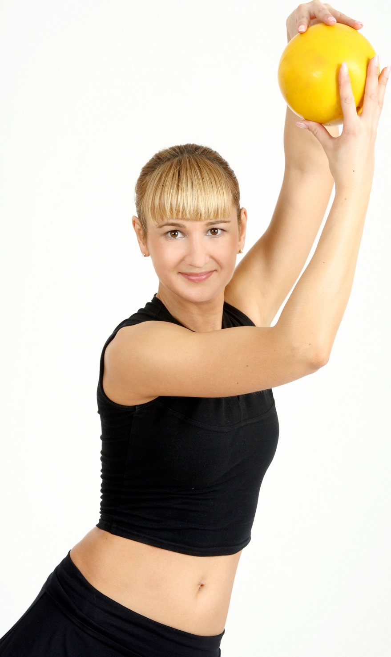
Physical health
Being physically well can help performance
in the following ways:
All body systems work well.
  Efficient gas exchange at the lungs.
  Heart delivers oxygen and
  nutrients to the working muscles.
  Circulatory system regulates
  the temperature.
Free from illness so they can
continue to train.
Free from injury.

Slide 6
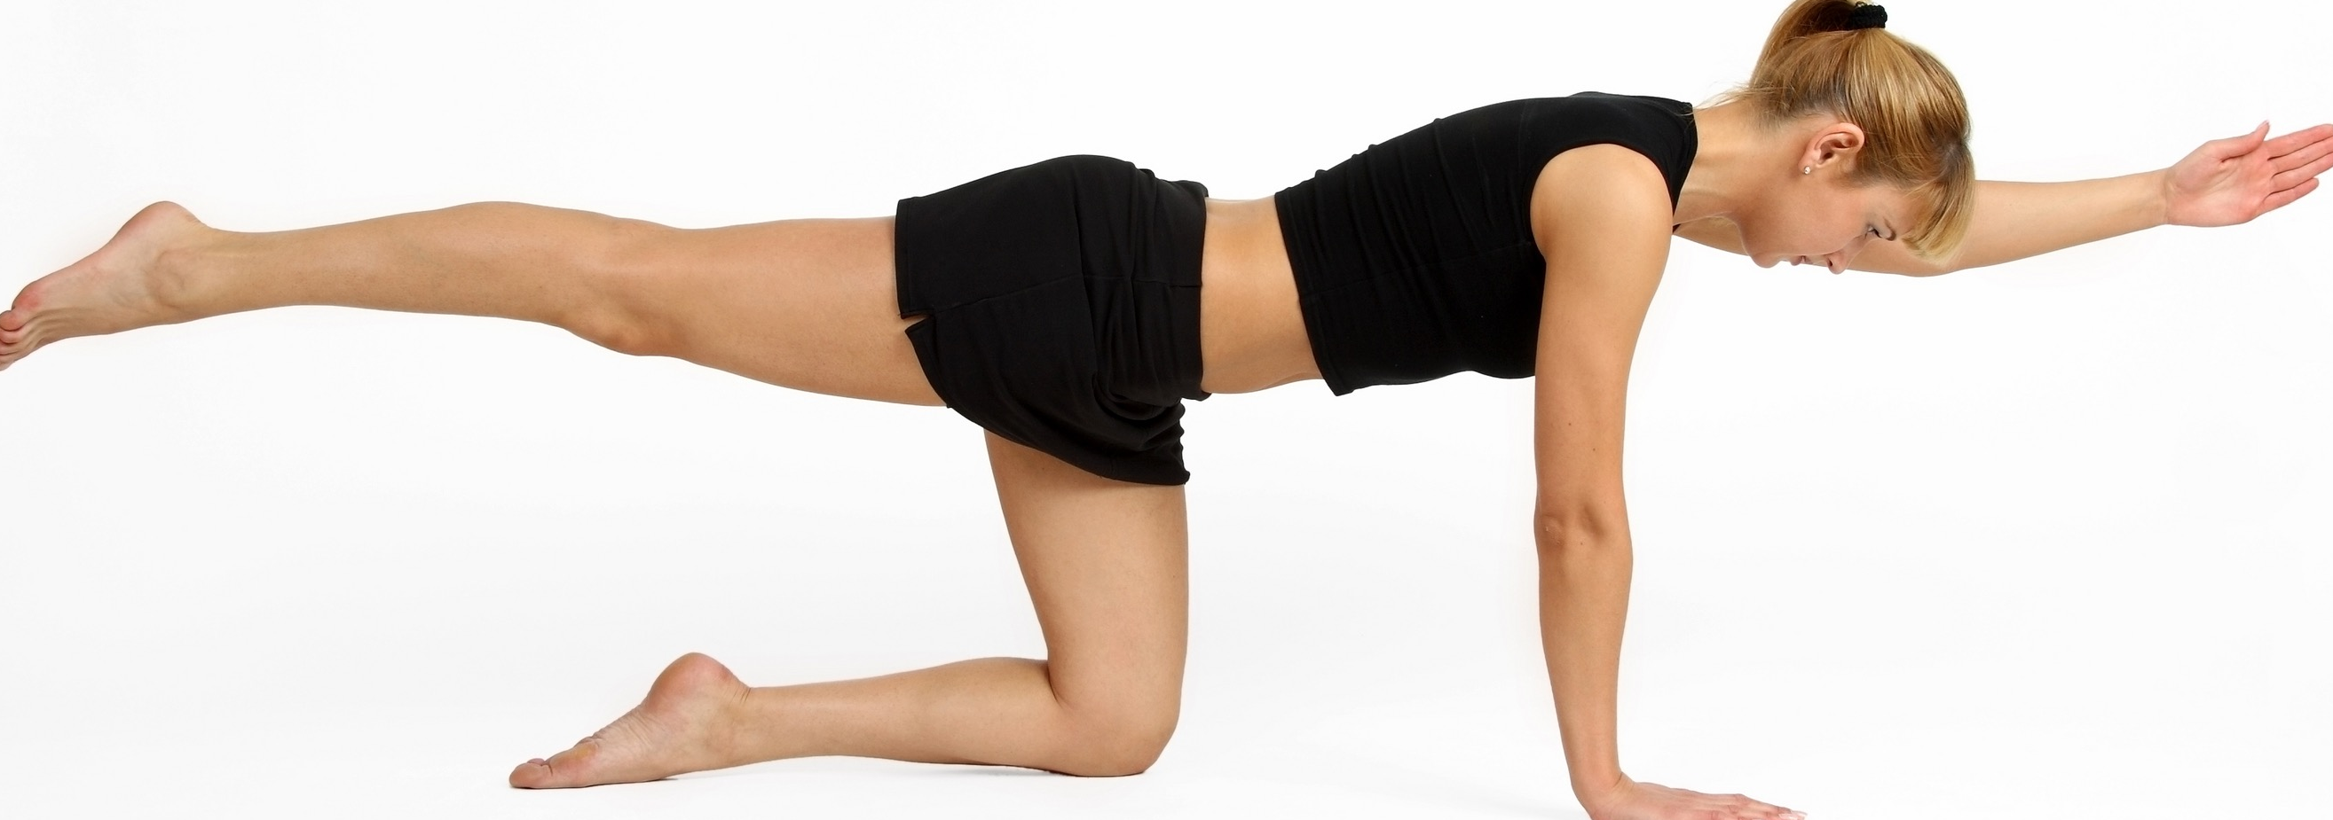
Physical health
Co-ordination
Reaction time
Body composition
We use fitness components to increase our physical health. Here is a reminder of what they are:
Cardiovascular endurance
Strength
Muscular endurance
Power
Flexibility
Speed
Agility
Balance

Slide 7
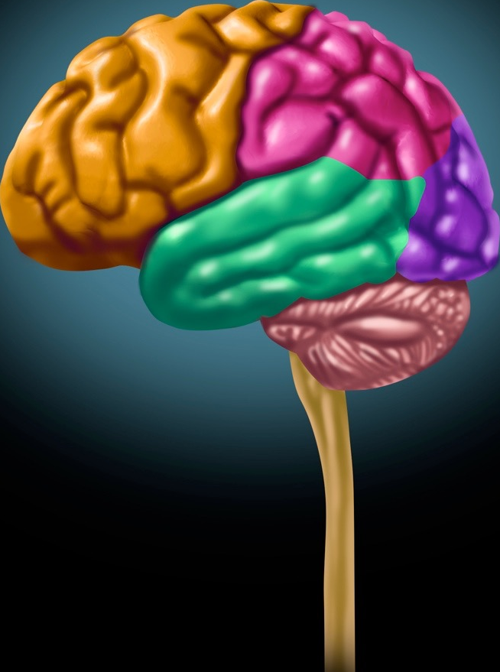
Emotional health
People who are emotionally or mentally well display the following:
They are able to cope with
stress.
They can control their
emotions.
They feel good and confident
about themselves.

Slide 8
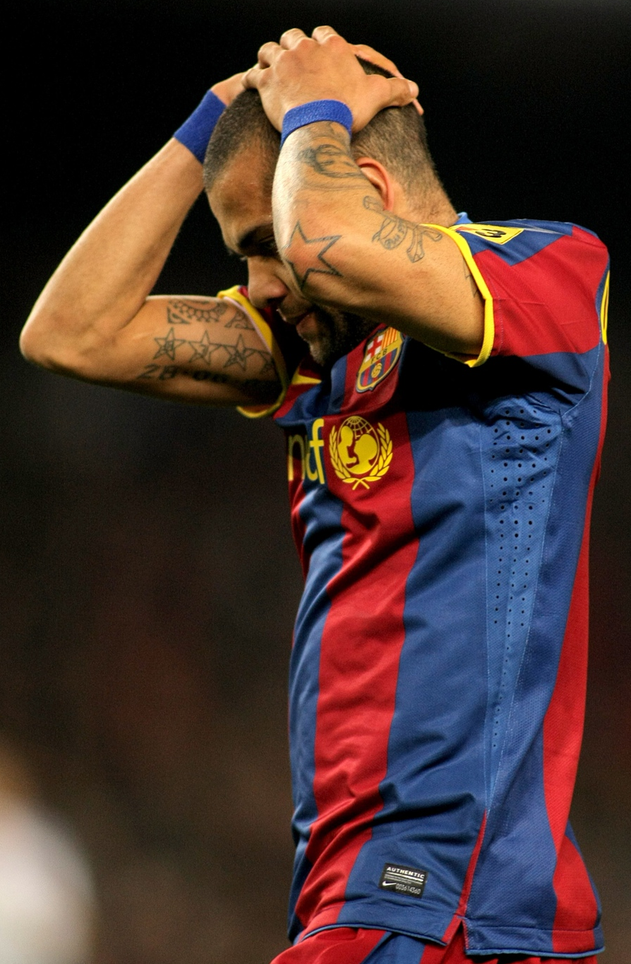
Emotional health
Poor emotional health may affect
performance in the following ways:
When situations go against them
they can become emotional.
Being unhappy can cause poor performance.
Poor sleep patterns result in higher fatigue.
Low confidence means they are less inclined
to be creative and take risks.
Low concentration and alertness makes
mistakes more likely.
Low motivation.

Slide 9
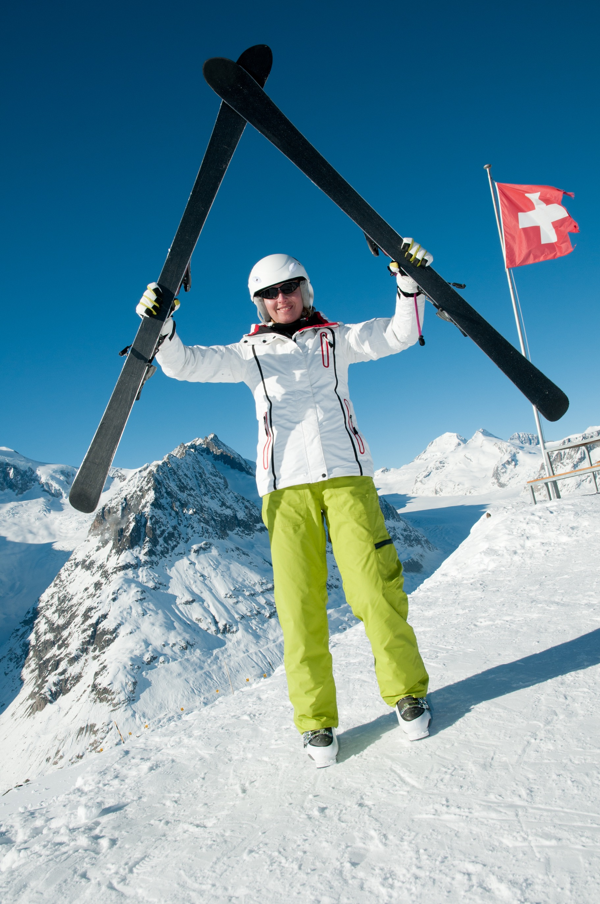
Emotional health
Physical activity promotes emotional health in the following ways:
Exercising releases endorphins which are the hormones that make us happy.
You’ll feel more energetic.
Feeling healthier boosts confidence.
Exercise has been linked to brain cell
production and this can reduce the
risk of age related diseases such as
dementia.

Slide 10
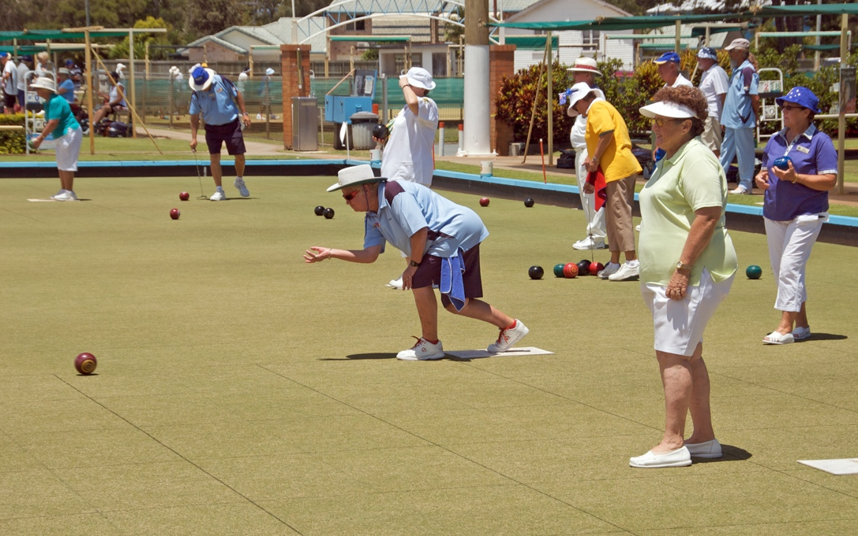
Social health
People who are socially well display the following:
They have essential
human needs such as
clothing, food and shelter.
They have friendship
and support.
They can mix with others.
They have some value in society.
Avoid or resolve disputes.
Able to adapt to changing situations.

Slide 11
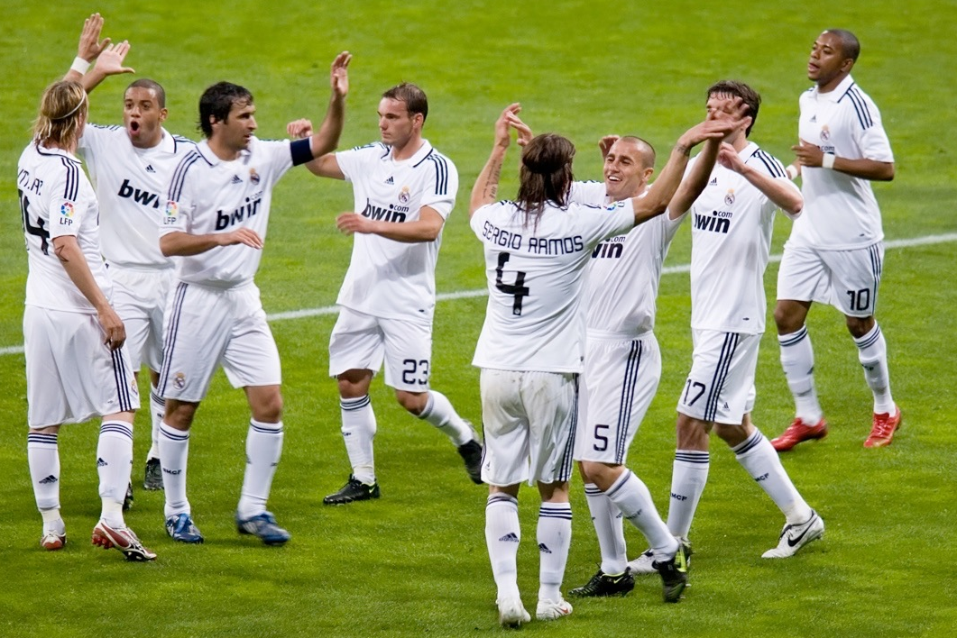
Social health
Physical activity helps promote social
health in the following ways:
Provides a platform to form good
friendships with team mates.
Promotes friendship and support.
They feel valued in society and this increases confidence.
They develop social skills such as
co-operation.
When people working towards a common goal they develop teamwork skills.

Slide 12

Healthy checklist
To be healthy and fit a
person needs the following:
  A healthy lifestyle.
  A balanced diet.
  A well designed Personal
  Exercise Programme (PEP)
  Avoid drugs, smoking,
  alcohol and pollution.
  Sleep.
  Enjoyment and fun.
  Good personal hygiene.

Slide 13
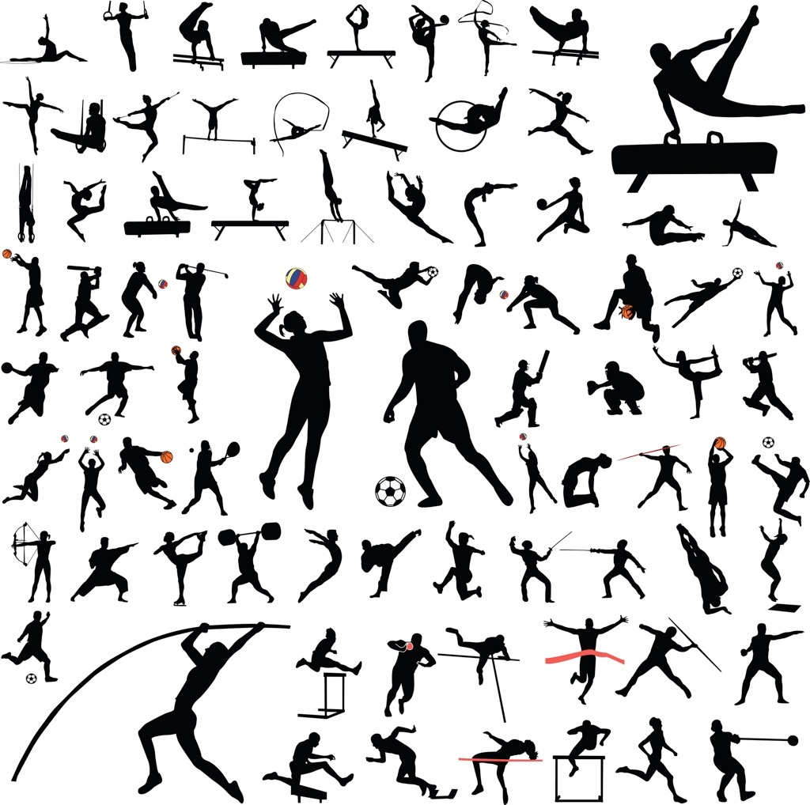
Fitness
“Fitness is the ability to meet the demands of the environment.”
Being fit:
improves physical health.
improves emotional health.
improves social health.

Slide 14
Fitness
Positive effects of being fit
Assists in maintaining optimum body weight and reduces the risk of obesity related diseases.
Improves sleep.
Boosts confidence and happiness.
Improves the immune system and musculoskeletal systems reducing the risk of illness and injury.
Able to recover from exercise quickly.
Able to complete daily tasks more easily.

Slide 15
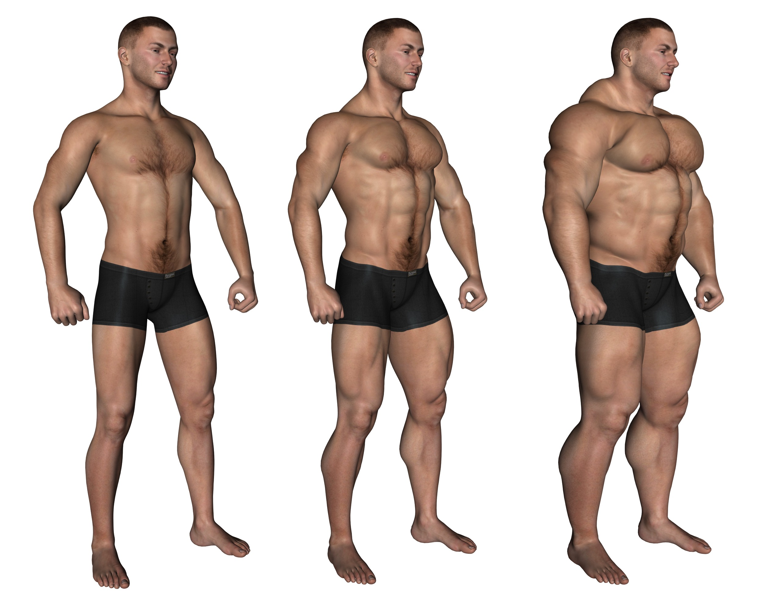
Fitness
Negative effects of being fit
Some people become addicted to exercise which can lead to overtraining injuries (tennis and golfer's elbow).
Can cause body dysmorphia (obsession with body shape and size).
Some negative bone conditions
can be caused from overtraining
(osteoarthritis and osteoporosis)
Some soft tissue injuries can
develop when individuals do not
rest.

Slide 16
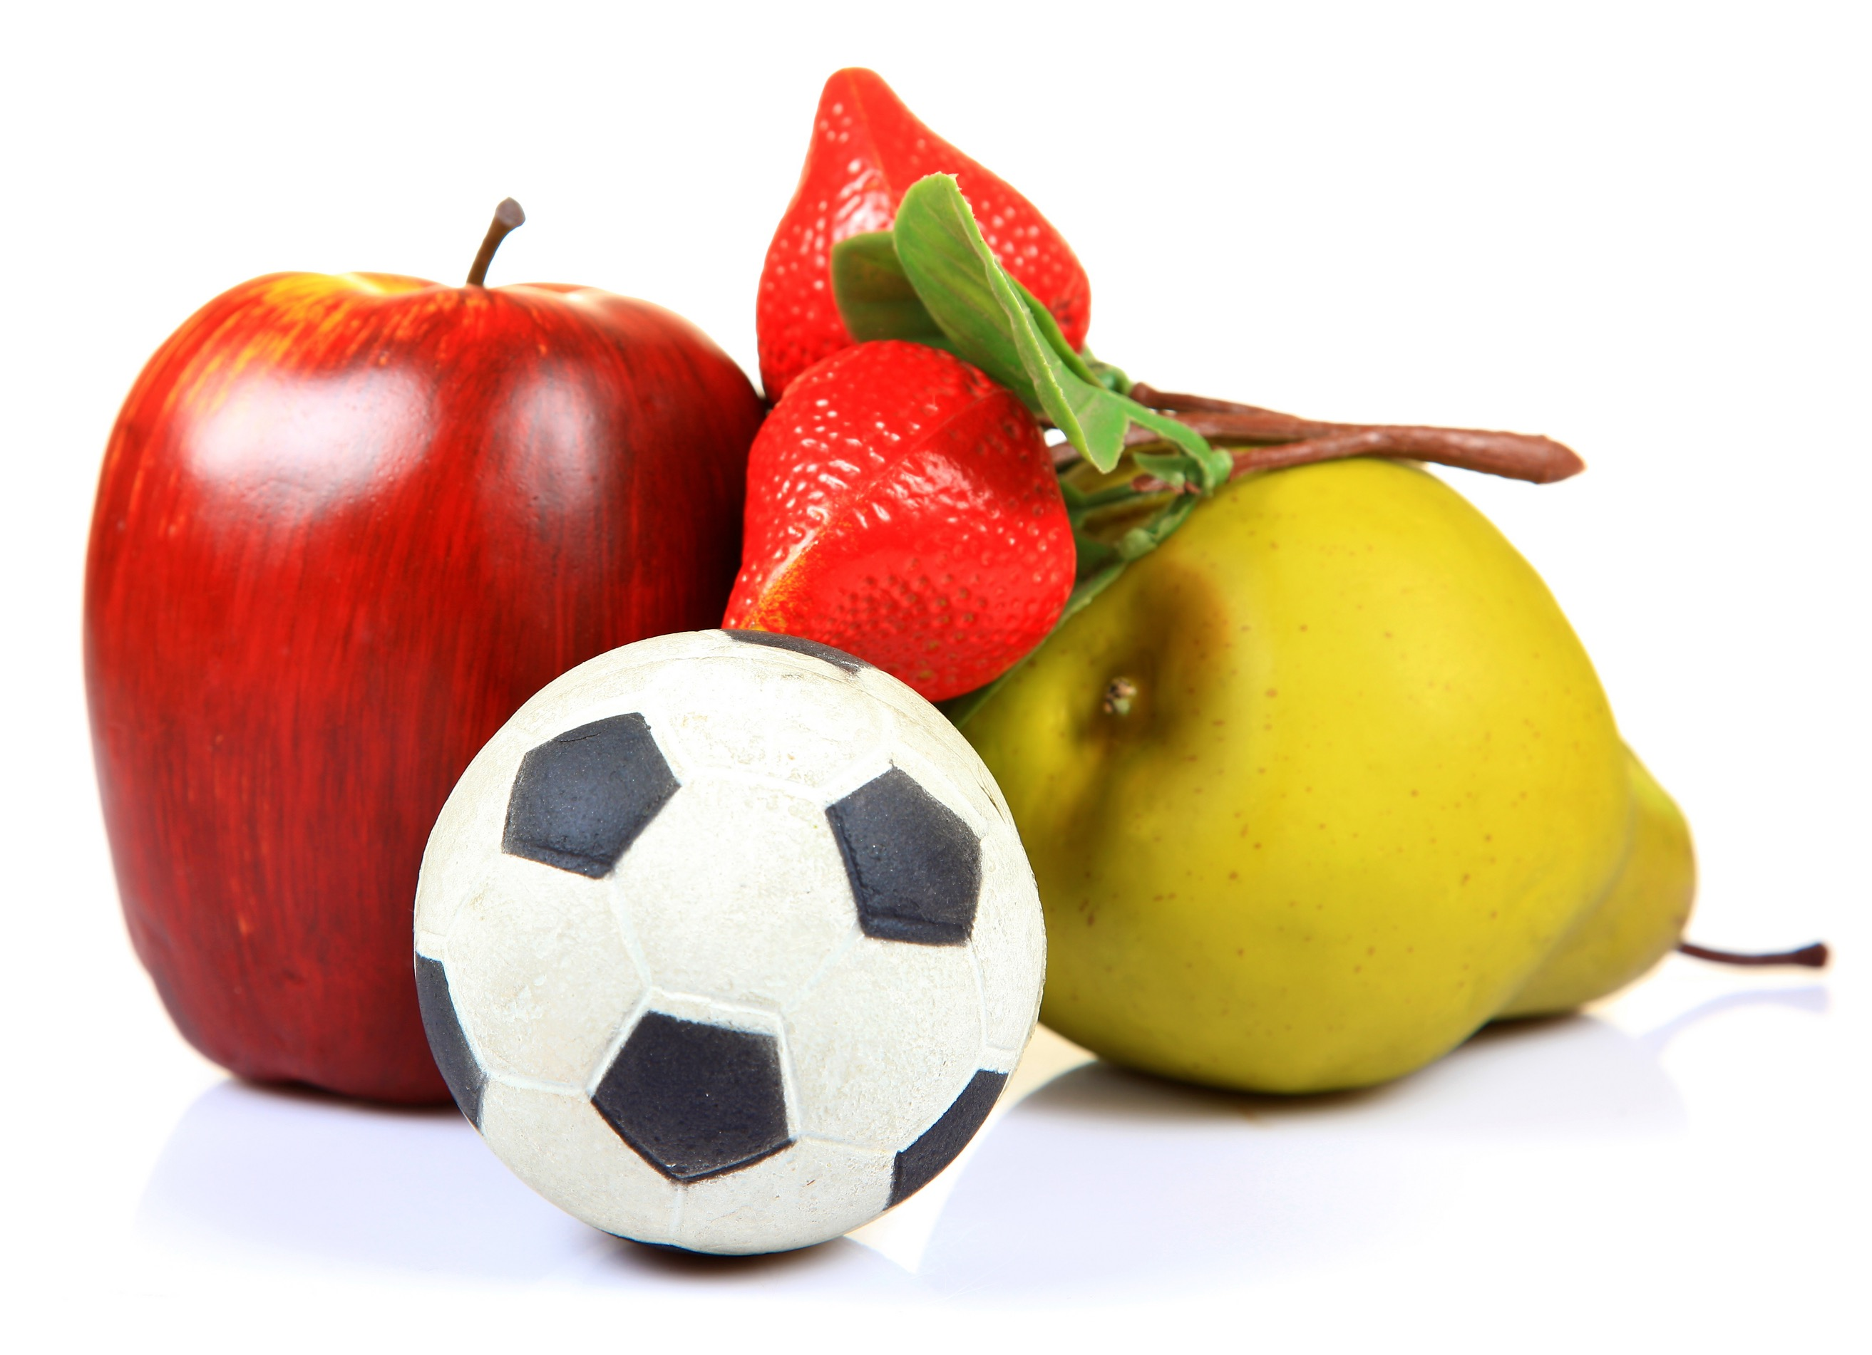
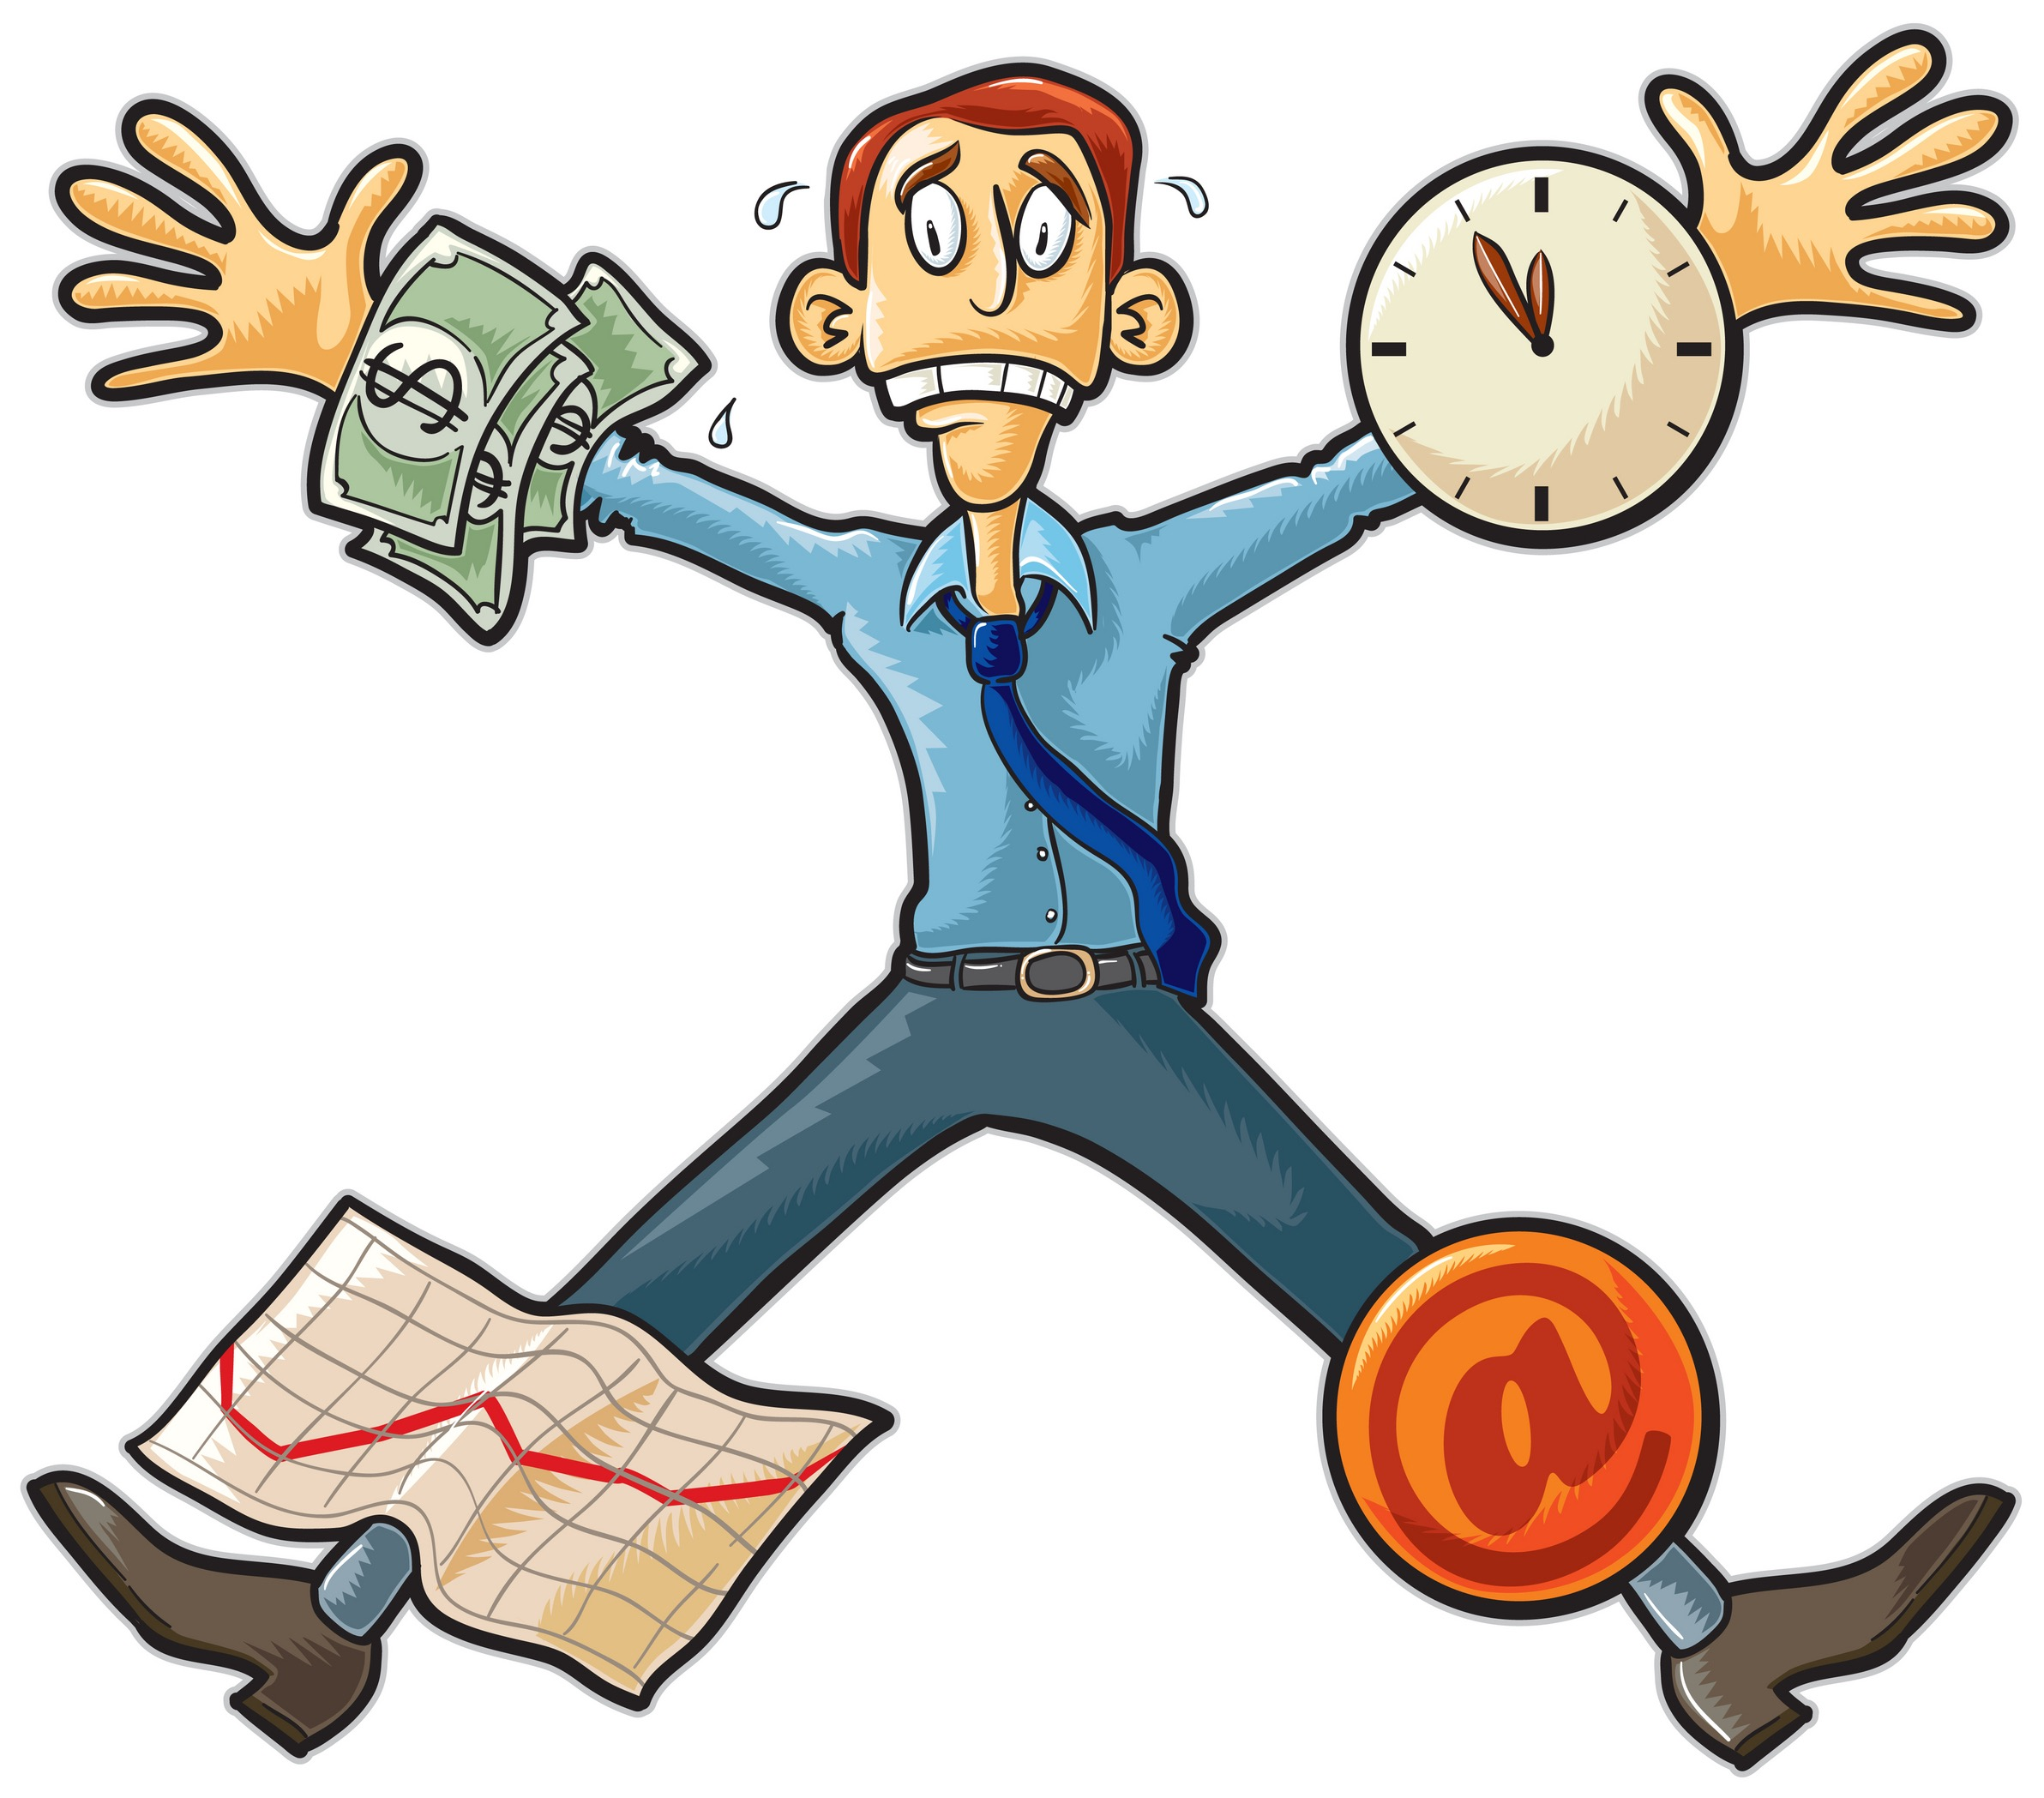
Lifestyle choices
Lifestyle choices include:
  Diet
  Activity levels
  Work
  Rest
  Sleep balance

Slide 17
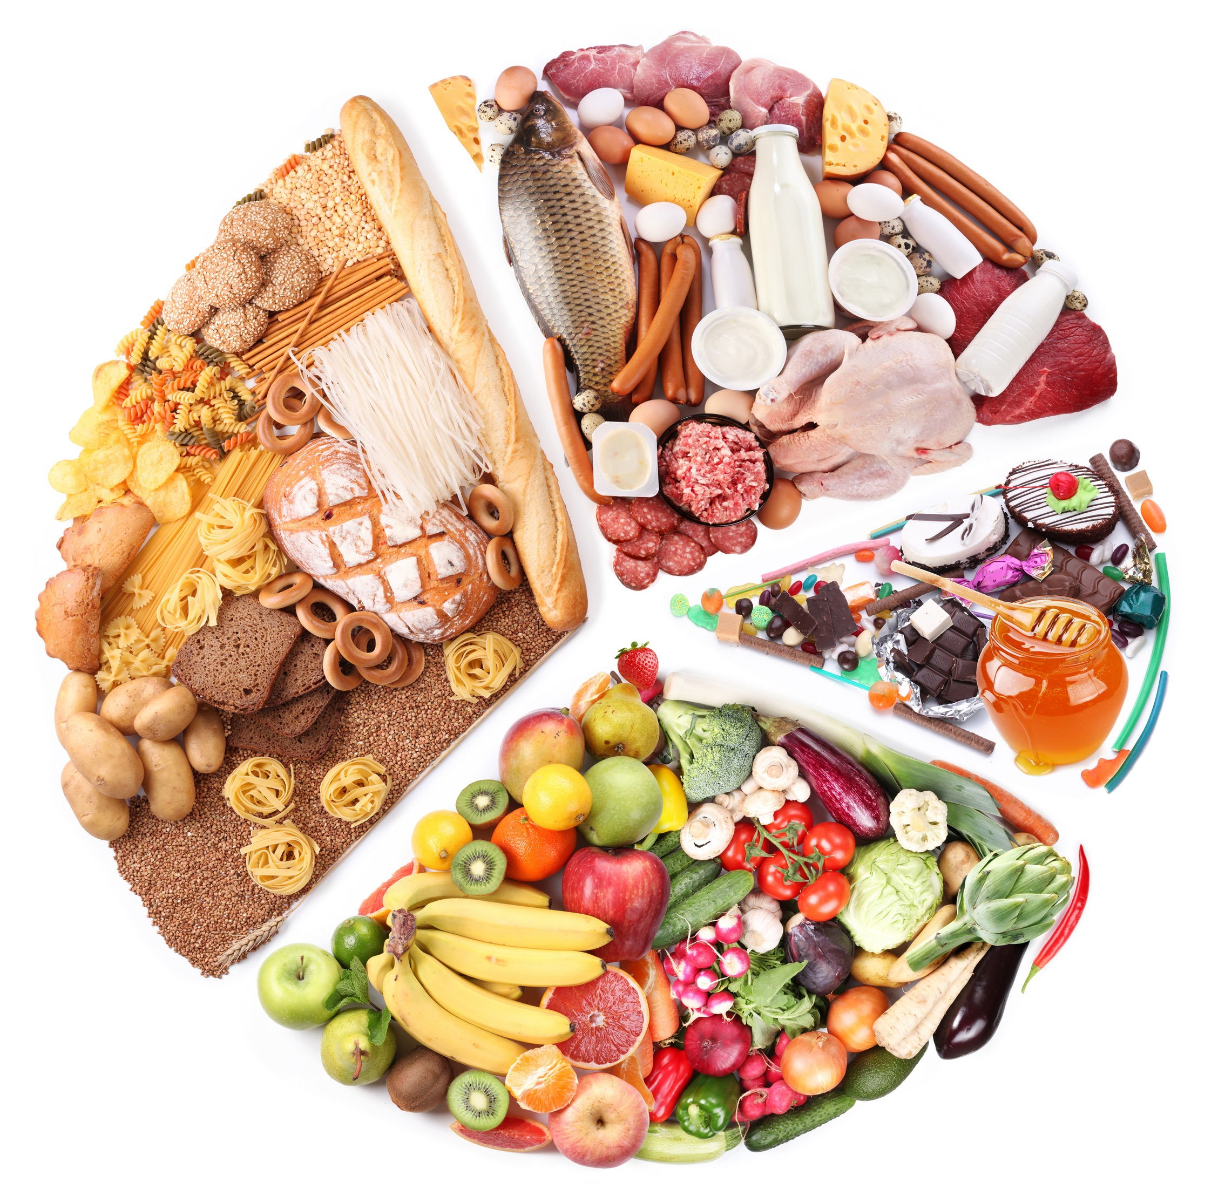
Diet
A healthy diet will:
  Boost energy levels.
  Reduce the risk of obesity related
  diseases such as Type II diabetes.
  Improve emotional health.
A poor diet will:
  Cause mood swings and decrease emotional health.
  Lead to nutrient deficiencies and related diseases.
  Impact sleep and concentration levels.

Slide 18
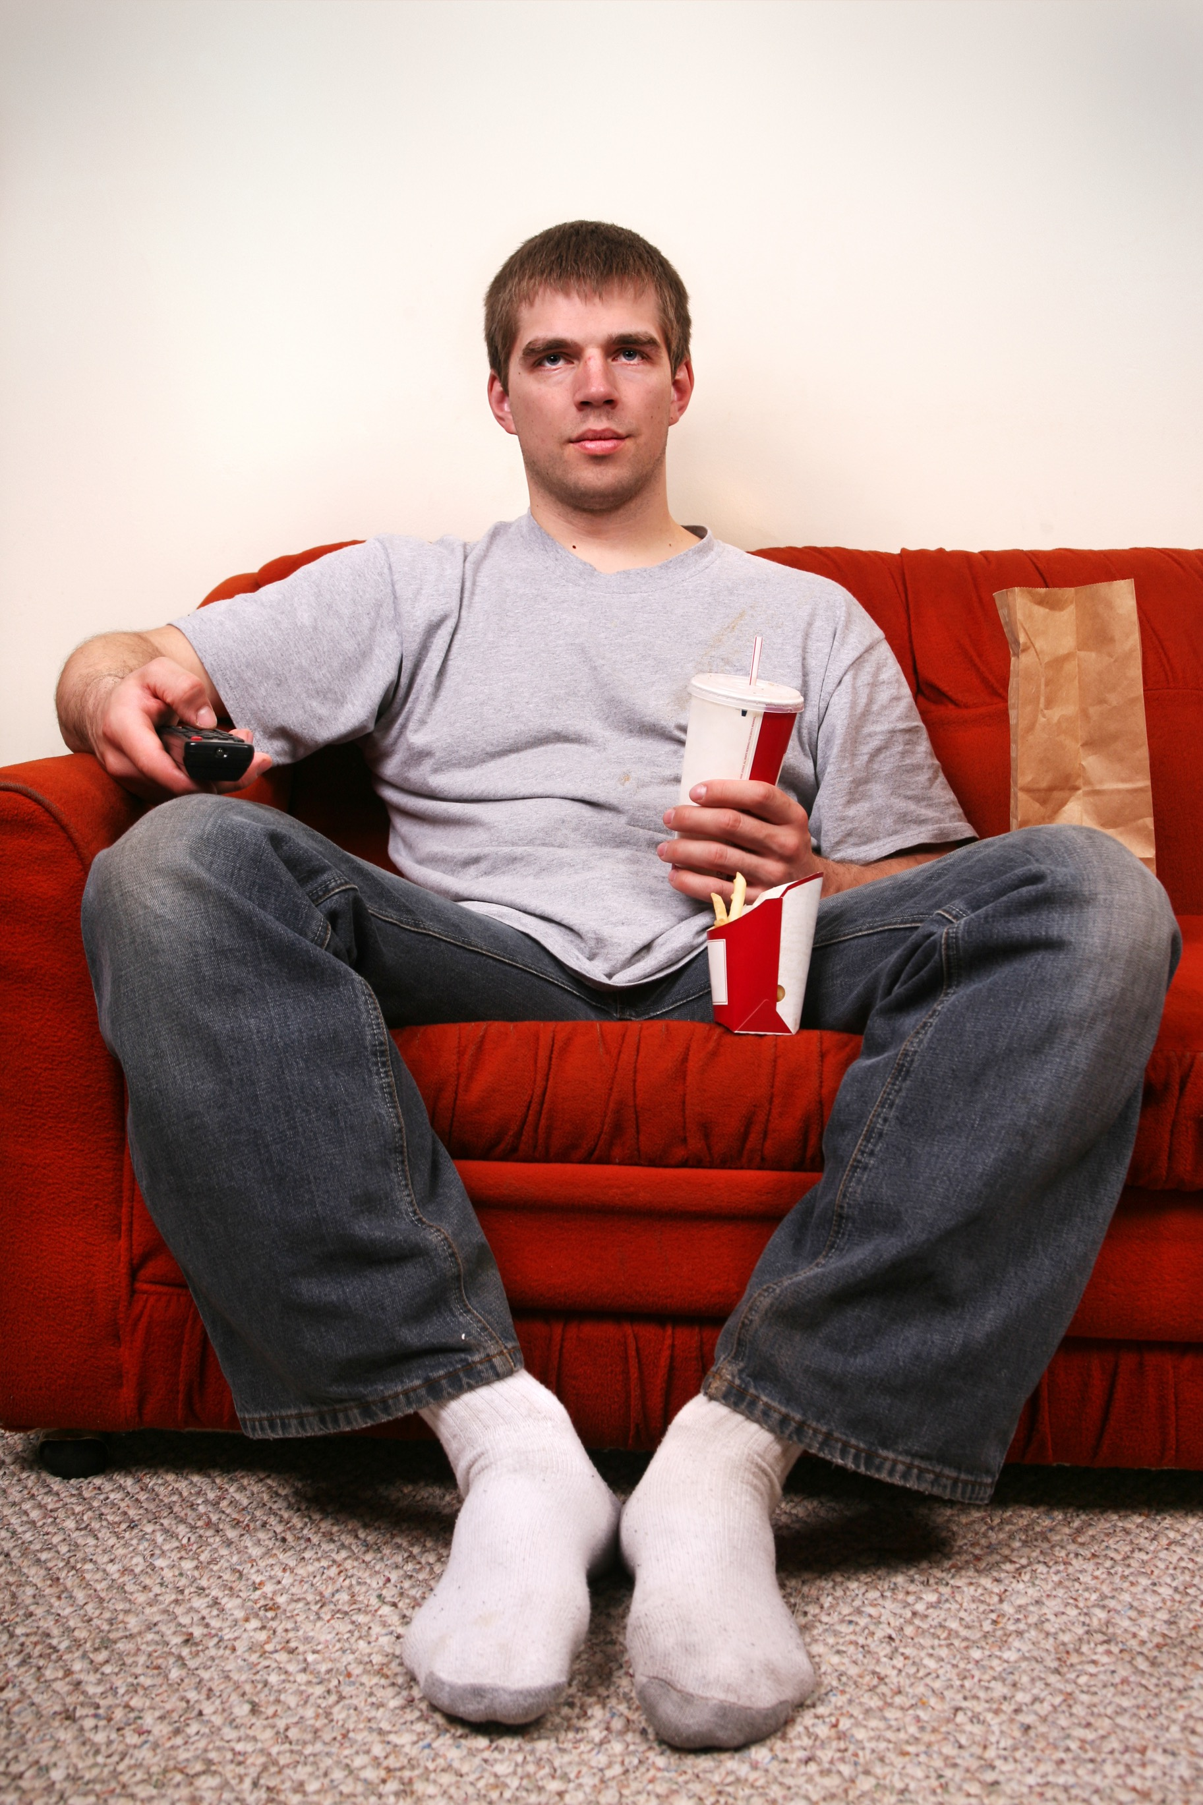
Activity levels
Maintaining an active lifestyle will:
  Reduce the risk of sedentary related diseases.
  Reduce feelings of anxiety and stress.
  Improve confidence and fitness.
Leading an inactive life will:
  Reduce confidence and self-esteem.
  Increase the risk of certain
  diseases.
  Make everyday tasks more difficult.

Slide 19
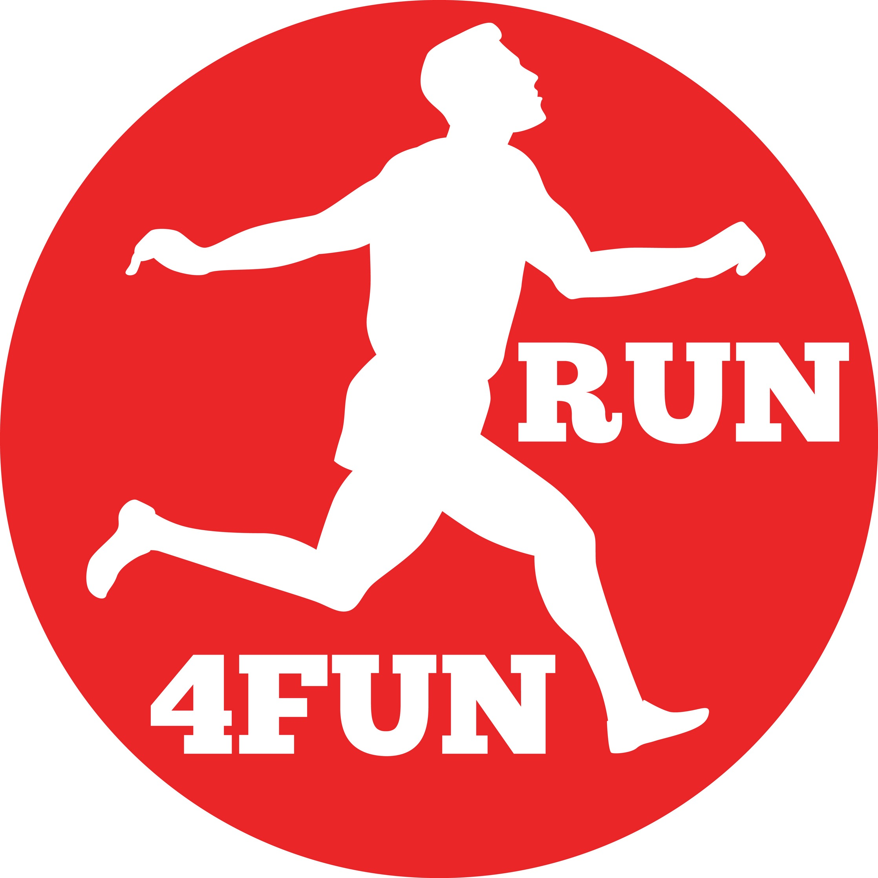
Work, rest and sleep
It is important to balance your work, rest and sleep.
A good work, rest and sleep balance will:
  Lead to increased productivity at work.
  Improve physical, emotional and social health.
  Reduce anxiety and improve feelings of calm and control.
  Lead to better lifestyle choices.
A poor work, rest and sleep balance will:
  Decrease physical, emotional and social
  health.
  Lead to poor lifestyle choices.
  Increase the risk of obesity.

Slide 20

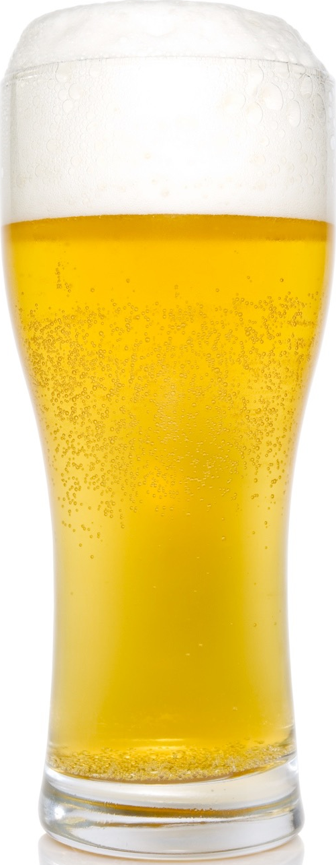
Recreational drugs
Smoking
Contains harmful components such as
nicotine, tar and carbon monoxide.
Smoking for long periods of time can result
in heart disease, lung and mouth cancer,
emphysema and bronchitis.
Alcohol
Not harmful in small amounts but large
consumption over a long period of time can
cause large health concerns.
It can cause problems with co-ordination,
aggression and lowers the level of glycogen in the muscles. More serious drinkers are at risk of kidney and liver damage.

