Slide 1
The consequences of sedentary lifestyle
2.2.1 Health, fitness and well-being

Slide 2
Health
Obesity
Sedentary Lifestyle
Overweight
The consequence of a sedentary lifestyle
Body Mass Index
Physique
Disease
Over Fat

Slide 3
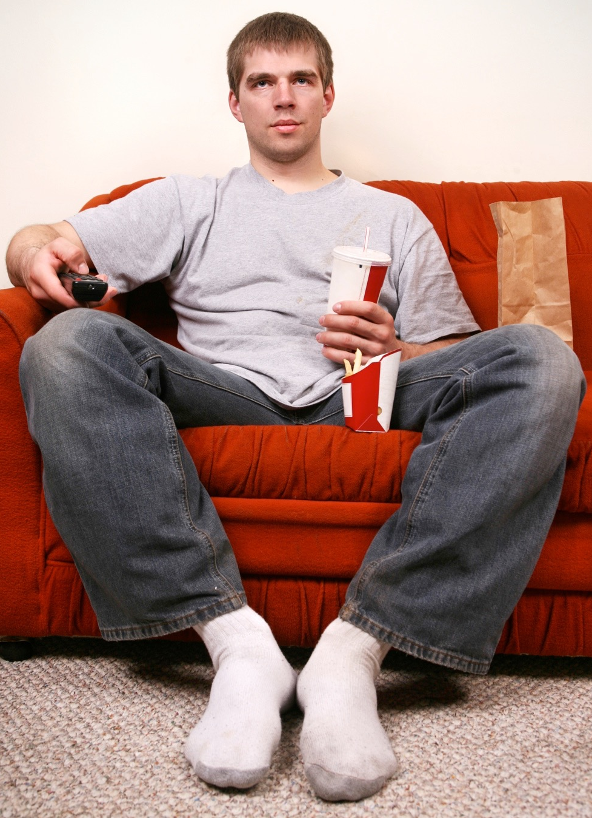
Sedentary lifestyle
This is a lifestyle with irregular exercise or none at
all.
Due to an increase in technology and
entertainment many are choosing to stay
at home and watch the television rather
than playing sport. This is called the
“couch potato” syndrome.
Technological advances have reduced the amount of physical exertion required in a number of jobs.
Many current professions require workers to sit at computers rather than move around.
Domestic chores are easier due to the introduction of washing machines, dish washers and vacuum cleaners.

Slide 4
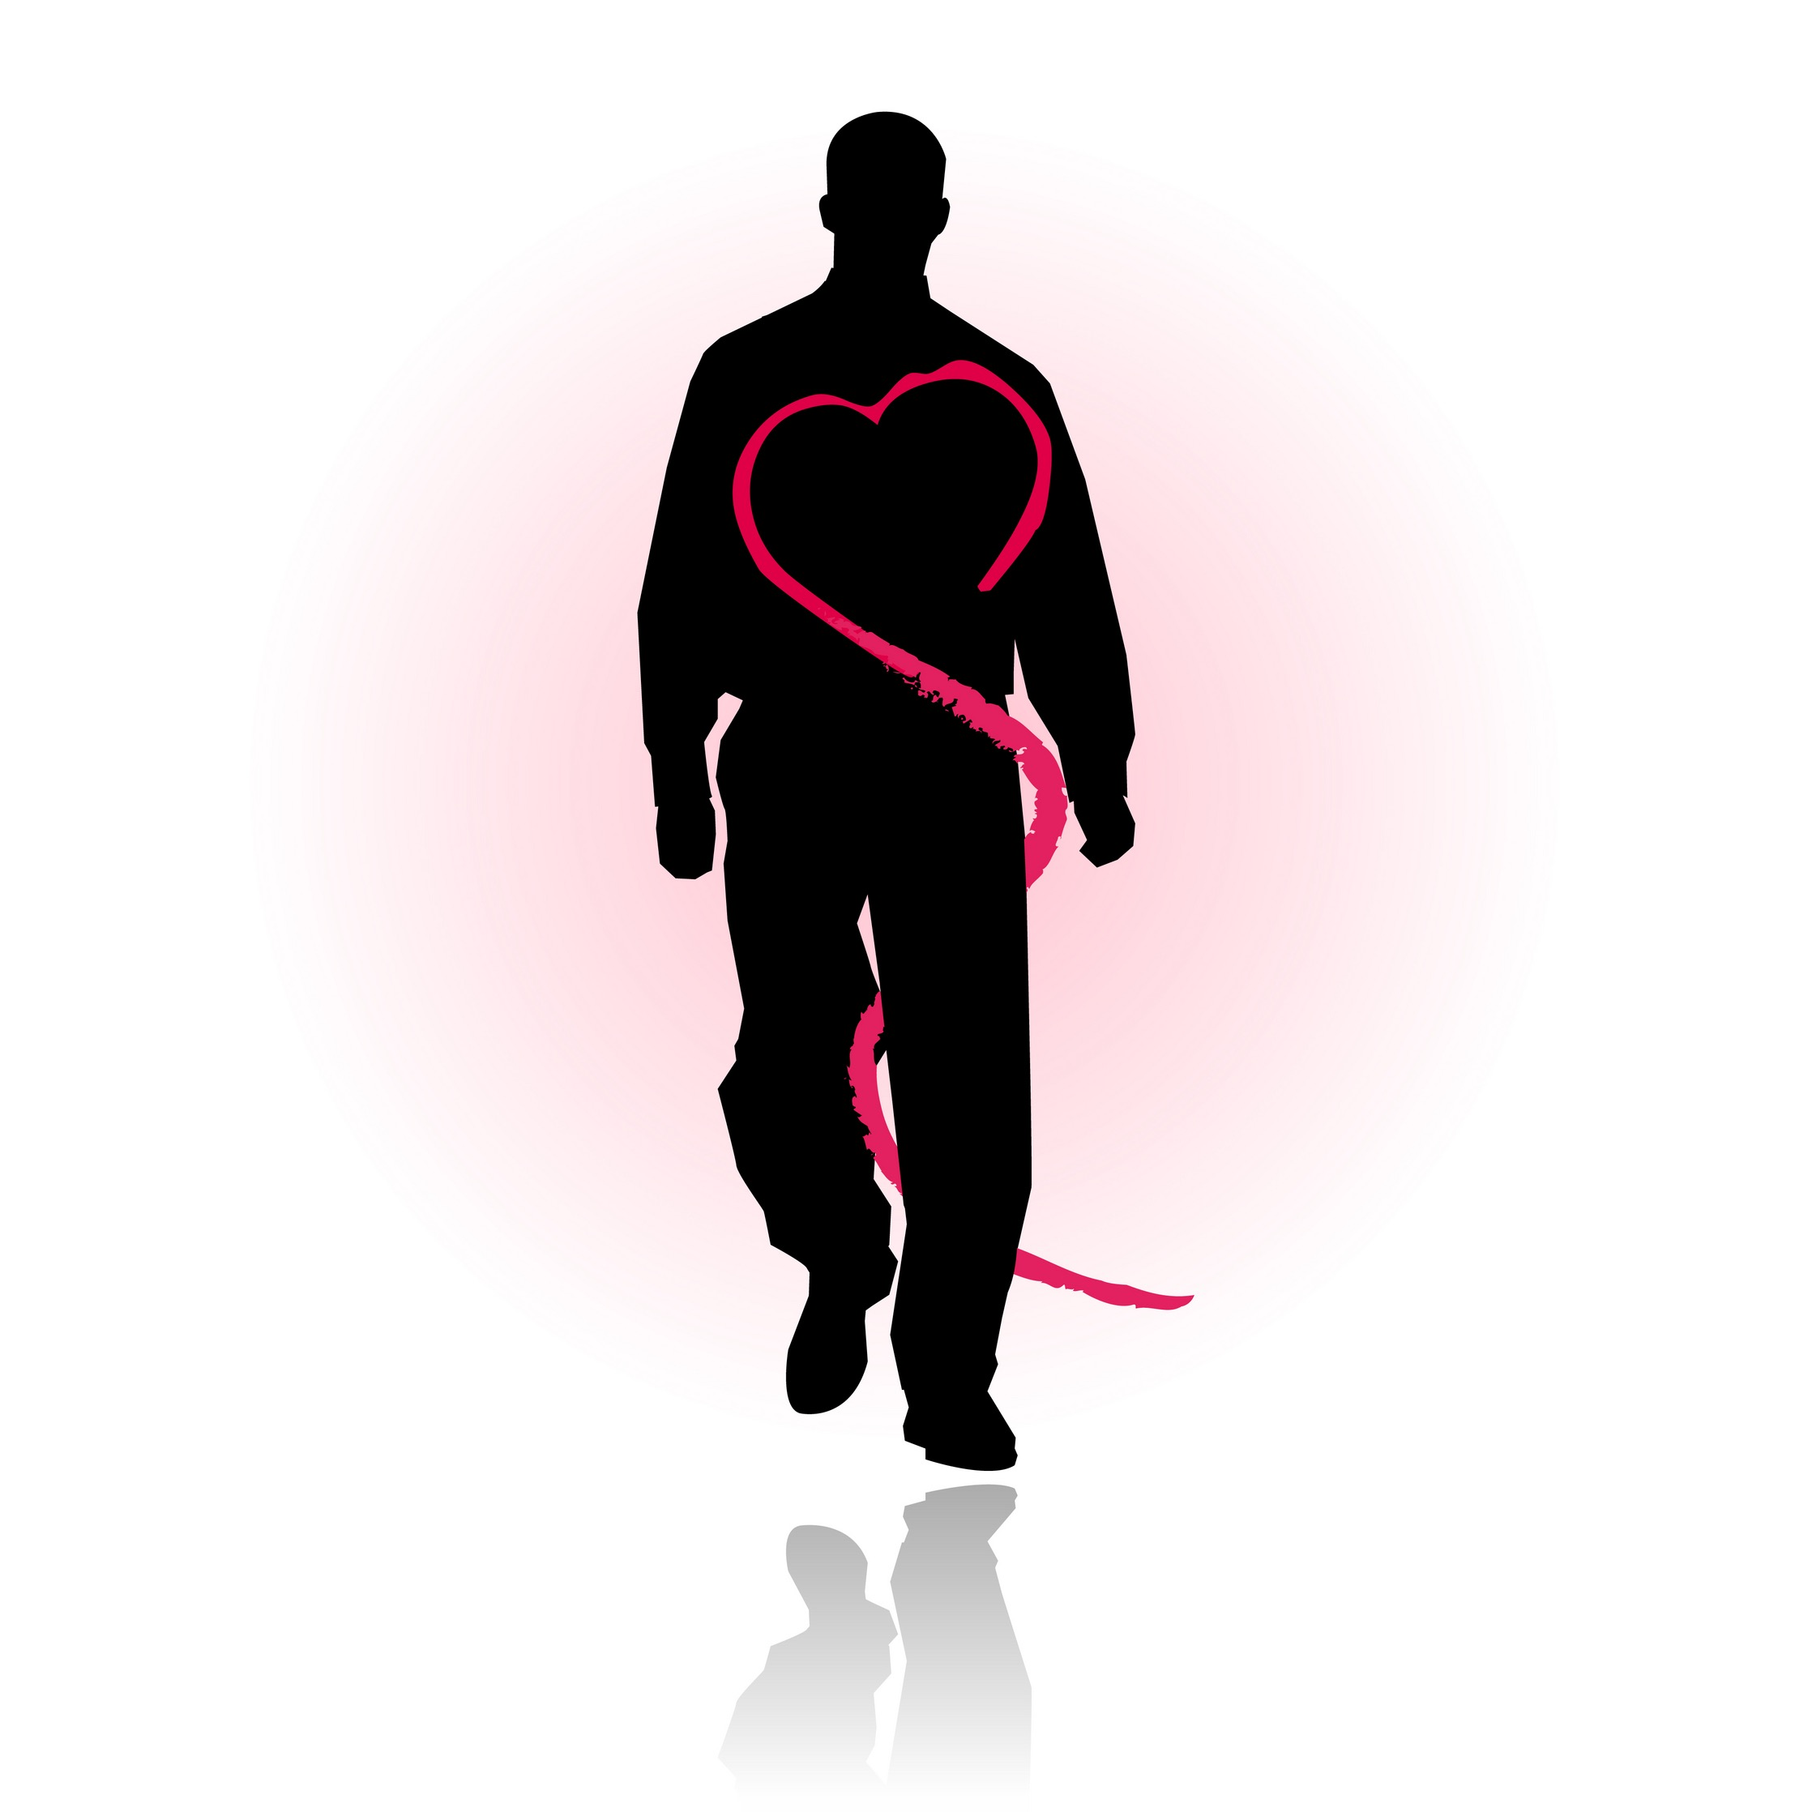
Consequences
Consequences of a sedentary lifestyle.
  Weight gain which can lead to obesity.
  Heart disease.
  Hypertension.
  Diabetes.
  Poor sleep.
  Poor self-esteem.
  Lethargy.

Slide 5
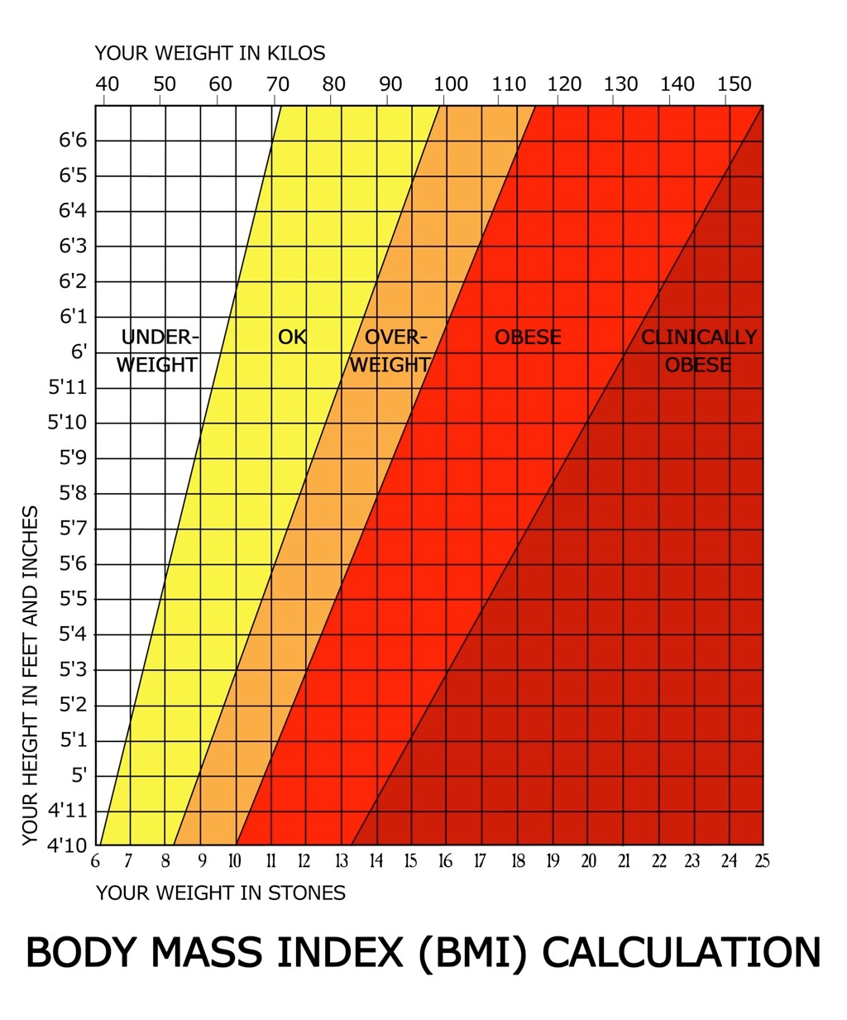
Body Mass Index (BMI)
BMI is a measure of a person's body composition. The equation is:
Weight
Height²
The higher the BMI, the more
body fat. This calculation
can, however, be inaccurate for
certain individuals such as:
  Muscular athletes.
  Pregnant women.
  Elderly people.

Slide 6
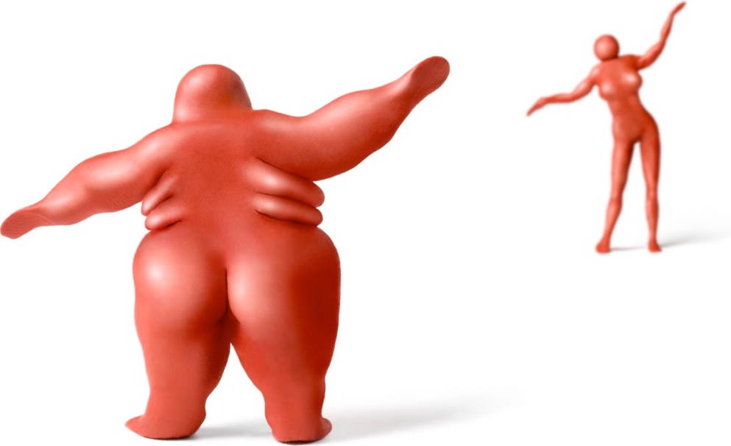
Body Mass Index (BMI)
Body mass index can be used in a number of ways by a performer.
  Indicates fitness levels.
  Allows them to see if they need to lose weight.
  They can compare their score against the norm.
  A score between 18-25 indicates a desirable BMI.
  A score over 25 indicates being
  overweight.
  A score over 30 indicates
  obesity and is a health risk.
  A score over 40 indicates a
  serious health risk.

Slide 7
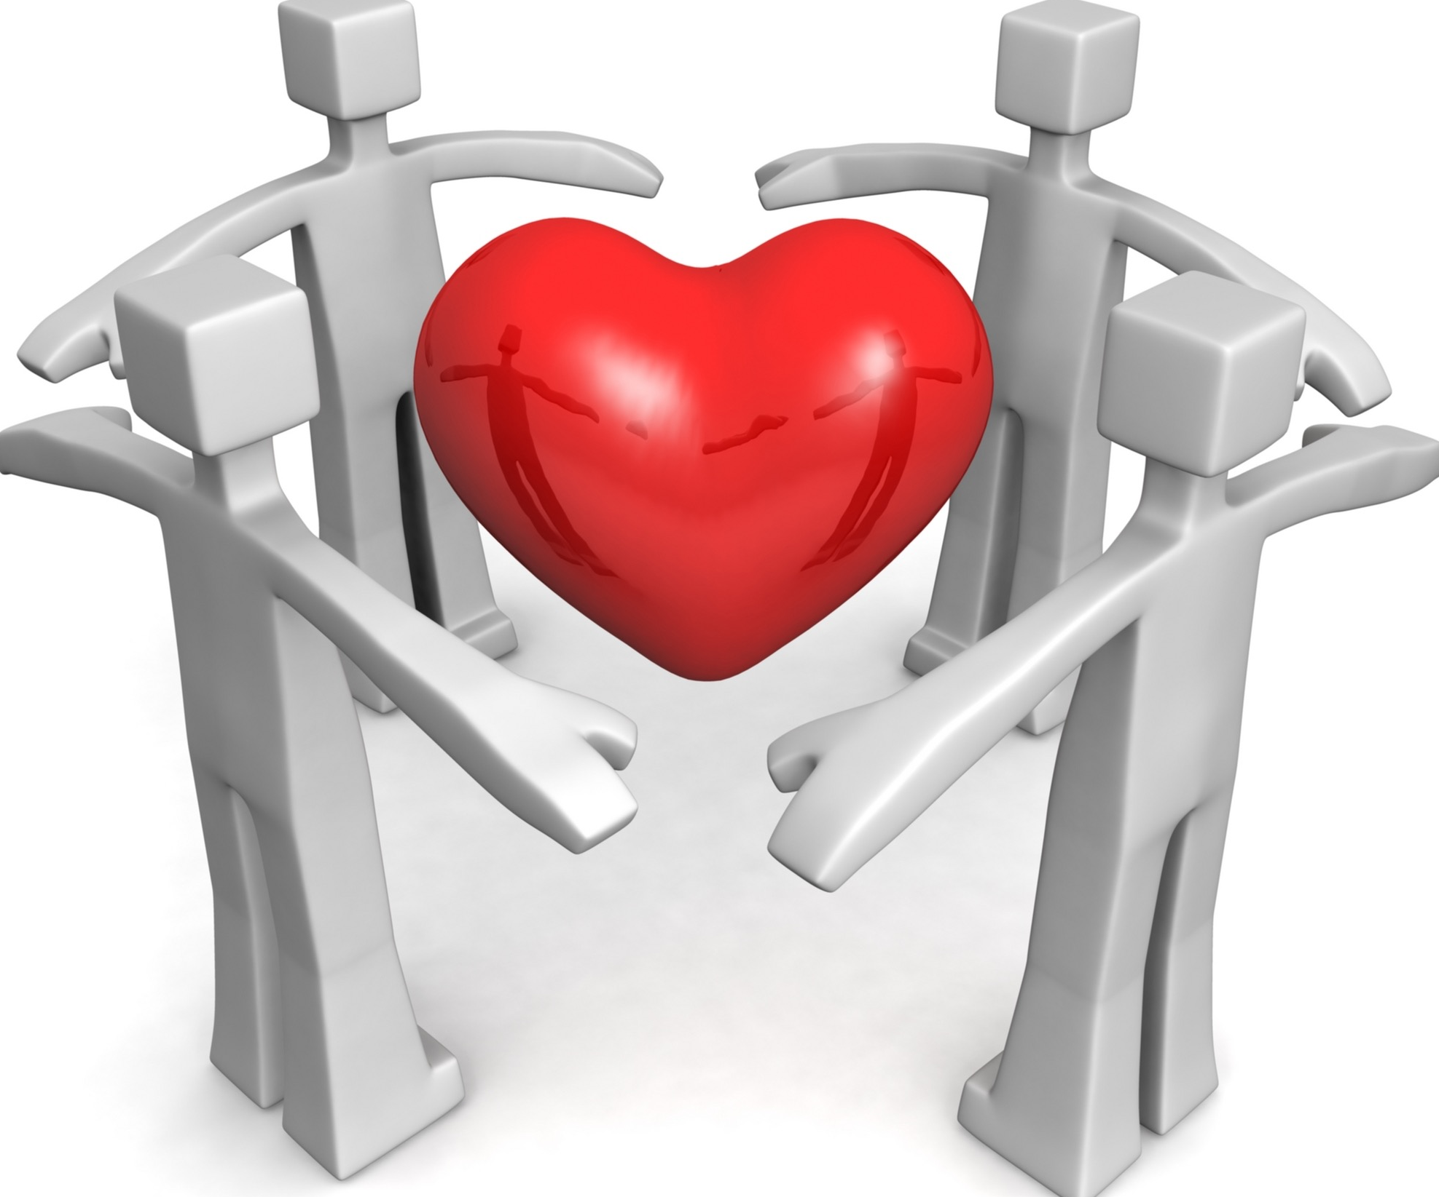
Obesity
Obesity can affect a person's performance and their health.
Performance
    Decreases stamina and cardiovascular endurance.
    Decreases flexibility.
    Decreases speed and power.
    Decreases agility.
Physical ill health
    Increases the risk of high blood pressure.
    Increases the risk of heart disease and heart attacks.
    Increases the risk of Type II diabetes.
    Poor posture and loss of muscle tone.
    Increased risk of osteoporosis.

Slide 8
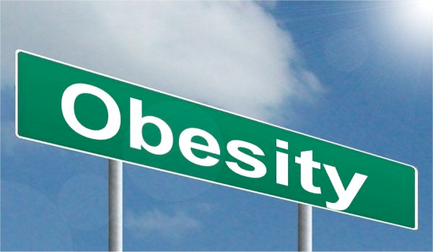
Obesity
Mental ill health
    Increases the risk of depression.
    May result in a loss of confidence.
Social ill health
    May result in a lack of socialising
    Morbidly obese people may find it hard to leave the house.

Slide 9
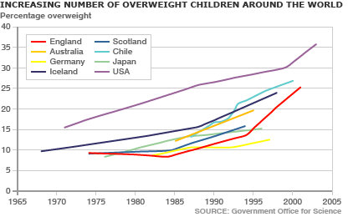
Graphical interpretation and analysis
Describe the trend of childhood obesity in the different nations.

