Slide 1
Energy use, diet, nutrition and hydration
2.1.3 Health, fitness and well-being

Slide 2
Fats
Basal Metabolic Rate
Vitamins
Macronutrients
Carbohydrates
Energy use, diet, nutrition and hydration
Energy Balance
Micronutrients
Minerals
Proteins
Fibre
Water

Slide 3
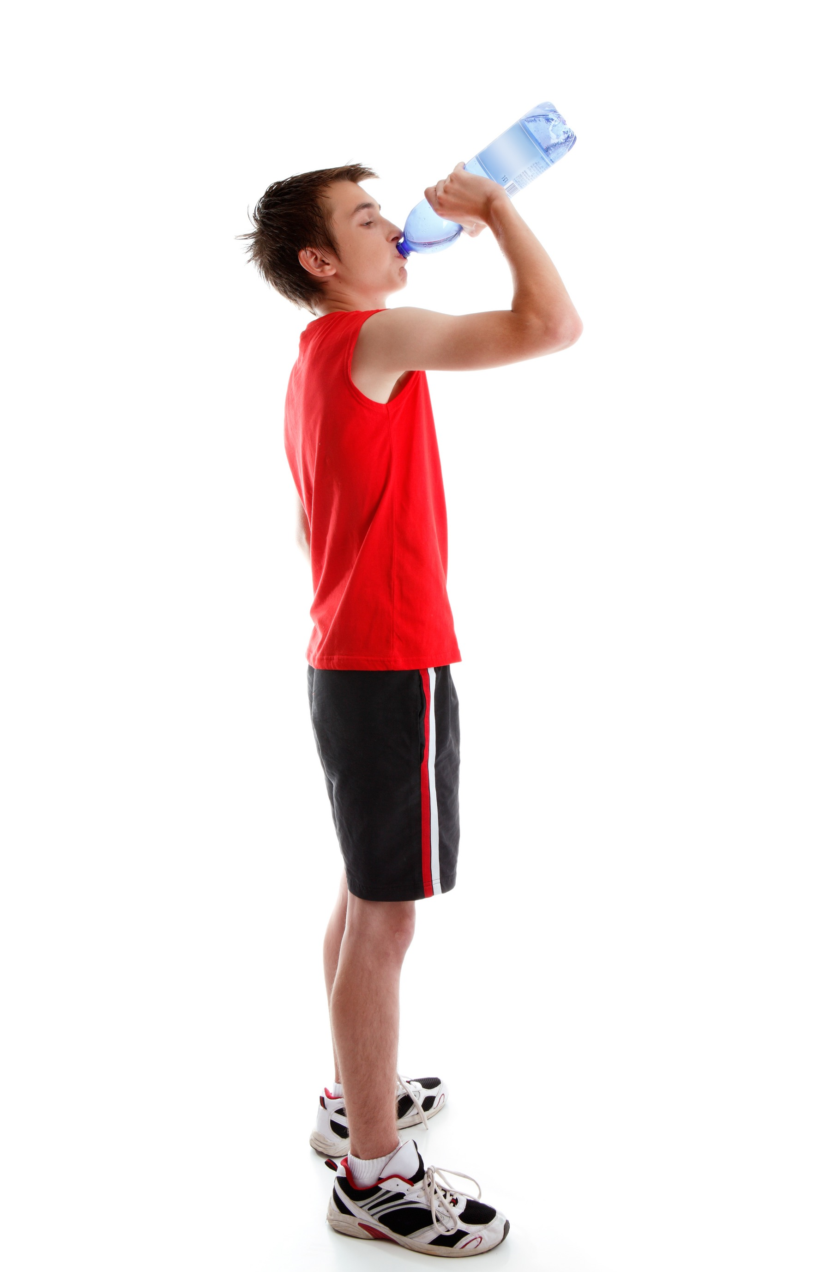
Basal metabolic rate
The rate at which we burn calories for energy is called our basal metabolic rate.
  Physical activity can increase our basal metabolic rate so we need to consume more calories.
  When we eat is also important.
  Ensure you leave at least two hours before exercise.
  During exercise you can consume small quantities that are easily digested.
  After activity you should consume plenty of liquids and after a period a balanced meal.

Slide 4

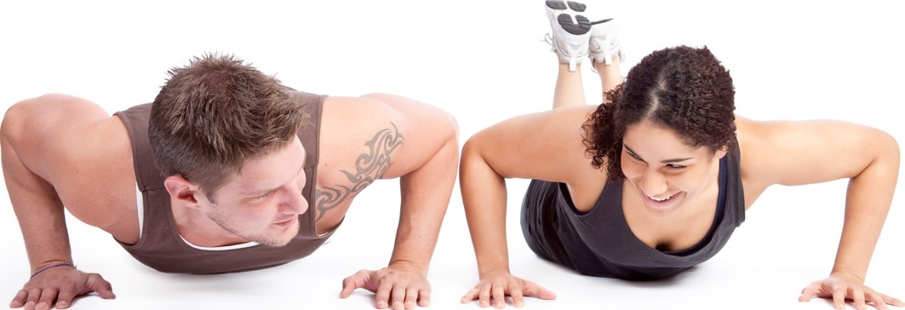
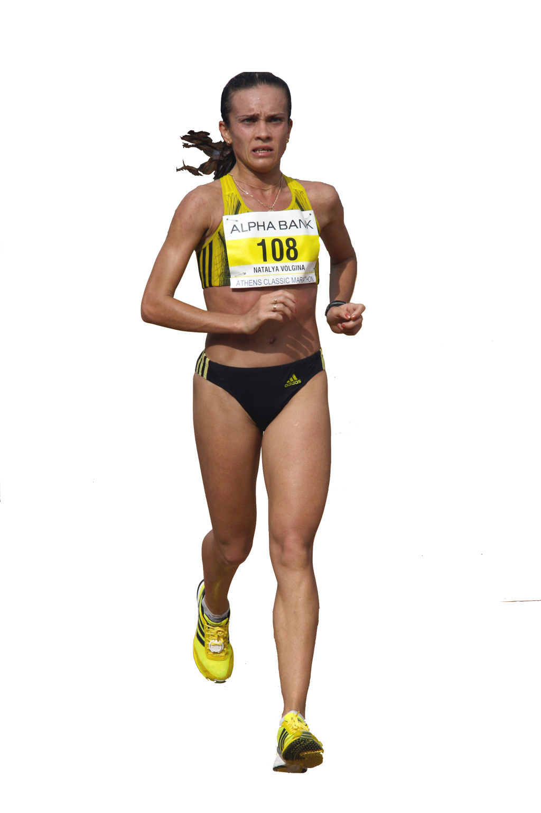

Energy
Average females need 2,000 kcal/day and males need
2,500 kcal/day. This may vary depending on the following factors:
  Teenagers need more energy
  than young children.
  Males tend to need more
  energy than females.
  Athletes need more energy than
  non-athletes.
  People with active lifestyles
  need more energy than people
  with non-active lifestyles.
  Taller people need more than
  shorter people.

Slide 5
Energy
To maintain energy balance the food intake needs to match energy needs.
An increase in energy intake can result in weight gain.
An increase in energy needs without an increase in energy intake will result in weight loss.
Energy Intake
Energy Needs

Slide 6
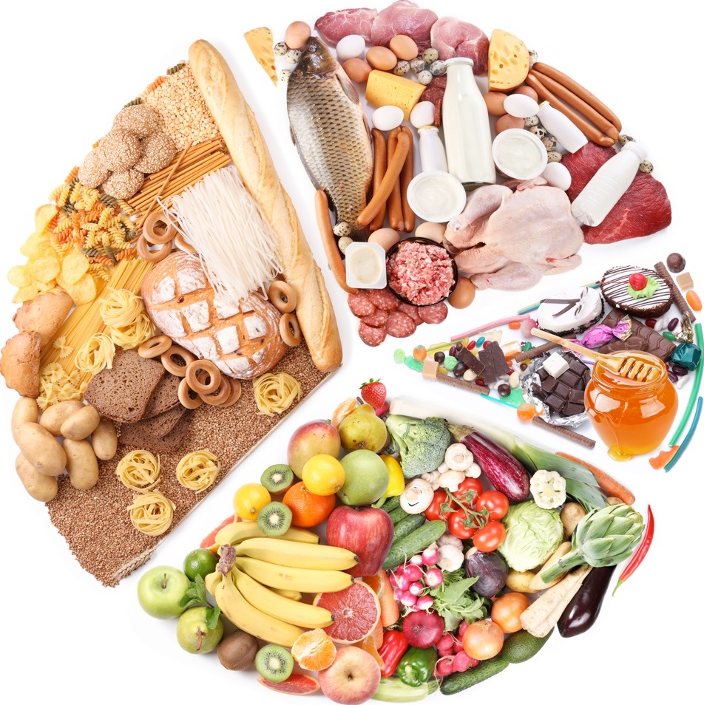
Macronutrients
Macronutrients are the types of food we need in large amounts. These include:
  Carbohydrates
  Proteins
  Fats

Slide 7

Carbohydrates
Why are they important?
  Provide the most ready
  source of energy.
  Allows the athlete to perform for longer
  and is used for endurance events such as
  cycling and marathon running.
Sources of food
  Complex carbohydrates - Bread, rice, pasta and potatoes.
  Simple sugars - Sweets and cakes.
Useful sources of energy
  Over half of our energy needs are taken from carbohydrates, athletes need even more.

Slide 8
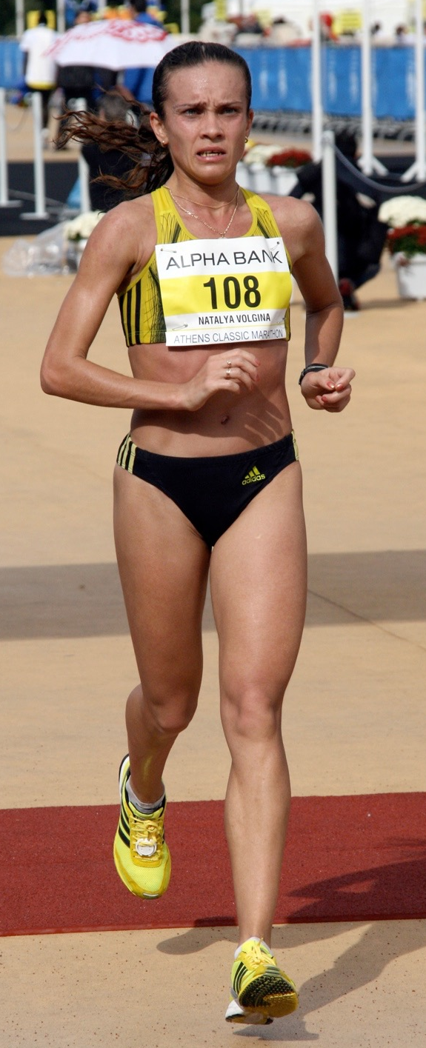
Carbohydrates
Carbohydrate loading is a technique used by endurance athletes to maximise their carbohydrate stores.
  This involves eating high carbohydrate meals 24 hours before the day of the competition.
  This helps maximise the glycogen stores.
  One downside is this can leave the performer feeling heavy and sluggish.
  It should, however, offset the effects of fatigue.
Notes:
New slide

Slide 9
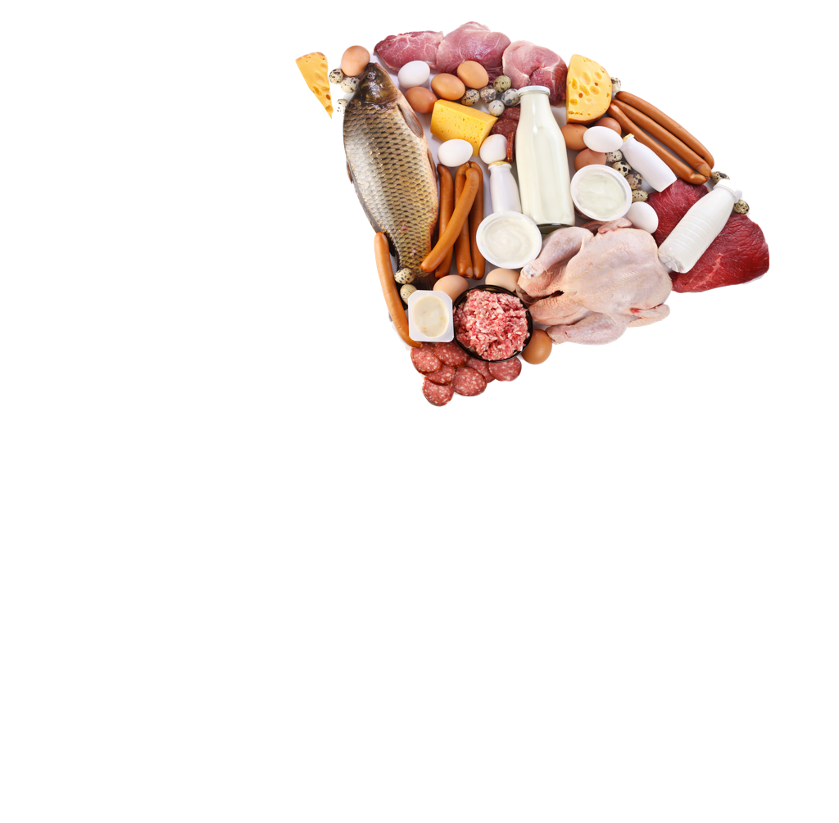
Protein
Why are they important?
  They provide amino acids that build muscle tissues to make the body stronger.
  They repair muscle tissue.
Sources of food
  Meat, eggs and nuts.
Useful sources of energy
  Protein provides a small
  amount of energy if needed.

Slide 10
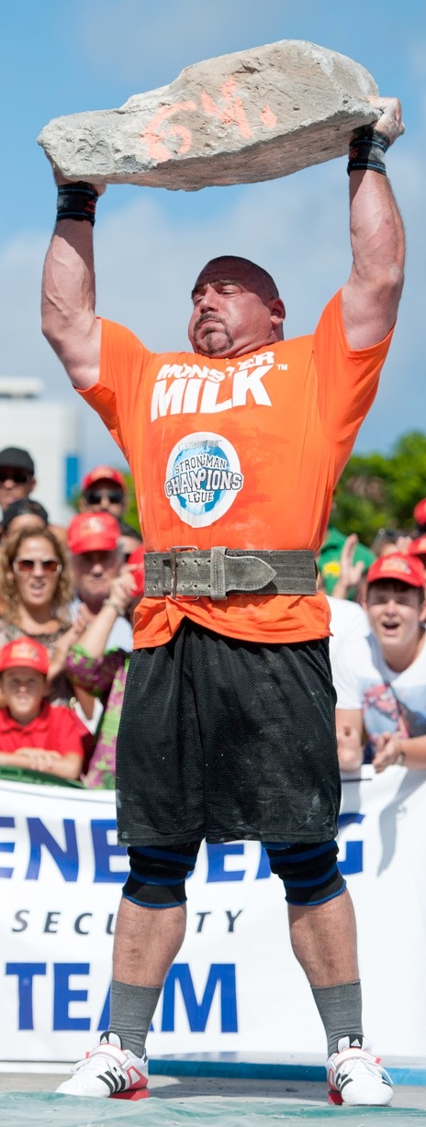
Protein
Power and strength athletes need to build muscle.
  To assist them they combine
  training with a high protein diet.
  They should consume 1.2 - 1.7 grams
  per kilogram of body weight.
  Power athletes should consume protein
  very soon after exercise.
  A high protein diet is also used
  during the rehabilitation from an
  injury.
  This kind of diet can also help
  athletes who need to lose weight.
Notes:
Additional slide

Slide 11

Fats
Why are they important?
  Provide large amounts of energy.
  They contain essential fatty acids
  that the body needs to function.
  Insulates the body against the cold.
Sources of food
  Saturated fats - Butter, cheese, ice cream and fatty meats.
  Unsaturated fats - Avocado, nuts, soybean and olive oils.
Useful sources of energy
  Fats provide 50% or more of our energy needs.
  They can only be used at low intensities when oxygen is in plenty supply.

Slide 12
Micronutrients
Micronutrients are chemical substances that are essential to normal growth and development.
  Vitamins
  Minerals

Slide 13

Vitamins and minerals
Vitamins and minerals
Why are they important?
    Aid growth.
    Boost our immune system.
    Regulate body functions.
Sources of food
    Fruit and vegetables
Useful sources of energy
    Vitamins and minerals do not generate any energy.

Slide 14
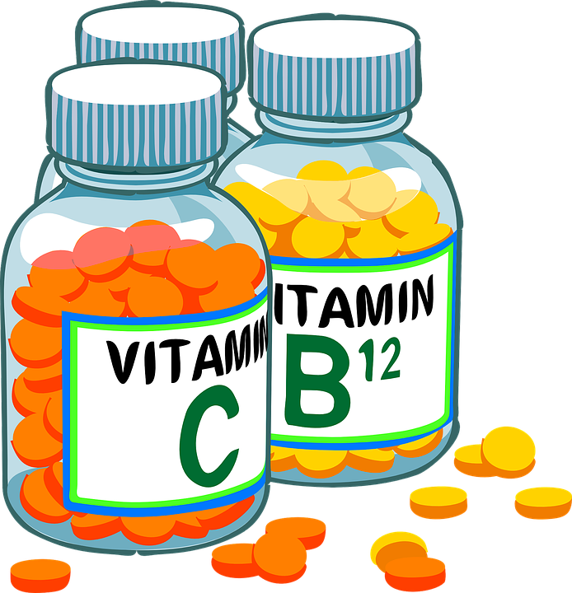
Vitamins and minerals
Important vitamins
B3 and B6 help with gaseous exchange.
Vitamin C assists with exercise
induced asthma.
Vitamin D assists with mood
and energy regeneration.
Vitamin E reduces the risk of
pneumonia.
Notes:
Additional slide

Slide 15
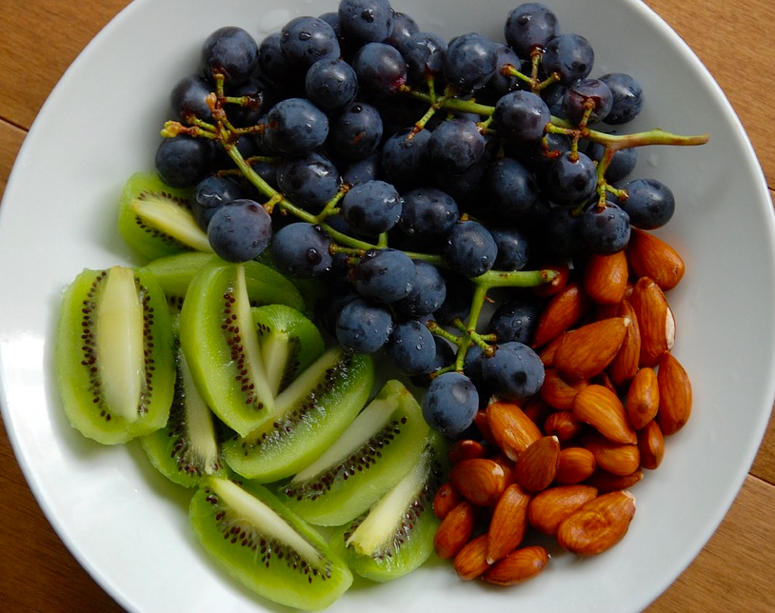
Vitamins and minerals
Important minerals
Calcium
Iron
Iodine
Magnesium
Zinc
Phosphorus
Notes:
Additional slide

Slide 16
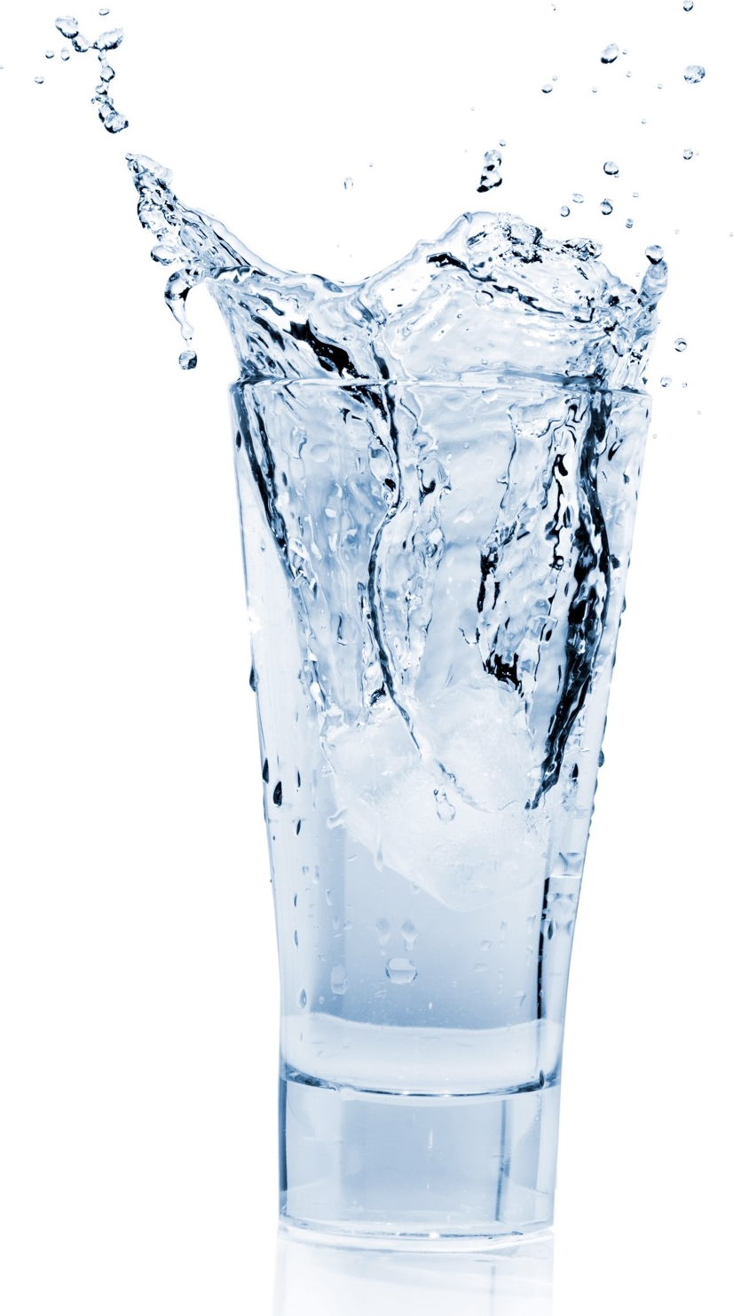
Water
Water
Why is it important?
  Incorrect water balance can cause dehydration.
  Lubricates joints.
  Removes waste products.
  Regulates temperature.
Sources of food
  Water can be found in most food and drink products but the best way to hydrate is to drink it directly.
Useful sources of energy
  Water provides no energy but it does aid the chemical
  reactions that release energy.
2 - 2.5 litres

Slide 17
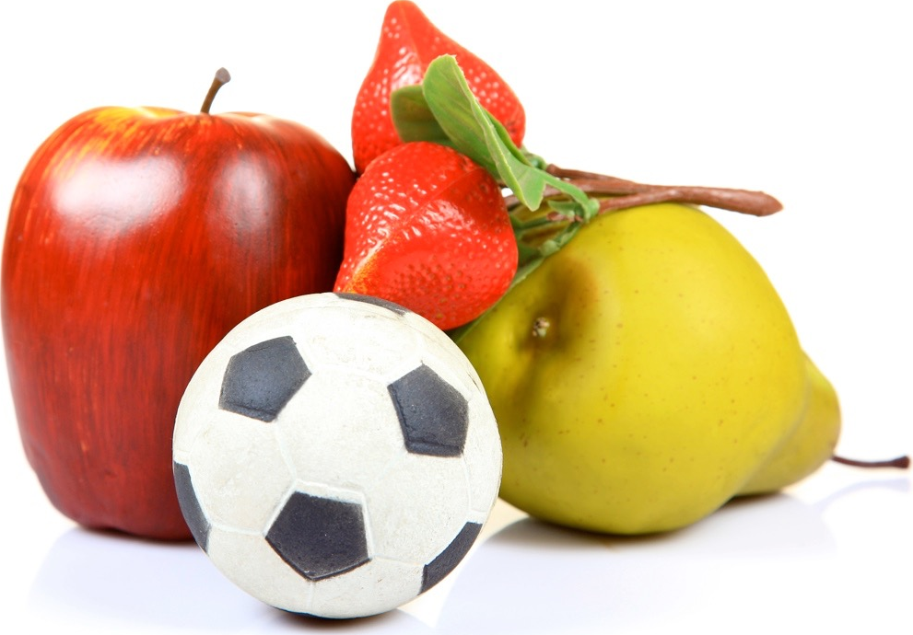
Fibre/roughage
Fibre/Roughage
Why is it important?
  It pushes your food along your
  intestine preventing constipation.
  It absorbs poisonous wastes
  from digested foods.
  Makes you feel full.
Sources of food
  Fruit, vegetables, bread and
  cereals.
Useful sources of energy
  Fibre is not a source of energy.

Slide 18
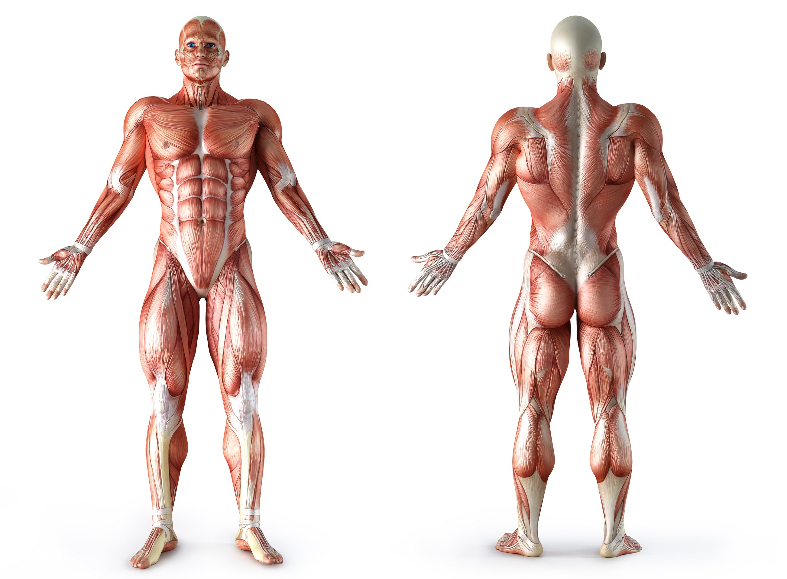
Optimum weight
The four main factors that influence your optimum weight.
Gender - Men have a higher muscle mass and skeleton so have a higher optimum weight.
Height - Increased height results in a larger skeleton and a higher optimum weight.
Muscle girth - Increased
muscle mass results in a
higher optimum weight.
Bone structure - A high bone
density increases the
optimum weight.

Slide 19

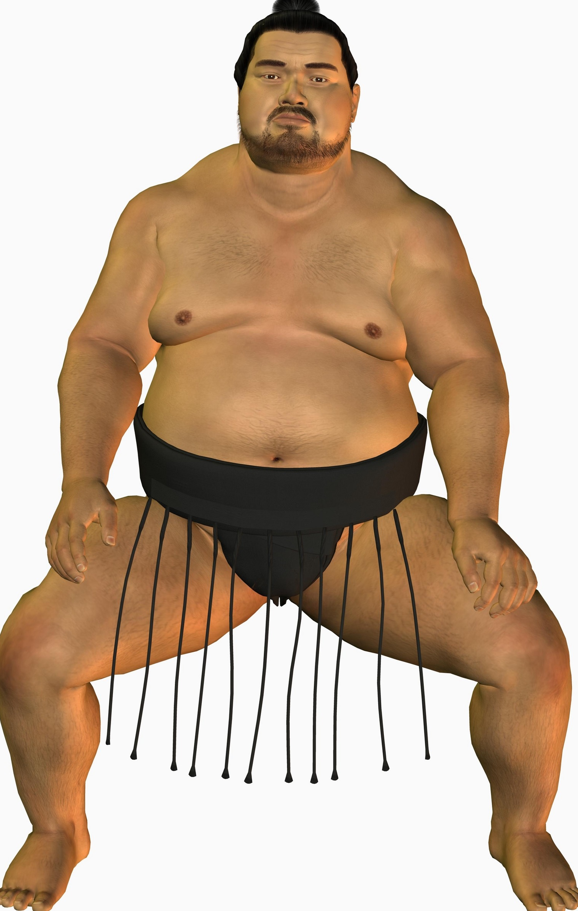
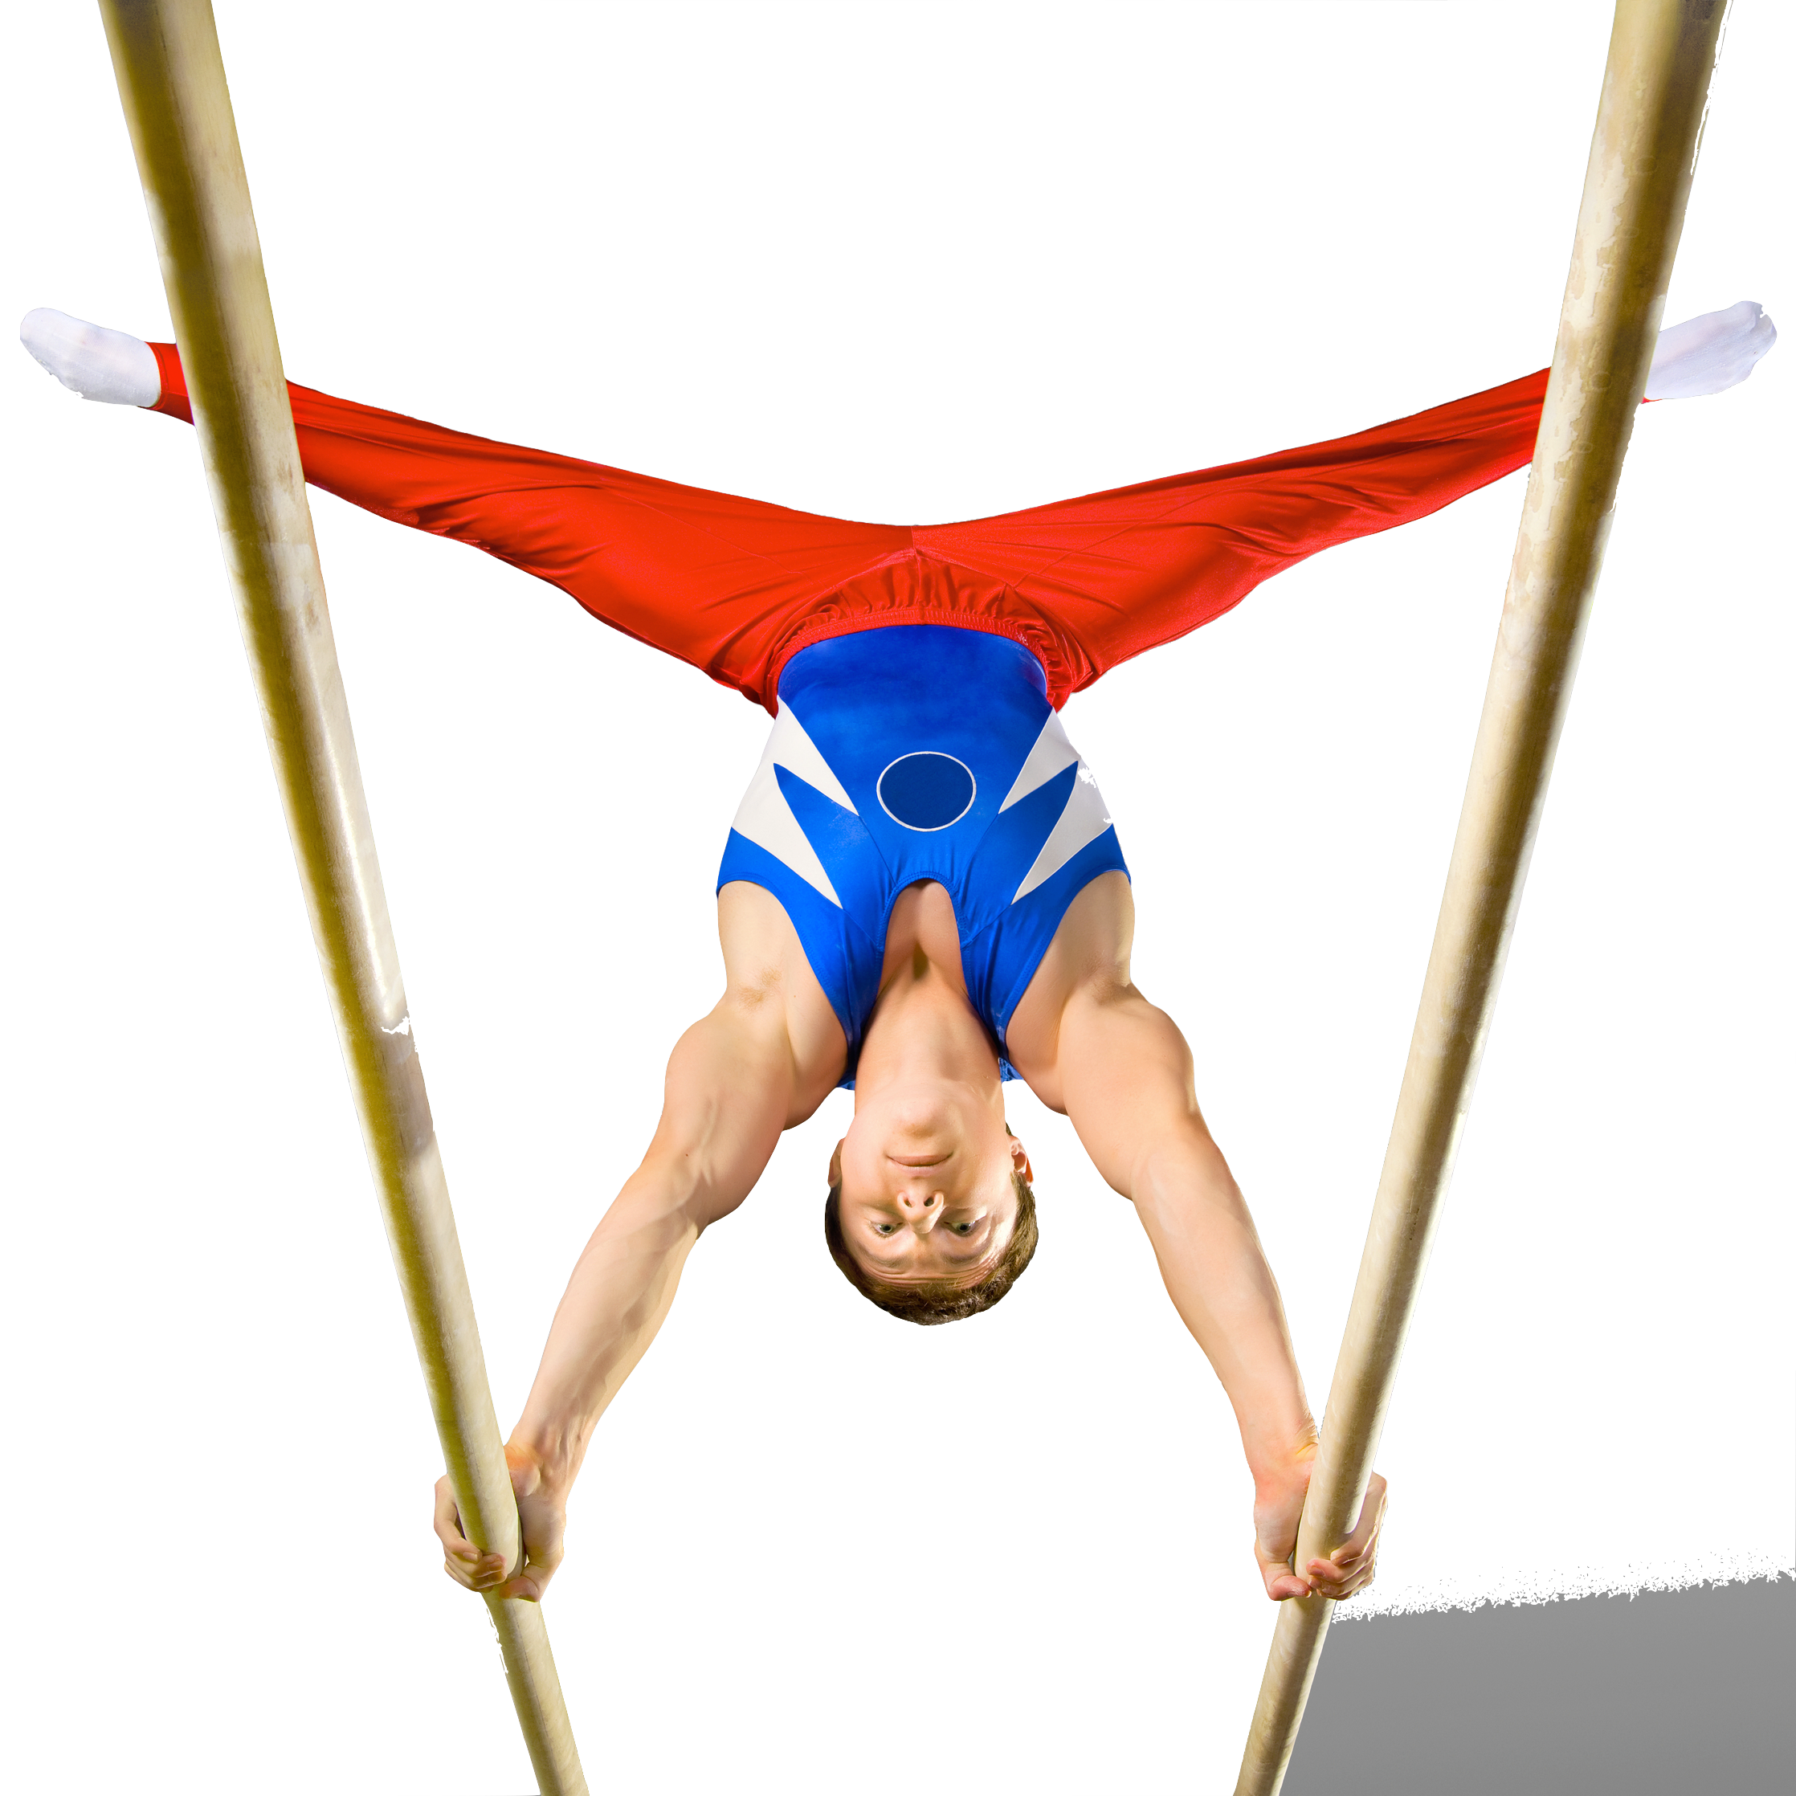
Optimum weight
Different athletes have different optimum body weights. Here we can see the different body types of these athletes.

