Slide 1
Anaerobic and aerobic exercise
1.1.3 Applied anatomy and physiology

Slide 2
Glucose
Oxygen
Aerobic Respiration
Anaerobic and Aerobic Exercise
Lactic Acid
Carbon-dioxide
Energy
Anaerobic Respiration

Slide 3
Aerobic respiration
Aerobic respiration is when we use oxygen to create energy.
The two fuel sources most used are carbohydrates (glucose) and fats (fatty acids).
Energy
Glucose
Oxygen
Carbon-dioxide
Water
+
+
+
Energy
Fatty Acids
Oxygen
Carbon-dioxide
Water
+
+
+

Slide 4
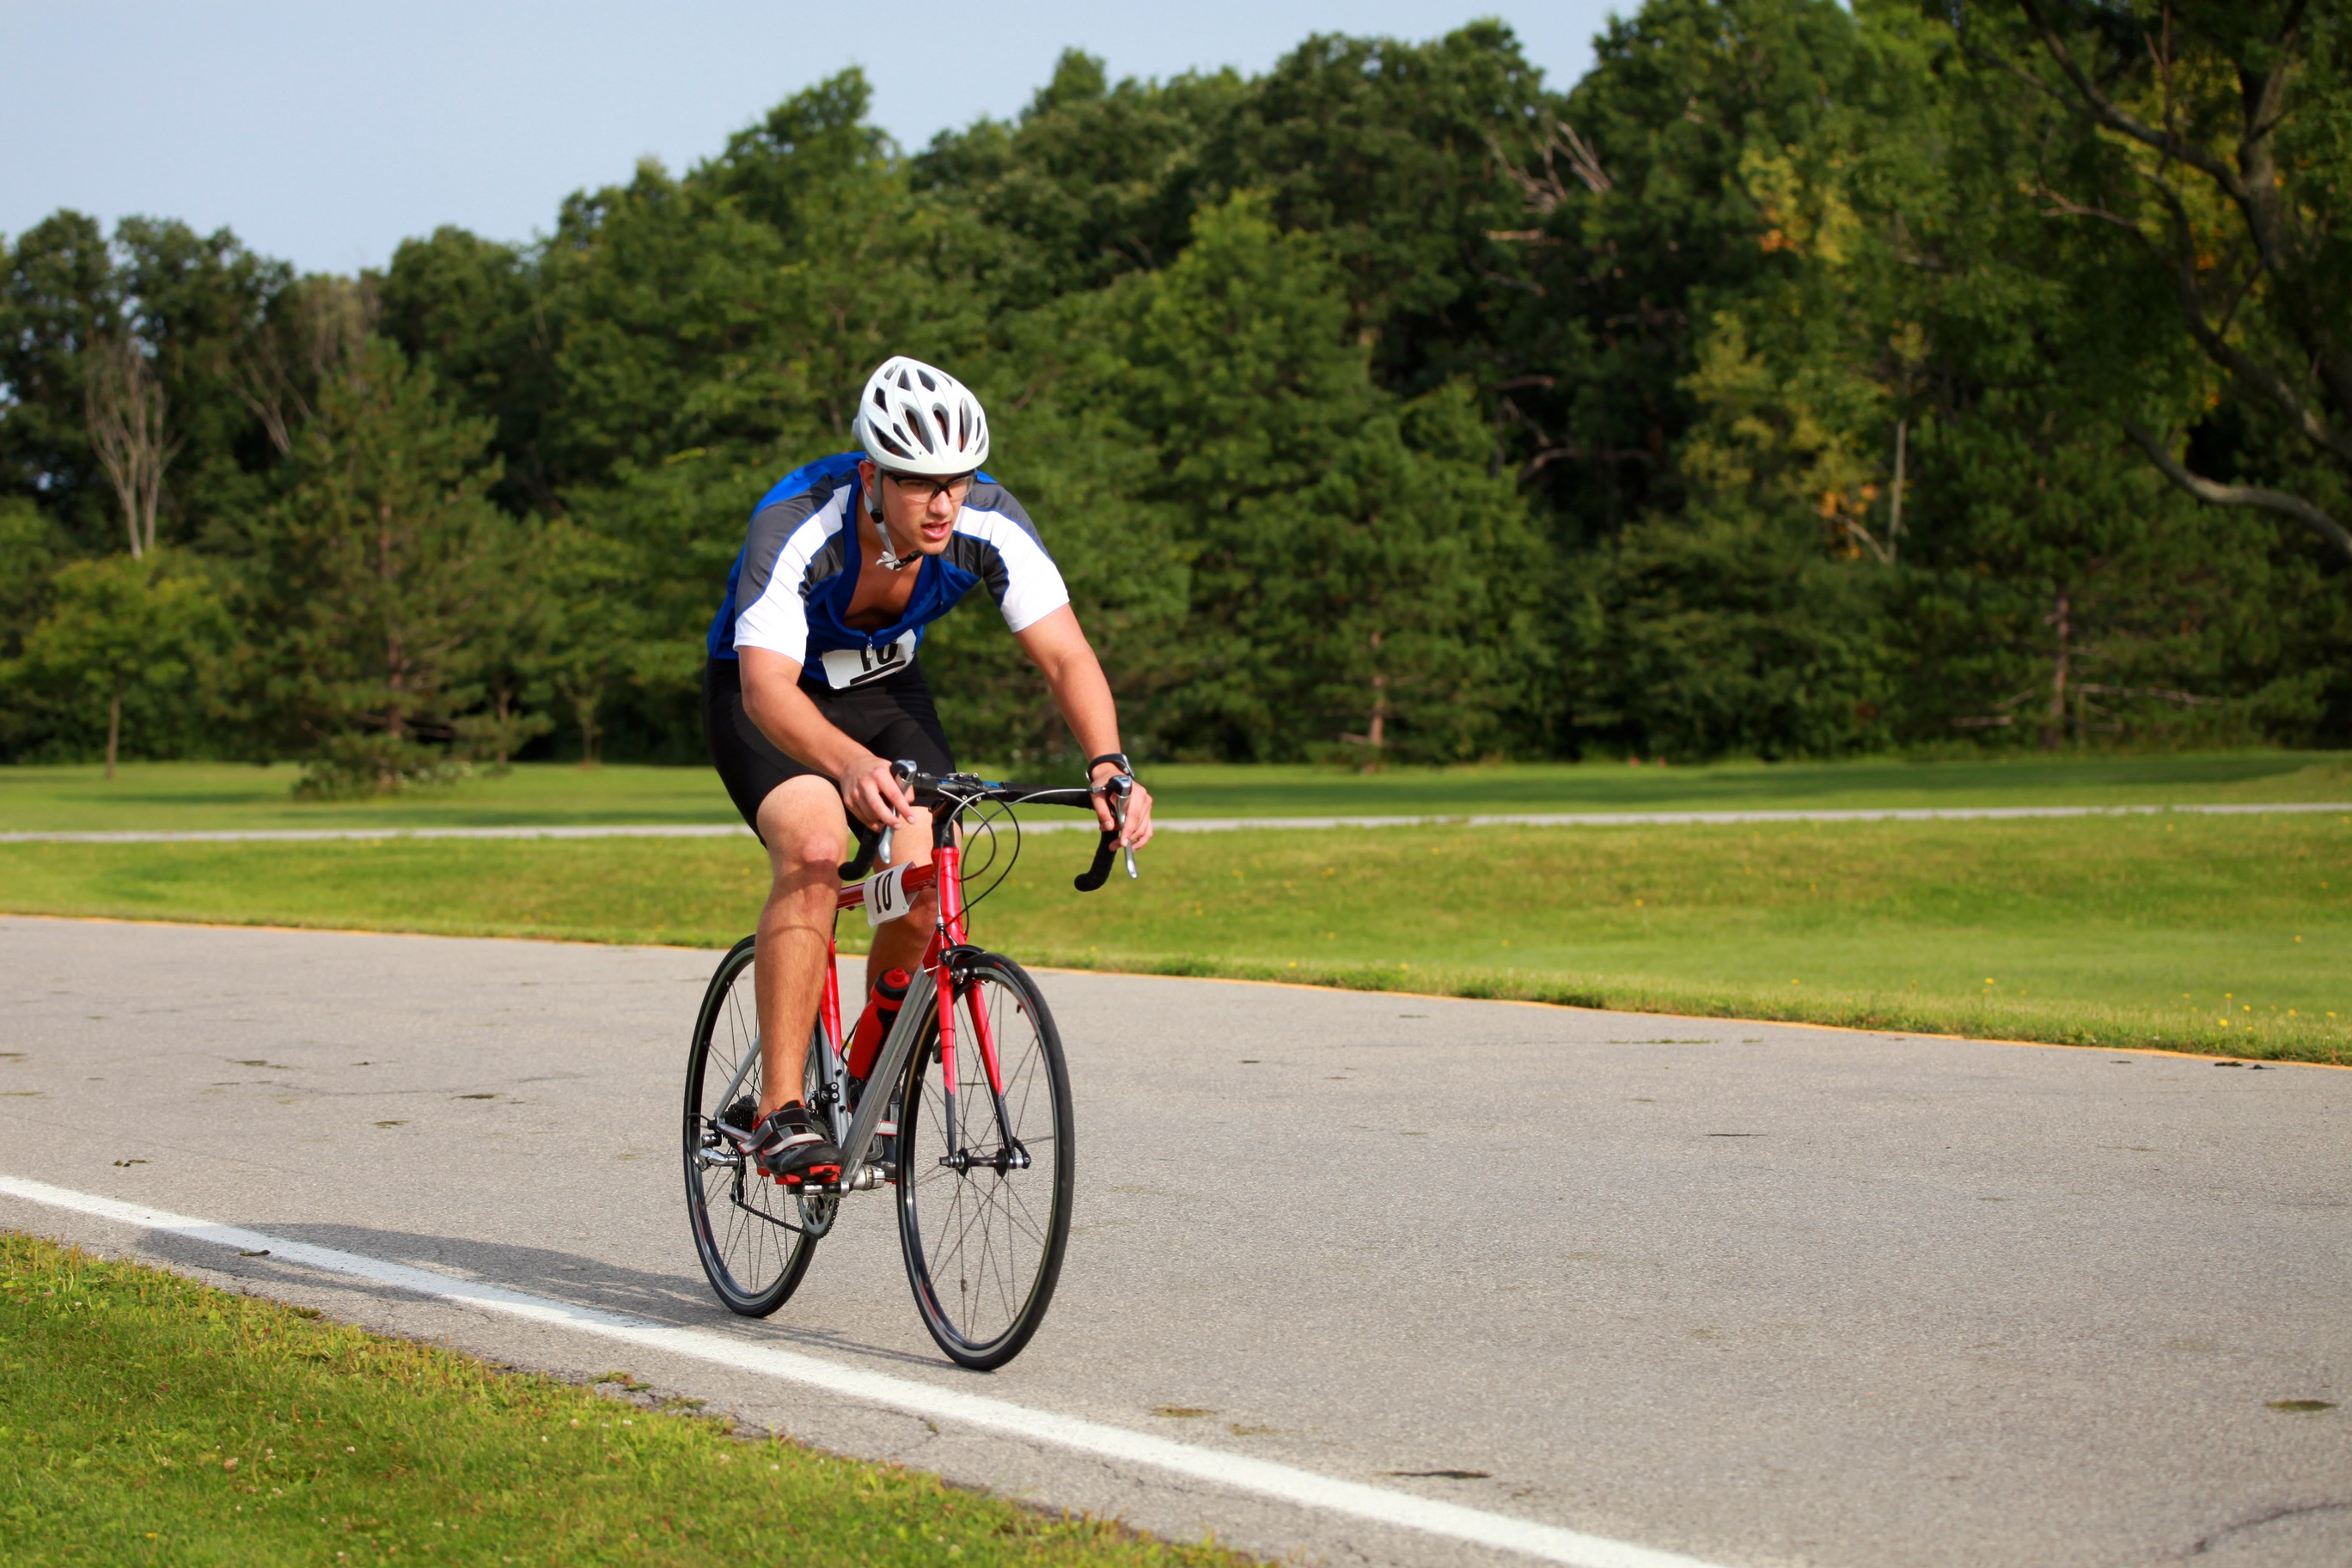
Aerobic respiration
Aerobic respiration is predominantly used for low to moderate intensity and long duration.
Few harmful waste products are produced during aerobic respiration.
Sports that rely on the aerobic system are long distance cycling,
running and swimming.

Slide 5
Anaerobic respiration
Anaerobic respiration is when we do not take enough oxygen in to meet high energy demands.
This might be when we are working at full intensity i.e. sprinting or throwing.
Glucose is broken down without oxygen.
As a result a waste product called lactic acid is produced which reduces performance.
Energy
Glucose
Lactic Acid
+

