Slide 1
The short- and
long-term effects of exercise
1.1.4 Applied anatomy and physiology

Slide 2
Vasodilate
Cardiac Output
Heart Rate
Respiratory Change
Temperature
The short- and long-term effects of exercise
DOMS
Hypertrophy
Bradycardia
Stroke Volume
Vasoconstrict

Slide 3

Heart rate
Heart Rate
When you start to exercise the
heart rate increases.
This coupled with an increased stroke volume increases the cardiac output resulting in an increased blood flow and better oxygen delivery.
The increase in heart rate depends on the intensity of the exercise. Intense exercise results in a large increase in the heart rate.

Slide 4
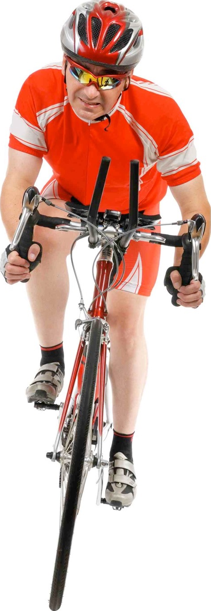
Respiratory changes
Respiratory Changes
  Breathing frequency increases.
  Depth of breathing increases,
  resulting in an increase in
  tidal volume.
  Minute ventilation = tidal volume x breathing frequency.
  Minute ventilation increases.

Slide 5
Vascular changes
Blood Shunted to Working Muscles
  To increase oxygen delivery to the muscles.
  The arteries widen (vasodilate) at the muscles to increase blood flow.
  The arteries narrow (vasoconstrict) to other organs that have lower energy demands i.e. stomach and intestines.
Vasodilation
Vasoconstriction

Slide 6
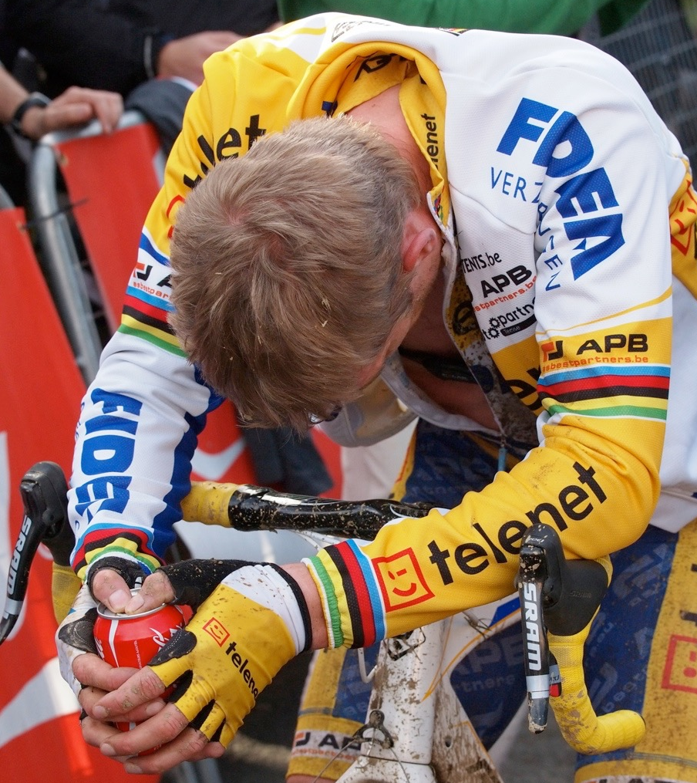
Other changes
During prolonged aerobic performance and
anaerobic respiration lactic acid is produced. This makes the muscles fatigue and you will feel tired.
Performers must eventually stop due to cramp.
Feel light headed.
Experience nausea.

Slide 7

Recovery
Cardiovascular and respiratory systems continue to work hard to repay the oxygen debt and remove lactic acid.
During the recovery phase
breathing rate and heart rate
remains elevated.
When the body has recovered
breathing rate and heart rate
return to resting levels.

Slide 8
The short-term effects of exercise on stroke volume (SV)
The average resting stroke volume
is 70 milliliters per heartbeat (ml/beat),
depending on the fitness of the individual.
Stroke volume peaks during sub maximal exercise.
As the intensity increases the stroke volume decreases slightly. This is due to an increased
heart rate causing the heart to only fill partially.
As the intensity of exercise
increases stroke volume
increases. The heart beats
with more force per contraction.
Exercise Intensity

Slide 9
The short-term effects of exercise on heart rate (HR)
An anticipatory rise in
heart rate occurs
before exercise.
Once the heart rate reaches its maximum,
it plateaus. Heart rate will also plateau
when the supply of oxygen meets the
demand shown in the sub maximal graph.
During recovery the heart rate
stays elevated and reduces
slowly.
When exercise begins the heart rate increases to supply oxygen to the working muscles.
Anaerobic
Aerobic
Average resting heart rate is 75bpm
depending on the fitness of the individual.
Prior
Exercise
Recovery

Slide 10
The short-term effects of exercise on cardiac output (Q)
Cardiac output also plateaus when
heart rate reaches it maximum or
supply of oxygen meets demand.
Resting cardiac output is
approximately 5 litres
per minute (l/min)
Following exercise cardiac output remains elevated and reduces slowly to remove lactic acid and repay oxygen debt.
Anaerobic
Cardiac output increases
due to the increase in
heart rate and stroke volume.
Aerobic
Cardiac output also experiences an anticipatory rise.
Prior
Exercise
Recovery

Slide 11

Long term effects of exercise
Resting heart rate decreases (bradycardia). 60 beats per minute in an adult is considered bradycardia.
Change in body shape and an increased lean body mass.
Improvements in specific components of
fitness such as muscular endurance,
cardiovascular endurance, speed, suppleness
(flexibility) and strength. These
improvements depend on the type of
exercise you perform.
Increase in stamina so you can exercise
for longer.
Muscles increase in size and strength
(hypertrophy).

