Slide 1
Lever Systems
1.2.1 Movement analysis

Slide 2
Plantar Flexion
Dorsi Flexion
Levers
Load
Fulcrum
Effort
Lever Systems
Adduction
Flexion
Abduction
Extension
Rotation

Slide 3
Levers
Muscles and bones work together as a series of levers to create movement.
A lever is a rigid bar that comprises three components:
  Fulcrum (the point at which the lever rotates)
  Load (the resistance applied to the lever system)
  Effort (the effort/muscle needed to move the lever system)
The classification of lever depends on the order in which these three components are in relation to each other.

Slide 4

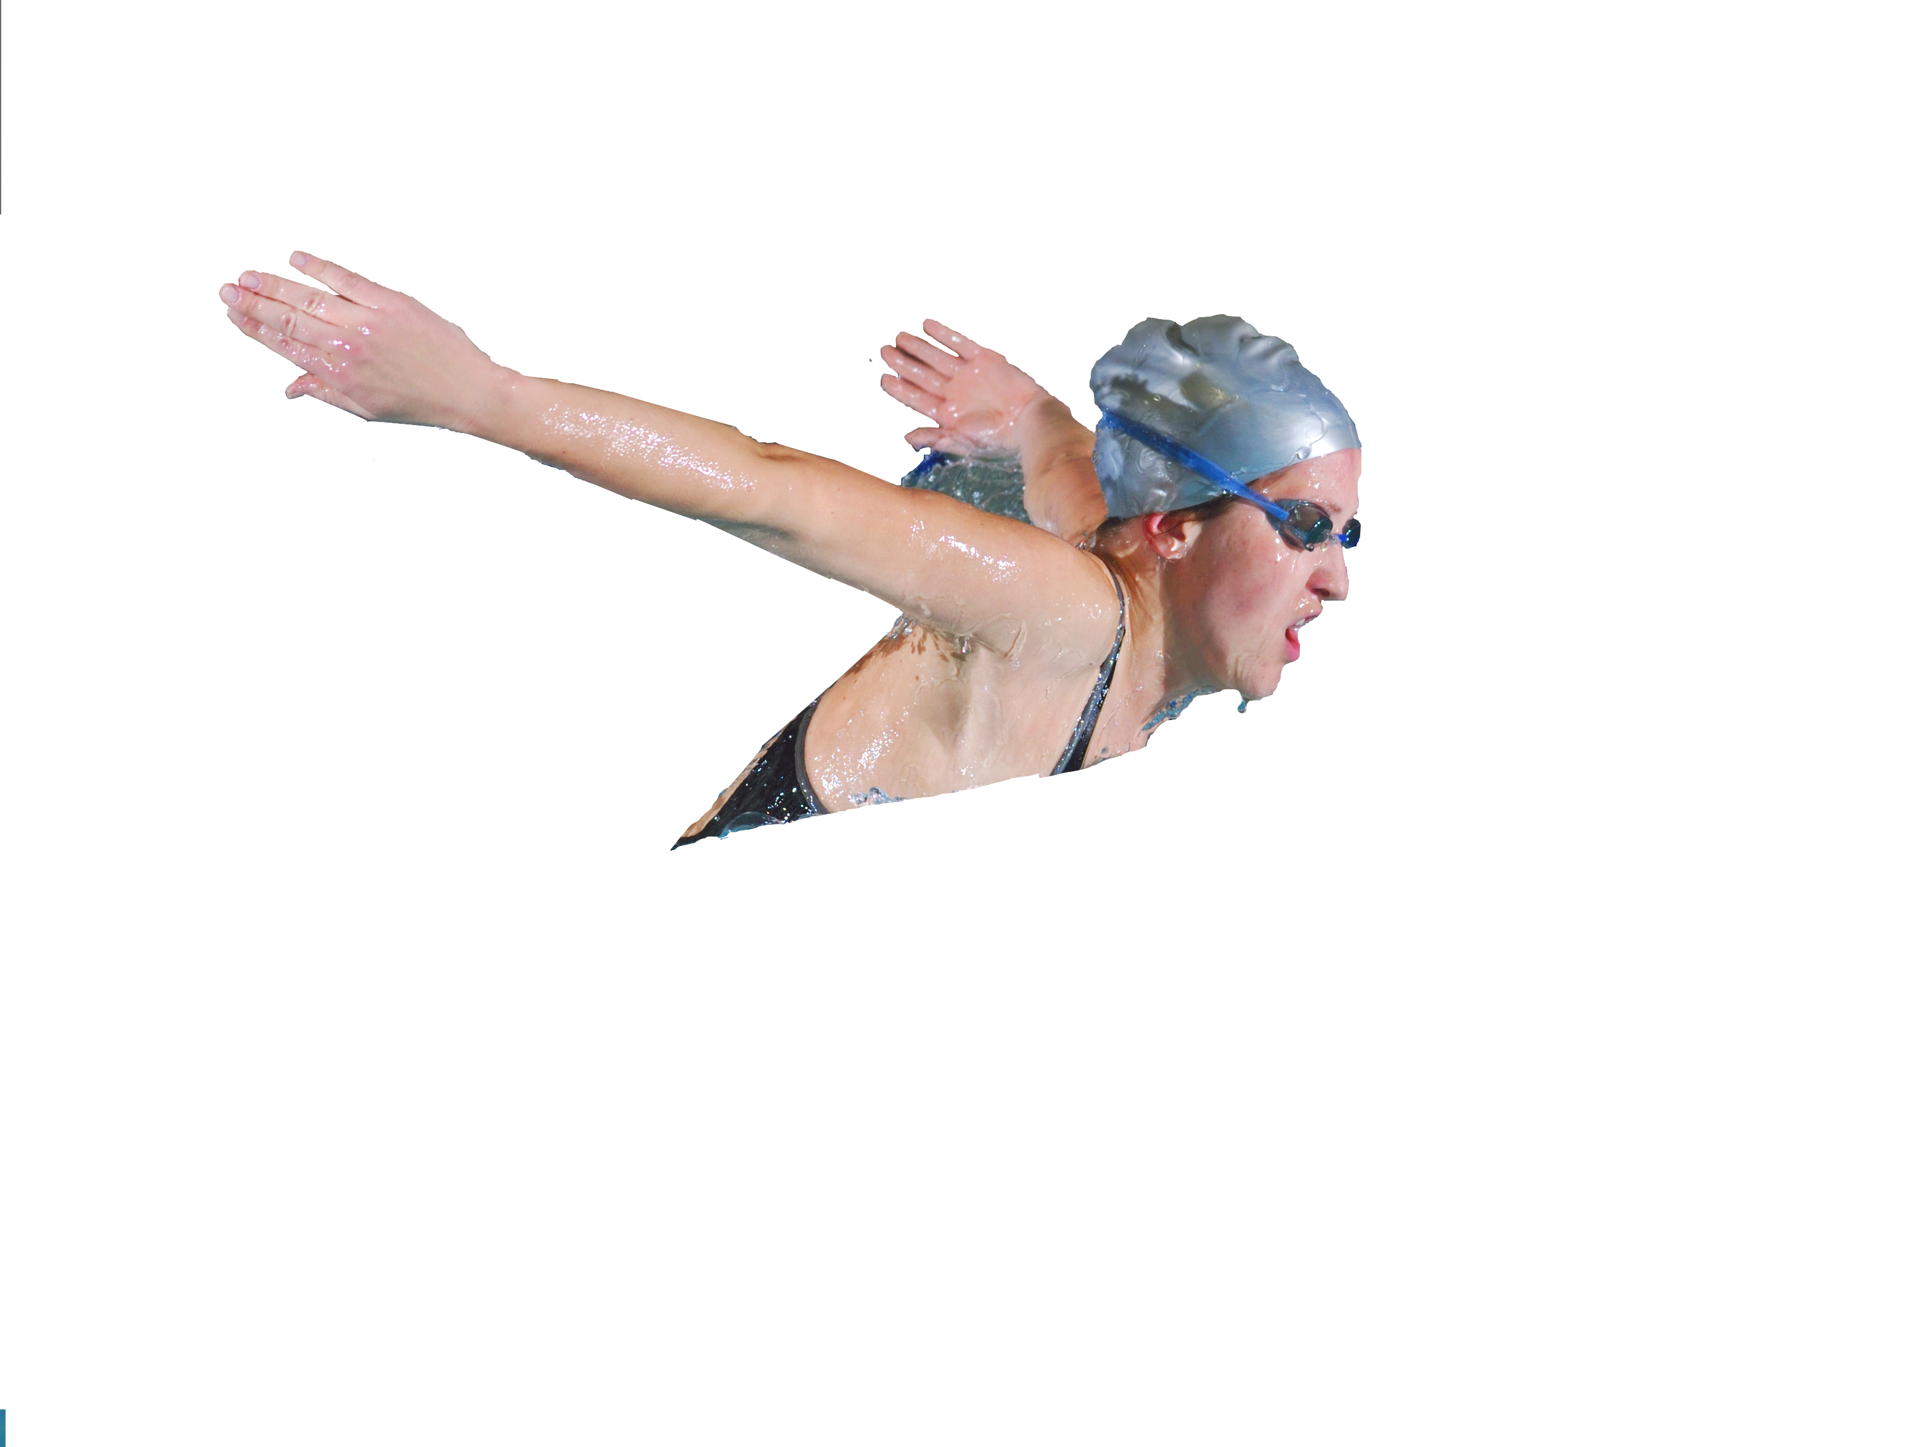
First class levers
First class levers are organised in a see saw order to move the load.
Effort
Movement
Load
Fulcrum
Examples of first class levers:
  nodding the head i.e breathing in
  Swimming or heading in Football.

Slide 5
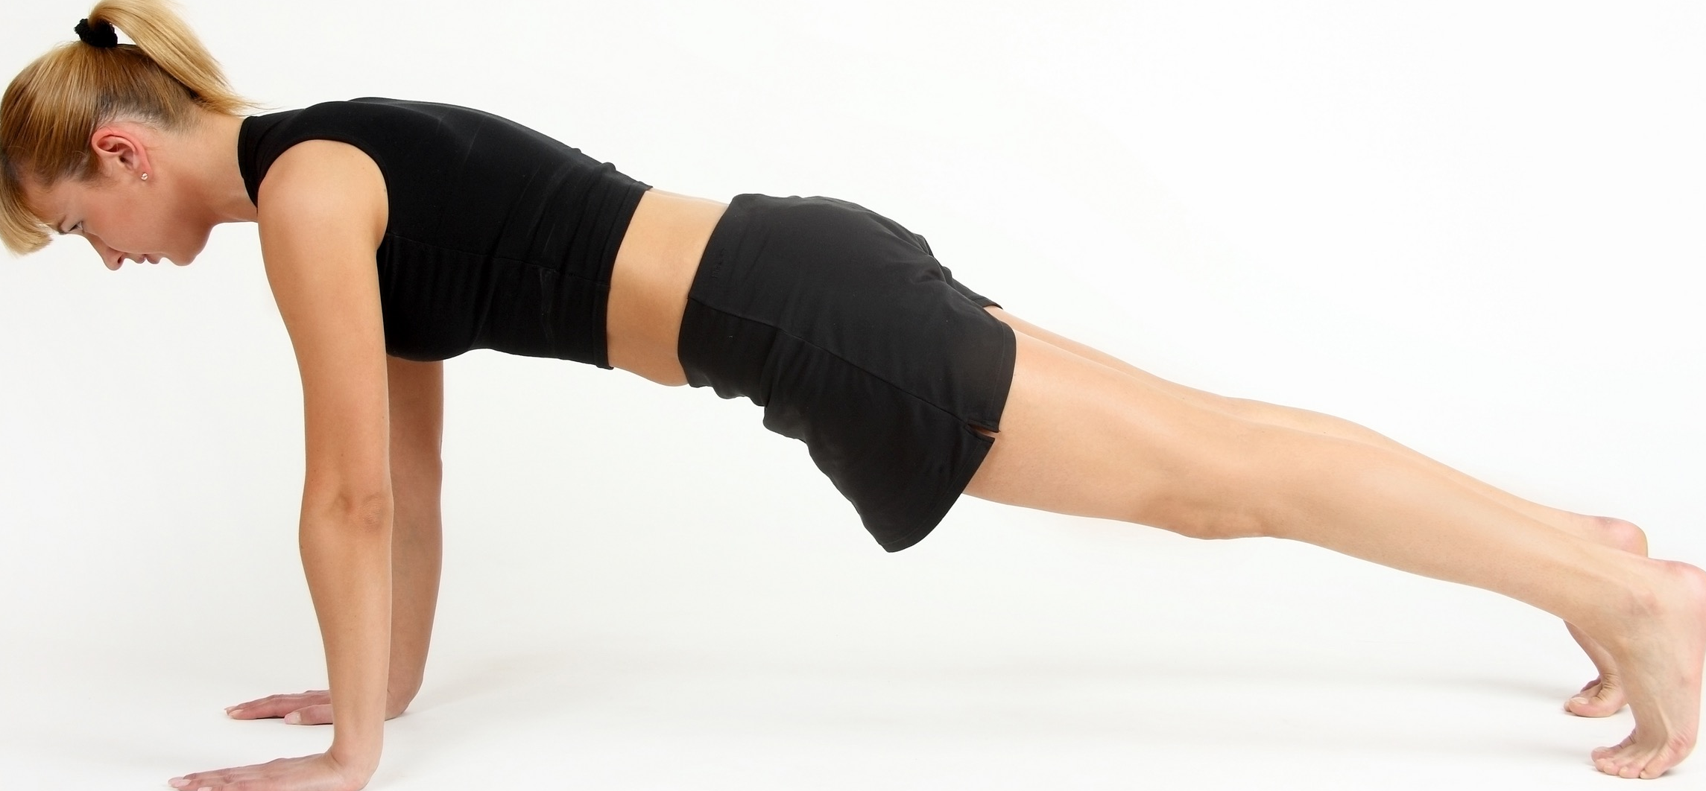
Second class levers
Second class levers are organised in a wheelbarrow order to move the load.
Effort
Movement
Load
Fulcrum
Examples of second class levers:
  press up

Slide 6
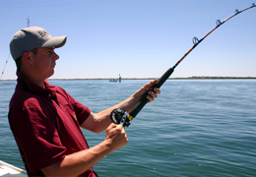
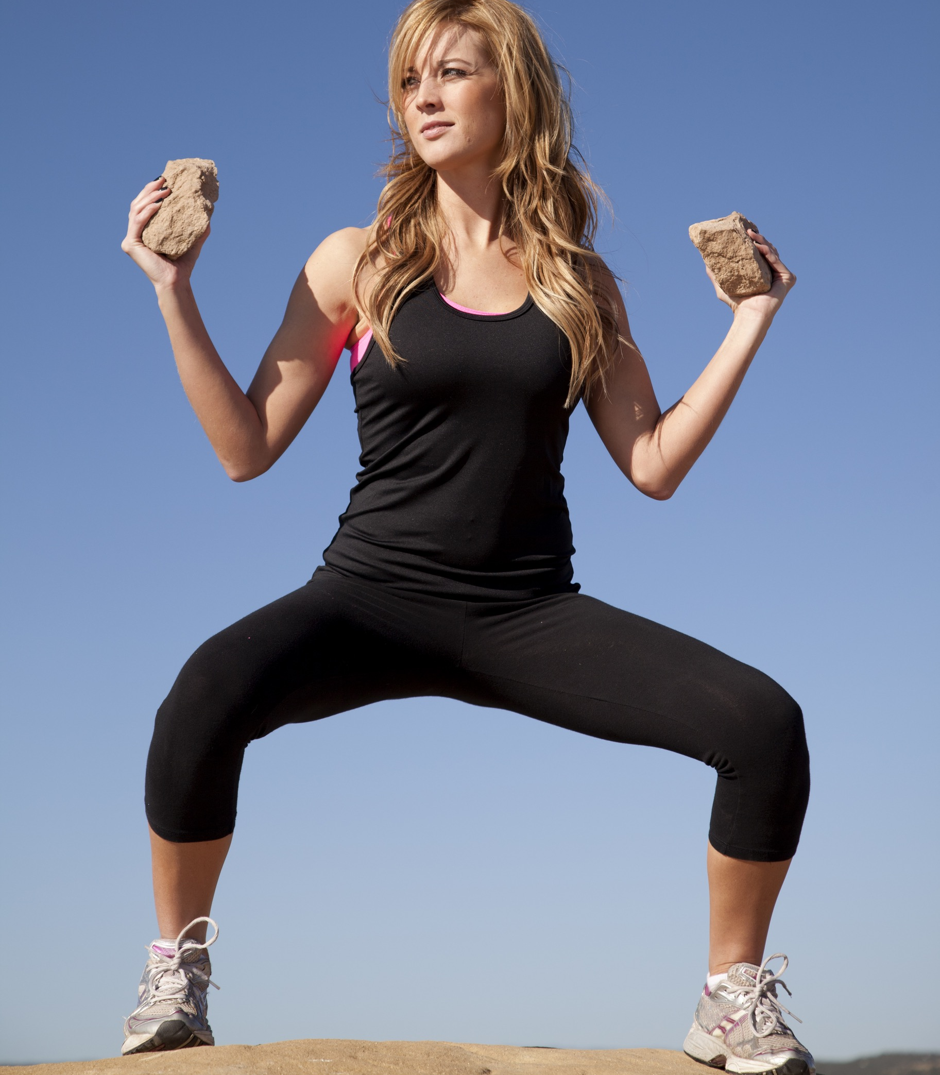
Third class levers
Third class levers are organised in a fishing rod order to move the load.
Effort
Load
Movement
Fulcrum
Examples of third class levers:
  bicep curl (effort is where the muscle
  attaches to the lever)

Slide 7
Mechanical advantage
Mechanical advantage
When a lever’s effort arm is longer than its load arm then it is said to have high mechanical advantage.
When a lever’s effort arm is shorter than the load arm it is said to have low mechanical advantage.
Mechanical advantage = effort arm
load arm

Slide 8
Mechanical advantage
First class levers
Second class levers
High
High or Low
Load arm
Load arm
Effort arm
Effort arm
Third class levers
Low
Load arm
Effort arm

Slide 9
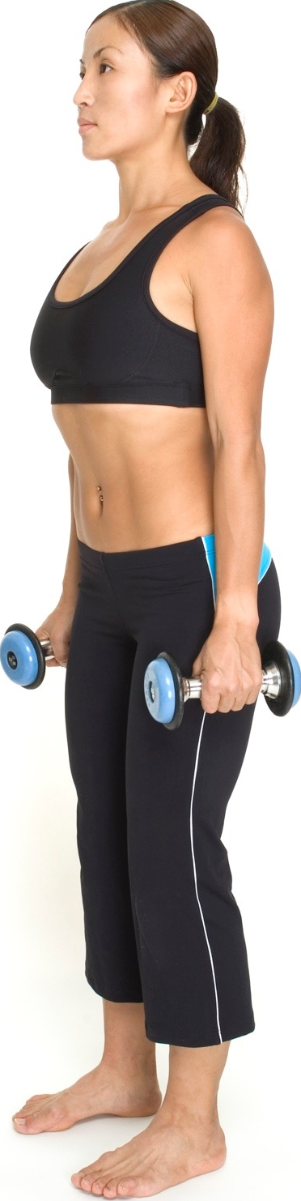
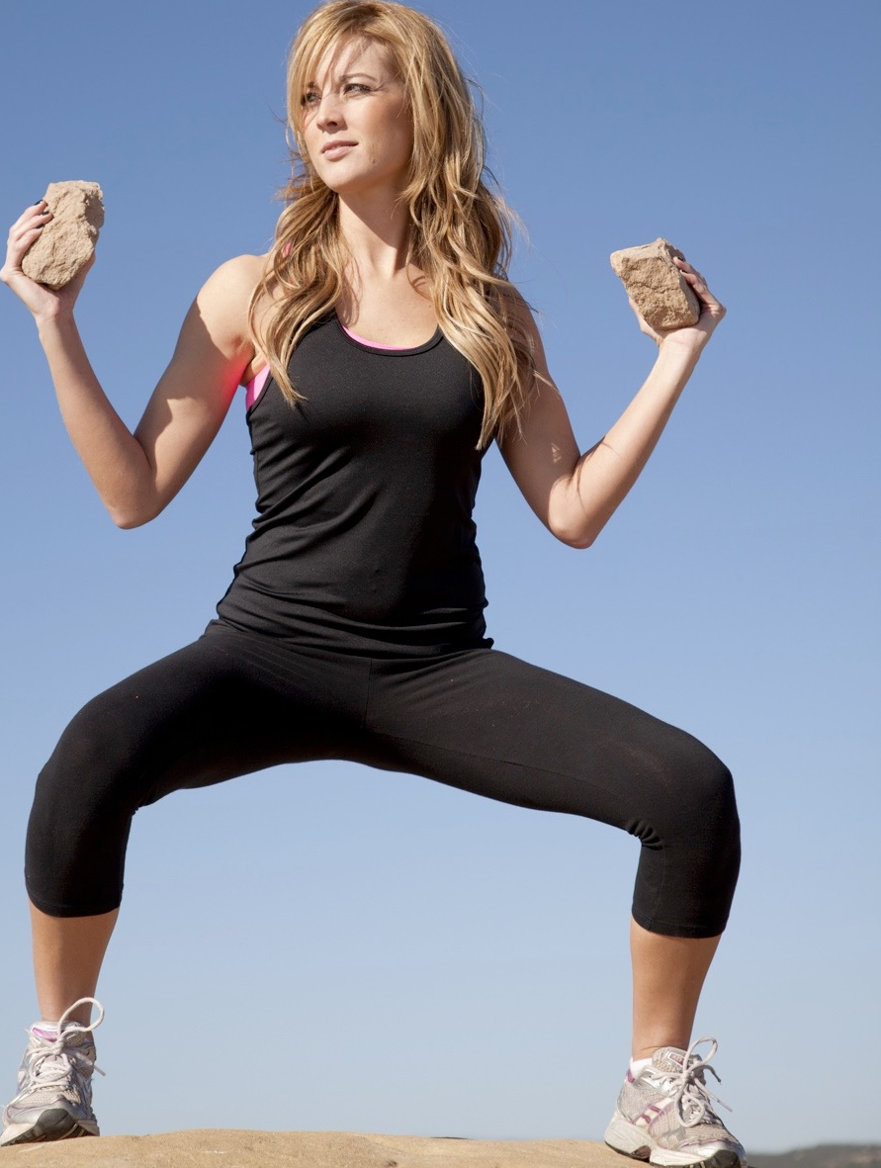
Range of movement
Flexion
Decrease the angle at the joint
Extension
Increase the angle at the joint
Shoulder
and Elbow
Shoulder
and Elbow
Hip
and Knee
Knee
and Hip

Slide 10

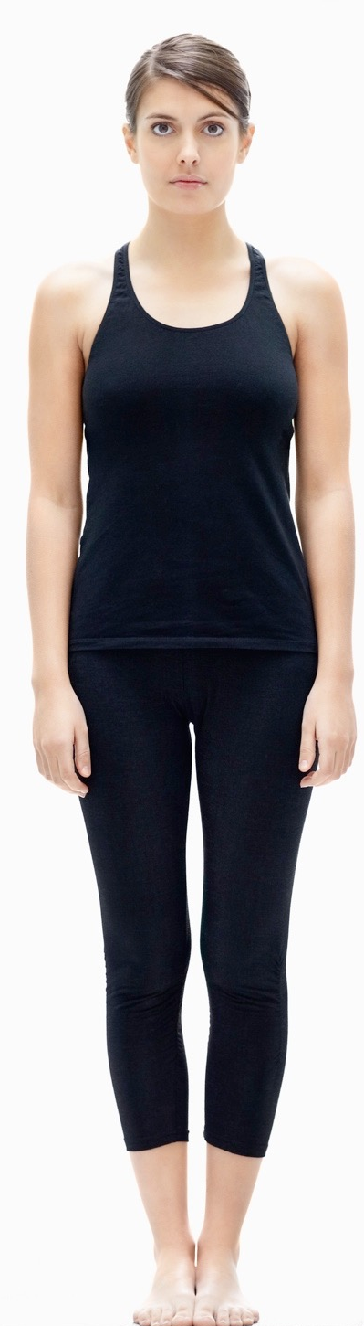
Range of movement
Abduction
Move the limb away
from the central axis
Adduction
Move the limb towards
the central axis
Hip and
Shoulder
Hip and
Shoulder

Slide 11
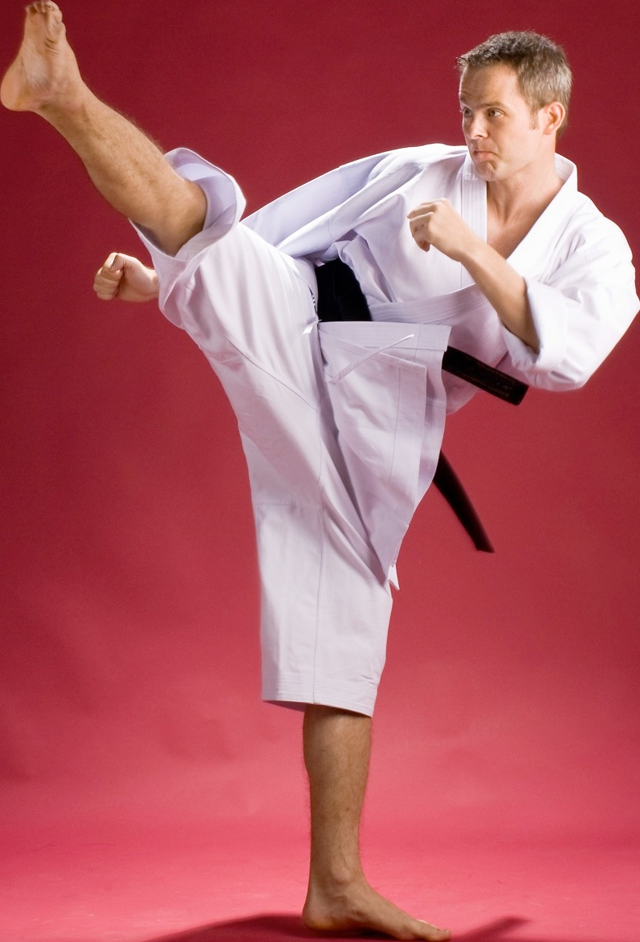


Range of movement
Rotation
Movement around an
axis/rotational movement
Hip
Neck
Shoulder
Hip

Slide 12
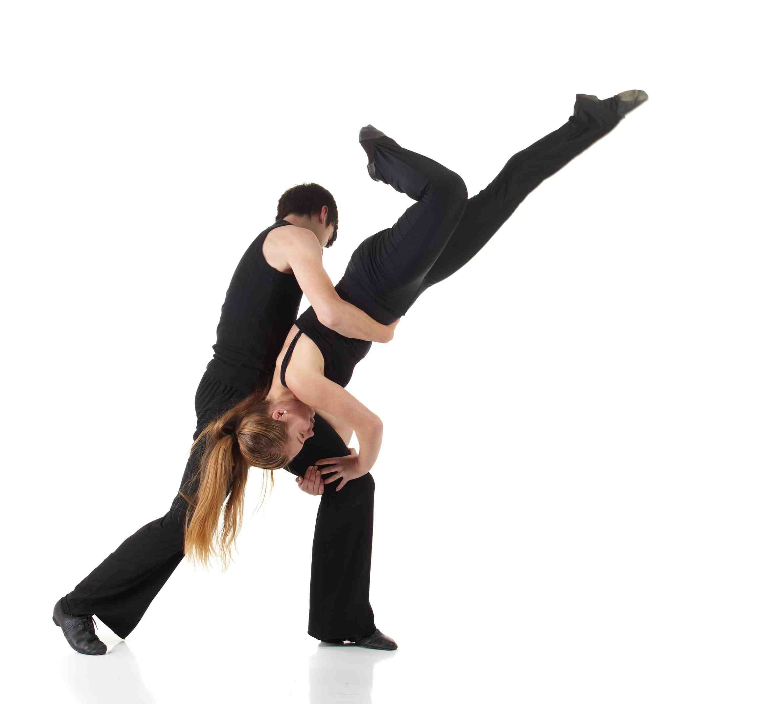
Range of movement
Plantar flexion
Movement at the ankle joint
that points the toes
Dorsiflexion
Movement at the ankle joint
that flexes the foot upwards

Slide 13
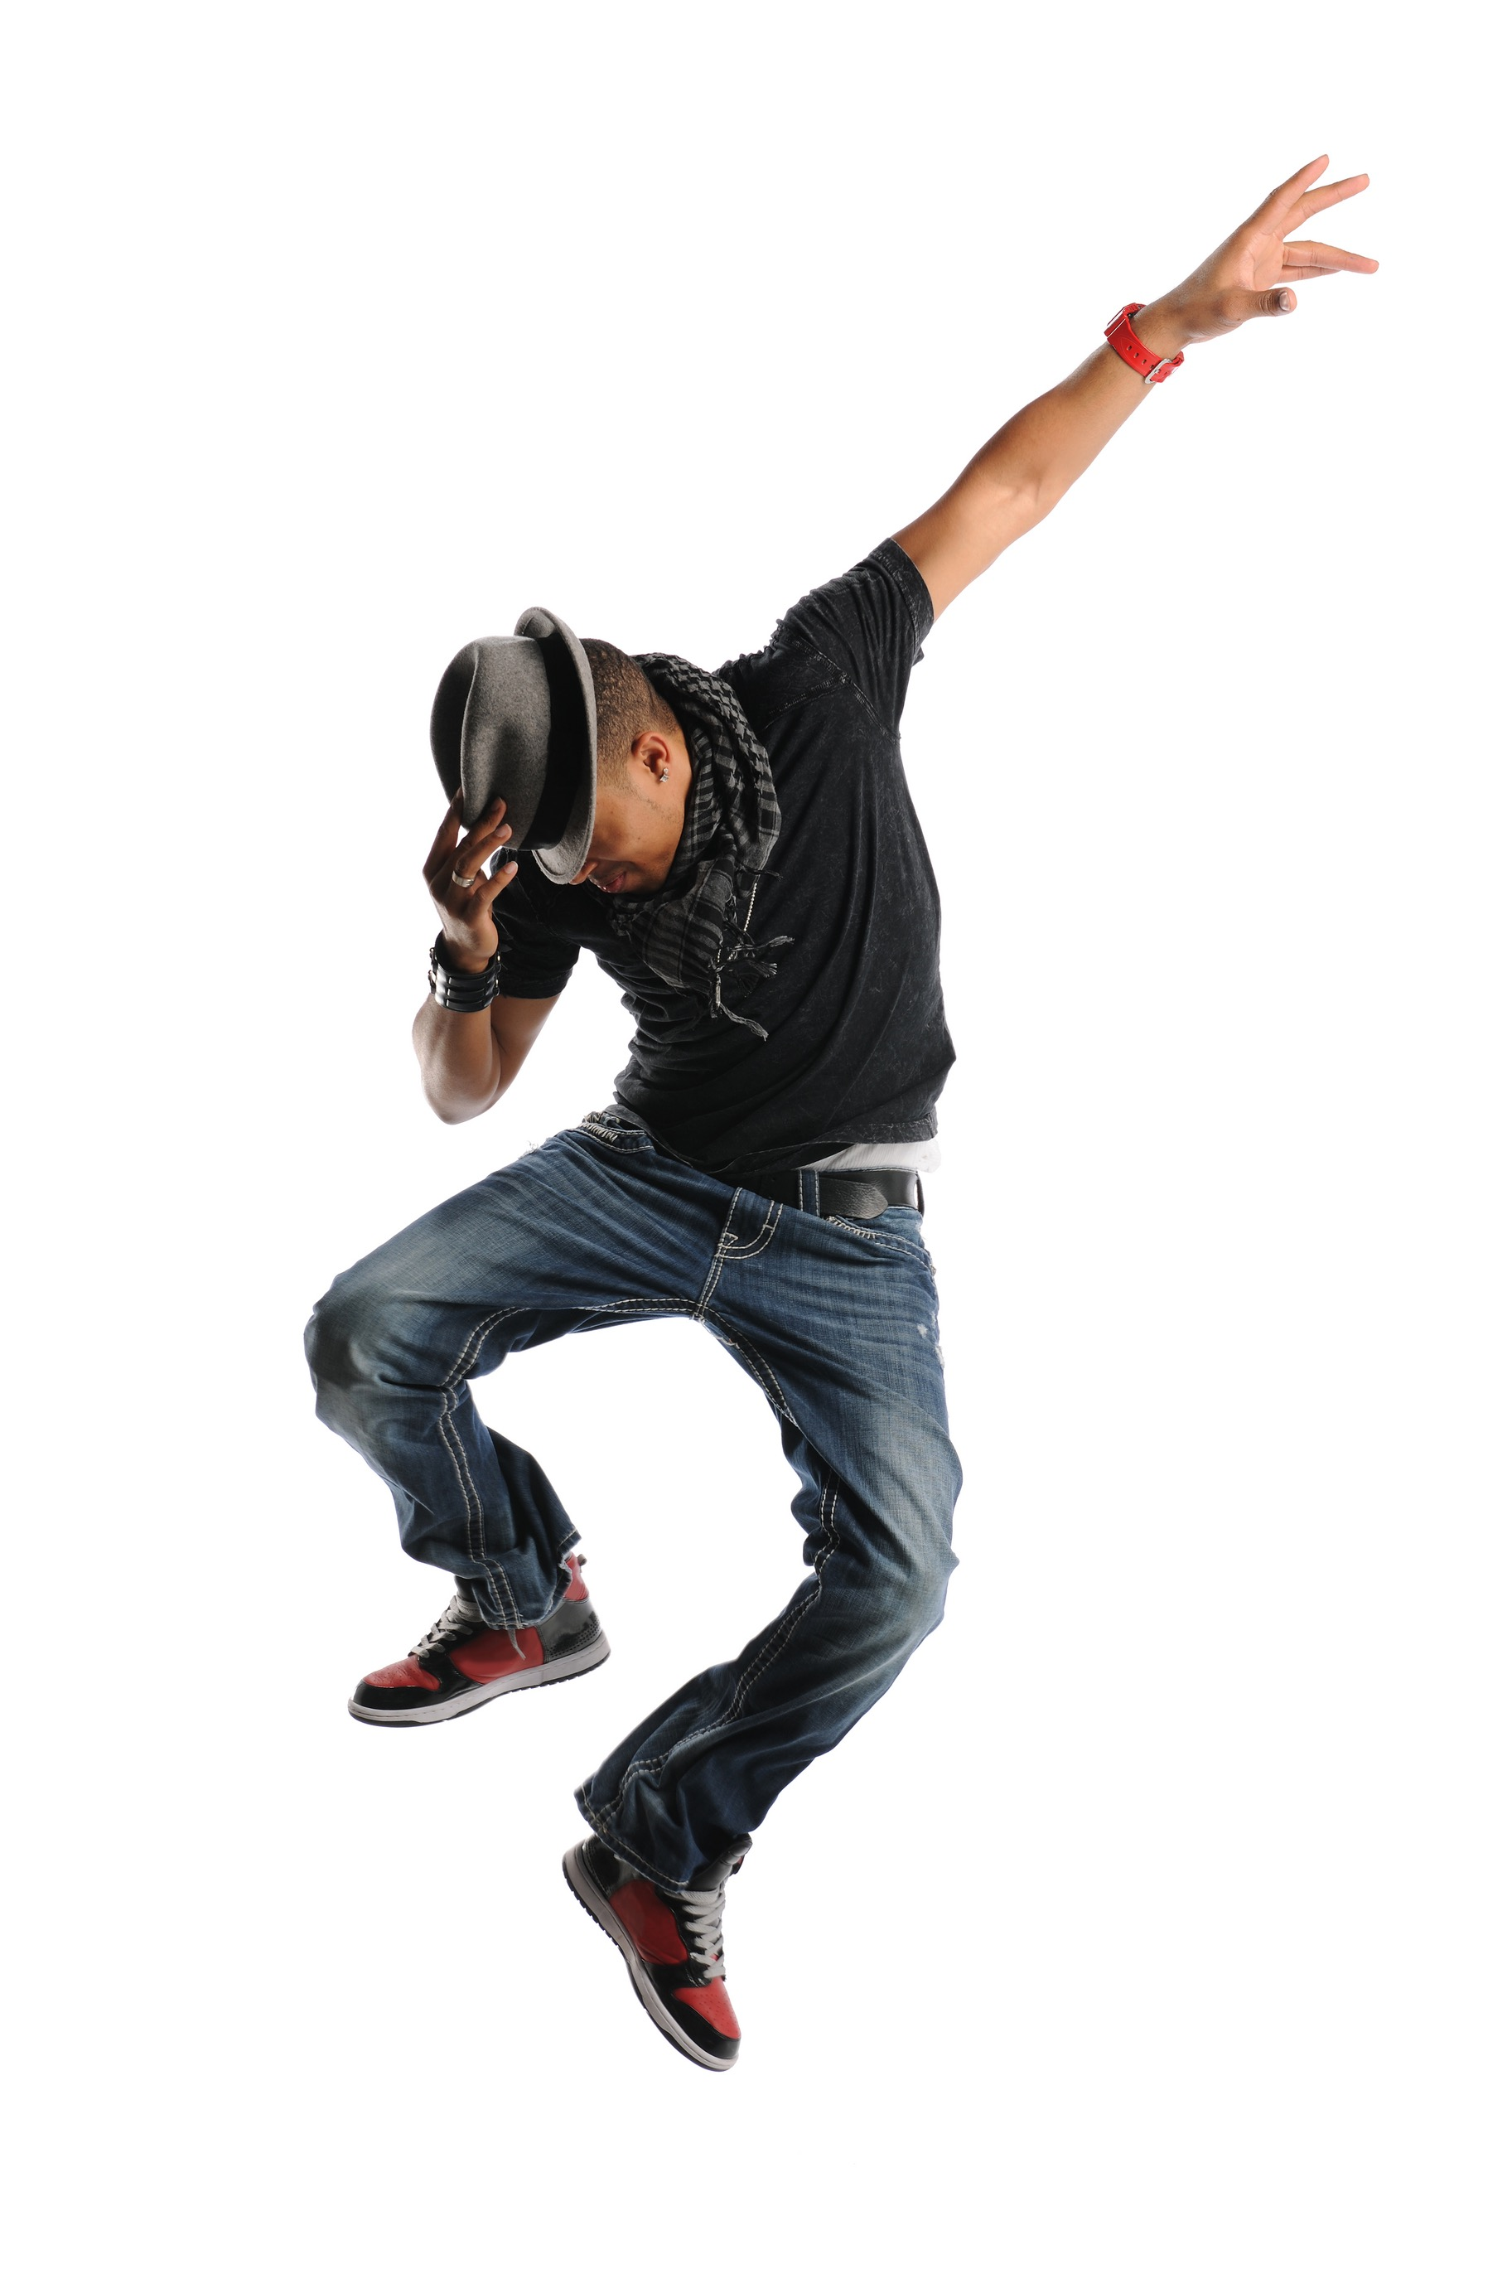
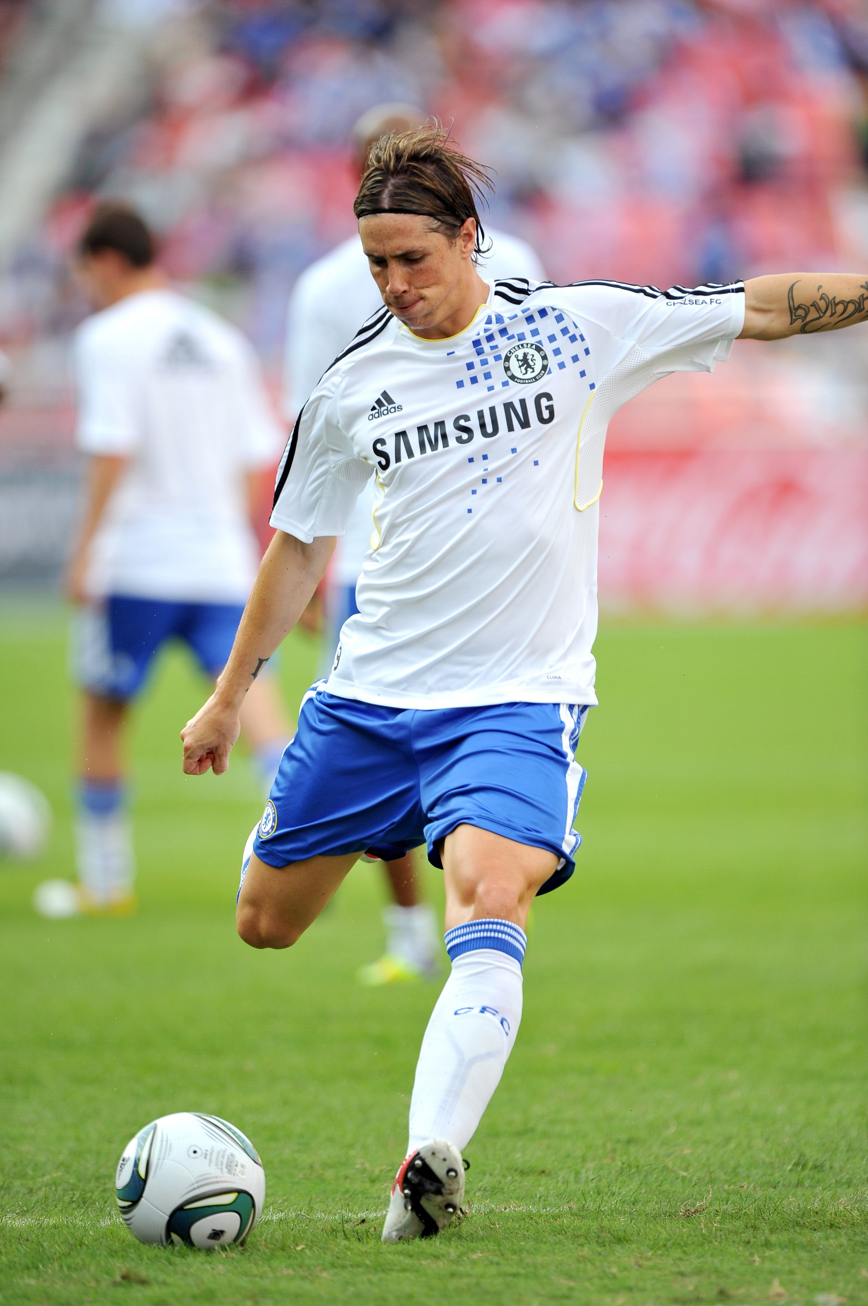
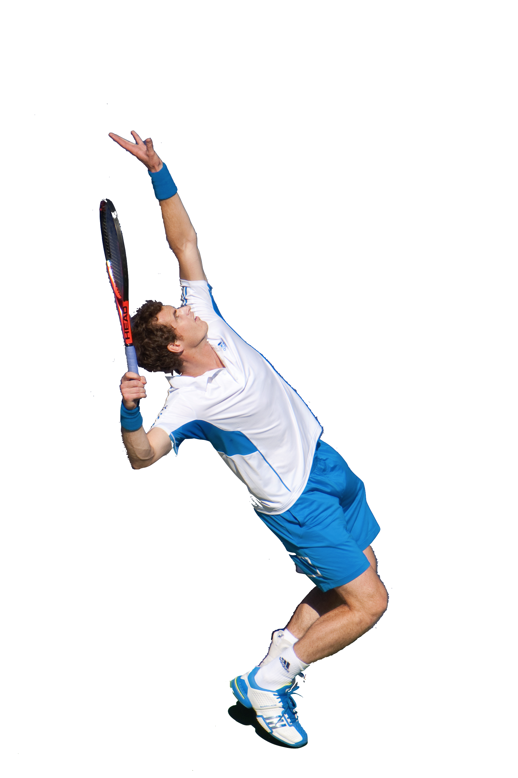
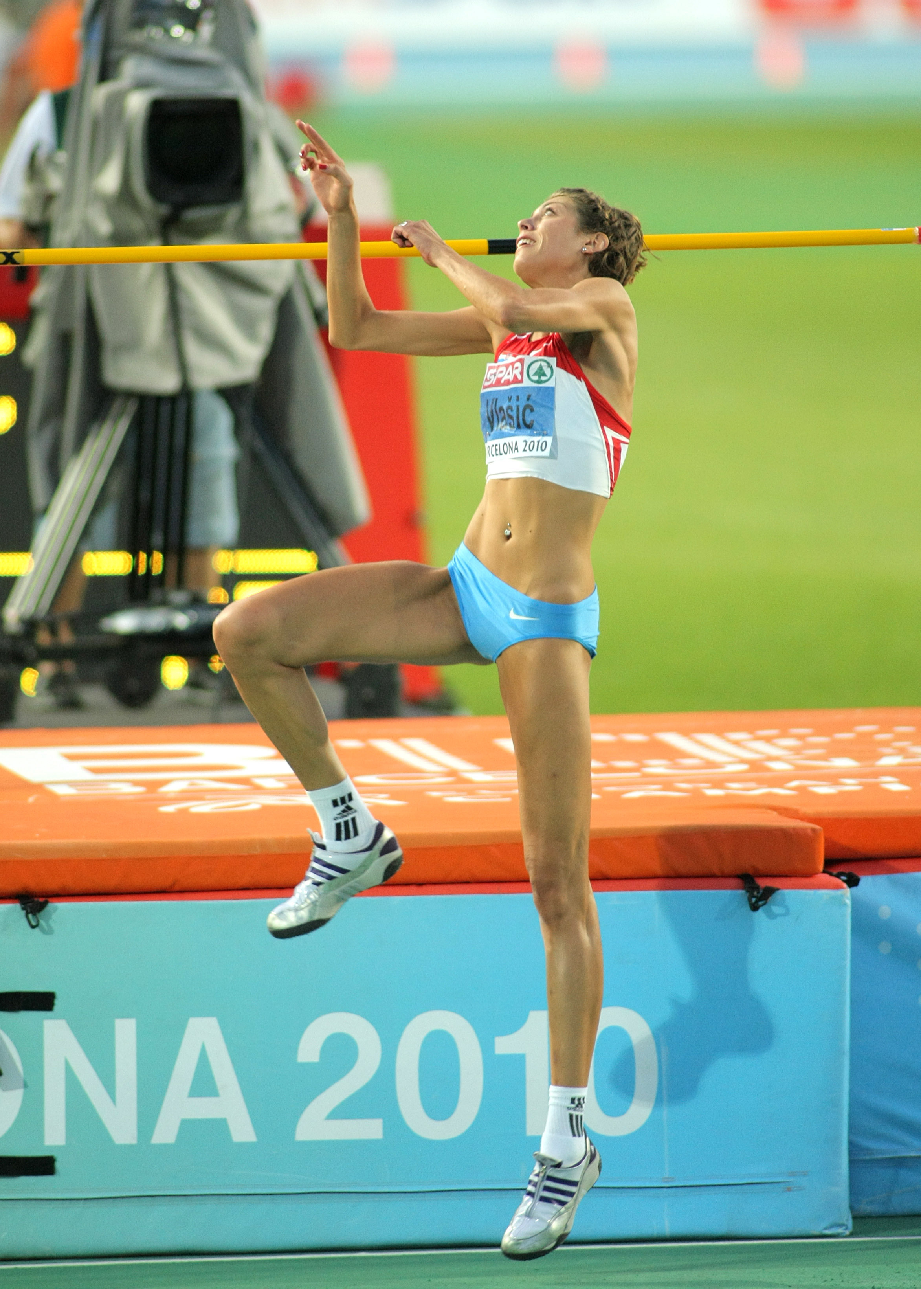
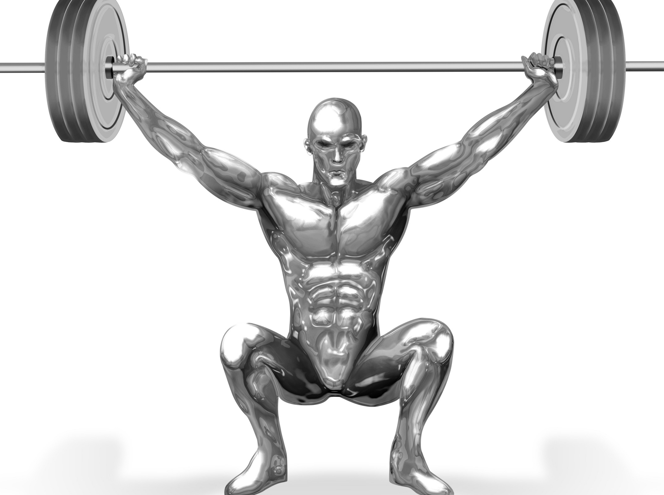
Sporting examples
Jumping involves plantar flexion at the ankle
Dancing involves adduction and abduction at the shoulder and hip
Kicking involves flexion and extension at the knee
Tennis serve involves rotation at the shoulder
Weight lifting involves dorsiflexion at the ankle

