Slide 1
Planes and axes of movement
1.2.2 Movement analysis

Slide 2
Frontal Plane
Sagittal Axis
Transverse Plane
Longitudinal axis
Planes and axes of movement
Sagittal Plane
Transversal axis

Slide 3
Planes and axes
A plane is where the body is divided into two parts.
Movement occurs in a plane.
An axis is an imaginary straight line that passes through the body.
The three planes and associated axes are:
  Frontal plane and sagittal axis.
  Transverse plane and longitudinal axis.
  Sagittal plane and transverse axis.

Slide 4
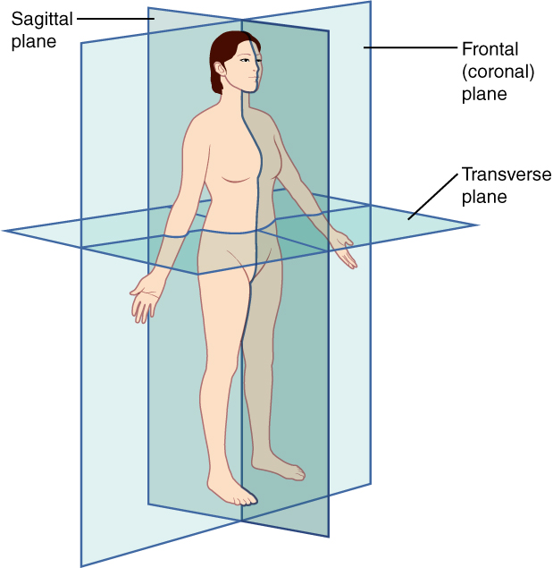

Frontal plane -Sagittal axis
Frontal Plane
Cartwheel
Sagittal Axis

Slide 5


Transverse plane-Longitudinal axis
Longitudinal Axis
Discus spin
Transverse Plane
360º
Spin

Slide 6
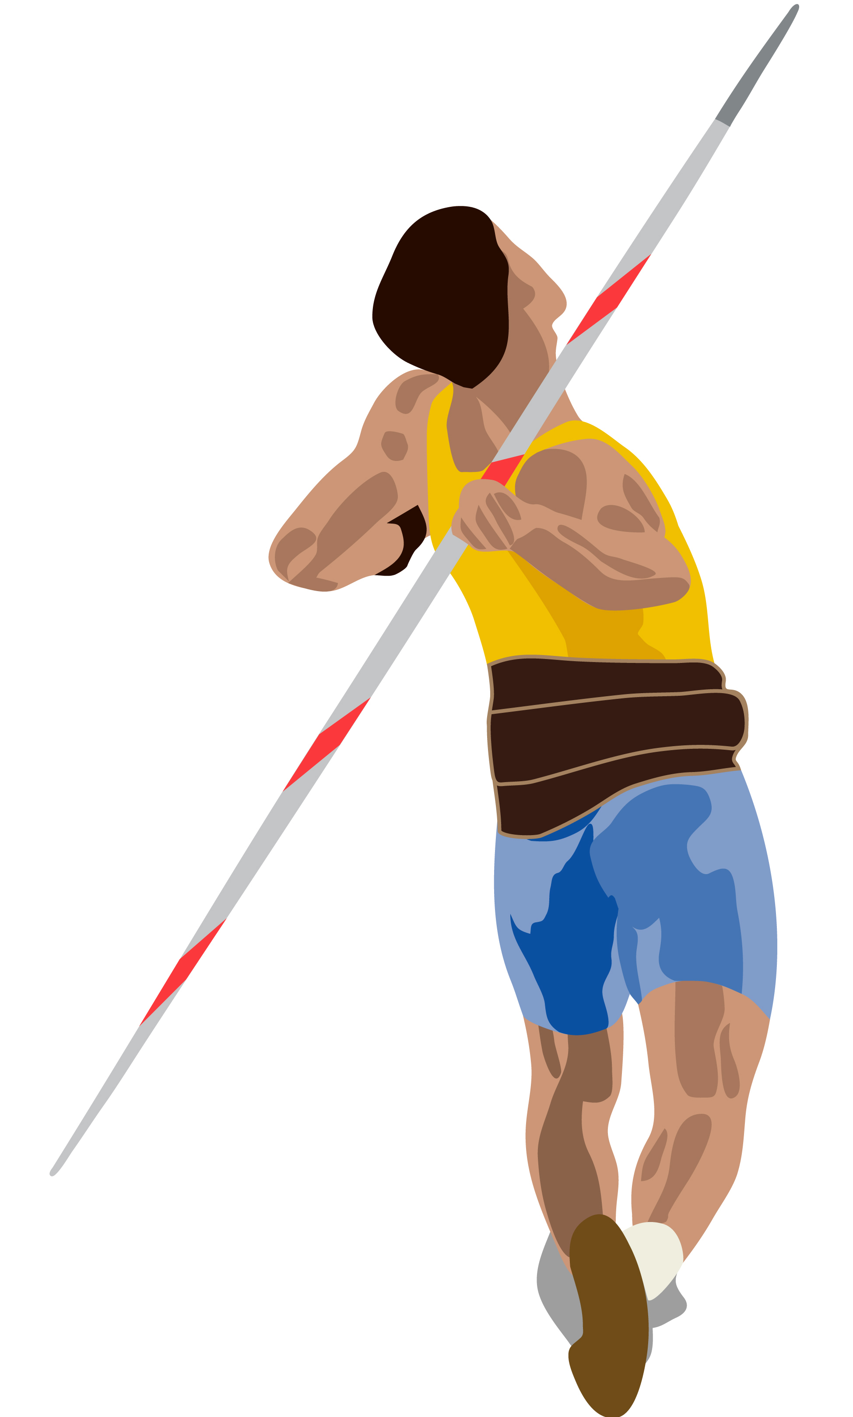


Sagittal plane-Transverse axis
Sagittal Plane
Throw
Running
Transverse Axis
Somersault

