Slide 1
The relationship between health and fitness
1.3.1 Physical training

Slide 2
Well-being
Physical
Mental
The relationship between health and fitness
Social
Health
Fitness
Performance

Slide 3

Health
“Health is a state of complete physical, mental and social well-being”
—World Health Organisation (WHO)
There are four components of
health and well-being:
  Physical health.
  Emotional health.
  Social health.
  Health and Fitness.

Slide 4
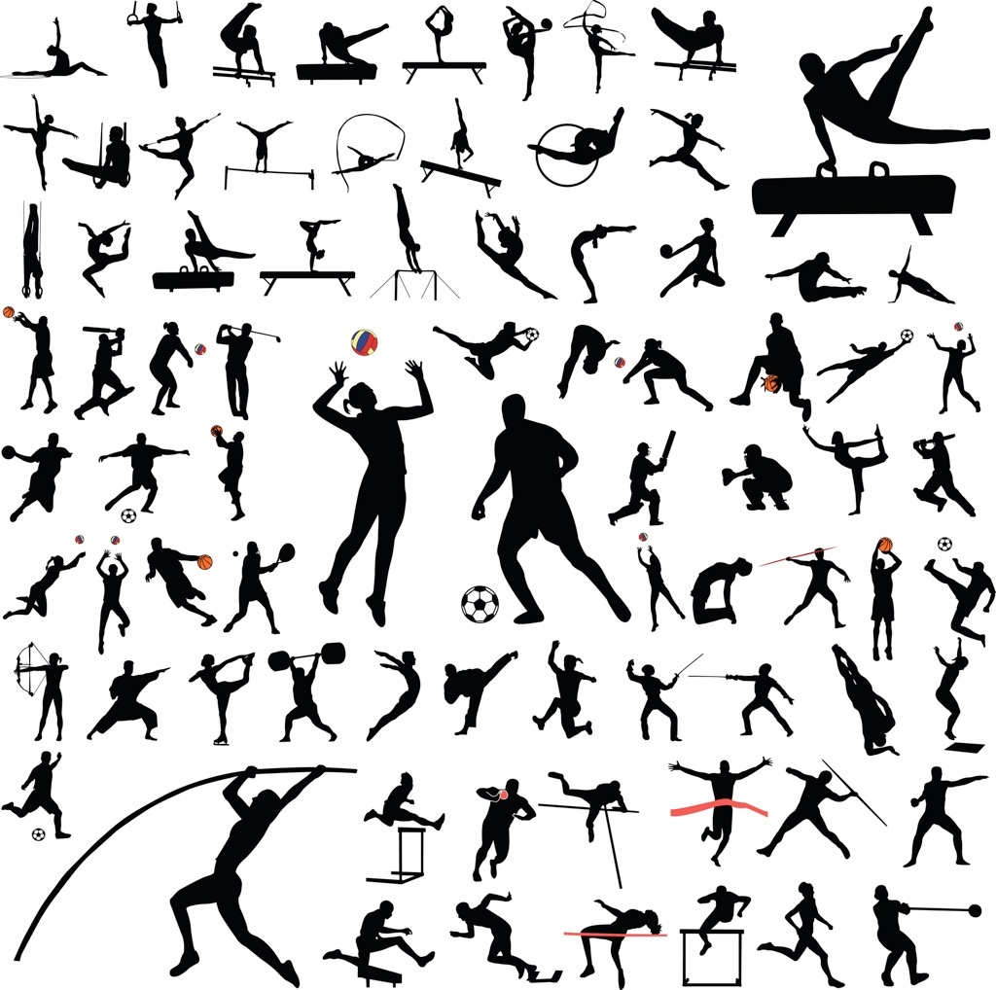
Fitness
“Fitness is the ability to meet the demands of the environment.”
Everything that you experience and surrounds you is your environment. Home, school, commuting, sports, hobbies, meeting friends, shopping and housework.

Slide 5

Relationship between health and fitness
To be healthy, we must be fit and to be fit we must exercise.
However, that is not the complete picture, for example:
  Fitness only focuses on your physical ability and you may be unhealthy in other aspects of your life i.e. illness or pain.
  Mental health is also important to your health. Exercise and performance can be stressful and impact on your health.
  Social health also contributes to our
  health and if you exercise on your own
  then this aspect does not develop.
  Fitness decreases if we are unhealthy and unable
  to exercise.

Slide 6
Exercise and performance
Exercise is any activity that involves physical movement.
Exercise improves fitness, and health.
The fitter you become the more able you are to perform.

