Slide 1
The principles of training
1.3.3 Physical training

Slide 2
Karvonen Formula
Training Methods
Training programme
Progression
Specificity
The principles of training
FITT
Overload
Training Zones
Reversibility

Slide 3

Training programme
When people decide to get fit the best
method is to create a training programme
that meets the needs of the individual
and their goals.
  A training programme should be
  designed using the SPOR Training principles.
  A person should use a variety of training methods to achieve their exercise goals.
We will look at these principles of training and training methods in more detail.

Slide 4
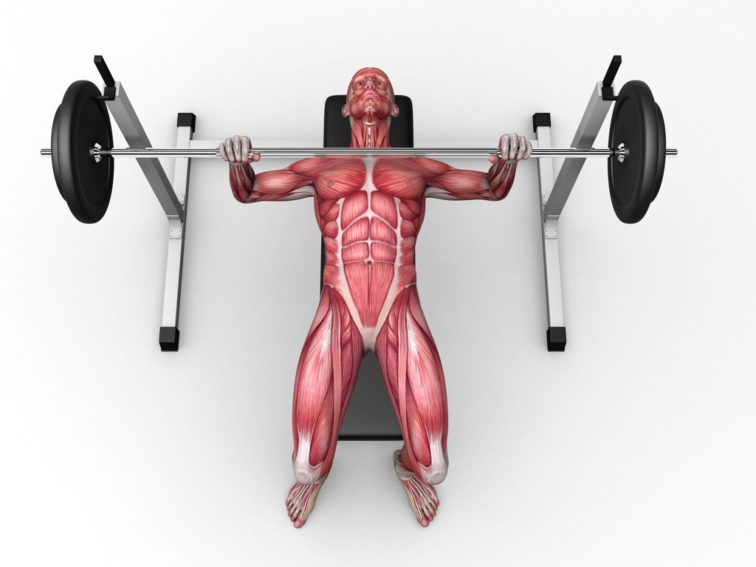
SPOR Principles of Training
The four SPOR training principles help an athlete design their fitness programme.
Specificity
  An athlete needs to identify the muscles
  they need to train as well as the energy
  system (aerobic or anaerobic) and fitness components.
  You should also ensure that you
  are rehearsing the specific skills
  for your sport in training.

Slide 5

SPOR Principles of Training
Progressive overload
  The aim of all training programmes is to
  progress your fitness.
  Progression needs to be gradual as too
  much too soon can cause injury.
  There is a danger of plateauing
  in training and staying at the
  same level. Motivation and
  determination is then required
  to push on and progress further.

Slide 6
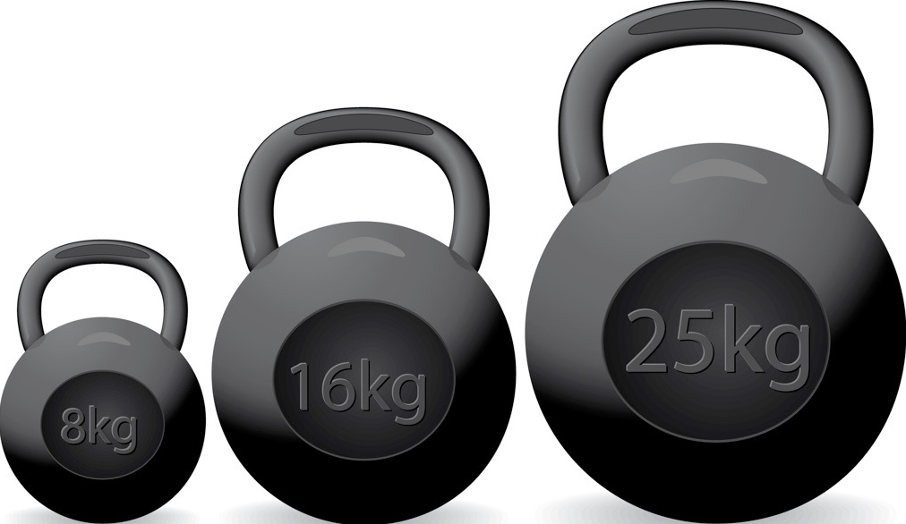
SPOR Principles of Training
Overload
To ensure that the athlete makes progress we must gradually make the training programme more difficult.
We can do this using the FITT principles;
  Frequency - Increase the number of
  sessions you do (how often).
  Intensity - Increase the resistance or
  speed you are working at (how hard).
  Time - Increase the amount of time
  you train per session (how long/duration).
  Type - To ensure overload you should take part in different types of training, i.e. interval, continuous, running, swimming.

Slide 7

SPOR Principles of Training
Reversibility
If you stop training then you can quickly lose fitness.
Your muscles may shrink, this is called atrophy.
This can sometimes happen when you have a long-term injury.
If you stop, it can take up to three times as long to gain that fitness back.

Slide 8

Heart rate
Resting Heart Rate
    The average resting heart rate is 72 beats per minute.
Working Heart Rate
    When we start to exercise our heart rate increases.
Recovery Heart Rate
    This is lower than the working heart rate but still higher than resting so additional oxygen can be taken in to repay oxygen debt.

Slide 9
Types of training
The principles of training need to be applied to the training methods you use. In the GCSE course we focus on 7 training methods.
    Circuit
    Weight/resistance
    Plyometrics
    Fartlek
    Continuous
    Interval
    Fitness classes
For each type of training you need to know the advantages, the disadvantages and how to apply the SPOR training principles.

Slide 10
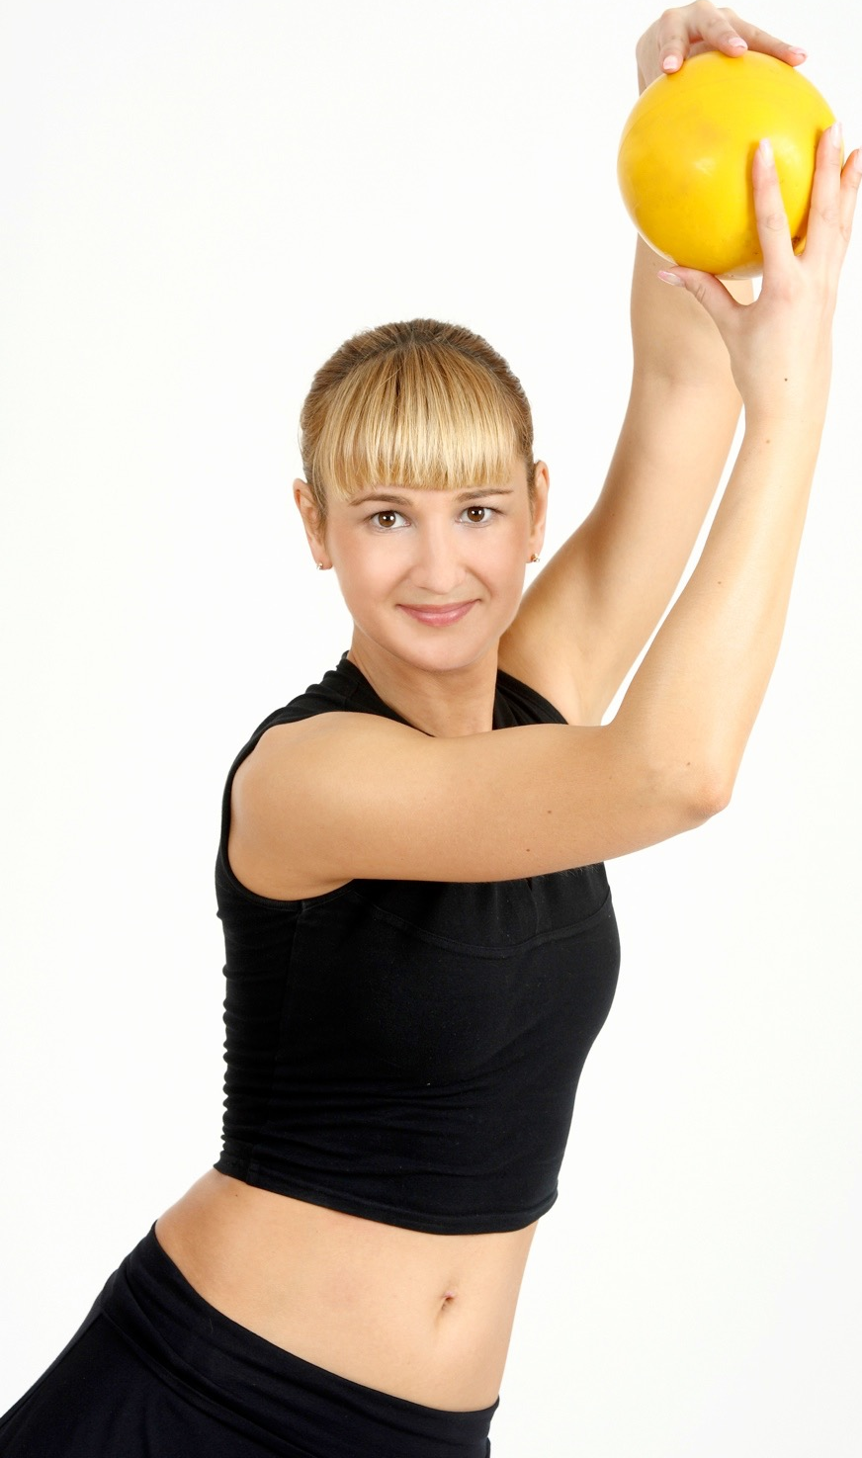
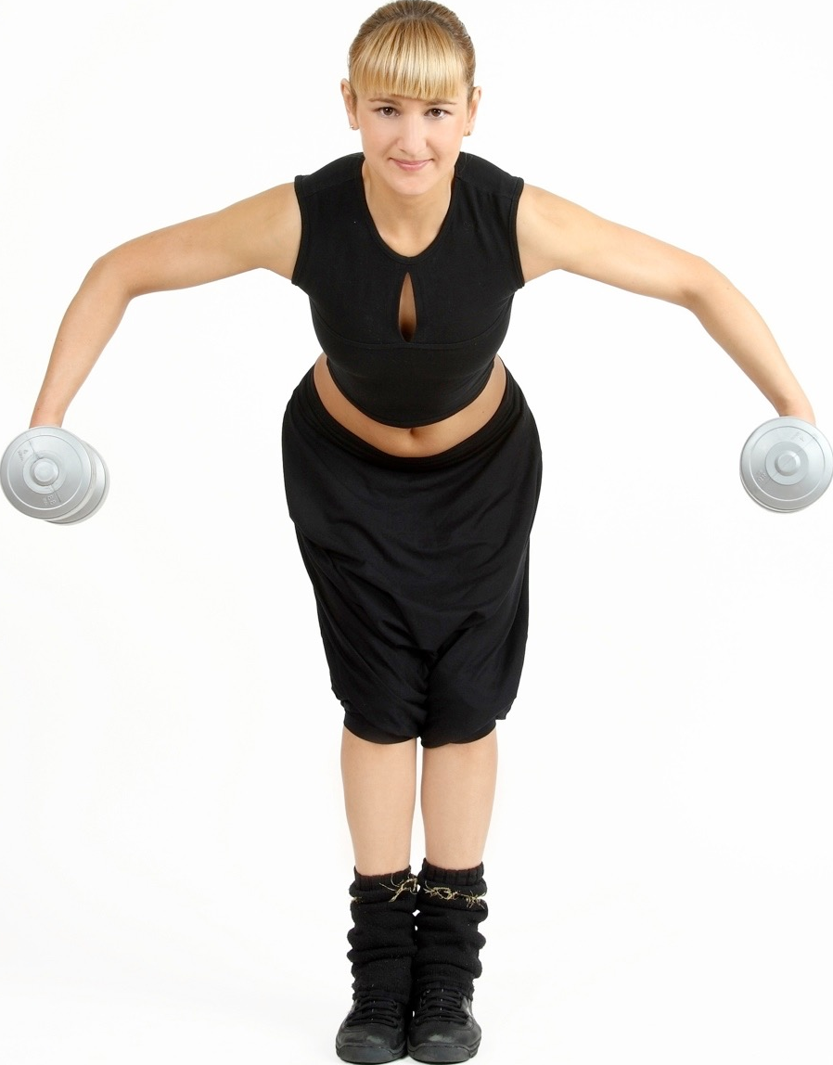
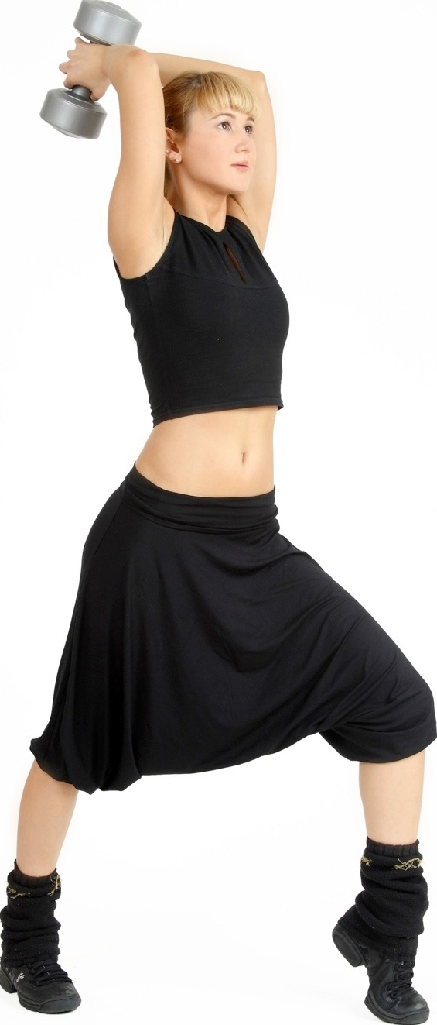
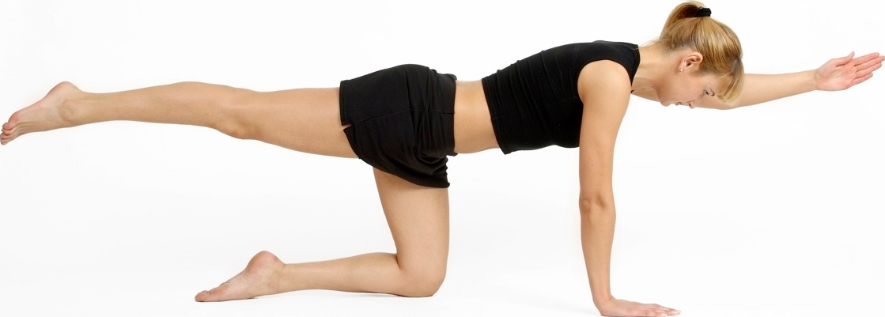
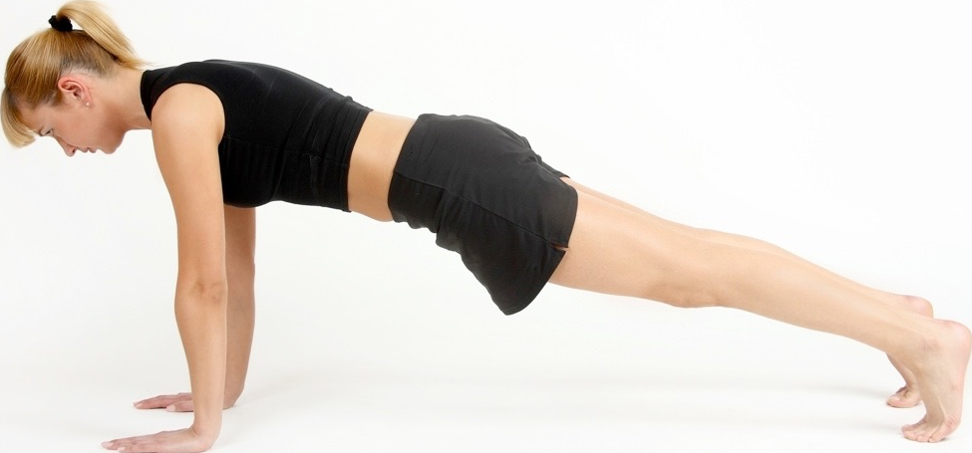
Types of training
Circuit Training
A number of exercises or skill stations are set up in a circuit.
A circuit usually has 6-12 stations.
Timed circuits - complete as many reps as possible in a given time
Fixed load circuits - complete a set number of repetitions
Varied circuits - the time and the work:rest ratio changes from circuit to circuit
Advantages
    All components of fitness can be trained.
    Large groups can train together.
    Easy to set up.
Disadvantages
Not really suited to individual training.
Large space is required.
Fatigue can affect technique and cause injury.
Athletes it would benefit
The flexibility of this training method benefits a range of athletes especially games players.

Slide 11
Types of training
Weight/Resistance Training
Weight training involves the use of free weights (experienced) or resistance machines (less experienced).
To develop muscular endurance, lift lighter weights for a high number of reps.
To develop strength/power, lift heavier weights for low reps.
Advantages
  Can focus on specific muscles or muscle groups.
  Depending on the weight and the number of reps either strength/power can be the focus or muscular endurance.
Disadvantages
When using weights, poor technique can lead to injuries.
A spotter is needed when using heavy weights.
Weights can be expensive and you usually need to pay to use a gym.
Athletes it would benefit
Sports where power, strength and muscular endurance are important fitness components. These include boxing, rugby, sprinting and climbing.

Slide 12
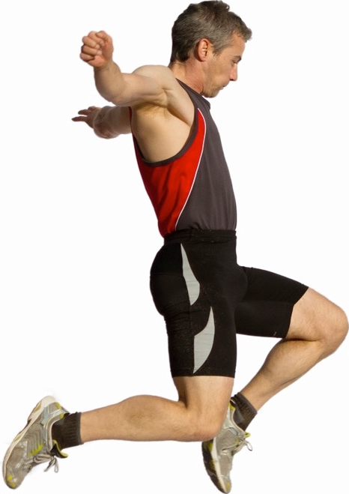
Types of training
Plyometrics
Plyometrics are used to develop fast, explosive and powerful muscle contractions.
The exercises involve different power jumping movements.
On the downward phase the muscle extends and lengthens (eccentric isotonic contraction). A powerful contraction on the upward phase of the jump is produced (concentric isotonic contraction).
Advantages
  It simulates sporting movements, allowing you to run faster, throw further and jump higher and longer.
  Requires little or no equipment.
  The exercises can be done anywhere.
  Short and high intensity work out.
Disadvantages
The main disadvantage of plyometrics is the risk of injury. The exercise puts a large amount of strain on muscles and joints.
Three days of recovery is needed between each session.
Good levels of strength are needed.
Athletes it would benefit
Any sports that rely on power for high performance. These include sprinting, high jump, discus throwing.

Slide 13
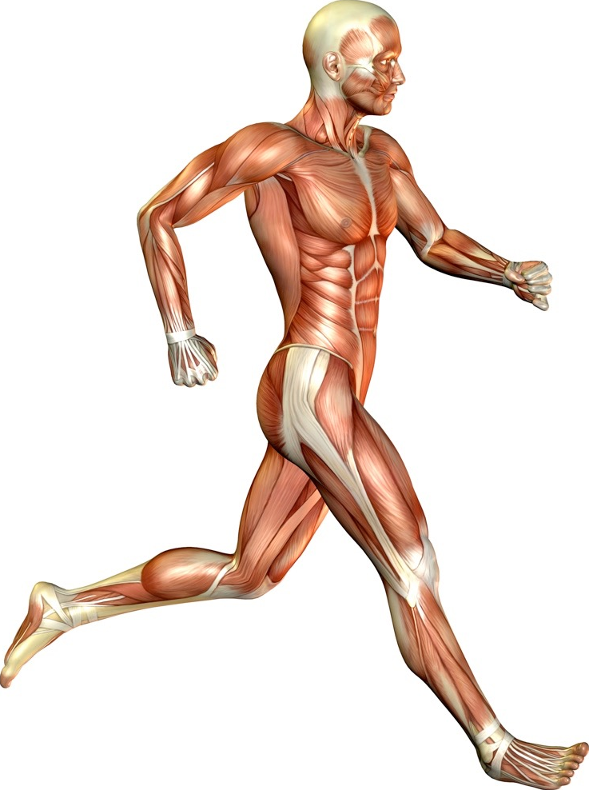
Types of training
Fartlek Training
Fartlek means “speed play” in Swedish.
The method involves exercising and changing the speed and intensity you work at.
An example is running at 80% for 30 secs, then 50% for 2 mins, then 70% for 1 minute. This is repeated for the desired amount of time.
Advantages
  Improves both the aerobic and anaerobic systems.
  Helps to recreate the demands of game play.
  Can be done anywhere and individually.
  Adds variety and relieves boredom.
Disadvantages
Sometimes it is hard to determine how hard to work at the different intensities.
High motivation is needed from the performer when the harder parts of the session are being performed.
Athletes it would benefit
This would benefit experienced athletes who are required to vary their pace during performance. This includes long distance runners, footballers, hockey players, rugby players and cyclists.

Slide 14
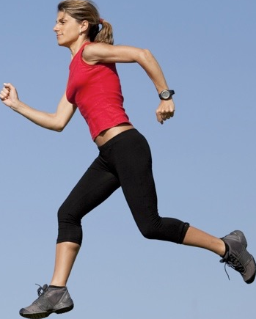
Types of training
Continuos Training
Continuous training focuses on improving the aerobic system and cardio-vascular endurance.
It requires the athlete to perform cardio-vascular activities such as running, cycling and swimming in the aerobic training zone for a minimum of 20 minutes.
Continuous training is also a good way to burn calories.
Advantages
  Improves aerobic performance.
  No specialist equipment needed.
  Easy to overload by increasing the distance or time.
  Ideal for beginners and people training individually.
Disadvantages
Performing the same activity for long periods of time can be boring.
Not suitable for groups or teams.
Does not improve anaerobic fitness.
Overuse injuries such as shin splits can occur.
Athletes who would benefit
Any athlete who requires large amounts of cardio-vascular endurance to perform.
Cyclists and marathon runners.

Slide 15
Types of training
Interval Training
Interval training involves working at high intensity followed by a period of rest or low intensity.
This is repeated a number of times.
An example is - 200m, 3 mins rest, 200m, 3 mins rest, 200m, 3mins rest.
You can change the distance or the time you’re allowed to rest.
Advantages
  Allows you to mix aerobic and anaerobic work.
  Training is suitable to team sports.
  Monitoring progress is easy.
  No specific facilities or equipment are needed.
Disadvantages
Working the body at maximum intensity can result in injury.
High motivation is needed from the performer to work at high intensity.
At least 48 hours of recovery is needed.
Athletes who benefit
Any athlete who is required to work anaerobically for long or short amounts of time.
Racket players, middle distance athletes and games players.

Slide 16
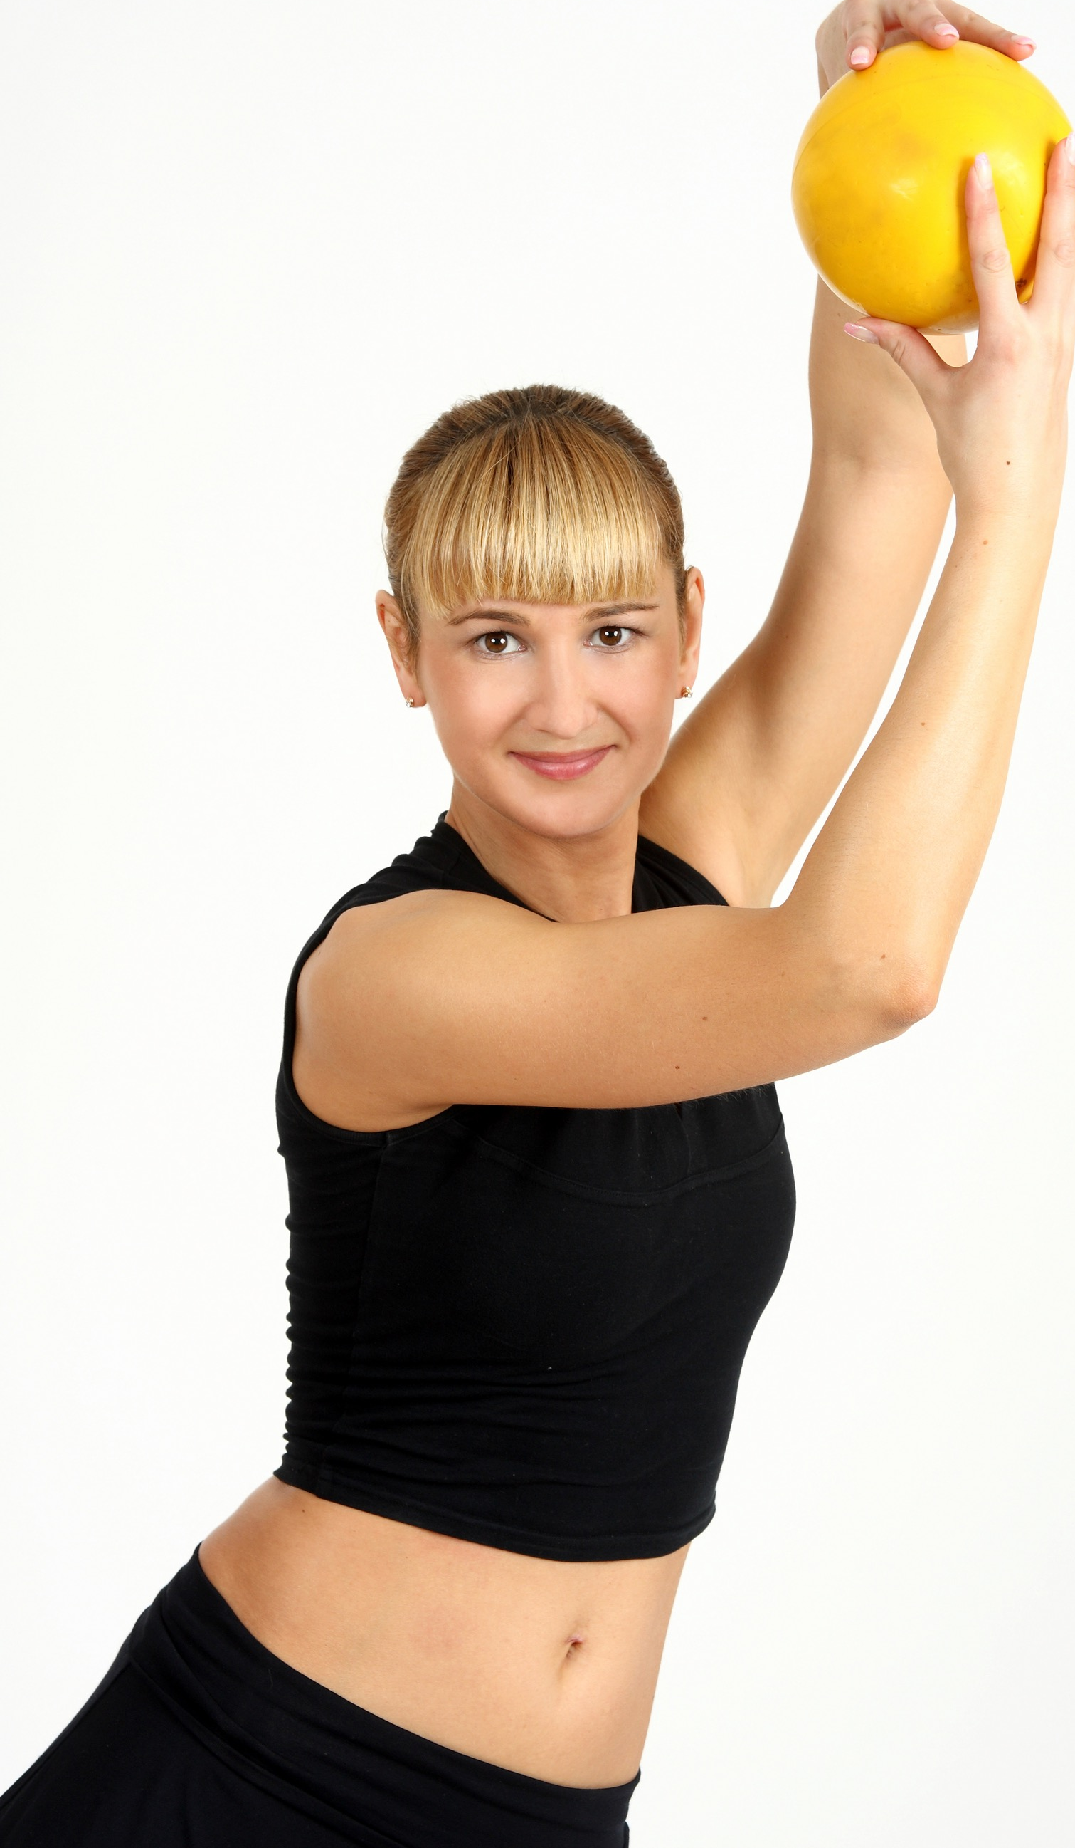
Types of training
Fitness classes
Body pump - Group exercise that involves resistance training to improve strength.
Aerobics - Exercise that involves movements to music to improve cardiovascular fitness.
Pilates and Yoga - Exercises that focus on core body strength
Spinning - High intensity work on stationary bikes to improve cardiovascular fitness.
Advantages
  Variety reduces boredom.
  Meet new people.
  Motivating and encourages high effort.
  Training is organised for you.
Disadvantages
Classes cost money so this type of training can be expensive.
Classes are not tailored to individual needs.
Incorrect technique may not be corrected.
Athletes it would benefit
All athletes, as this is important in injury prevention.
Specialist flexibility athletes such as gymnasts, dancers and trampolinists.

Slide 17
Karvonen formula
Training zones are an effective way to measure intensity.
To calculate your target heart rate we use the Karvonen formula and these heart rate measurements
  RHR = Resting heart rate.
  MHR = Maximum heart rate = 220 - age
  THR = Target heart rate
THR = (MHR - RHR) x % Intensity + RHR

Slide 18
Aerobic training zone
  To improve your cardiovascular endurance you must raise your heart rate into the training zone and stay there for at least 15 minutes.
  Aerobic training thresholds are calculated between 60 and 80% of the maximum heart rate using the Karvonen Formula.
60-80% Aerobic Training Zone
Recovery Time
Rest 60 bpm
Rest 60 bpm

Slide 19
Anaerobic training zone
  Anaerobic training zone
  Anaerobic training thresholds are calculated between 80 and 90% of the maximum heart rate using the Karvonen Formula.
80%-90% Anaerobic Training Zone
Recovery Time
Rest 60 bpm
Rest 60 bpm

