Slide 1
Skeletal and muscular systems
1.1 Anatomy and physiology

Slide 2
Joints
Antagonistic Pairs
Skeletal System
Isotonic Contractions
Skeletal and Muscular System
Synergists
Range of movement
Muscular System
Isometric Contractions

Slide 3
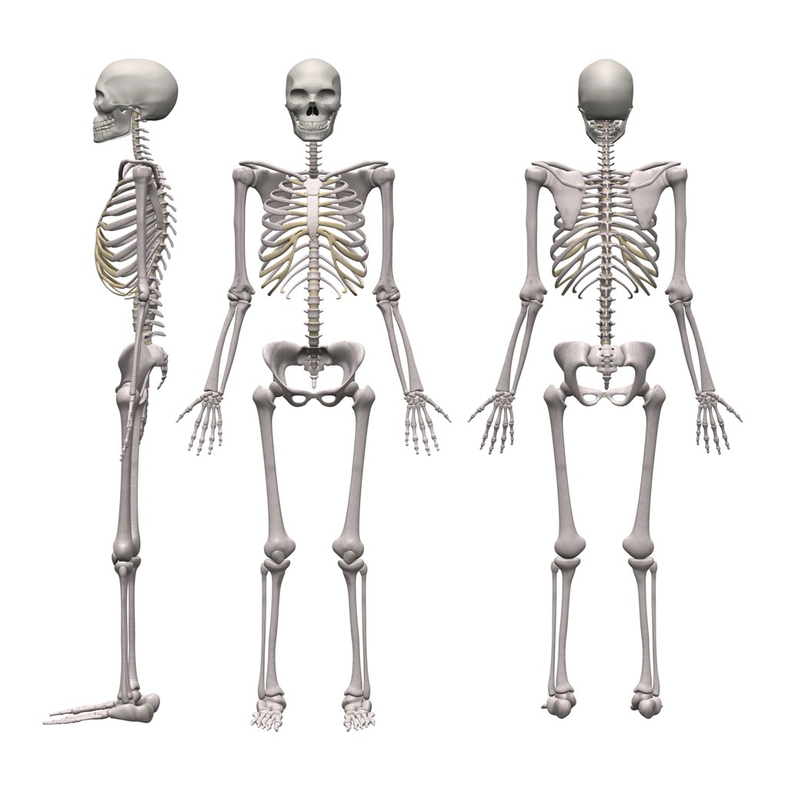
Skeletal System
Scapula
Cranium
Clavicle
Sternum
Humerus
Ribs
Ulna
Vertebrae
Pelvis
Radius
`
Femur
Carpals
Patella
Metacarpals
Tibia
Phalanges
Fibula
Talus
Tarsals
Metatarsals
Phalanges

Slide 4
Joints
The human body has joints where bones meet and articulate to create movement.
Shoulder - scapula, clavicle, humerus.
Elbow - humerus, radius, ulna.
Hip - pelvis, femur.
Knee - femur, patella, fibula, talus.
Ankle - tibia, fibula, talus.

Slide 5
Types of bones
Scapula
Cranium
Clavicle
Long Bone
Storage of minerals, blood cell production, levers for movement
Sternum
Humerus
Ribs
Ulna
Vertebrae
Irregular
Bone
Muscle attachment
Radius
Pelvis
`
Femur
Carpals
Patella
Flat Bone
Protection and muscle attachment
Metacarpals
Tibia
Phalanges
Fibula
Short Bone
Strong and supports weight
Talus
Tarsals
Metatarsals
Phalanges

Slide 6
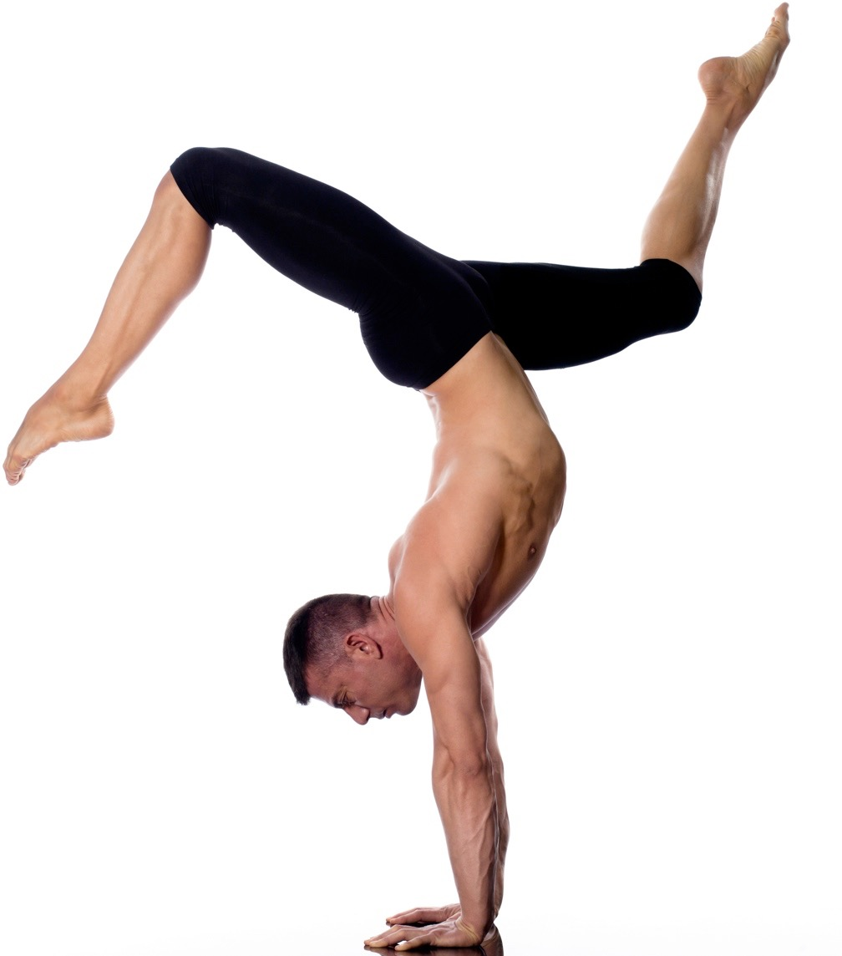
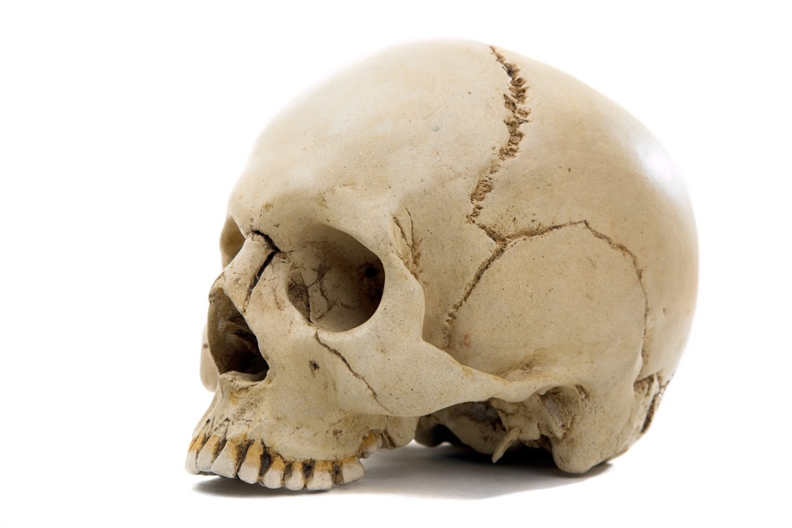
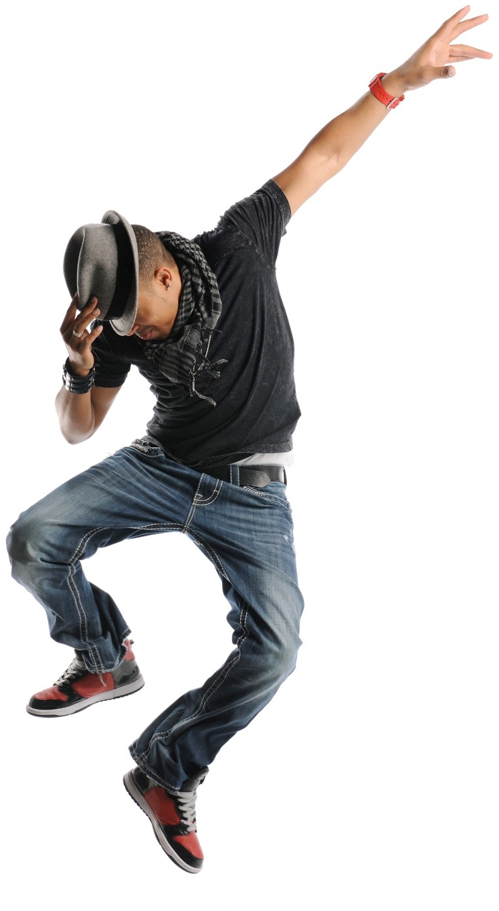
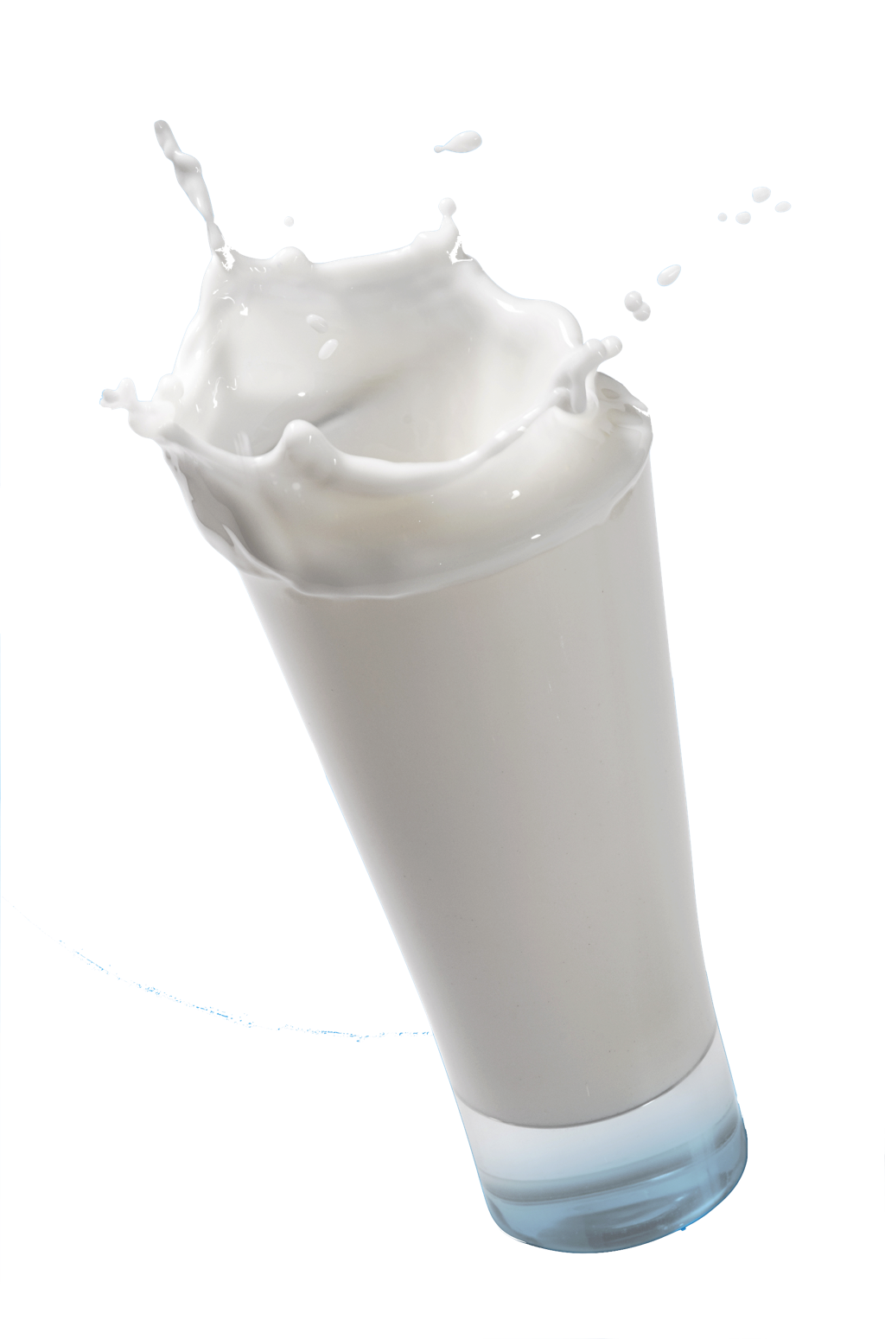
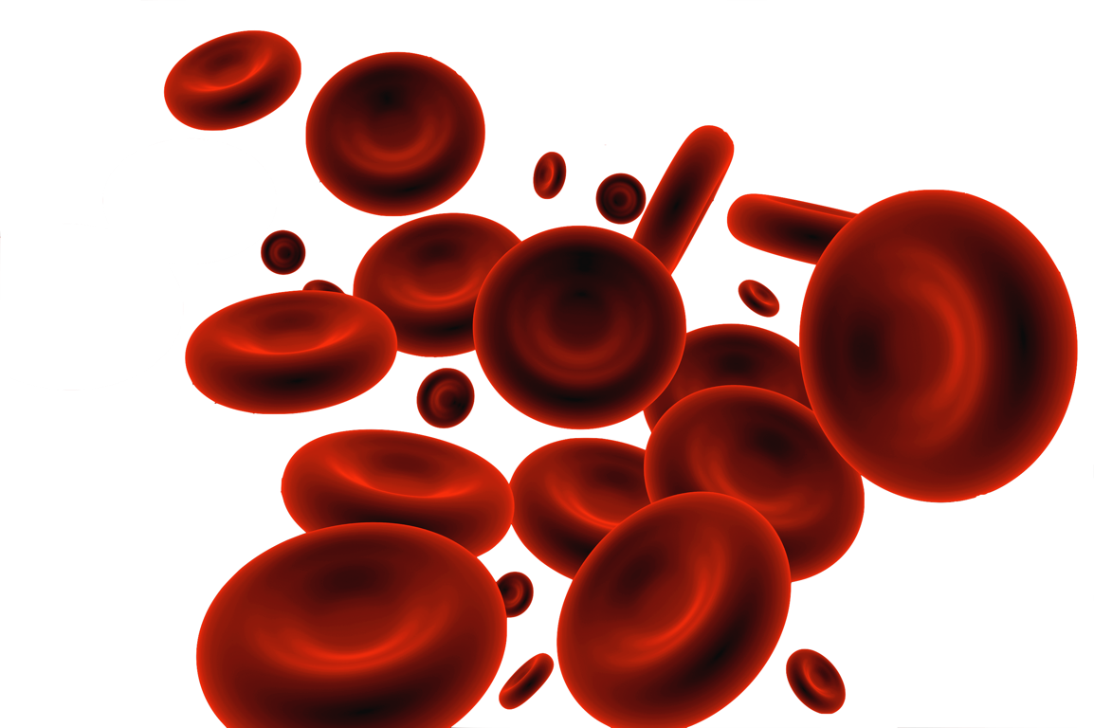
Functions of the skeletal system
  Support - Bones are strong and are able to bear our weight. For example carpals support and weight bear in a handstand.
  Protection - Bones protect our vital organs. For example the flat bones of the cranium protect the brain when heading the ball.
  Structural shape and points for attachment - Muscles attach to bones so when they contract our bone becomes a lever which generates force and allows us to reach. For example when the bicep contracts it moves our radius and ulna when throwing a ball.
  Storage of minerals - Our bones store calcium and phosphorus and release it when needed. This keeps the correct balance of minerals in our body for optimum sports performance.
  Production of blood cells - The marrow in our bones (i.e. femur) produce vital blood cells. Red blood cells for oxygen carriage, white blood cells for fighting disease and platelets for clotting blood when we cut ourselves whilst performing.

Slide 7
Joints
Fibrous/Fixed/Immovable
    These joints prevent movement, act as a shock absorber and protect vital organs.
    They are held together by
    tough fibre.
    This type of joint is very strong.
    Examples are joints in your cranium, pelvic girdle and sacrum.

Slide 8
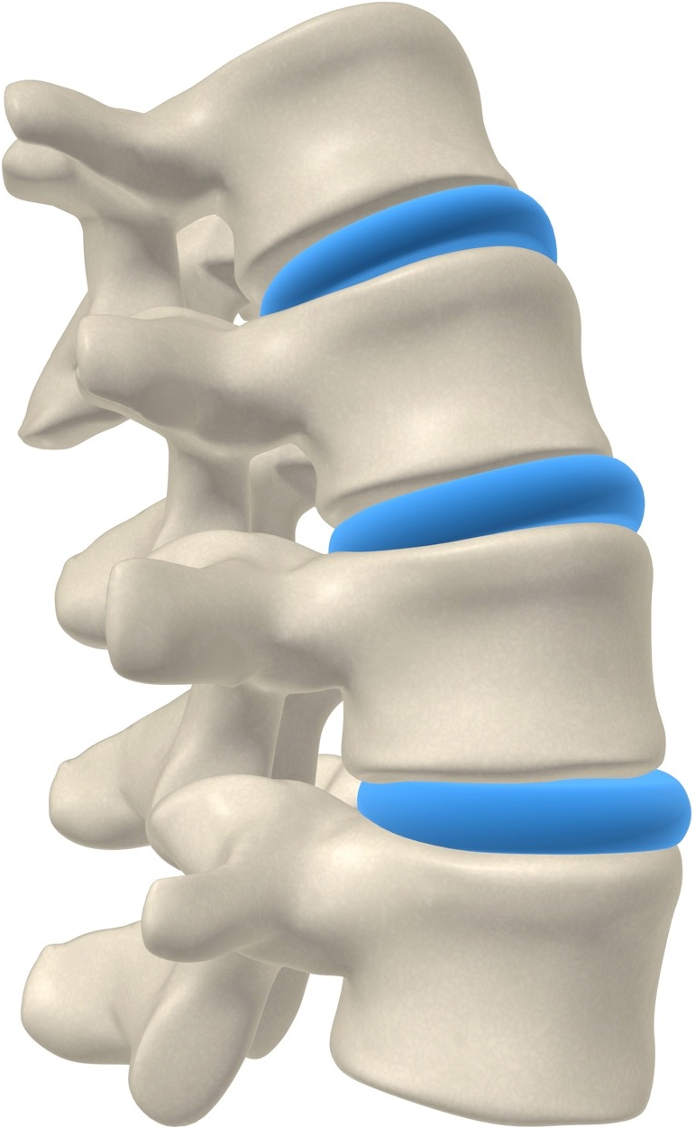
Joints
Slightly movable or Cartilaginous
    These joints can only move a little.
    They are joined together by a
    cushion material called cartilage.
    These keep the bones from rubbing together as well as acting as a shock absorber and limiting movement.
    Ligaments keep the joint in place.
    Examples are joints of the vertebrae and between your ribs and sternum.

Slide 9
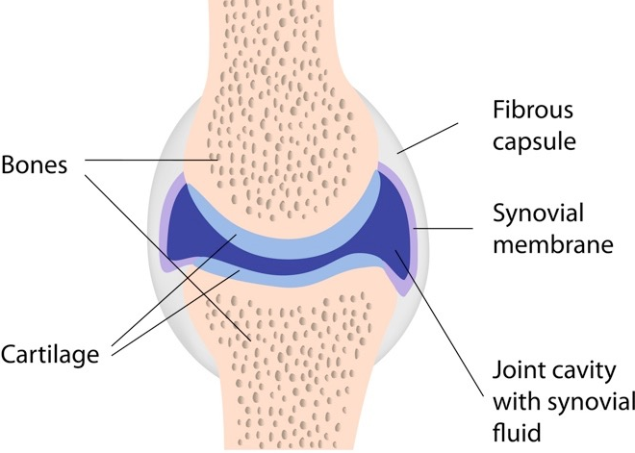
Joints
Joint
Freely Movable or Synovial Joints
    These joints move freely.
    There are many parts to the synovial joint
    that work together to allow smooth movement:
      Joint capsule holds the joint together
      Joint cavity is the space between the two bones
      Synovial fluid fills the joint cavity and acts as a lubricant preventing friction/pain and wear and tear.

Slide 10
Cartilage and Ligaments
Synovial joints also have two other important components: cartilage and ligaments.
Hyaline cartilage is at the ends of the bones.
  It stops the bones from touching
  The smooth material reduces friction preventing wear and tear of the bone.
  The cartilage also acts as a shock absorber.
Ligaments join bone to bone and stabilise the joint.
  Prevents unwanted movement.
  Prevents dislocation of the joint.

Slide 11
Types of Joints
Ball and Socket
  Allows the largest amount of movements and are found at the shoulder and the hip.
  Hinge
  Allows two types of movement and are found at the elbow and the knee.
  Pivot
  Allows only one type of movement and can be found at the neck as well as the radio-ulna joint.
Range of Movement
Flexion
Extension
Abduction
Adduction
Rotation
Range of Movement
Flexion
Extension
Range of Movement
Rotation

Slide 12
Types of Joints
Saddle
  Also allows a full range of movement and can be found at the thumb.
  Gliding
  Allows a full range of movement and are found between the joints in your hand.
  Condyloid
  Allows a full range of movement and are found in the wrist.
Range of Movement
Flexion
Extension
Abduction
Adduction
Limited Rotation
Range of Movement
Small gliding movements
Range of Movement
Flexion
Extension
Abduction
Adduction
Limited Rotation

Slide 13
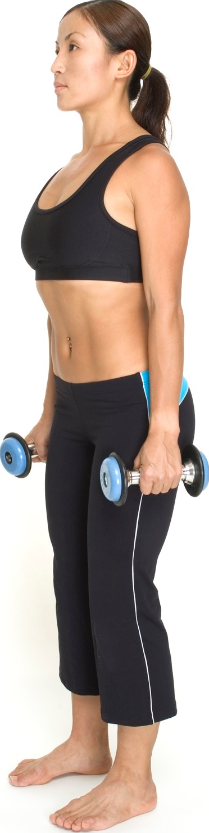
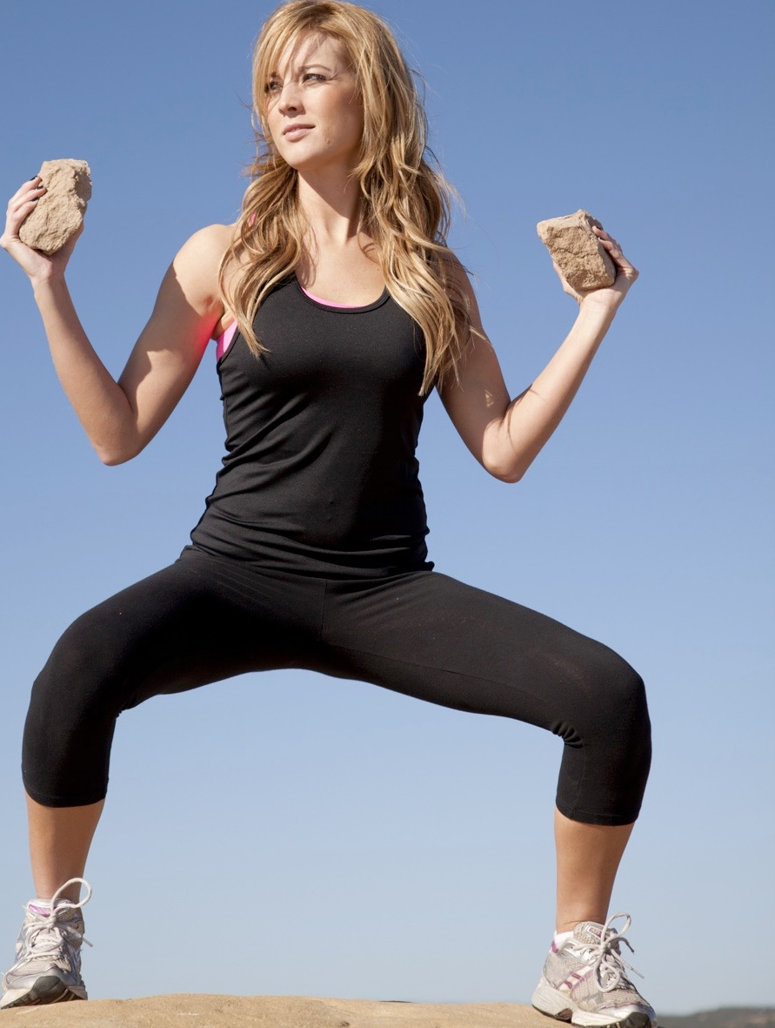
Range of movement
Flexion
Decrease the angle at the joint
Extension
Increase the angle at the joint
Shoulder
and Elbow
Shoulder
and Elbow
Hip
and Knee
Knee
and Hip

Slide 14

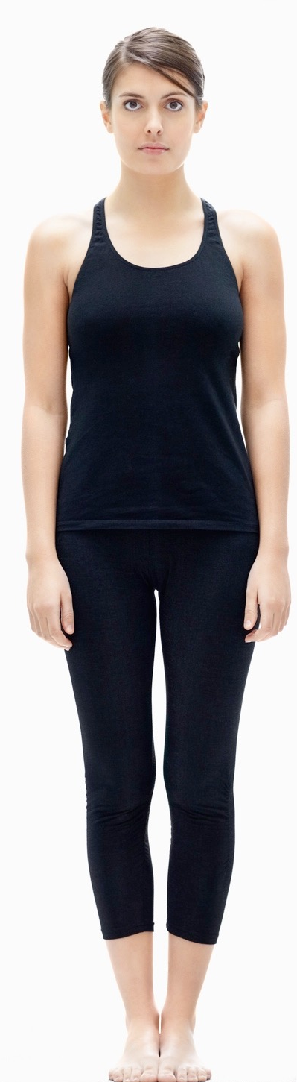
Range of movement
Abduction
Move the limb away
from the central axis
Adduction
Move the limb towards
the central axis
Hip and
Shoulder
Hip and
Shoulder

Slide 15
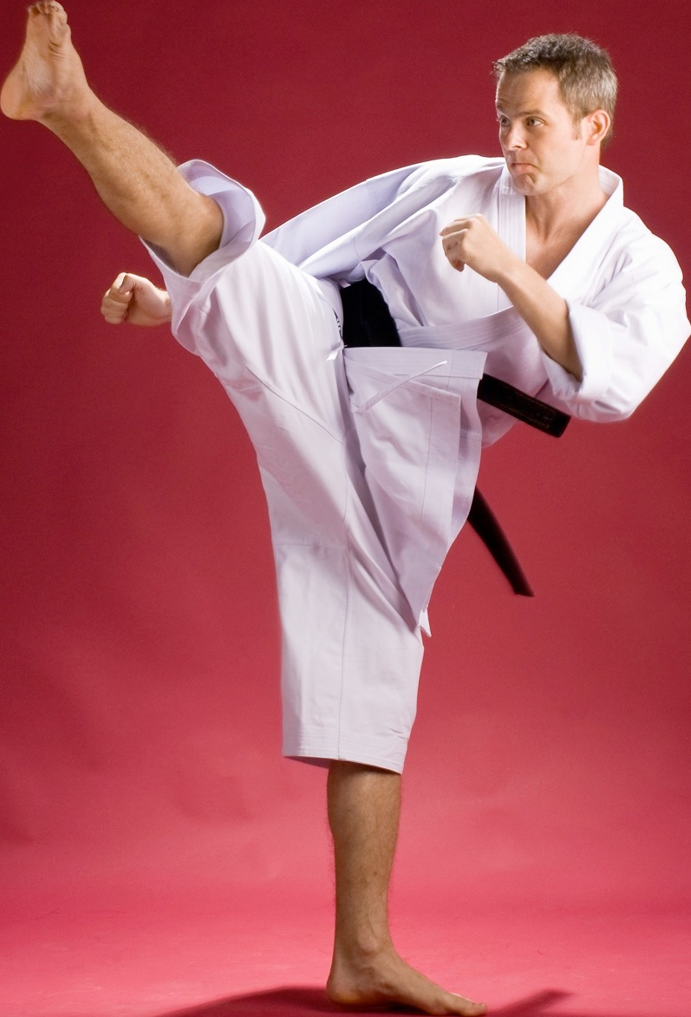
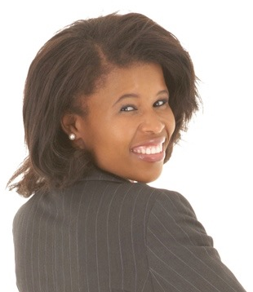
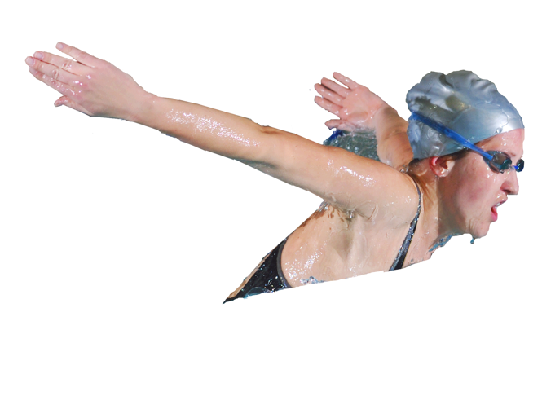
Range of movement
Rotation
Movement around an
axis/rotational movement
Hip
Neck
Shoulder
Hip

Slide 16
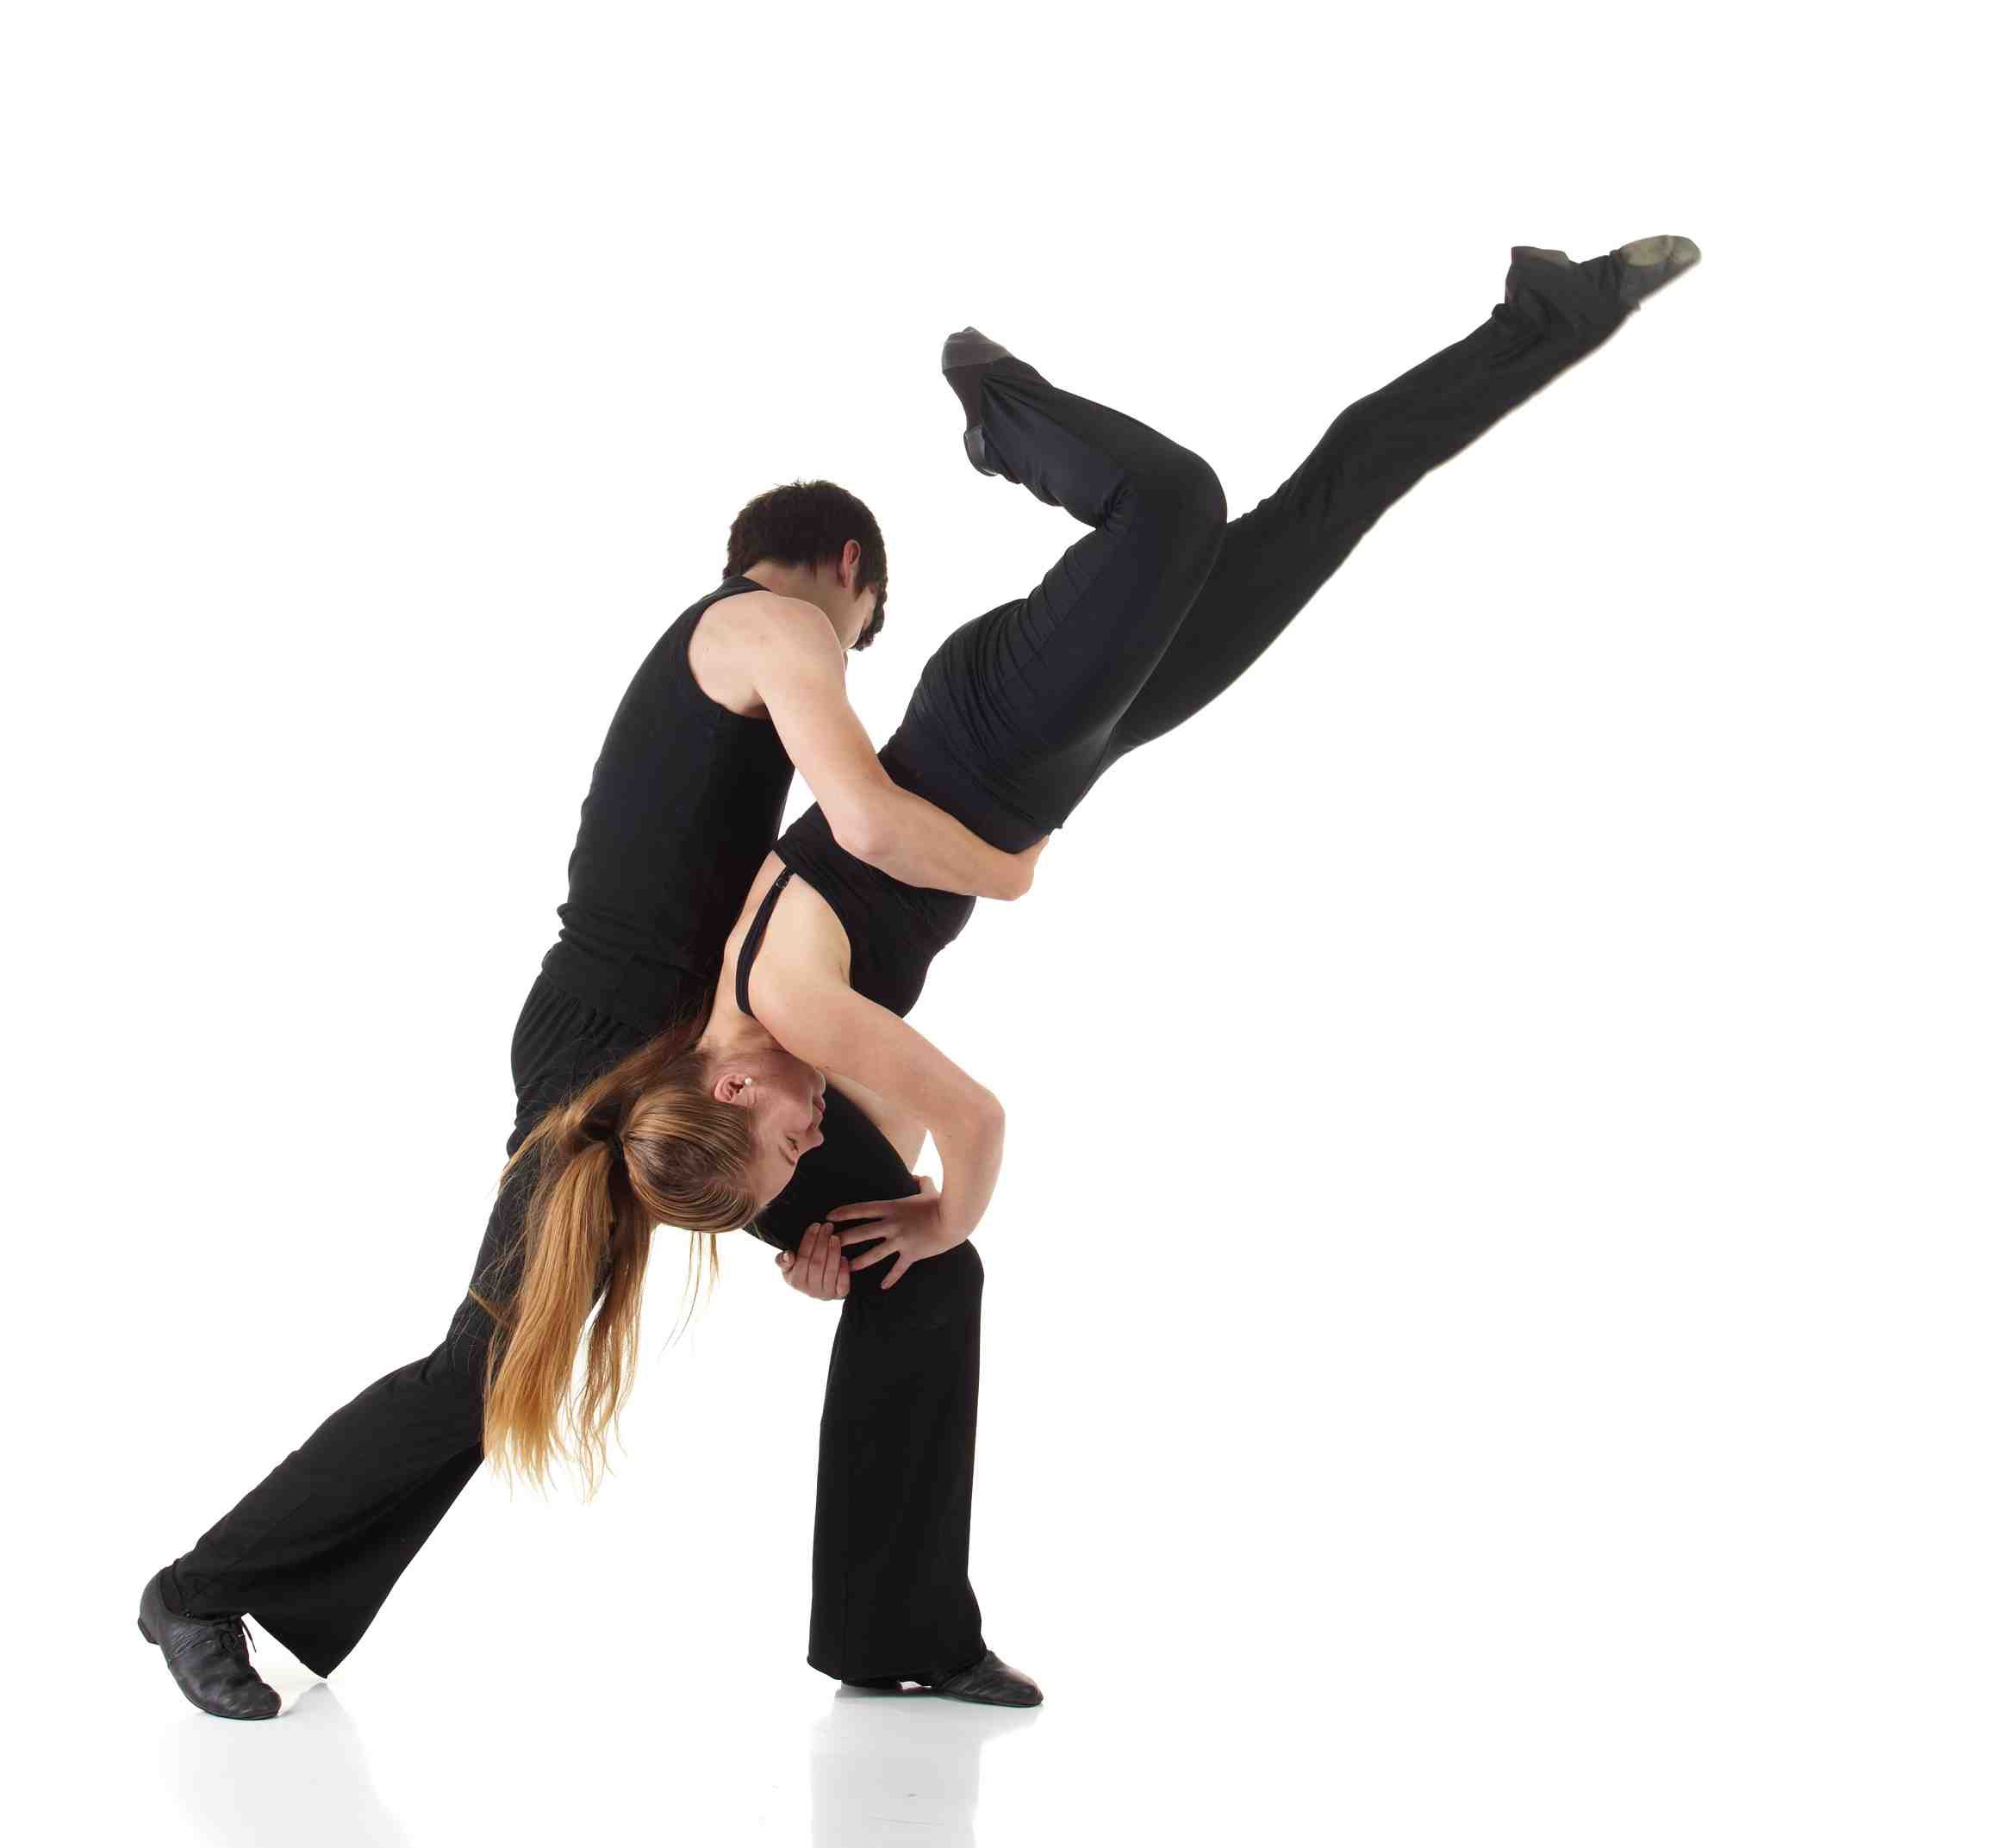
Range of movement
Plantar flexion
Movement at the ankle joint
that points the toes
Dorsiflexion
Movement at the ankle joint
that flexes the foot upwards

Slide 17
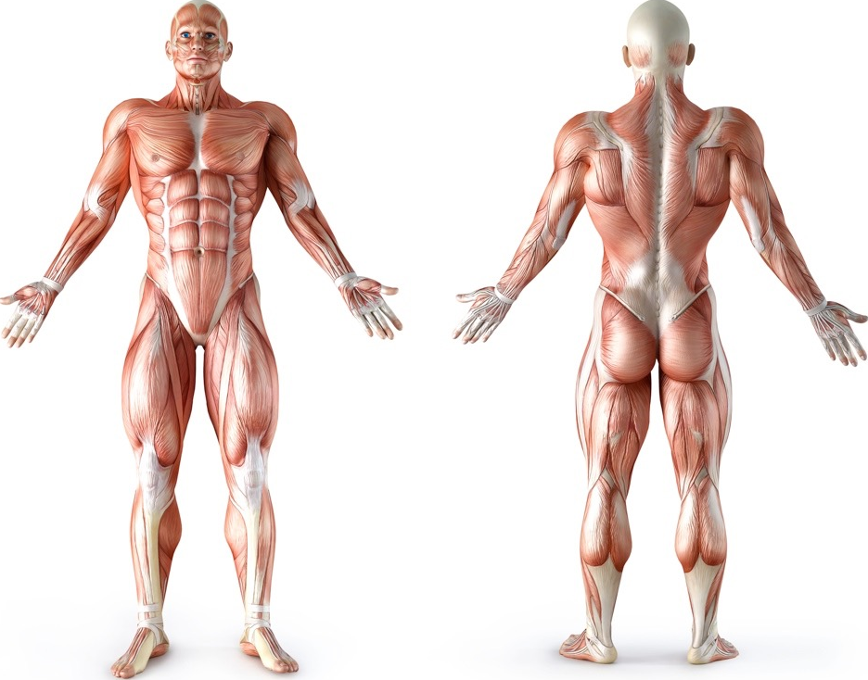
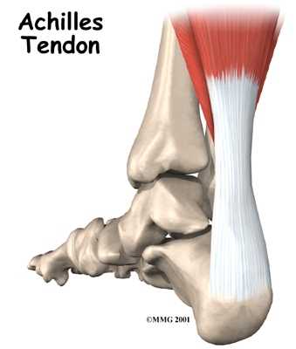
Muscular System
Deltoid
Trapezius
Triceps
Pectorals
Latissimus
Dorsi
Biceps
Abdominals
Gluteals
Hamstrings
Hip flexors
Gastrocnemius
Tibialis anterior
Quadriceps

Slide 18
Muscle Action
Muscle | Main Action
Deltoid | Flexion, extension, adduction and abduction at the shoulder
Trapezius | Rotation at the shoulder
Pectorals | Rotation and adduction at the shoulder
Biceps | Flexion at the elbow
Triceps | Extension at the elbow
Latissimus Dorsi | Adduction, extension and rotation at the shoulder
Abdominals | Flexion at the trunk
Gluteals | Rotation and extension at the hip
Quadriceps | Extension at the knee
Hamstrings | Flexion at the knee
Gastrocnemius | Extension (plantar flexion) at the ankle joint

Slide 19
Tendons
  The function of tendons are:
Attaches muscle to bone.
Strong and able to withstand large forces.
Stores energy.
Allows movement.

Slide 20
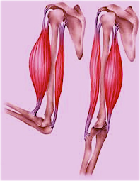
Antagonistic Pairs
Two good examples of
antagonistic pairs are:
    Hamstrings and
    quadriceps at the
    knee
    Biceps and triceps at
    the elbow
Tendon of
Origin
Agonist
Antagonist
Tendon
of Insertion

Slide 21
Antagonistic Pairs
Muscles can only pull so
they have to work in pairs
to create movement.
  When the muscle contracts it pulls on the moveable bone attached by the tendon of insertion.
  It pulls towards the tendon of origin on the fixed bone.
Tendon of
Origin
Agonist
Antagonist
Tendon
of Insertion

Slide 22
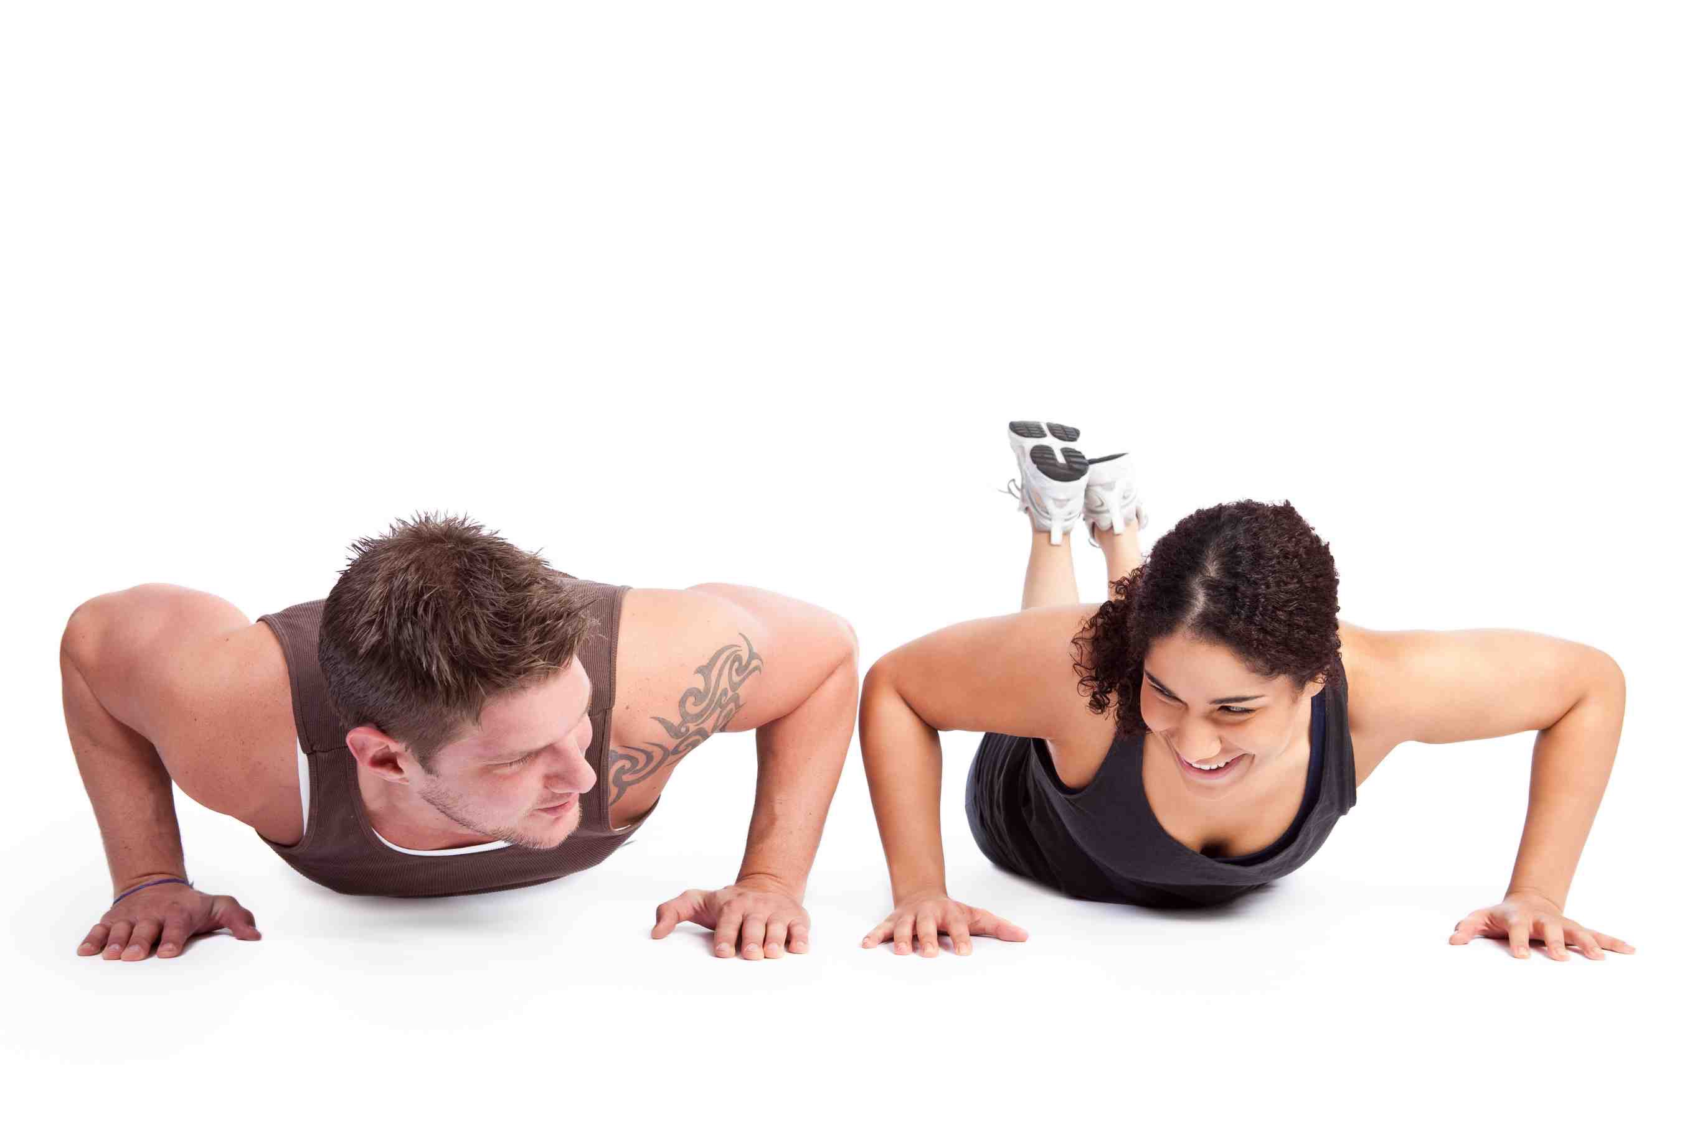
Antagonistic Pairs
The contracting muscle is called the prime mover or agonist.
The other muscle in the pair relaxes and this is called the antagonist.
During movement other muscles called synergists contract to support the contraction.

Slide 23
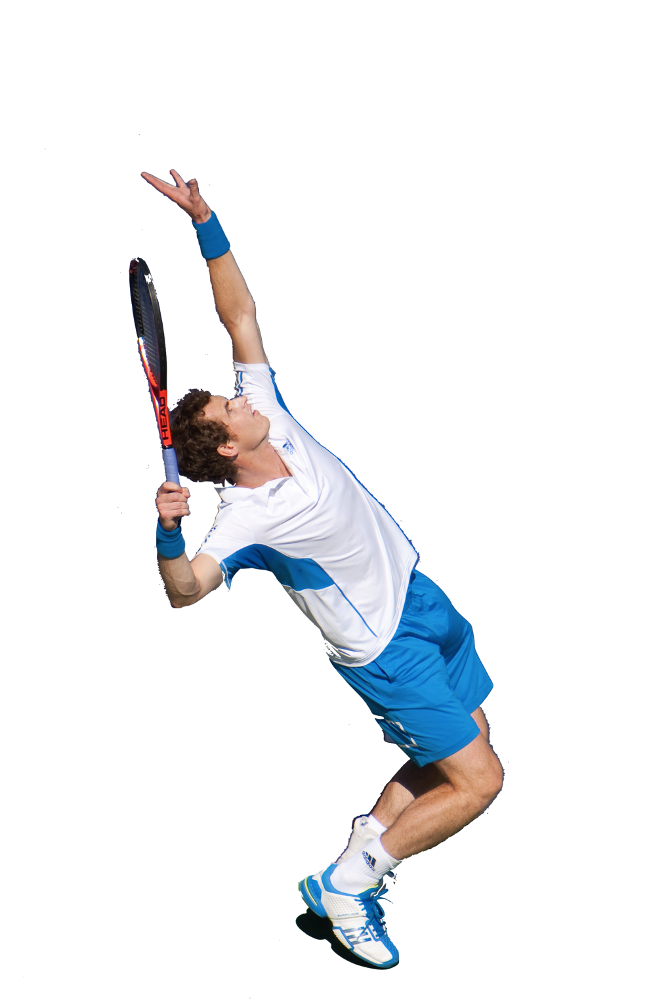
Types of Muscular Contractions
  Isotonic Contraction - Muscle contraction that results in limb movement.
  This is the most frequent muscle contraction during sports play.
  When the muscle contracts it causes a concentric movement.
  When the muscle relaxes it causes an eccentric movement.
  Training your muscles isotonically improves dynamic (moving) strength, power and endurance.

Slide 24
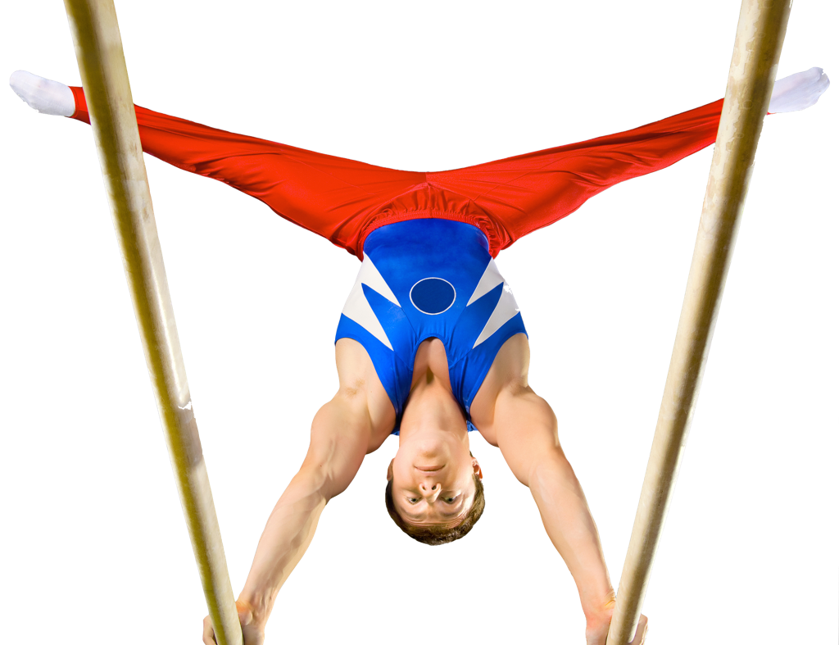
Types of Muscular Contractions
  Isometric Contraction - Muscle contraction with no limb movement.
    Despite contracting the muscle length stays the same.
    One muscle may contract isometrically to stabilise a movement so others can contract isotonically.
    Less sports require this muscle
    contraction but examples are
    gymnastic handstand or rugby scrum.
    Training isometrically provides little improvements.

Slide 25
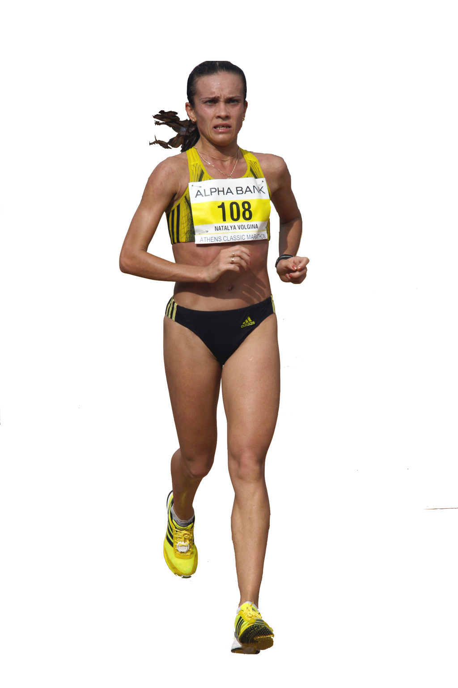
Fast Twitch and Slow Twitch
There are three different types of muscle fibre
Slow Twitch (Type I) | Fast Twitch (Type IIa) | Fast Twitch (Type IIx)
Contracts slowly | Contracts quickly | Contracts quickly
Low force production | Intermediate force production | High force production
Uses aerobic energy | Uses anaerobic energy | Uses anaerobic energy
Fatigues slowly | Fatigues quickly | Fatigue very quickly
Suited to long distance sports | Suited to middle distance sports | Suited to explosive sports

Slide 26
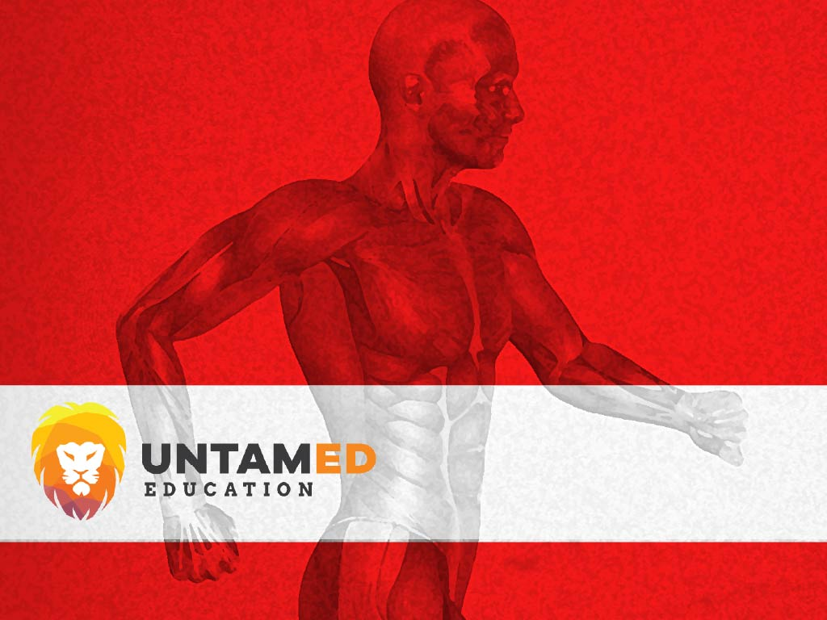
A-PE — THE ULTIMATE
RESOURCE CENTRE FOR PE
All resources are board specific and
designed to meet the learning needs of your students.
If you need a learning task, a worksheet, exam style questions, relevant videos or a presentation....IT”S ALL HERE.
© Copyright
Find out more at
www.a-pe.co.uk

