Slide 1
Classification of skills
3.1 Skill acquisition and psychology

Slide 2
Skill
Cognitive Stage
Autonomous Stage
Ability
Closed
Open
Classification of skills
Fine
Complex
Associative Stage
Gross

Slide 3
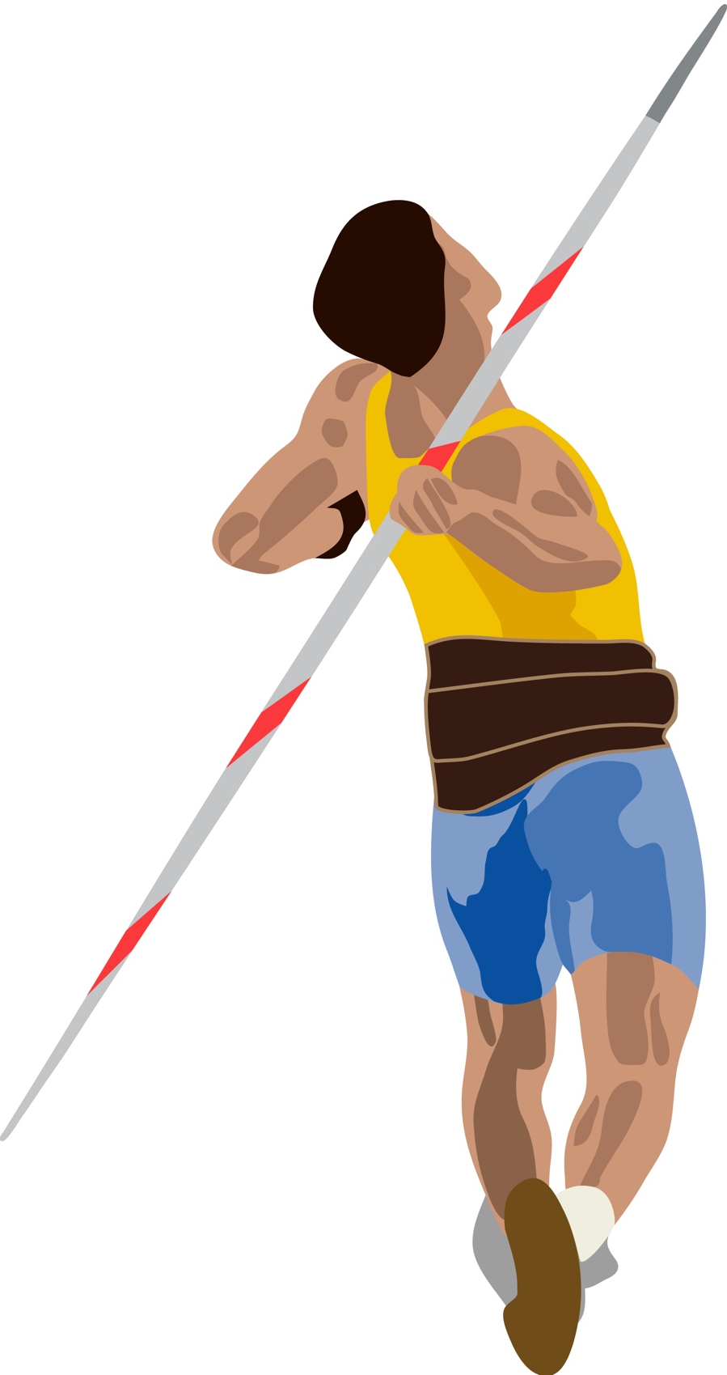

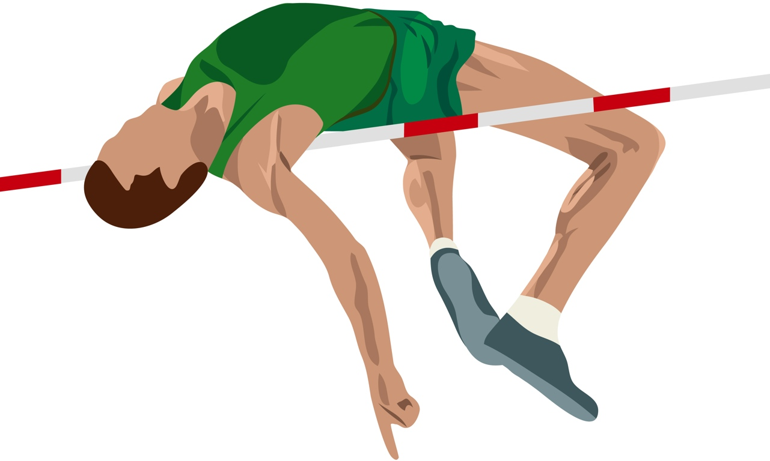
Skill and ability
Skill is defined as:
  “Skill is the learned ability to bring about
  a pre-determined result with maximum certainty and efficiency”
Ability is defined as:
  “Ability is inherited not learnt. It does not change throughout a person's life. Abilities impact a person's potential to learn skills.”

Slide 4
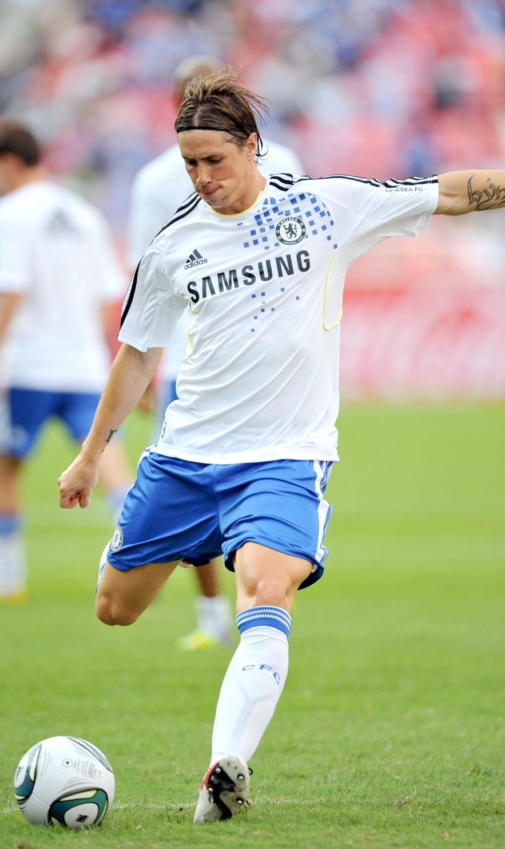
Skilled performance
A person who has a high level of ability
in a particular skill will demonstrate certain characteristics.
They will perform with accuracy.
Their motivation is goal-directed.
They perform with fluency and consistency.
The performance will be aesthetically pleasing.
They perform with coordination.

Slide 5
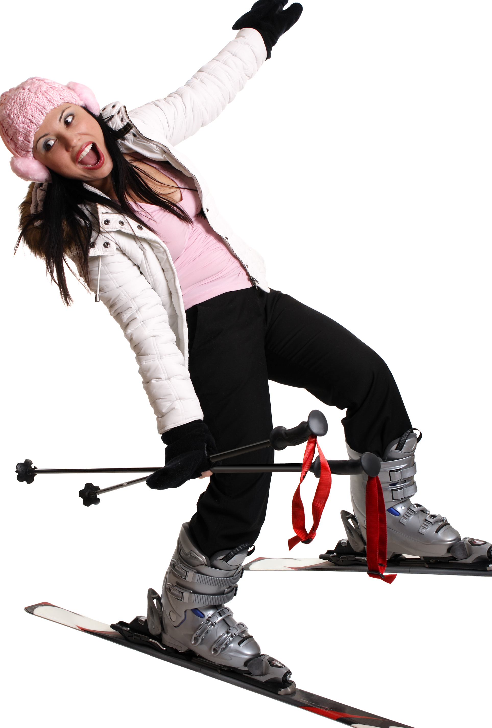
Stages of skill learning
There are three stages of skill learning:
Cognitive stage (understanding phase)
  This is the first stage of learning and relies mainly
  on visual and verbal input as well as trial and error.
  Learners may appear clumsy as they transition from understanding the skill to executing it.
  Performances are inconsistent.
  Correct performances must be reinforced through external feedback.
  Performing the skill requires all the athlete’s attention and so they rely on the coach for cues

Slide 6
Stages of skill learning
Associative stage (verbal motor phase)
  Through practice, the brain receives sensory information that allows the performer to refine the skill. Visual cues are now replaced with proprioceptor cues (how it feels).
  Performances are becoming more consistent as motor programmes are being formed.
  While the simpler parts of the skill now look fluent and are well learned, the more complex elements require most of the spare attention.
  The athlete is starting to get a sense of internal 'kinaesthetic' feedback when they perform the skill well.
  They are starting to detect and correct their own errors and success rate has risen to 5-7 out of 10.

Slide 7
Stages of skill learning
Autonomous stage (motor phase)
  This is the final stage of motor skill learning. The movement requires little thought from the performer and becomes automatic.
  Performances have become consistent, fluid and aesthetically pleasing.
  The motor programmes involved are well learned and stored in the long-term memory.
  There is now spare attention which can be focused on opponents and tactics.
  To retain the new skill at this level, it must be constantly practised to reinforce the motor programmes. (Success is now 9 out of 10.)

Slide 8
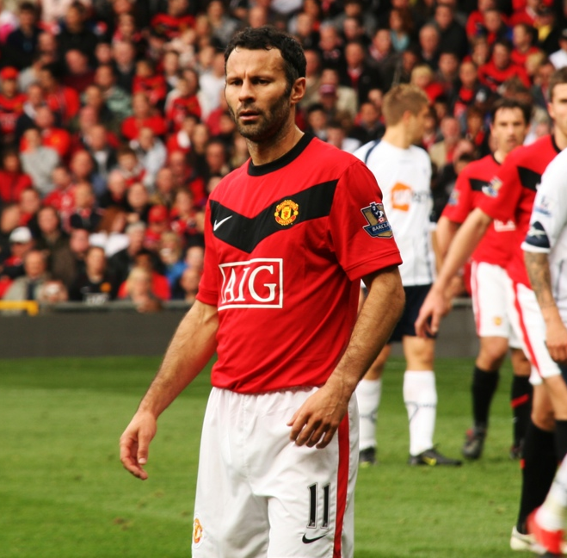
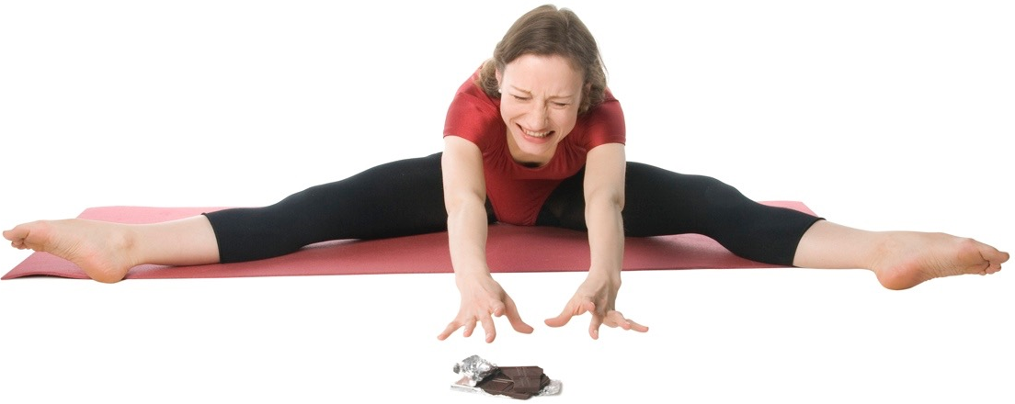


Factors affecting various skill levels
Age and Maturity
    The more experienced you are at practising a skill
    the better you become.
Motivation
    If you enjoy practising the skill or you have a
    goal to aim for you're more likely to practise the skill.
Anxiety
    Too much anxiety can negatively affect your
    performance.
Arousal Conditions
    Arousal is your readiness to perform. If your arousal
    levels are at the optimum then your skill performance
    will be optimum.

Slide 9
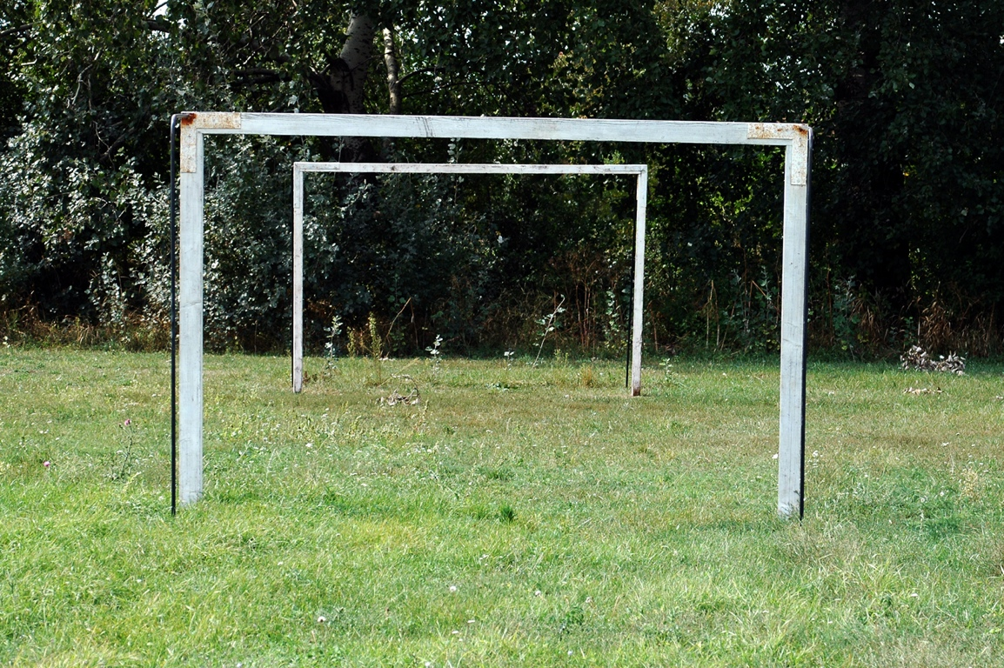
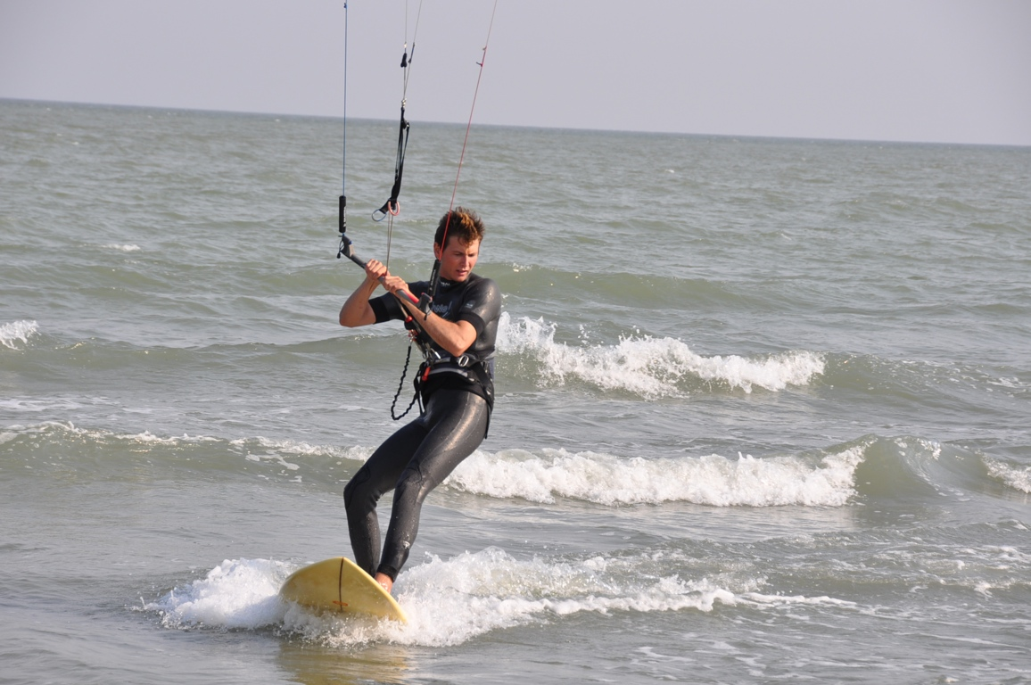
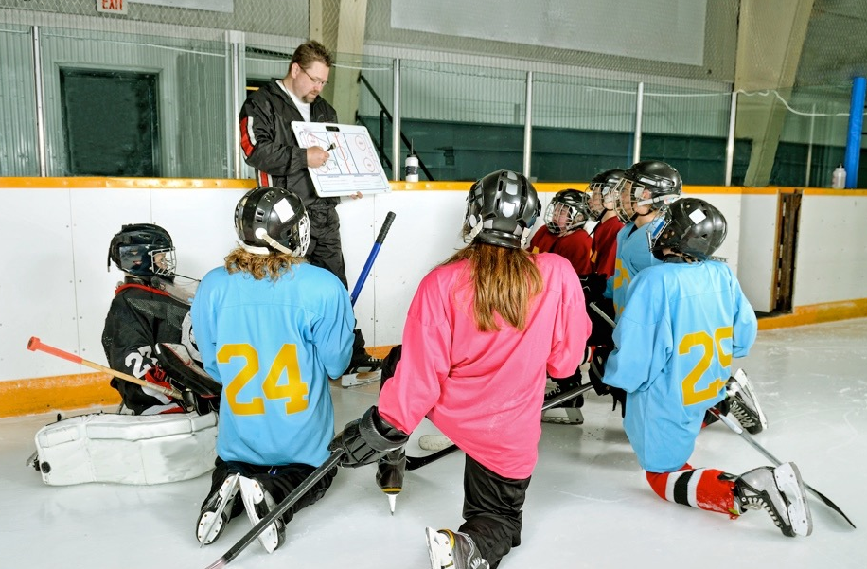
Factors affecting various skill levels
Facilities
    Performing on high quality surfaces and
    arenas can positively affect your skill
    performance. Poor surfaces can hinder performance.
Environment
    Skill performance can be affected by the environmental conditions i.e. if it is too
    hot/cold/windy.
Teaching and Coaching
    A high quality coach or teacher will ensure
    you get the best feedback on your skill
    performance and the best training.

Slide 10
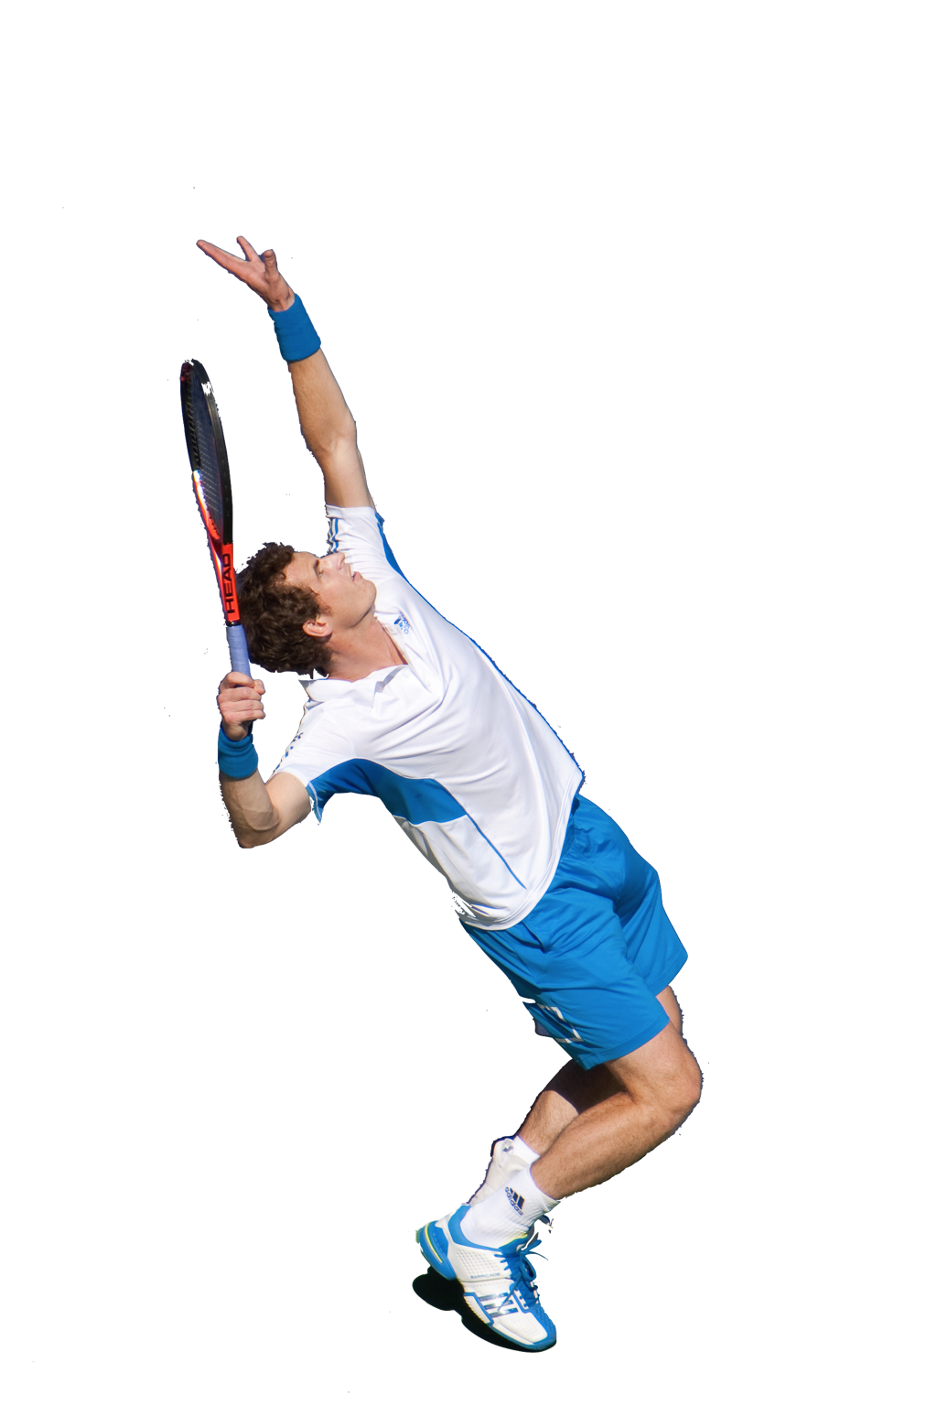
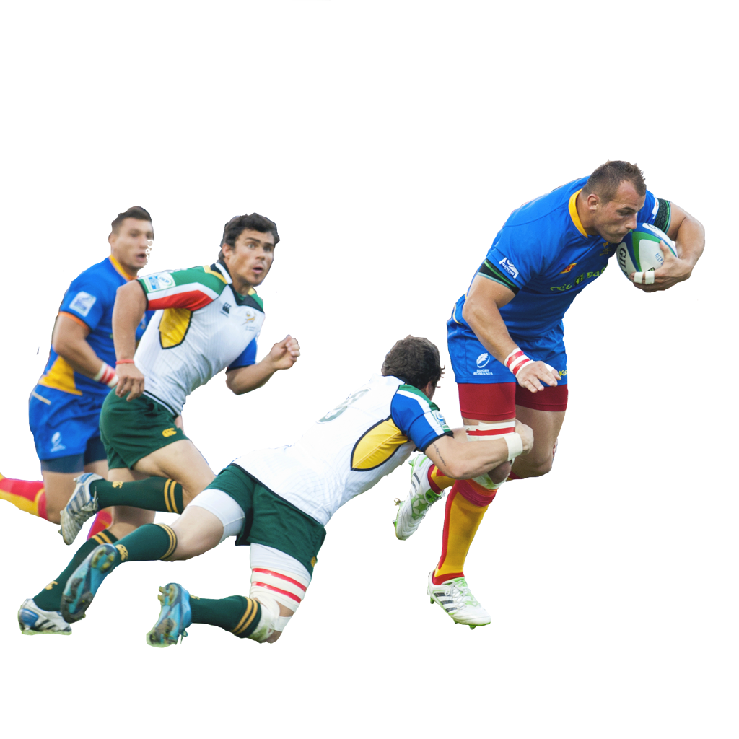
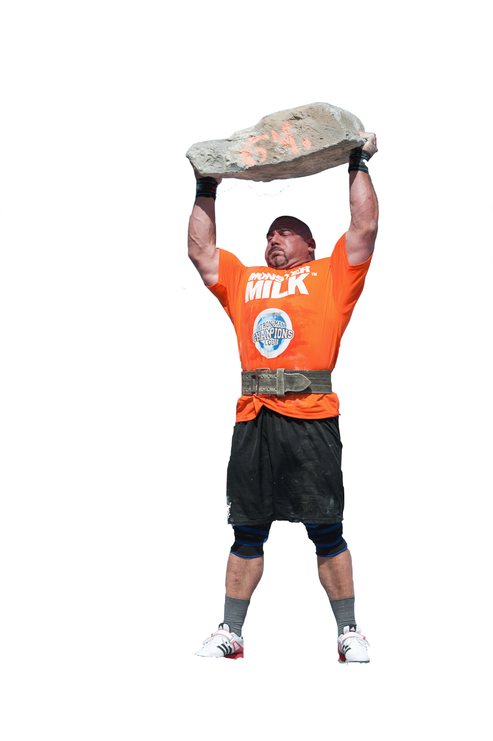

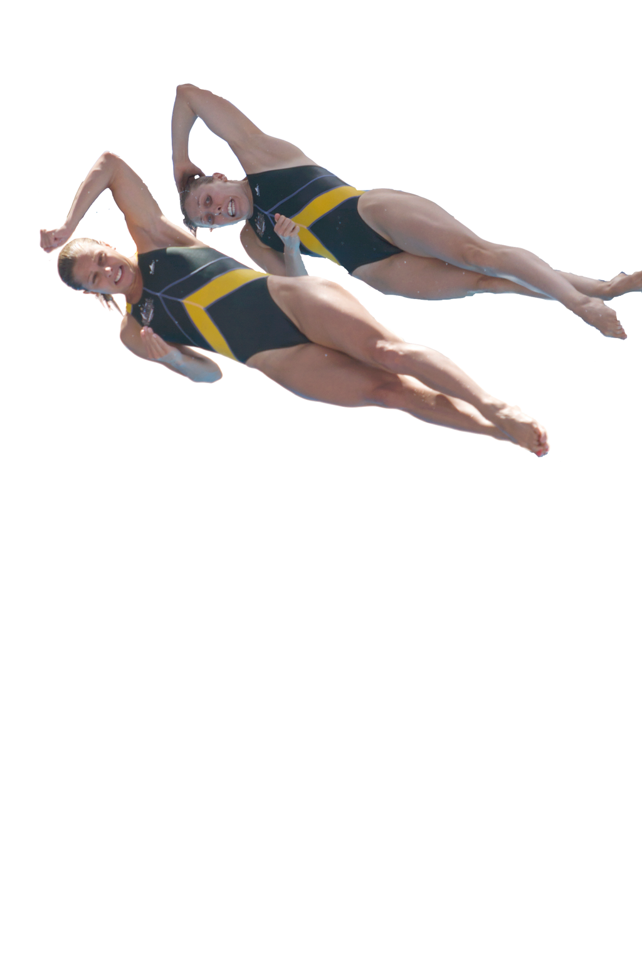
Skill continuums
Skills can be classified on these 3 continuums:
  Open and Closed Skills
  Fine and Gross Skills
  Basic and Complex Skills
open
closed
fine
gross
basic
complex

Slide 11
Open skills
Open Skills
    Some skills need to be
    constantly adapted or
    modified during play.
    The environment is not
    under the performers control,
    usually because others are involved.
    Some affecting factors may be, opponents, weather and surface.

Slide 12
Closed skills
Closed skills
    These skills are fairly fixed and require
    little adjustment during competition.
    Closed skills are practised repeatedly
    until they become consistent and effective.
    The performer is in control of the environmental factors e.g. in a tennis
    serve the skill is the same every time.
    Some other closed skills do have environmental factors that may require some adaptations for example, the crowd and the goalkeeper when taking a penalty in Football.

Slide 13
Fine and gross skills
Fine Skills
    Use small muscle movements.
    The movement is usually precise
    and intricate.
    They usually involve good hand-eye
    co-ordination.
Gross skills
    Involves large muscle movements.
    The movement is not very precise.
    Weight lifting is a good example of
    a gross muscle movement.

Slide 14
Basic and complex skills
Basic Skills
    This is a simple movement.
    It requires little concentration and thought.
    Movements can include throwing.
Complex skills
    Use large amounts of concentration.
    The movements are extremely complex and need
    to be practised over and over for
    them to be performed accurately.
    A synchronised dive is a good
    example of a complex skill.

