Slide 1
Information processing
3.2 Skill acquisition and psychology

Slide 2
Decision Making
Limited Channel Capacity
Input
Feedback
Output
Basic information processing
Short-term Memory
Selective attention
Single Channel Hypothesis
Long-term Memory

Slide 3
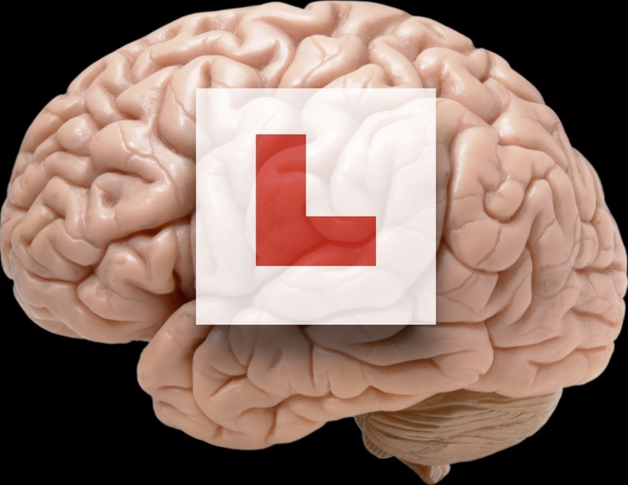
Information processing
The brain is split into the long-term (LT), where information is stored and retrieved when needed and short-term (ST), the working memory where information arrives, is discarded or stored in the LT.
They work together to learn and repeat skills in the following way.
1. Information arrives at the ST memory
2. It stays here for only two minutes
3. The ST focuses on the important information. This is called selective attention
4. The skill is practised and reinforced by the coach
5. Skill is transferred to LT memory
When the brain receives similar information it scans
the long term memory for the skill movement.

Slide 4
Learning
Learning is done in our brain! So it is important to understand how it does this best.
The Information Processing Model briefly describes how information is collected, filtered and acted upon and then remembered.
Input
Information collected from the eyes, ears and muscles. Selective attention occurs.
See the goal keeper
off his line
Decision Making
Information is filtered and the long-term memory checked to make a decision. This occurs in the short term memory
Chip the goal keeper
Output
Information is sent to the muscles and action is taken after the decision is made.
Strike under the ball
to lift it high
Feedback
This is how it felt (intrinsic), how it looked, how it sounded, what your coach said (extrinsic).
Chip wasn’t long enough and the keeper saved the shot.

Slide 5
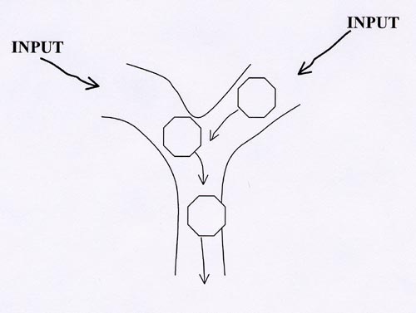
Limited channel hypothesis
The brain is designed to process a limited amount of information at any one time. If we try to do more then performance will suffer.
The Single Channel Hypothesis states that the brain only has one channel for processing information and if needed must switch between tasks.
Selective attention makes sense of the information only passing along useful information.

