Slide 1
Goal setting and SMARTER targets
3.3 Skill acquisition and psychology

Slide 2
Exciting
Recorded
Realistic
Agreed
Time-phased
Goal setting and SMARTER targets
Specific
Measurable
Goal-setting

Slide 3

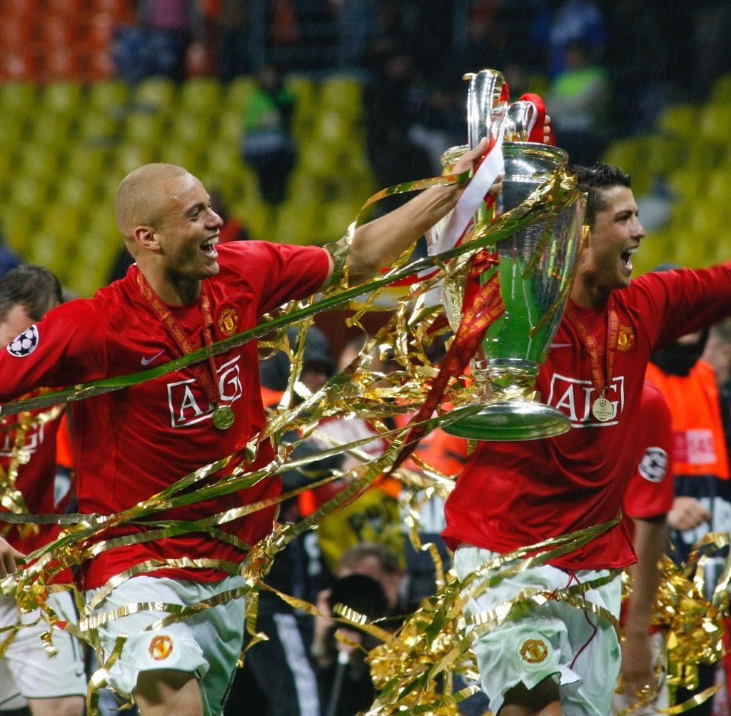
Motivation
Extrinsic Motivation
“Motivation that comes from outside our own personal drives”
Prize money.
Medals and trophies.
Publicity.
Fame.
Intrinsic Motivation
“The internal drive to
participate or do well”
Fun and enjoyment.
Satisfaction
and pride.
For its
own sake.
Personal accomplishment.

Slide 4
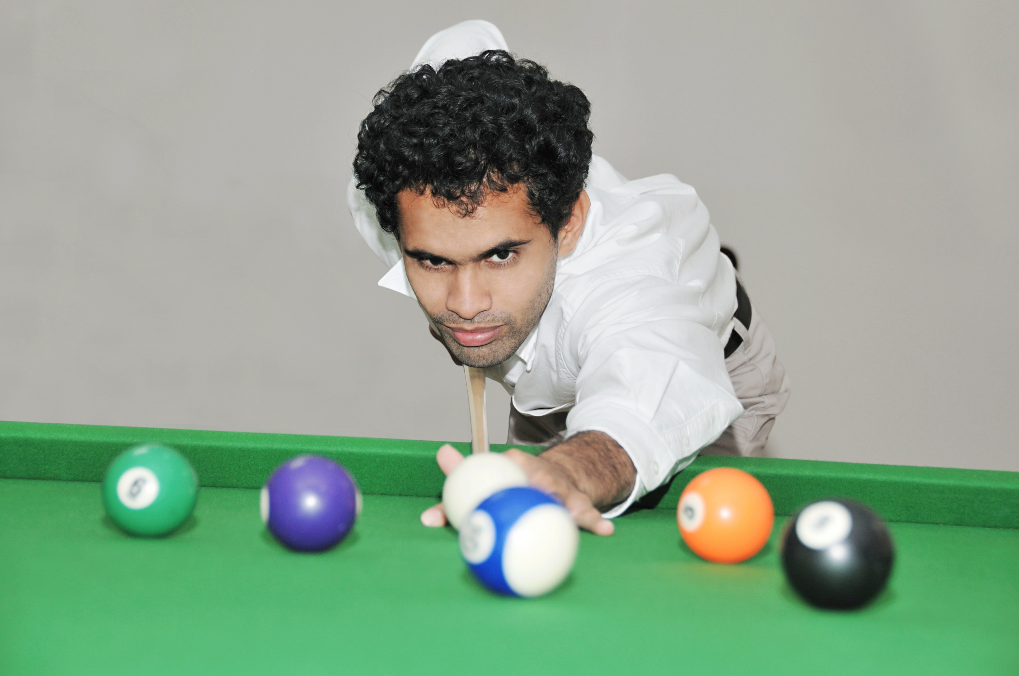
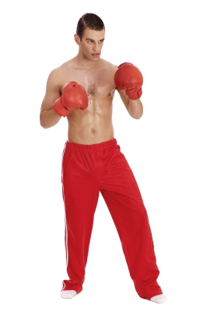
Personality types
Your personality may determine which sports you are attracted to. There are two main types:
Introvert
Tend to be quiet and dislike large groups.
They tend like sports which require
self-motivation, individual performances, low
arousal and precision. Example sports would be archery, snooker and long-distance running.
Extroverts
Tend be more loud and excitable.
They like team sports that are exciting, fast paced,
high arousal and simple motor skills.
Example sports would be rugby and boxing.

Slide 5


Arousal
  “The state of readiness and alertness.”

Slide 6
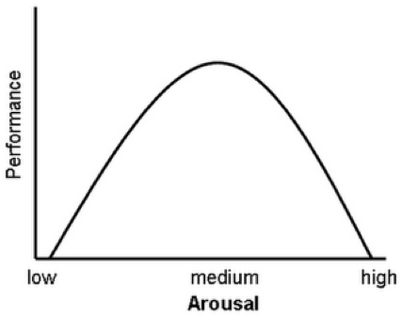
Arousal
Look carefully at
the graph.
Describe the relationship between performance and arousal levels.

Slide 7
Arousal
When arousal is at the appropriate level performance will be at its optimum.
If arousal is low the quality of performance is poor.
When arousal is too high performance is poor.

Slide 8
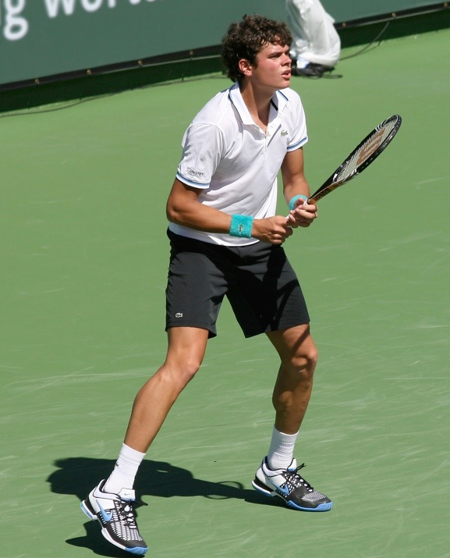
Arousal
When you are frightened or nervous adrenalin is squirted into the blood.
It makes the heart beat faster
so the athlete is ready to perform.
There is an increase in the amount
of oxygen and glucose to ensure
muscles are ready for action.
Blood vessels in the gut constrict
shunting more blood to the muscles.
It makes muscles tense, ready for action.

Slide 9
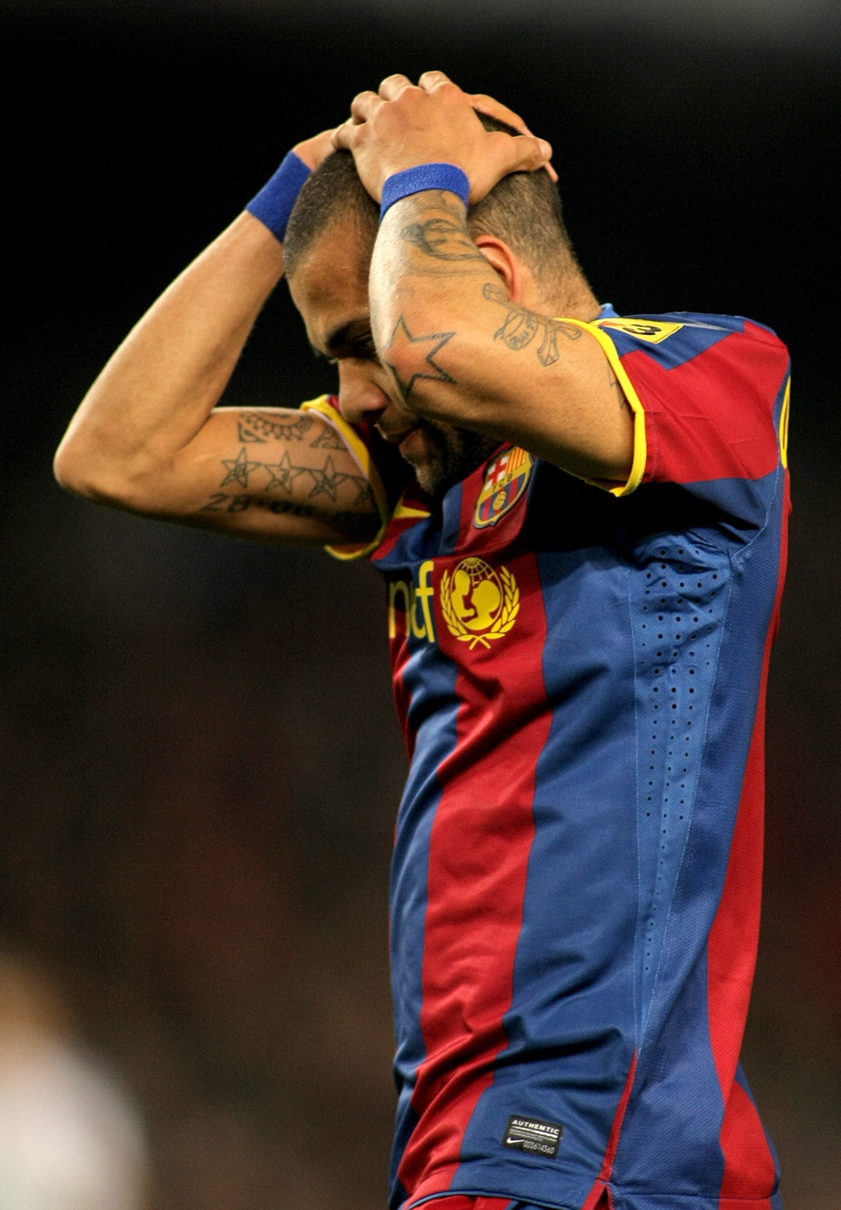
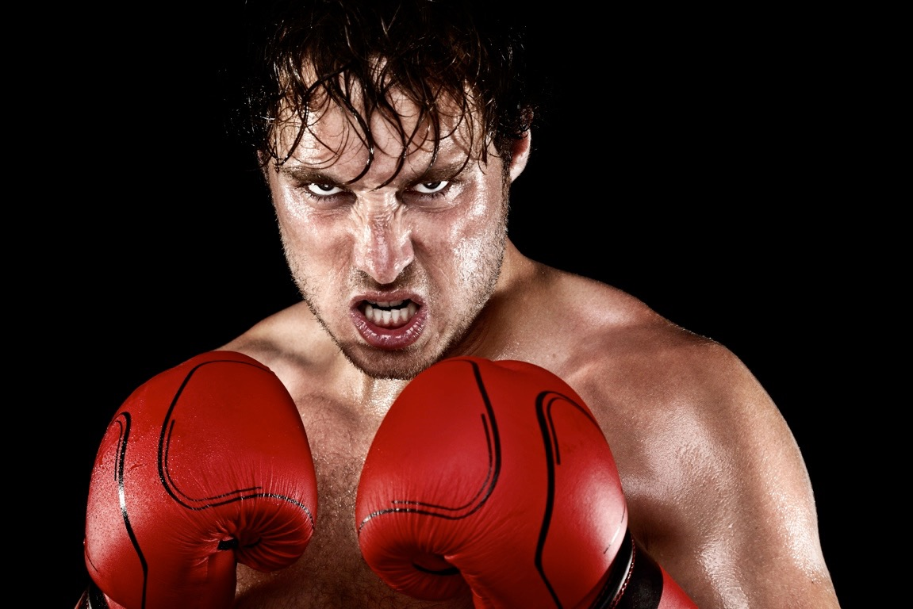
Under and over arousal
Under arousal is characterised by lethargy, whilst over arousal leads to lack of focus.
Little energy if the arousal is
too low.
  Distracted from the task and
  makes mistakes.
  Lack of concentration.
  Over aggressive if the arousal
  level is too high.
  Contact sports and gross motor skills
  require high levels of arousal.
  Fine motor skills and precision
  sports require lower levels of arousal.

Slide 10
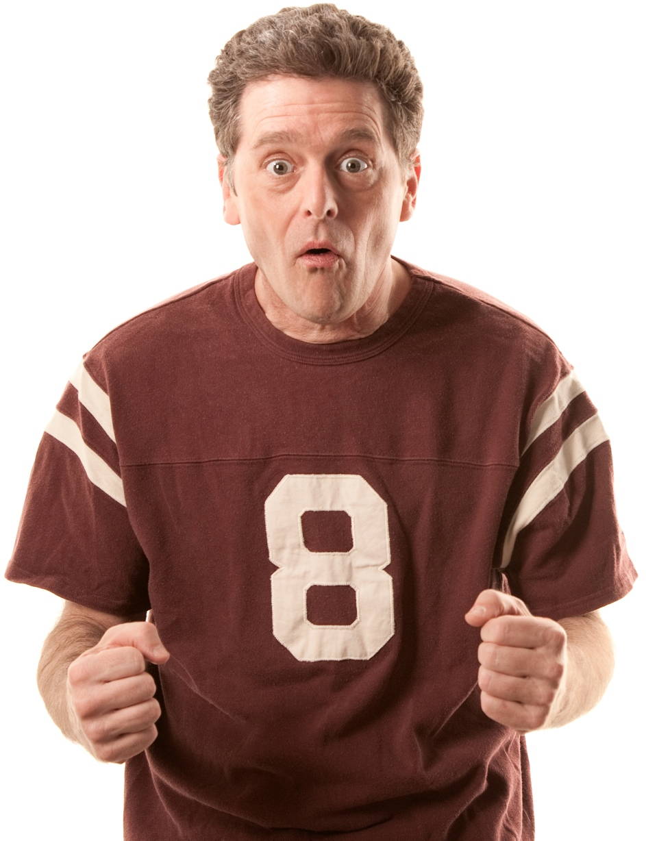
Anxiety
Anxiety is a cause in the decline of performance and can be a cause of over-arousal.
Definition:
“Anxiety is a negative emotional
state that results in negative
physical and mental behaviours
such as constant worry or
sweating, shaking and feeling
sick.”

Slide 11

Symptoms of arousal
Somatic Anxiety - Physical responses
Dry mouth.
Increase in breathing rate.
Heart rate increase.
Sick feeling in the stomach.
Sweaty palms.
Nervous/shaking.
Cognitive Anxiety - Mental responses
Fear
Confusion
Negative thoughts
Poor concentration
Low confidence

Slide 12
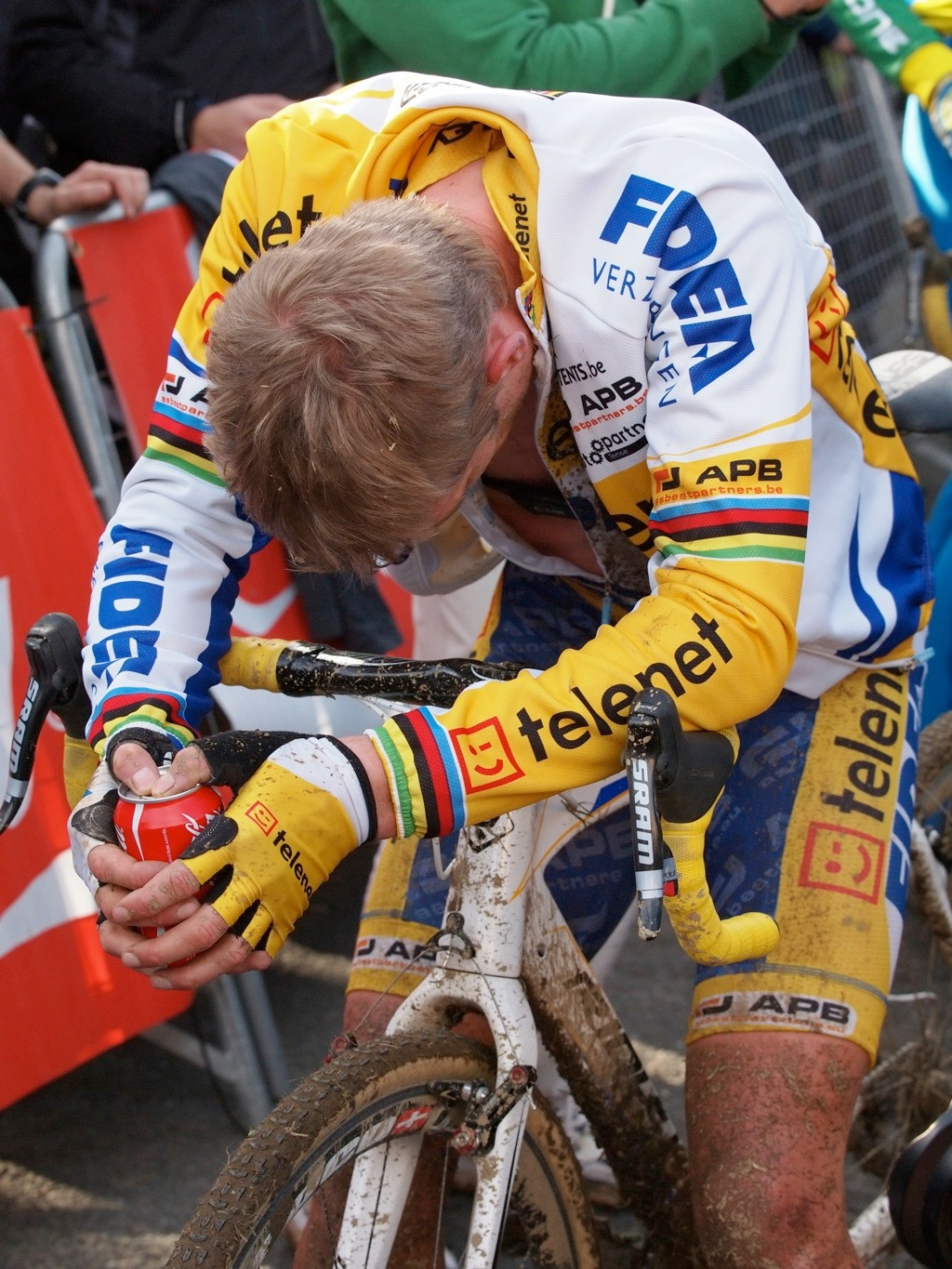

Causes of anxiety
There are both internal and external causes.
External Causes
Bright lights.
Noise from the crowd.
Team talk from
coach/team mates.
Peer pressure.
Family.
Television.
Press coverage.
  Internal Causes
Fatigue.
Injuries.
Internal pressure
to succeed/perform.
Perceived importance of competition.

Slide 13
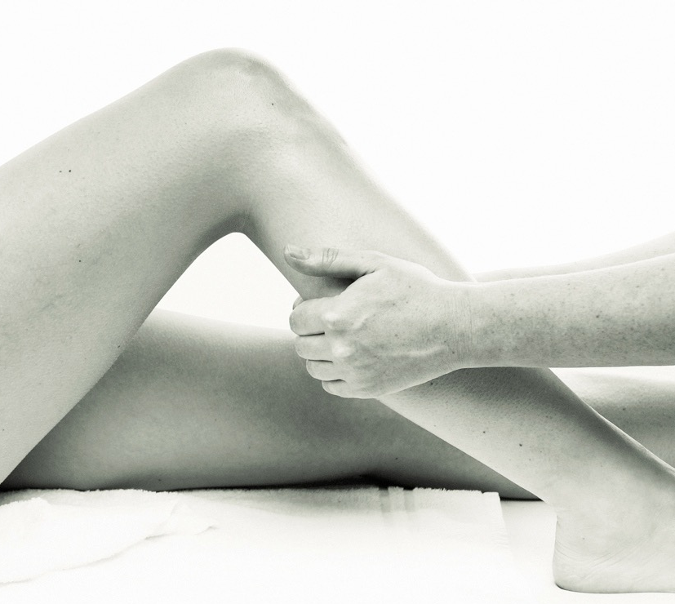
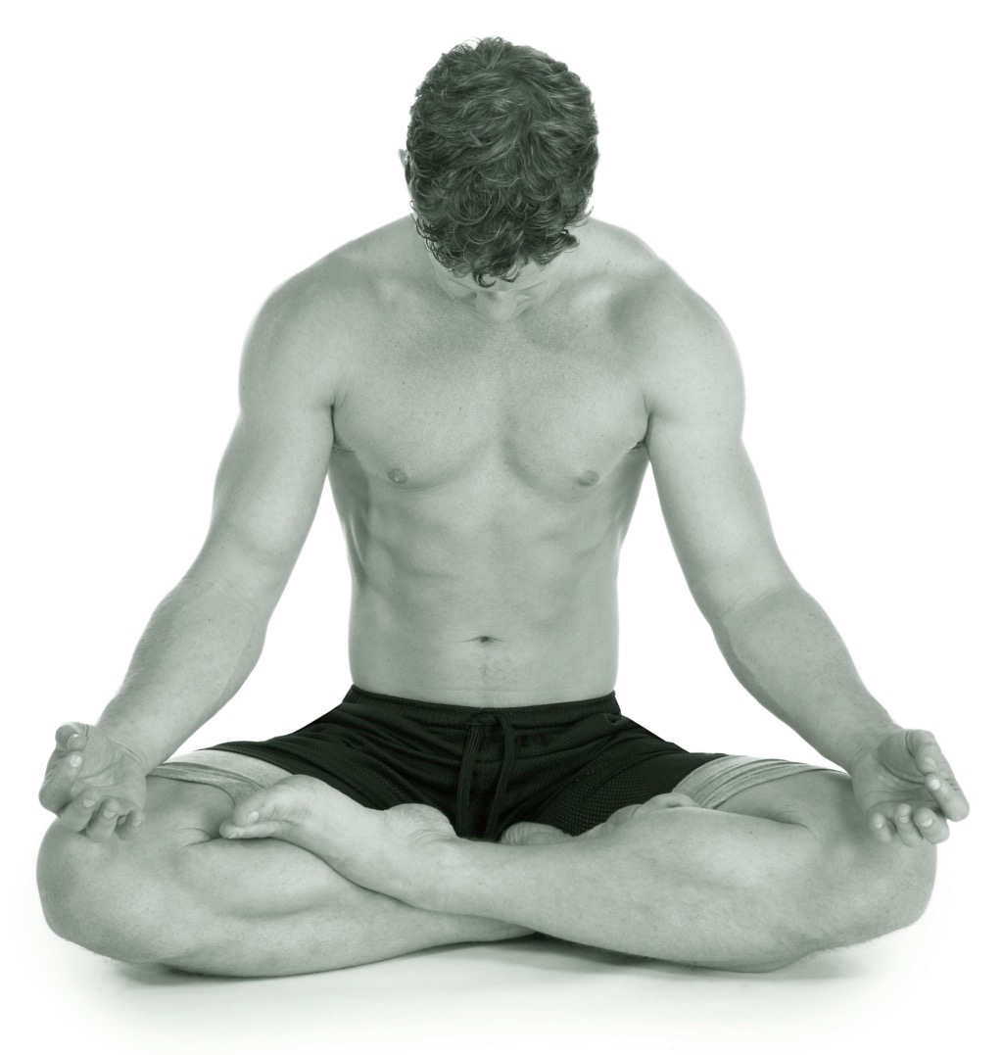
Controlling anxiety and arousal
Relaxation
Physical - Involves a number of
techniques where the intertwined
nature of the body and mind is used
to relax the athlete. This might be in
the form of progressive
muscle relaxation or muscle manipulation.
Mental - This can be in the form of
meditation or positive “self-talk”. The
performer should breathe deeply and
slowly. The performer can also use
distraction techniques like listening to
music.

Slide 14
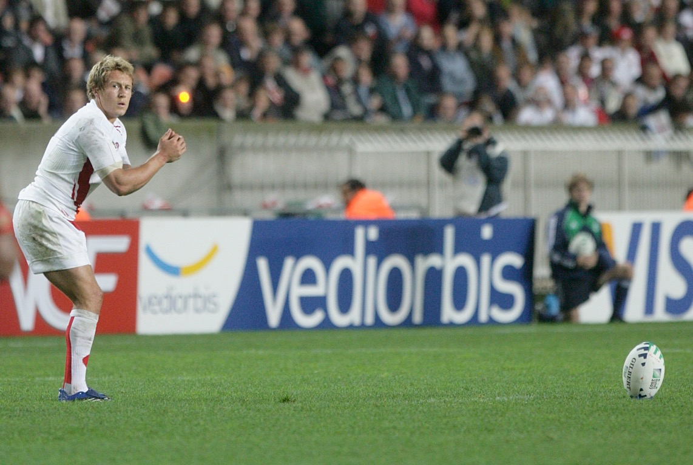
Controlling anxiety and arousal
2. Visualisation and Mental Rehearsal
  Mental rehearsal is the process of imagining the entire performance. You imagine yourself performing well and this increases confidence. It also decreases anxiety and in doing so reduces heart rate.
  Visualisation involves imagining a snap shot of the performance. A tennis player may take a few seconds to visualise him or herself hitting the perfect serve in the place where he or she
  wants.
  A quarterback can go through a
  play in his mind just before
  performing the play.

Slide 15

Goal setting
Goal setting is a really good method used to control anxiety, focus training and increase motivation.
To ensure your goals are effective you should make sure they are SMARTER.

Slide 16
Goal setting
Specific – The goal should be focused on the specific skill or muscle group you want to develop.
Measurable – The goal should be measurable so progress can be seen and further motivate.
Agreed – The athlete should accept the goal so there is commitment to training.
Realistic – If the goal is too easy or too hard then the athlete will not be motivated. Challenging but realistic targets are best.
Time-phased – Having a date to aim for focuses the
athlete to achieve their goal in the time provided.
Exciting – The goal needs to be inspiring and
exciting so the athlete is motivated to achieve it.
Recorded – Progress is best seen when the
results are recorded.
S
M
A
R
T
E
R

Slide 17
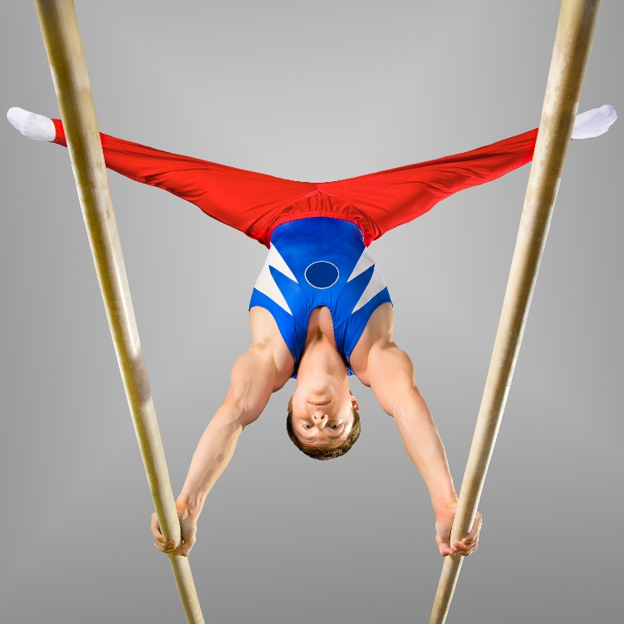
Goal setting examples
Sprinting
Performing a personal best time at the Olympic Games.
Weight Lifting
Lifting 10kg extra in eight weeks of training.
Gymnastics
Execute a front somersault in a floor
routine by the next competition.

