Slide 1
Guidance and feedback on performance
3.4 Skill acquisition and psychology

Slide 2
Intrinsic Feedback
Negative
Extrinsic Feedback
Mechanical
Guidance and feedback on performance
Visual
Verbal
Guidance
Manual
Positive

Slide 3
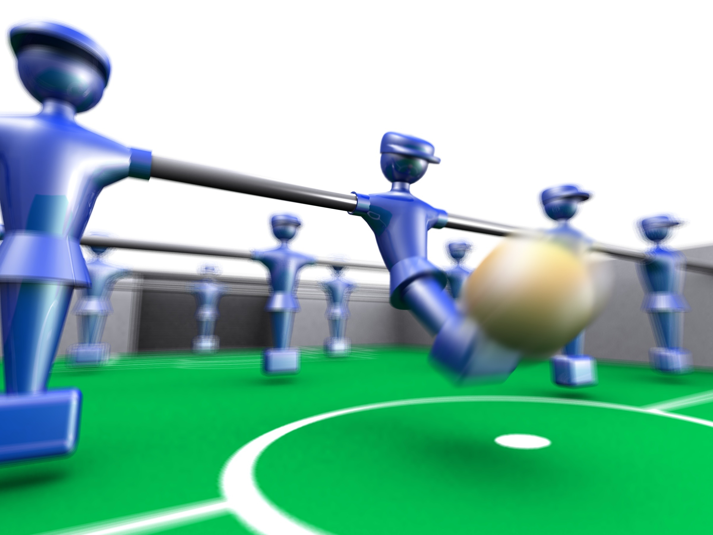
Types of guidance
Guidance is a way of giving information to a performer.
It assists in learning a skill or refining a performance.
There are four different types:
  Visual
  Verbal
  Manual
  Mechanical

Slide 4
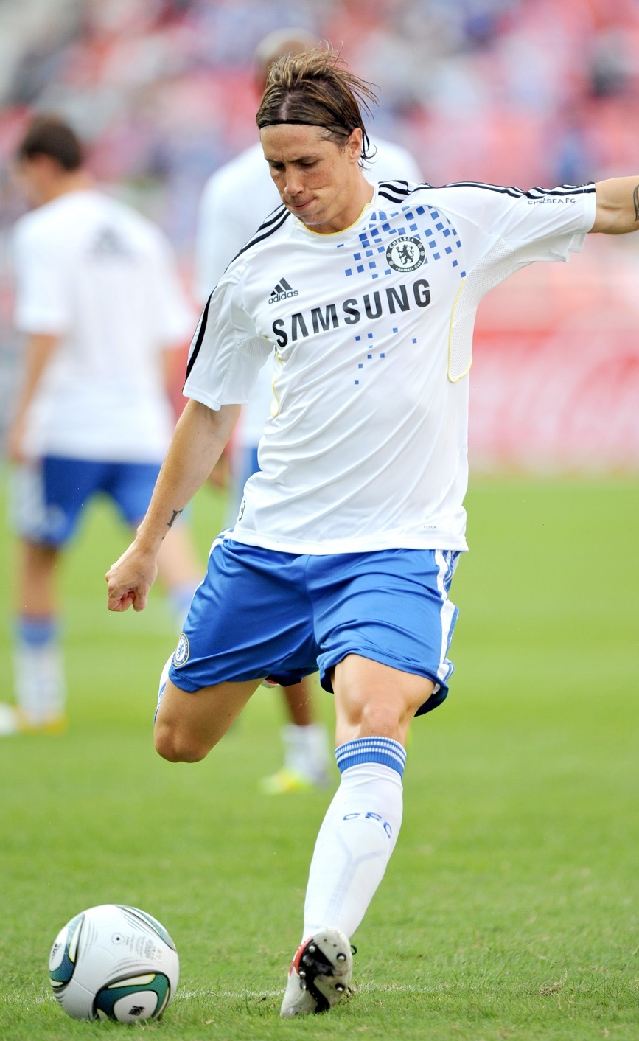
Visual
Visual (Guidance you can see)
Watching someone else perform the skill on a video, in a picture or in real life. This can be motivating, inspiring and informative.
Copying someone you admire is stronger
than someone you don’t so role models
are powerful demonstrators.
It is useful for all levels of performer especially
young and inexperienced performers.
When teaching a skill through demonstration it is important that the learner is paying full attention, has the ability to copy the skill and is motivated to repeat it.
Suitable for learners at the cognitive stage of learning.

Slide 5

Verbal
Verbal (Guidance you can listen to)
This is when someone describes the skill.
The performer hears the guidance.
Coaches are able to give instant feedback that meets the individual’s needs.
Higher-level performers are able to
respond more readily than inexperienced
performers.
However, this type of guidance can be boring
and often complex tactics or skills are hard
to describe.
Suitable for performers at the associative
or autonomous stage of learning.

Slide 6
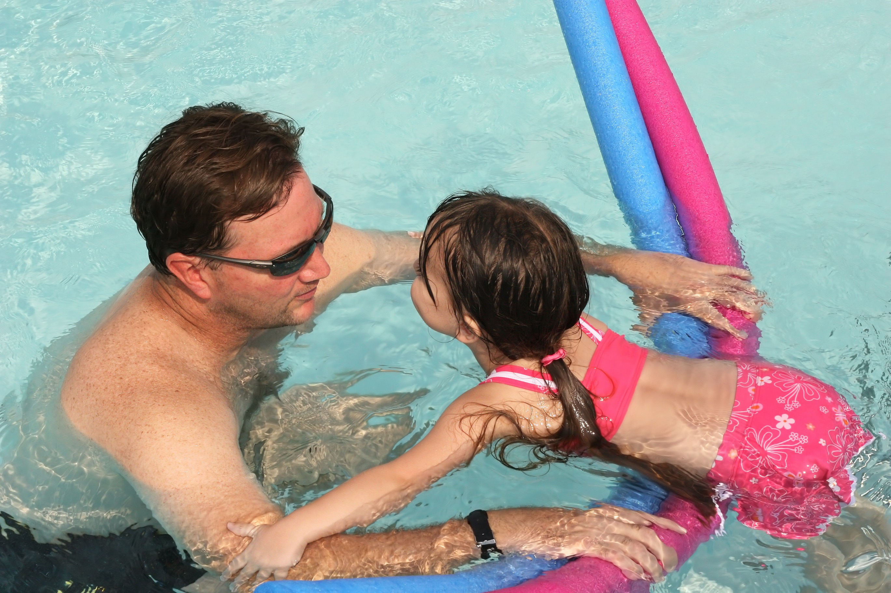
Manual
Manual (Guidance you can feel)
This involves a coach physically guiding you through the skill. It allows the performer to feel the movement safely.
They move the body into position and support them in the skill. This is effective for beginners or learners at the cognitive stage of learning.
However, it can be demotivating as
the performer may not feel they are
performing the skill themselves and
it may feel different without the
manual guidance.

Slide 7
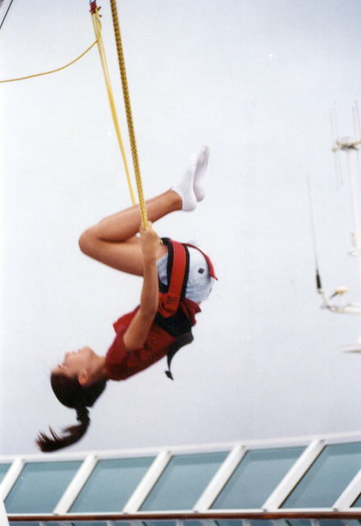
Mechanical
Mechanical (Guidance you can feel)
The use of aids or objects to assist in the skill learning process.
These are used in high risk skill
learning found in Gymnastics or
Trampoline.
It allows the performer to learn
without fear.
However, the equipment is often
expensive and the performer may
rely on the aid.
This guidance is suited to performers
at the cognitive or associative stage of learning.

Slide 8
Feedback
The brain is also constantly receiving feedback from all the senses this helps to improve and refine the skill learnt. There are different types of feedback:
Intrinsic Feedback – Comes from inside.
This feedback from the body’s own
sensors, seeing the ball fly when
you hit it, hearing the sound of
contact on the ball, feeling the
contact on the ball.
This feedback is most useful to performers at the associative or autonomous stage of learning.

Slide 9

Feedback
Extrinsic Feedback - Comes from outside sources.
There are two types of extrinsic feedback;
  Knowledge of Results - Seeing you scored.
    Tells you the outcome of your actions.
  Knowledge of Performance - Your coach tells you that you need to open out of the somersault earlier in diving.
    Tells you how well you have performed.
This is most suited to performers at the
cognitive stage of learning.

Slide 10

Feedback
Positive
Used to motivate the athlete and let them know what they are doing correctly.
However, it may make the athlete feel the performance was more positive than it actually was.
Negative
Used to inform the athlete about an incorrect movement and what they must do to correct it.
It can be demotivating and overuse can leave athletes not knowing what to focus on.

