Slide 1
Factors affecting access and participation in physical activities
4.1 Social, cultural and ethical influences

Slide 2
Youth Sports Trust
People
Centres of Excellence
PESSCL
Age
Fashion
Resources
Media
Factors affecting access and participation in physical activity
Health and Well-being
Cultural Differences
Sport England
Roles
Socio-Economic

Slide 3
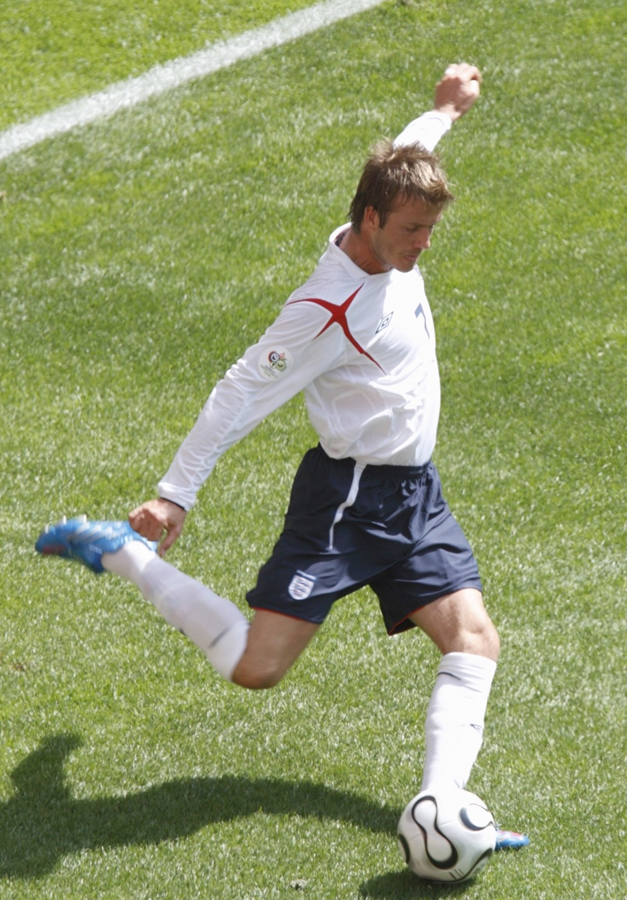
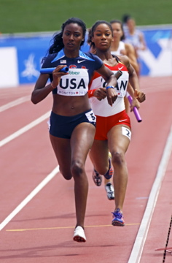

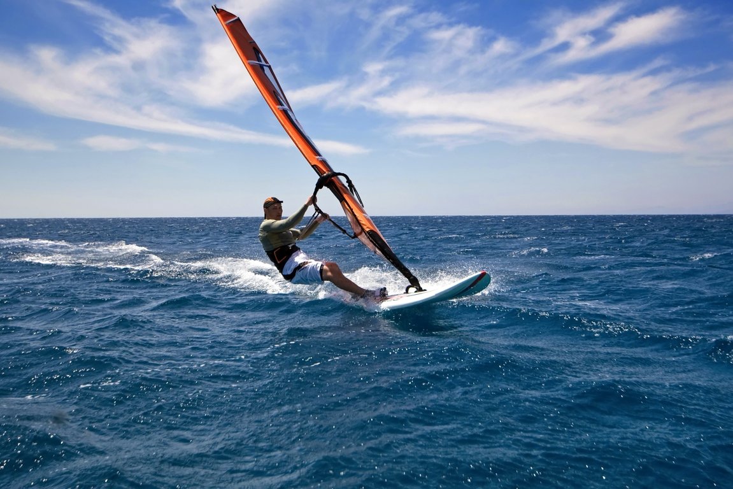

Factors that affect participation
  Cultural Differences
  Age
  Disability
  Gender
  Social and cultural differences
  People
  Family
  Peers
  Role Models
  Media Coverage
  Resources
  Facilities
  Access
  Environment
  Time
  Socio-economic
  Status
  Cost

Slide 4
Family
Parents and family interests in sport can greatly influence
the choices of the younger family members. Reasons for
this are;
  Sporting traditions in a family.
  Membership of family members to sports clubs.
  The family atmosphere of a club where families
  come together and socialise through sport and shared interests.
  Young people watch their family members participate and see them as a role-model to aspire to.
  Parents often have to fund and transport children to and from the sports event so they may have input into which ones they do.
  Family members may be the first people to introduce the young people in the family to sport. First impressions can be lasting.

Slide 5
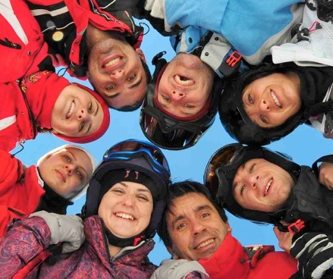
Peers
People who are a similar age can greatly influence our choices.
  If a close peer who takes part in an activity can encourage you to also take part. This is called “peer pressure”.
  Starting an activity with a friend can often be easier.
  You may feel more confident if there is someone there who you know.

Slide 6
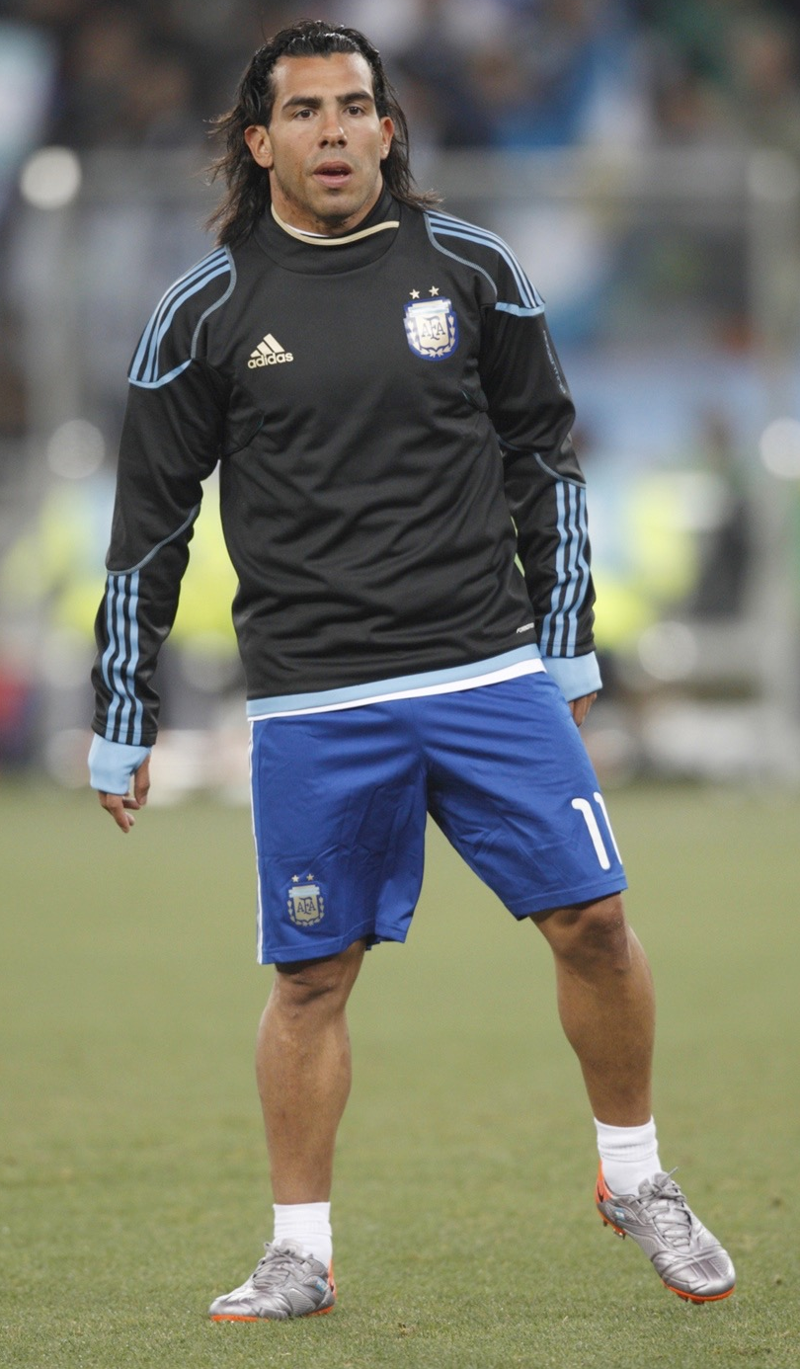
Role models
    Increased media coverage has introduced
    fame into sport with many athletes being
    idolised.
  Their actions and behaviour are reported on regularly and this can often influence the attitude and behaviour of their fans.
  Top-class athletes can encourage those who aspire to be like them to take part in sport.
  Many are involved in campaigns to raise the level of participation in their sport i.e. David Beckham Football Academies.

Slide 7
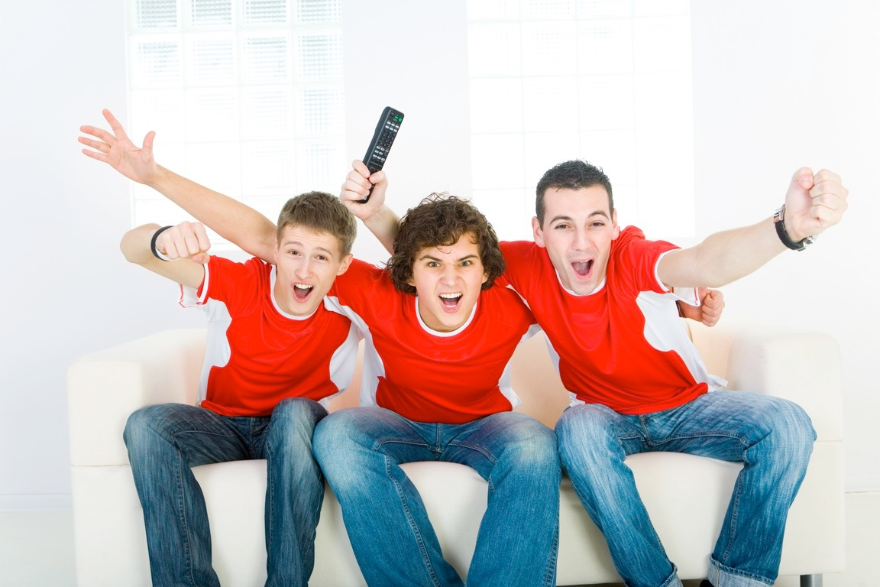

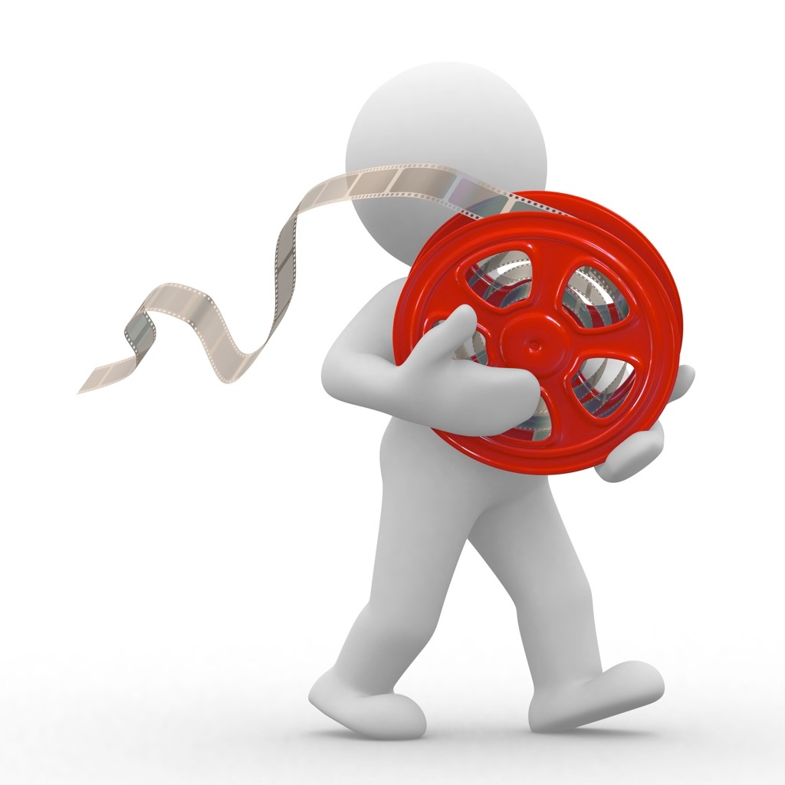



Media
In our day to day lives we are surrounded by media and this is what makes it so influential.
There are many different types:
Television
Film
Radio
Magazines
Newspapers
Books

Slide 8

Positive effects of the media
Media has had a large role in raising participation in sport. This phenomenon is due a number of factors;
    Edited highlights and high profile presenters
    inspire others to get involved.
    Pundits can educate people about different
    sports.
    Provides news and updates in that sport.
    Motivational music is often combined with exciting clips of sports performances.
    Programmes are frequent and timed so large audiences can watch it.
    Greater public awareness of disability and minority sports if they receive exposure on the television.

Slide 9
Positive effects of the media
  Attracts more sponsorship and funding into sport, which improves standards of performance, equipment and facilities.
  The technology of television is used in decision
  making in the games.
  Enhances development in sport.
  Helps attract sponsors to the sport as well as the money from broadcasting rights.
  The increase in sports channels has increased the coverage of minority sports.
  More sports are available to all.
  Increased depth of coverage. Some football clubs have their own channels.
  More live sport can be viewed by more people.

Slide 10
Negative effects of the media
If the media does not promote the sport people are less likely to understand it and therefore take part.
  Less media coverage can mean less
  sponsorship, funding and other financial
  support.
  The situation is a vicious circle. People don’t
  watch sports that are not popular so the media doesn’t show less popular sports. An example is American Football, which is very rarely shown on UK channels.
  Can discourage watching sport live.
  Replays can undermine sports officials.
  Sport coverage can suffer from over-exposure and people lose interest.

Slide 11


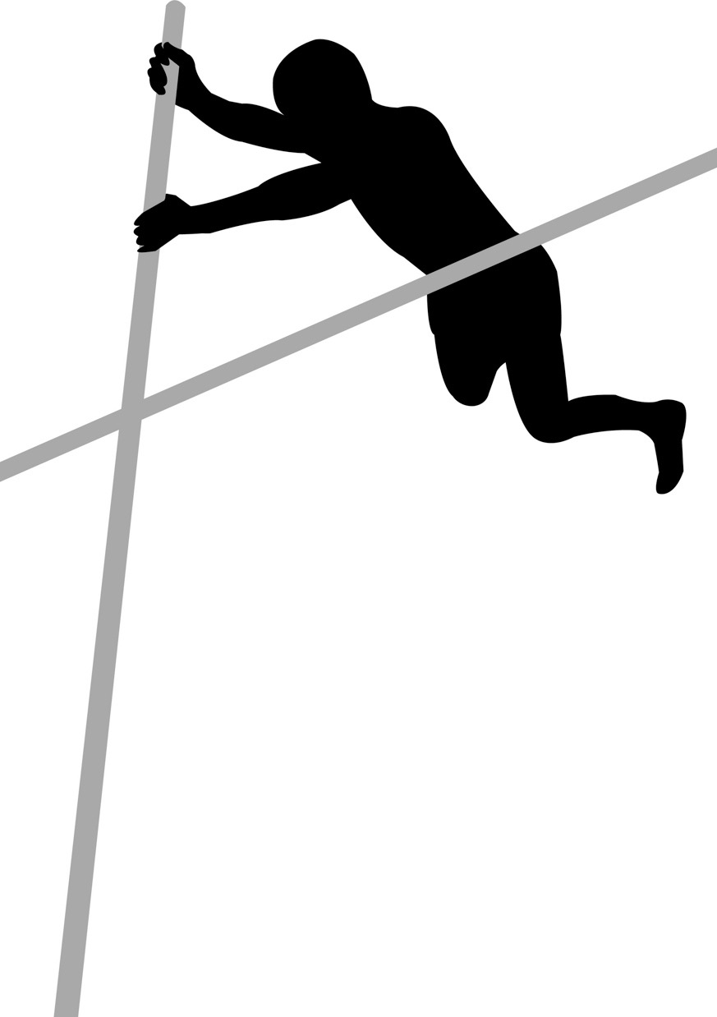
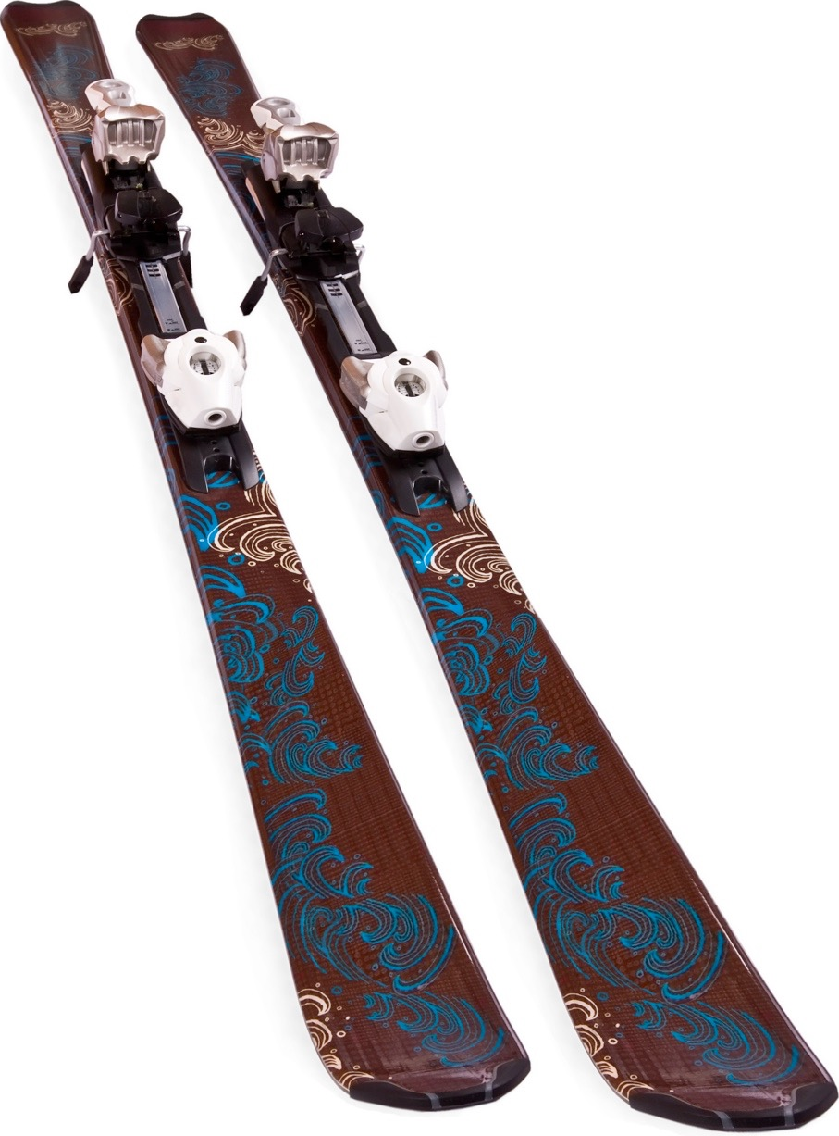
Negative effects of the media
The media has influenced some changes to rules in sport.
    Squash - To make the scoring more exciting competitors score on every point rather than scoring only on their serve.
    Athletics - Grand Prix events allow for the whole meet to be completed in one evening.
    Rugby and Tennis - Introduction of video referees to make decisions on tries and balls called out.
    Tennis - Tie breaks at the end of a set so matches finish more quickly.
    Football - New off-side rule to prevent stoppages. Also names have been added to shirts so viewers can easily recognise players.
    Rugby - 5 points for a try has been introduced to increase the score.
    Skiing - To make winter sport competitions more exciting to watch they have introduced extreme snowboarding and skiing where competitors perform acrobatics.

Slide 12

Negative effects of the media
The impact of media and television on the sports
performers, managers and coaching staff can also
be very negative.
  The media can often intrude on sports stars
  and managers' personal lives trying to find a
  sensational story. This makes it difficult for
  them to concentrate on training.
  If the media smears negativity about a team or performer this can cause them to lose confidence. It can also stir crowds and spectators to be negative also. The media has sometimes been blamed for the England football team’s poor performance.
  As well as playing, sports stars and managers are often asked to give interviews and make appearances. This can disrupt training and recovery time.

Slide 13
Negative effects of the media
  The major television corporations make high physical demands on players by insisting on teams competing in many competitions. The Premiership teams for example play more games than the Bundesliga and La Liga. Some England players often feel more tired and exhausted come the World Cup or European Football Championship.
  Some players receive huge amounts of publicity and it is often reported that they lose interest in performing and start to
  become more interested in fame and media
  exposure.
  The start time and day of matches have had to fit
  in with the wishes of broadcasting companies
  rather than in the interest of the players.
  The media is often speculating about the
  transfer market and who will be bought
  and sold, this can cause performers to feel
  stressed and under perform.

Slide 14
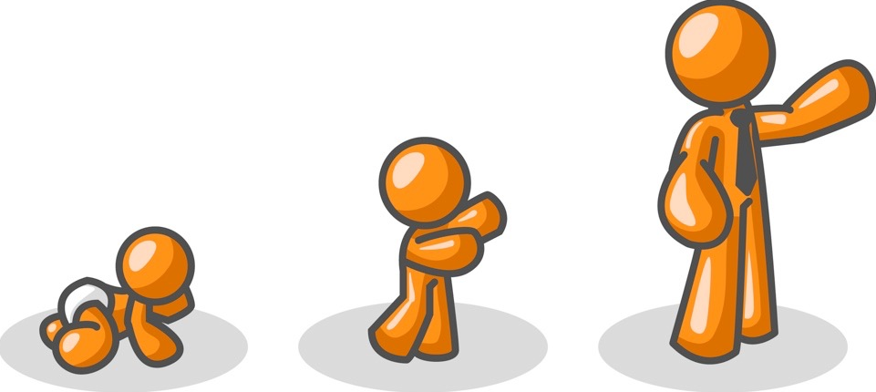
Age
Due to better medical care people are living longer. This means our population is getting older.
    Age limits in some sports can restrict participation i.e. Netball, Rugby, Golf.
    A sports club size depends on the number of age groups.
    Each age group usually has its own section with separate competitions.
    Older people now recognise the importance of physical activity to their health.
    The public and private sector caters more to older people with specialised sessions and activities.
    Concessions for activities for the elderly and off-peak times are increasing in local leisure facilities.

Slide 15
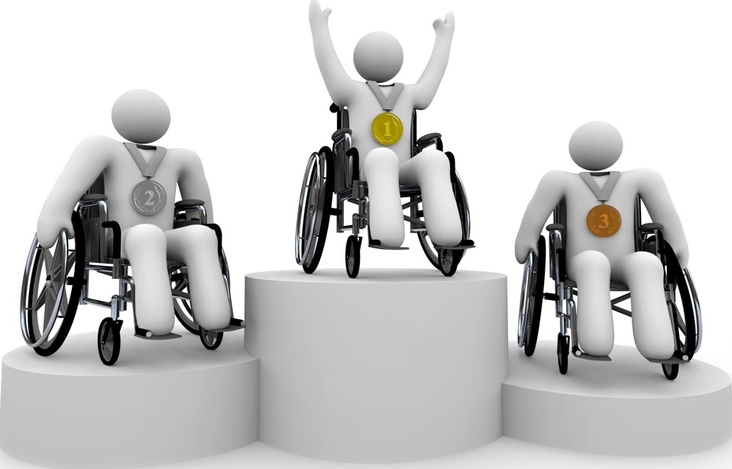
Disability
  Sport for All has encouraged disabled athletes to take part in disability sport as well as other activities.
  Leisure centres and clubs have made their facilities more accessible to disabled athletes by installing ramps and electronic doors.
  There have been adaptations to mainstream popular sports so athletes with disabilities can access them.
  Make disability sports such as Goalball and Wheelchair Basketball available.
  Other initiatives such as Disability Sport Cymru are focusing on sporting opportunities for disabled participants.

Slide 16
Gender
Although both men and women are encouraged to take part in sport they usually compete separately.
  Physical differences in size and strength could result in mixed participation being unsafe or unfair.
  Recently there have been movements towards traditional sports being less stereotyped towards one gender, women play Football and men play Netball.

Slide 17
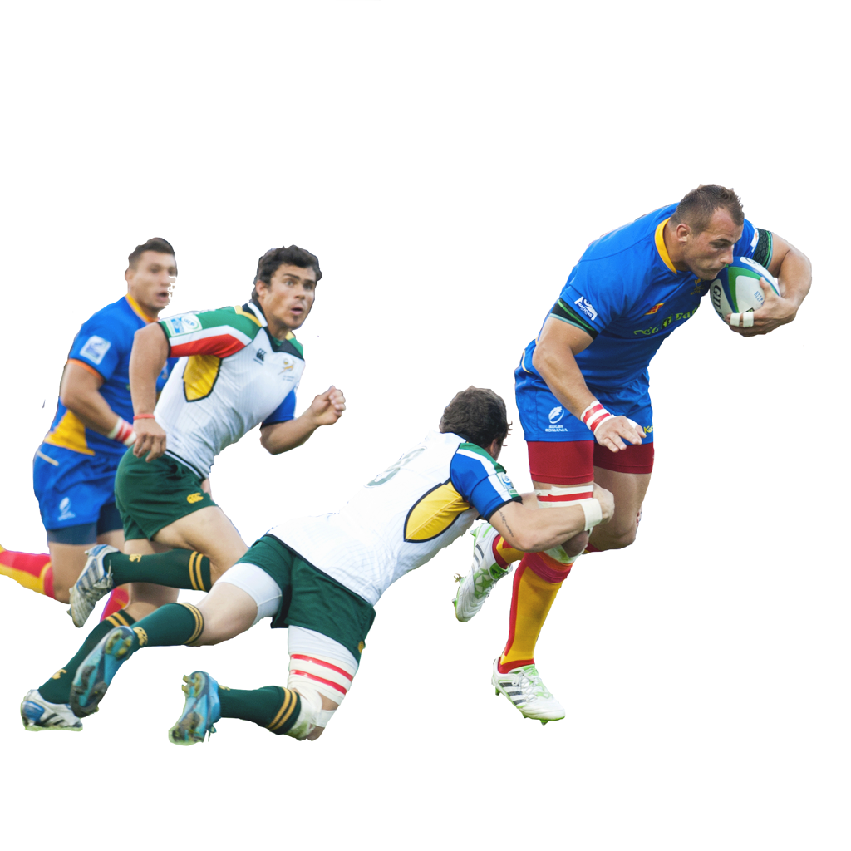
Gender
Men in Sport
  Sport offers an outlet for energy,
  enthusiasm and aggression.
  Sports such as Rugby and Boxing are
  physically demanding contact sports and these are popular with men.
  The success and popularity of a club attracts new members resulting in the continuation and tradition of this sport.
  Males will often join a club to feel part of a team working towards a common goal.
  Clubs often have social events where people can eat, drink and socialise together.

Slide 18
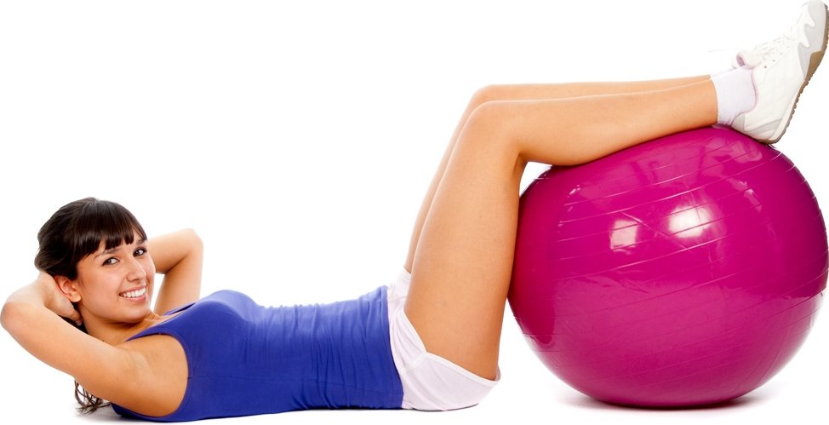
Gender
Women in Sport
  Women may be more attracted to sports that have less physical contact such as Dance, Netball and Tennis.
  There is a high participation of women in non-competitive activities such as Aerobics and fitness.
  Women, like men, are attracted to joining clubs for social reasons.
  Sports that require an increase in muscle mass are less popular with women as most wish to maintain their feminine shape.
  Trends in women’s sport are still evolving and the interests of younger girls are changing. Women’s Football is currently one of the fastest growing sports.

Slide 19
Gender
The involvement of women in top-level sport is increasing due to a number of factors.
  The sports council and governing bodies have increased the opportunities for women in sport.
  An increase in media exposure to women competing at the highest level has created role models for the youth and encouraged other women to become involved.
  Women's sport is now attracting more sponsorship and prize money. This has resulted in more
  female athletes being able to
  compete professionally.
  More high-profile women are being
  asked by companies to advertise
  their products as they want to be
  associated with their wholesome
  image.

Slide 20

Social and cultural barriers
Many individuals from minority ethnic groups enjoy participation in physical activity. However, they can face a number of unique barriers.
Some areas that are highly populated by ethnic minorities don’t have a large amount of sports facilities.
A large number of individuals from ethnic minorities face socio-economic barriers.
Sporting prejudices such as African-Caribbean's being poor swimmers, may discourage individuals from certain sports.
Family and home commitments are valued far higher than sports participation. Child care provision at sports facilities may offer some solution.

Slide 21
Social and cultural barriers
Strategies that can be used to raise participation in minority groups.
  Identify the needs of this particular minority group.
  Appoint a community officer to work with minority groups.
  Make links with schools and promote
  activities for this group.
  Targeted advertising to minority groups.
  Run specialist classes at local sports
  centres i.e. women only classes.
  Provide dual use facilities with schools
  in areas with a high population of minority groups.
  Relax the rules i.e. women don’t have to wear traditional swimming costumes if this conflicts with their cultural views.

Slide 22
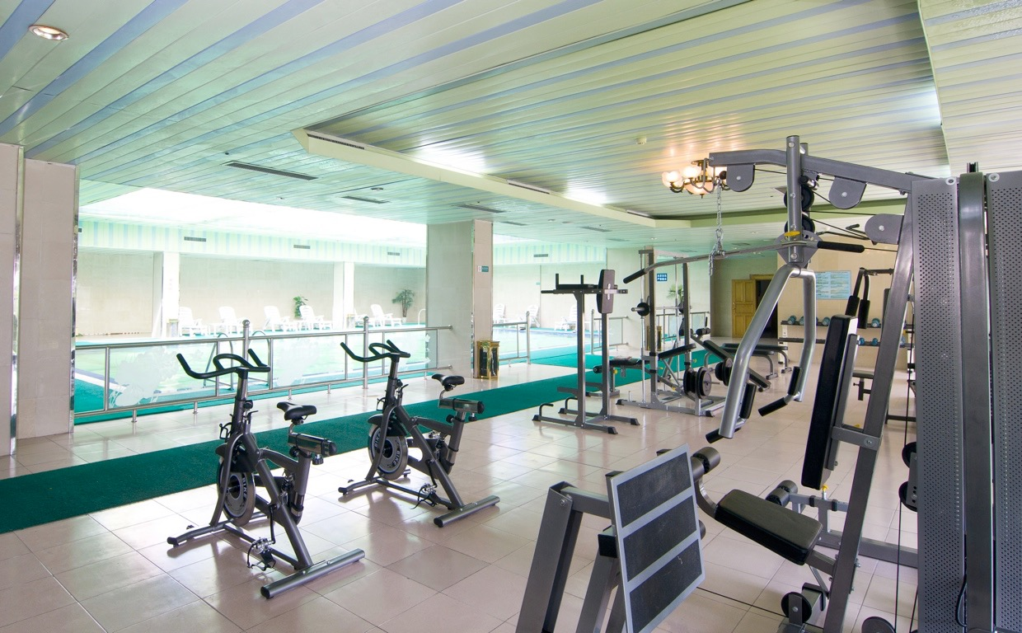
Facilities
There have been a growth in facilities and availability in the 21st century. The facilities on offer to you may influence the sports you take part in.
  Schools have opened up their facilities for dual use
  on an evening.
  Some leisure centres and fitness gyms open up at unsociable hours so people can go before and after work.
  Some swimming pools and leisure centres have women only sessions.
  Government and lottery funding has been used to improve the quantity and quality of facilities.

Slide 23
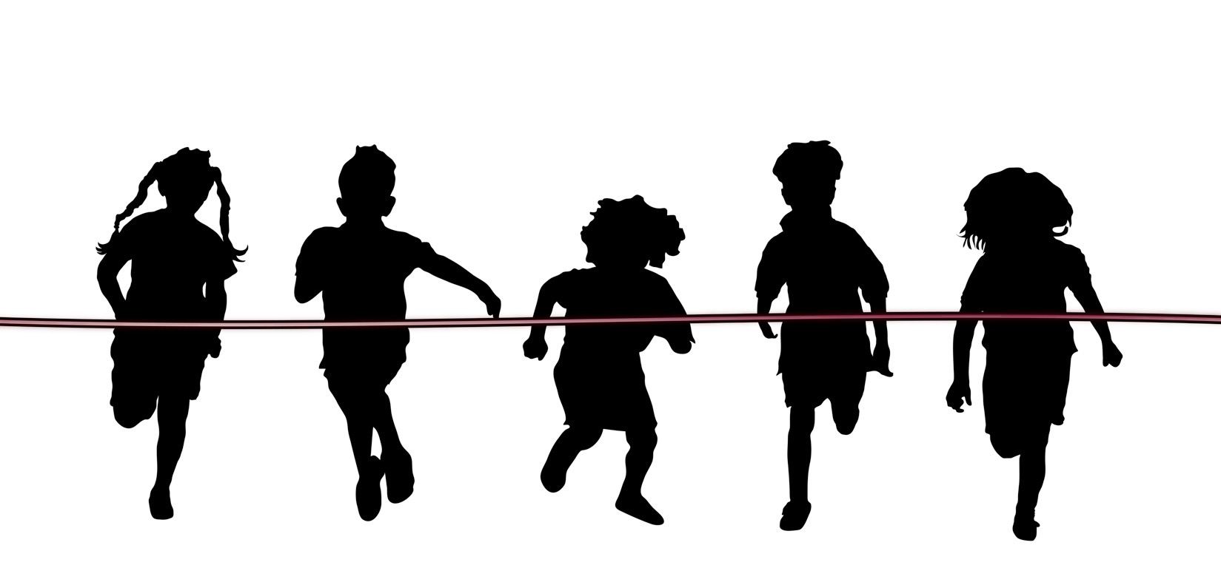
Facilities
For participation to increase in sport people must be able to access it.
  Many initiatives provide additional facilities such as creches and transport to help
  those who have children and
  are less independent.
  Lowering the cost of using facilities or taking part in events and competitions makes them more accessible to those who have low incomes or are unemployed.

Slide 24
Environment
The location of a person to sports facilities can
determine what sport they take up. Things they
need to consider:
  The proximity of the facilities to
  where someone lives. Someone
  who lives in an urban area may have more choice.
  The climate you live in may limit your choice. Someone who lives in a hot country may find it difficult to go snowboarding.
  If you live near the sea you may be more inclined to take part in water sports than someone who lives inland.
  In places where there is a high demand for an activity but the environment isn’t suited it is created artificially. Examples of this are indoor rock climbing centres and indoor ski centres.

Slide 25
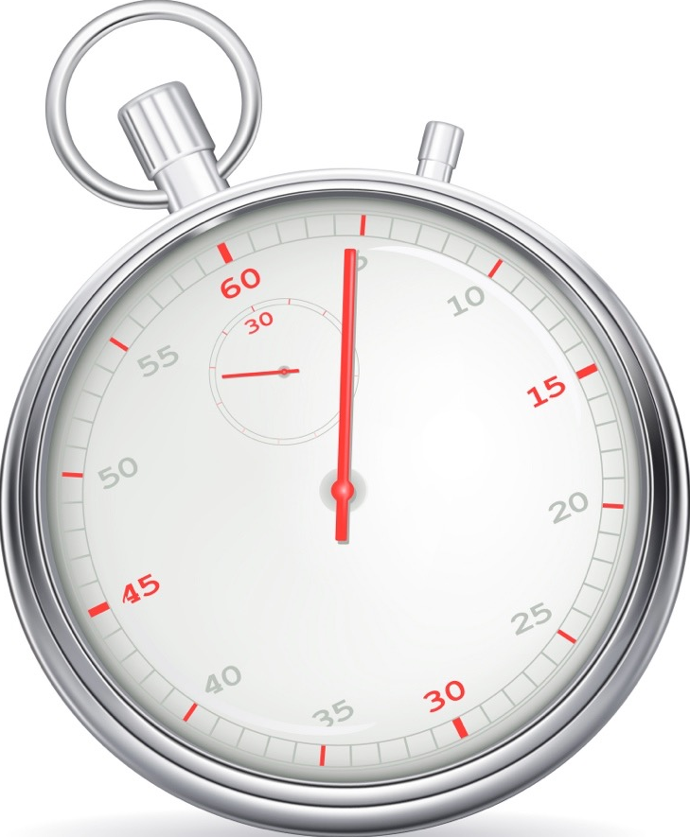
Time
  The amount of free time people have can greatly influence if a person will participate in physical activity or not.
  Individuals who have regular blocks of time off work can take part in sports that require overnight stays such as mountaineering expeditions.
  Individuals with shorter blocks of time off may be more likely to join a local club.

Slide 26
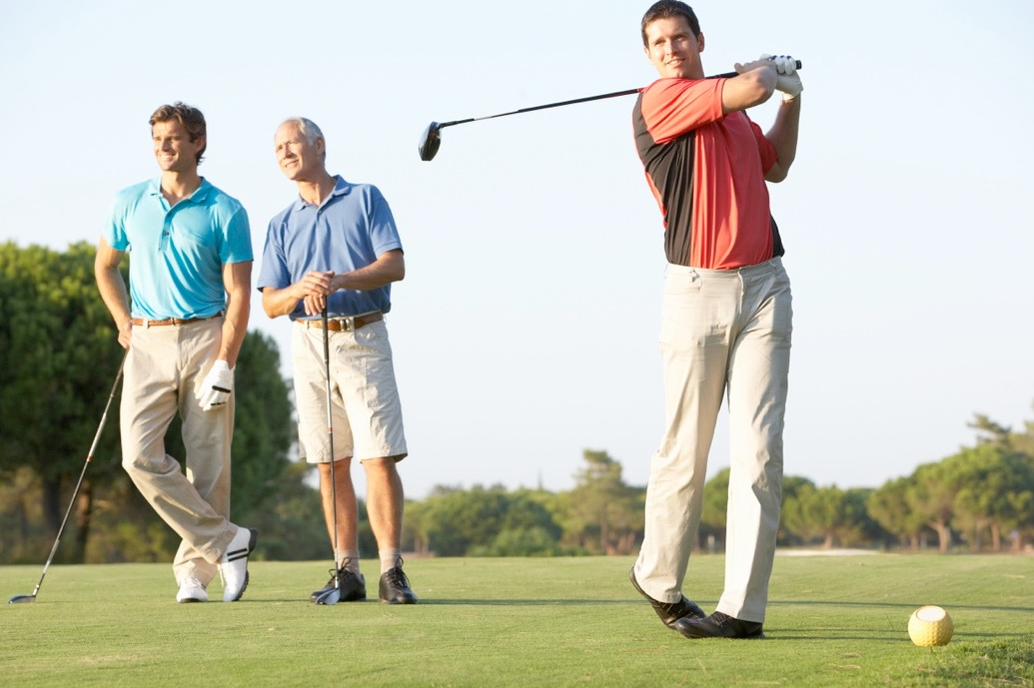
Cost
A large amount of research
indicates that your socio-economic
status may influence the amount
of physical activity you undertake.
  Activities that are considered more upper or middle class are played by those who are wealthier. These include Golf and Tennis.
  In general those who are regularly in employment and work in middle or upper management are more likely to take part in physical activity.

Slide 27
Cost
What activities you take part in may largely
be determined by what you can afford.
Some activities cost more than others.
    Activities like sailing, golfing and
    skiing can be very expensive,
    so only those who have a larger disposable income can afford.
    Others such as jogging, playing football in the park and swimming are cheaper and more can take part.
    A number of leisure facilities offer discounts to those who are on benefits due to unemployment and other social circumstances.

Slide 28
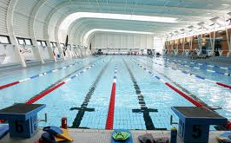
Strategies to raise participation
Increasing participation in sports has been high on the agenda of the UK government for some time. To achieve this they have invested millions of pounds and set up a number of initiatives.
The National Sports Centres
  These centres are offered to the local community as well as elite athletes.
  There are many of these centres across the UK.
  Clubs can be based at these
  centres.
  Courses are organised and
  available to all.
  Facilities are available to hire.

Slide 29

Strategies to raise participation
2. School Sport Partnerships.
Aim
  These organisations are involved in
  bringing schools, clubs and coaches together to offer more opportunities in community sport.
Strategy
  Organising sports festivals for local schools.
  Increase coaching availability to schoolchildren.
  Generating young leaders in sport and offering opportunities to gain coaching qualifications.
  Coordinating resource sharing within the community including coaching expertise.

Slide 30

Strategies to raise participation
3. Sport England
This organisation was created by the government to deliver its
sporting objectives.
Aims
  Create active communities leading to independent active individuals.
  Create healthy communities.
  Create sustainable communities.
Strategy
  Start - improving the health of the nation through the participation in sport.
  Stay - creating a network of clubs, facilities, competitions, coaches and volunteers so people continue to be involved in sport.
  Succeed - create pathways for the most talented to be successful.
  After the success of this strategy in 2008 Sport England released a follow up initiative called “Grow, Sustain, Excel”.

Slide 31
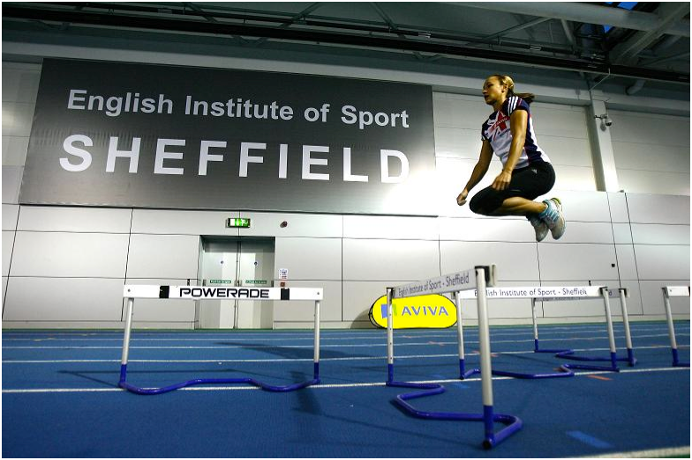
Strategies to raise participation
4. Centres of Excellence
  A number of top class facilities
  are located all over the UK
  catering to individual sports.
  In addition to this a number of Universities have been categorised as centres of excellence. These include Loughborough and Leeds.
  These facilities tend to have state of the art equipment and coaches to support our most talented athletes.
  Many of these centres offer their facilities to the local community to come and try.

Slide 32
Strategies to raise participation
5. Physical Education, School Sport and Club Links (PESSCL)
Aim
  To increase the opportunities and participation of 5-16 year olds so they remain involved throughout their lives.
Strategy
  To provide links to clubs, organisations and community schemes so schoolchildren are participating in two hours of high quality sport each week. Some of the links include;
    Sports colleges - Promotes excellence in PE through sharing facilities and expertise.
    Step into Sport - Youth Sport Trust, Sport England and Sports Leaders UK which aim to increase the opportunities in leadership awards.
    Club Links - Creating opportunities
    for schoolchildren to become a member
    of a local sports club.

Slide 33

Strategies to raise participation
6. Youth Sport Trust
    This organisation is focused on developing opportunities in
    sport for young people to experience and develop.
    They do this through a number of initiatives.
      TOP programme includes;
  TOP Link - develops a pathway for 11-16 year olds to experience leadership in sport and dance. This includes taking on a number of roles such as administrator, young ambassador, official or coach.
  Top Active Kids Programme - This is a joint initiative with major sponsor Sainsbury’s. Individuals or families collect vouchers and give them a sports group of their choice to exchange for equipment.
  Others include; TOP Tots (1.5-3 yrs), TOP Start (3-5 yrs), Top Play (4-9 yrs), Top Sports (all ages), TOP Sports Ability and TOP Resources.

Slide 34
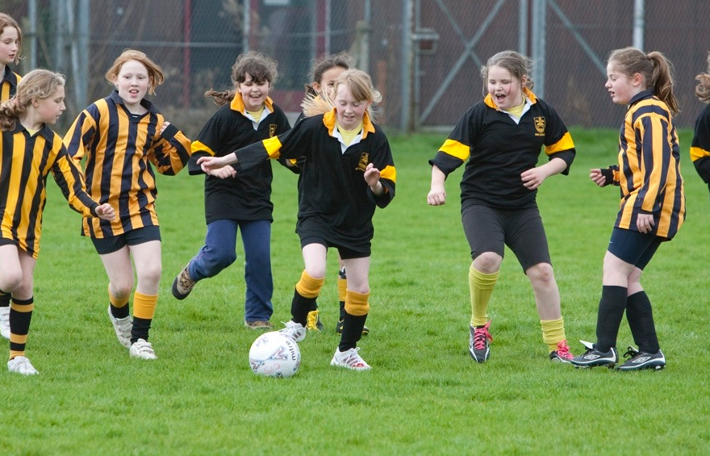
Strategies to raise participation
Local authorities
  These facilities may include public parks,
  playing fields, swimming pools, sports
  centres, facilities in schools and youth centres.
  Dual-use facilities are usually located in schools. Students use the facilities in the day and local leagues and clubs hire them in the evening.
  These facilities in particular have a large responsibility for raising participation in sport.
  Facilities are generally affordable offering discounts to pensioners, the unemployed and students.
  Clubs can be based at the sports centre.

Slide 35

Strategies to raise participation
Schools play a fundamental role in encouraging young people to take part in sport. They do this in a number of ways.
  PE lessons are compulsory which provides an opportunity to promote physical activity.
  They offer extra-curricular activities.
  School based sports clubs.
  Examination courses such as GCSE PE.
  Links with local clubs and School Sports Partnerships.
  Offer facilities for dual use by local clubs and leagues.
  Use local facilities in the community i.e. water sports centres and rock climbing walls.
  School sports bulletins and newsletters.

