Slide 1
Commercialisation of physical activity and sport
4.2 Social, cultural and ethical influences

Slide 2
Money
Role Models
Technology
Commercialisation of physical activity and sport
Sponsorship
Media
Commercialisation

Slide 3
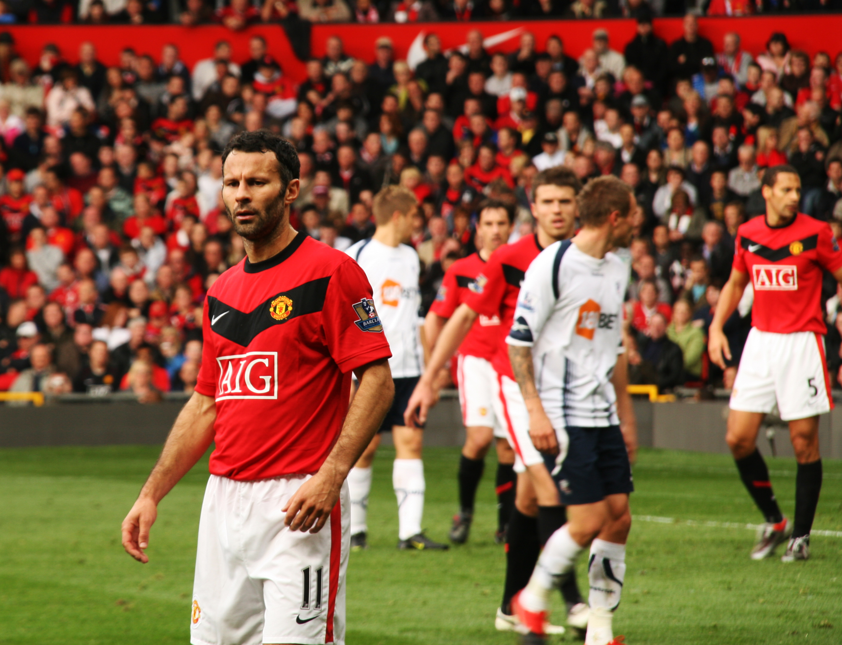
Commercialisation
Commercialisation involves making a profit through the management or exploitation of a person or organisation.

Slide 4
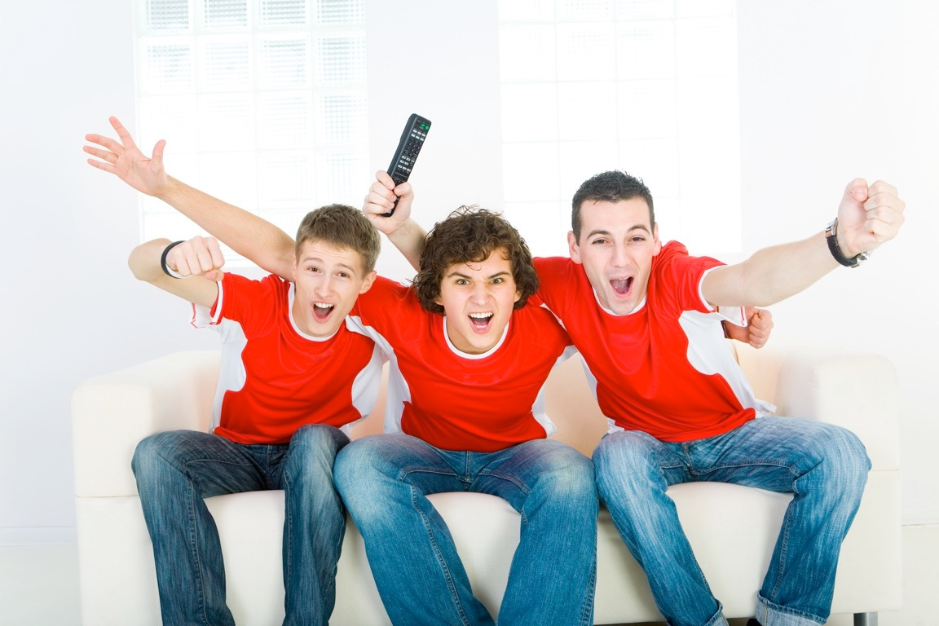
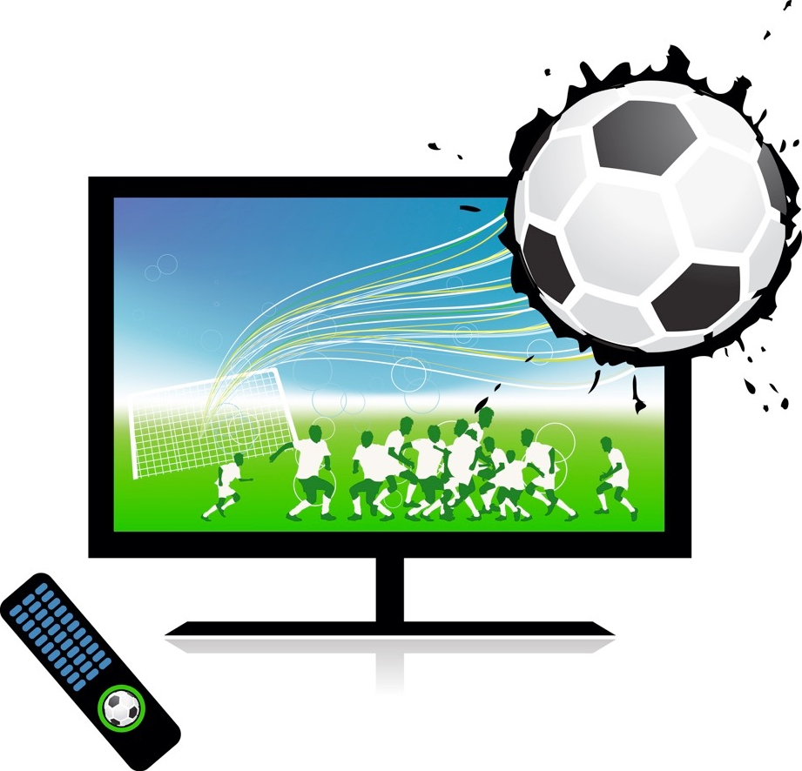




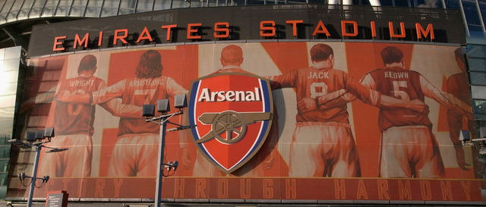
Media coverage
Media Coverage
In our day to day lives we are
surrounded by media and this is what
makes it so influential.
There are many different types:
    Television
    Internet
    Radio
    Magazines
    Newspapers
    Billboards

Slide 5
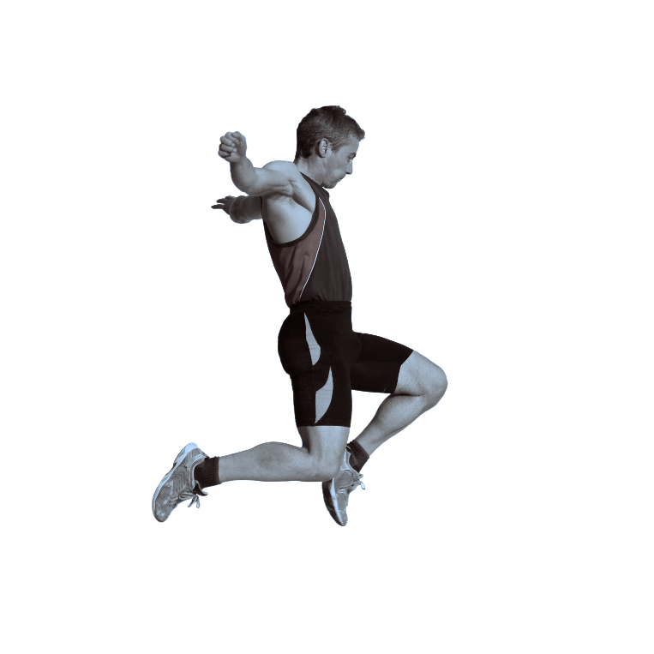
Media coverage - performer
Advantages
  Increased funds to pay higher wages to the performer.
  Increased exposure can result in performers being seen as heroes or role models.
  More money for technology and equipment.
  More money for coaching and training.
Disadvantages
  Media presence can increase the pressure on the performer.
  Sponsors can make demands on athletes.
  Intense media scrutiny of athletes private lives.
  Increased number of competitions can lead to injury.
  Women are paid less.

Slide 6
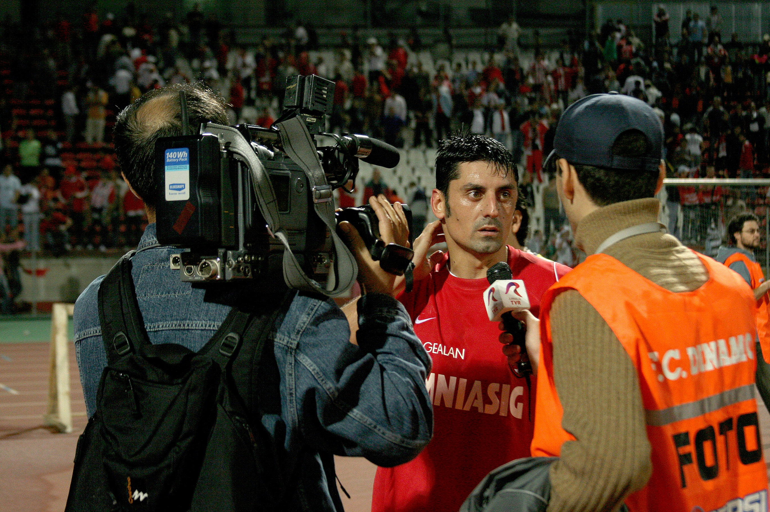
Media coverage - officials
Advantages
  Increased funds to pay higher wages to the officials and make it a profession.
  Increased exposure can result in officials being seen as heroes or role models.
Disadvantages
  Media presence can increase the pressure on the official .
  Any mistakes made by the official are highlighted and become very public.

Slide 7

Media coverage - sport
Advantages
  Increased funds to support grass-roots development.
  More money for technology and equipment.
  More money for coaching and training.
  Larger prize funds for the competition.
  More role models for the sport.
  Media attention increases interest in the sport.
Disadvantages
  Rules of the sport may be changed to suit media and sponsors.
  Minority sports and women’s sports get less coverage.
  The media sensationalises controversies.
  Sports may become dependent on the money.
  Sponsors may sell products that contradict the healthy lifestyle sport promotes.

Slide 8

Media coverage - spectators
Advantages
  Events and games are scheduled so more people can spectate.
  Commentary educates the viewer and provides information.
  Instant replays, slow motion and close ups available due to funded technology.
  Spectators can feel a part of their role models' lives.
  Top level facilities for spectating.
Disadvantages
  Timings of events mean some athletes have to perform late in the evening so more can watch.
  More watch sport than play sport.
  Some sports are expensive to watch due to viewing rights.
  Tickets and
  merchandise
  are expensive.
  Less popular
  sports are shown less.

Slide 9
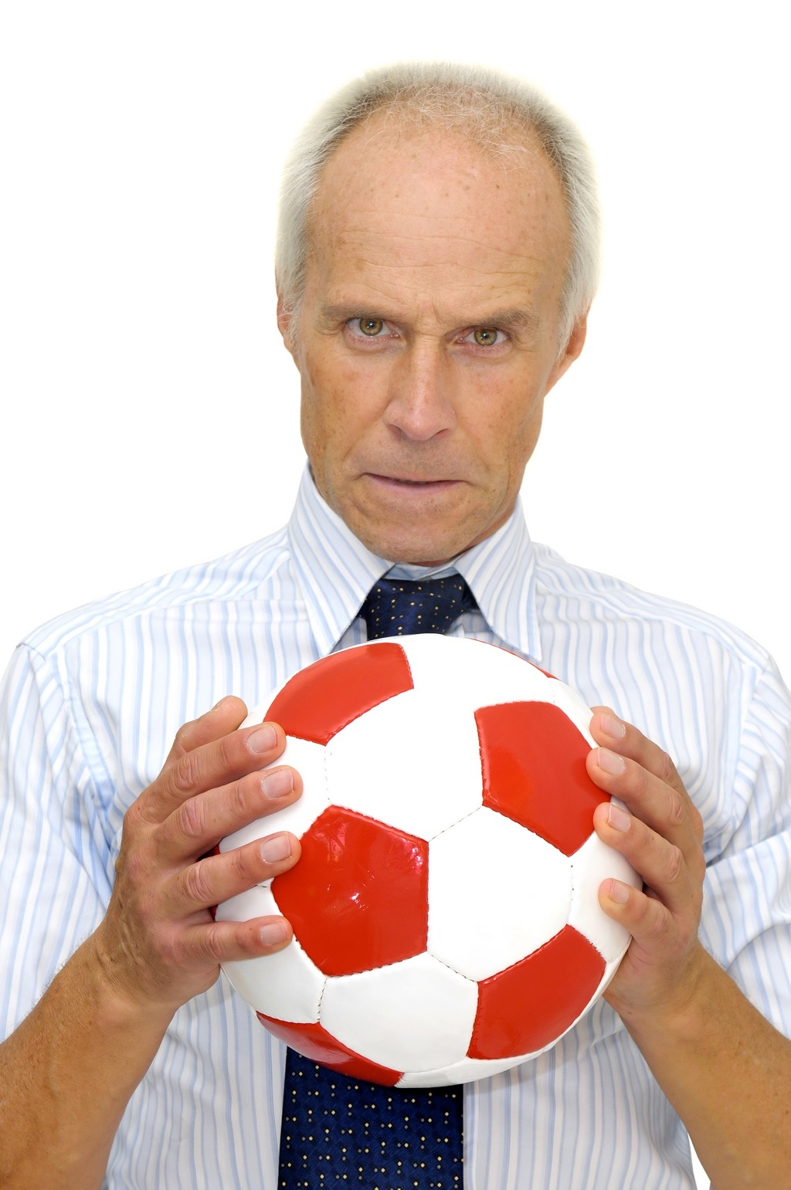
Sponsorship
Sponsorship is where businesses and corporations provide financial backing to clubs, events and individuals. This includes clothing/footwear/equipment or provision of specialist facilities.
In return, businesses get exposure
and are able to advertise their
brand to the wider audience
involved in that event or sport.
Sometimes sponsors are
affected when a performer
behaves poorly.

Slide 10
Sponsorship - performer
Advantages
  They can provide equipment and transport
  for a sports team or athletes.
  A sponsor can provide the financial
  assistance to individual elite athletes who
  could not afford to train without this backing.
Disadvantages
  Teams and athletes can feel exploited by sponsors as they are often forced to make appearances, give interviews, wear certain clothing, behave in certain ways and take part in photo shoots or promotional videos.

Slide 11
Sponsorship - sport
Advantages
  Assist in helping to meet the cost of an expensive event.
  A sponsor can provide a high level of promotion.
  If an event makes a loss, a sponsor has the financial power to cover the costs.
Disadvantages
  If a sponsor withdraws their assistance, it can
  have a devastating consequence to the event or individual.
  Some sponsors contradict the healthy
  message promoted by sport.

Slide 12
Sponsorship - spectators
Advantages
  A major sponsor can attract better athletes and result in more people watching an event.
  Better stadiums and well funded events.
Disadvantages
  Sponsors make and sell sports clothing at an increased cost and upgrade every season to make more money.
  Spectators are constantly advertised to throughout the event.

Slide 13

Sponsorship - sponsor
Advantages
  Sponsoring a major event or popular club/athlete improves the image of the sponsor.
  The sponsor will receive a high level
  of advertising in the media.
  Being associated with popular events
  encourages viewers and participants
  to see the product positively.
  There are often tax benefits to sponsorship.
  Many sponsors have corporate boxes in stadiums and premium tickets to events so they can use these to organise their own corporate events.

Slide 14

Sponsorship - sponsor
Disadvantages
  Sponsorship is expensive and if it is too
  high they may refuse to get involved.
  The event may not link with the image
  of the company.
  The event or the individual person may
  have a poor reputation or behave badly
  and this can reflect on the image of the company.
  The event may not attract enough publicity.
  Lack of confidence in the company organiser.
  The event may not provide enough corporate opportunities for the sponsor.

Slide 15
Technology
Sports are now embracing technology to assist with increasing performance and officiating.
Examples of this are:
  Goal line technology in Football.
  Electronic timing in Athletics and Swimming.
  Hawkeye in Tennis and Cricket.
  Lighter materials in Cycling, Skiing and Golf.
  Surgery in Baseball.

Slide 16
Technology - performer
Advantages
  Equipment technology has increased and improved athletic performance.
  Advances in equipment technology have reduced the risk of injury.
Disadvantages
  The use of Hawkeye or goal line technology slows down the game and can interrupt a performer's flow.
  The technologies are only available to performers at the highest level.

Slide 17
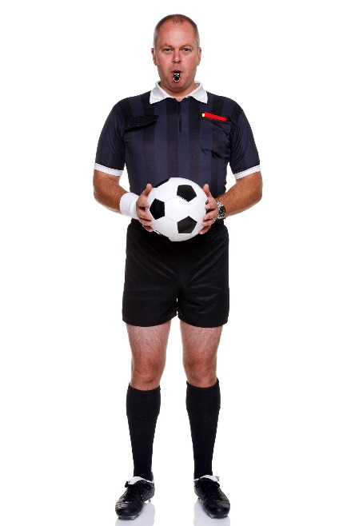
Technology - officials
Advantages
  Assists officials in making the correct decision and avoid scrutiny.
  Decisions are more accurate and there is less controversy.
  Less post-match criticism and less pressure.
Disadvantages
  Officials can still be wrong, technology cannot be used for every decision.
  Loss of respect for officials' decision being final.

Slide 18
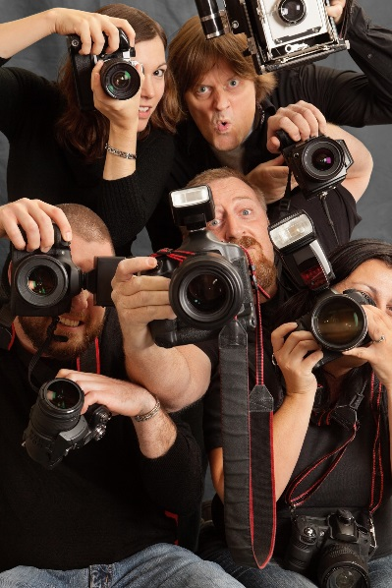
Technology - sport
Advantages
  Improved video technology has allowed sports to reach a wider audience.
  More people can participate due to advances in equipment such as prosthetic limbs.
Disadvantages
  Advances in drugs and equipment that give athletes an illegal advantage can bring scandal to a sport.
  Can ruin the tradition of a
  sport.

Slide 19
Technology - spectators
Advantages
  Enhanced home viewing experience due to camera and video technologies.
  On screen information improves sports knowledge.
  Improved facilities.
Disadvantages
  Access to certain sports or matches can be expensive due to pay per view TV.
  Spectators are constantly exposed to advertising to pay for the new technologies.

