Slide 1
Ethical and socio-cultural issues
4.3 Social, cultural and ethical influences

Slide 2
Performance Enhancing Drugs
Contract to compete
Hooliganism
Ethical and socio-cultural issues
Gamesmanship
Sportsmanship
Etiquette

Slide 3
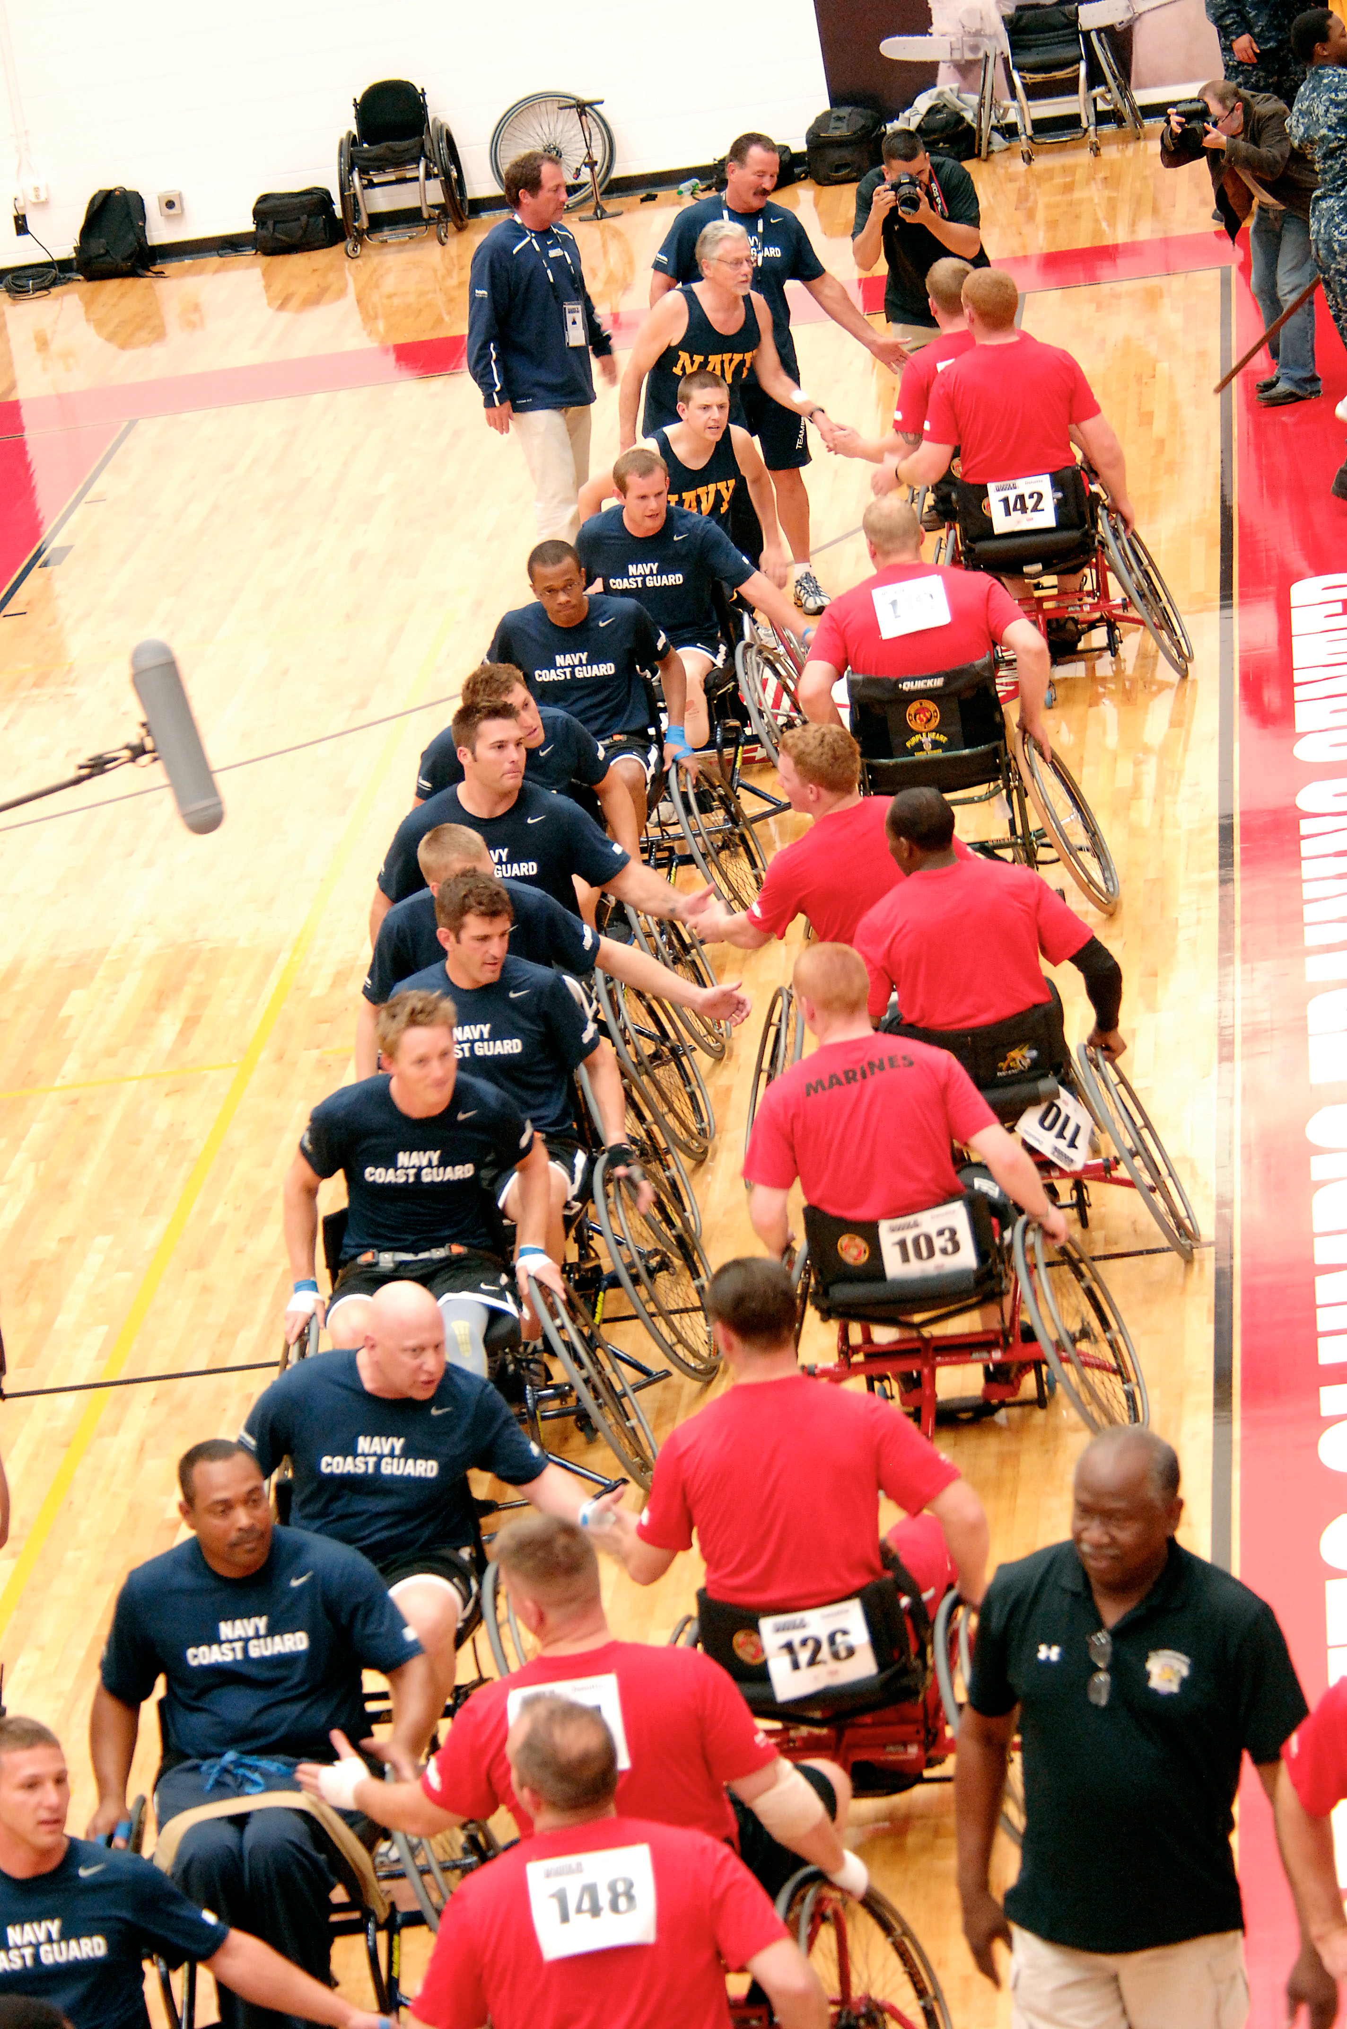
Ethical conduct
To be ethical means to be in accordance with the principles of right and wrong.
Unethical conduct in sports can be demonstrated in a number of ways.
  Etiquette
  Sportsmanship
  Gamesmanship
  Performance enhancing drugs
  Hooliganism

Slide 4
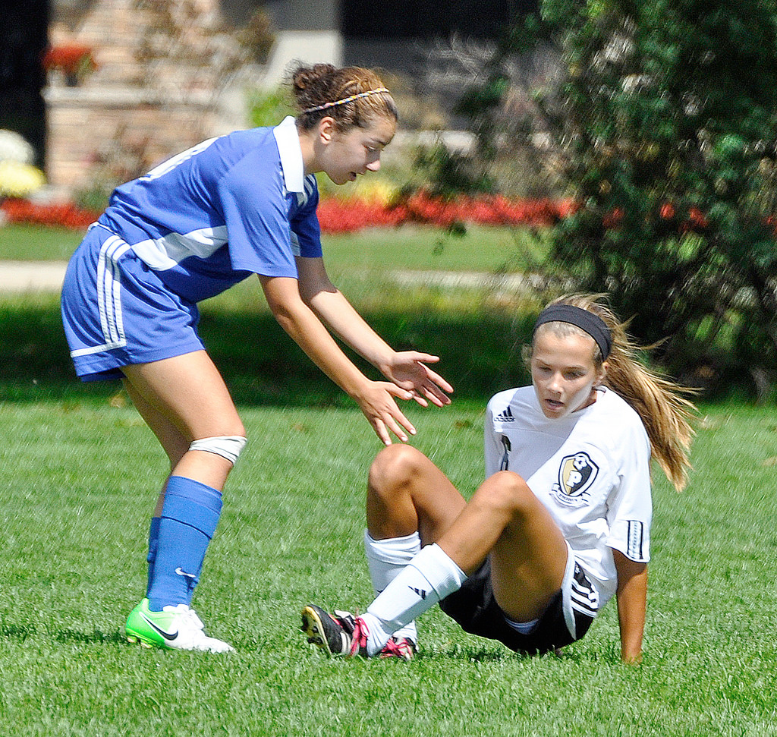
Etiquette
Etiquette are unwritten rules and guidelines in sport.
An official will not enforce etiquette.
Etiquette demonstrates respect for other players, the officials, the audience and the sport.
Examples of good etiquette:
  Kicking the ball out when a player
  is injured in Football.
  Shaking your opponent's and
  official's hand.
  Bowing or touching gloves with
  your opponent in martial arts
  activities.

Slide 5
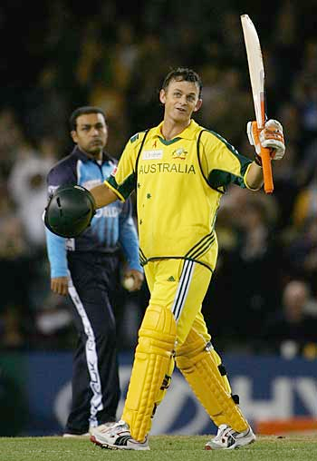
Sportsmanship
Sportsmanship is demonstrated by competing in the spirit of the game.
A good sports person will play within the rules of the sport and demonstrate etiquette.
A performer who demonstrates good sportsmanship is a good role model for others to follow.
Examples of this are:
  Not receiving a red or yellow card.
  Walking if you know you are out in
  Cricket.

Slide 6
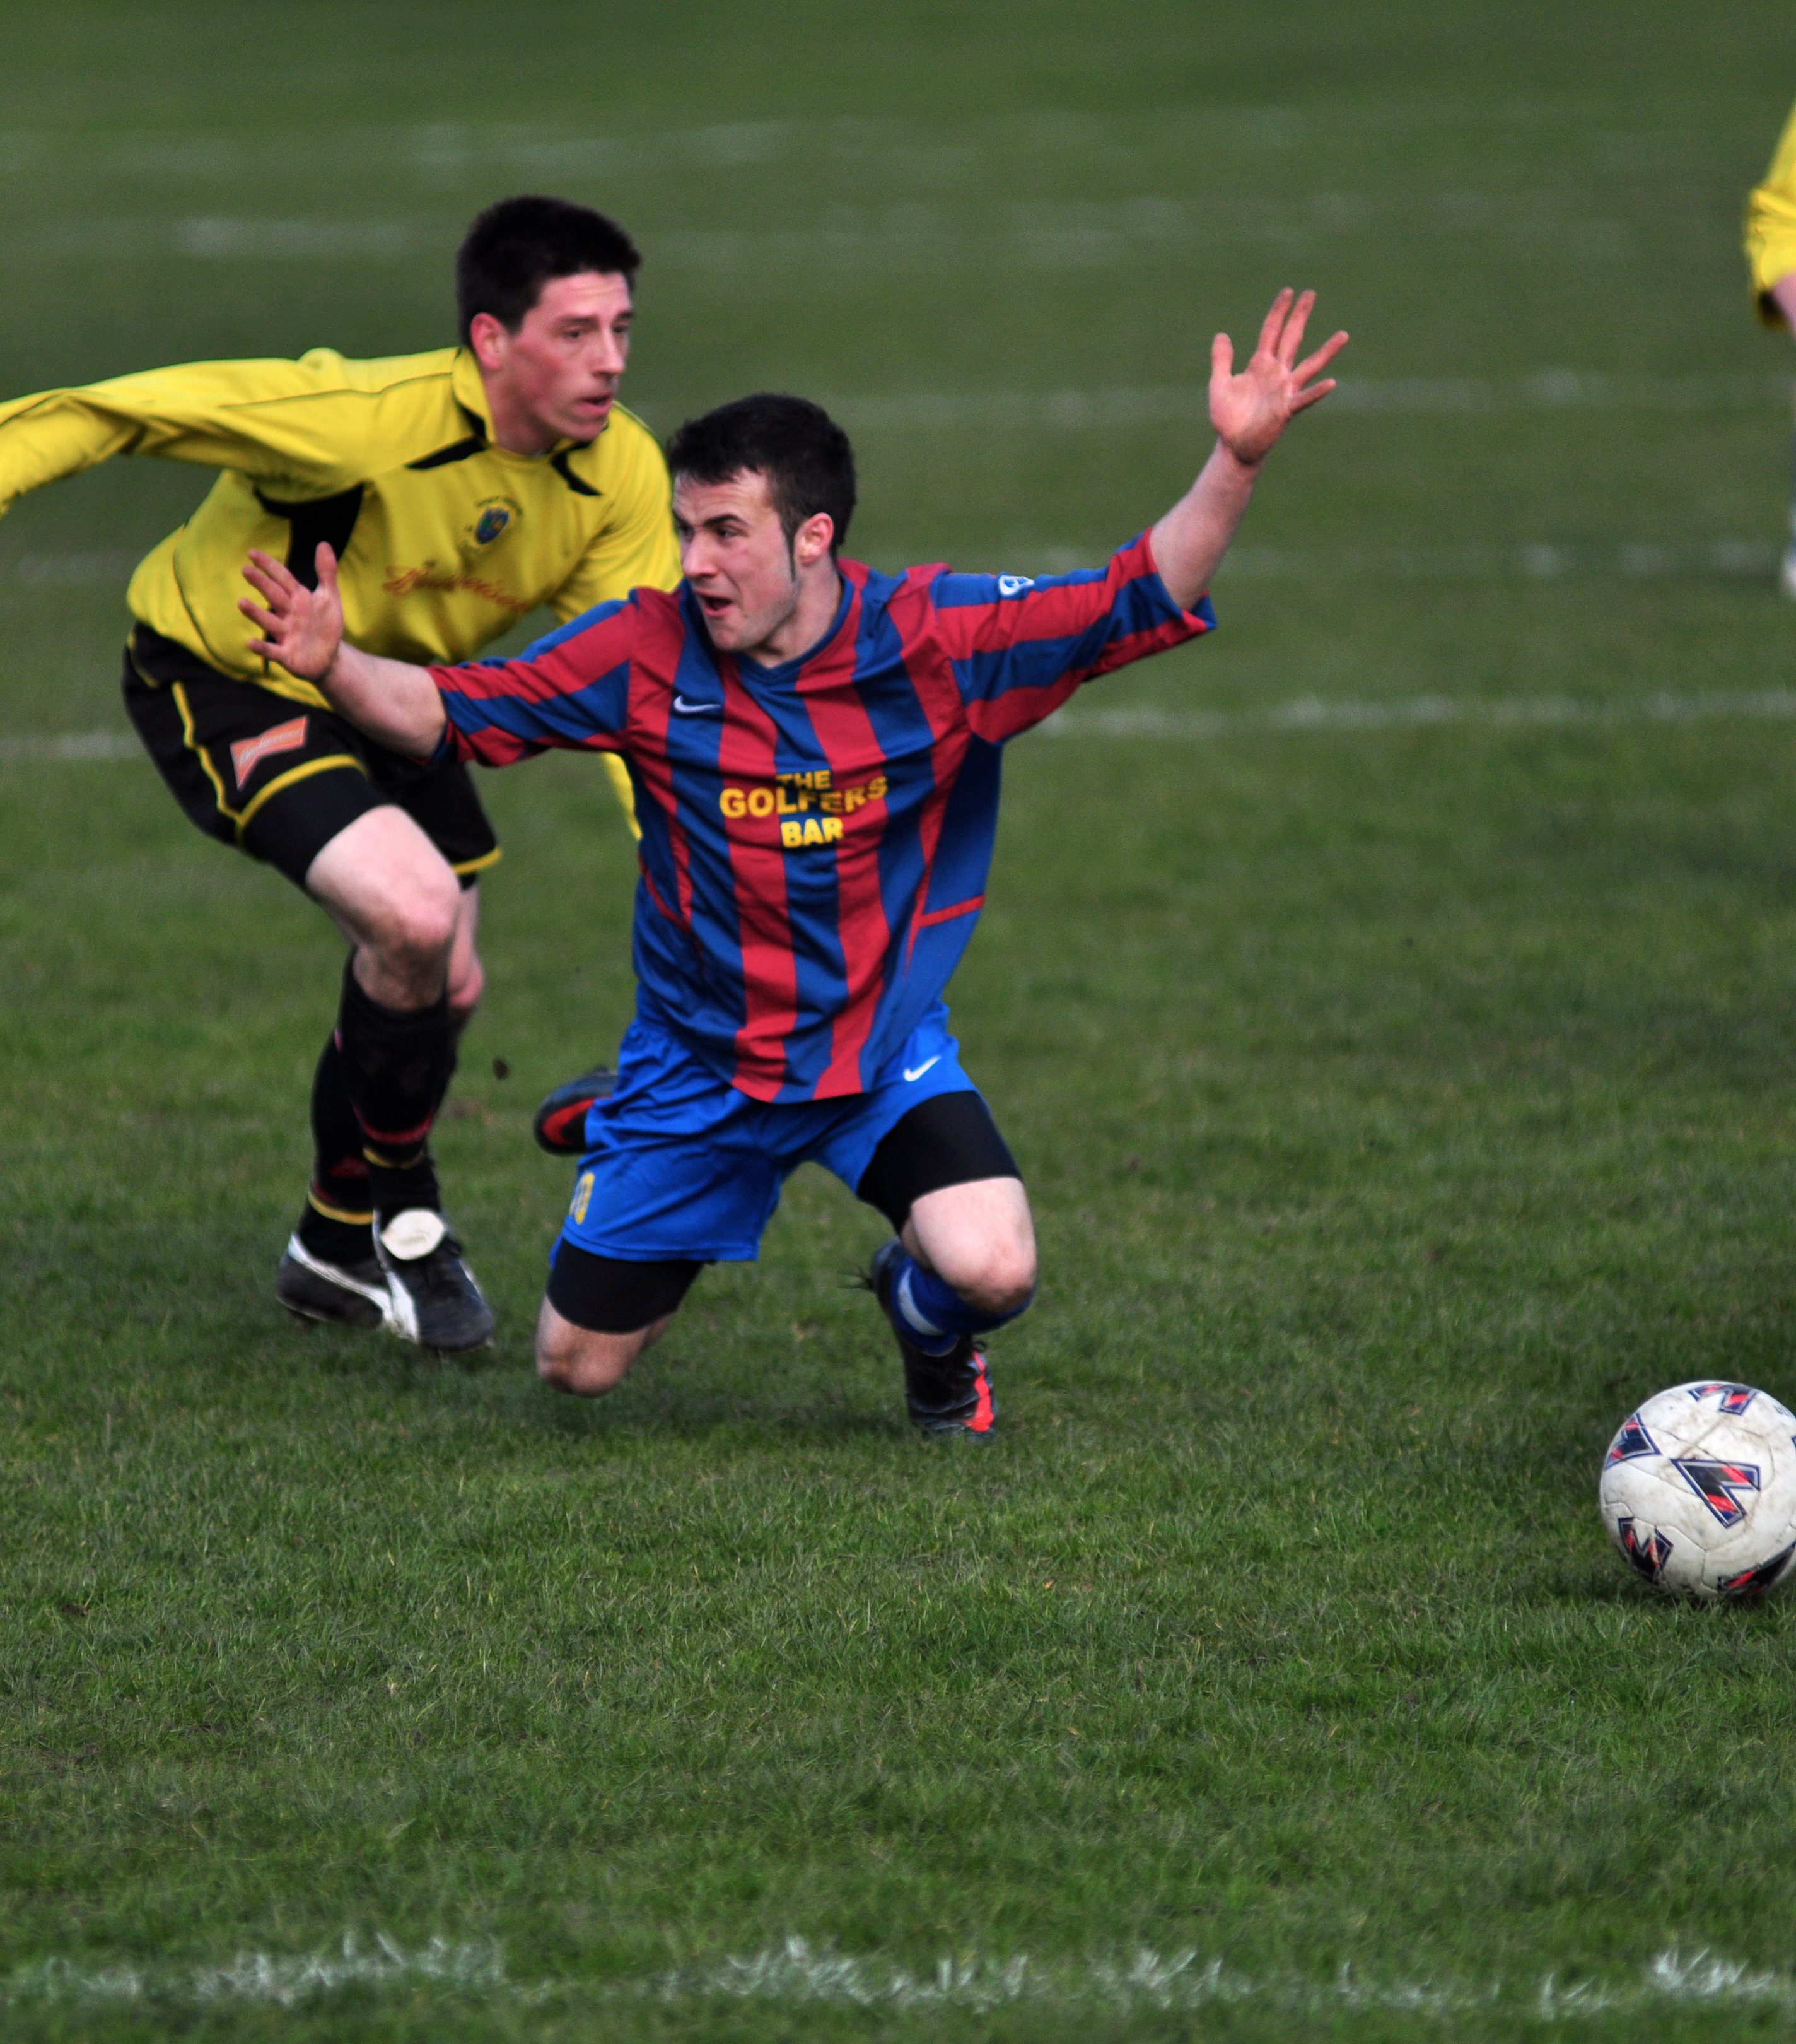
Gamesmanship
Gamesmanship is the opposite of sportsmanship.
Athletes that demonstrate gamesmanship bend the rules and guidelines to gain an advantage so they can win.
Examples of this are:
  Faking an injury to waste time or to cause your opponent to lose momentum.
  Diving in Football to get a penalty.
  Barracking an opponent so they
  lose focus.

Slide 7
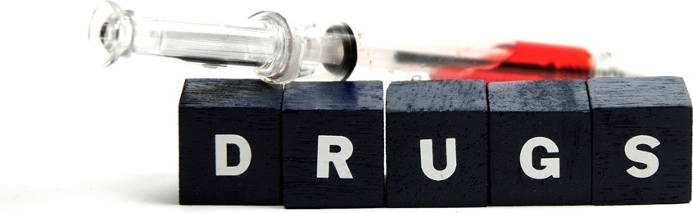
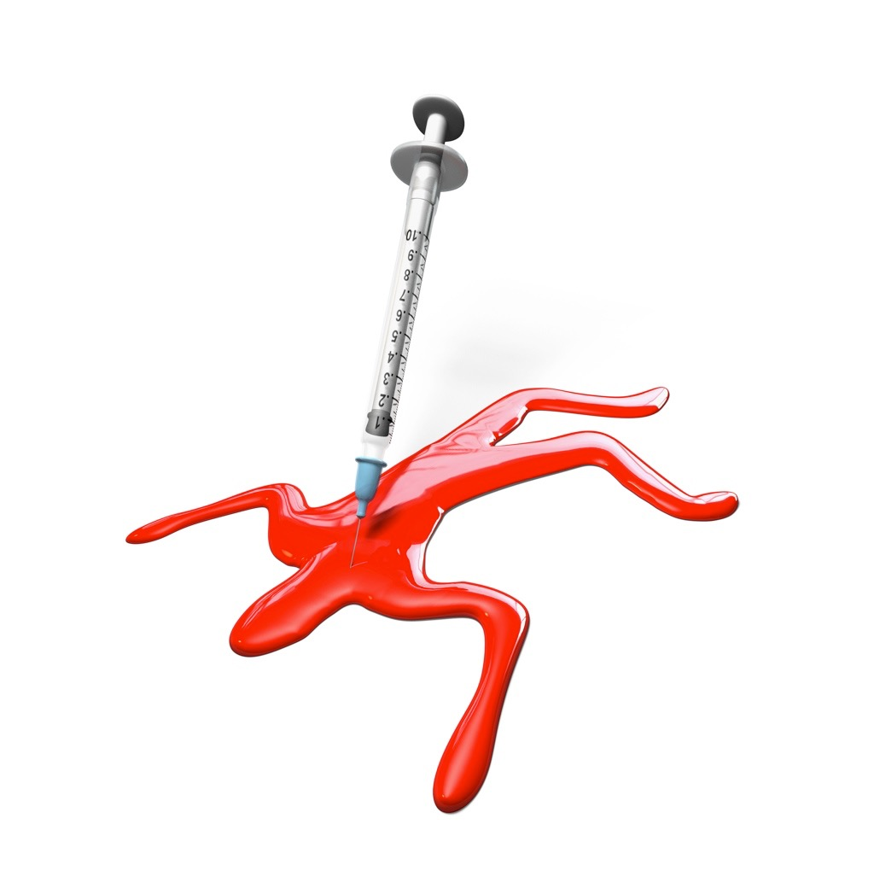
Drugs
Drugs are:
“Any chemical introduced to
the body which affects how
the body works.”
Doping is:
“Term used to improve
performance by taking drugs.”

Slide 8
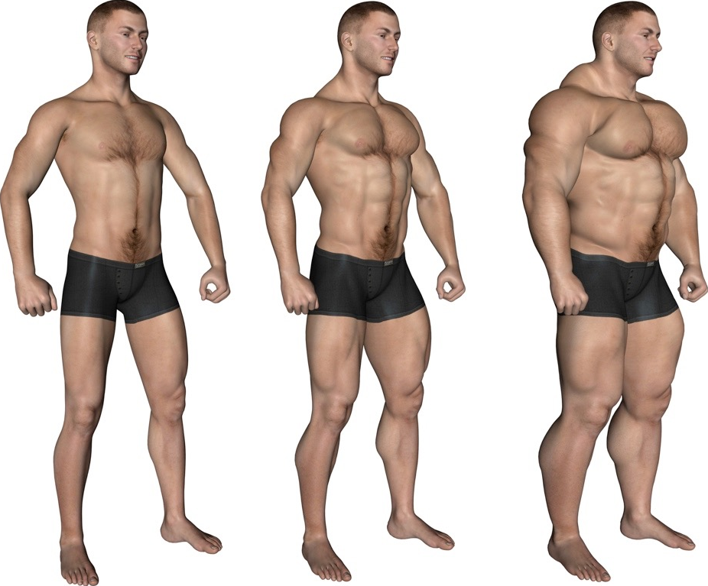
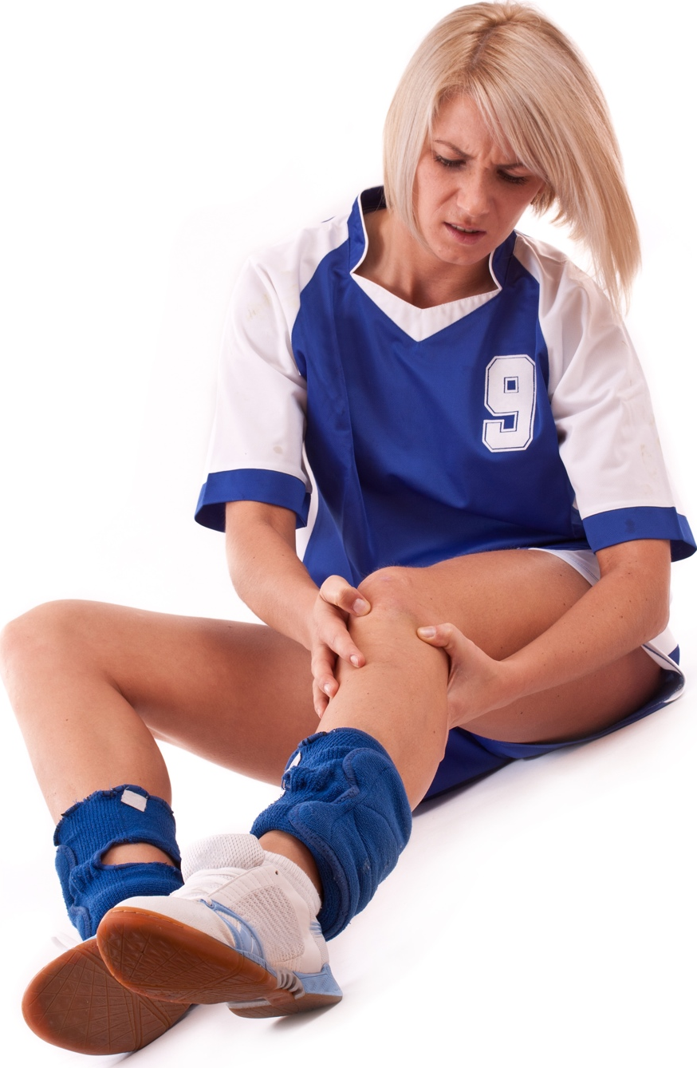
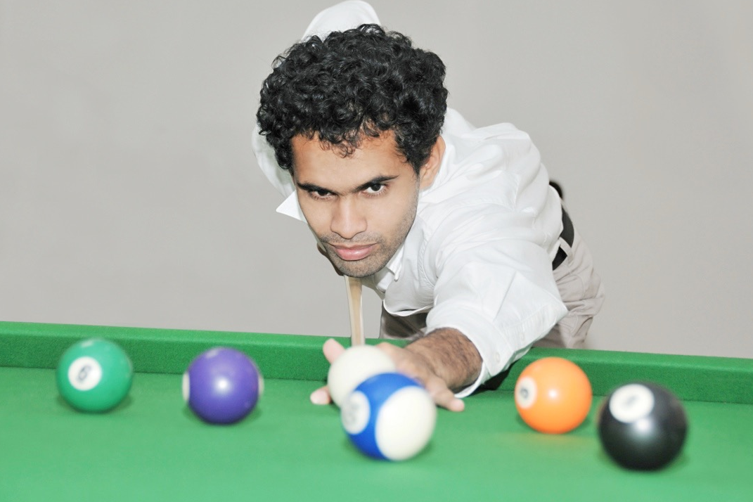
Types of drugs
Sports performers may take performance enhancing drugs for a number of reasons. Here are some:
  Steroids help to build muscle quickly.
  Narcotic-analgesics help to kill pain and allow the performer to keep going.
  Stimulants make the performer more alert.
  Beta blockers calm performers before an event.
  Diuretics allow the performer to lose weight
  quickly and mask the other drugs in the
  system.
  Peptide hormones such as erythropoietin (EPO)
  copy natural performance enhancing
  hormones in the body.

Slide 9
Types of drugs
The following drugs are banned by the International Olympic Committee:
Type of Drug | Effect on Performance | Risks | Sports Used
Stimulants | Reduces tiredness. | Impotence, high blood pressure, heart failure, paranoia and insomnia. | Endurance events such as swimming and cycling.
Narcotic-analgesics | Painkillers mask the pain of injury. | Injuries become more severe, nausea, drowsiness, dry mouth and constipation | Used in all sports where injuries are sustained.
Diuretics | Increases the amount of water excreted. Flushes other drugs out of the system. | Muscle weakness, and dehydration. Loss of sodium and potassium salts. | Sports that have weight categories such as Boxing and Horse Racing.
Anxiety reducing drugs - Beta Blockers | Slow down and regulate the heart and reduce hand shake. | Diarrhoea, slow heart rate and impotence. | Shooting and Archery
Peptide hormones (Erythropoietin) | They mimic the effect of naturally occurring hormones. Increase muscle strength and growth. | Allergic reactions, high blood pressure, abnormal growth in hands, feet and face. | Weight lifter to increase muscle mass.
Anabolic Steroids | Quick increase in strength. Able to train for longer. | Heart disease, high blood pressure, kidney and liver disease, infertility and aggression. | Strength and power related sports such as weightlifting and sprinting

Slide 10
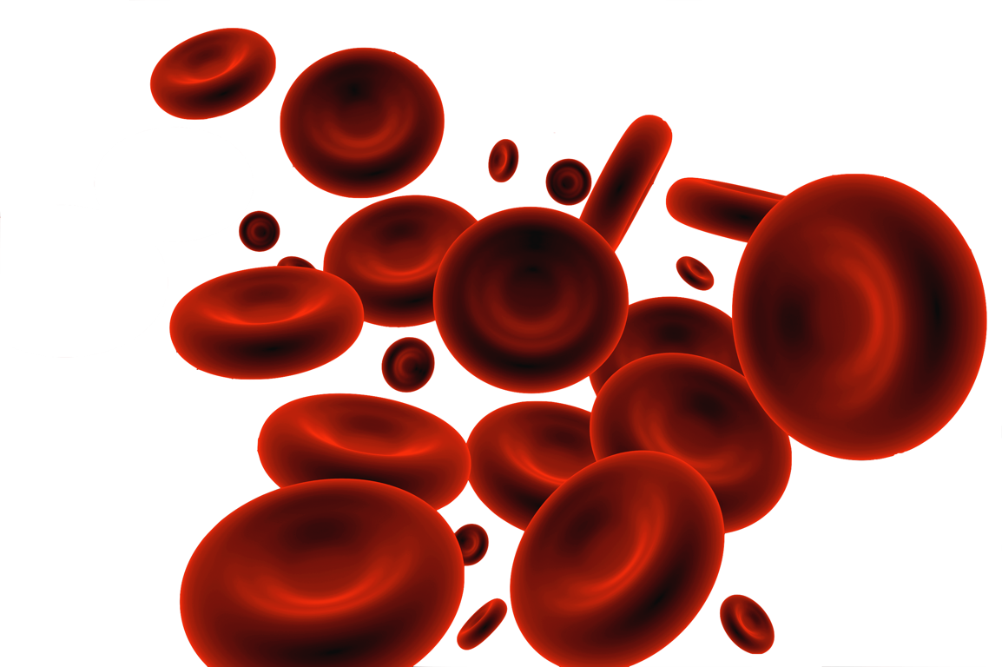
Blood doping
The method:
    Blood is drawn from the athlete a few weeks
    before competition.
    The red blood cells are separated and frozen.
    Just before the event the red blood cells are
    thawed and injected back into the athlete.
    The higher the concentration of red blood cells the more oxygen can be delivered to the working muscles resulting in higher performance.
    Endurance athletes such as cyclists and marathon runners may use this method.
The dangers:
    Transmission of infectious diseases such as HIV.
    Cheating can result in being banned.
    Kidney damage from allergic reactions.
    Overload of the circulatory system.

Slide 11
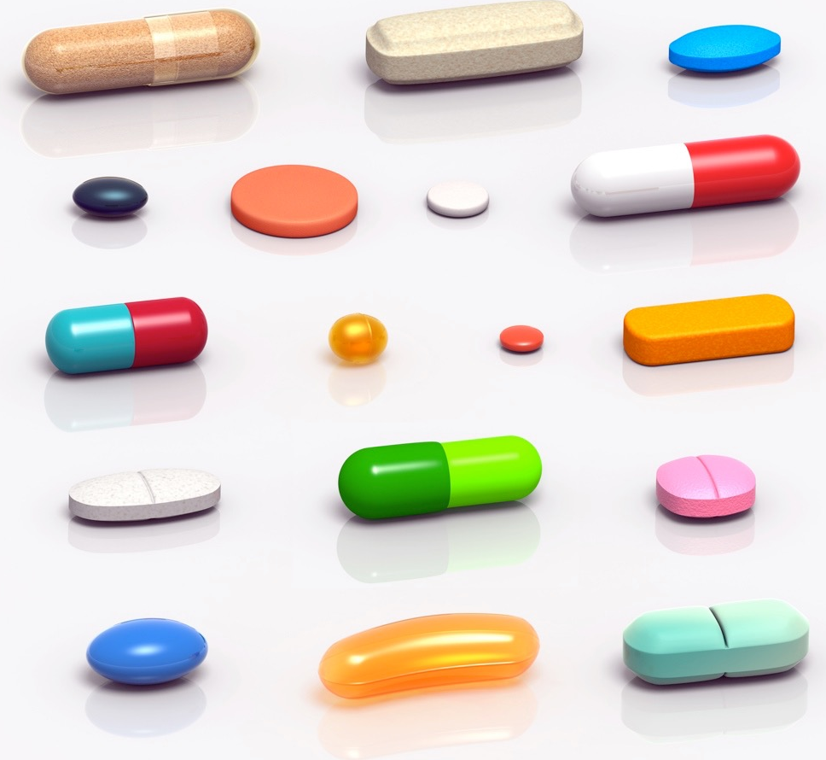
Reasons for taking drugs
Despite the dangers some athletes still take performance enhancing drugs. Why?
    Feel the pressure to win.
    They want to be the best.
    To win prize money.
    To achieve fame and wealth.
    Improve performance.
    To keep up with the competition.
    So they can train harder for longer.
    Allows them to recover from injury quicker.

Slide 12
Disadvantages of taking drugs
There are disadvantages of taking drugs and blood doping.
    Seen as a cheat/damaged reputation.
    Loose sponsorship deals and public humiliation.
    Must hand back any titles and medals.
    Receive fines, disqualification
    and bans.
    Health risks and side effects.
    The sport, sponsor, other
    competitors or event's
    reputation and credibility is damaged.

Slide 13

Drug testing
The World Anti-Doping Agency makes a list of banned substances every year.
Any athlete can be selected for testing, at any time, in any location.
Athletes must provide a diary of their location throughout the year.
Blood or urine may be sampled and sent to a lab to be tested for traces of any banned substance using gas chromatography
and mass spectrometry.

Slide 14

Reasons for banning drugs
Athletes who choose to use drugs
gain an unfair advantage over
athletes who do not.
Performance enhancing drugs
jeopardise the performer's health.
Some drugs change the natural balance of hormones in the body.
Athletes can be coerced into taking drugs so they can compete against the athletes who are choosing to take drugs.
It maintains the essence of the “spirit of sport” and doping is contrary to the spirit of sport.

