Slide 1
Leisure and recreation
4.4 Social, cultural and ethical influences

Slide 2
Leisure
Sport
Location
Recreation
Facilities
Leisure and Recreation
Family
Peers
Availability
Technology

Slide 3

Leisure
“The free time a person has
when not working or sleeping.”
How is leisure different from sport?
  A sport is competitive.
  A sport is always organised and has rules.
  A sport requires physical effort and complex skills.
  Sport played professionally can have financial rewards.

Slide 4
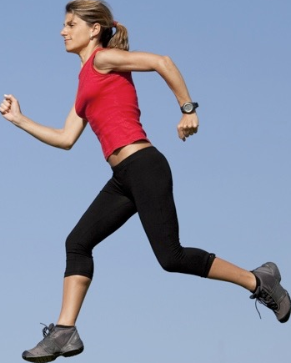
Definitions
Definition of Recreation
“A voluntary activity a person might do during leisure time.”
Definition of Physical Recreation
“Any physical activity a person
may choose to do during
leisure time.”
Definition of Sport
“An activity involving physical exertion and skill in which an individual or team competes against another or others for entertainment.”
Definition of Play
“To engage in activity for enjoyment and recreation rather than a serious or practical purpose.”

Slide 5
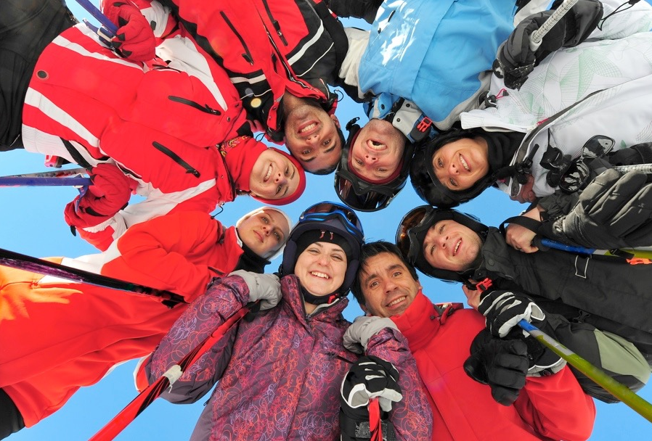
Leisure
There are a number of factors that can determine what we do with our leisure time.
  Age.
  Interests.
  Facilities and
  availability.
  Living location.
  Social circumstances.

Slide 6
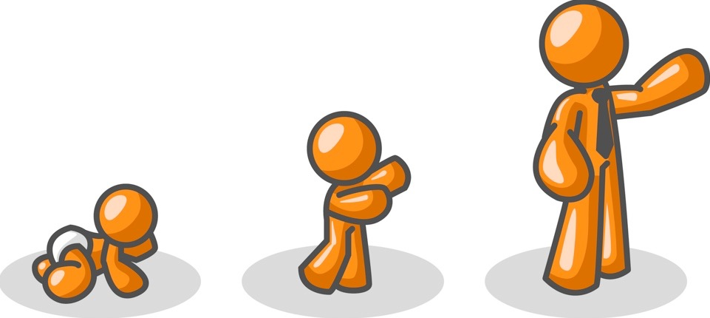
Age
Due to better medical care, people are living longer and having less children in the western world. This means our population is getting older and therefore the types of recreational activities on offer are changing.
Older people take part in leisure activities
for a number of reasons:
    Once retired they have additional
    time so they may become bored.
    They meet new people and make friends.
    A club usually has social activities too and this can improve a person’s social life.
    Increase their fitness and give a better quality of life.

Slide 7
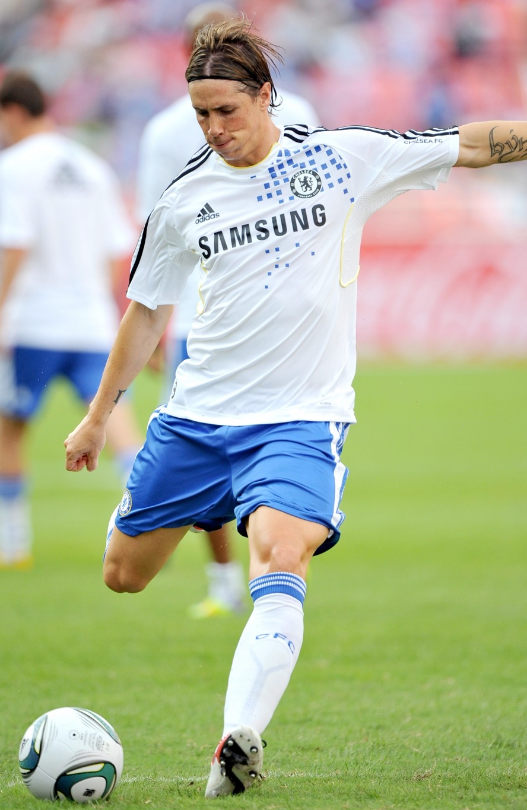
Interests
What you are interested in can determine what activities you want to take part in. Your interests may be due to a number of factors.
    The popularity of sports in the media
    and local area.
    The sporting opportunities
    available at school or in the local area.
    The environment you live in (i.e. if you
    live in the alps you may be interested in
    winter sports such as skiing).
    The sports your friends and family are interested in.

Slide 8
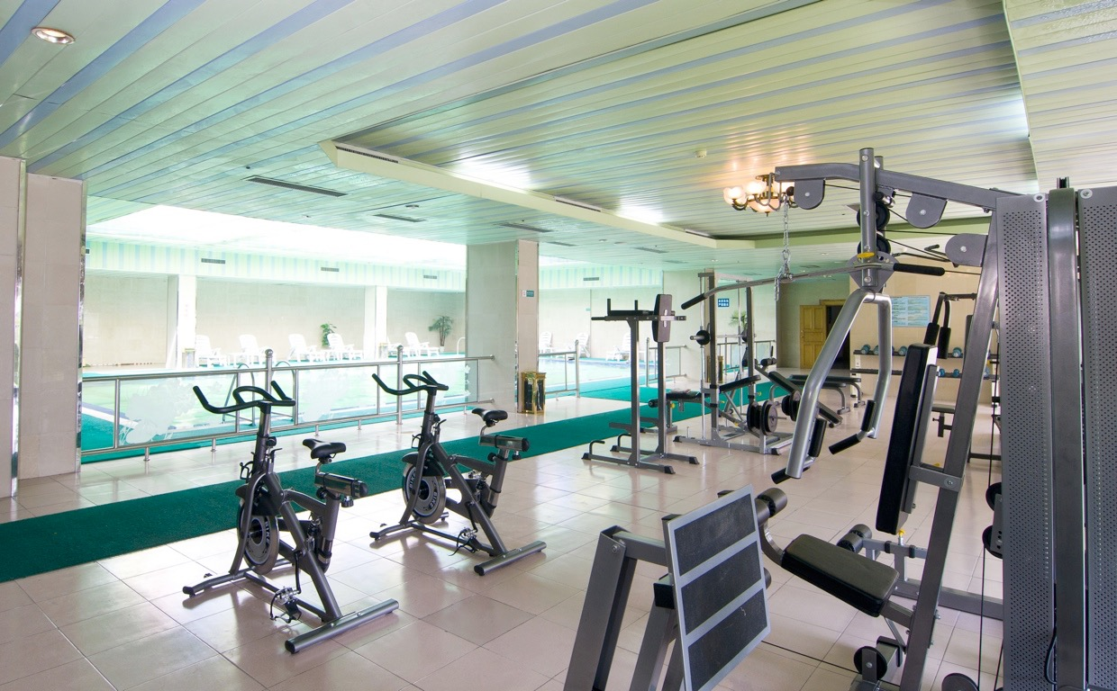
Facilities and availability
There has been a growth in facilities and availability in the 21st century. The facilities
on offer may influence
the sports you take part in.
    Schools have opened up
    their facilities for dual use
    on an evening.
    Some leisure centres and fitness gyms open up at unsociable hours, so people can go before and after work.
    Some swimming pools and leisure centres have women only sessions.

Slide 9
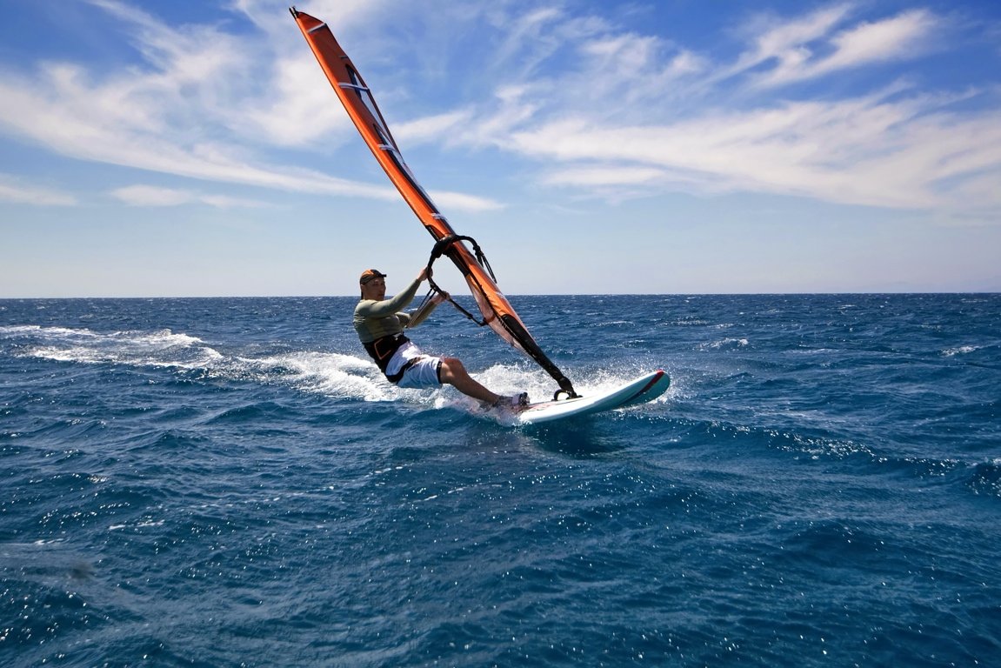
Living location
The location of a person to sports
facilities can determine what sport they
take up. Things they need to consider:
  The proximity of the facilities to
  where they live. Someone
  who lives in an urban area may have more choice.
  The climate they live in may limit choice. Someone who lives in a hot country may find it difficult to go snowboarding.
  Living near the sea, lakes or rivers may incline people more to take part in water sports than others who live inland.

Slide 10

Social circumstances
What activities you take part in may largely
be determined by what you can afford.
Some activities cost more than others.
    Activities like Sailing, Golf and
    Skiing can be very expensive and
    so only a few can afford them.
    Others such as jogging, playing football in the park and swimming are cheaper and more people can take part.
    A number of leisure facilities offer discounts to those who are on benefits due to unemployment and other social circumstances.

Slide 11

Peer influences
People who are a similar age can greatly
influence our choices.
A close peer who takes part in an
activity can encourage you to also take
part. This is called “peer pressure”.
Peer pressure can also be negative if your peer group has negative attitudes towards physical activity.
Starting an activity with a friend can often be easier.
You may feel more confident if there is someone there who you know.

Slide 12
Family influences
Parents and family interests in sport can
greatly influence the choices of the younger
family members.
Reasons for this are;
  Sporting traditions in a family.
  Parents often have to fund and transport children to and from the sports event so they may have input into which ones they do.
  The socio-economic status of the family may be a barrier to expensive sports.
  Family members may be the first people to introduce the young people in the family to sport. They may pass on a positive attitude to sport but similarly they may pass on a negative attitude.

Slide 13

Growth in leisure activities
Modern people have more time for leisure than ever before. This has resulted in a growth of leisure activities and facilities.
Reasons for increased leisure time:
Advances in technology.
  People work shorter
  days.
  Longer holidays.
  Increased unemployment.
  Early retirement.

Slide 14

Growth in leisure activities
Improvements in health care and health awareness.
  People participate longer due
  to a longer life expectancy.
  Early diagnosis of illness
  occurs so recovery is quicker.
  More availability of physiotherapy, so
  participants can recover more quickly.
  Physical activity is encouraged by all
  sectors as a preventative measure to
  illness.

Slide 15
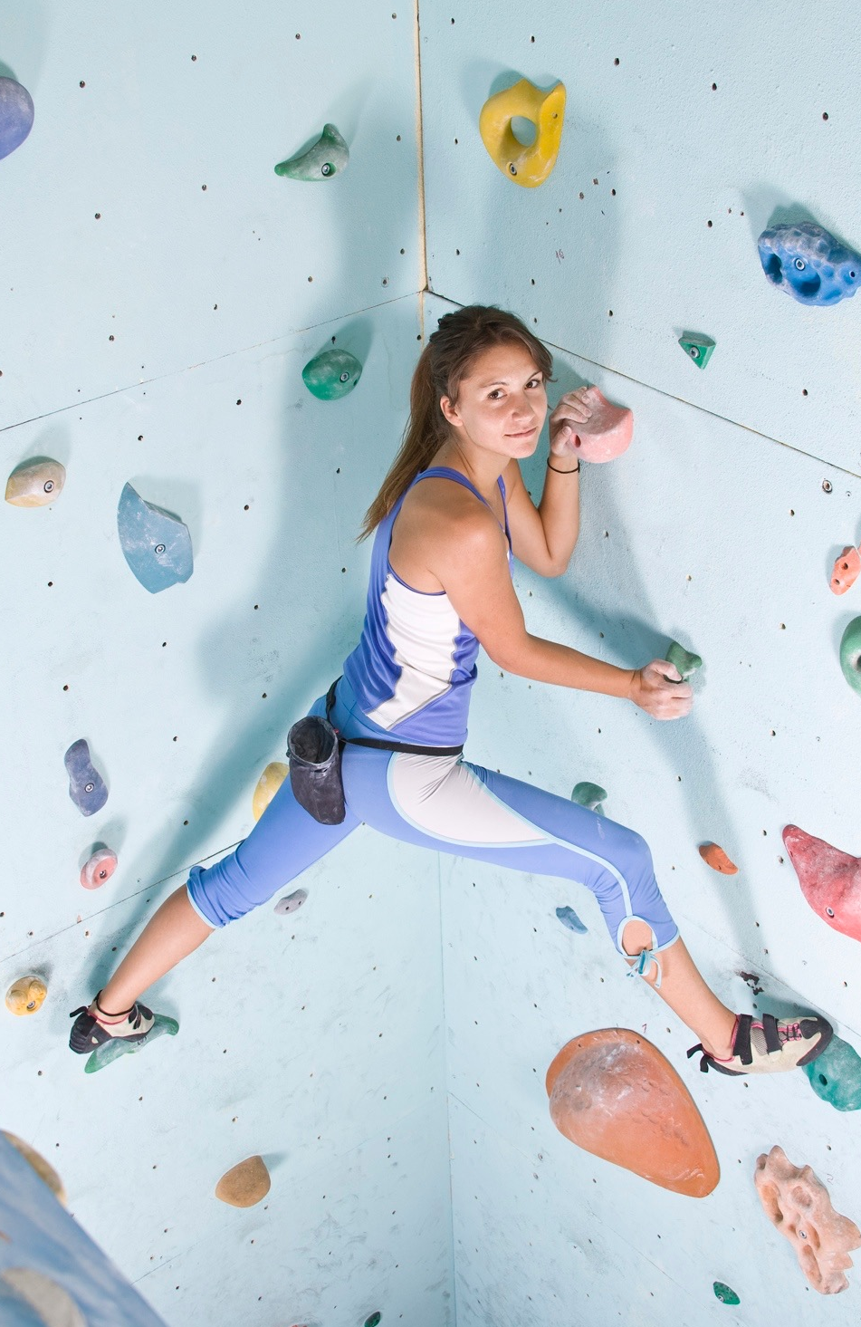
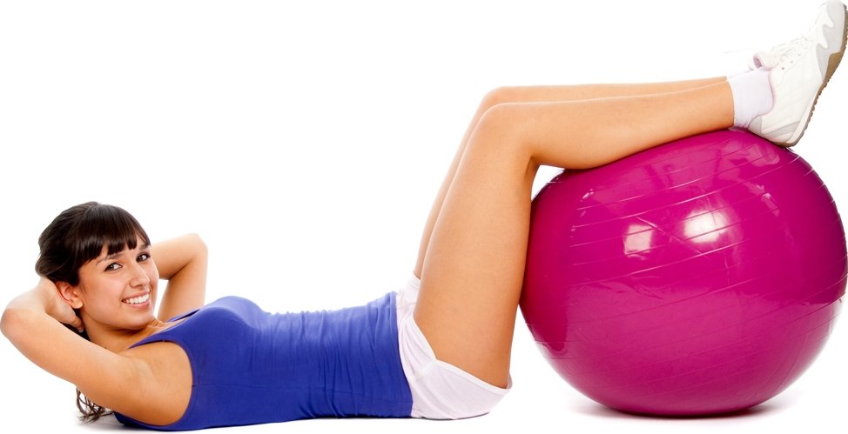
Growth in leisure activities
Growth in
leisure time and
activities.
Growth in facilities available.

Slide 16
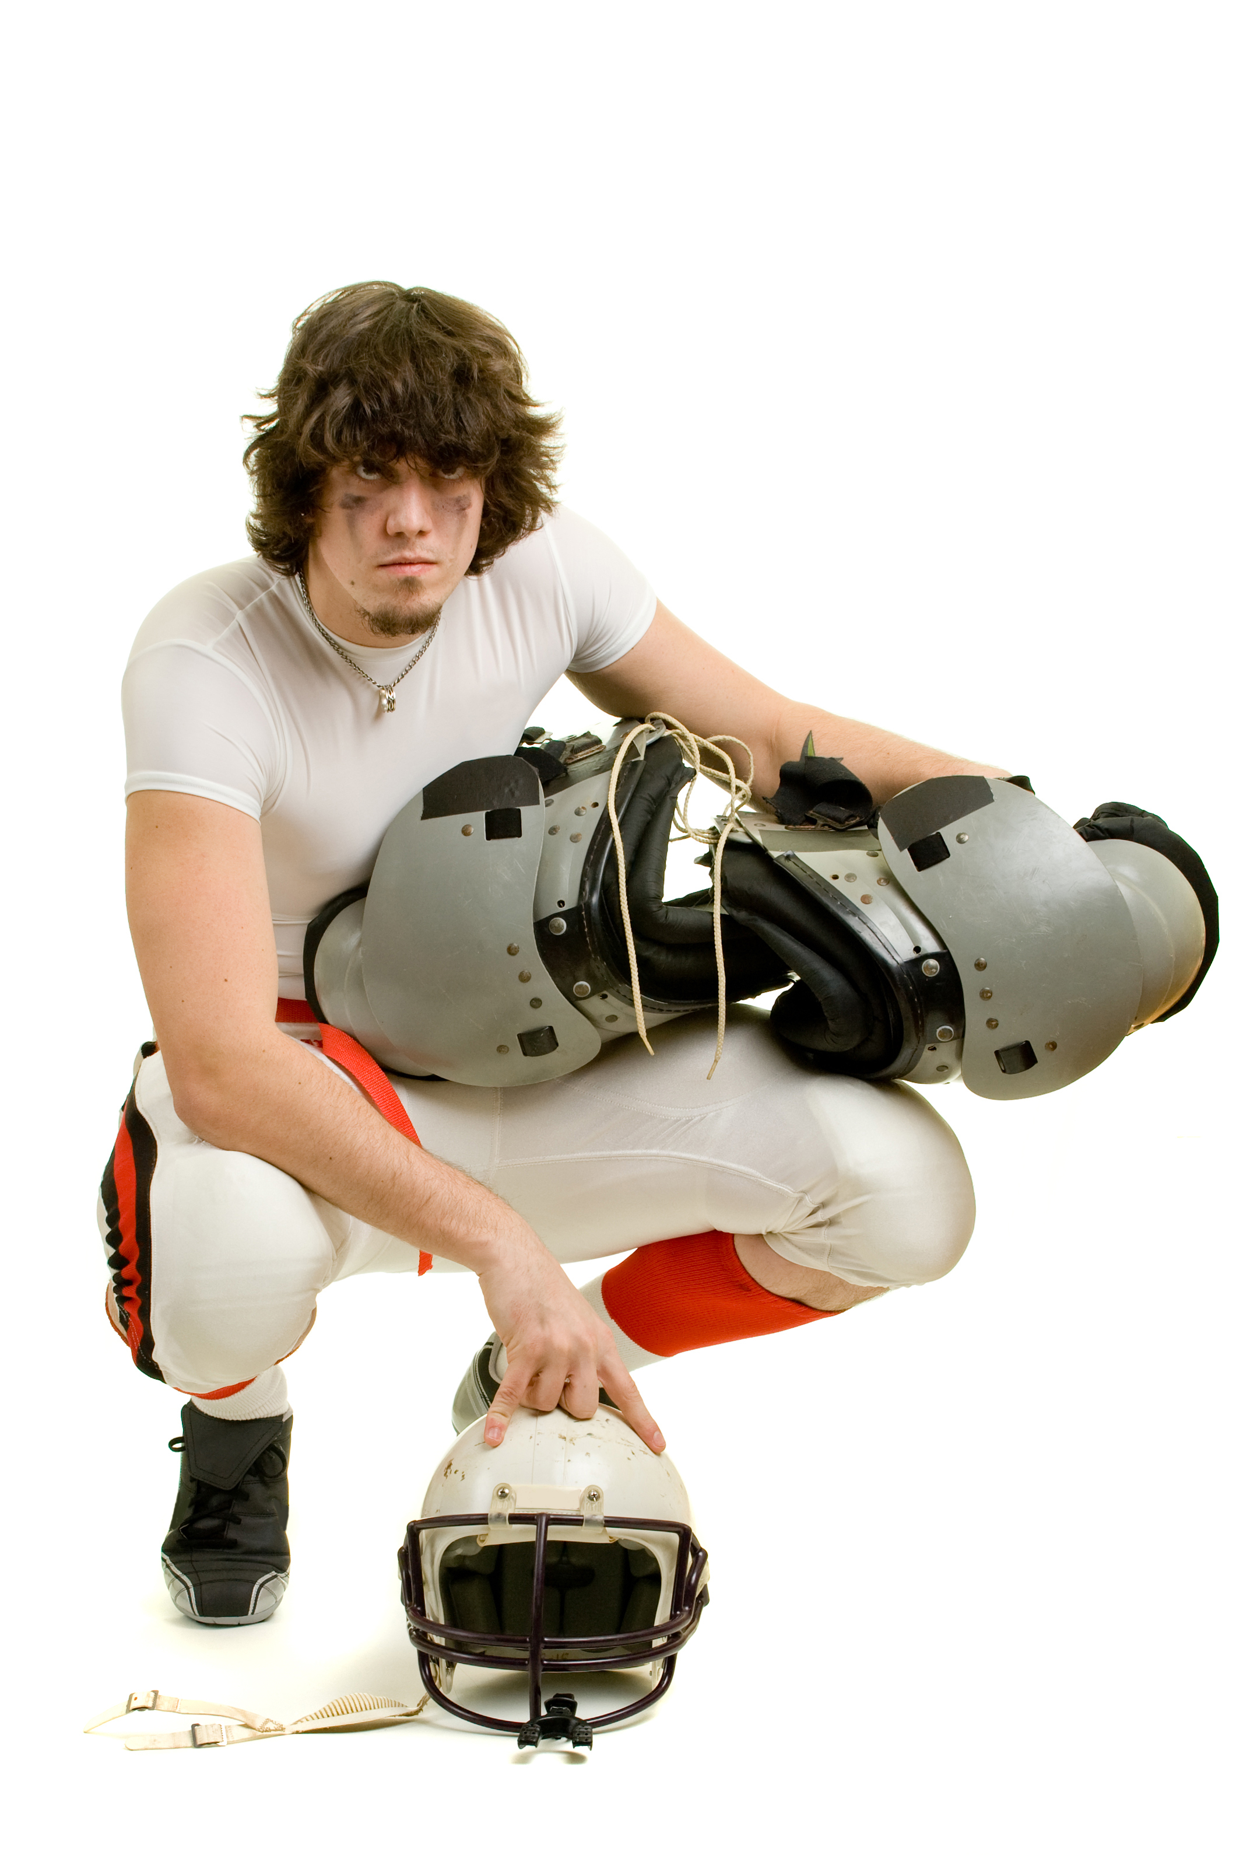
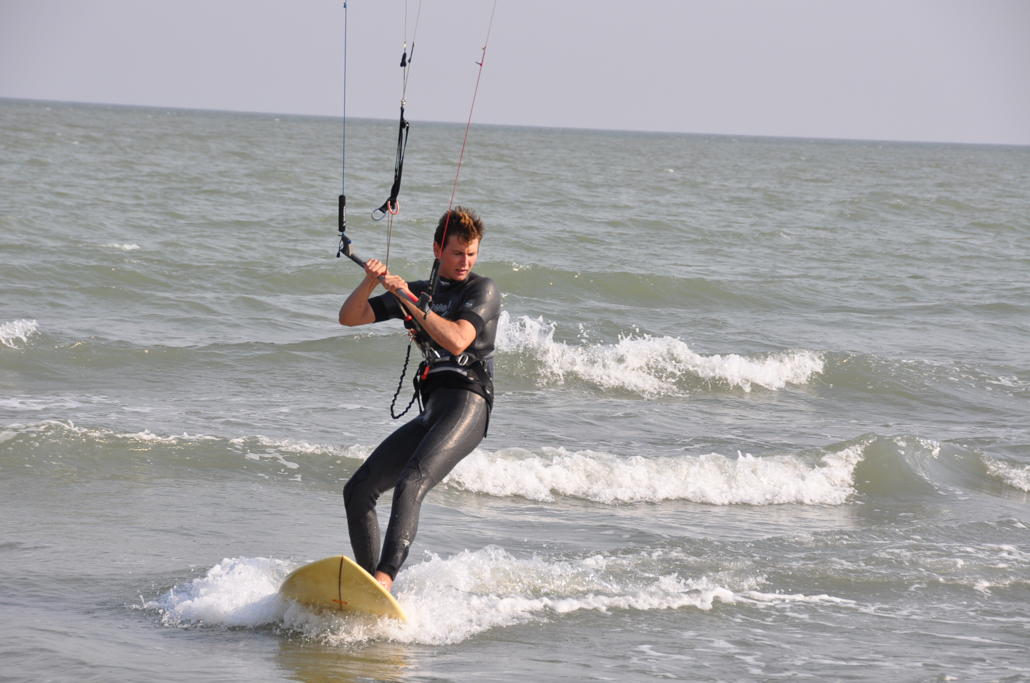
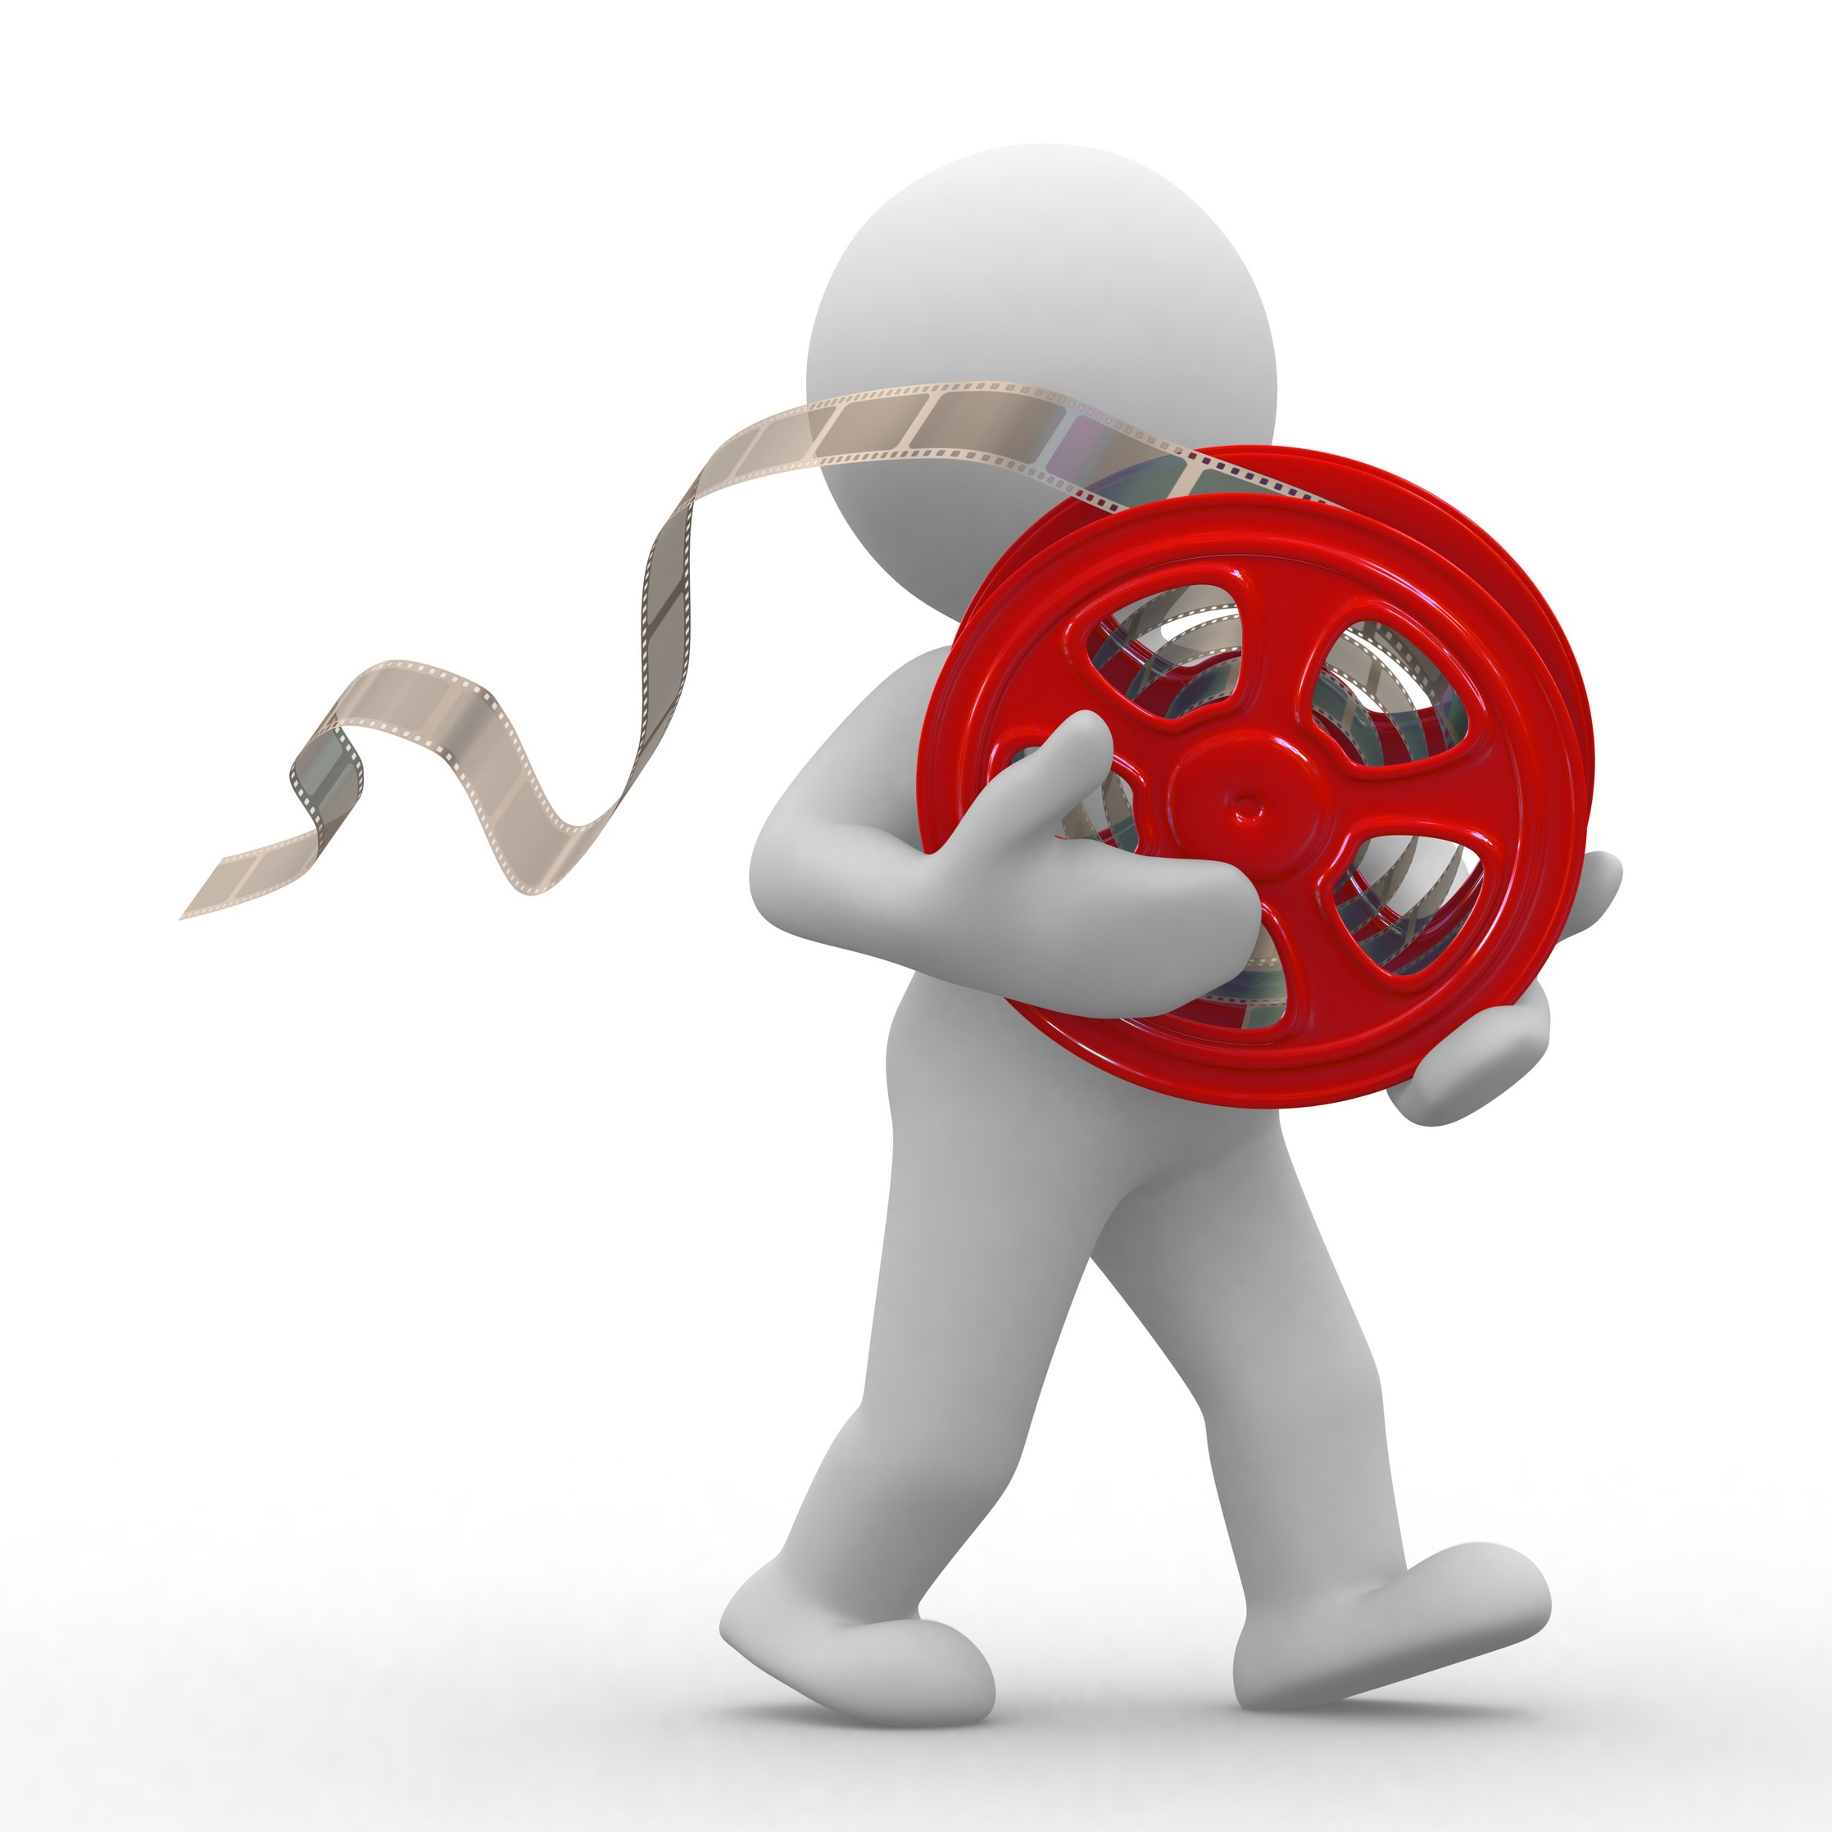
Growth in leisure activities
Reduced cost of equipment.
Improvements in travel methods.
Wider media coverage.

