Slide 1
Sports development and global events
4.5 Social, cultural and ethical influences

Slide 2
Sports Development
Olympics
Hosting
Elite
Performance
Sports Development and Global Events
Foundation
Global Events
Professional
Amateur

Slide 3
Sports Development Pyramid
The Sports Participation Pyramid demonstrates the performance progression and pathway in sport.
Top-class athletes performing internationally in major events i.e. The Olympics, and World Cup
Elite
Entering local competitions and leagues. Training regularly and receive coaching.
Performance
Participation
Taking part in your free time, sports clubs and extra-curricular activities
Foundation
PE and recreational
participation

Slide 4
Athletes
Professional
  At this level a person is taking part to earn money.
  Training and competing is their full-time career.
Amateur
  Amateur performers take part in sport for fun as a hobby.
  They do not receive any payment for playing.
Differences between the two
  Traditional differences.
  There is sometimes blurring between professional and amateur status e.g. scholarships, token “jobs”, trust funds.
  Both amateurs and professionals can now compete at the Olympic Games.

Slide 5





Global events
Global events are where many different countries compete against each other.
These may include:
      Olympic Games.
      Commonwealth Games.
      Paralympic Games.
      Football World Cup.
      Rugby World Cup.

Slide 6
Benefits of global events
There are many benefits of global events
to both participants and sports fans.
A famous quote from Nelson Mandela
talks about the power of sport politically,
emotionally and socially.
"Sport has the power to change the world.
It has the power to unite in a way that little else does. It speaks to youth in a language they understand. Sport can create hope where once there was only despair. It is more powerful than governments in breaking down racial barriers. It laughs in the
face of all types of discrimination."
—Nelson Mandela

Slide 7
Benefits of global events
Supporters and athletes from many different countries can meet and develop friendships.
Global events can transcend race, religion, culture and class through a shared interest and love of sport.
Top athletes are able to compete at the very highest level.
A global event can unite a nation and
develop an interest in sport where previously there was none.

Slide 8
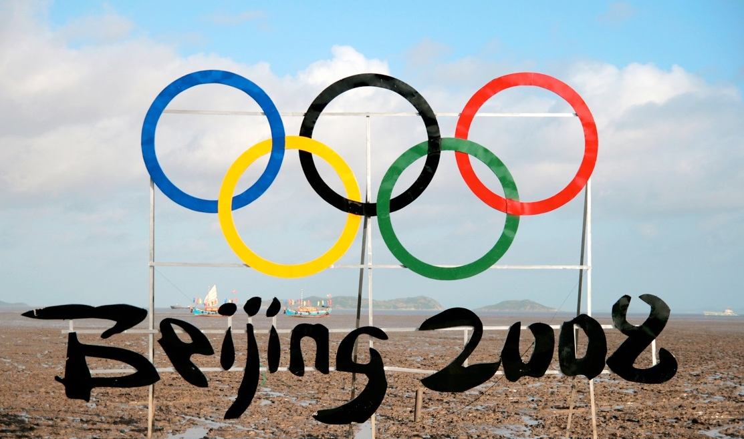
Benefits of hosting
The host nation for each international
sports event is decided after a complex,
time consuming and expensive
bidding system conducted by the governing body i.e. International Olympic Committee or FIFA.
There are numerous reasons why a country may wish to host a global event, each one will be considered in detail.
  Benefits to sport in the host country.
  Social benefits in the host country.
  Long-term benefits of hosting.

Slide 9

Benefits to sport
Benefits to Sport in the Host Country
Increased funding in sport, from individual
grants to new training facilities.
Coaching structures are improved so the host nation can perform at their best on the world stage.
New stadiums and sports facilities are built.
Increased interest in sport in the host nation and more participation.
The host nation receives automatic qualification for the tournament.
Increased publicity for sport.

Slide 10
Benefits of hosting
The host nation usually performs better.
      Athletes perform better due to the
      feel-good factor of performing in front
      of home fans.
      The enthusiasm from home fans is usually more intense.
      Athletes do not have to travel or acclimatise in home nation.
      Athletes in host nation generally are provided for better with facilities and accommodation.
      Athletes receive automatic qualification.
      Increase in national pride.

Slide 11
Benefits of hosting
Social benefits to the host country
  Greater wealth and better economy due
  to increased tourism and more employment.
  Improved infrastructure: rail, roads, ports and airports.
  Housing developments previously used to house athletes can be used by the city population.
  Puts the country on the map and increases the country’s international standing.
  Hosting a global event can bring a real feel good factor to the host nation.
  More sporting opportunities in the nation due to improved facilities.

Slide 12
Benefits of hosting
Long-term benefits to the host nation
  Increased tourism.
  Improved sports facilities and coaching structures.
  Better transport networks/infrastructure.
  Wealth created from the event can be used for other social projects in the country.
  Increased participation in sports in general.
  Country becomes more economically attractive and businesses invest.

