Slide 1
Sports development and global events
“The Apprentice”
4.5 Social, cultural and ethical influences

Slide 2
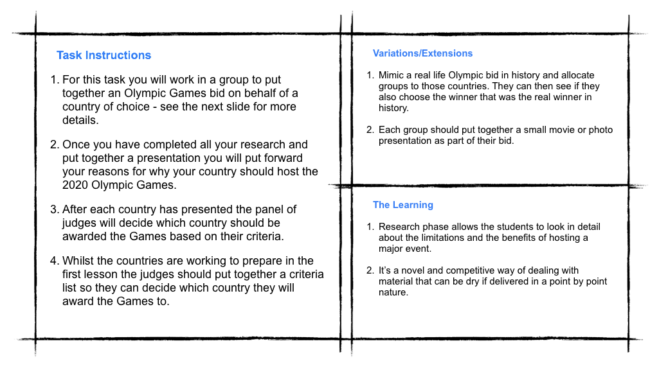

Slide 3

“Today’s task is to put forward an Olympic Bid for a country of your choice. The only catch is that it cannot be for a country that has already hosted.”
“Research, discuss and formulate your argument as to why the Olympic Committee should choose your country to host the Olympics”
Each person in the team must have a role i.e. researchers, pitchers, speech writers, finance & logistics experts”

Slide 4
Positive Impact on Your Country | Negative Impact on Your Country
Unite the nation | Financial cost
New Facilities | Global expectation and pressure
New accommodation buildings | Security
Improved infrastructure | Cost of improving infrastructure
Improved tourism | Pollution
Attract new investments into the country | Crime

