Slide 1
Risk of injury
4.6 Social, cultural and ethical influences

Slide 2
Winding
R.I.C.E
Strain
Blisters
Bruises
Sprain
Risk and Injuries
Cool Down
Warm Up
Cuts
Ruptured Tendon
Grazes

Slide 3
Actual and Perceived Risk
Actual risk
The amount of risk which actually exists at a given moment in time.
  Climbing a rock face with limited experience and no safety equipment.
Perceived Risk
Individual's subjective assessment of the real risk present at any time.
  Climbing on an indoor climbing wall with an experienced instructor and safety equipment may seem high risk for a novice when infact it is low risk.

Slide 4
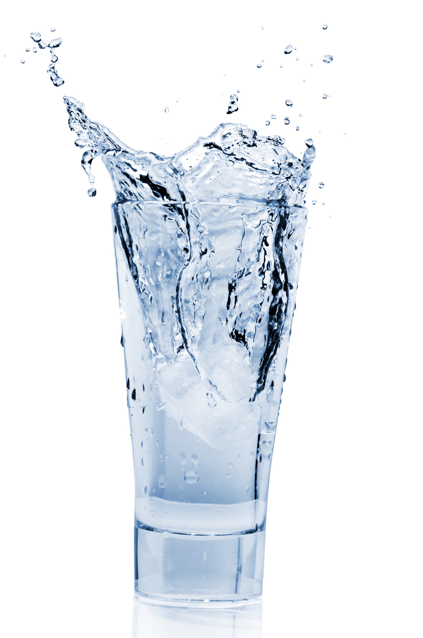
Risk
There are a number of ways to reduce risk in different environments including indoor sports halls, playing fields, swimming pools and artificial surfaces:
  Warm up and cool down properly.
  Use the correct protective clothing and equipment.
  Appropriate clothing and footwear.
  Know the rules and regulations and
  follow them.
  Participate at the appropriate level of
  competition.
  Maintain hydration.
  Lifting and carrying equipment safely.

Slide 5
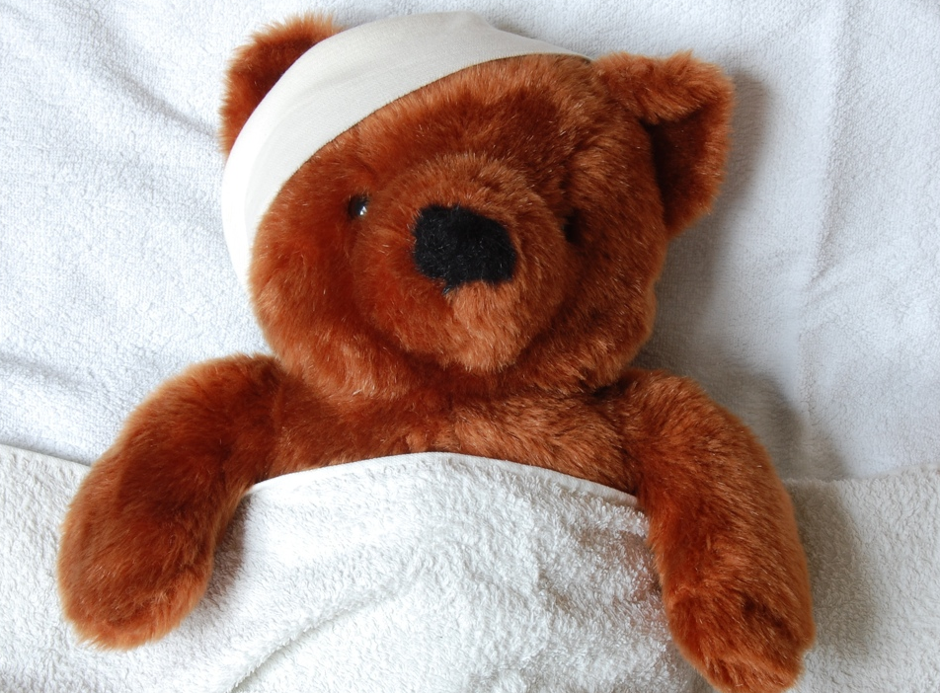
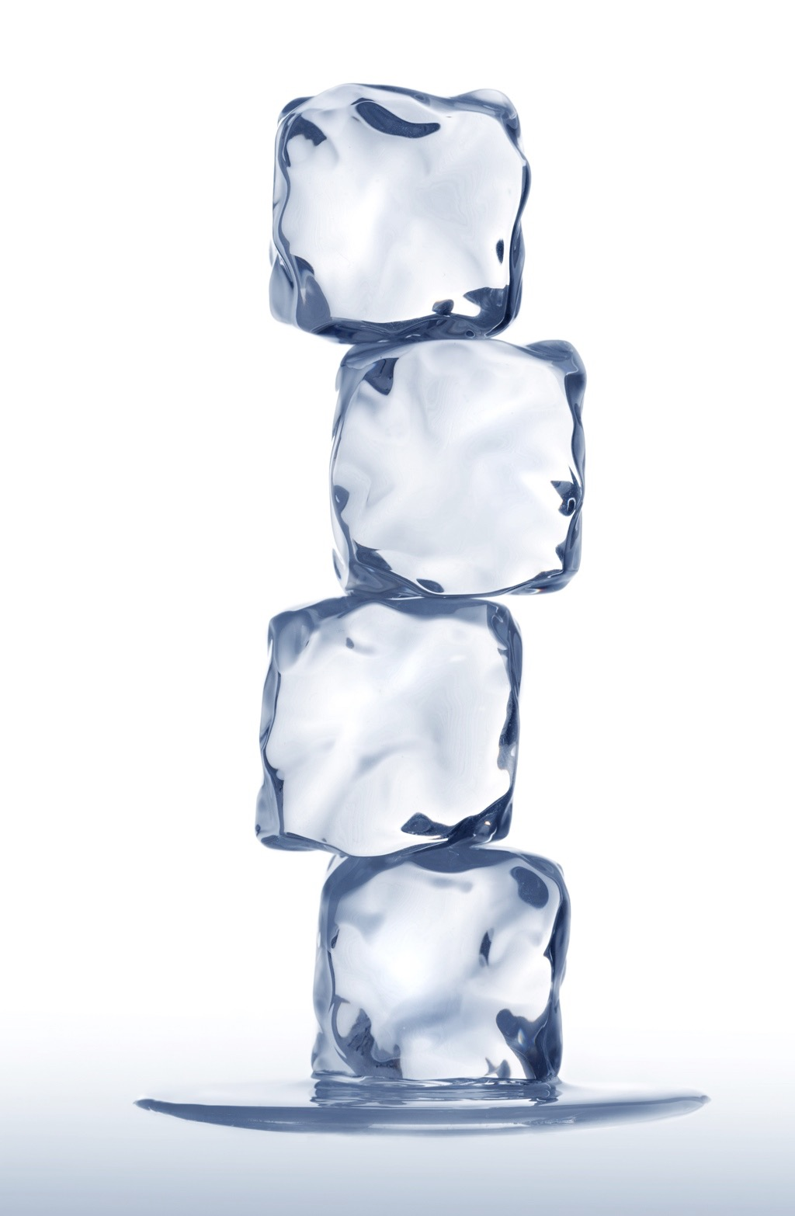
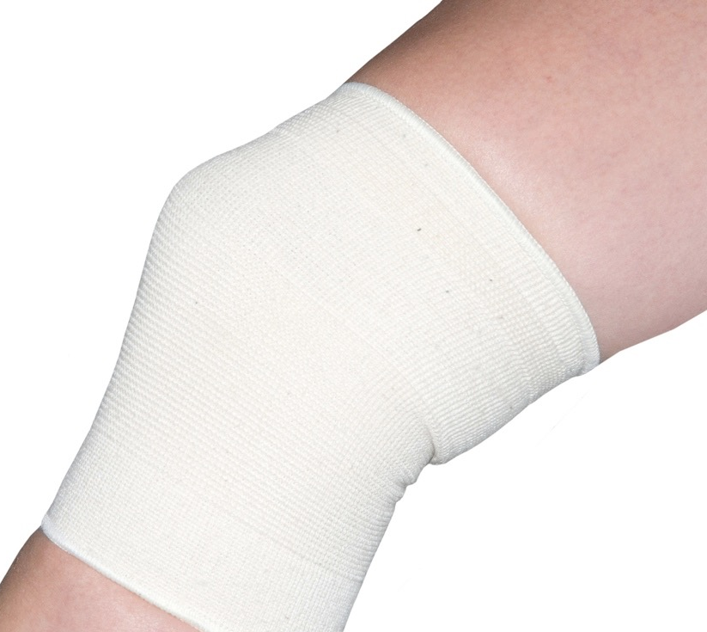
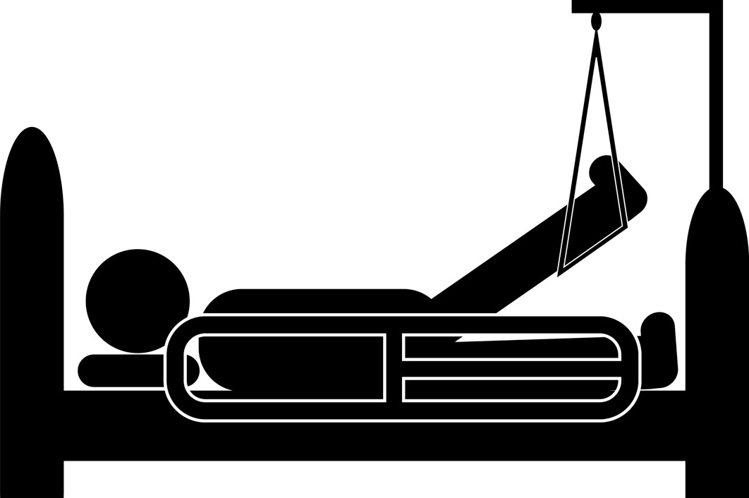
R.I.C.E
There is one form of treatment that is used for a number of minor injuries and you can remember it using the acronym R.I.C.E.
          Rest - sit down or lie down and do not move.
          Ice - cool the injured area by applying ice.
          Compression - use a
          bandage to stop the swelling.
          Elevation - Raise the joint higher than the heart to reduce the swelling.

Slide 6
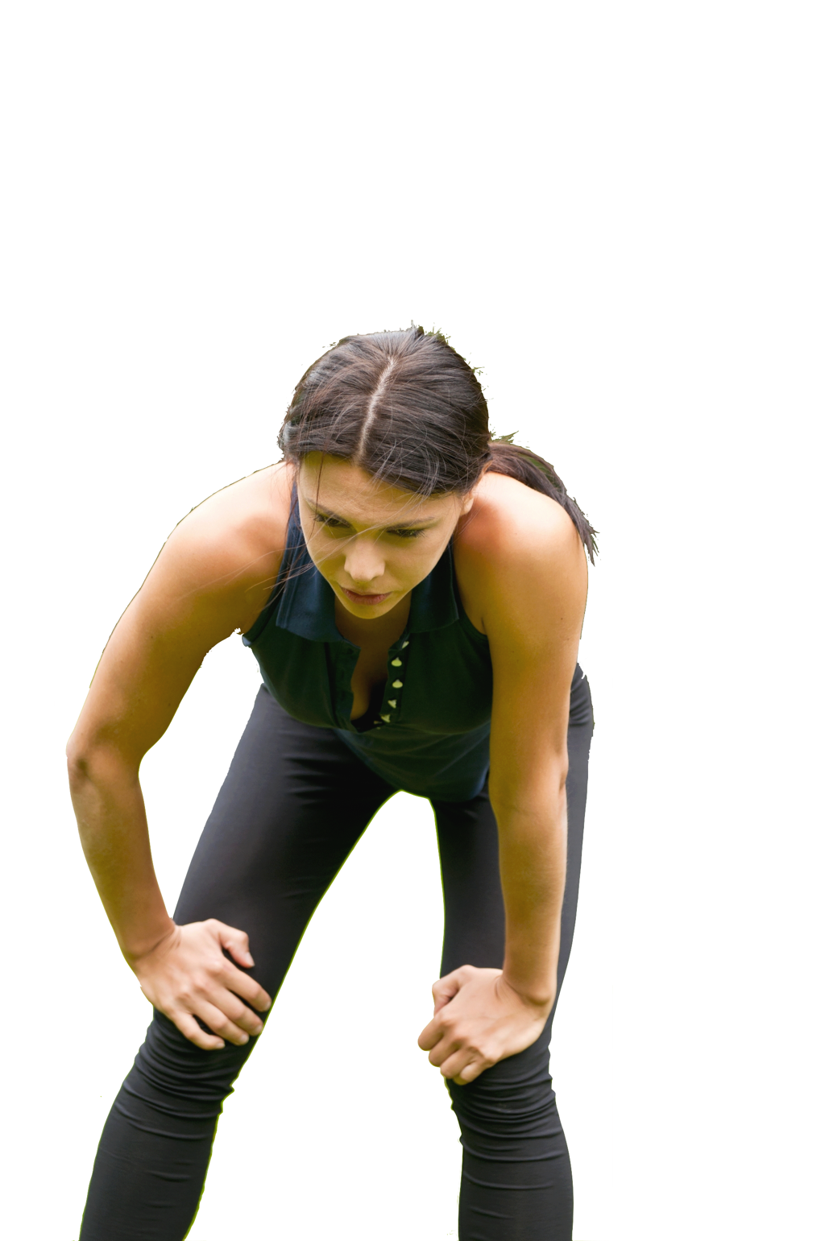
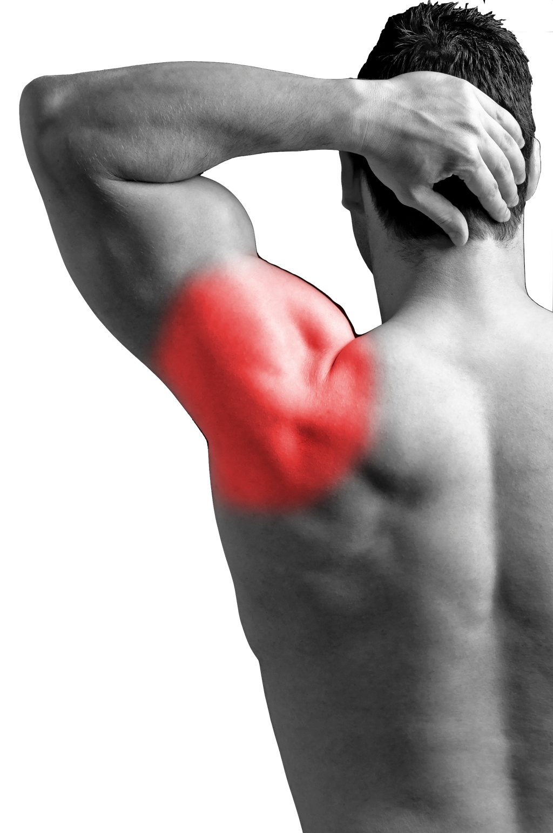
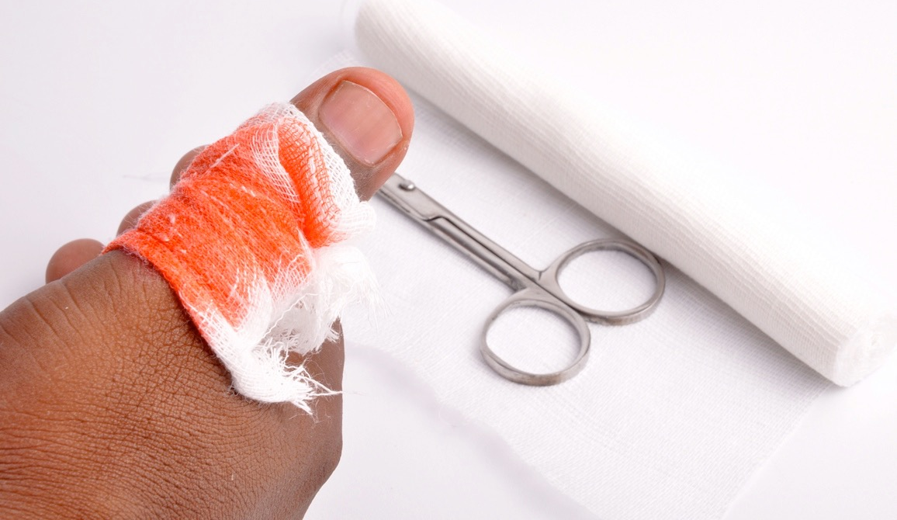
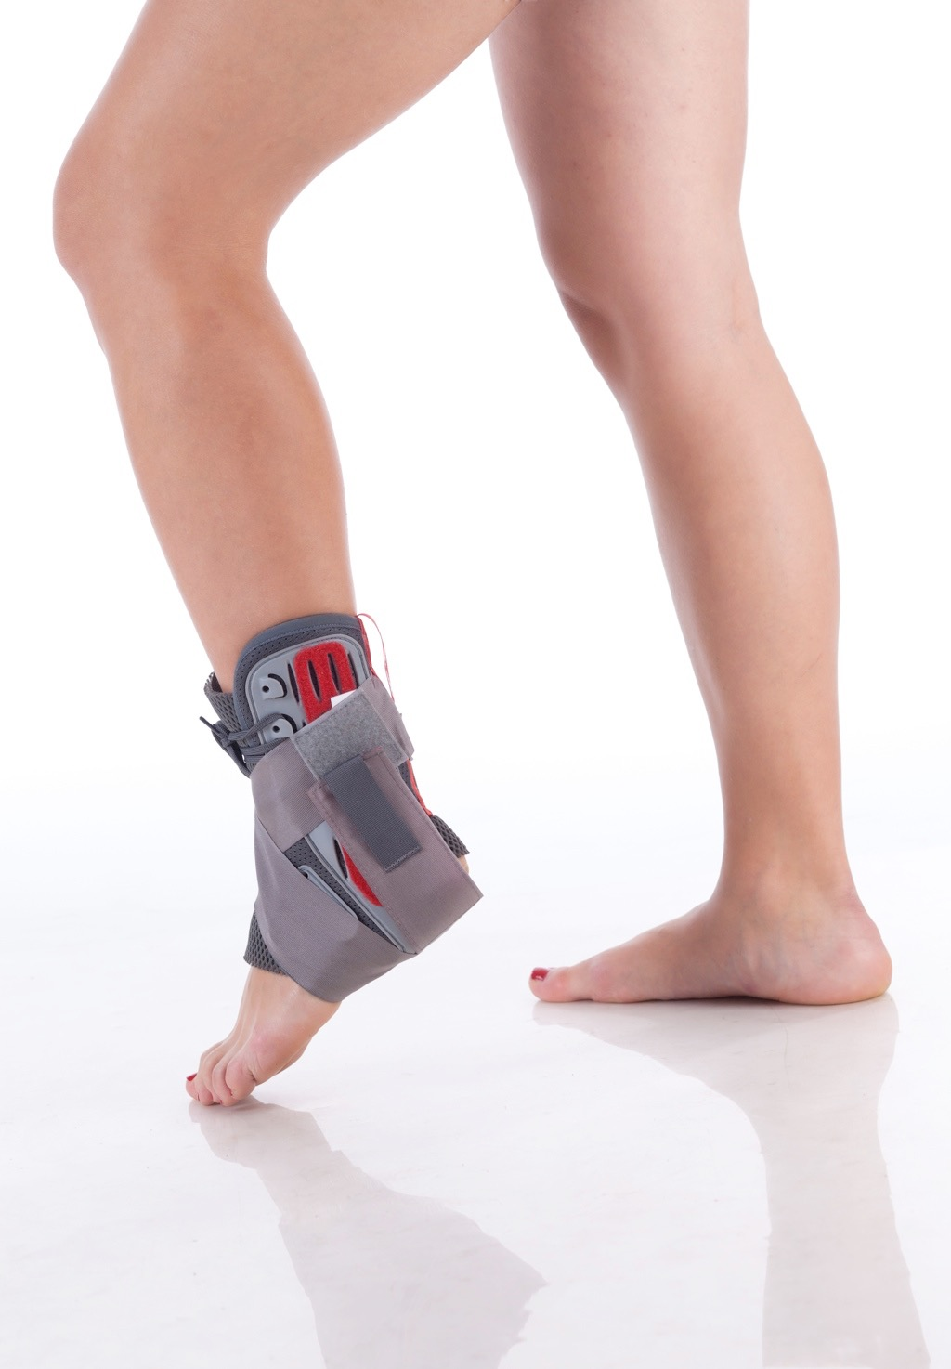
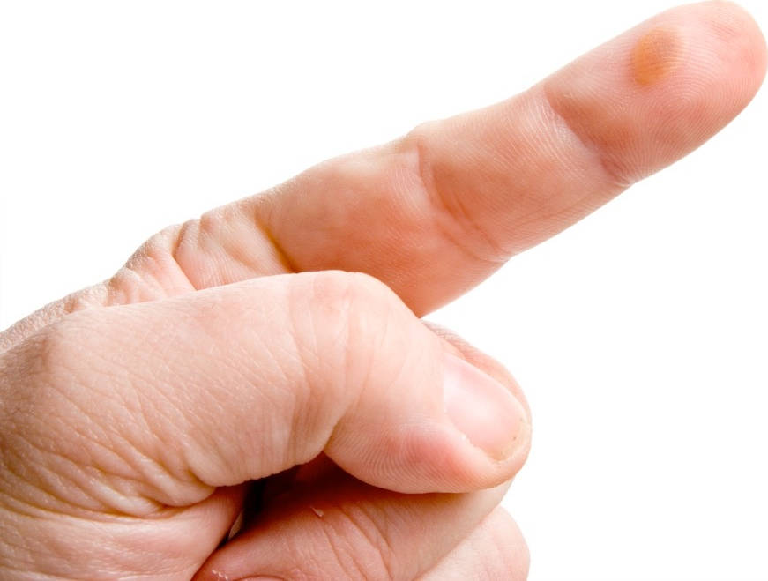
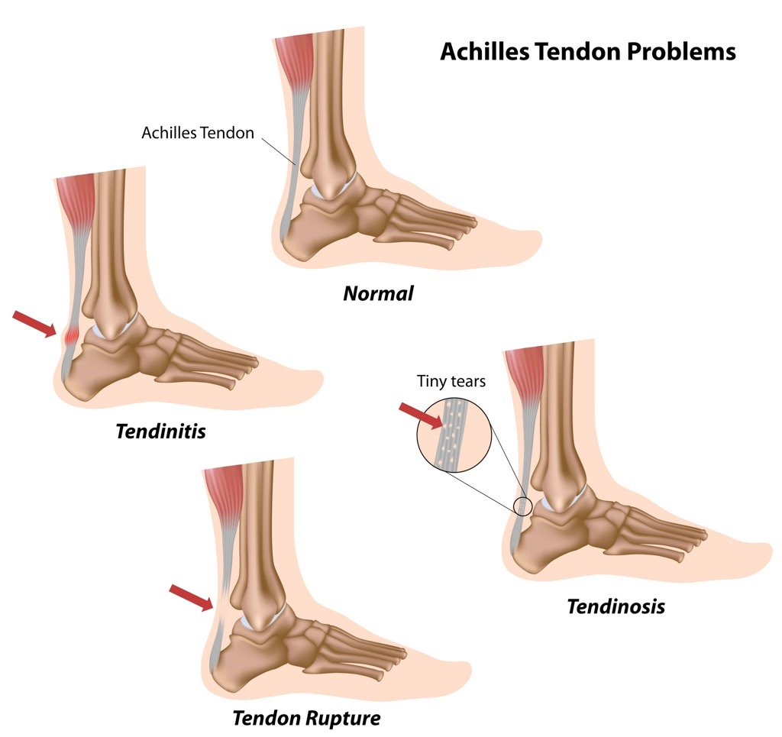
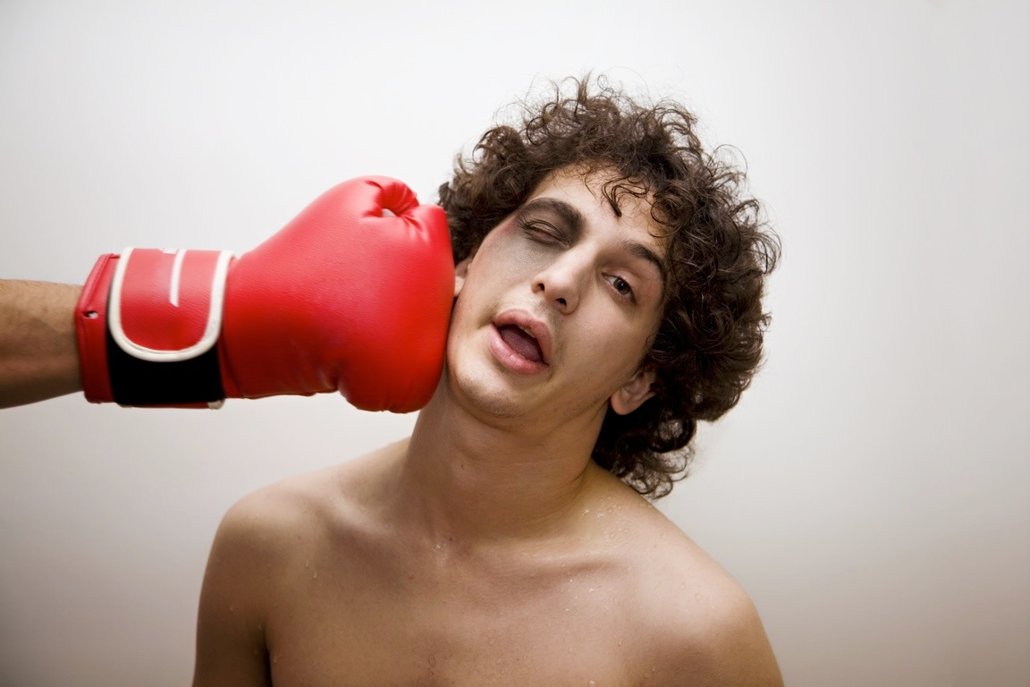
Types of Injury
There are a number of injuries you need to be aware of in this course.
Winding |  | Strain
Cuts and Grazes |  | Sprain
Blister |  | Ruptured Tendon
Bruises

Slide 7
Winding
Winding - caused by a blow to the abdomen, which results in pain and makes it hard to breathe.
    Assume a crouching position so the muscles
    can relax.
    Recovery should take up
    to 15 minutes.

Slide 8
Strains
Strains - caused by a tear in the
muscle tissue or tendon, resulting in pain,
swelling and bruising.
Strains should be treated with R.I.C.E.
    Rest - sit down or lie down and
    do not move.
    Ice - cool the injured area by applying ice.
    Compression - use a bandage to stop the swelling.
    Elevation - Raise the joint higher than the heart to reduce the swelling.

Slide 9
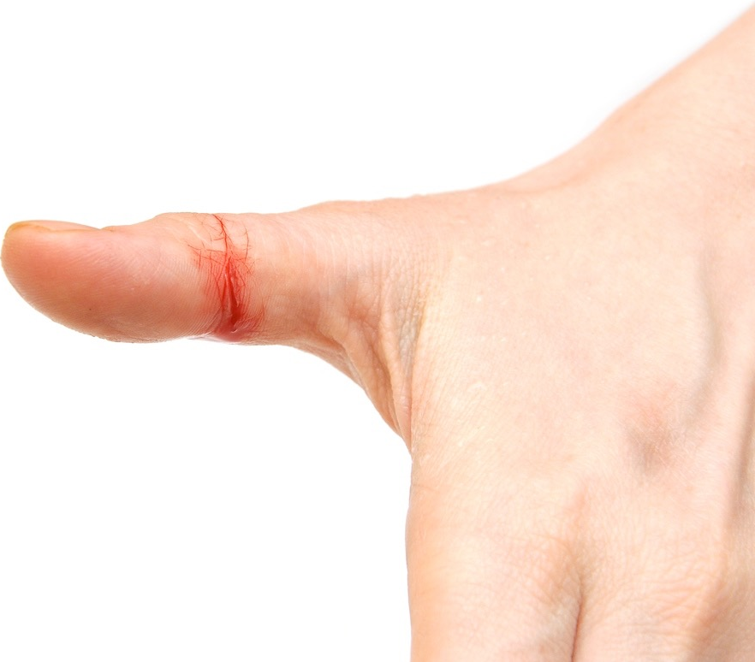
Cuts and Grazes
Cuts - caused by an impact
breaking the skin.
    Requires immediate
    attention to reduce
    the loss of blood.
    They should be cleaned
    with an antiseptic first.
    Dress them with a plaster or bandage or both so they don’t get infected.

Slide 10
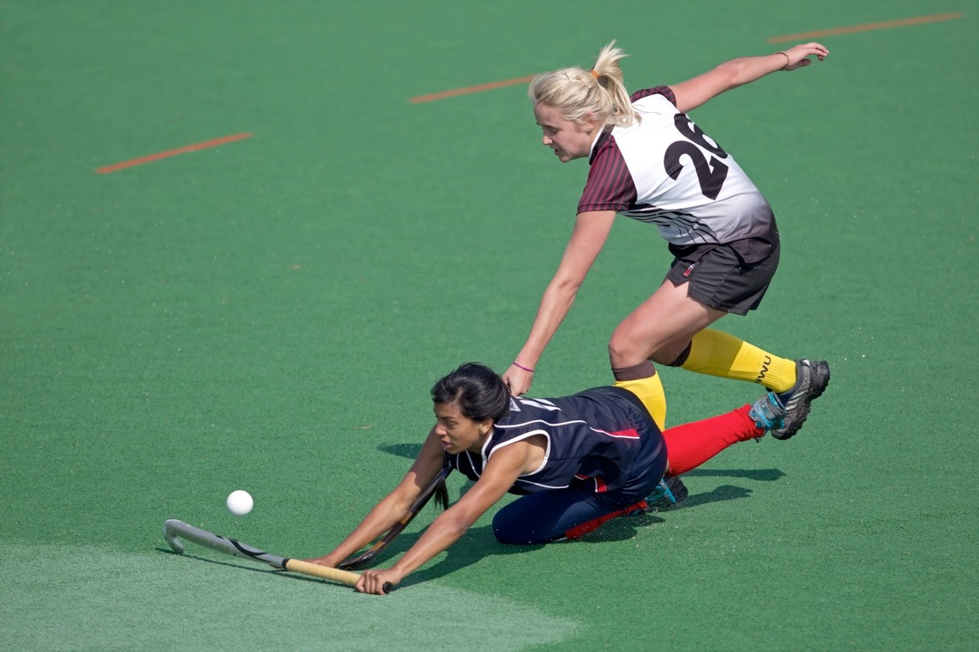
Cuts and grazes
Grazes or abrasions - caused by rubbing against a rough surface
    Need to be cleaned
    thoroughly as there may
    be grit or dirt in the wound.
    The graze should then be
    covered to prevent
    further infection.

Slide 11
Sprain
Sprains - caused by stretched or
torn ligaments from a sudden twisting
movement.
Sprains should be treated with R.I.C.E.
    Rest - sit down or lie down and do
    not move.
    Ice - cool the injured area by applying ice.
    Compression - use a bandage to stop
    the swelling.
    Elevation - raise the joint higher than the heart to reduce the swelling.

Slide 12
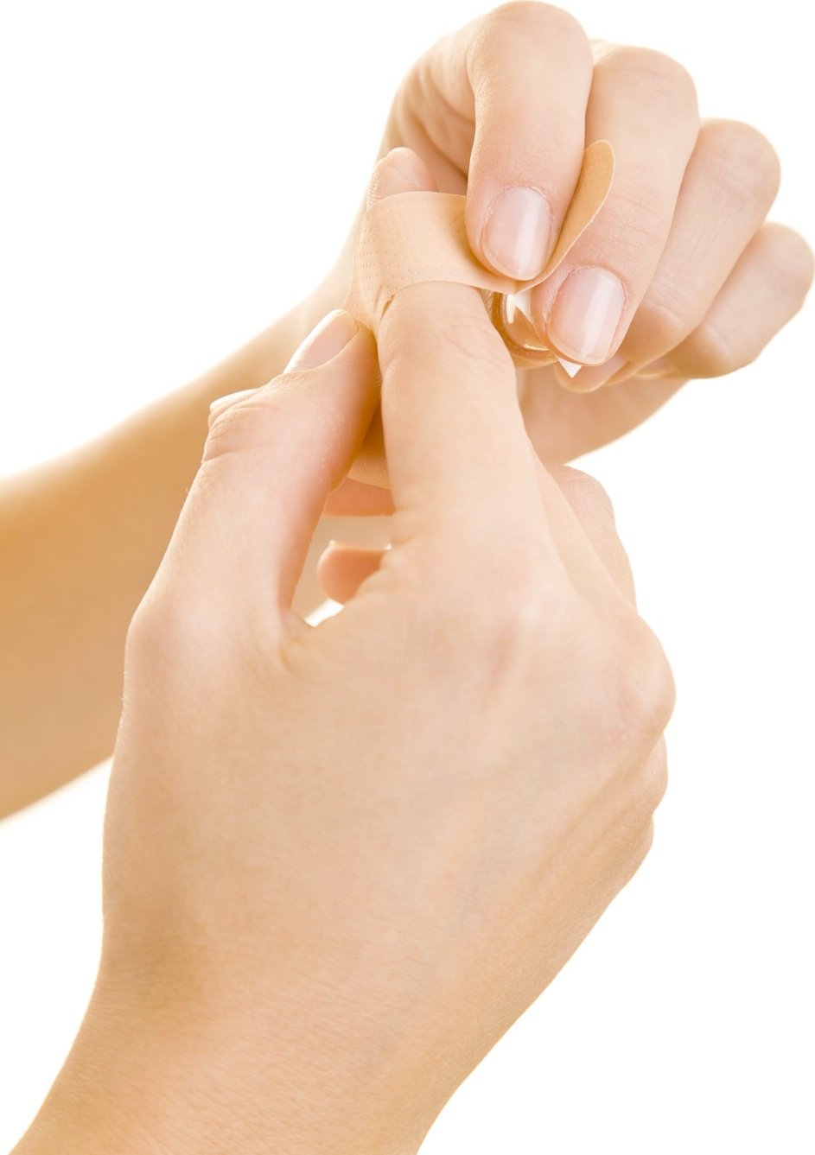
Blisters
Blisters - caused by the skin rubbing (friction) against other surfaces.
    A bubble is created just underneath the skin.
    Never burst the bubble
    as it may become infected.
    Instead dress the blister
    and avoid more rubbing.

Slide 13
Ruptured tendon
Ruptured Tendon - caused by an impact trauma.
    A ruptured tendon is a serious injury.
    You should seek medical help immediately if you hear a snap or lose movement in an area of your body.
    Surgery is usually
    required to fix a
    ruptured tendon.

Slide 14
Bruises
Bruising - caused by damaged blood
vessels and blood pooling under
the skin and surrounding tissue,
causing discolouration.
Bruises should be treated with R.I.C.E.
    Rest - sit down or lie down and
    do not move.
    Ice - cool the injured area by applying ice.
    Compression - use a bandage to stop the swelling.
    Elevation - raise the joint higher than the heart to reduce the swelling.

Slide 15
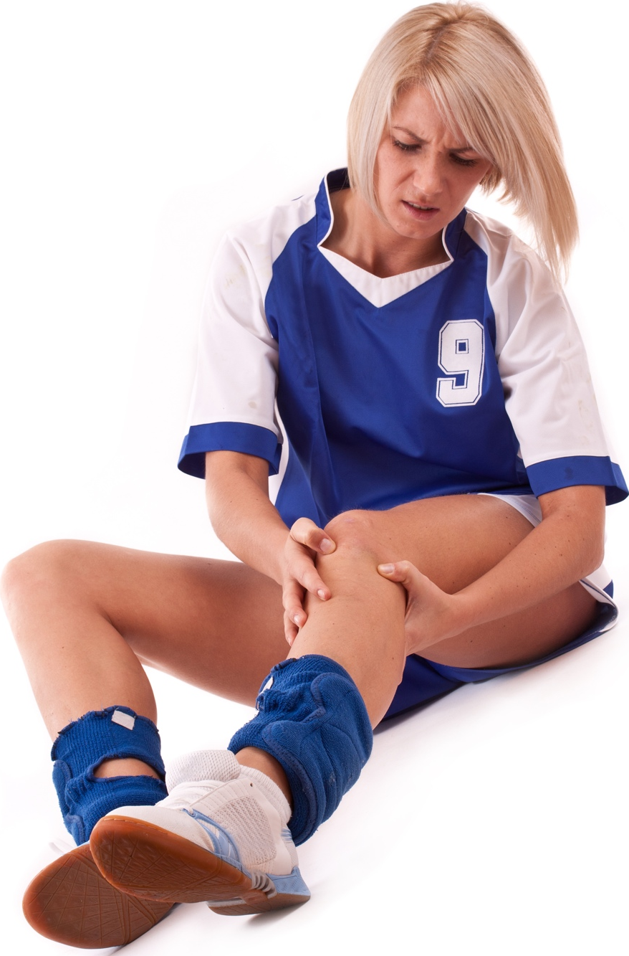
Causes of injuries
Colliding with another person.
Sudden or twisting movements.
Hot, cold, wet or windy environments.
Wearing inappropriate clothing.
Not following instructions or
the rules.
Not warming up and cooling
down.
Impacting with the ground or another person.

