Slide 1
Energy supply and the effects of exercise on the body
1.3 Anatomy and physiology

Slide 2
Glucose
Oxygen
Aerobic Respiration
Carbon dioxide
Anaerobic Respiration
Energy Supply and the Effects of Exercise on the Body
Cool Down
Lactic Acid
EPOC
Oxygen Debt
Energy

Slide 3
Aerobic Respiration
Aerobic respiration is when we use oxygen to create energy.
We can usually supply enough oxygen for low to medium intensity activities.
Energy
Glucose
Oxygen
Carbon dioxide
Water
+
+
+
Long distance/low intensity sports such as cycling, running and swimming use the aerobic system.

Slide 4
Anaerobic Respiration
Anaerobic respiration is when we do not take enough oxygen in to meet high energy demands.
This might be when we are working at full intensity for a short amount of time i.e. sprinting or throwing.
Glucose is broken down without oxygen.
As a result a waste product called lactic acid is produced which reduces performance.
Energy
Glucose
Lactic Acid
+

Slide 5
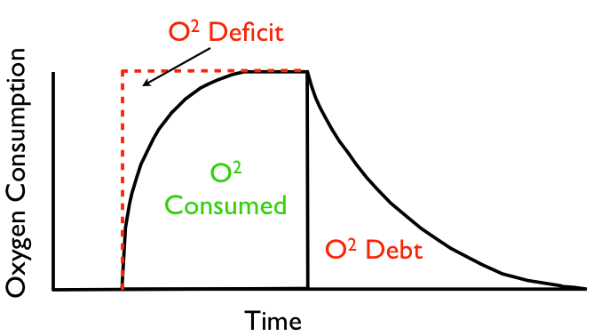
Excess Post-Exercise Oxygen Consumption (EPOC)
      Oxygen Debt (EPOC)
During recovery we
continue to consume
a large volume of
oxygen.
This extra amount that is consumed after exercise compared to rest is called our oxygen debt.
When we exercise anaerobically our oxygen debt increases as we are forced to breakdown glucose without oxygen which creates lactic acid.
The excess oxygen consumed is used to remove lactic acid.

Slide 6
Oxygen Debt (EPOC)
O² Deficit
Oxygen Consumption
O²
Consumed
O² Debt
Time

Slide 7
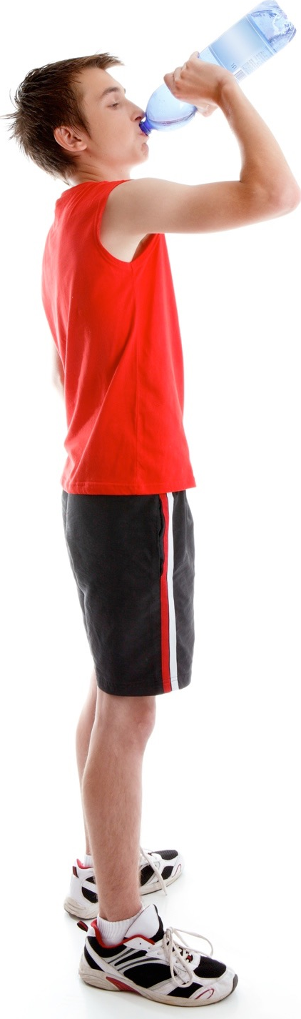
Recovery
  Cool Down - After taking part in physical activity you should do some light exercise and stretch thoroughly to aid recovery.
  Prevents soreness.
  Elevated heart rate and breathing rate clears
  lactic acid.
  Players can also do a number of other activities to
  aid recovery.
  Eat - Carbohydrates replace energy used in exercise.
  Drink water - Rehydrates the body after
  losing fluids through sweating.
  Rest - Allows the muscles to repair themselves.
  Plunge pools of ice-cold water - Reduces
  Delayed Onset of Muscle Soreness (DOMS).
  Compression garments - Reduces swelling.

Slide 8
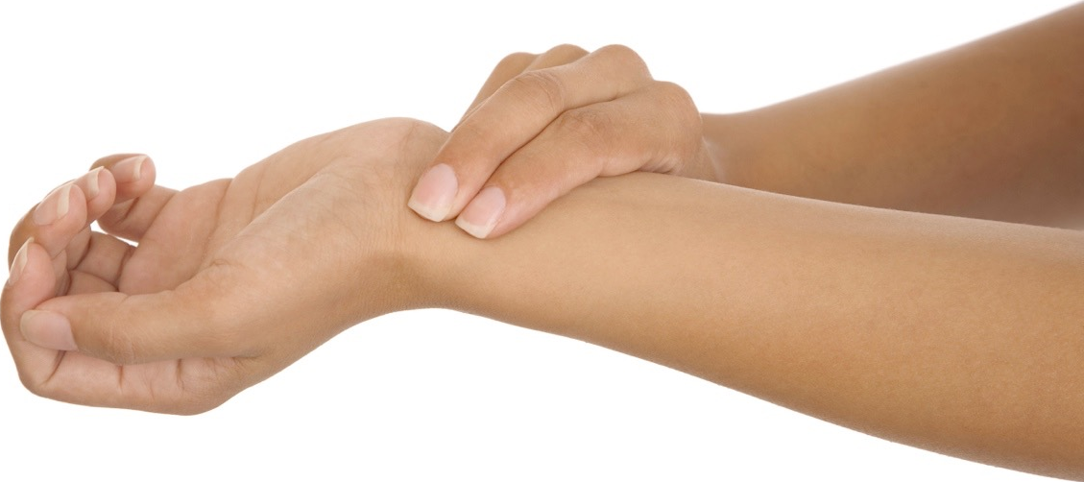
Heart Rate
Heart Rate
When you start to exercise the
heart rate increases.
This coupled with an increased stroke volume increases the cardiac output resulting in an increased blood flow and better oxygen delivery.
The increase in heart rate depends on the intensity of the exercise. Intense exercise results in a large increase in the heart rate.

Slide 9
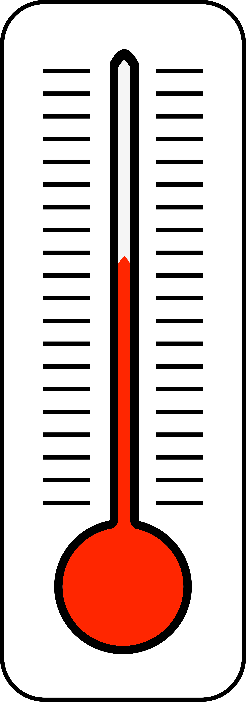
Increased Temperature
Increased Temperature
When energy is produced and muscles contract heat is created.
Increased muscle contractions result in a large increase in temperature.
The body redirects the blood to the surface of the skin so it can be removed.
Heat is lost through evaporation (sweating), radiation and convection.
The skin becomes hot, red and sweaty.

Slide 10
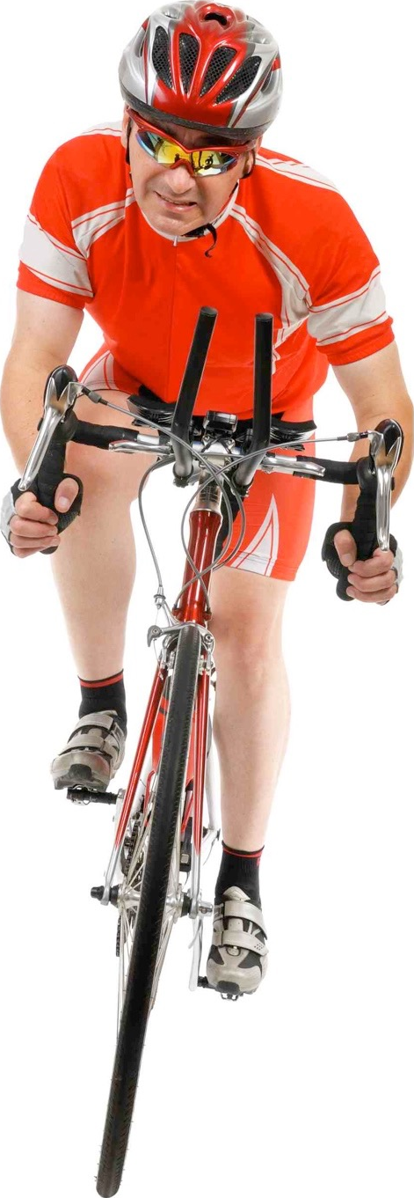
Respiratory Changes
Respiratory Changes
  Breathing rate increases.
  Depth of breathing increases,
  resulting in an increase in
  tidal volume.
  Increased gaseous exchange of
  oxygen and carbon dioxide at
  the lungs.

Slide 11
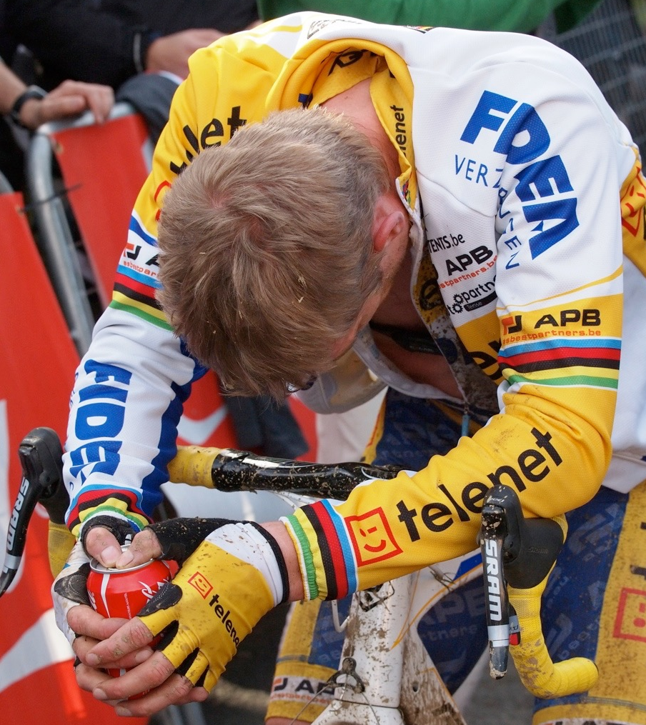
Other Changes
During prolonged performance and
anaerobic respiration lactic acid is produced. This makes the muscles fatigue (DOMS) and you will feel tired.
Performers must eventually stop due to cramp.
Feel light headed.
Experience nausea.

Slide 12
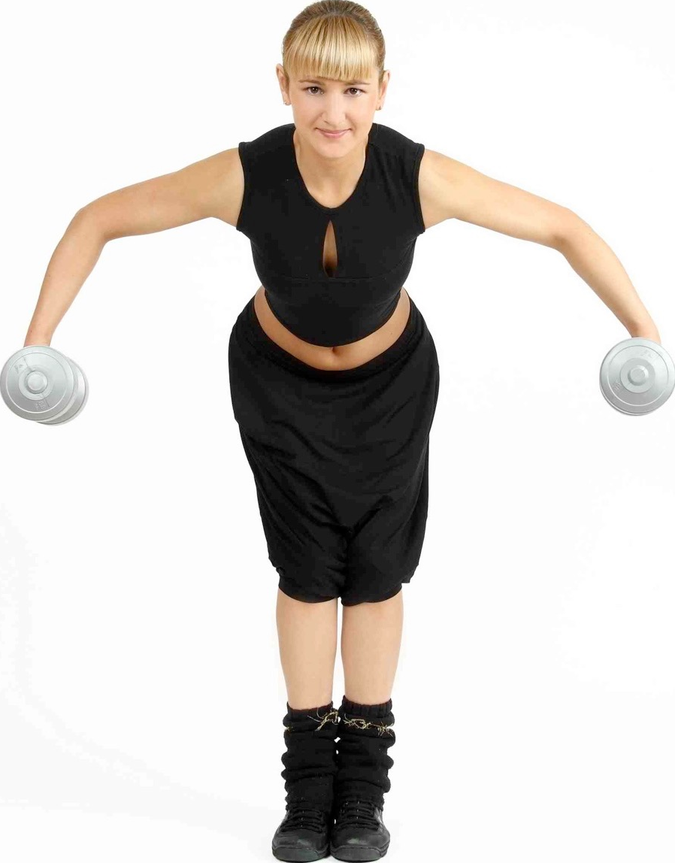
Long-term effects of exercise
Resting heart rate decreases (bradycardia). 60 beats per minute in an adult is considered bradycardia.
Change in body shape. Increased lean body mass.
Improvements in specific components of
fitness such as muscular endurance,
cardiovascular endurance, speed, suppleness
(flexibility) and strength. These
improvements depend on the type of
exercise you perform.
Increase in stamina so you can exercise
for longer.
Muscles increase in size and strength
(hypertrophy).

Slide 13
Long-term effects of exercise
Increased red blood cell production
Arteries (blood vessels) grow larger and more elastic so blood pressure is reduced.
Lactic acid is removed more efficiently.
Decreased recovery time.
Increase lactic acid tolerance.
Increased gaseous exchange.

