Slide 1
Simple biomechanics
1.4 Anatomy and physiology

Slide 2
Plantar Flexion
Dorsi Flexion
Force
Gravity
Load
Simple Biomechanics
Effort
Levers
Acceleration
Air resistance
Fulcrum

Slide 3
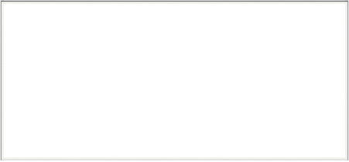

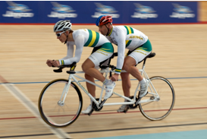
Principles of Force
Force =
mass x acceleration
A force can be a pull or a push
  Push and pull forces
  are used when turning
  the pedals on a bike.
  An increase or decrease in force
  can cause acceleration or
  deceleration.
Pulling the pedals
Pushing
the pedals

Slide 4
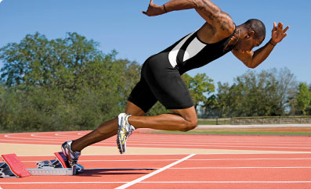
Applications of Force
Sprinter in the blocks
Air resistance
Gravity
Ground reaction
force

Slide 5
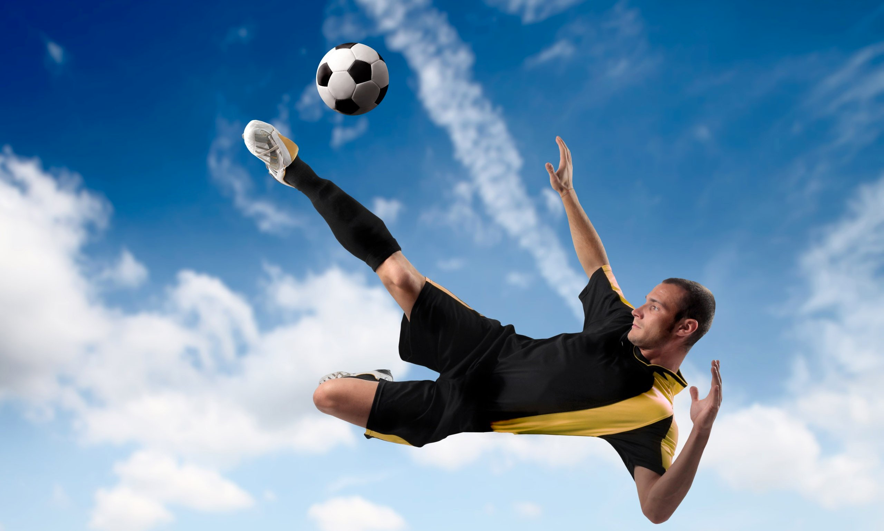
Applications of Force
Object in the air
Force applied
at release
Air resistance
Gravity

Slide 6
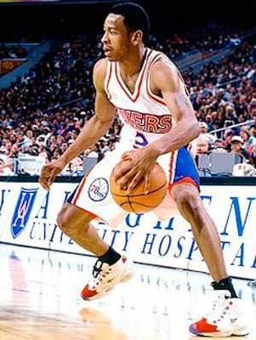
Applications of Force
Moving performer
Air resistance
Muscular force
Gravity

Slide 7
Levers
Muscles and bones work together as a series of levers to create movement.
A lever is a rigid bar is comprised of three components:
  Fulcrum (the point at which the lever rotates)
  Resistance (the resistance applied to the lever system)
  Effort (the effort/muscle needed to move the lever system)
The classification of lever depends on the order in which these three components are in relation to each other.

Slide 8
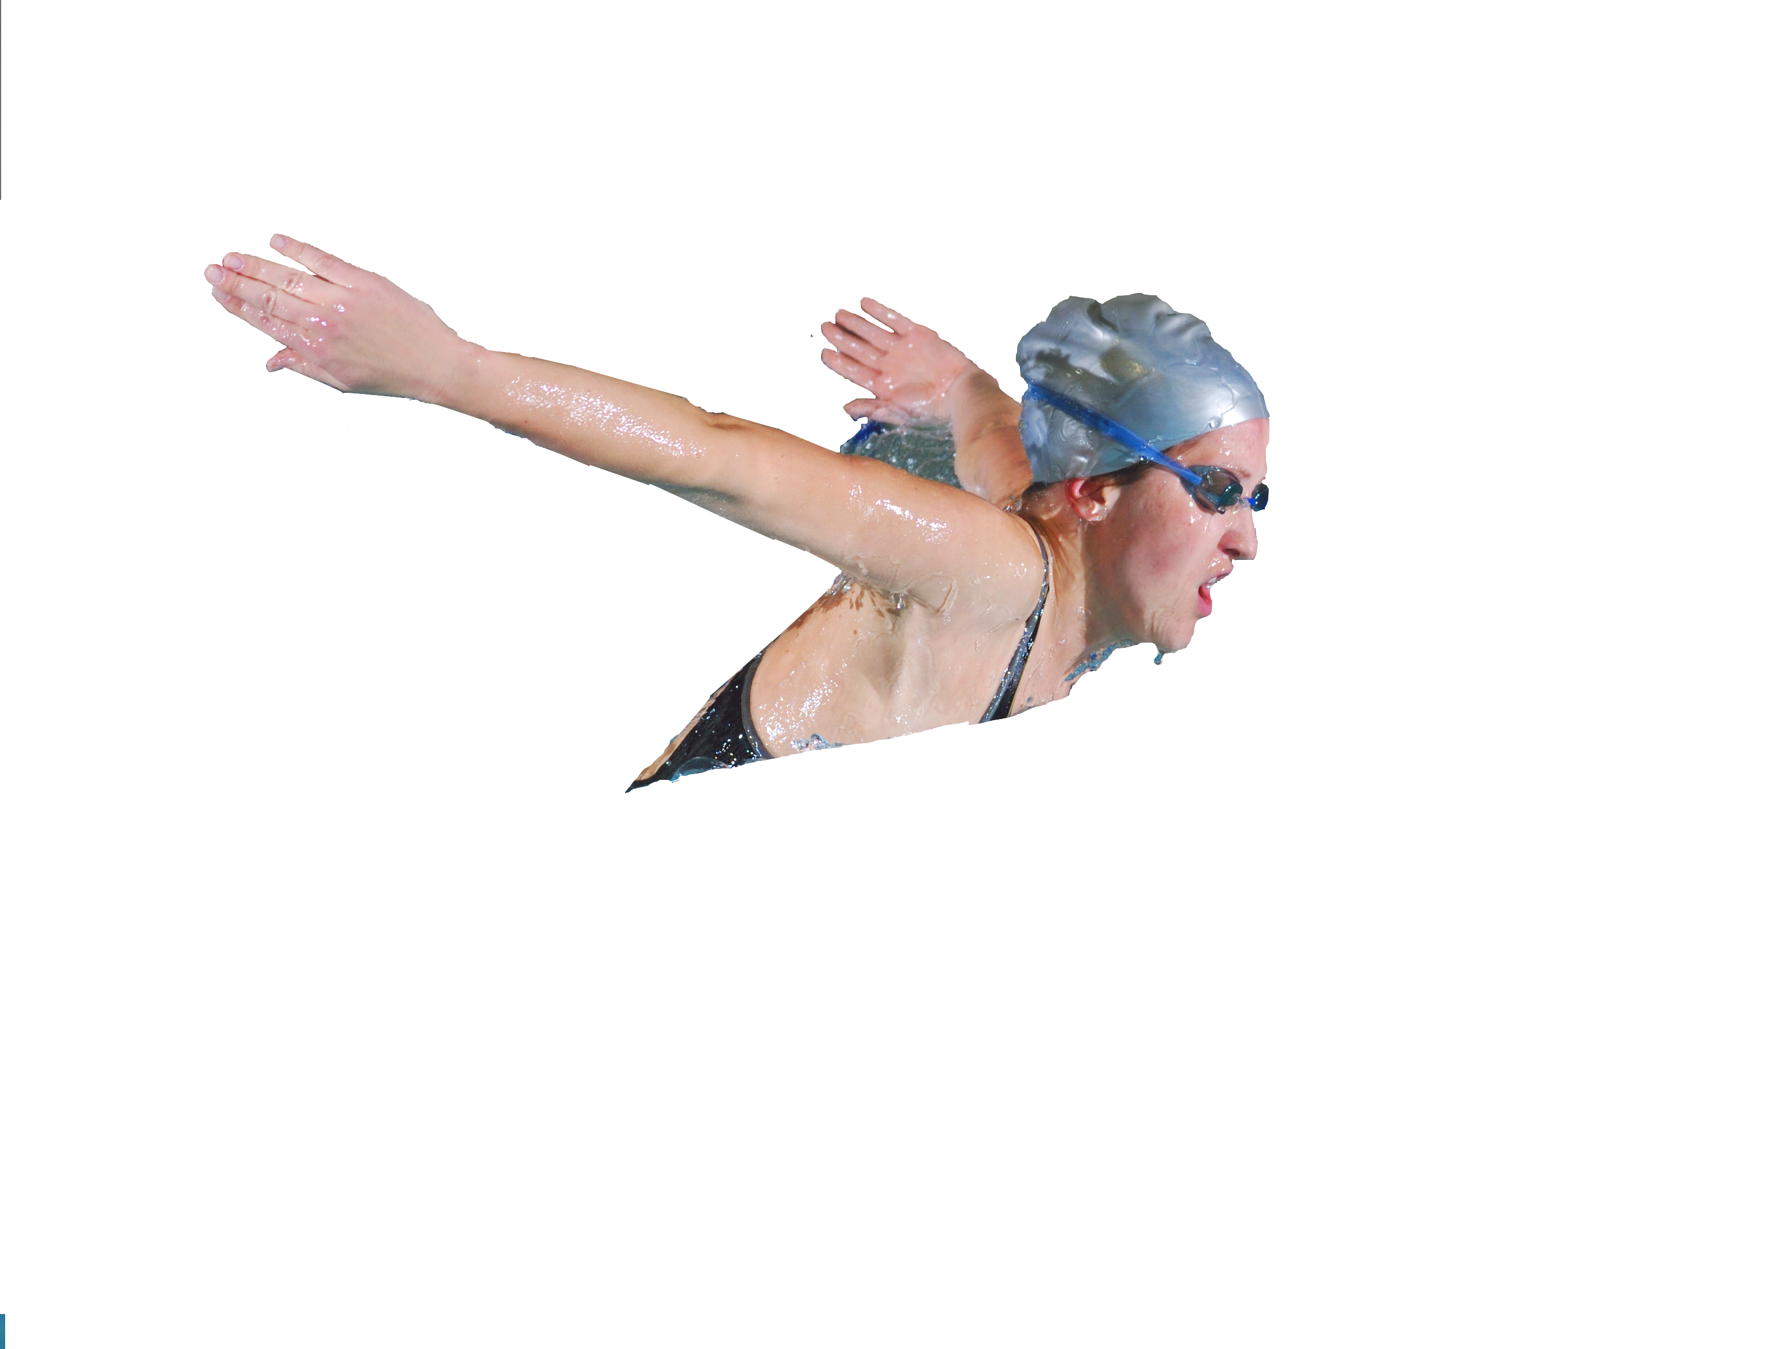

Levers
First class levers are organised in a see saw order to move the load.
Examples of first class levers:
  nodding the head
  i.e. breathing in Swimming or heading
  in Football.
Effort
Movement
Resistance
Fulcrum

Slide 9
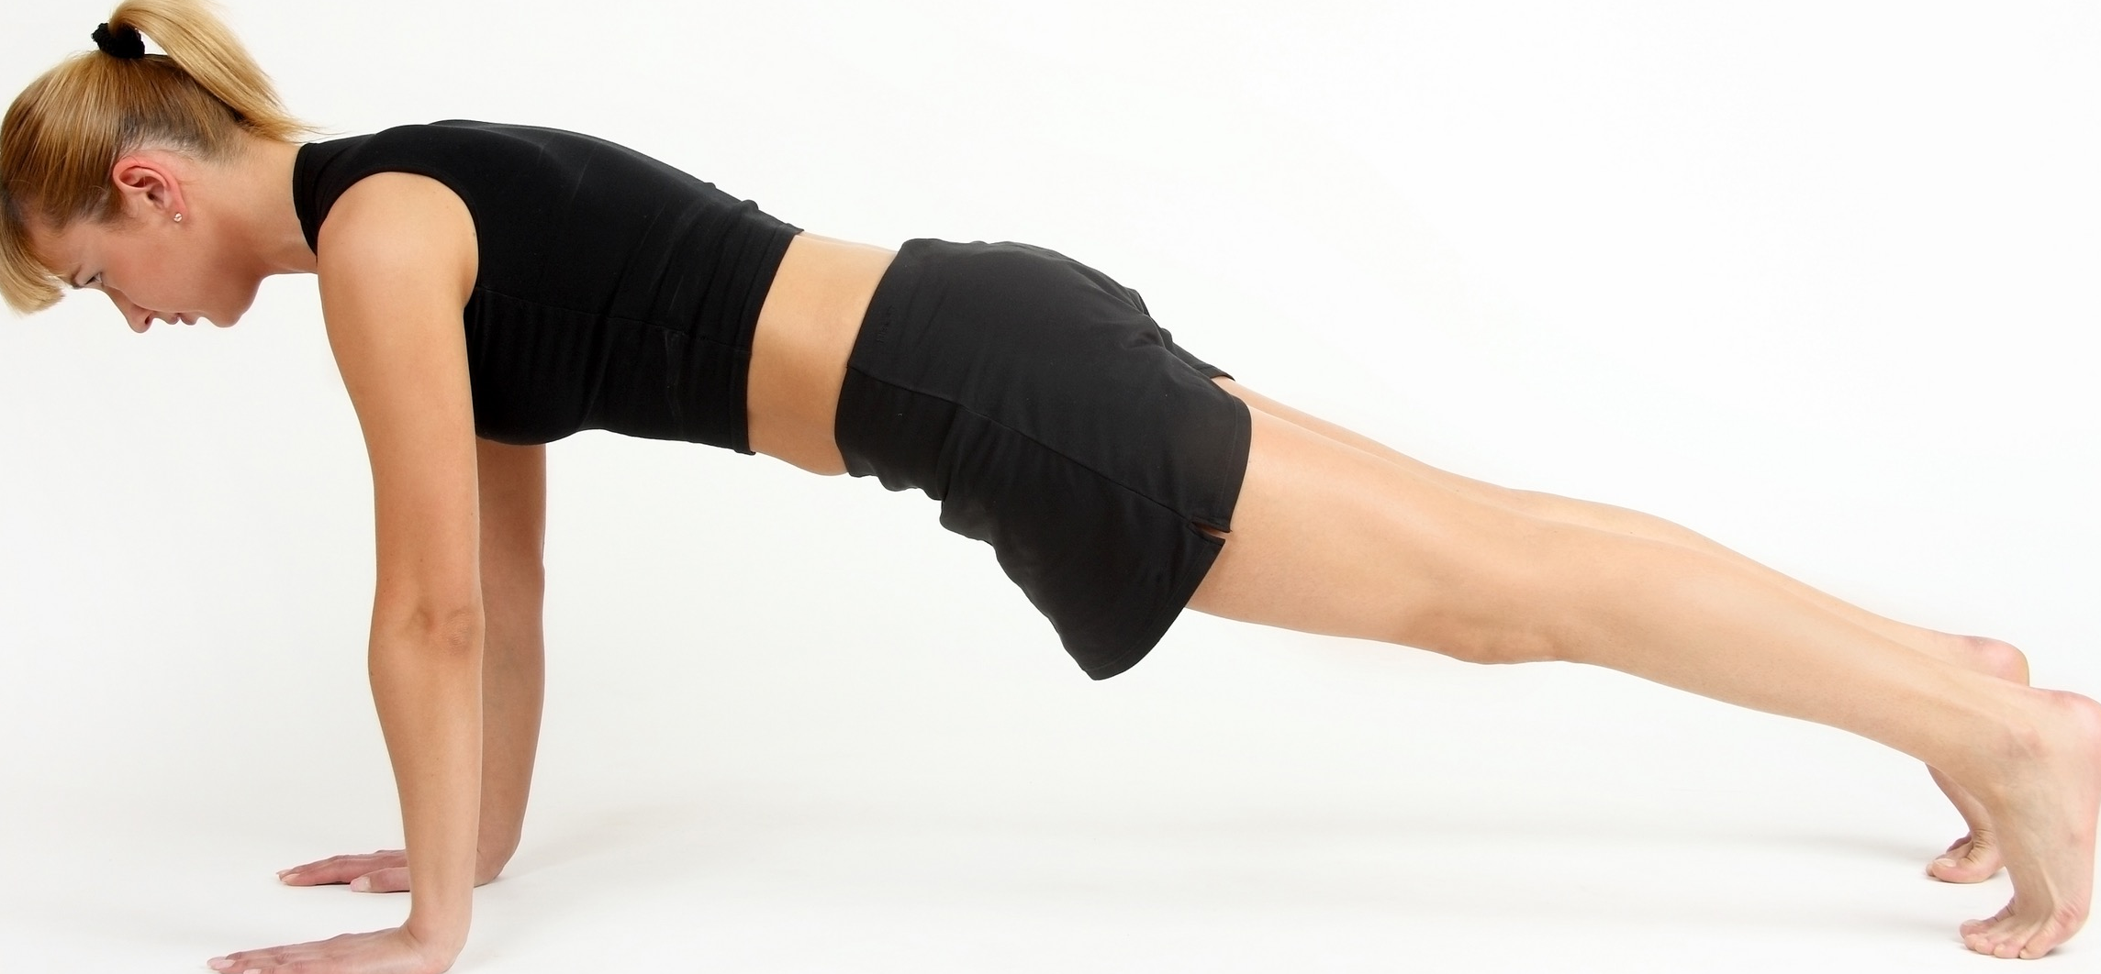
Levers
Second class levers are organised in a wheelbarrow order to move the load.
Examples of second class levers:
  press up
Effort
Movement
Resistance
Fulcrum

Slide 10
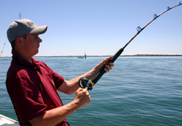
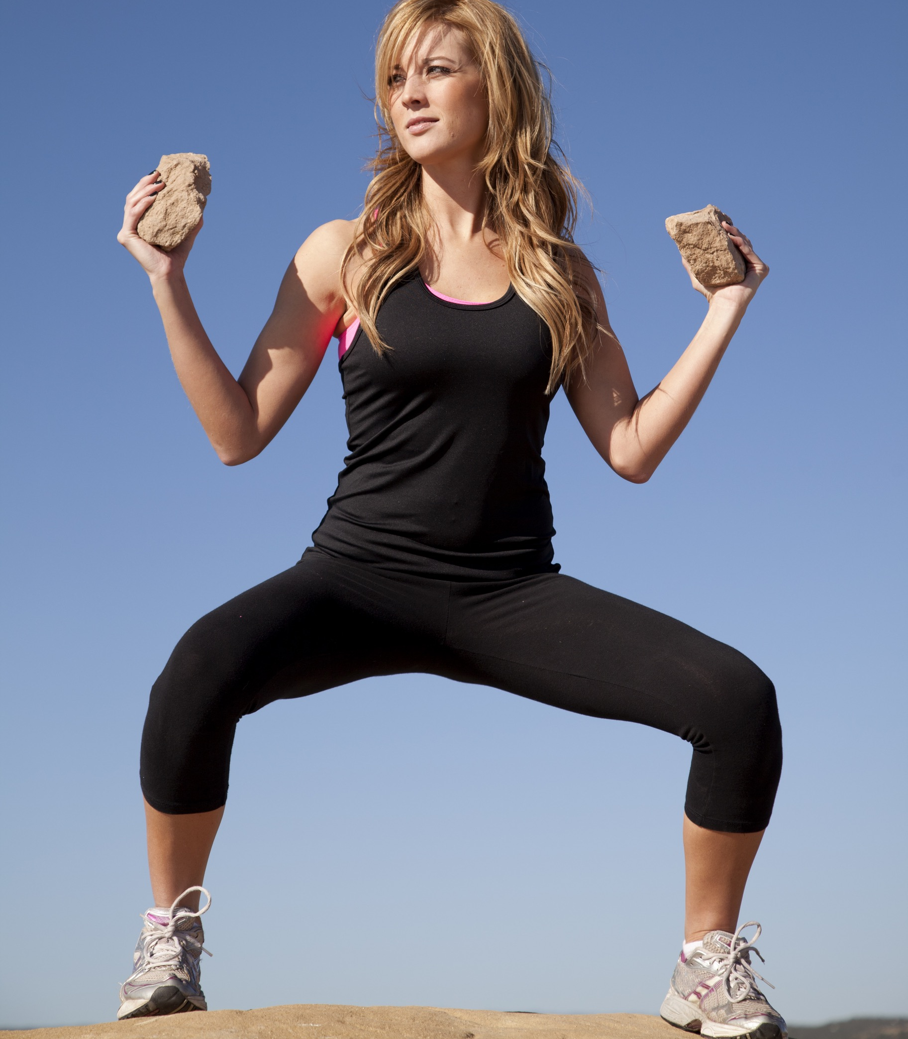
Levers
Third class levers are organised in a fishing rod order to move the load.
Examples of third class levers:
  bicep curl (effort is where the muscle
  attaches to the lever)
Effort
Resistance
Movement
Fulcrum

