Slide 1

The relationship between health and fitness
2.1 Health, fitness and training

Slide 2
Well-being
Physical
Mental
The relationship between health and fitness
Social
Fitness
Health

Slide 3

Health
“Health is a state of complete physical, mental and social well-being and not merely the absence of disease and infirmity”
—World Health Organisation (WHO)
To understand this definition we
need to consider the following:
  Physical health and well-being.
  Mental health and well-being.
  Social health and well-being.
  Health and Fitness.

Slide 4
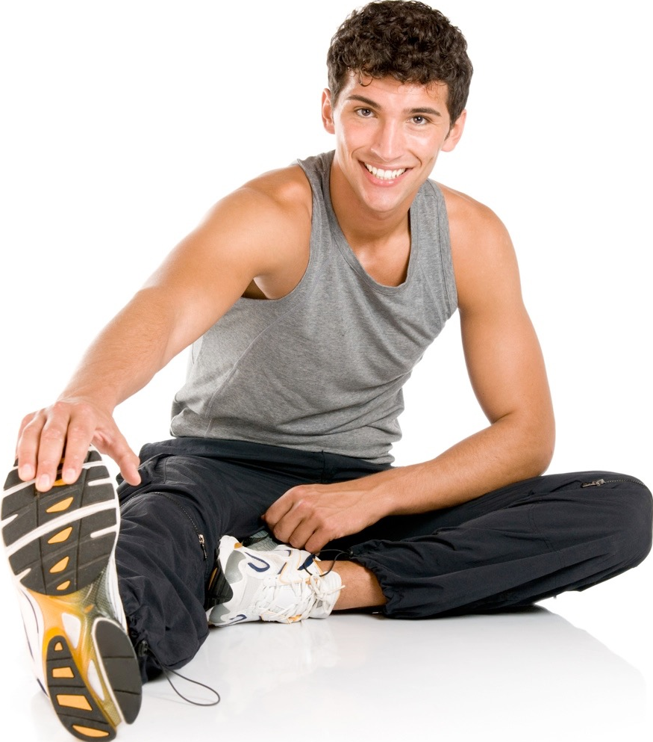
Physical health and well-being
People who are physically well display the following:
  All their body systems work well.
  They are free from injuries and illnesses.
  They are able to carry out everyday physical tasks.

Slide 5
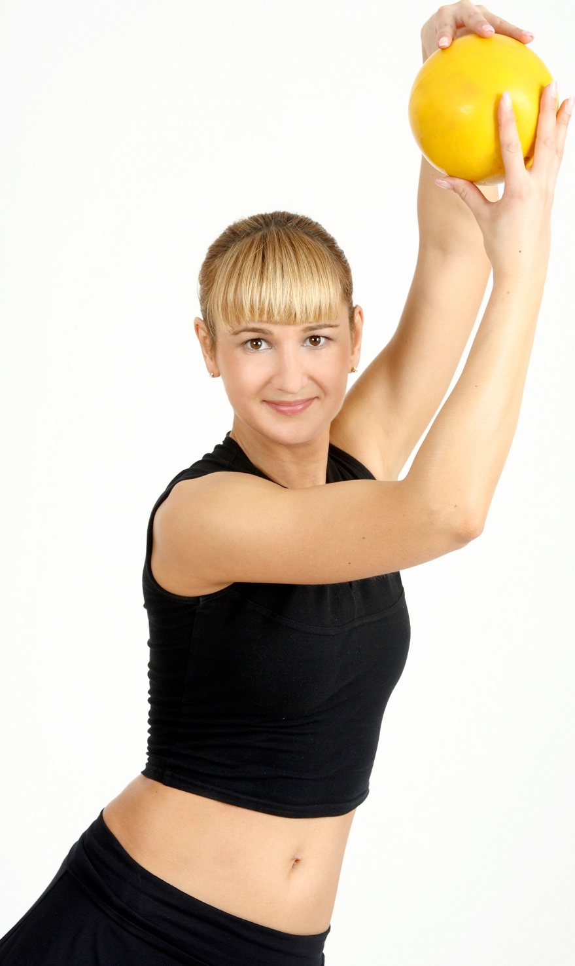
Physical health and well-being
Being physically well can help performance
in the following ways:
All body systems work well.
  Efficient gas exchange at the lungs.
  Heart delivers oxygen and
  nutrients to the working muscles.
  Circulatory system regulates
  the temperature.
Free from illness so they can
continue to train.
Free from injury.

Slide 6
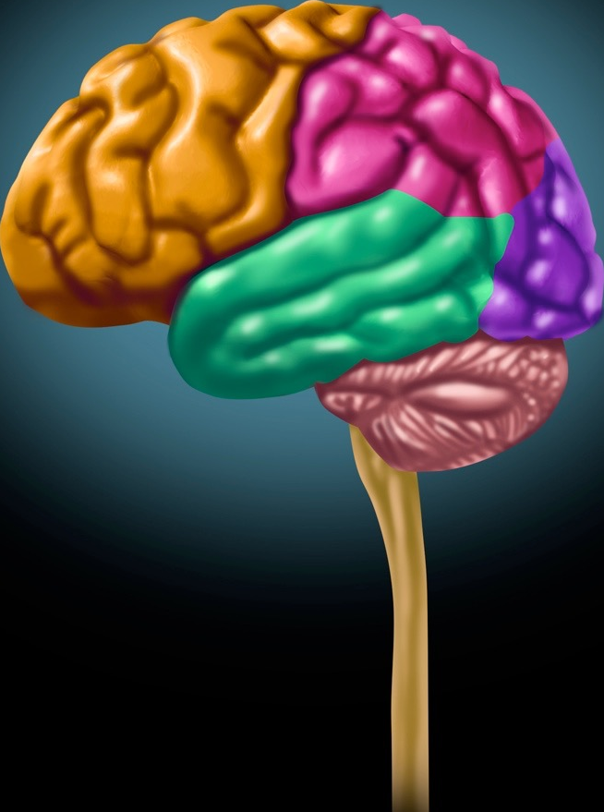
Mental health and well-being
People who are mentally well display the following:
They are able to cope with stress.
They can control their emotions.
They feel good and confident about themselves.
Physical activity promotes mental well-being.

Slide 7
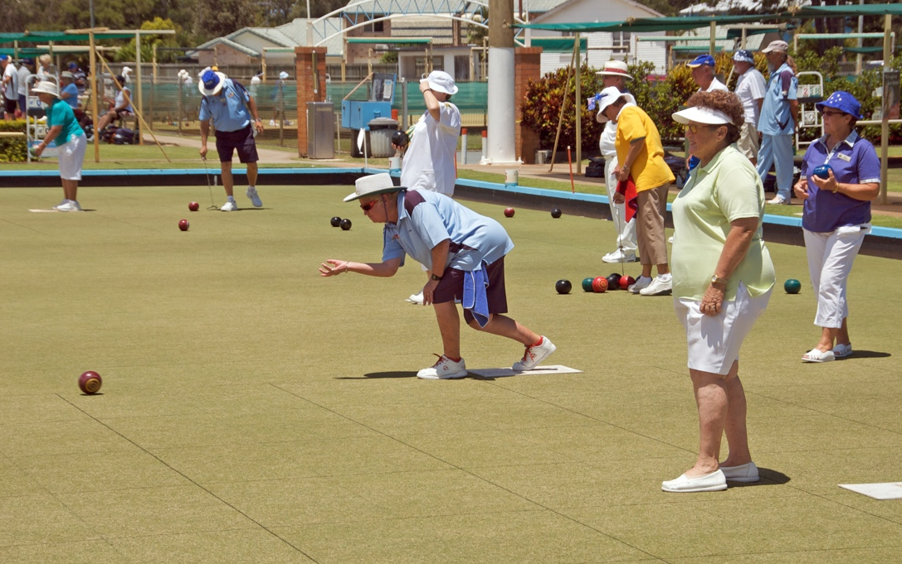
Social health and well-being
People who are socially well display the following:
They have essential
human needs such as
clothing, food and shelter.
They have friendship
and support.
They can mix with others.
They have some value in society.
They get a feeling of worth.

Slide 8
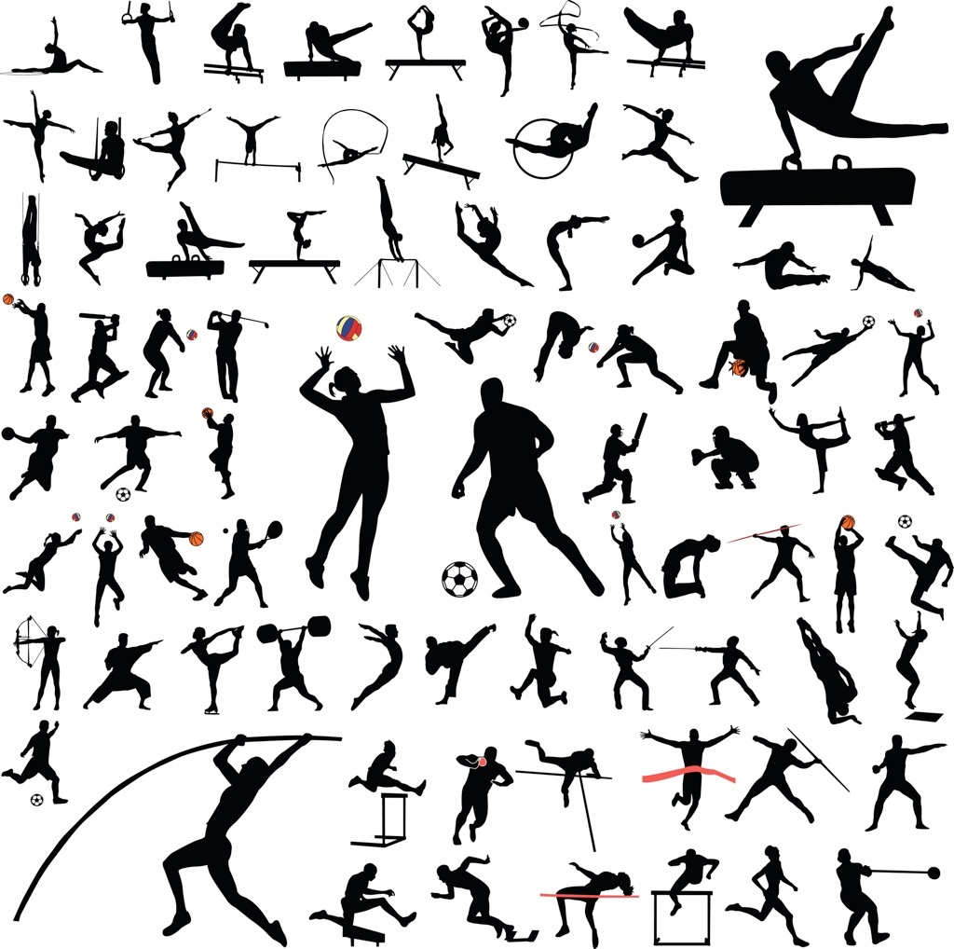
Fitness
“Fitness is the ability to meet the demands of the environment.”
Everything that you experience and surrounds you is your environment. Home, school, commuting, sports, hobbies, meeting friends, shopping and housework.

Slide 9
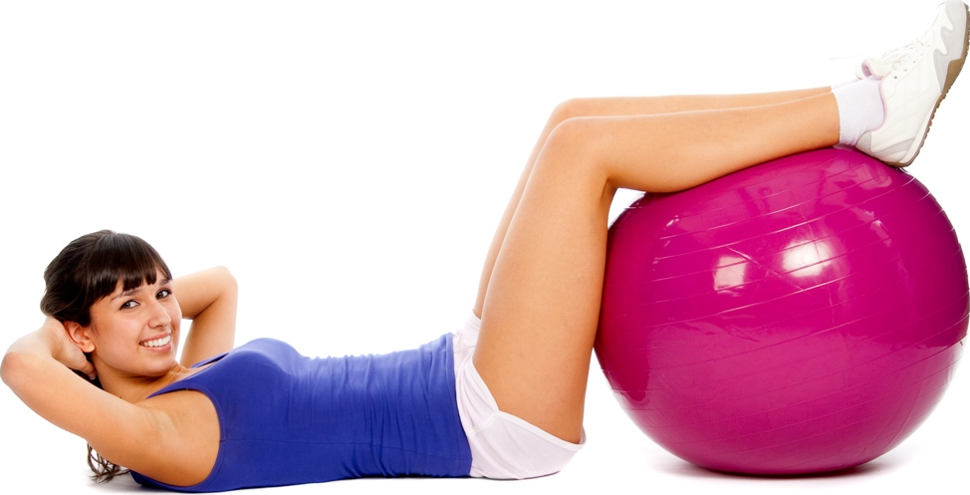
Relationship between health and fitness
Health and fitness are closely linked. Being fit allows us to meet the demands of our environment.
  Fitness can increase even if we are unhealthy, provided we can still train.
To stay healthy we need to:
  live a healthy active lifestyle.
  eat a balanced diet.
  maintain a level of fitness to help maintain health.

