Slide 1
Energy use, diet, nutrition and hydration
2.2 Health, fitness and training

Slide 2
Fats
Basal Metabolic Rate
Vitamins
Carbohydrates
Energy use, diet, nutrition and hydration
Energy Balance
Minerals
Proteins
Water
Fibre

Slide 3
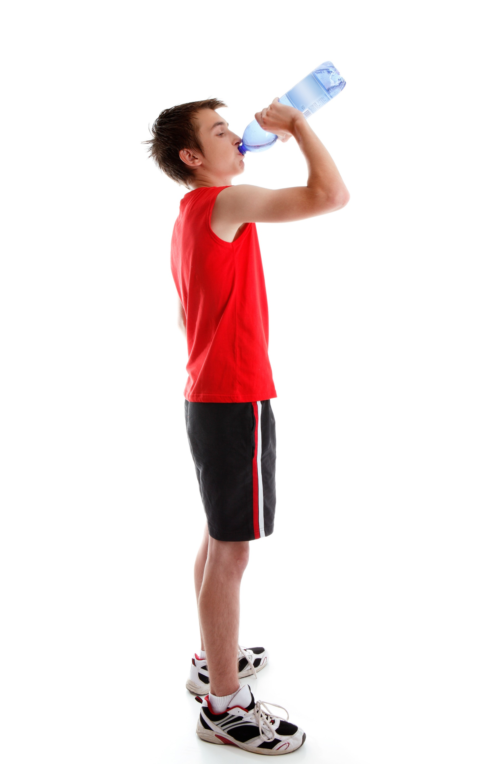
Basal Metabolic Rate
The rate at which we burn calories for energy is called our basal metabolic rate.
  Physical activity can increase our basal metabolic rate so we need to consume more calories.
  When we eat is also important.
  Ensure you leave at least two hours after
  and before exercise.
  During exercise you can consume small quantities that are easily digested.
  After activity you should consume plenty of liquids and after a period a balanced meal.

Slide 4
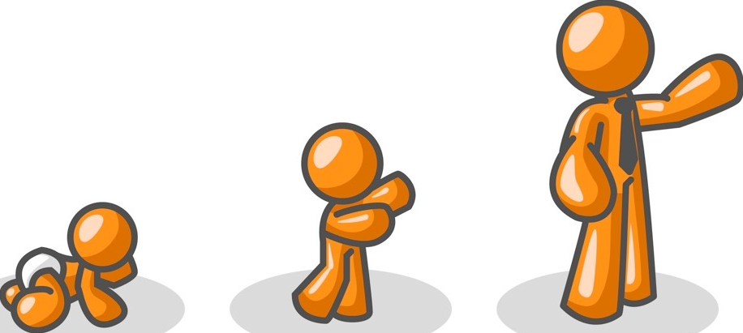
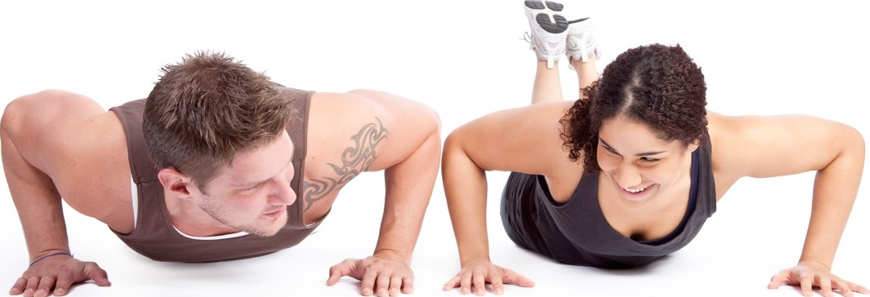
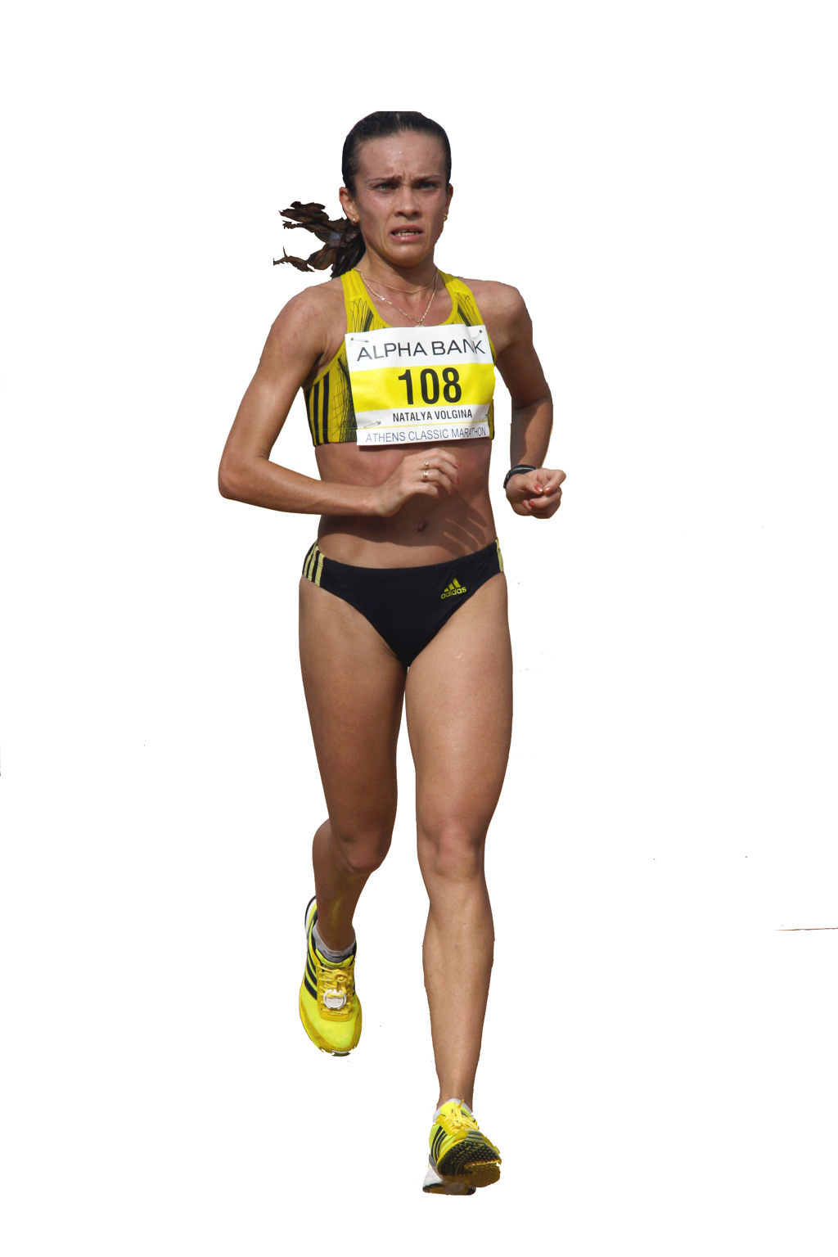
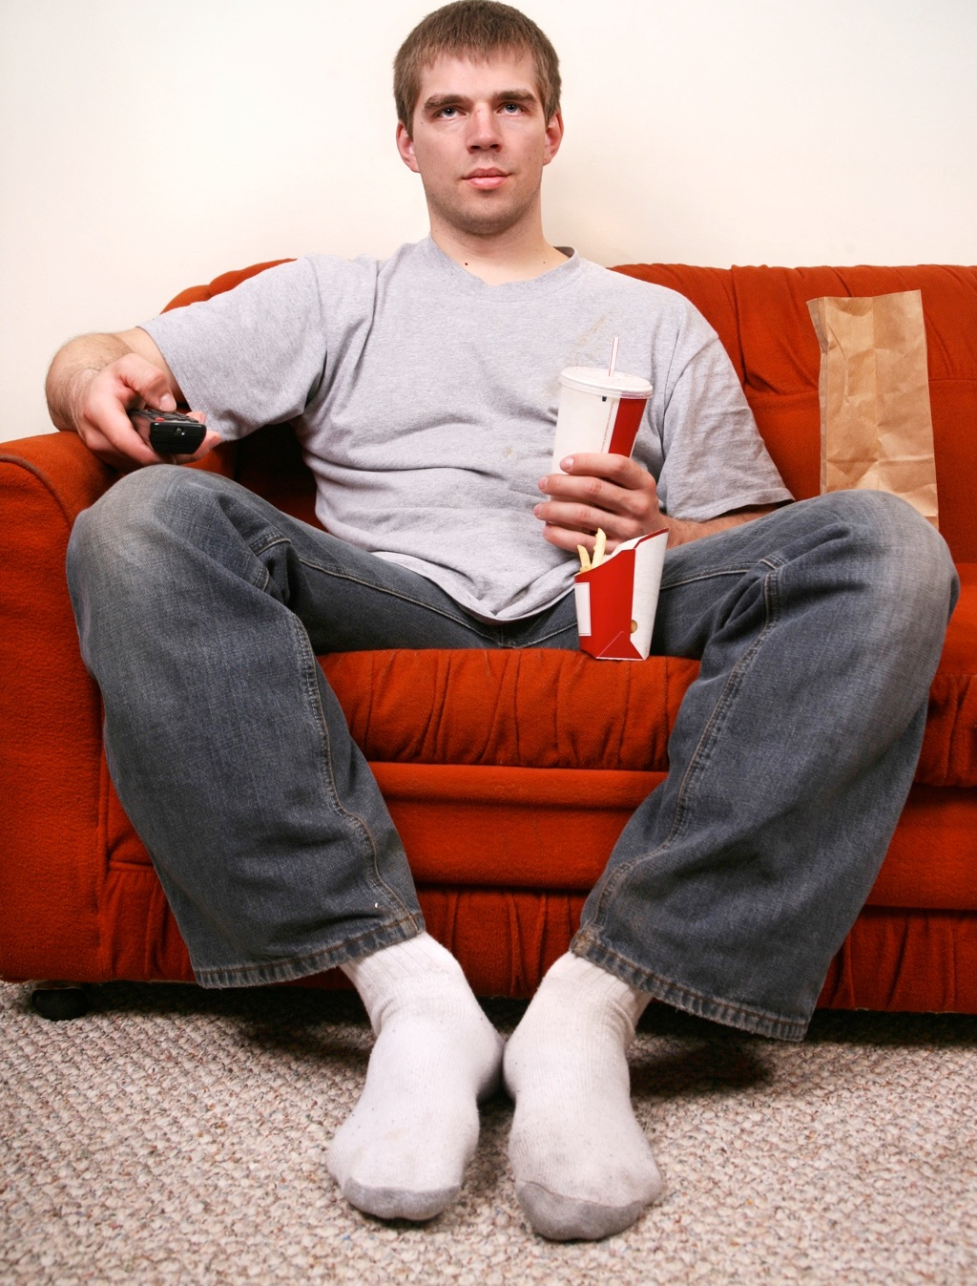
Energy
Average females need 2,000 Kcal/day and males need 2,500Kcal/day. This may vary depending on the following factors:
  Teenagers need more energy
  than young children.
  Males tend to need more
  energy than females.
  Athletes need more energy than
  non-athletes.
  People with active lifestyles
  need more energy than people
  with non-active lifestyles.
  Taller people need more than
  shorter people.

Slide 5
Energy
To maintain energy balance the food intake needs to match energy needs.
An increase in energy intake can result in weight gain.
An increase in energy needs without an increase in energy intake will result in weight loss.
Energy Intake
Energy Needs

Slide 6
Energy
Energy is derived from food sources:
muscle cells release energy from glucose in a process called respiration.
some glucose is converted to glycogen and stored in the muscles and liver.
Energy Intake
Energy Needs

Slide 7
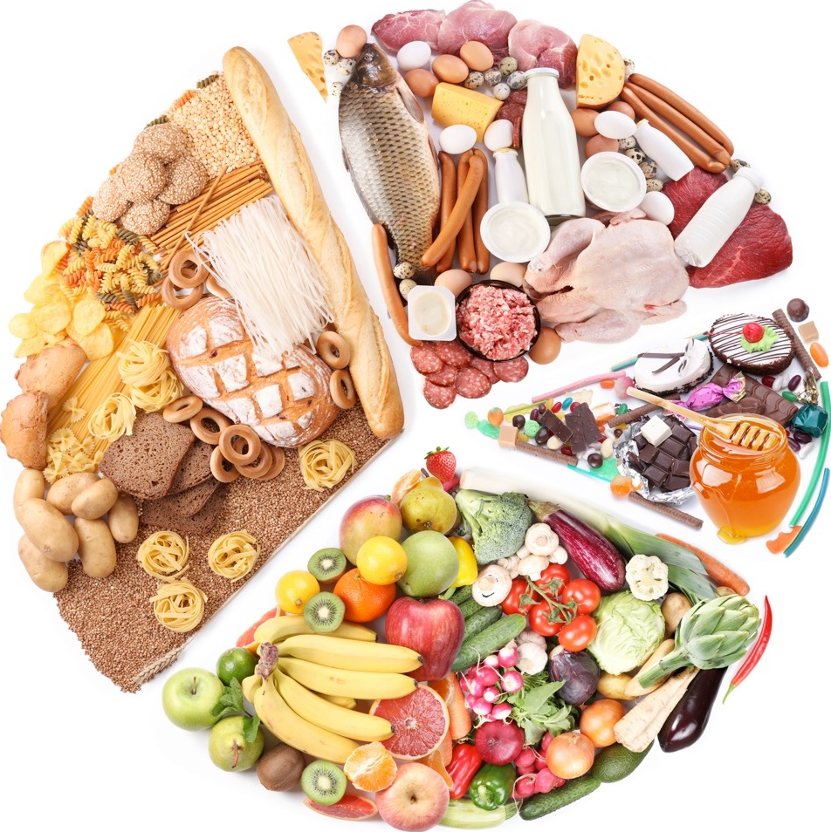
Carbohydrates
The body needs a balanced diet as unused calories are stored as fat and nutrients are needed for growth and hydration.
  Carbohydrates
  Proteins
  Fats
  Vitamins
  Minerals
  Water
  Fibre

Slide 8
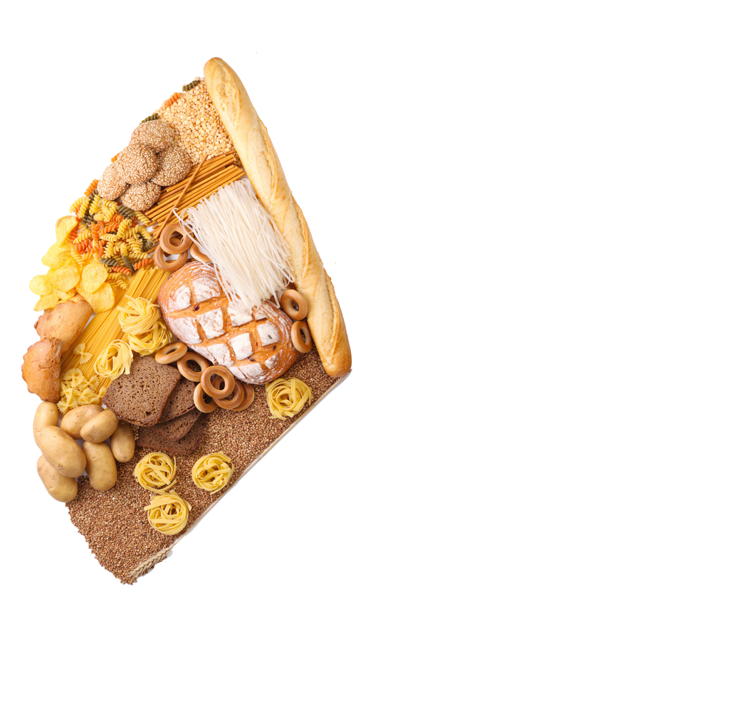
Carbohydrates
Carbohydrates
Why are they important?
    Provides the most ready
    source of energy for cell respiration.
    Allows the athlete to perform for longer and is used for endurance events such as cycling and marathon running.
Sources of food
    Bread, rice, pasta and potatoes.
Useful sources of energy
    Over half of our energy needs are taken from carbohydrates, athletes need even more.

Slide 9
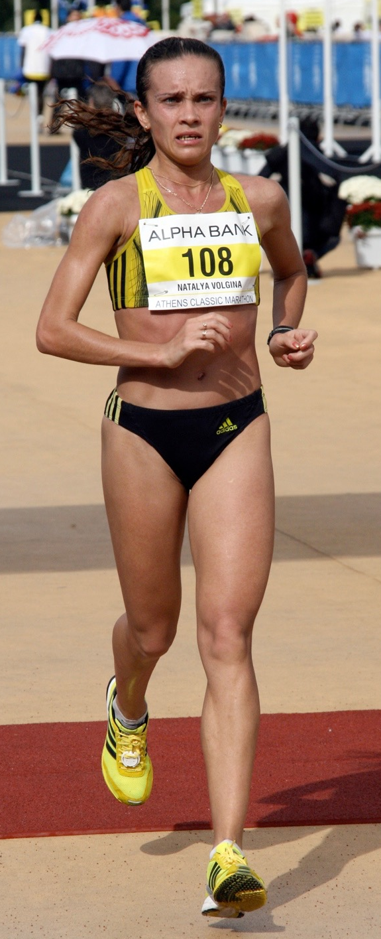
Carbohydrates
Carbohydrate loading is a technique used by endurance athletes to maximise their carbohydrate stores.
  This involves eating high carbohydrate meals 24 hours before the day of the competition.
  This helps maximise the glycogen stores.
  One downside is this can leave the performer feeling heavy and sluggish.
  It should, however, offset the effects of fatigue.
Notes:
New slide

Slide 10
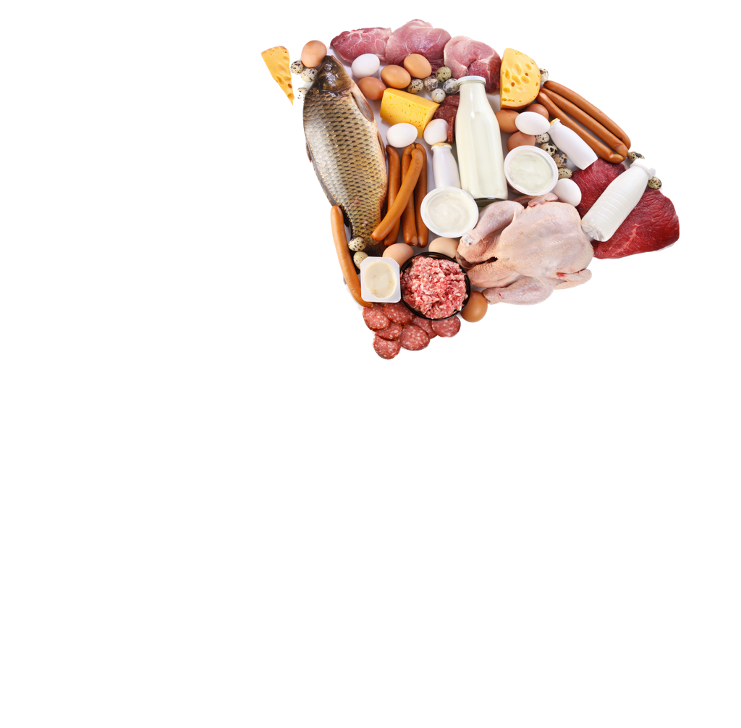
Protein
Protein
Why are they important?
    They build muscle tissues
    to make the body stronger.
    They repair muscle tissue.
Sources of food
    Meat, eggs and nuts.
Useful sources of energy
    Protein provides a small
    amount of energy if needed.

Slide 11
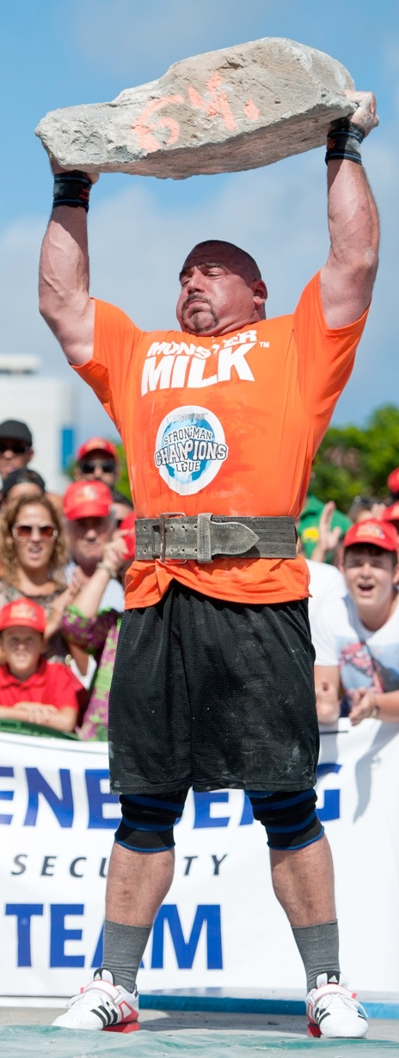
Protein
Power and strength athletes need to build muscle.
  To assist them they combine
  training with a high protein diet.
  A high protein diet is also used
  during the rehabilitation from an
  injury.
  This kind of diet can also help
  athletes who need to lose weight.
  Many power athletes will also
  consume protein supplements.
Notes:
Additional slide

Slide 12
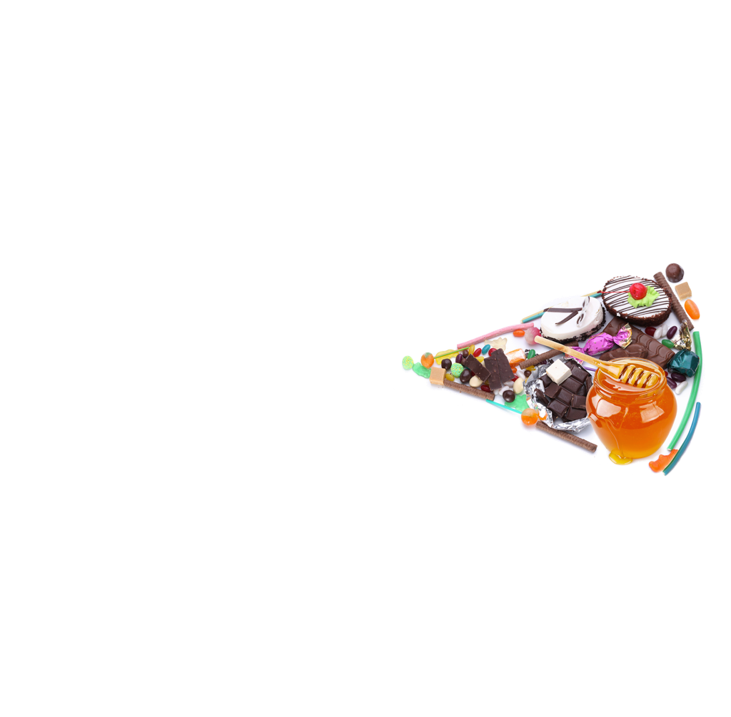
Fats
Fats
Why are they important?
    Provides large amounts of energy.
    They contain essential fatty acids
    that the body needs to function.
    Insulates the body against the cold.
Sources of food
    Butter, cheese, ice cream, fatty meats and oil.
Useful sources of energy
    Fats provide 70% of our energy needs.
    They can only be used at low intensities when oxygen is in plenty supply.

Slide 13
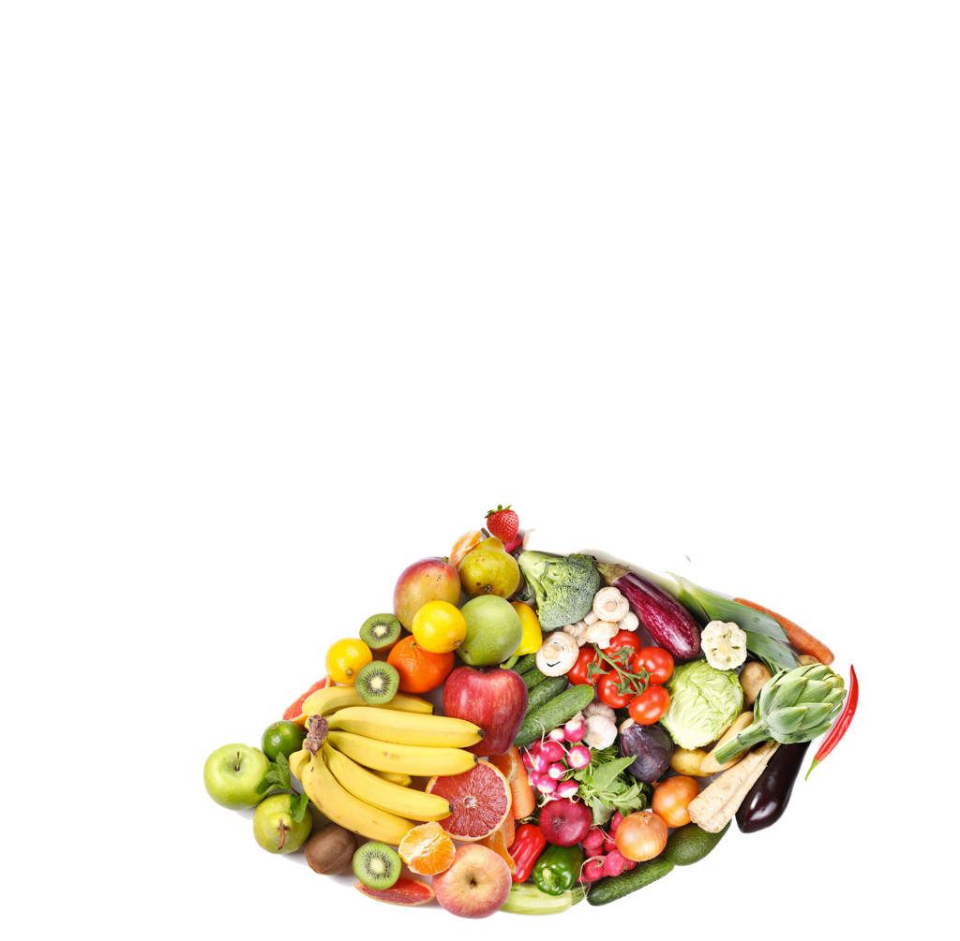
Vitamins and Minerals
Vitamins and minerals
Why are they important?
    Aids growth.
    Boosts our immune system.
    Regulates body functions.
Sources of food
    Vegetables and fruit.
Useful sources of energy
    Vitamins and minerals do not generate any energy.

Slide 14
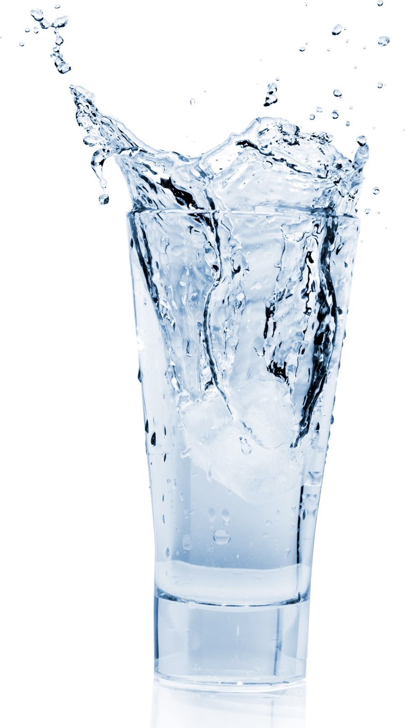
Water
Water
Why is it important?
    Water balance prevents dehydration.
    Dehydration causes:
    Blood plasma is made up of mostly water so without it the
    blood will thicken and slow blood flow.
    Blood thickening causes increased heart rate and irregular heart beat.
    Causes an increase in temperature and overheating.
    Slows reactions and decision making.
    Increase in muscle fatigue and cramps.
Sources of food
    Water can be found in most food and drink products but the
    best way to hydrate is to drink it directly.
Useful sources of energy
    Water provides no energy but it does aid the chemical
    reactions that release energy.

Slide 15
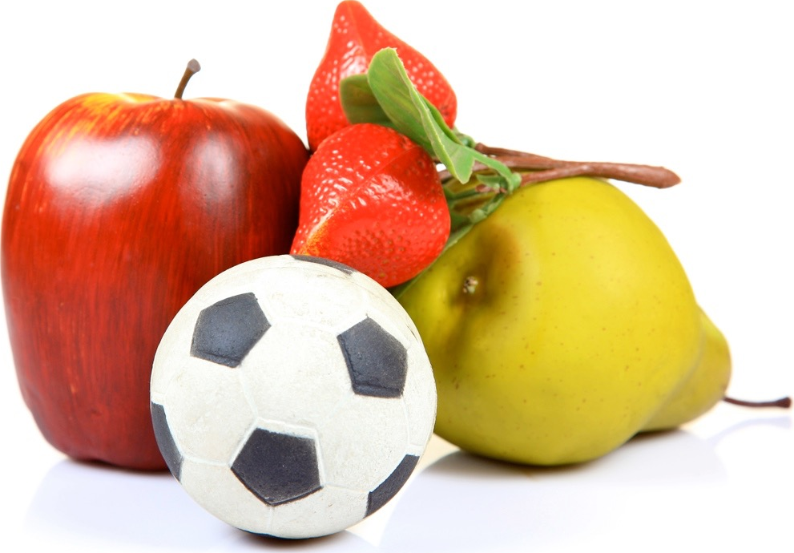
Fibre/Roughage
Fibre/Roughage
Why is it important?
    It pushes your food along your
    intestine preventing constipation.
    It absorbs poisonous wastes
    from digested foods.
    Makes you feel full, so you eat less
Sources of food
    Fruit, vegetables, bread and
    cereals.
Useful sources of energy
    Fibre is not a source of energy.

