Slide 1
The components of fitness
2.3 Health, fitness and training

Slide 2
Health-related Fitness Components
Power
Flexibility
Strength
Muscular endurance
Cardio-vascular endurance
The components of fitness
Skill-related Fitness Components
Speed
Agility
Co-ordination
Reaction Time
Balance
Timing

Slide 3
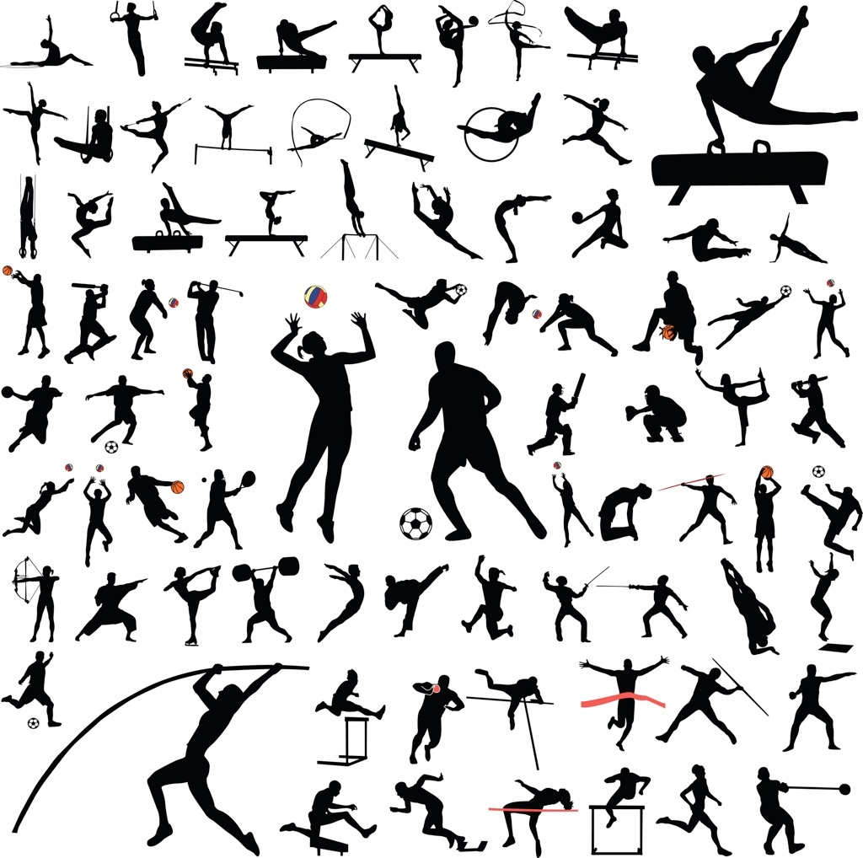
Fitness Components
  “Fitness is the ability to meet the demands of the environment.”
  Fitness components are separated into two different categories.
Health-Related Fitness Components
    Cardiovascular Endurance
    Muscular Endurance
    Strength
    Flexibility
    Power
    Speed
Skill-Related Fitness Components
    Agility
    Balance
    Co-ordination
    Reaction Time
    Timing

Slide 4
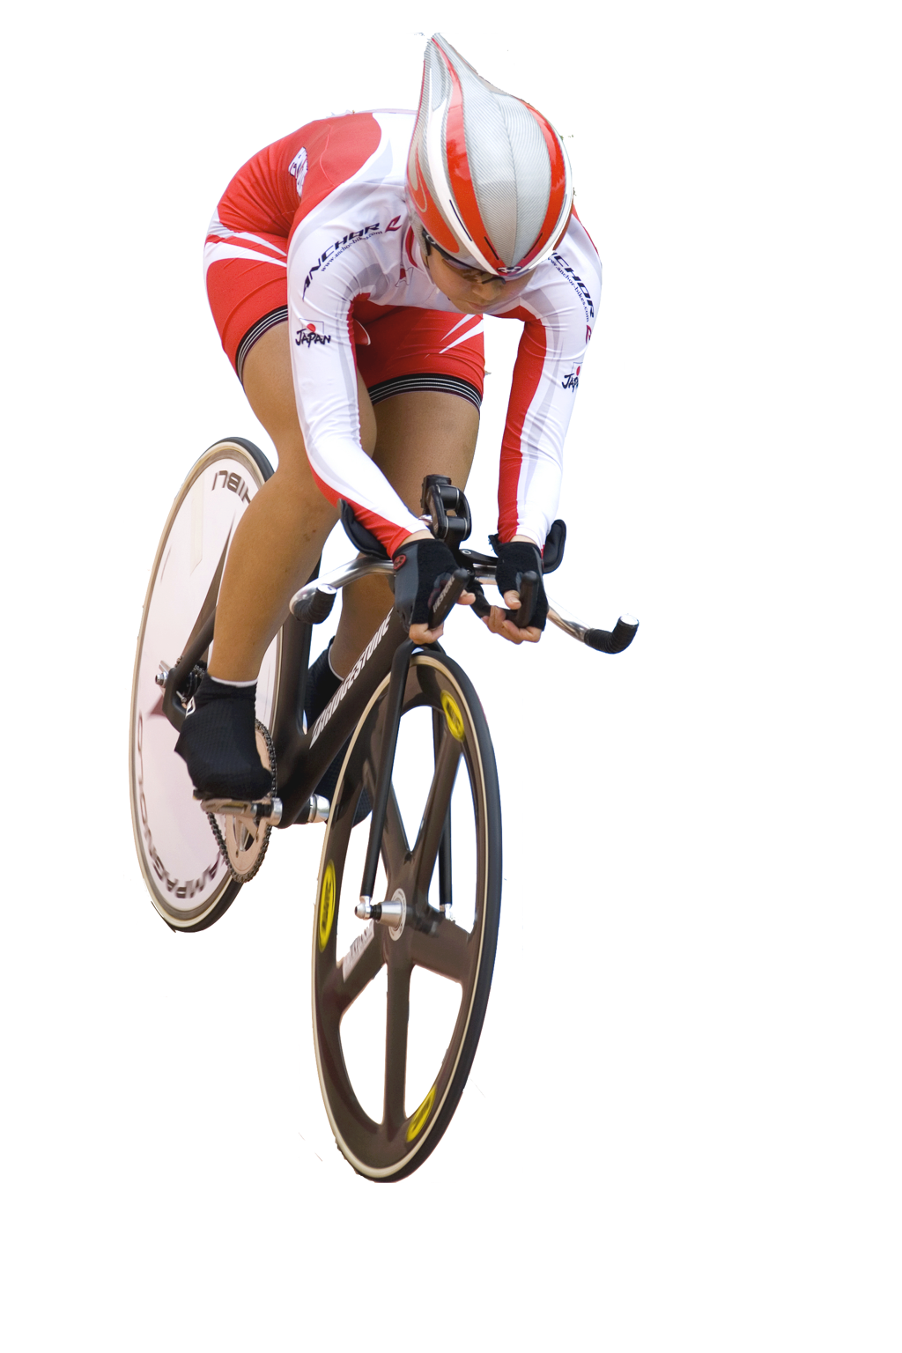
Cardiovascular Endurance
Cardiovascular Endurance
(Aerobic Fitness or Stamina)
“The ability to perform for a long period of time”
Explanation
Cardiovascular refers to the heart and
the circulatory system (blood vessels)
This is determined by the body’s ability
to take in oxygen and deliver it to the working muscles efficiently.
Good cardiovascular endurance is
needed for: Marathon running, swimming (long distance), cycling (long distance).

Slide 5
Cardiovascular Endurance
Cardio-Vascular Endurance (Aerobic Fitness or Stamina)
Measurement
Multi-stage fitness test - a distance of 20m is measured out and participants must run shuttles over this distance. A track is played and the athletes must reach the end of the shuttle by the time it bleeps.
As the levels increase the time between the bleep decreases and participants must increase their speed until they are no longer able to keep up. This test is a good predictor of VO2 Max.
12 Minute Cooper Run - A track of a known distance is created. The subject then runs around the track for 12 minutes at a pace they can sustain for the amount of time. The amount of laps they complete is recorded and the distance covered calculated.

Slide 6
Muscular Endurance
Muscular Endurance
“The ability for muscles to repeat contractions without tiring”
Explanation
Being able to continue the muscle contracting over prolonged periods of time can result in a build up of lactic acid and energy stores depleting.
The fitter the person the longer they can
offset lactic acid build up.
Good muscular endurance is needed for:
rowing, swimming and cycling (long distance).

Slide 7
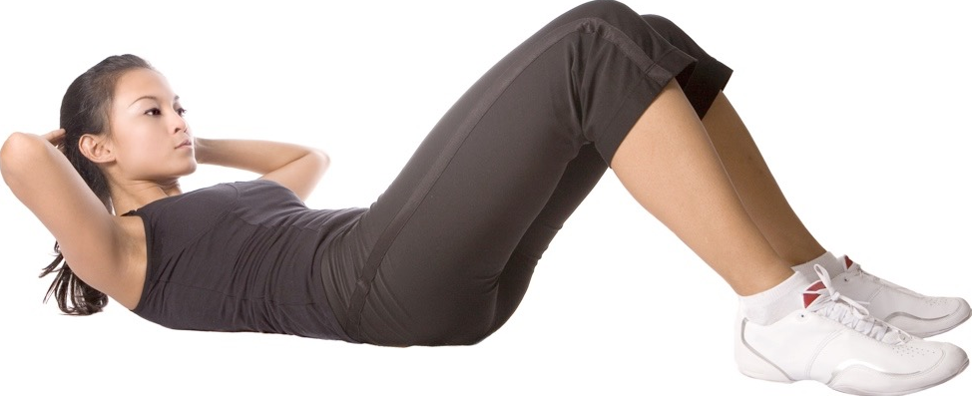
Muscular Endurance
Muscular Endurance
Measurement
Multi-Stage Abdominal Curl Conditioning Test
Lie on the mat with your knees bent at
right angles and your feet flat on the
ground.
Rest your hands on your thighs.
Raise your upper body until your hands touch your knees.
Return to start position.
Count the number of complete sit-ups
in one minute.

Slide 8
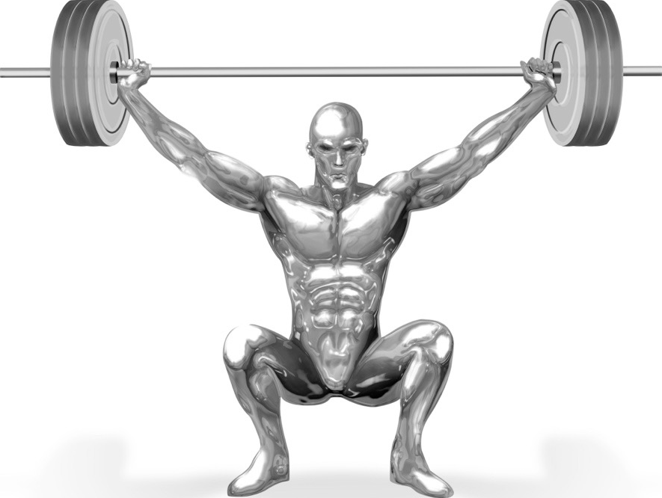
Strength
Strength
“The ability to bear weight.”
Explosive Strength
  This is the maximum amount of strength that can be generated in one fast burst of movement.
  Athletic throwing and jumping athletes need to have this kind of strength to record a large distance.
Maximal strength
  The greatest force possible in a single contraction.
Dynamic Strength
  This is the strength an athlete can apply over a prolonged period of time.
  Footballers and long distance runners need this kind of strength to complete repeated contractions over a long period of time.
Static Strength
  This is the greatest amount of strength that can be applied to an immovable object.
  Rugby players need to apply this strength in a rugby scrum.

Slide 9
Strength
Strength
Measurement
Hand Grip Strength Test
Adjust the hand grip dynamometer to suit your hand.
Hang the dynamometer by your side in line with your forearm with your dominant hand.
The maximum strength is applied to
the meter without the arm moving.
The results of the two attempts are
added together and divided by two to
reach a score.
Notes:
Image

Slide 10
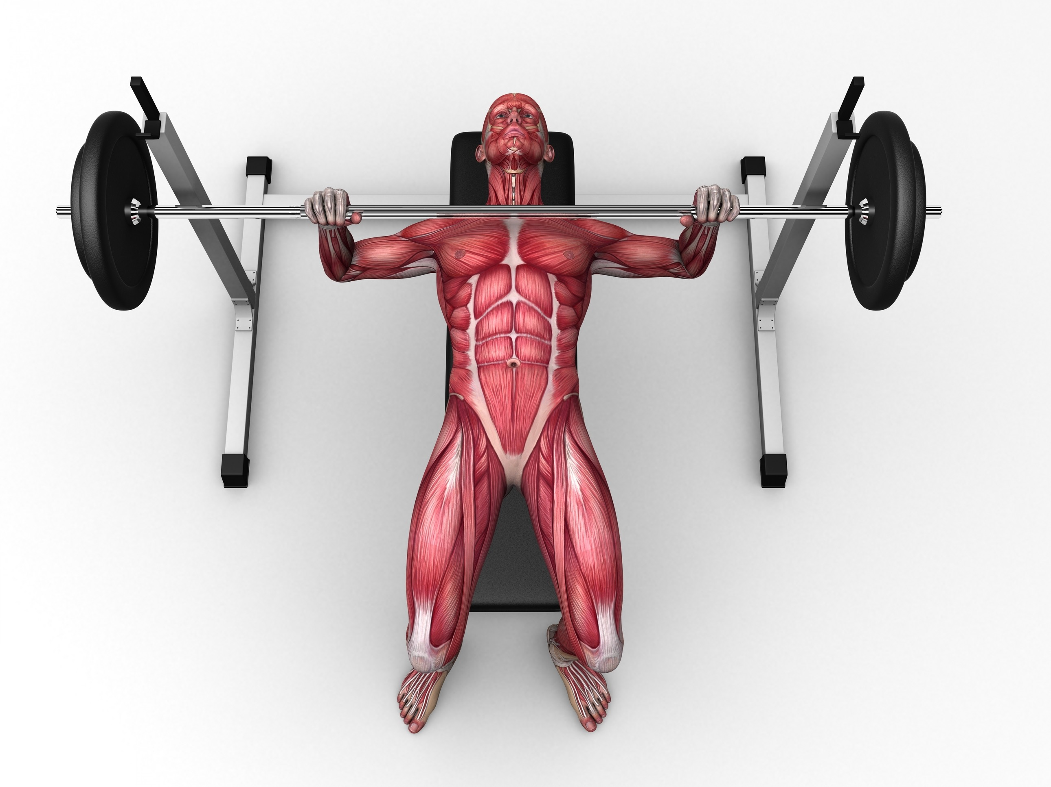
Strength
Maximal Strength
Measurement
One rep max test
Choose a realistic achievable weight.
Using the correct technique lift the bar once.
Rest.
If you feel you can, increase the
weight and lift again.
Repeat until you reach one rep max.
Record the kilogram weight.
Notes:
Image

Slide 11

Flexibility
Flexibility
“The range of movement at a joint”
Explanation
Reduces the risk of muscle and tendon injury.
Good flexibility is needed for:
  Gymnastics - Splits
  Dance - Split leap
  Football - Slide tackle
Measurement
Sit and Reach Test - Participants sit with their feet flat against a bench or sit and reach block. They lean as far forward as they can without bending their knees. A measurement is taken from the fingertips with the soles of the feet being 0cm.

Slide 12
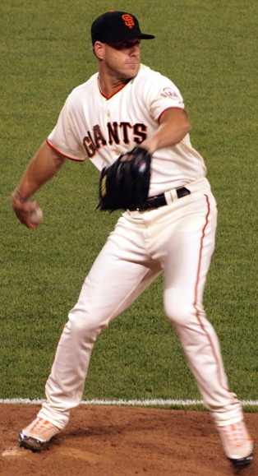
Power
Power
“An individual’s ability to generate
force rapidly”
Explanation
This is the body’s ability to do strength performances rapidly.
Power = Speed x Strength.
Strength and power are needed for: high jumping, shot putting, weight lifting.

Slide 13
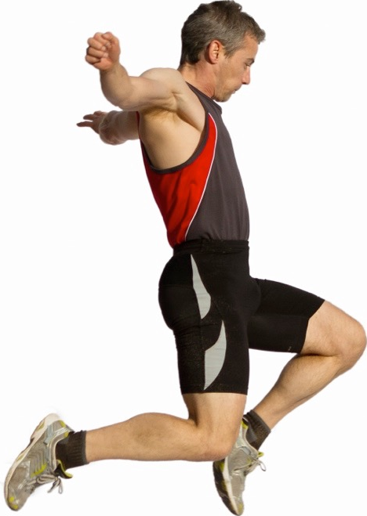
Power
Power/explosive strength
Measurements
Vertical Jump Test - Standing sideways to the wall, with your feet flat on the floor, stretch up as high as you can and make a mark on the wall (you can do this by dipping your hand in chalk). Then jump as high as you can, touching the wall again. Measure the distance between the two marks on the wall to see the height of your jump.
Notes:
Image

Slide 14
Speed
Speed
“The ability to move a body part quickly”
Explanation
This is how quickly a person can cover a
distance or how quickly they can perform
a single movement.
Speed is needed for:
  A fast bowl in Cricket or Baseball
  Throwing a javelin
  100m sprint
Measurement
30m Sprint Test - Measure a distance of 30m. Run at maximum speed between the markings and time with a stopwatch.

Slide 15
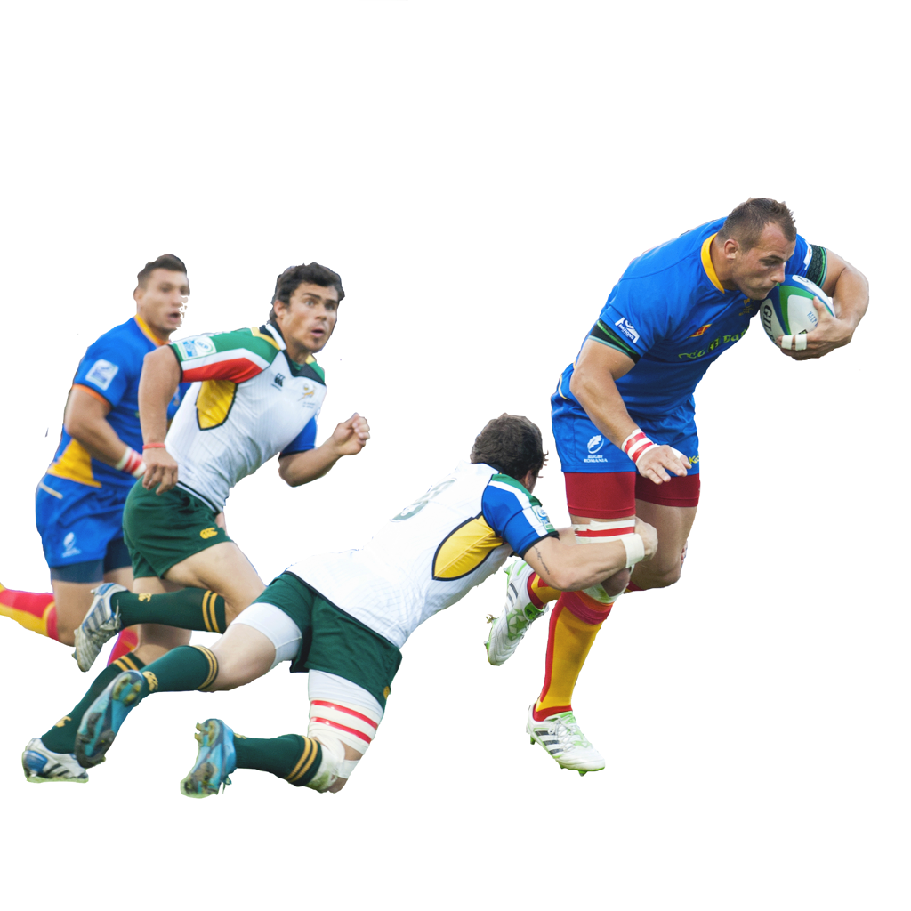
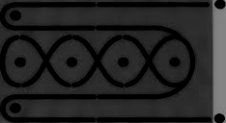
Agility
Agility
“The ability to change
direction quickly.”
Explanation
Being able to change the position of the body quickly without losing control is important in many sports and skills such as:
  Dribbling in Football - to take it
  around a player.
  Faking a run in Basketball
Measurement
Illinois agility test - Set out the course above. The person lies down on their front. On the whistle they sprint to the first cone, weave in and out of the middle cones and sprints from the last cone to the finish line.

Slide 16

Balance
Balance
“The ability to hold a position without falling.”
Explanation
Static balance is stationary balance
  Holding your centre of mass directly over
  the base of support increases balance.
    Handstand in Gymnastics.
Dynamic balance is balance while in motion
  Resisting a tackle in Rugby
Measurement
Stork Stand Test - The subject must first be blindfolded and then told to place their hands on their hips. They lift one leg and place one foot against the knee of the other leg. The amount of time the subject can stay stable is timed.

Slide 17
Co-ordination
Co-ordination
“The ability to move the body parts smoothly and accurately in response to your senses”
Explanation
Being able to intentionally move more than one body part at the same time accurately.
Co-ordination is needed for most
sports but in particular:
  Dance movements
  Tennis serve
Measurement
Anderson Wall Toss Coordination Test - Standing 2 metres from the wall the subject throws the ball underarm and catches it with their other hand. This is repeated for 30s and the number recorded.
Wall

Slide 18
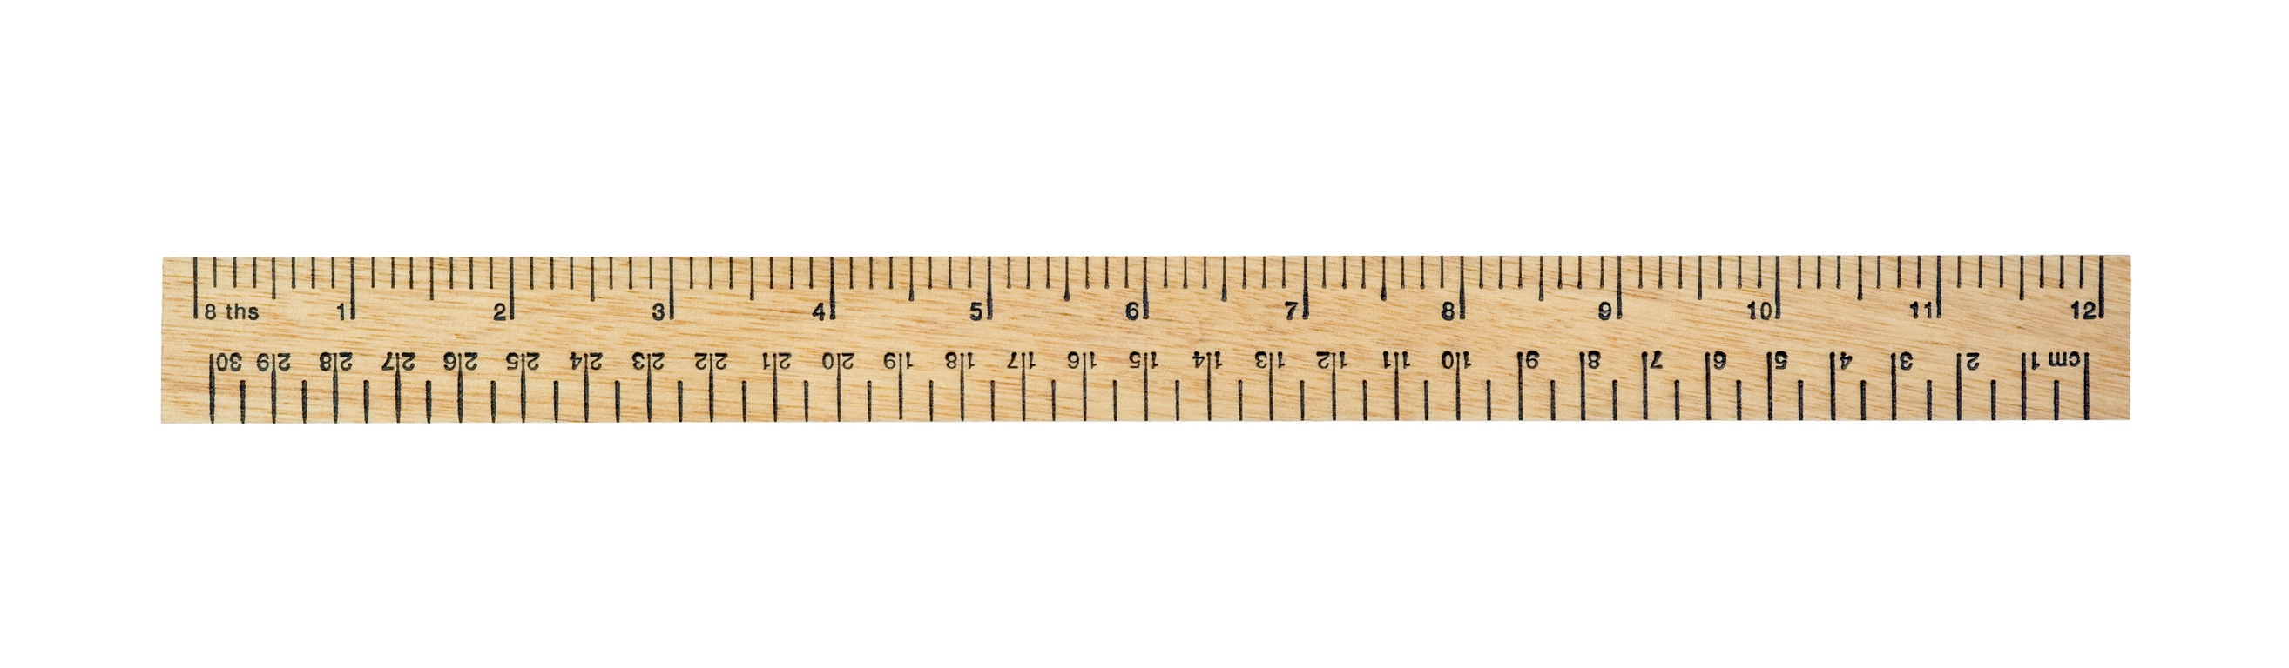
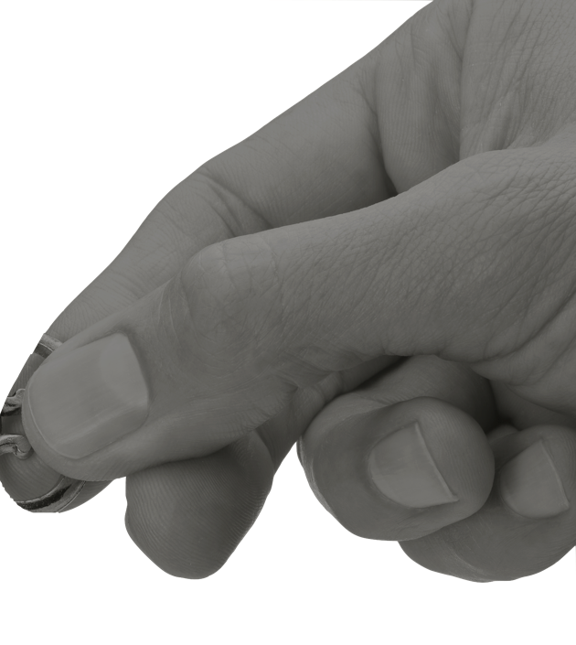
Speed of reaction
Speed of Reaction
“The speed of reaction to a stimulus”
Explanation
This is how fast you can initiate a movement
after you are presented with a stimulus.
  Sprinting from the blocks when you hear
  the gun.
  A goalkeeper reacting to a deflected shot.
Measurement
Ruler Drop Test - Place the hand on the edge of the table with the hand overhanging the end. A metre ruler is placed between the space of the finger and thumb at the 50cm mark. The ruler is dropped and the result is recorded minus 50cm.

Slide 19
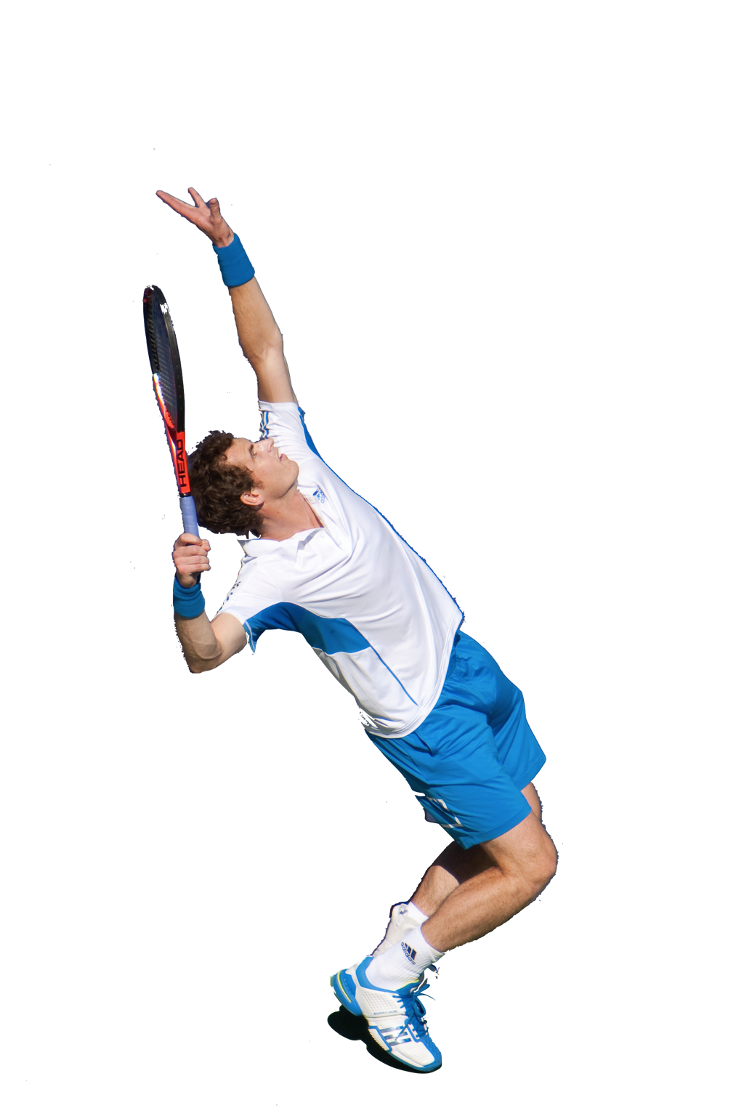
Timing
Timing
“The ability to act at just the right time.”
Explanation
Being able to move at the correct moment
in time during skill performance can determine
the outcome of a performance.
Striking the ball at the right moment when
performing a volley in Football.
Timing when to initiate a tackle in Rugby
or American football.
Measurement
There is no formal test that is used to measure timing as this is skill specific and should be tested when performing the skill.

Slide 20

Reasons to test
The reasons to test are:
  identify strengths or weaknesses in a performance or training programme.
  monitors improvement.
  gives a base line level of fitness.
  allows individual scores to be
  compared to group norms or
  national averages.
  allows goals to be set and motivates.
  informs the training programme.
  determines the suitability of different physical activities.

Slide 21

VO₂ Max
(Maximum Oxygen Uptake)
Vo₂ max is a measure of endurance. It can be calculated using high tech equipment or estimated using the Multi-Stage Fitness Test (click here to look up yours)
A range of factors can affect your VO₂ Max.
  Age
  Gender
  Genetics
  Lifestyle
  Training

Slide 22
Limitations of testing
The limitations of testing are:
  tests are often not sport specific
  or too general.
  they do not replicate the movements
  in activity.
  they do not replicate competitive
  conditions.
  some may not be motivated to
  perform at their maximum.
  correct procedures must be used to increase validity.

