Slide 1
The principles of training
2.4 Health, fitness and training

Slide 2
Training programme
Progression
Specificity
The principles of training
Overload
FITT
Training Methods
Reversibility

Slide 3

Training programme
When people decide to get fit the best
method is create a training programme
that meets the needs of the individual
and their goals.
  A training programme should be
  designed using the SPORT Training principles.
  A person should use a variety of training methods to achieve their exercise goals.
We will look at these principles of training and training methods in more detail.

Slide 4
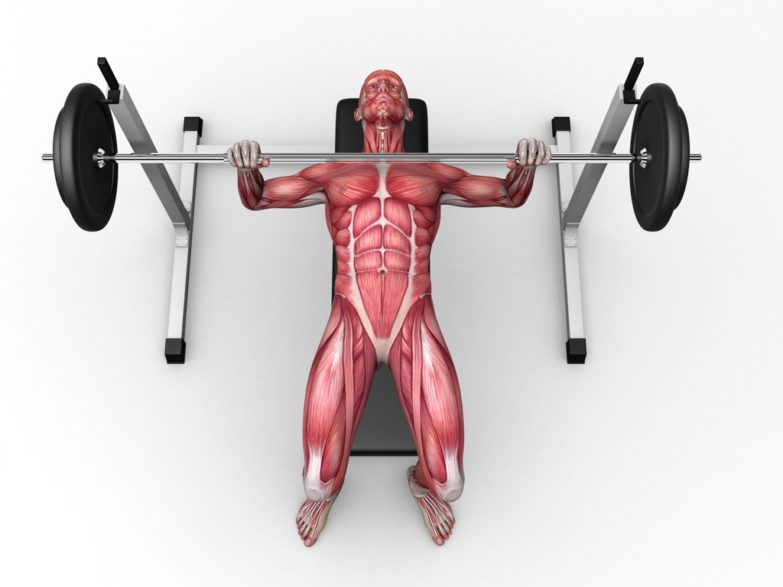

SPORT principles of training
The five SPORT training principles to help an athlete to design their fitness programme.
Specificity
  An athlete needs to identify the muscles
  they need to train as well as the energy
  system (aerobic or anaerobic) and fitness components.
  You should also ensure that you are rehearsing the specific skills for your sport in training.
Progression
  The aim of all training programmes is to
  progress your fitness.
  Progression needs to be gradual as too
  much too soon can cause injury.
  There is a danger of plateauing in training and
  staying at the same level. Motivation and determination
  is then required to push on and progress further.

Slide 5
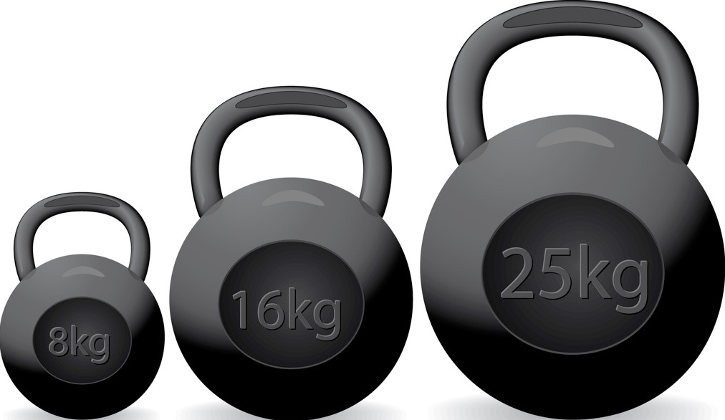
SPORT principles of training
Overload
To ensure that the athlete makes progress we must gradually make the training programme more difficult.
We can do this using the FITT principles;
  Frequency - Increase the number of
  sessions you do (how often).
  Intensity - Increase the resistance or
  speed you are working at (how hard).
  Time - Increase the amount of time
  you train per session (how long/duration).
  Type - To ensure overload you should take part in different types of training, i.e. interval, continuous, running, swimming.

Slide 6


SPORT principles of training
Reversibility
If you stop training then you can quickly lose fitness.
Your muscles may shrink, this is called atrophy.
This can sometimes happen when you have a
long-term injury.
If you stop, it can take up to three times as long to gain that fitness back.
Tedium
When you are training in the same way you may experience tedium.
Boredom can reduce motivation levels.
Variety is important in maintaining motivation.

Slide 7

Heart rate
Resting Heart Rate
    The average resting heart rate is 72 beats per minute.
Working Heart Rate
    When we start to exercise our heart rate increases.
Recovery Heart Rate
    This is lower than the working heart rate but still higher than resting so additional oxygen can be taken in to repay oxygen debt.

Slide 8
Types of training
The principles of training need to be applied to the training methods you use. In the GCSE course we focus on 7 training methods.
    Circuit
    Weight/resistance
    Plyometrics
    Fartlek
    Continuous
    High-Intensity Interval Training (HIIT)
    Static stretching
For each type of training you need to know the advantages, the disadvantages and how to apply the SPORT training principles.

Slide 9
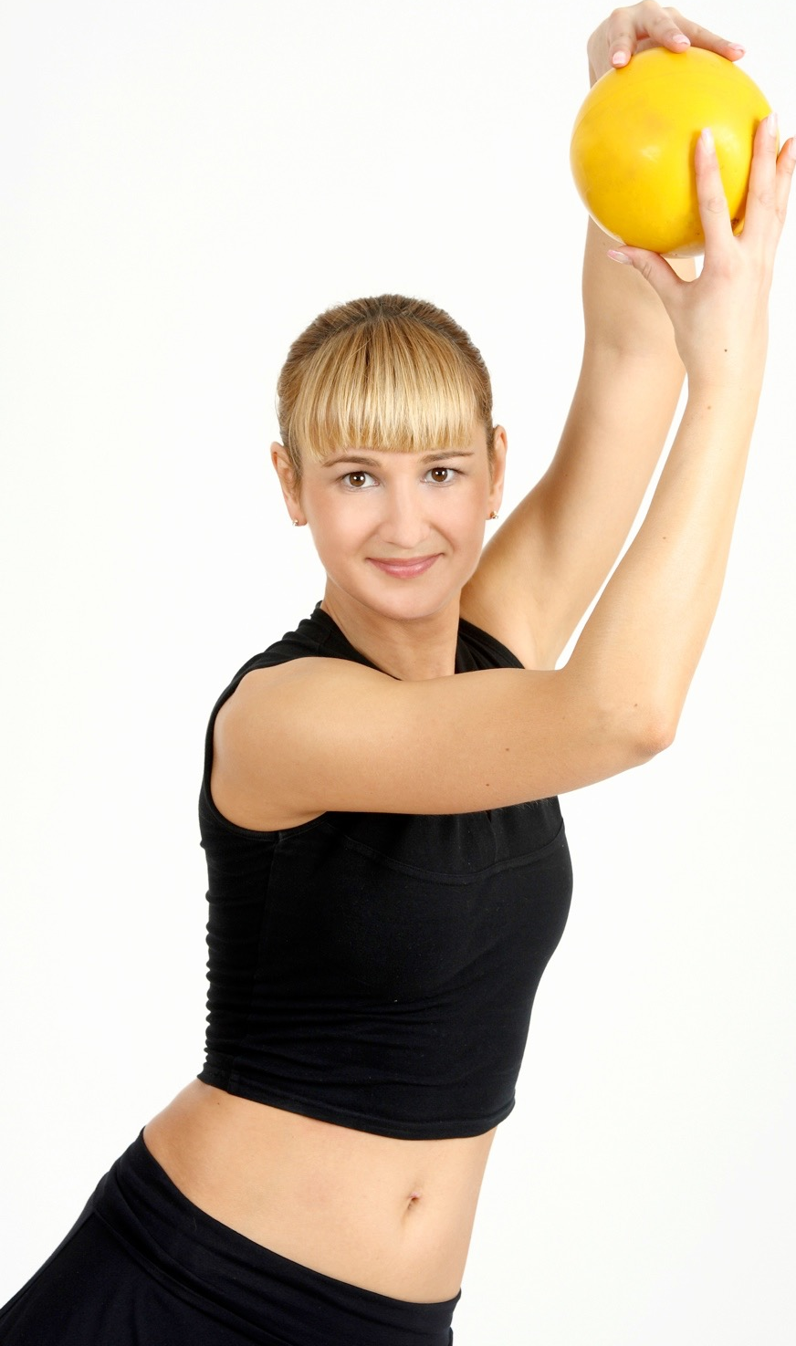
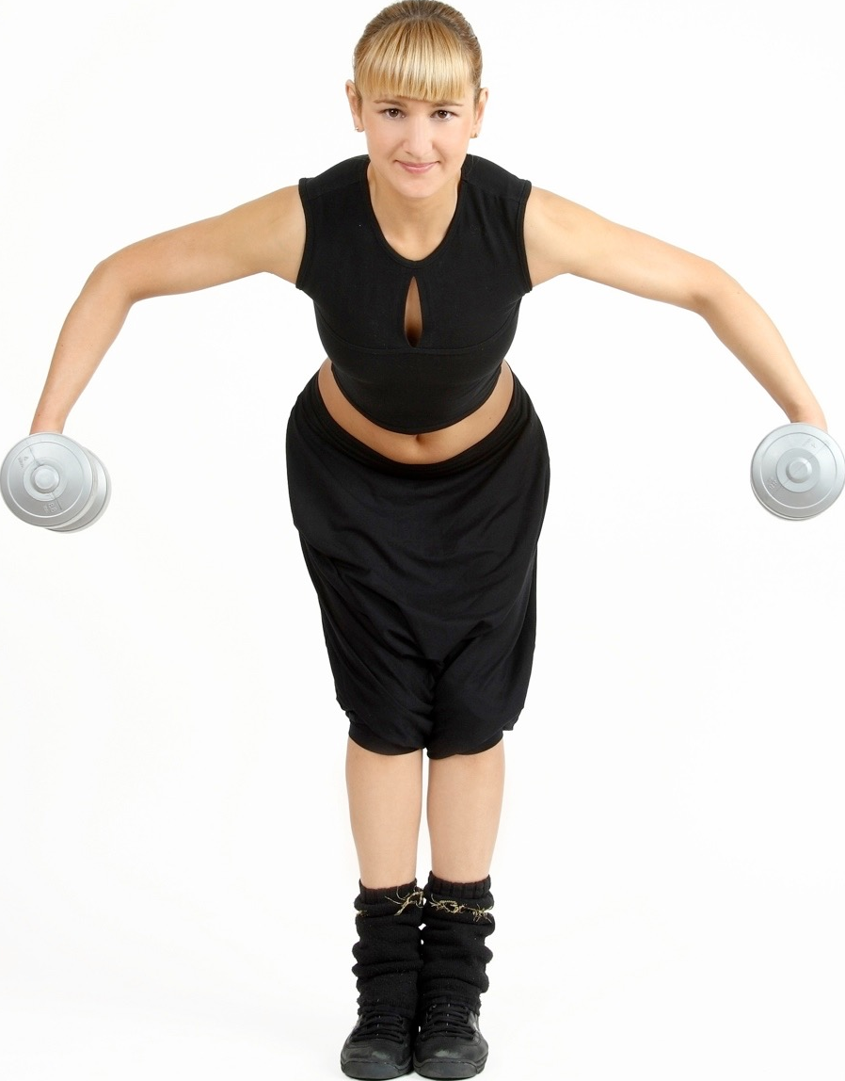
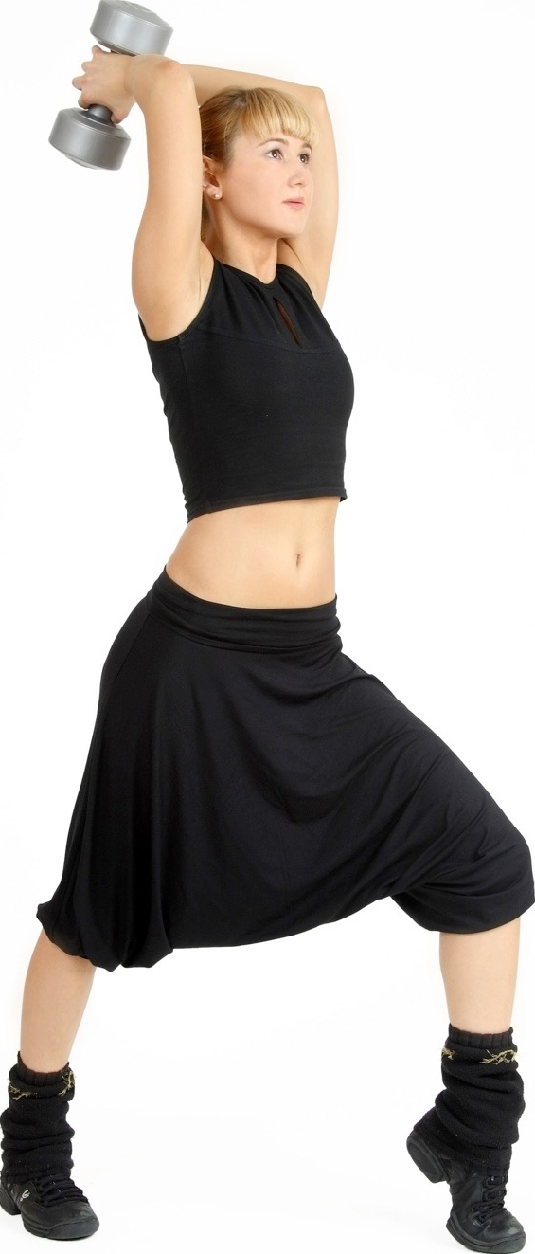
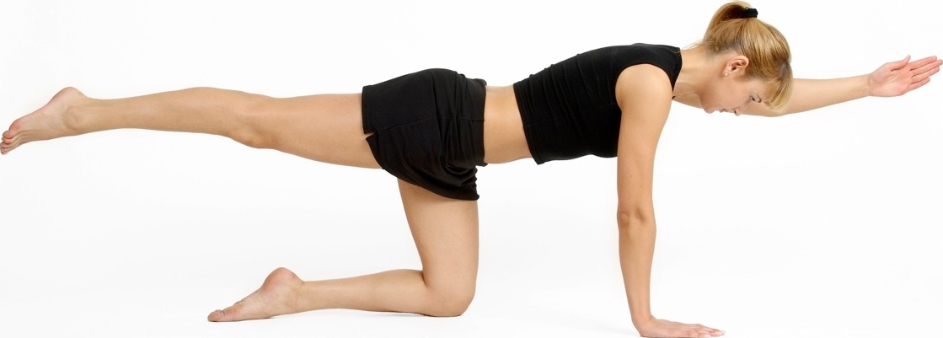
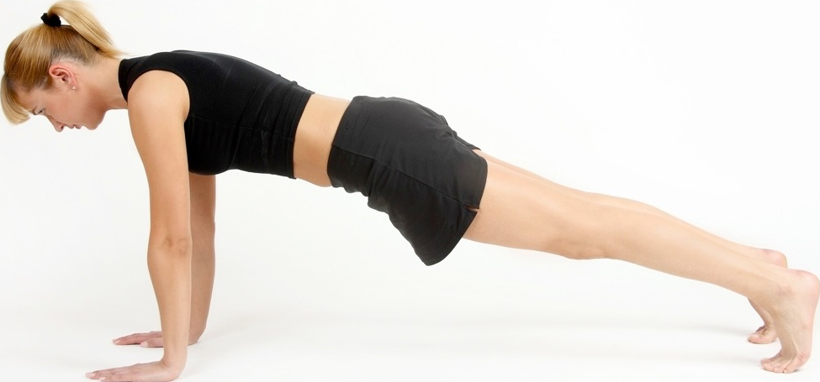
Types of training
Circuit Training
A number of exercises or skill stations are set up in a circuit.
A circuit usually has 6-12 stations.
Timed circuits - complete as many reps as possible in a given time
Fixed load circuits - complete a set number of repetitions
Varied circuits - the time and the work:rest ratio changes from circuit to circuit.
Stations can be assigned to improve specific components of fitness or energy systems.
Advantages
    All components of fitness can be trained.
    Large groups can train together.
    Easy to set up.
Disadvantages
Not really suited to individual training.
Large space is required.
Fatigue can affect technique and cause injury.
Safety considerations e.g. equipment

Slide 10
Types of training
Weight/Resistance Training
Weight training involves isotonic movements using free weights/kettle bells (experienced) or resistance machines (less experienced).
To calculate the intensity of training athletes use their one rep. max for individual movements.
Used in sports where power, strength and muscular endurance are important fitness components. These include boxing, rugby, sprinting and climbing.
Advantages
  Can focus on specific muscles or muscle groups.
  Depending on the weight and the number of reps either strength/power can be the focus or muscular endurance.
Disadvantages
When using weights, poor technique can lead to injuries.
A spotter is needed when using heavy weights.
Weights can be expensive and you usually need to pay to use a gym.

Slide 11
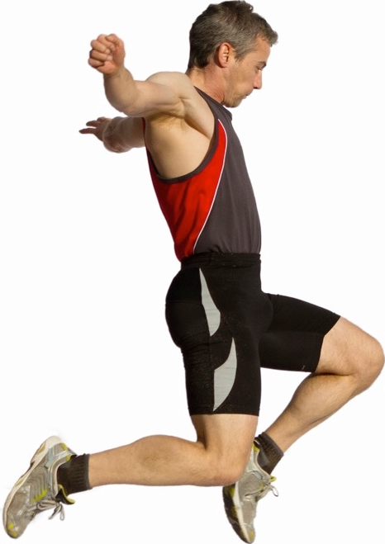
Types of training
Plyometrics
Plyometrics are used to develop fast, explosive and powerful muscle contractions.
The exercises involve different power jumping movements such as depth jumping and hurdle jumps.
On the downward phase the muscle extends and lengthens (eccentric isotonic contraction). A powerful contraction on the upward phase of the jump is produced (concentric isotonic contraction).
Advantages
  It simulates sporting movements, allowing you to run faster, throw further and jump higher and longer.
  Requires little or no equipment.
  The exercises can be done anywhere.
  Short and high intensity work out.
Disadvantages
The main disadvantage of plyometrics is the risk of injury. The exercise puts a large amount of strain on muscles and joints.
Three days of recovery is needed between each session to prevent injury.
Good levels of strength are needed.

Slide 12
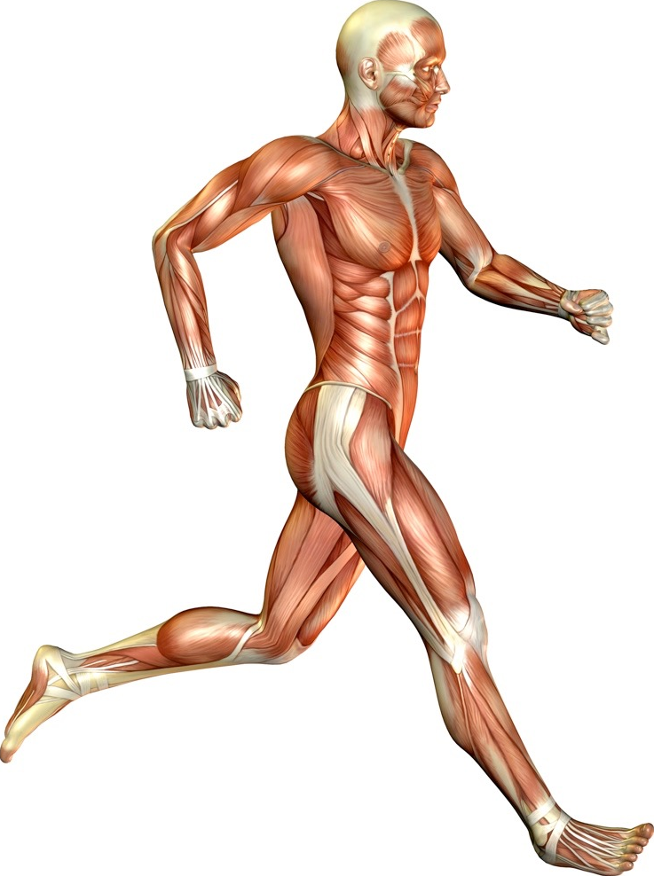
Types of training
Fartlek Training
Fartlek means “speed play” in Swedish.
The method involves exercising and changing the speed and intensity you work at.
An example is running at 80% for 30 secs, then 50% for 2 mins, then 70% for 1 minute. This is repeated for the desired amount of time.
Different methods can be used such as running, cycling and swimming with varying speeds and terrains.
Uses the Borg scale to measure intensity (click here for more info)
Advantages
  Improves both the aerobic and anaerobic systems.
  Helps to recreate the demands of game play.
  Can be done anywhere and individually.
  Adds variety so relieves boredom.
Disadvantages
Sometimes it is hard to determine how hard to work at the different intensities.
High motivation is needed from the performer when the harder parts of the session are being performed.

Slide 13
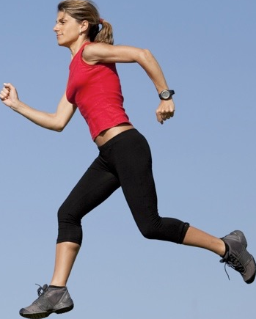
Types of training
Continuous Training
Continuous training focuses on improving the aerobic system and cardio-vascular endurance.
It requires the athlete to perform cardio-vascular activities such as running, cycling, rowing and swimming in the aerobic training zone for a minimum of 20 minutes.
Athletes must work between 60-80% of their maximal heart rate.
Continuous training is also a good way to burn calories.
Athletes must ensure they wear the correct footwear to avoid injury.
Advantages
  Improves aerobic performance.
  No specialist equipment needed.
  Easy to overload by increasing the distance or time.
  Ideal for beginners and people training individually.
Disadvantages
Performing the same activity for long periods of time can be boring.
Not suitable for groups or teams.
Does not improve anaerobic fitness.
Over use injuries such as shin splints can occur.

Slide 14
Types of training
High-Intensity Interval Training (HIIT)
HIIT involves working at high intensity followed by a period of rest or low intensity.
This is repeated a number of times.
An example is - 200m, 3 mins rest, 200m, 3 mins rest, 200m, 3mins rest.
You can change the distance, the reps or the time you’re allowed to rest.
Rest allows for the removal of waste products.
Advantages
  Allows you to mix aerobic and anaerobic work.
  Training is suitable to team sports.
  Monitoring progress is easy.
  No specific facilities or equipment are needed.
Disadvantages
Working the body at maximum intensity can result in injury.
High motivation is needed from the performer to work at high intensity.
At least 48 hours of recovery is needed.
Risk of overexertion.

Slide 15
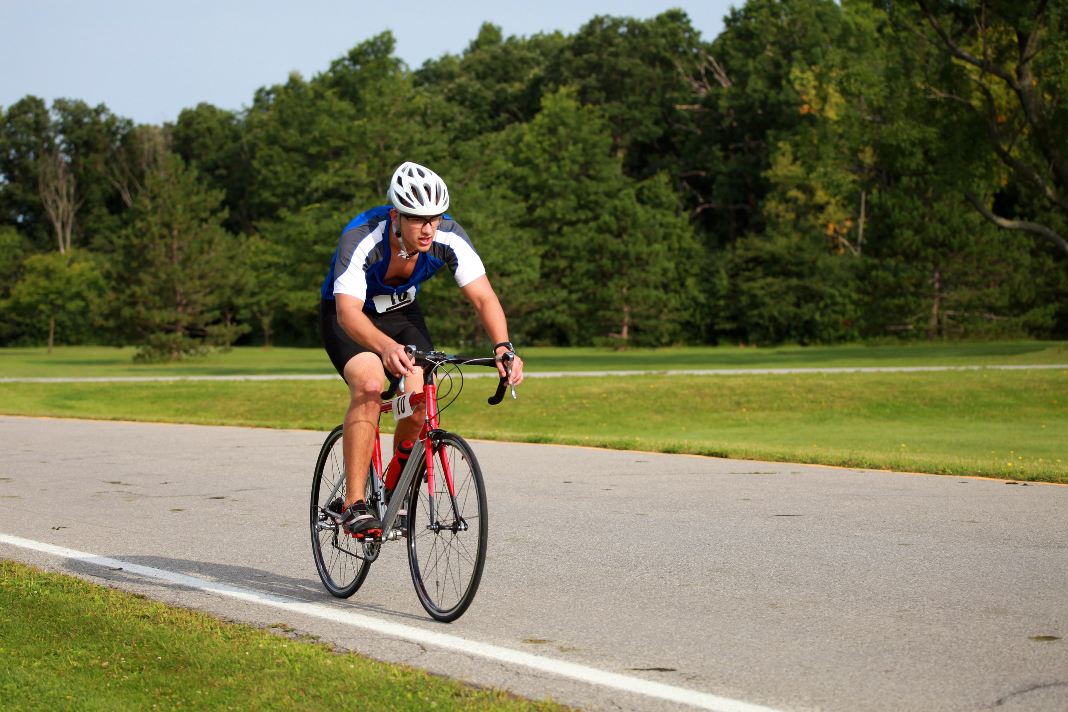
High altitude training
High Altitude Training
Altitude training increases the performance of the aerobic system.
Athletes train at high altitude where there is less atmospheric oxygen
The reduced oxygen supply forces the body to adapt and produce more red blood cells to carry more of the available oxygen.
When they return to sea level they use this advantage to increase performance.
Advantages
  It increases the oxygen-carrying capacity of the blood due to the increased concentration of red blood cells.
  As a result, the haemoglobin concentration in the blood increases.
  Increased aerobic performance.
  Enhances endurance.
Disadvantages
Expensive to travel to high altitudes.
Fitness can be lost or reduced quickly when returning to sea level.
May suffer from altitude sickness.
Does not increase anaerobic performance.

Slide 16
Aerobic training zone
  To improve your cardiovascular endurance you must raise your heart rate into the training zone and stay there for at least 15 minutes.
  Maximum Heart Rate = 220 - age
  Aerobic training thresholds are calculated between 60 and 80% of the maximum heart rate.
60-80% Aerobic Training Zone
Recovery Time
Rest 60 bpm
Rest 60 bpm

Slide 17
Anaerobic training zone
  Anaerobic training zone
  Maximum Heart Rate = 220 - age
  Anaerobic training thresholds are calculated between 80 and 90% of the maximum heart rate.
80%-90% Anaerobic Training Zone
Recovery Time
Rest 60 bpm
Rest 60 bpm

